Slide 1
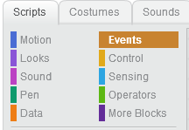
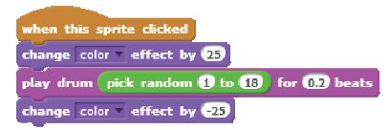

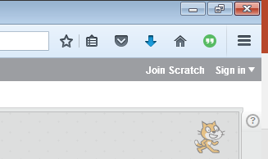
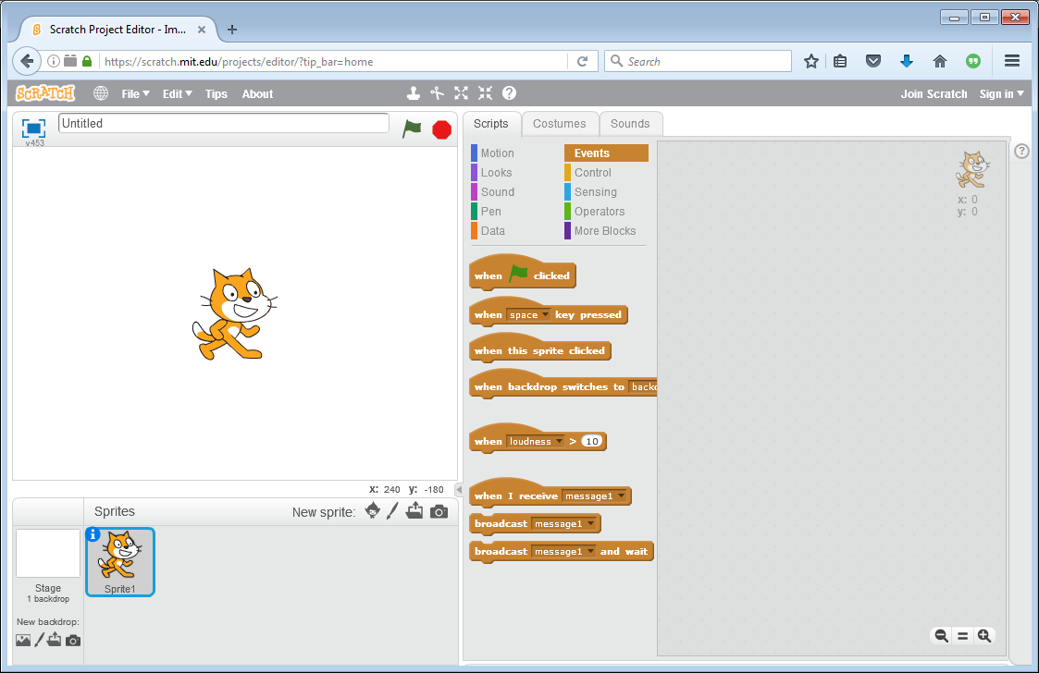
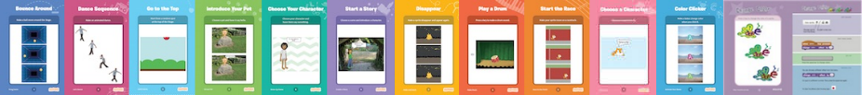
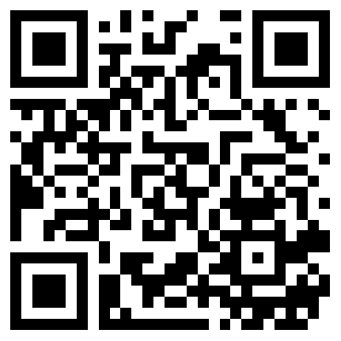

Scratch™
Programming at: https://scratch.mit.edu
New User or Existing User
Start your Project, click
Scratch™
Different Program Blocks in Scripts
Categories
Use Tip Bar by clicking (?) in top right:
Or
Try Scratch’ Cards
Click or Scan
Getting Started
What Can You Program?
What?
What a Sprite or Backdrop Can Do?
Help?
How?
Run or Stop scripts
When Tab changes… This area changes.
Project Name
Drag
Program
Blocks
Inspiration?
When selection changes…
This
changes.
 | Scratch Projects
Available at:
https://github.com/chaosbuster/StarterCards
EVERYONE HAS A PART IN KEEPING OUR MAKERSPACE CLEAN!
Creative Credits to MIT for Make A Card:

