Slide 1
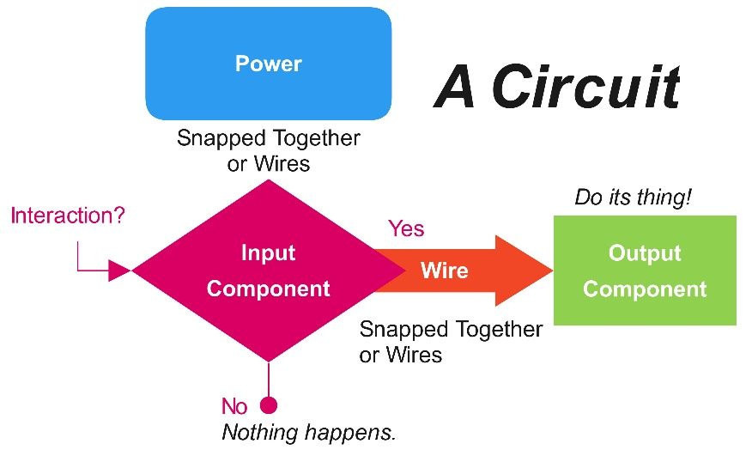



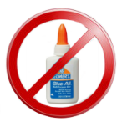

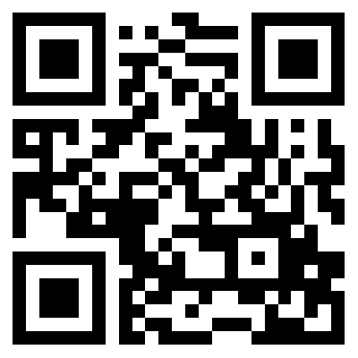
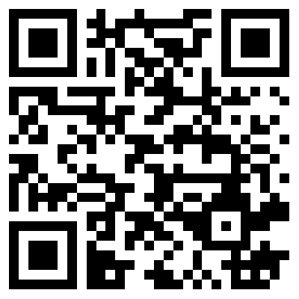
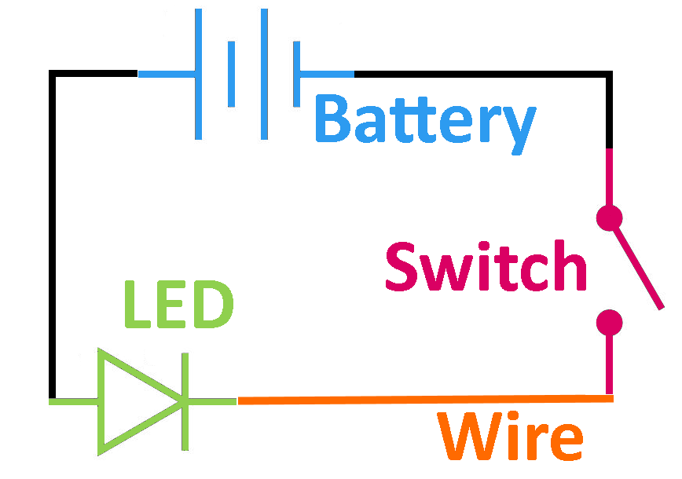
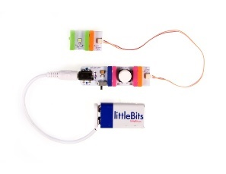

littleBits™
Wiring Schematic Example Physical Example
Try littleBits™’ Module Cards
littleBits™
Getting Started
What Can You Make?
What?
Handling?
Safety?
Inspiration?
littleBits™ Projects | Pinterest Projects
Help?
Available at:
https://github.com/chaosbuster/StarterCards
EVERYONE HAS A PART IN KEEPING OUR MAKERSPACE CLEAN!
Creative Credits to MIT for Make A Card:

