Slide 1
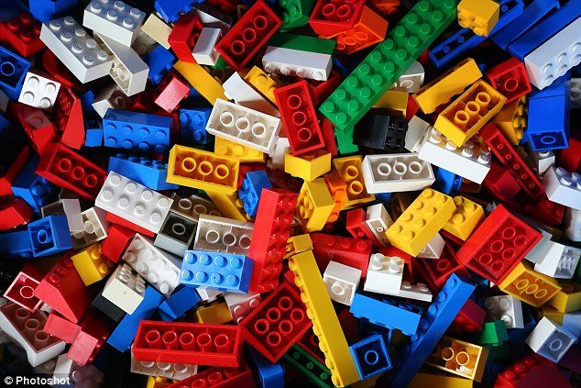
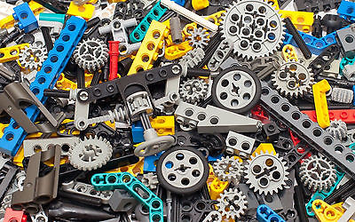






LEGO Creations
LEGOs can be grouped into two different types:
LEGO Creations
If you need some inspiration or building techniques then here are some QR Codes to some websites with ideas for each type of LEGO group.
Getting Started
What Can You Make?
Supplies?
What can you create with LEGOs?
Theme | Technic
The Theme grouping of LEGO parts can be assembled and connected in many ways, to construct objects; vehicles, buildings, and various artist creations. The base parts within the Theme group are: Bricks Plates Tiles | The purpose of LEGO Technic is to create more advanced models with movable arms, such as machines with wheels, pneumatics or electronic components. The base parts for LEGO Technic are: Bricks with Holes Plates with Holes Pins Axles Gears
Theme Building
PInterest | Building Techniques
Technic Building
Instructables | Sturdy Structures
Building Techniques | About Gears
Available at:
https://github.com/chaosbuster/StarterCards
EVERYONE HAS A PART IN KEEPING OUR MAKERSPACE CLEAN!
Creative Credits to MIT for Make A Card:

