Slide 1
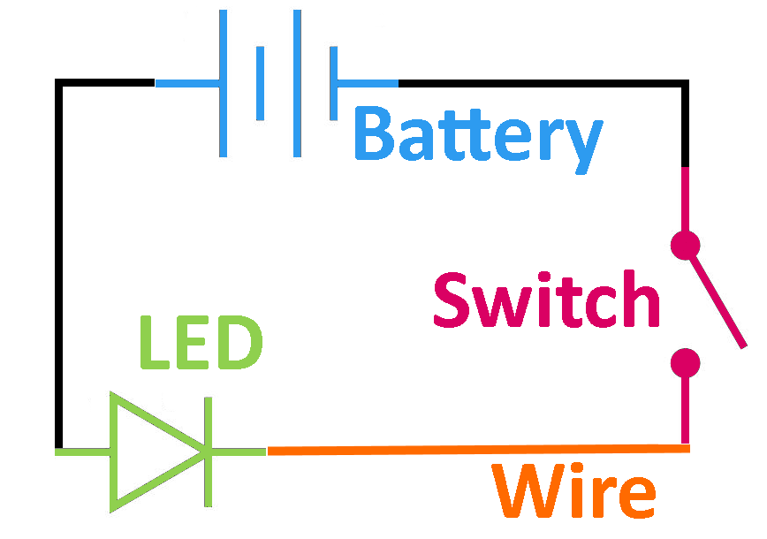


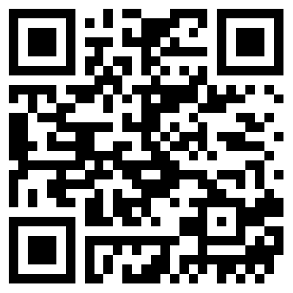


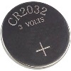
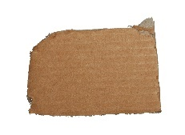


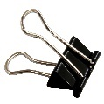

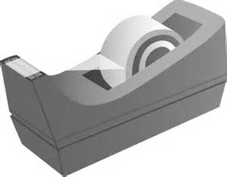
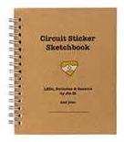

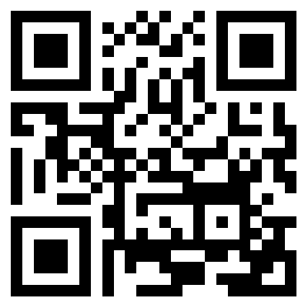
Chibitronics®
Circuits with copper wire and Chibitronics components on paper, cardboard or other surfaces.
Chibitronics®
Getting Started
What Can You Make?
What?
Handling?
Let’s Get Started!
Supplies?
Using Copper Tape | Simple Circuit
Parallel Circuits with Multiple LEDs | Interactive Circuit with Switch
Additional Projects | Other Techniques & Components
Copper Tape | Chibitronics LEDs | Battery
Paperclips | Paper or Cardboard | Tape
Chibitronics’ Circuit Sticker Sketchbook (Optional Reference)
Inspiration?
Available at:
https://github.com/chaosbuster/StarterCards
EVERYONE HAS A PART IN KEEPING OUR MAKERSPACE CLEAN!
Creative Credits to MIT for Make A Card:

