Slide 1
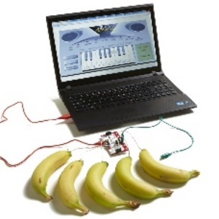
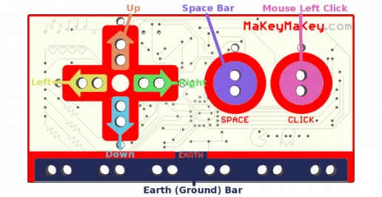
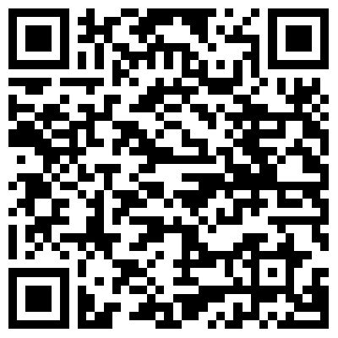
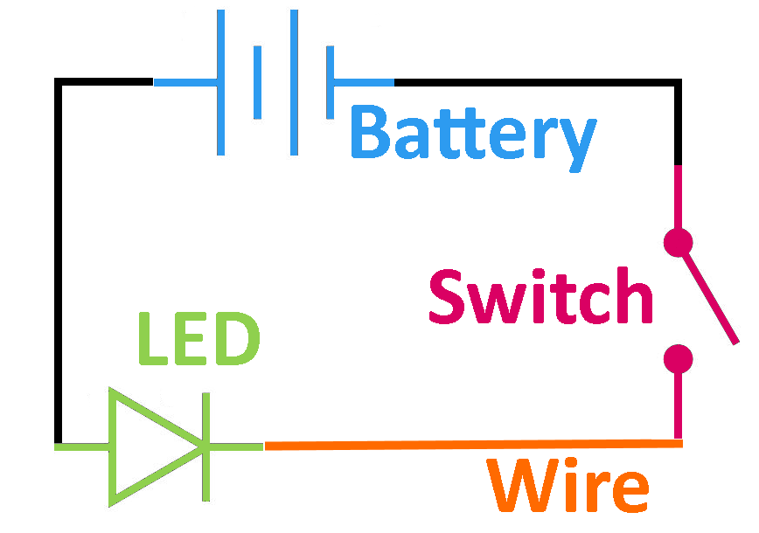
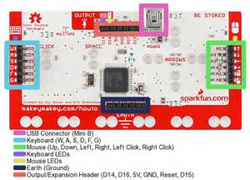
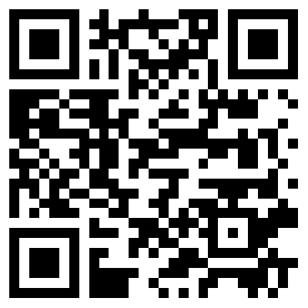
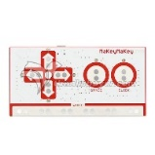
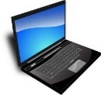
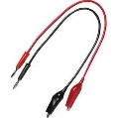


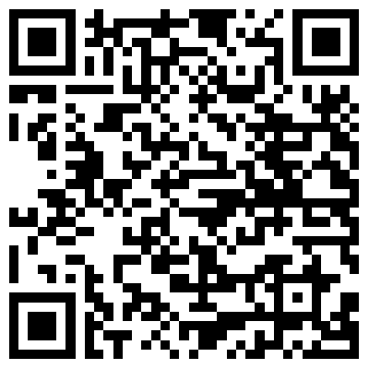
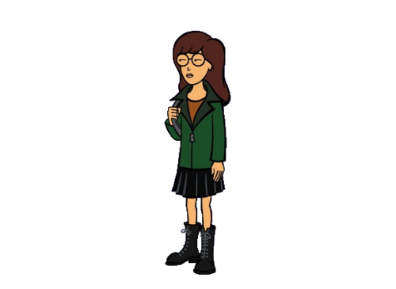
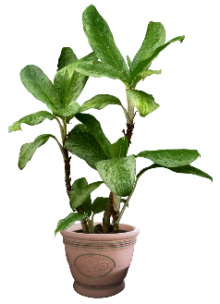
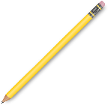
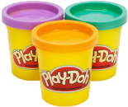

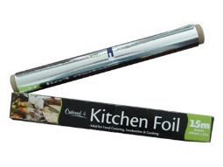

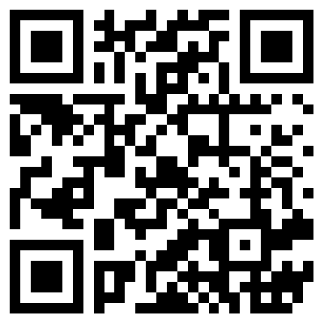
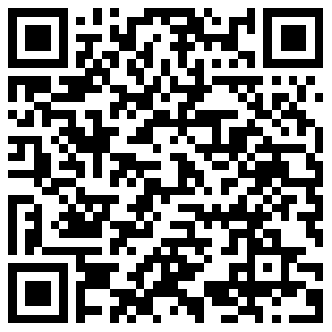
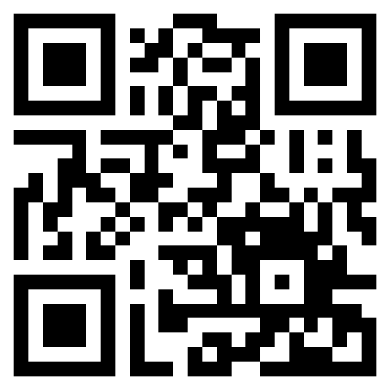
MaKey MaKey
Anything that is conductive can now interact as a keyboard or mouse to your computer. Uses circuitry!
MaKey MaKey
Scan for
MaKey
MaKey
Basics.
More
Detailed
Basic
Project
Example
Projects
Getting Started
What Can You Make?
What?
Let’s Get Started!
Supplies?
MaKey MaKey | Mini-B USB Cable | Computer with USB | Alligator Clip Wires | Jumper Wires
Whatever you think is conductive around you!
Inspiration?
Projects from Eduporium | Projects from Educade | Makey Makey Gallery
Available at:
https://github.com/chaosbuster/StarterCards
EVERYONE HAS A PART IN KEEPING OUR MAKERSPACE CLEAN!
Creative Credits to MIT for Make A Card:

