Slide 1
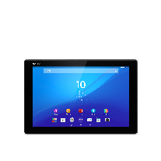

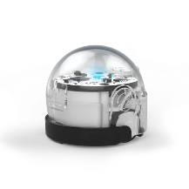
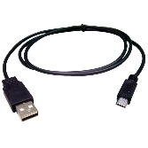
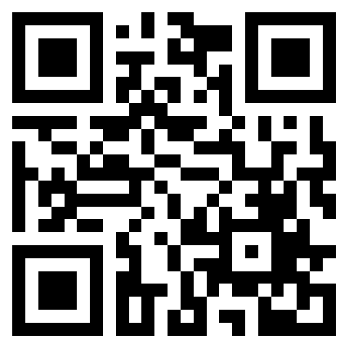

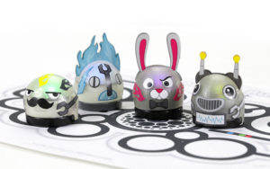
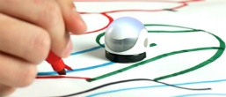

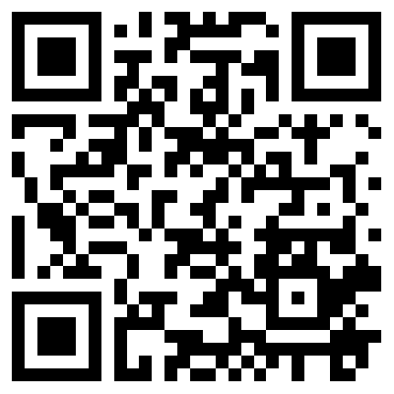
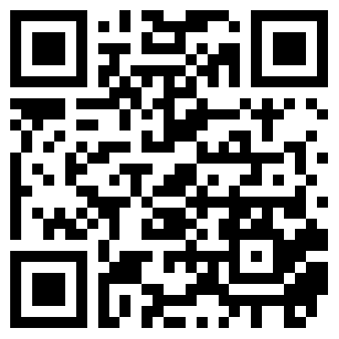
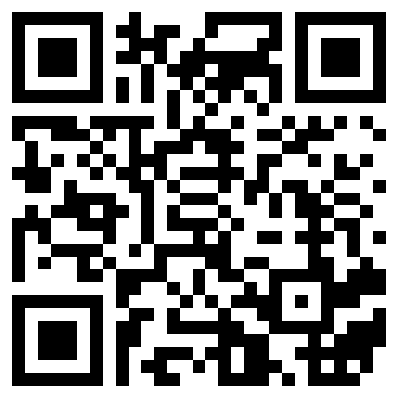
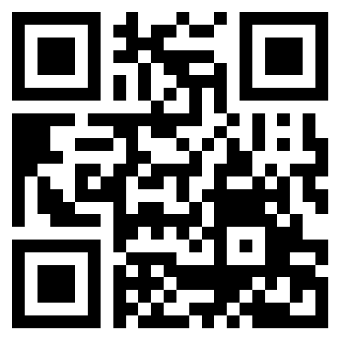
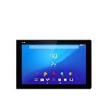
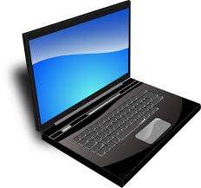
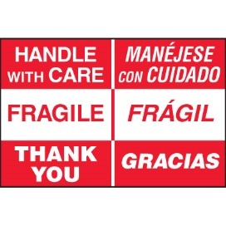


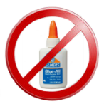

OzoBot Bit
OzoBot Bit USB Charging Cable iPad or Android
tablet
Optional: Skins & Printed Mazes Markers & Paper
.
OzoBot Bit
Find OzoGroove app on tablet.
If not found, Scan to download.
Find OzoBot Evo app on tablet.
If not found, Scan to download.
Programming on
Tablet or Laptop
If blinking Red then OzoBot Bit needs a charge.
Charge complete when solid Green.
Getting Started
What Can You Program?
Supplies?
Dancing?
More?
Draw Paths?
OzoBlockly Programming?
Video Intros | Color Codes
Video Intros | Game Challenges & Community
Handling?
Blinking Red?
Available at:
https://github.com/chaosbuster/StarterCards
EVERYONE HAS A PART IN KEEPING OUR MAKERSPACE CLEAN!
Creative Credits to MIT for Make A Card:

