Slide 1





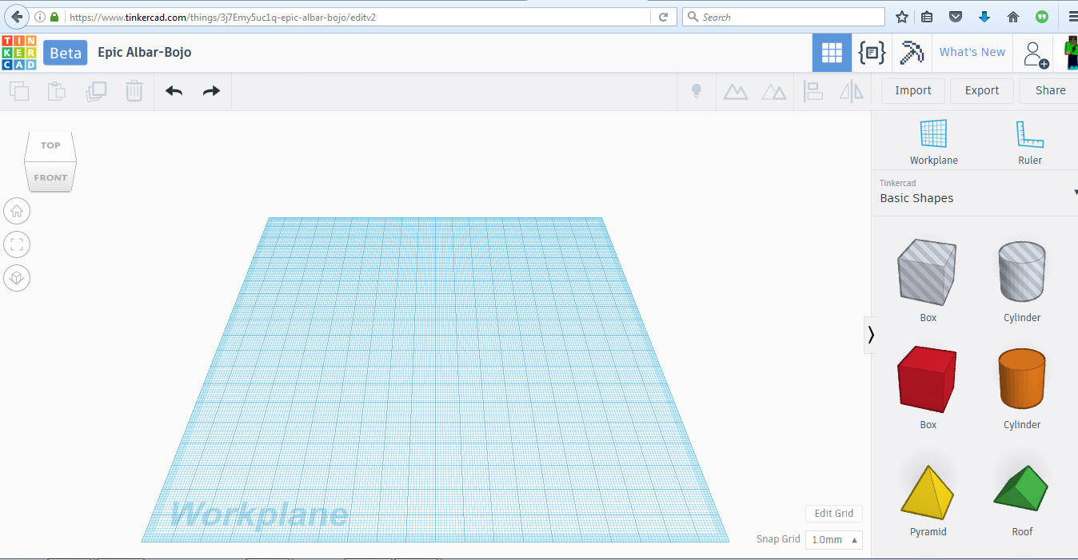



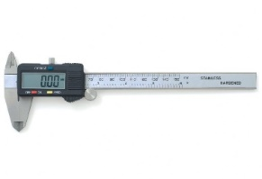
Tinkercad
Create a 3D Design at: https://www.tinkercad.com
New User or Existing User
Start your Project, go to area and
Tinkercad
Keep object on workplane, especially if 3D Printing.
Use the Ruler to specify sizes.
Use a Digital Caliper to help with measurements of a physical object that you are 3D designing.
Getting Started
What Can You Make?
What?
How?
If Signed In, Click Learn or Scan these on a device for videos help. | Getting Around | Shape Controls
Basic Shortcuts | Techniques | How Tos
Projects | Gallery | TinkerTips
Layout?
Grouping
Align
Project Name
Ruler
Inspiration?
Drag shapes
Tips?
Perspectives
Available at:
https://github.com/chaosbuster/StarterCards
EVERYONE HAS A PART IN KEEPING OUR MAKERSPACE CLEAN!
Creative Credits to MIT for Make A Card:

