Slide 1

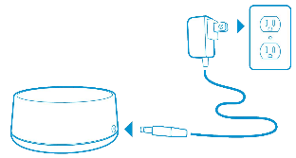
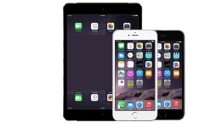
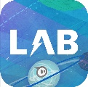
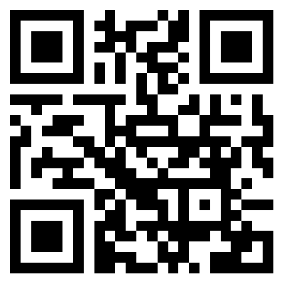
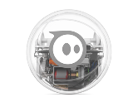
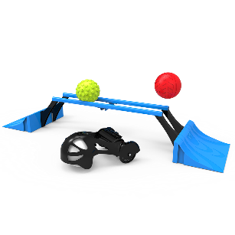
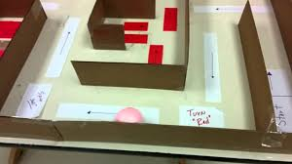



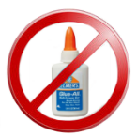
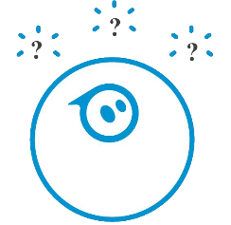
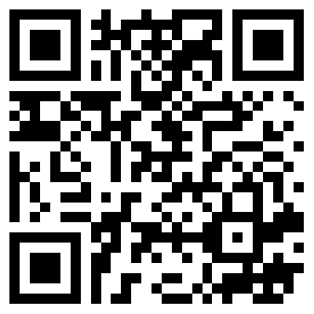
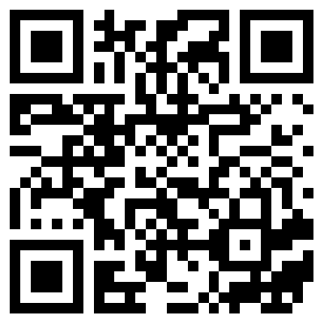
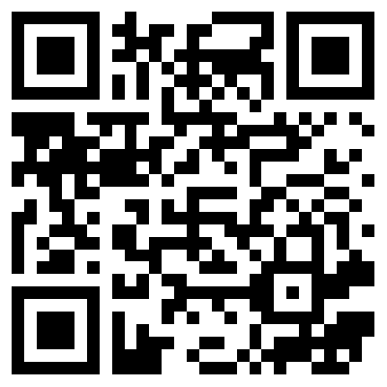
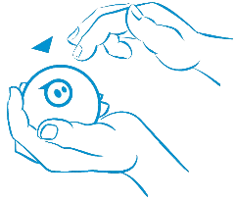
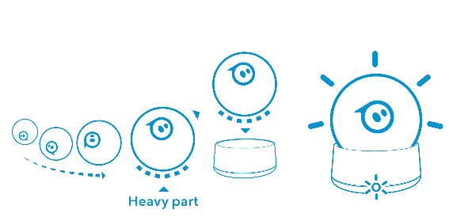
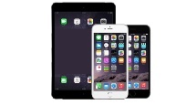
Sphero 2 (or SPRK)
Sphero 2.0 or Charging base iPad, iPhone
SPRK or Android
Accessories (Optional) Create Mazes (Optional)
Must be Charged, Awake, Paired and Connected before play.
1. Blinking 3 colors? 2. Bluetooth name are initials of
If not, tap logo hard. the 3 unique colors it is blinking.
3. Is Bluetooth ON in device Settings?
4. A Sphero name listed? If not, click Scan on device. Correct Sphero name listed? See #2.
Sphero 2 (or SPRK)
Can’t find Sphero Lightening Lab
app? Scan to download for
iOS, iPad or Android
Sphero turns white when device
Is connected and communicating.
If blinking Red then Sphero
needs a charge.
Charge complete
when solid Blue.
Getting Started
What Can You Program?
Supplies?
Programming?
Handling?
Awake?
Inspiration?
Block Intros | Maze Mayhem | Chariot Challenge
R | = | Red | O | = | Orange
B | = | Blue | P | = | Purple
G | = | Green | Y | = | Yellow
W | = | White
Example: Sphero-PBB
Paired?
Blinking Red?
Available at:
https://github.com/chaosbuster/StarterCards
NOTE: Some images from Sphero Quick Start Guides.
EVERYONE HAS A PART IN KEEPING OUR MAKERSPACE CLEAN!
Creative Credits to MIT for Make A Card:

