Slide 1
Kim Davis: Because Jesus Says So A Look At Media Bias In The United States Durham, Nichols, Williams, Soto – Oct 4 2015

Slide 2
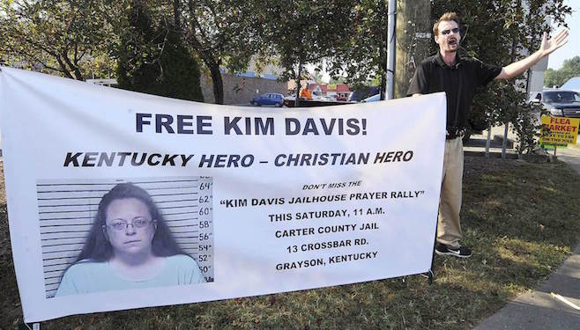
A Quick Introduction
Rowan county clerk in Kentucky
Denied same-sex couples marriage licenses
Had a secret meeting with the pope

Slide 3
Our Hypothesis
Is media bias uneven when comparing southern news outlets to other news outlets in the United States?
Null: Bias(other) = Bias(south)
Alternative: Bias(other) != Bias(south)

Slide 4
Variables
X | Explanatory
REGION (CATEGORICAL) | South or Other (West, Northeast)
REACH (CATEGORICAL) | Local or Regional
count | Word count of the article
Y | Response
Bias | Binary (0 no event or 1 event)

Slide 5
Other Questions
Region important when considering reach, length of article and gender?
Is there a valid interaction between the explanatory variables of word count, gender or reach?

Slide 6
Study Considerations
Population: Regional and local news outlets in the United States, specifically in California, Washington, New York, Oregon, Nevada, Alabama, Texas, Kentucky, Louisiana
Subjects: individual opinion based articles from male and female writers
Excluded all neutral and polarizing (GayStar News, Christian Monitor, Associated Press)

Slide 7
Sampling Plan
Stratification
60 observations gathered: 30 articles in South region, 30 articles in other region
Other region: California, Oregon, Washington, Nevada
Segmented by reach: 15 local articles, 15 national articles
South region: Alabama, Kentucky, Texas, Louisiana
Segmented by reach: 15 local articles, 15 national articles
40 total selected

Slide 8
Sampling Plan
Randomly select 10 (out of 15) articles from each reach strata
Randomize selection using a simple numpy random.sample() without replacement

Slide 9
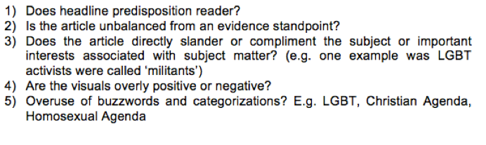
The Analysis
Original Plan: each member conducts five point analysis of each article, grades article based on binary value 0 (unbiased) or 1 (biased)
Consensus rules for article bias indicator (3/4 member grade 1 then 1)

Slide 10
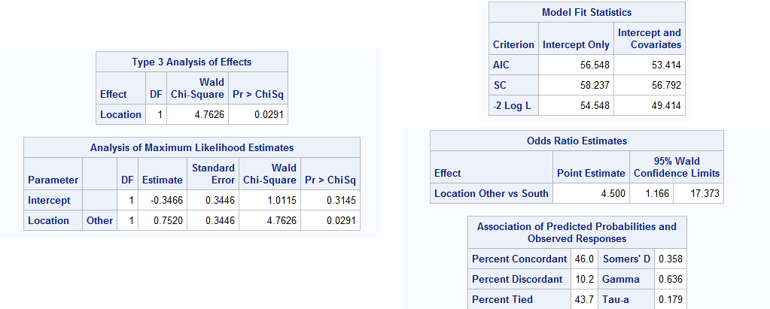
The Analysis – Regional Effect
P(Bias) = REGION
Due to a binary response value, we chose to use binary logistic regression for analysis

Slide 11
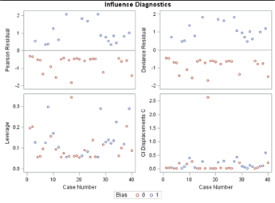
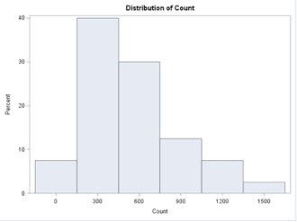
The Analysis – With More Cowbell
P(Bias) = count + REGION + REACH + (count*REACH)

Slide 12
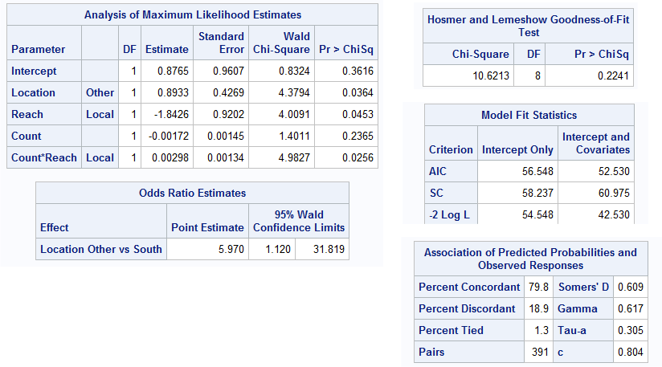
The Analysis – With More Cowbell

Slide 13
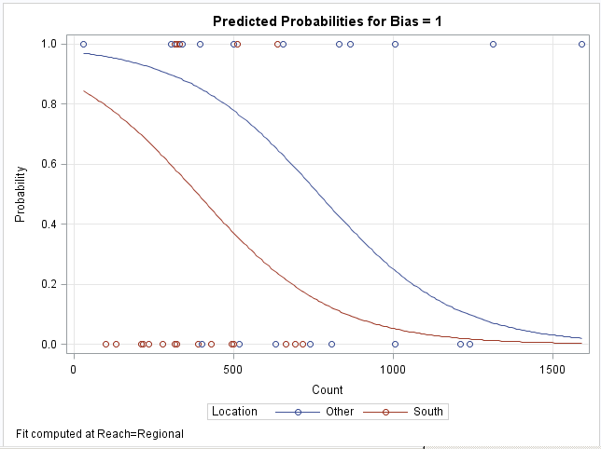
The Analysis – Effect Plot of Count By Region

Slide 14
Future Plans
AlchemyAPI - Sentiment Analysis (still owe Raghu a beverage)
Add gender, writer history variables based on cafe discussions
Change to MLR

