Slide 1
Investigation of employee attrition with predictive analytics
Mahesh Kuklani, Rene Pineda and Chaoshun Hu

Slide 2
Introduction
Voluntary attrition occurs when an employee leaves a company of his or her own accord.
Employee attrition statistics have worsened in recent years.
In order to deal with employee attrition and deal with its negative impacts, it is important to know about the most important causes of attrition.

Slide 3
Purpose
The purpose of this analysis is to try to dilucidate what are the most important factors that contribute to attrition, amongst the many factors affect an employee’s environment and satisfaction. Once these factors are determined, a company can take actions to control them.

Slide 4
How to keep employee
Divest?
Aggressively retain
Low value.
High Attrition Risk
High value.
High Attrition Risk
Attrition Risk
Grow-up
Maintain
Low value.
Low Attrition Risk
High value.
Low Attrition Risk
Employee lifetime value

Slide 5
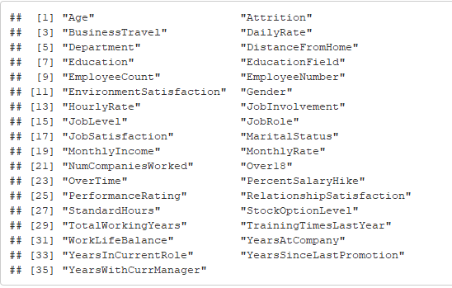
Raw Dataset
Dimension Size
1470 observations; 35 variables;
Column names

Slide 6
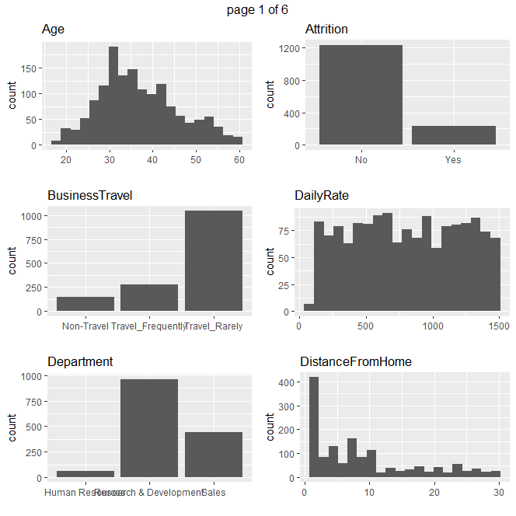
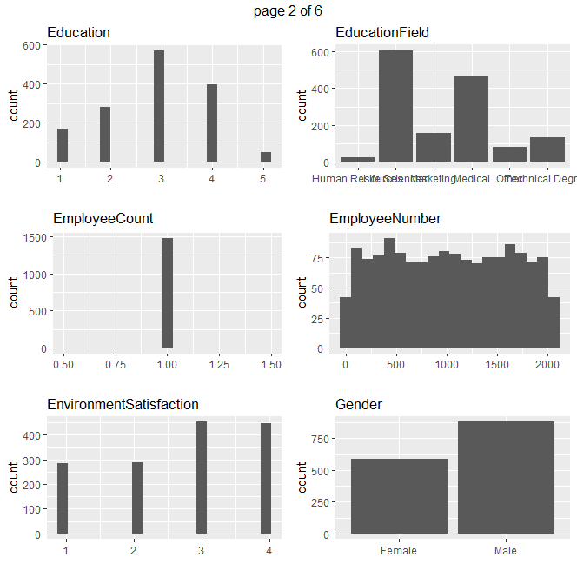
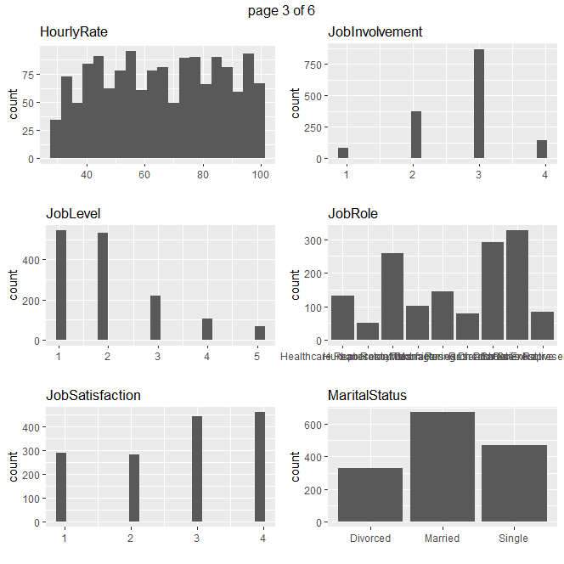
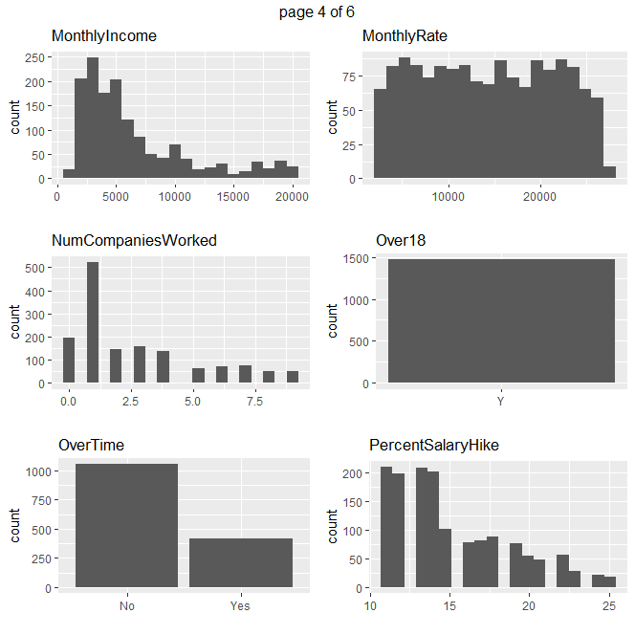
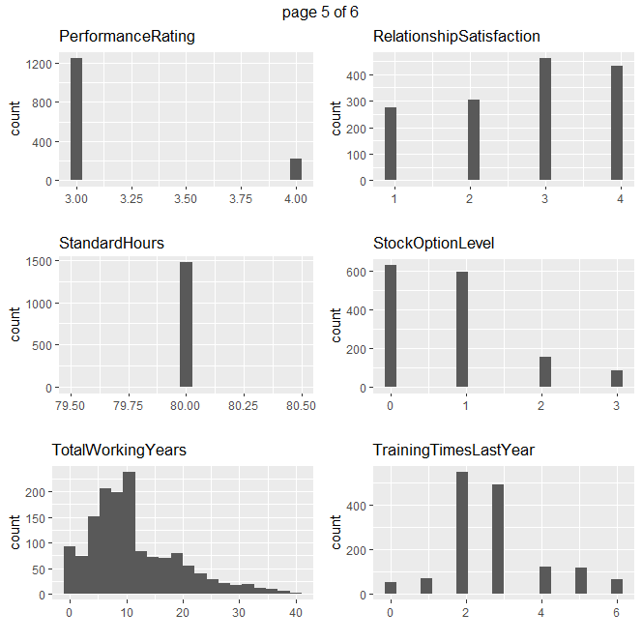
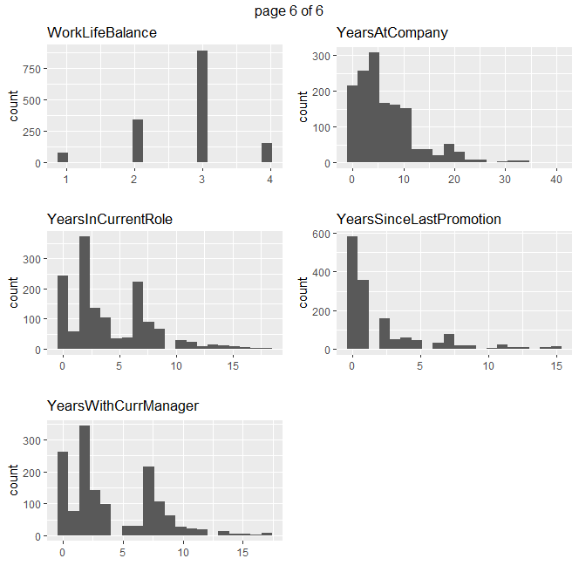
Raw Dataset Distribution
8 factors kicked off

Slide 7
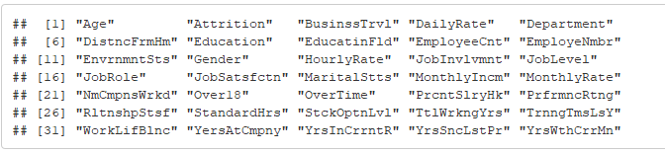
Data Cleaning and Preparation
Abbreviate column names

Slide 8
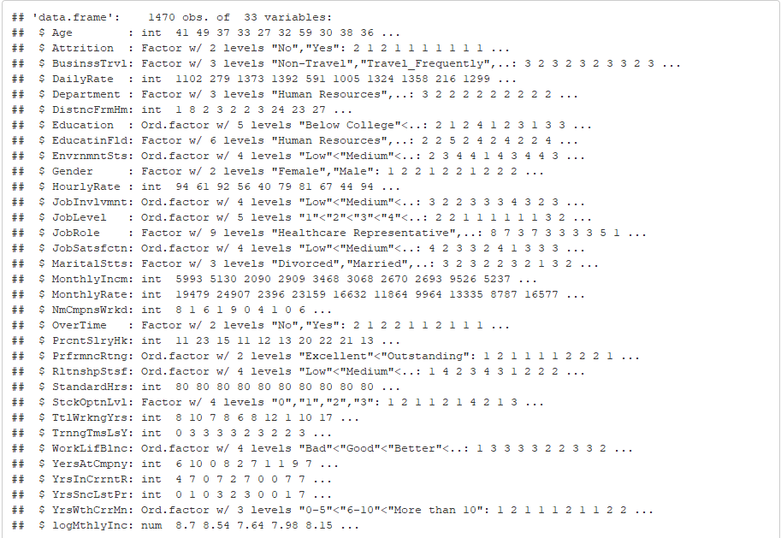
Data Cleaning and Preparation
Recode Variables from ‘numeric’ to ‘factor’

Slide 9
Preliminary Analysis
Descriptive statistics on at least 7 variables.
Age
Monthly Income
Distance From Home
Number of Companies Worked In
Percent Salary Raise
Total Working Years
Years At Company

Slide 10
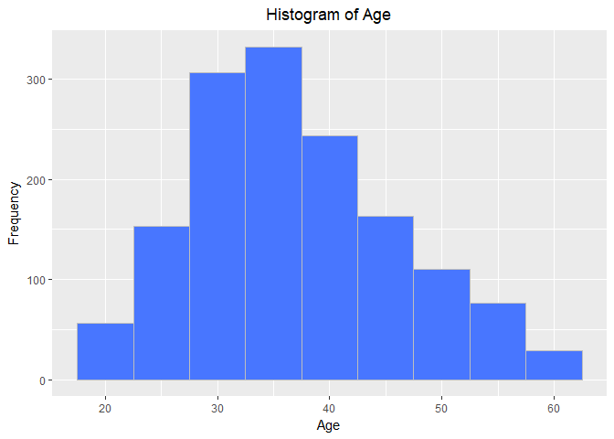
Preliminary Analysis Simple Histogram for two of the selected 7 factors

Slide 11
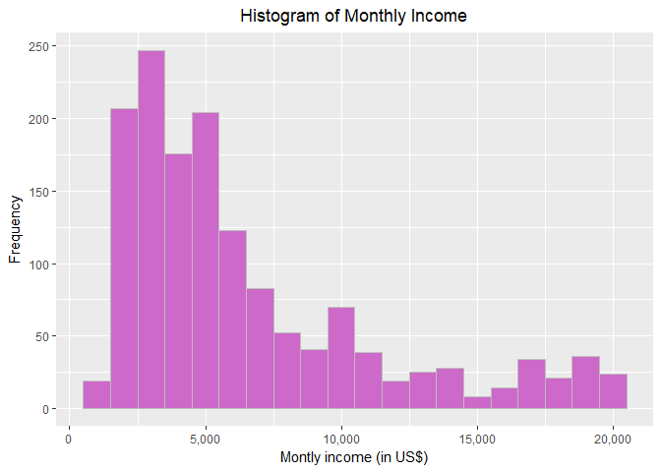
Preliminary Analysis Simple Histogram for two of the selected 7 factors

Slide 12
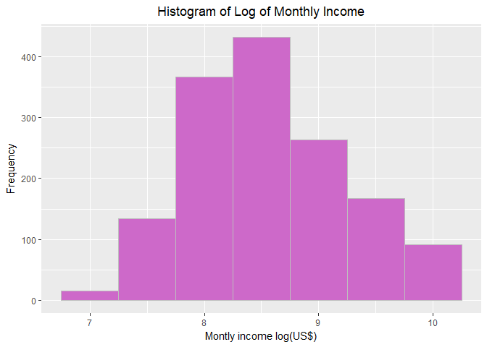
Preliminary Analysis Simple Histogram for two of the selected 7 factors

Slide 13
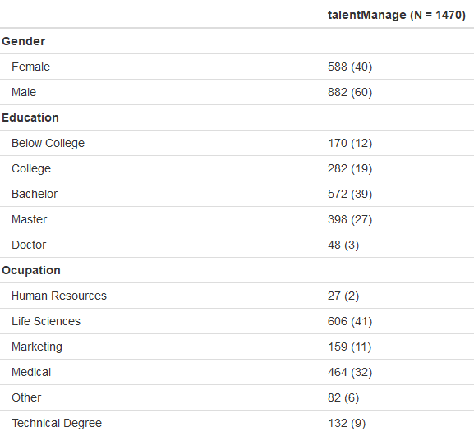
Preliminary Analysis Give the frequencies for Gender, Education, and Occupation

Slide 14
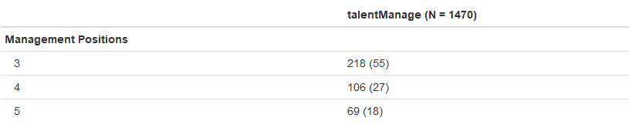
Preliminary Analysis Give the count of management positions

Slide 15
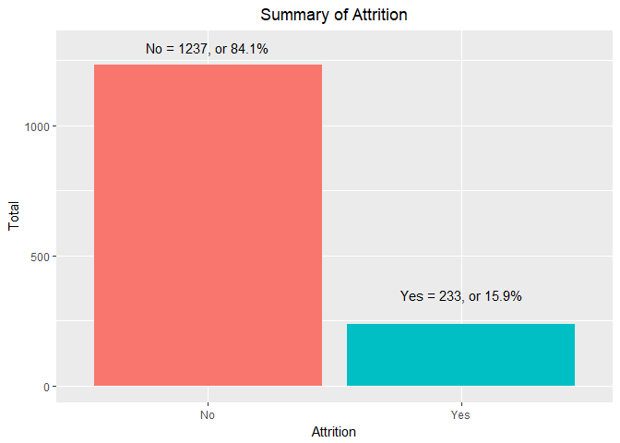
Additional Analysis Examine the proportion of attrition vs. No attribution

Slide 16
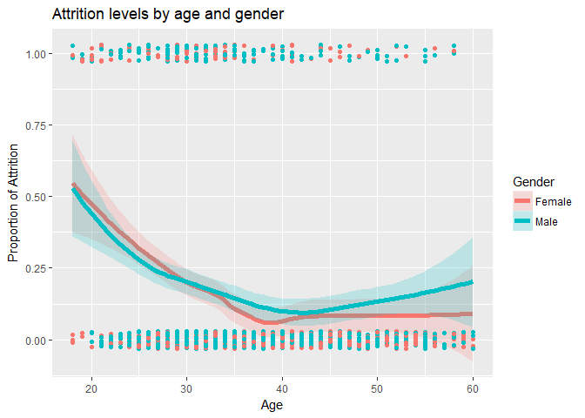
Additional Analysis whether there are differences in attrition by continuous and categorical variables

Slide 17
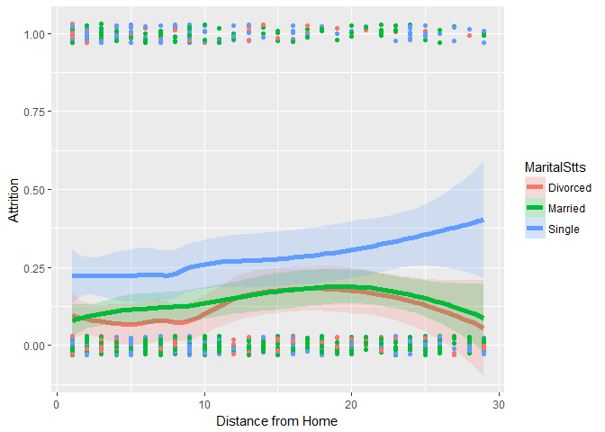
Additional Analysis using distance from home and marital Status

Slide 18
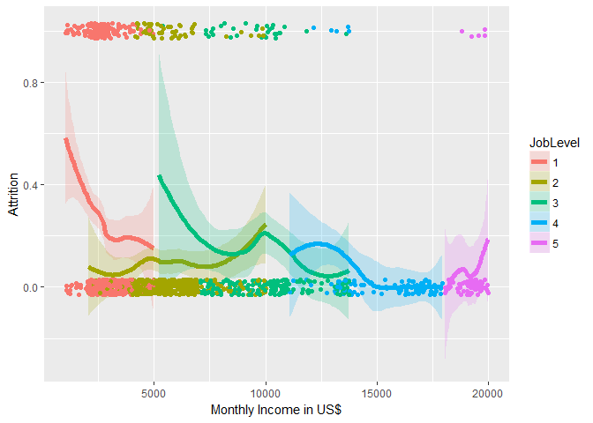
Additional Analysis using monthly income and job level

Slide 19
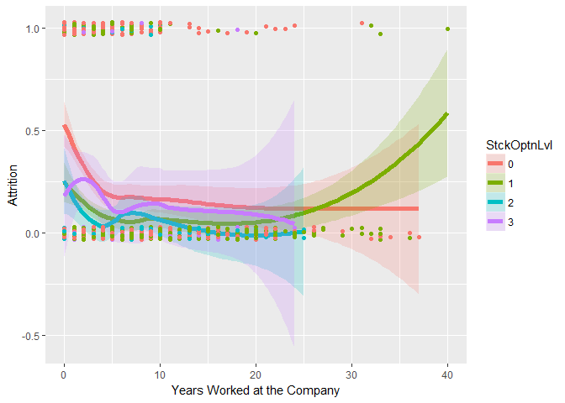
Additional Analysis using years in the company

Slide 20
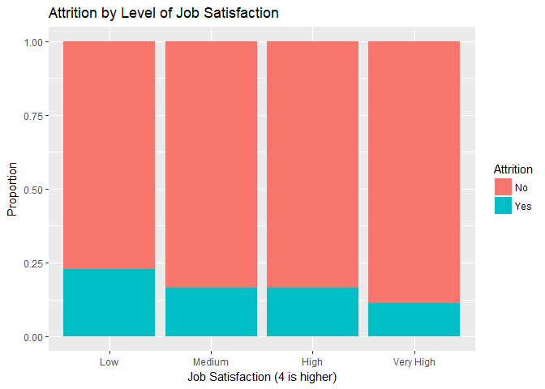
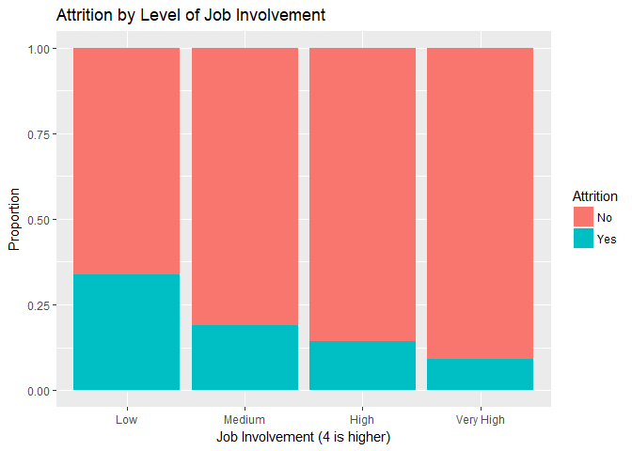
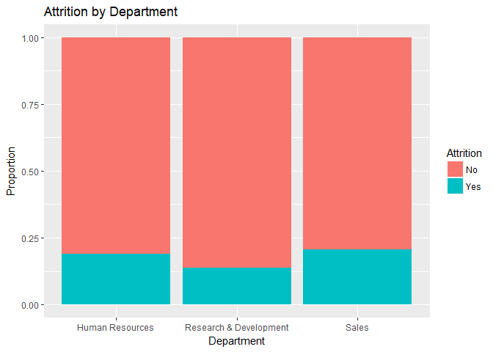
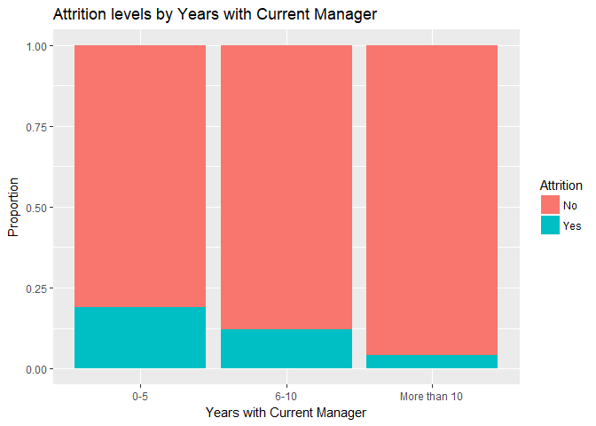
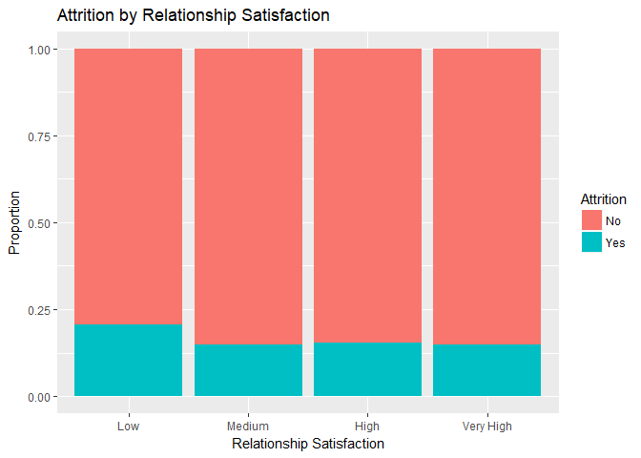
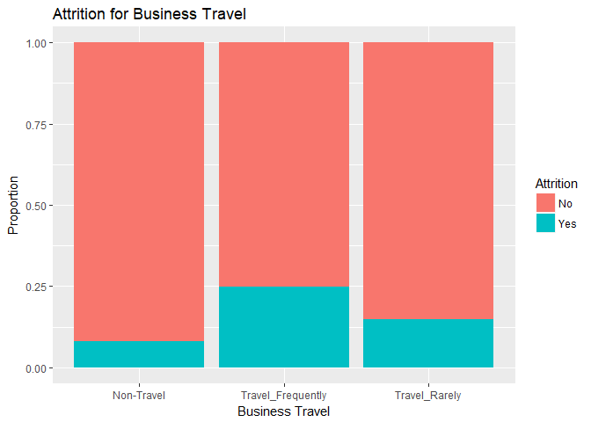
Attrition by Different factors

Slide 21
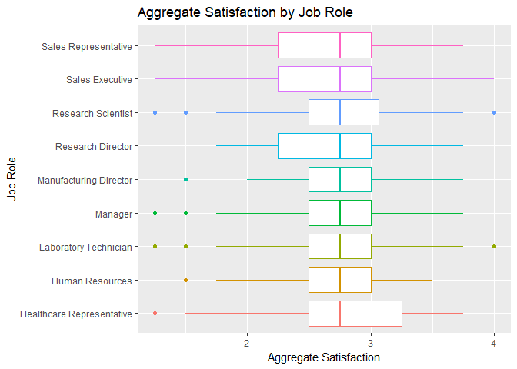
Additional Analysis

Slide 22
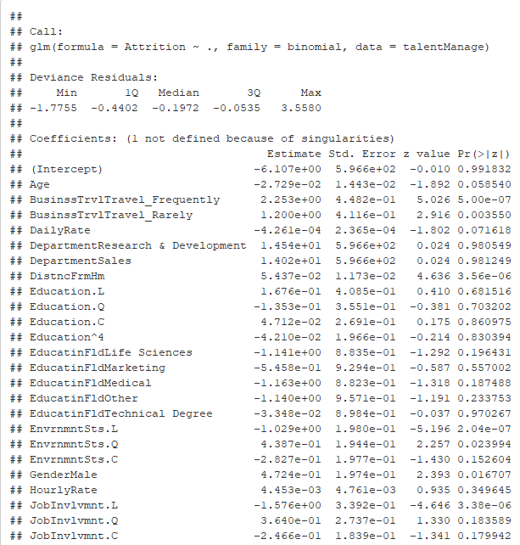
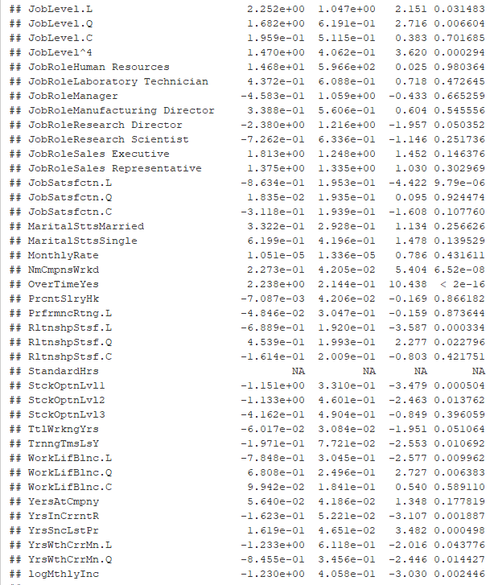
Deeper Analysis after full model regression Analysis of data using backward elimination

Slide 23
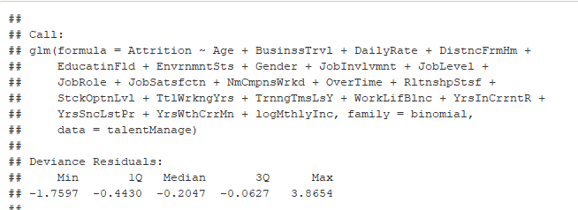
Backward Reduced Model#1 Regression

Slide 24
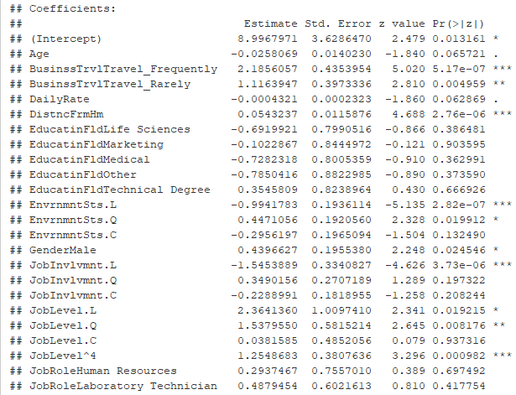
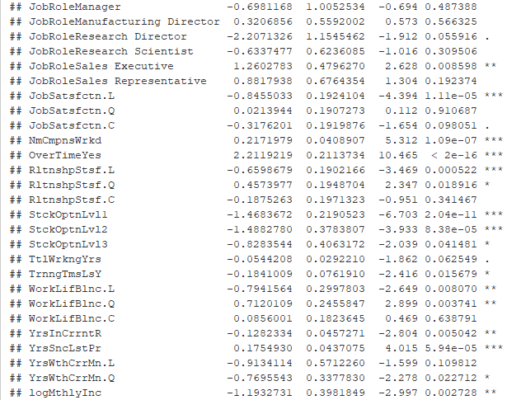
Coefficients

Slide 25
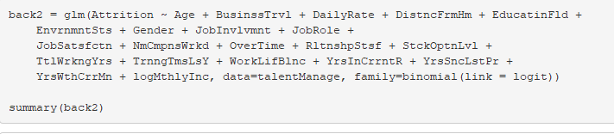
Backward Reduced Model#2 Regression

Slide 26
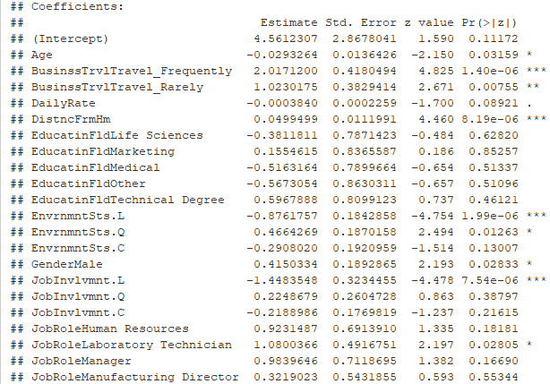
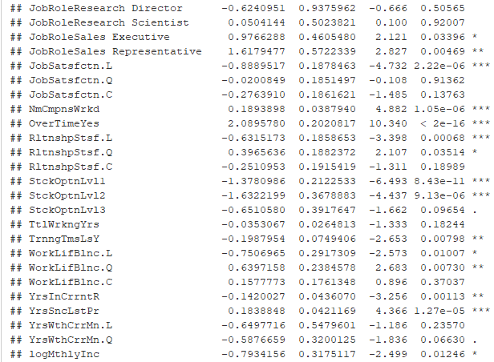
Coefficients

Slide 27
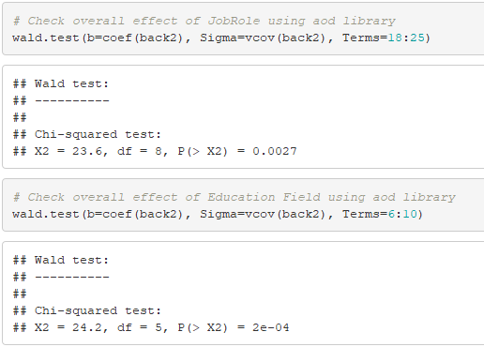
Check overall effect using aod library

Slide 28
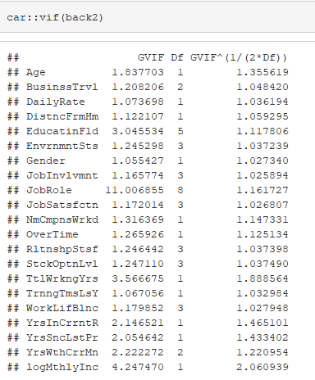
VIFs of the model #2

Slide 29
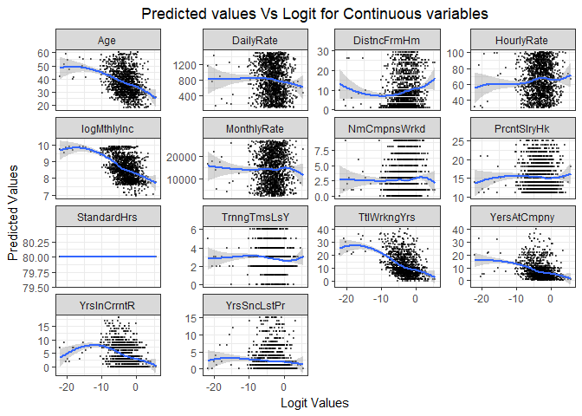
Visual Inspection of model #2

Slide 30
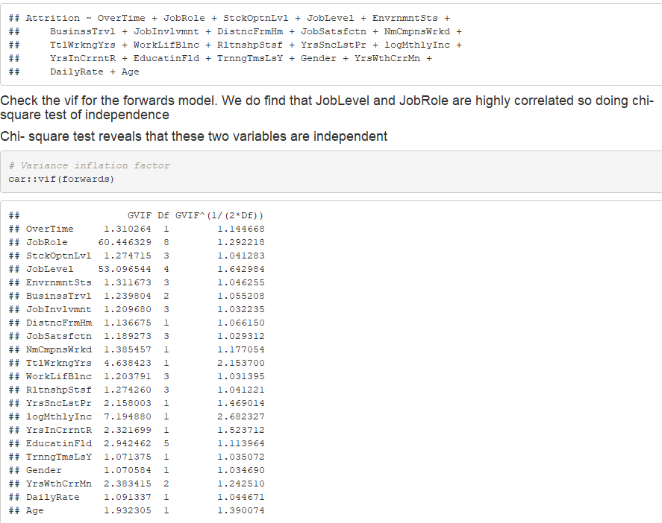
Forward Selection
Removing JobLevel since JobRole and JobLevel are highly correlated

Slide 31
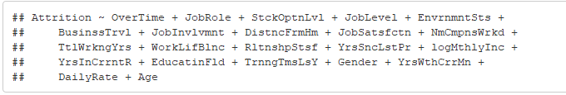
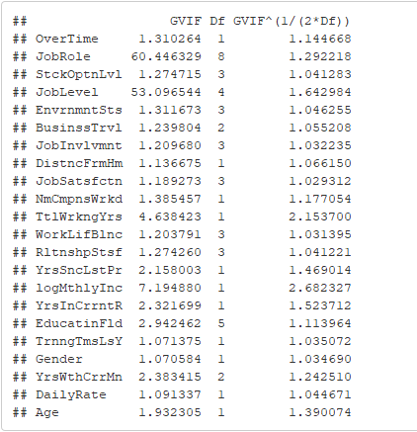
Stepwise selection
Removing JobLevel since JobRole and JobLevel are highly correlated

Slide 32
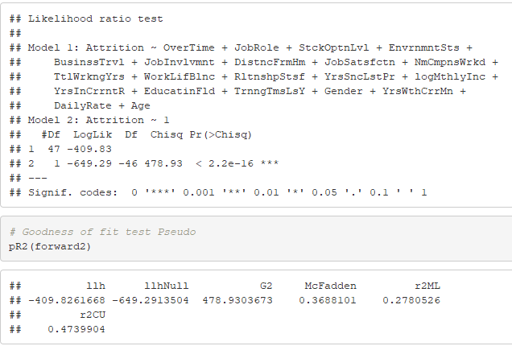
Goodness of Fit Test

Slide 33
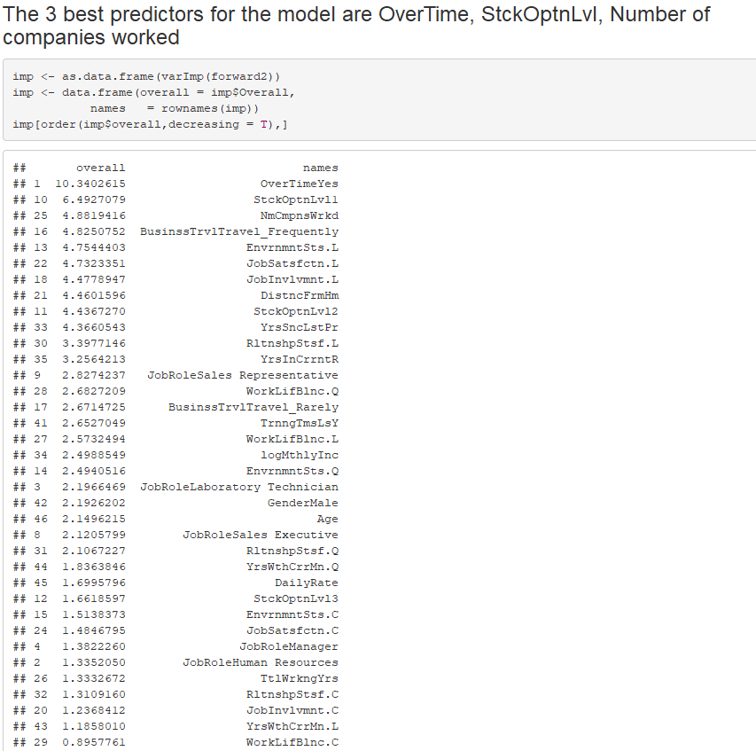
Test of individual predictors

Slide 34
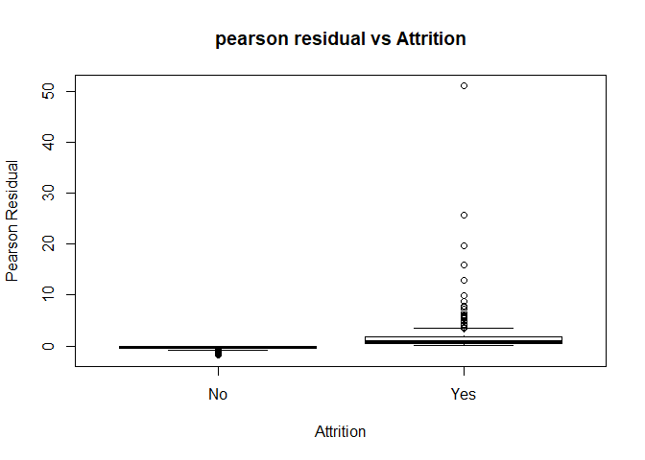
Pearson studentized residuals vs Attrition

Slide 35
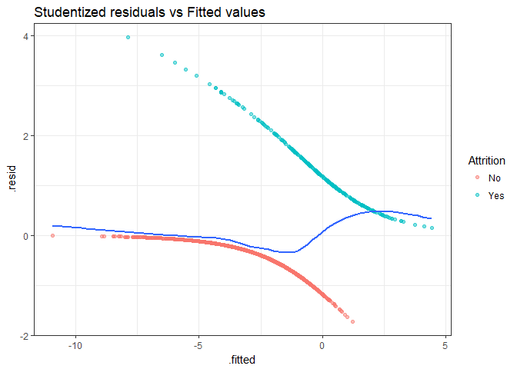
Studentized residuals vs Fitted values

Slide 36
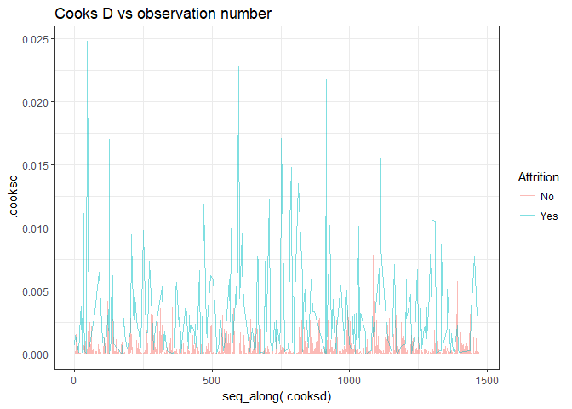
Cooks D vs Observation Number

Slide 37
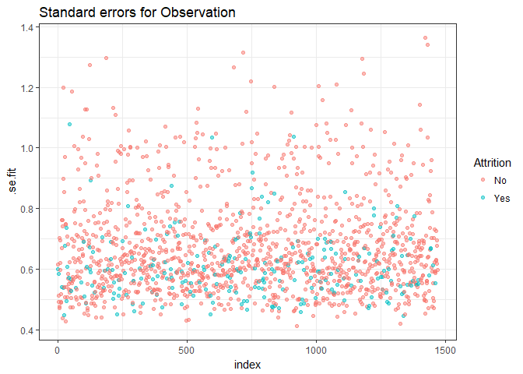
Standard errors for Observation

Slide 38
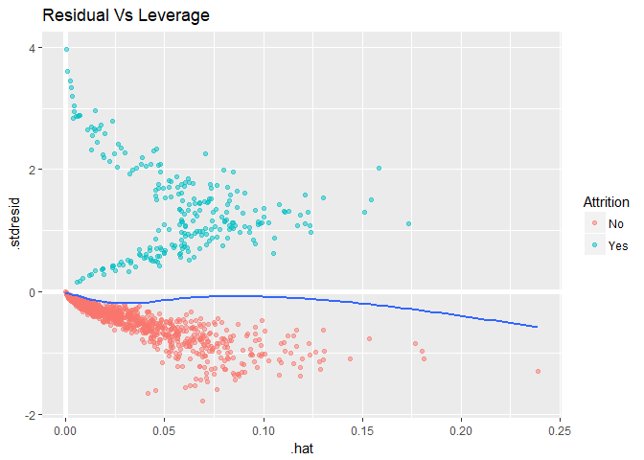
Studentized Residual vs Leverage

Slide 39
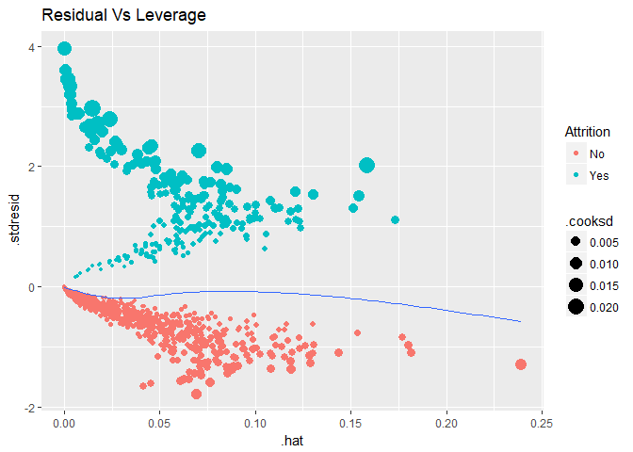
Studentized Residual vs Leverage

Slide 40
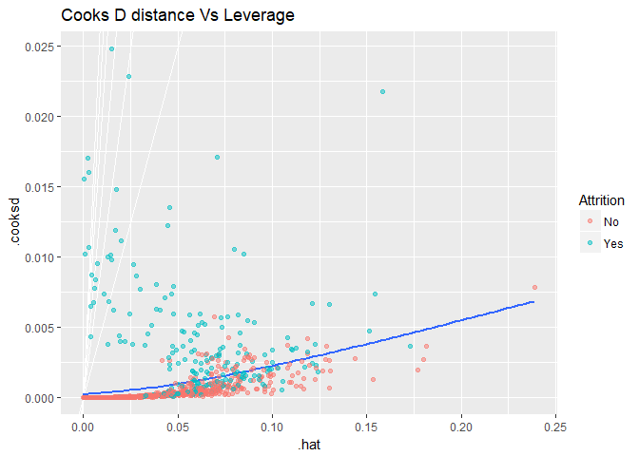
Cooks D distance vs Leverage

Slide 41
Summary
According to our analysis, check the likelihood ratio test of the nothing model with the stepwise and forward selection models, the best model is forward #2 as follows
Attrition ~ OverTime + JobRole + StckOptnLvl + EnvrnmntSts +
BusinssTrvl + JobInvlvmnt + DistncFrmHm + JobSatsfctn + NmCmpnsWrkd +
TtlWrkngYrs + WorkLifBlnc + RltnshpStsf + YrsSncLstPr + logMthlyInc +
YrsInCrrntR + EducatinFld + TrnngTmsLsY + Gender + YrsWthCrrMn + ## DailyRate + Age

