Slide 1
Investigation of employee attrition with predictive analytics
Mahesh Kuklani, Rene Pineda and Chaoshun Hu

Slide 2
Outline
Business Objectives
Data Sourced
Methodology
Evaluation/Results
Summary

Slide 3
Business Objectives
The purpose of this analysis is to try to dilucidate what are the most important factors that contribute to attrition, amongst the many factors affect an employee’s environment and satisfaction. Once these factors are determined, a company can take actions to control them.

Slide 4
How to keep employee
Divest?
Aggressively retain
Low value.
High Attrition Risk
High value.
High Attrition Risk
Attrition Risk
Grow-up
Maintain
Low value.
Low Attrition Risk
High value.
Low Attrition Risk
Employee lifetime value

Slide 5
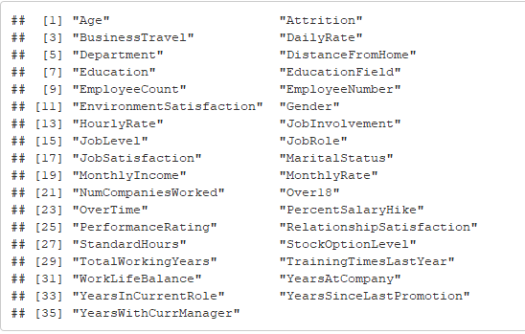
Data Sourced
Dimension Size
1470 observations; 35 variables;
Column names

Slide 6
Where We Got It

Slide 7
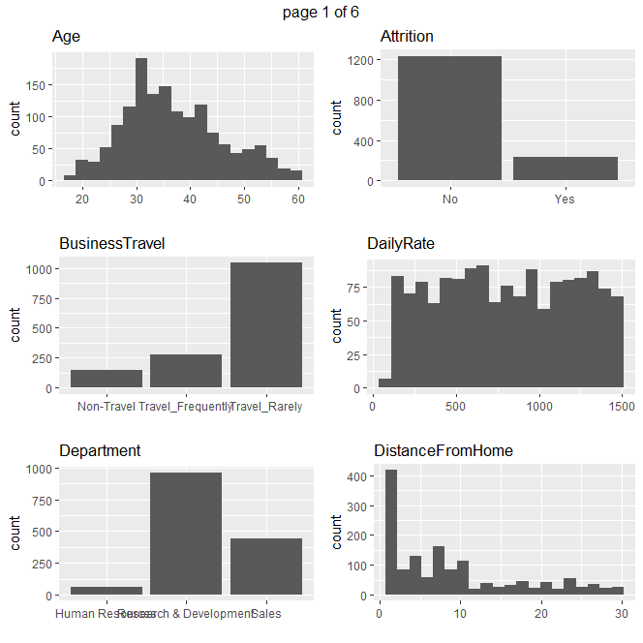
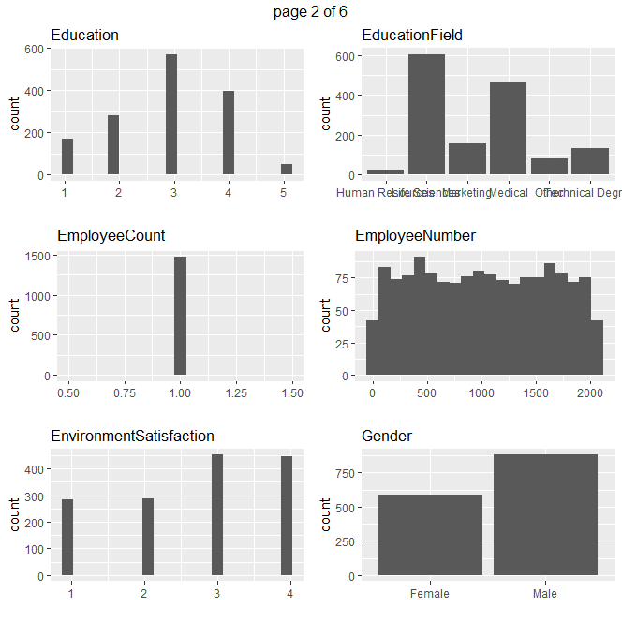
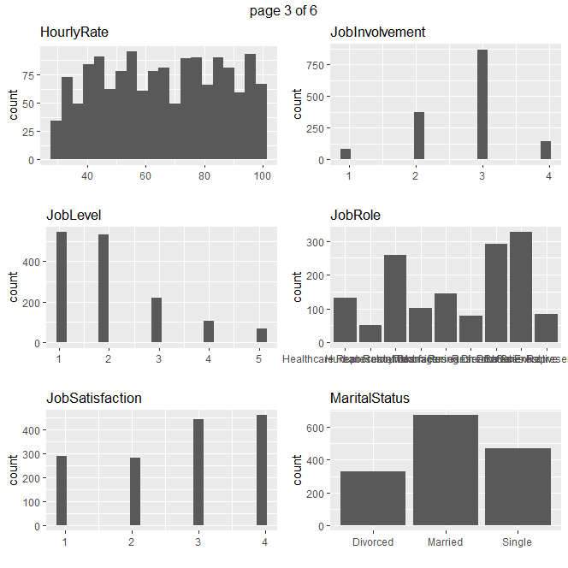
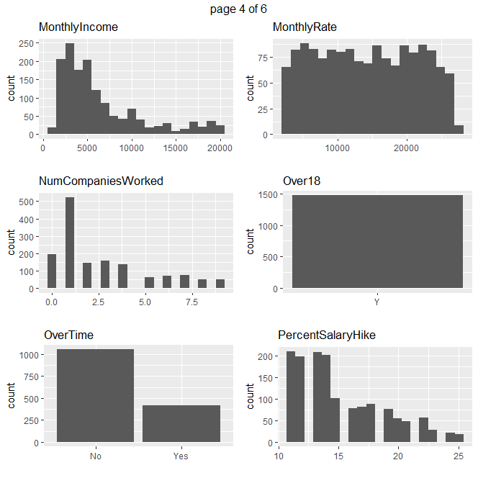
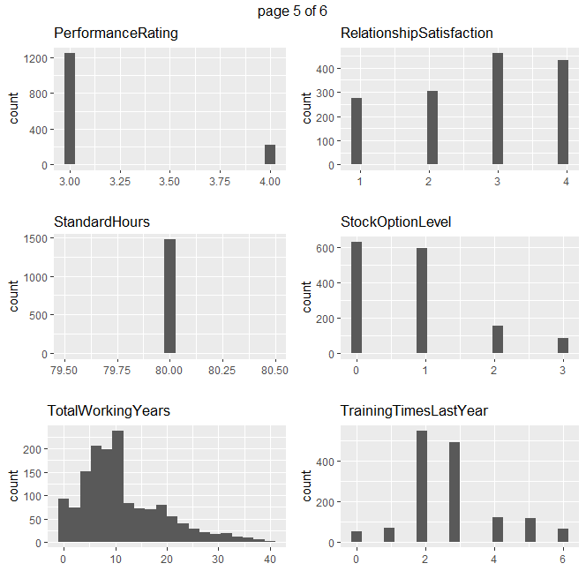
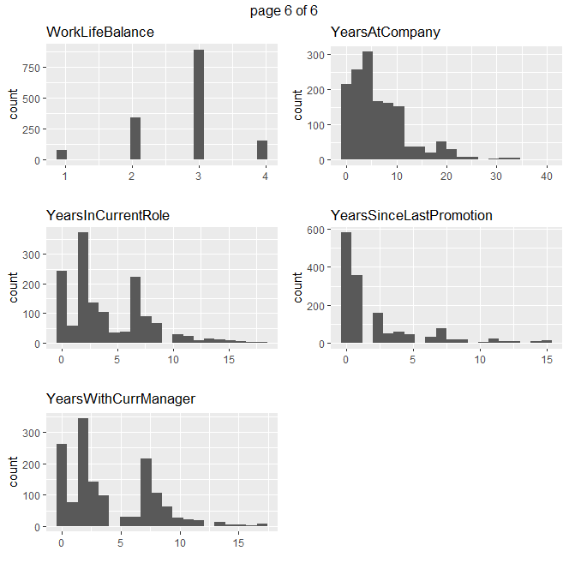
Basic Statistics (EDA)
7 factors doesn’t show good normality

Slide 8
Methodology
Steps
Data Preparation
Prelimiary Analysis
Additional Analysis
Model Using Multivariate Regression
Workflow
Full Model Regression
Forward Model 1
Forward Model 2

Slide 9
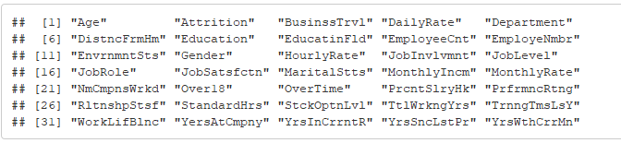
Steps: Data Cleaning and Preparation
Abbreviate column names

Slide 10
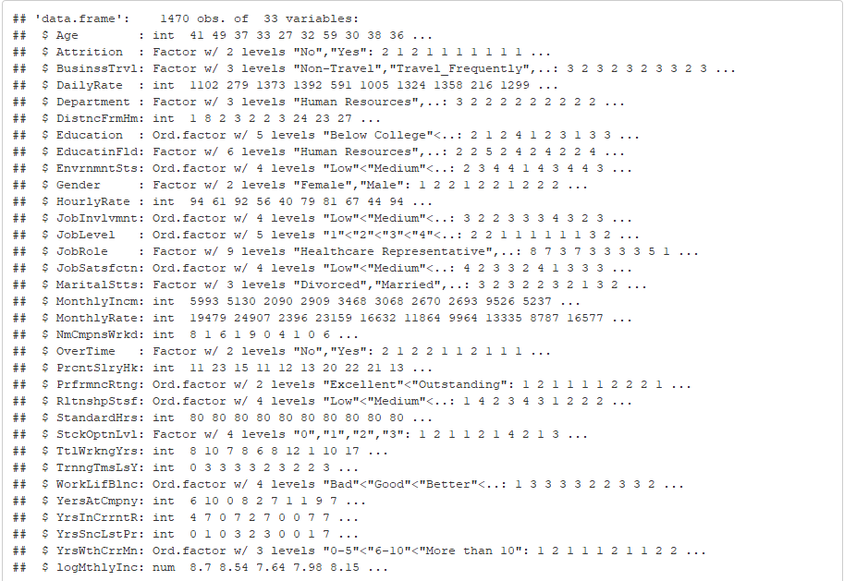
Steps: Data Cleaning and Preparation
Recode Variables from ‘numeric’ to ‘factor’

Slide 11
Steps: Preliminary Analysis
Descriptive statistics on at least 7 variables.
Age
Monthly Income
Distance From Home
Number of Companies Worked In
Percent Salary Raise
Total Working Years
Years At Company

Slide 12
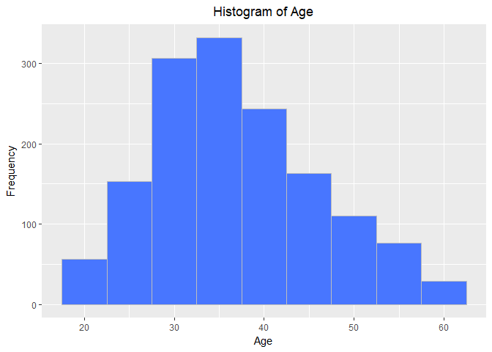
Steps: Preliminary Analysis Simple Histogram for two of the selected 7 factors

Slide 13
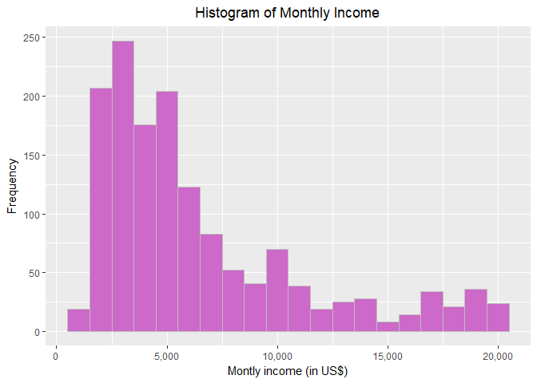
Steps:Preliminary Analysis Simple Histogram for two of the selected 7 factors

Slide 14
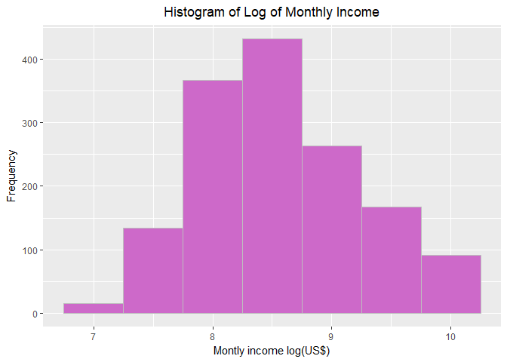
Preliminary Analysis Simple Histogram for two of the selected 7 factors

Slide 15
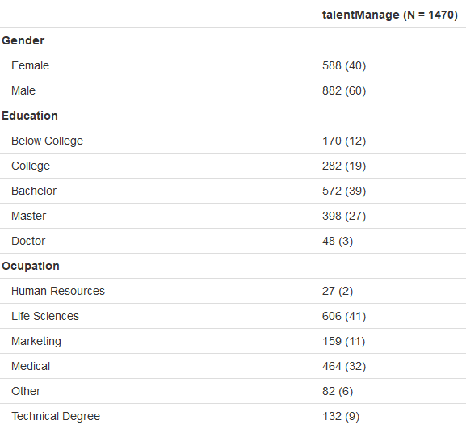
Preliminary Analysis Give the frequencies for Gender, Education, and Occupation

Slide 16
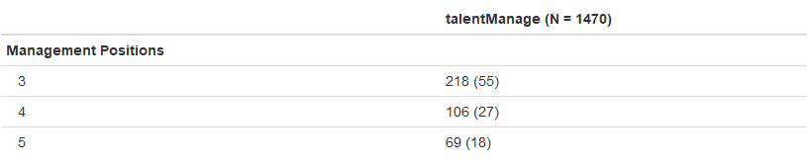
Preliminary Analysis Give the count of management positions

Slide 17
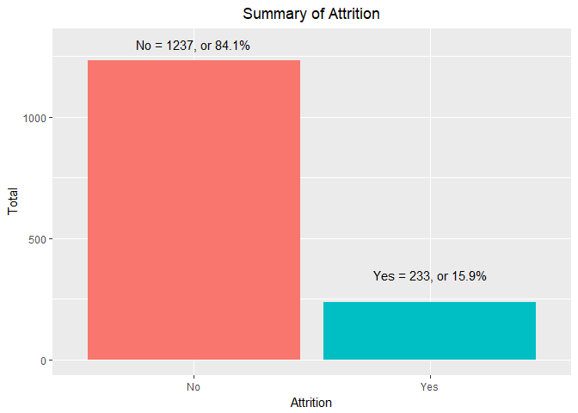
Additional Analysis Examine the proportion of attrition vs. No attribution

Slide 18
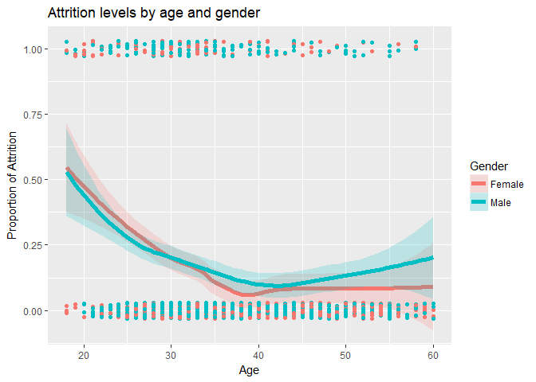
Additional Analysis whether there are differences in attrition by continuous and categorical variables

Slide 19
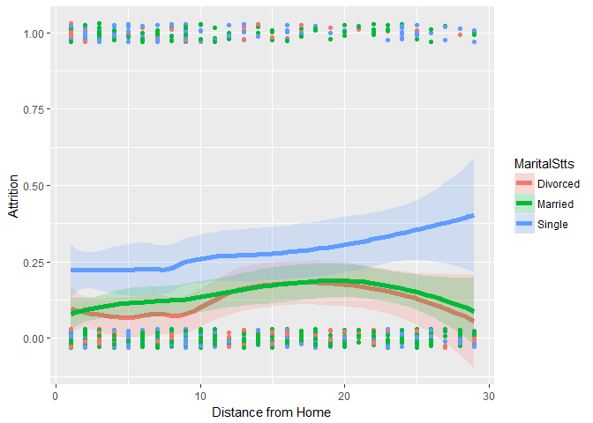
Additional Analysis using distance from home and marital Status

Slide 20
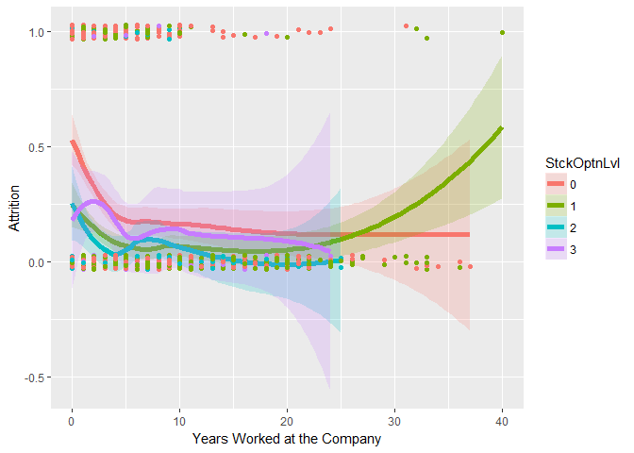
Additional Analysis using years in the company

Slide 21
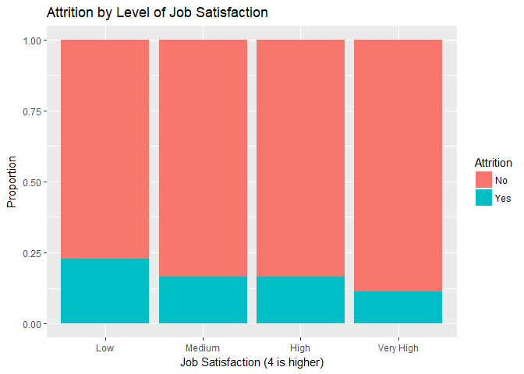
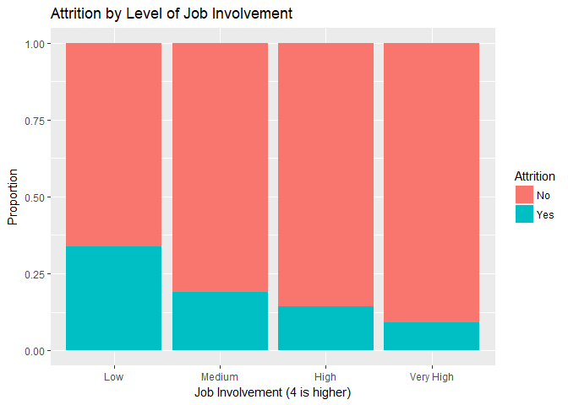
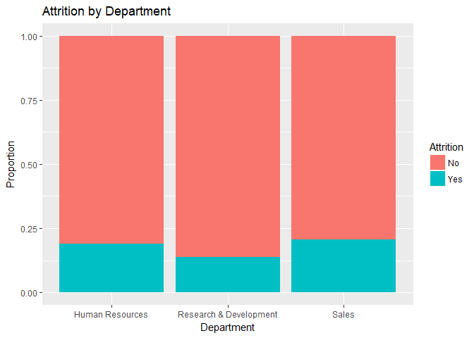
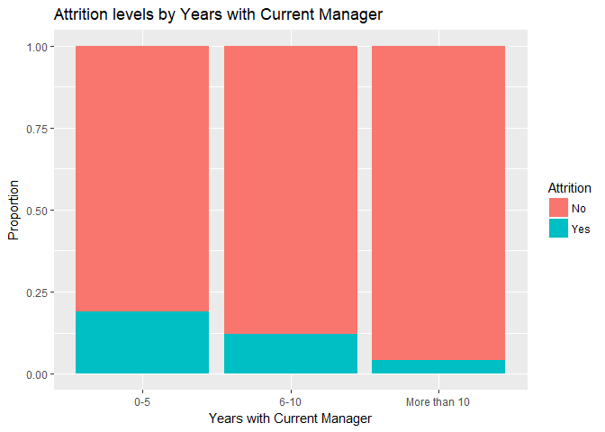
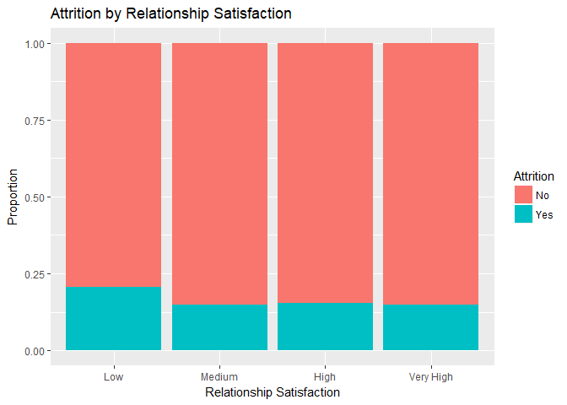
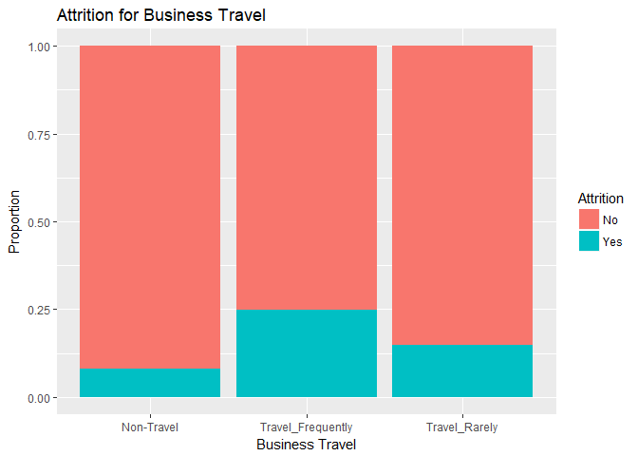
Attrition by Different factors

Slide 22
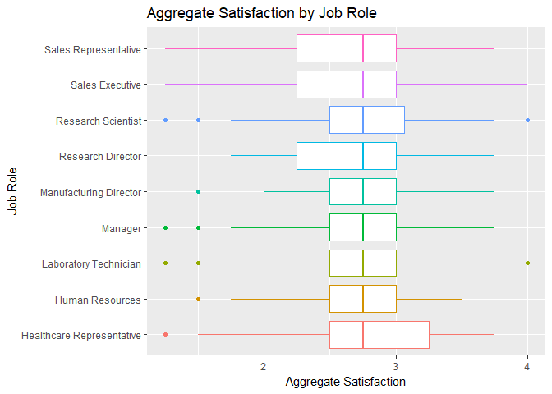
Additional Analysis

Slide 23
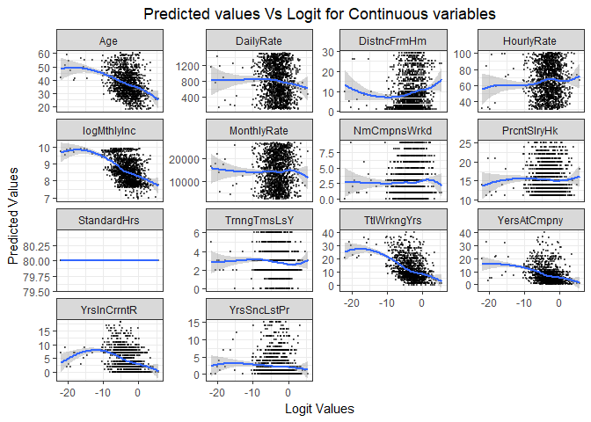
Visual Inspection of Continuous Variables

Slide 24
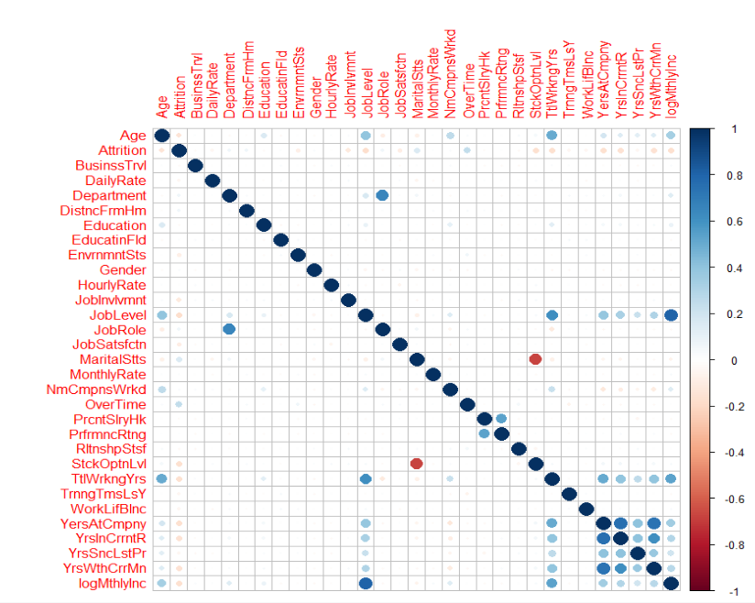
Additional Analysis: Correlation Plot

Slide 25
Evaluaion/Results
Tell me the percentages and why
Show me graphs with explanations
The top three factors that contribute to turnover
Tell me about any job role specific trends that may exist in the data set
Provide any other interesting trends and observations from your analysis
Other things to consider?

Slide 26
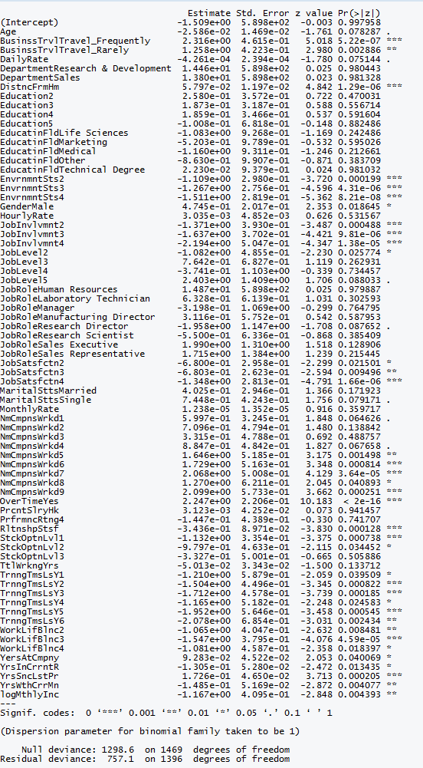
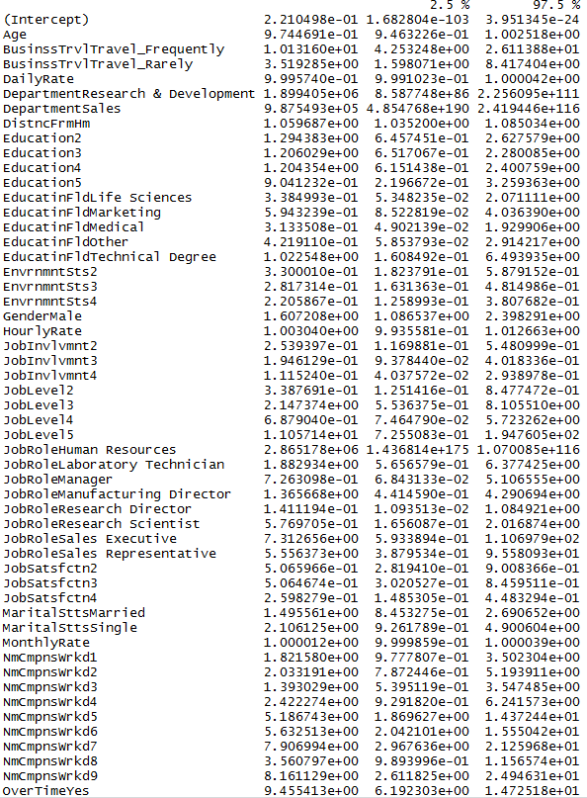
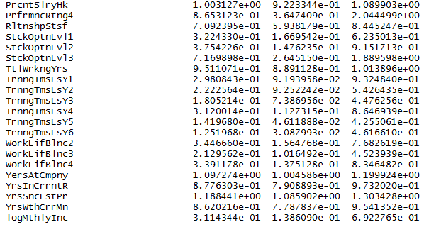
Evaluation : Percentages and why

Slide 27
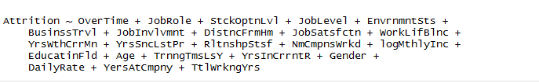
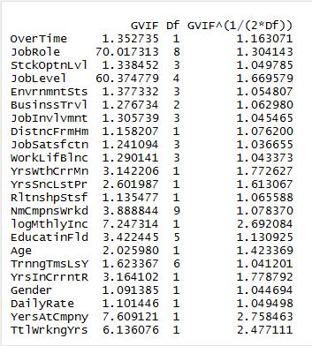
Forward Selection
Removing JobLevel since JobRole and JobLevel are highly correlated

Slide 28
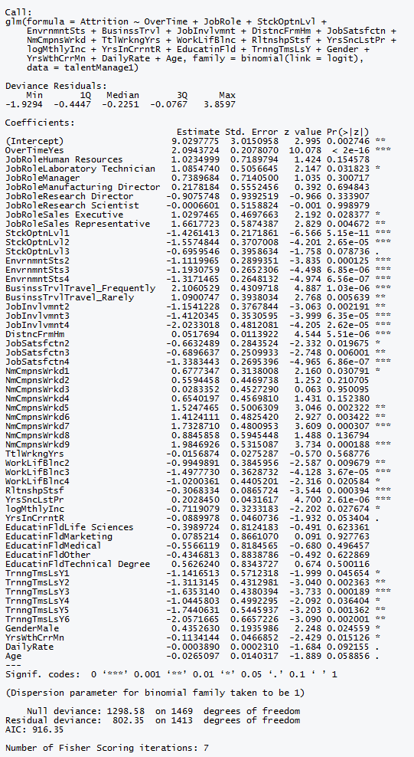
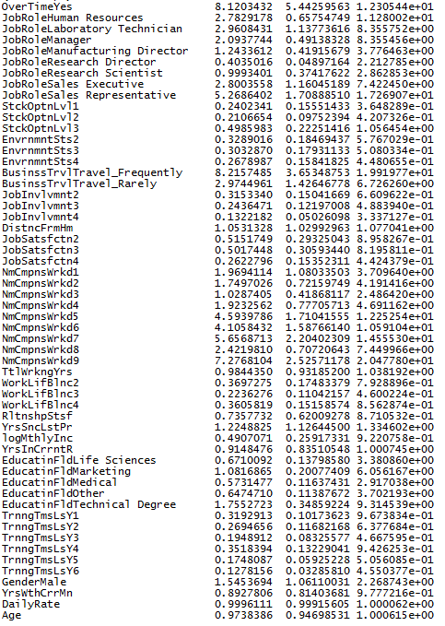
Forward Selection w/o Job Level

Slide 29
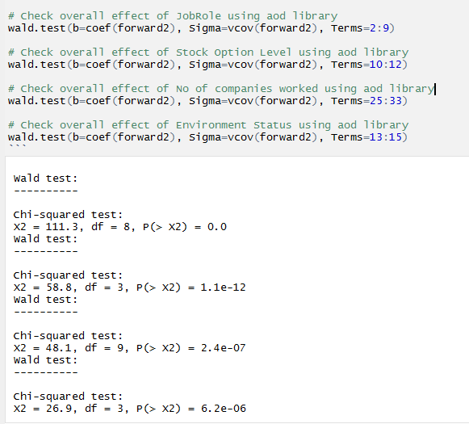
Check overall effect Of JobRole and Education Field

Slide 30
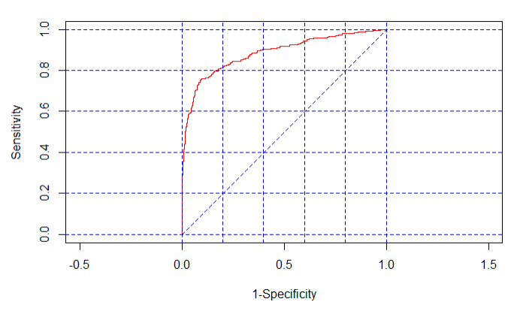
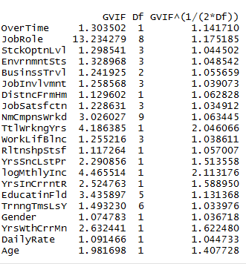
VIF for Forward model w/o Job Level and ROC Curve

Slide 31
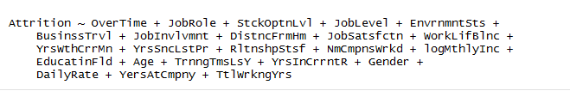
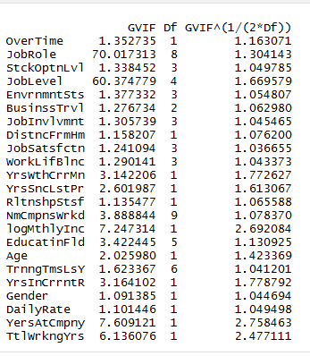
Stepwise selection
Removing JobLevel since JobRole and JobLevel are highly correlated

Slide 32
Deviance For Two Models (Forward AndStepwise)
Forward – 764.3014
Stepwise – 764.3014
AIC Values
Forward - 888.3014
Stepwise - 888.3014

Slide 33
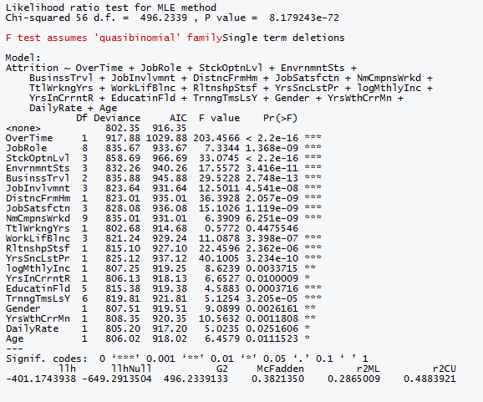
Goodness of Fit Test Between Forward Model and Reduced Null Model and Pseudo R^2
Null Hypothesis is that restricted model is better than the forward2 model
Pseudo R^2 is
0.38

Slide 34
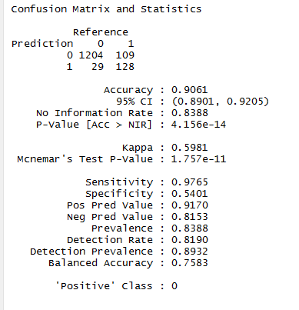
Accuracy of Prediction for FORWARD Model using Confusion Matrix
Accuracy of Prediction

Slide 35
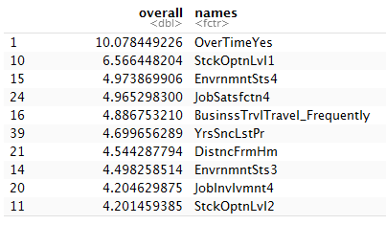
3 Best Predictors Of The Model
3 Best Predictors for the model are OverTime, Stock Option Level and Environment Status.

Slide 36
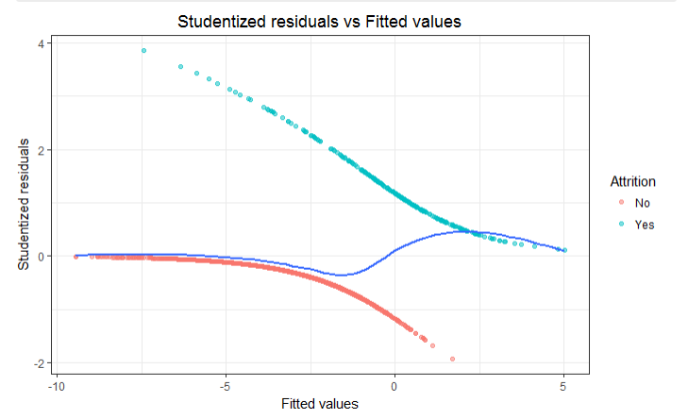
Studentized residuals vs Fitted values

Slide 37
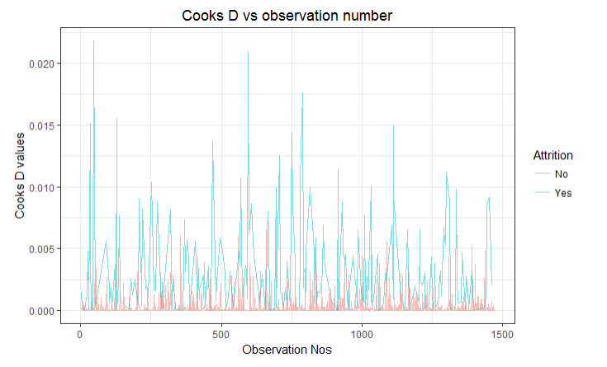
Cooks D vs Observation Number

Slide 38
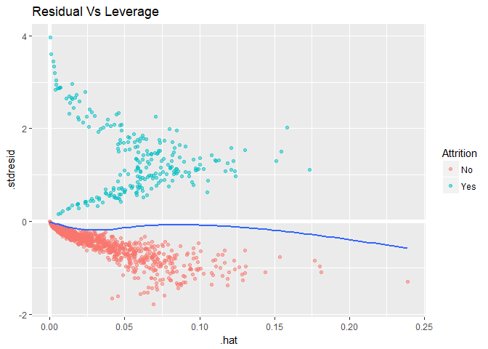
Studentized Residual vs Leverage

Slide 39
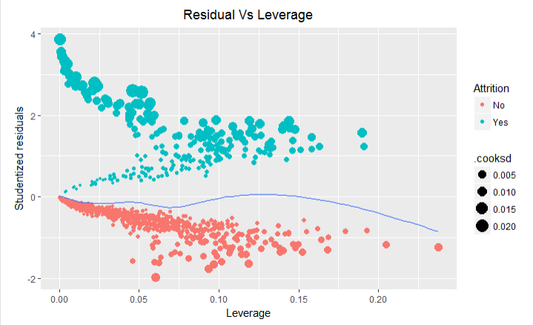
Studentized Residual vs Leverage based on Cooks D

Slide 40
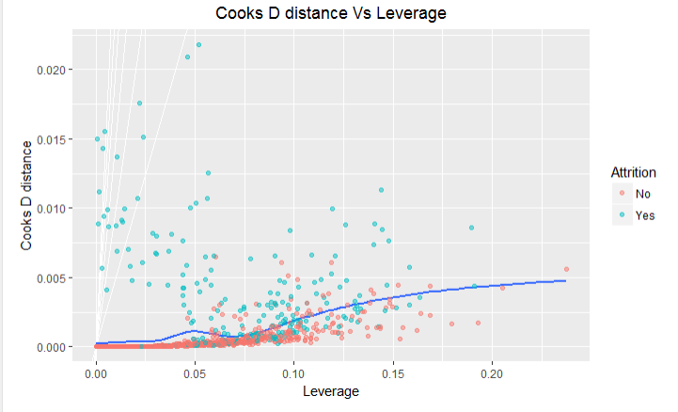
Cooks D distance vs Leverage

Slide 41
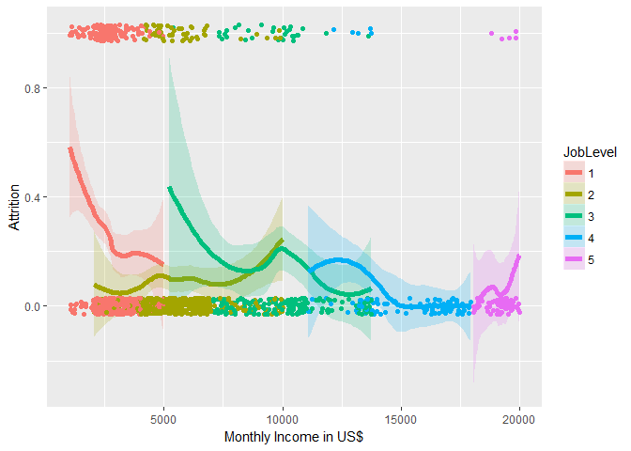
Additional Analysis using monthly income and job level

Slide 42
Summary
According to our analysis, check the likelihood ratio test of the nothing model with the stepwise and forward selection models, the best model is FORWARD 2 Model as follows
Attrition ~ OverTime + JobRole + StckOptnLvl + EnvrnmntSts +
BusinssTrvl + JobInvlvmnt + DistncFrmHm + JobSatsfctn + NmCmpnsWrkd +
TtlWrkngYrs + WorkLifBlnc + RltnshpStsf + YrsSncLstPr + logMthlyInc +
YrsInCrrntR + EducatinFld + TrnngTmsLsY + Gender + YrsWthCrrMn + ## DailyRate + Age

