Slide 1

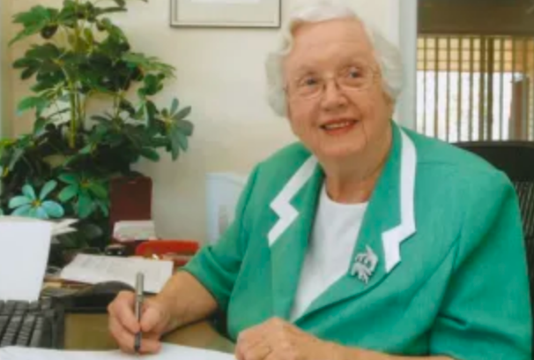




2
1
3
4
Housekeeper
Broker
Worker

