Slide 1
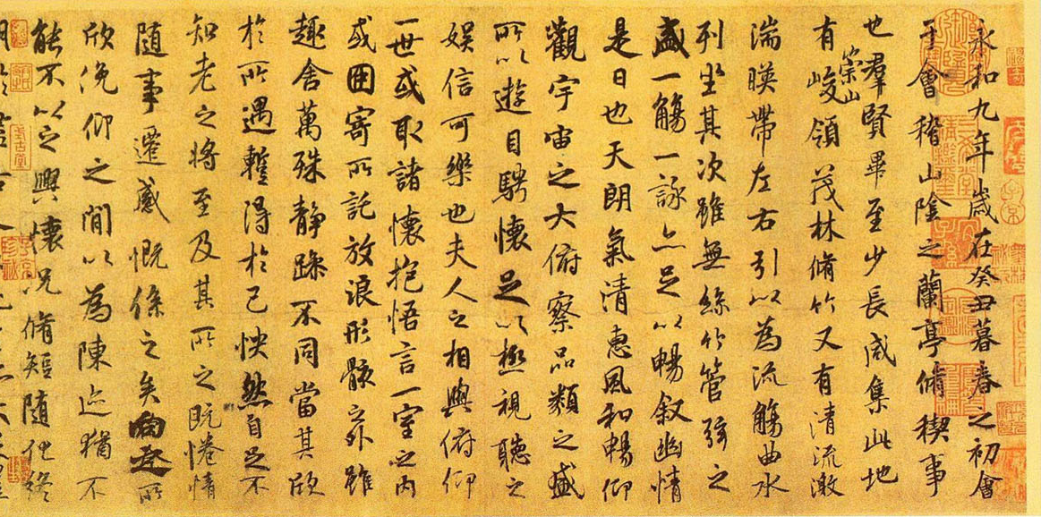







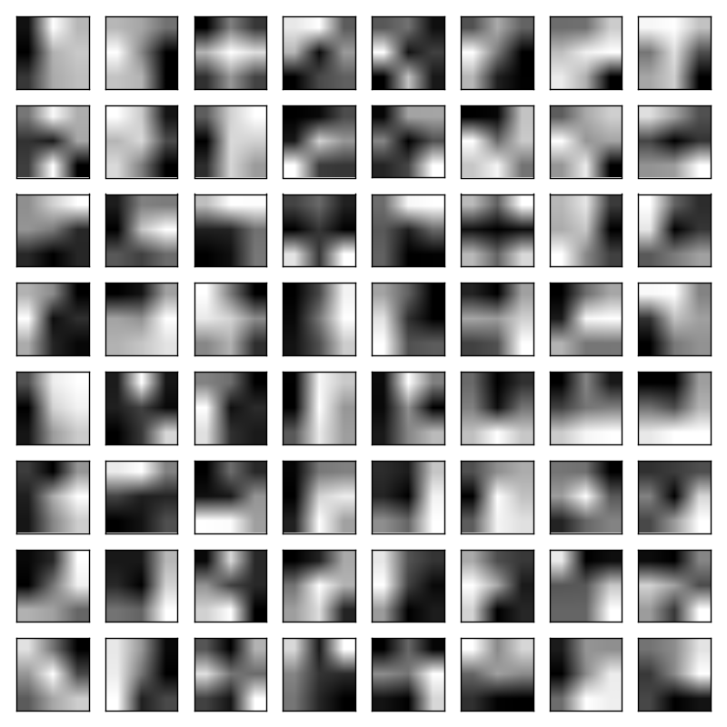
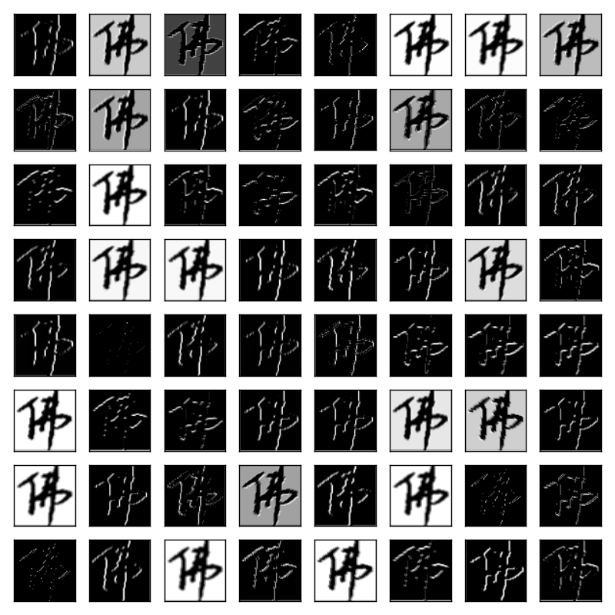
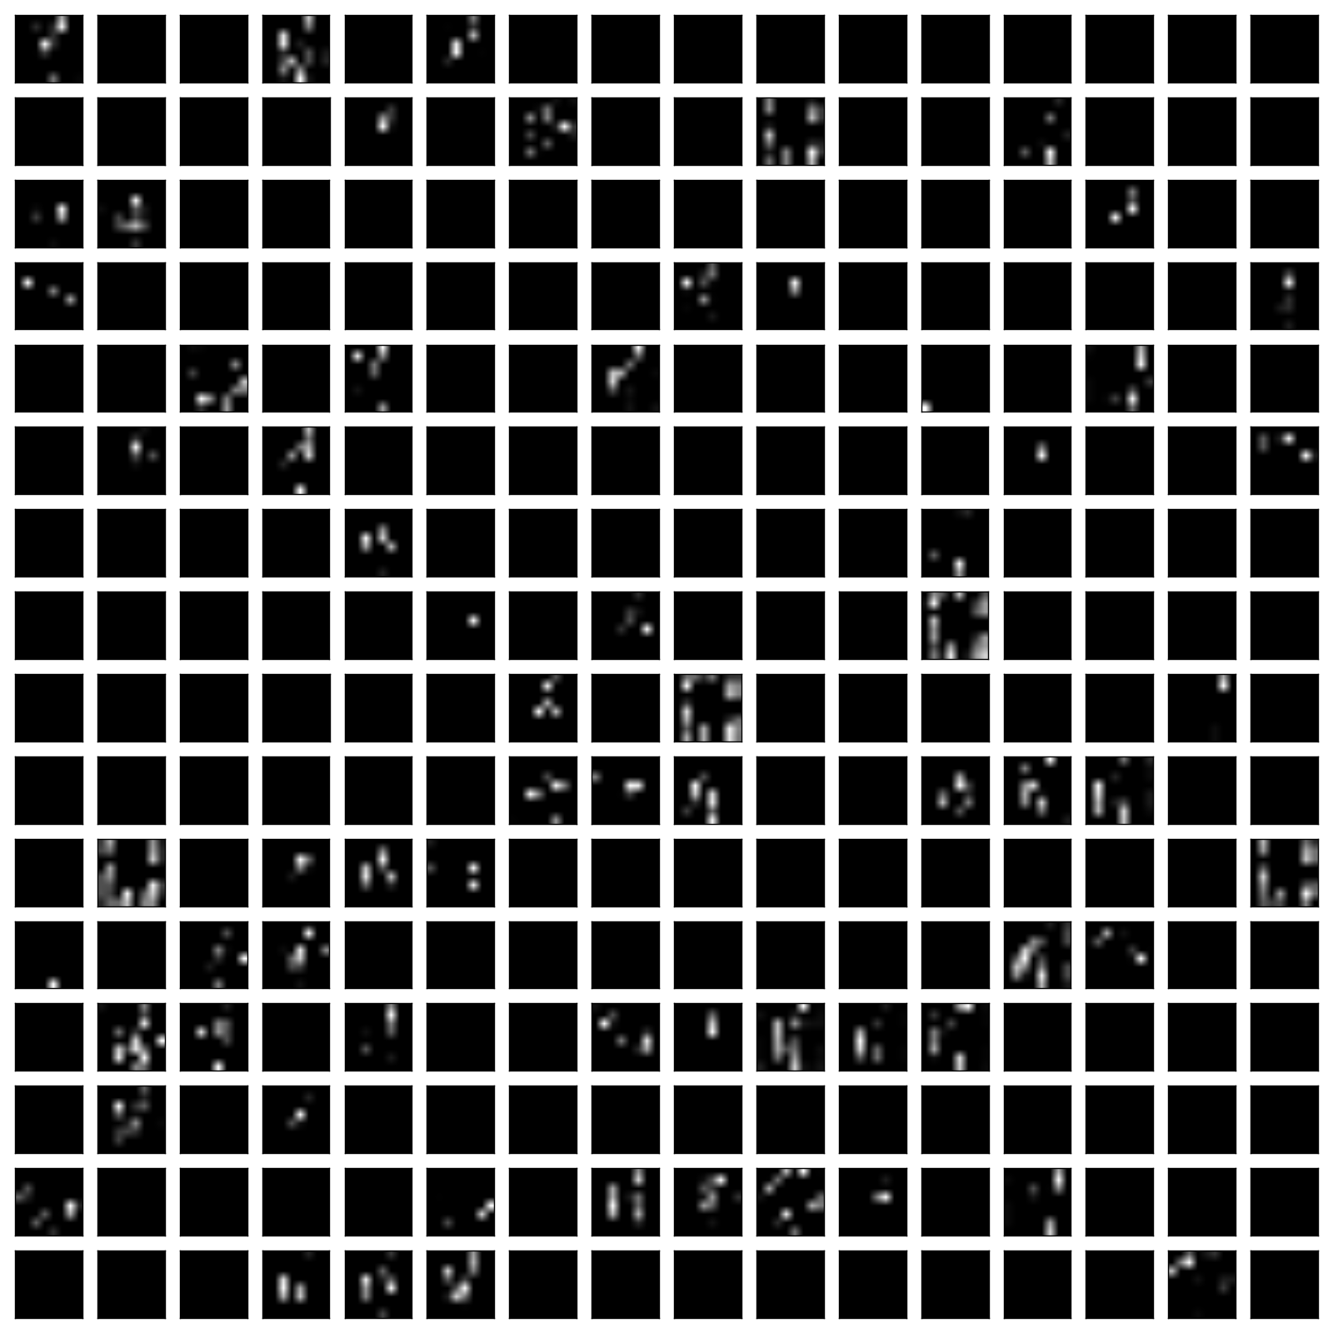
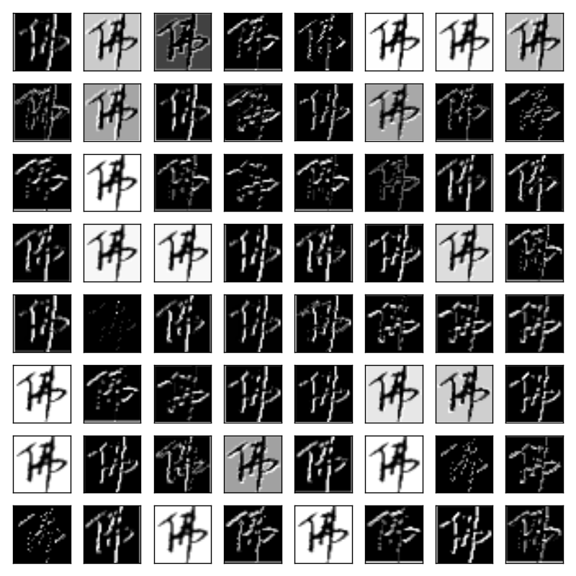
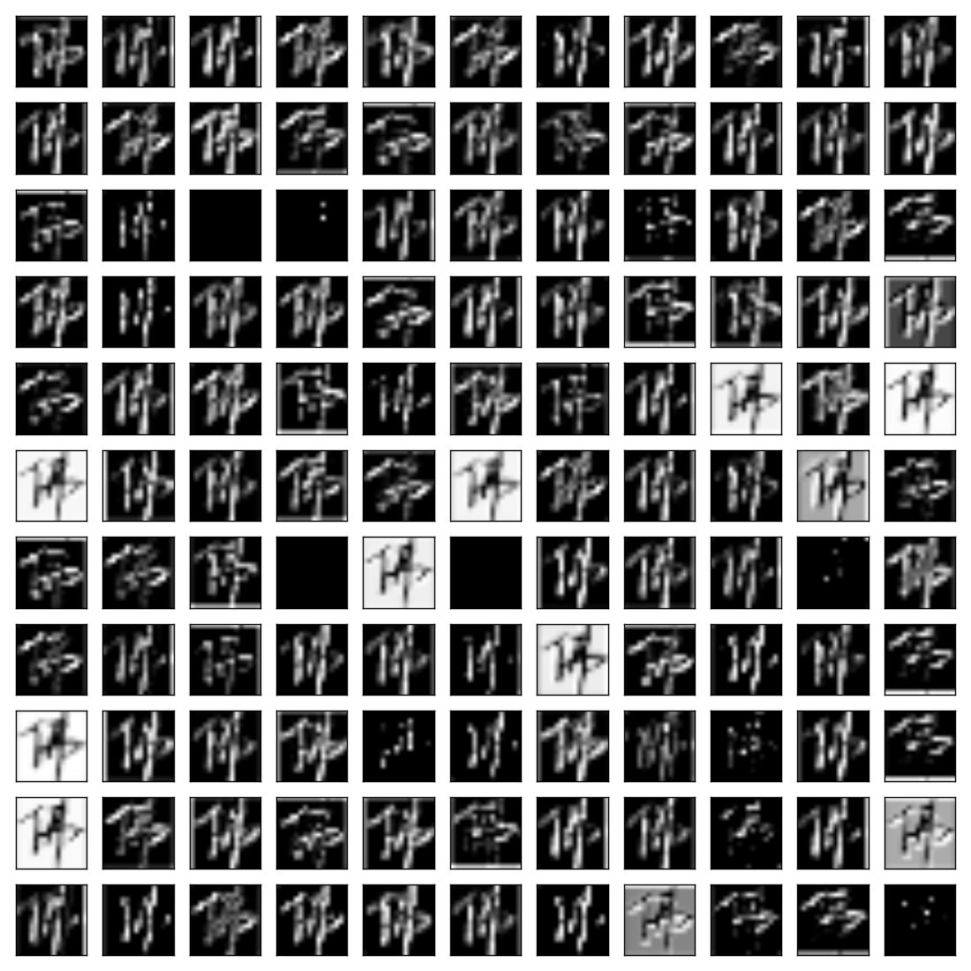


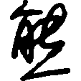














Convolutional Neural Network for Handwritten Chinese Character Recognition
Simon Fraser University
Chao Li, Johnson Pan, and Jiameng Yang
CHALLENGES
In comparison to digits and Latin alphabet character recognition, written Chinese characters:
– Orders of magnitude higher in number
in total over 50,000 characters, 3,000 of which are used daily.
– Significantly more complicated structurally
– Handwriting style varies hugely from person to person
e.g. Chinese character “统” (“Unify” in English) written by 3 people
Contribution: A different approach to preprocess images – binarize pixel into black and white from grayscale.
DATA PREPROCESSING
– extract images and corresponding labels from a ‘.pnt’ database
– center the characters and resize images to 64x64 pixels²
– convert resized images into binary images
e.g. preprocessing the Chinese character for “Buddha”
Convolutional Neural Network Configuration
Input
Convolution1
+ ReLU
Maxpooling1
Convolution2
+ ReLU
Maxpooling2
Convolution3
+ ReLU
Maxpooling3
Fully
Connected
Fully
Connected
Output 300 classes
+Softmax
center
+resize
convert
to binary
Dense$(1024)$
$$(1×64×64)$$
$$(64×64×64)$$
$$(64×32×32)$$
$$(128×32×32)$$
$$(128×16×16)$$
$$(256×16×16)$$
$$(256×8×8)$$
Dense$(1024)$
Visualization of filters and layer outputs
EXPERIMENTS
NETWORK STRUCTURES/PARAMETERS
Table I Various CNN configurations and Top-5 Accuracy (%)
Dataset | # Writers |  | # Classes | # Chinese Characters
CASIA HWDB1.0 | 300 |  | 300 | 99977 in total
 |  |  |  | 79887 for training | 20090 for test
Default Training Parameters |  |  |  | Top 5 Accuracy (%)
Learning Rate |  | Batch Size |  | 99.22
0.01 |  | 128
N1* | N2 | N3 | N4 |  | N5 | N6
conv64(3X3)
max pooling
conv128(3X3)
max pooling
conv256(3X3) |  | conv256(3X3)
 |  | conv256(3X3)
max pooling |  | max pooling
 |  |  |  | conv512(3X3)
 |  |  |  | max pooling
fully connected 1024 |  |  |  |  |  | fully connected 2048
dropout(0.5) |  |  |  |  |  | dropout(0.5)
fully connected 1024 |  |  |  |  |  | fully connected 2048
dropout(0.5) |  |  |  |  |  | dropout(0.5)
softmax
99.2* | 97.66 | 4.69 |  | 3.91 | 98.44 | 96.88
filter of convolution 1
output of convolution 1
Correctly classified:
Misclassified:
Samples for Chinese character “熊”
(“bear” in English)
output of maxpooling 3
Table II Various parameters and Top-5 Accuracy (%)
Modified Parameters |  | Top 5 Accuracy (%)
Learning Rate | 0.05 | 4.69
 | 0.1 | 3.12
Bach Size | 64 | 3.12
 | 32 | 5.21
output of maxpooling 1
output of maxpooling 2

