Slide 1
Audio LLM research weekly report – Week 7
Hongyu Jin
Notes:
Most of what I am talking about is covered in the guidelines for use, found at the front of the RDA.

Slide 2
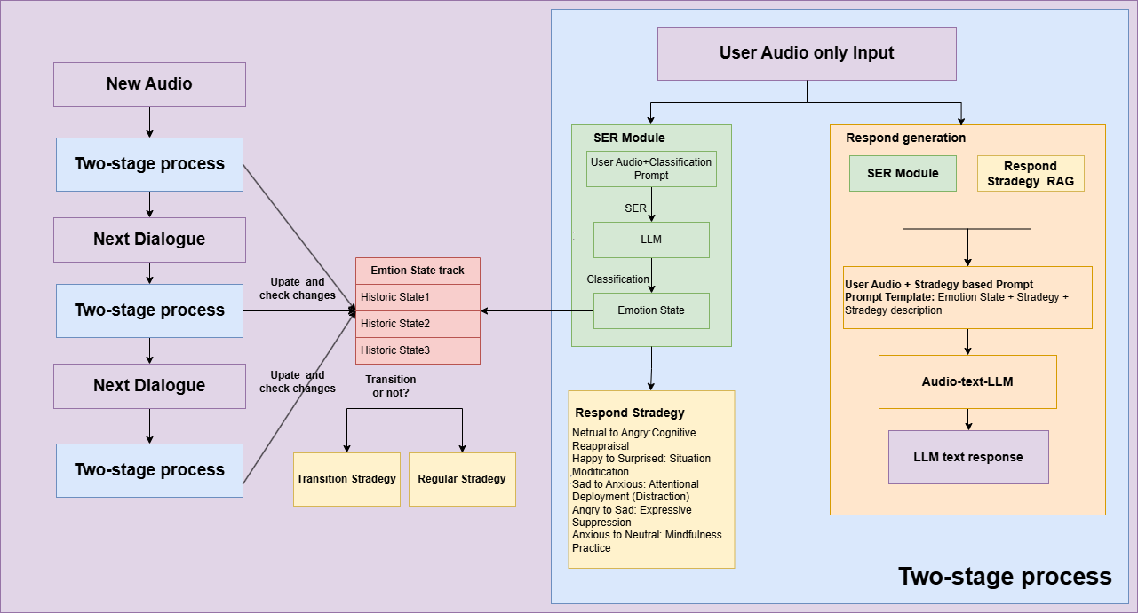
Model Structure
Notes:
The purpose of the RDA is to provide a legal mechanism for the retention & disposal of university records in accordance with legislative instruments and regulations issued under the Public Records Act 1973.
The Authority also -
identifies records which are required to be preserved permanently as part of the University’s archival heritage;
prevents the premature destruction of records which need to be retained for a specified period to satisfy legal, financial and other requirements of public administration;
specifies the minimum, and in some cases maximum, periods for which records are required to be retained;
authorises the destruction of those records not required permanently; and
mandates the prompt destruction of records as required under the Information Privacy Act 2000 and other instruments

Slide 3
Reward Dataset
DPO – Direct Preference Optimization
{
"prompt": "I've been feeling really down lately. I don't want to do anything.",
"chosen": "It sounds like you're feeling really low. That must be really hard.",
"rejected": "Maybe you could try exercising or finding a distraction."
}
Li et al., 2023 – "Direct Preference Optimization: Your Language Model is Secretly a Reward Model"

Slide 4
Reward Dataset
RRHF – Ranked Reward for Helpful Fine-Tuning
{
"prompt": "I feel like a failure.",
"replies": [
"You're not a failure — you're just going through a tough time.", // Rank 1
"Don't overthink it. Everyone goes through low points.", // Rank 2
"Maybe try to distract yourself with something else." // Rank 3
]
}
Yuan et al., 2023 – "RRHF: Rank Responses to Align Language Models with Human Feedback without Tears"

Slide 5
Reward Dataset
DPO – Direct Preference Optimization
{
"Input": "I've been feeling really down lately. I don't want to do anything."
+ {user audio clip}
"chosen": "{sythetic Data}.",
"rejected": "{IEMOCAP original dataset}."
}

Slide 6
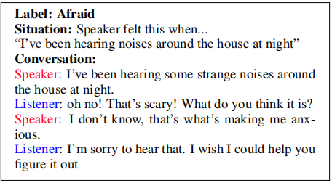
Reward Dataset
Empathetic Dialogues
Train BERT?
Finetune another LLM?
Generating response or Giving score?

Slide 7


© Copyright The University of Melbourne 2011

