Slide 1
Audio LLM research weekly report – Week 6
Hongyu Jin
Notes:
Most of what I am talking about is covered in the guidelines for use, found at the front of the RDA.

Slide 2
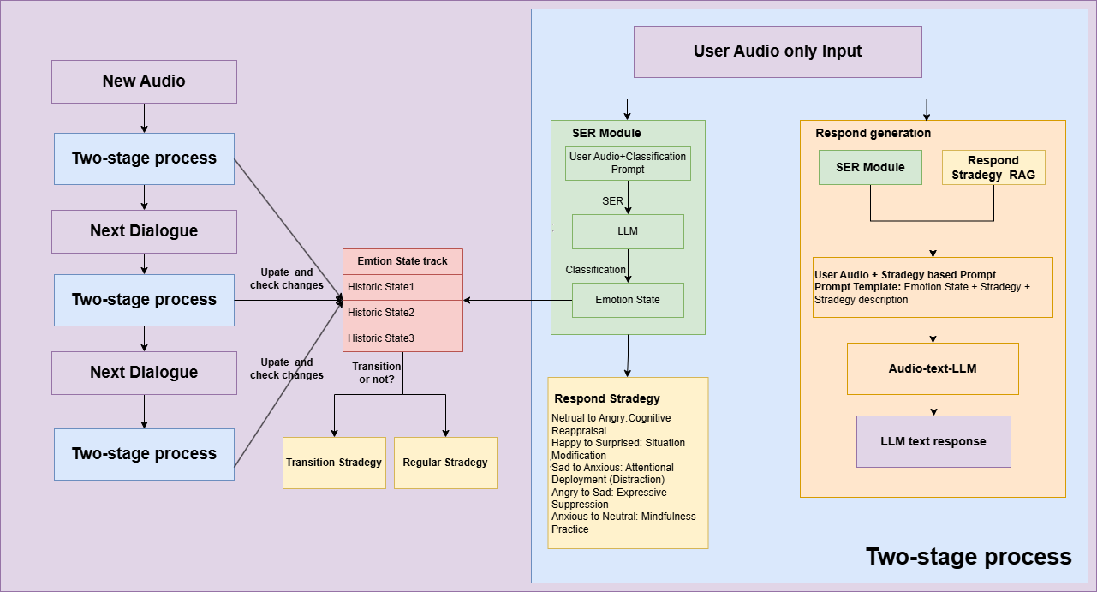
Model Structure
Notes:
The purpose of the RDA is to provide a legal mechanism for the retention & disposal of university records in accordance with legislative instruments and regulations issued under the Public Records Act 1973.
The Authority also -
identifies records which are required to be preserved permanently as part of the University’s archival heritage;
prevents the premature destruction of records which need to be retained for a specified period to satisfy legal, financial and other requirements of public administration;
specifies the minimum, and in some cases maximum, periods for which records are required to be retained;
authorises the destruction of those records not required permanently; and
mandates the prompt destruction of records as required under the Information Privacy Act 2000 and other instruments

Slide 3
GPT-4o Baseline on IEMOCAP
system prompt:
"You are an emotion detection assistant. Analyze the audio and determine the primary emotion expressed. Only respond with a single emotion word from this list: [Neutral, Frustration, Anger, Happiness, Excited, Sadness, Fear, Surprise, Disgust.]"
For GPT, prompt engineering can enforce single word response.
GPT-4o-mini-audio Total samples evaluated: 10039
Correct predictions: 3525
Accuracy: 35.11%
GPT-4o-audio
Total samples evaluated: 10039
Correct predictions: 4281
Accuracy: 42.64%

Slide 4
Multi-Dialogue Dataset IEMOCAP
Context
M1_001
F1_001
M1_003
Inference
M1_002
F1_002

Slide 5
Evaluation
M1+F1+M2+F2 -> M3(2 rounds dialogue)
2 rounds dialogue context
3 rounds dialogue context
two stage inference no context
two stage inference + 2 rounds dialogue context
two stage inference + 2 rounds dialogue context
Notes:
The University of Melbourne Records Retention and Disposal Authority (RDA) is
“…the University document that sets out requirements for retention and disposal of all types of records, in line with legislative requirements and University business needs…”
(Records Management Policy MPF1106)
Records Services is responsible for developing the RDA
The University Archivist, Legal Services and the Director, Internal Audit are also consulted
The final document is approved by the University Secretary
(Records Management Policy MPF 1106, Records Retention and Disposal Procedure MPF1109)

Slide 6
RAG for instruction pool
BLEURT
Input: A pair of sentences — one generated by a model (candidate), and one ground truth (reference).
Encoding: Both sentences are passed into a pre-trained BERT-based model.
Scoring: The model produces a regression score that predicts how similar the candidate is to the reference, on a scale roughly aligned with human evaluations.
Output: A real-valued score — higher is better (typically ranges from 0 to 1, but depends on the fine-tuning data).
common NLP metrics
ROUGE1
ROUGE2
ROUGEL
BLEU
METEOR
perplexity
Notes:
What records does the RDA apply to?
The RDA applies to University records only. A University record is defined as “…any record comprised of recorded information, in any format, created or received by staff of the University in the course of conducting their University duties…”
(Records Management Policy MPF1106)

Slide 7


© Copyright The University of Melbourne 2011

