Slide 1
Audio LLM research weekly report – Week 4
Hongyu Jin
Notes:
Most of what I am talking about is covered in the guidelines for use, found at the front of the RDA.

Slide 2
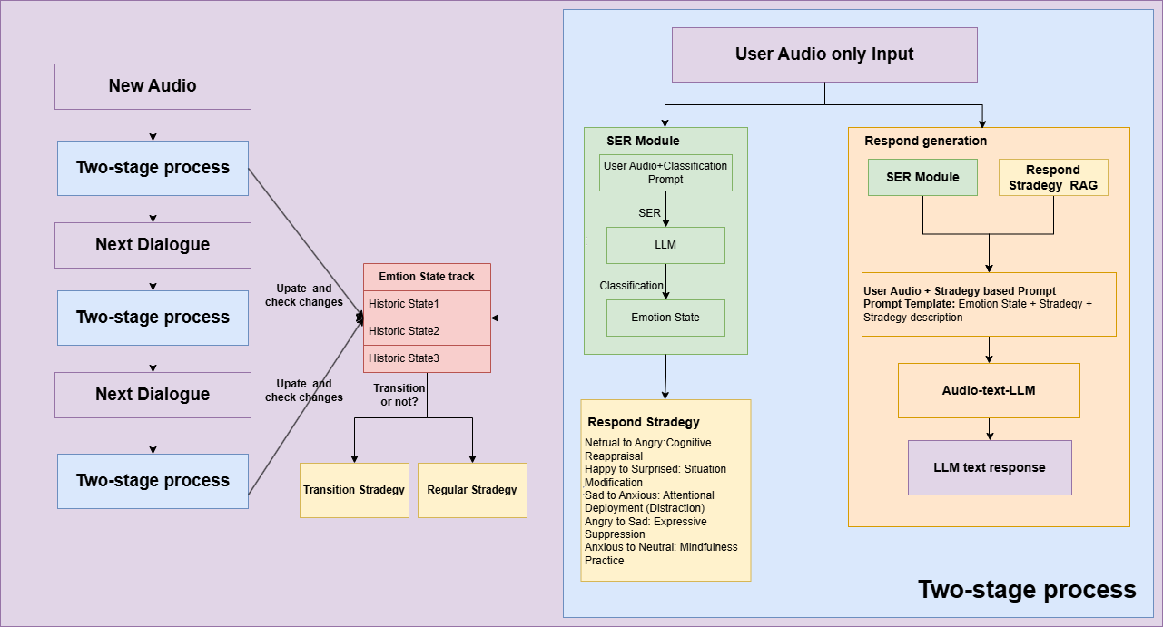
Model Structure
Notes:
The purpose of the RDA is to provide a legal mechanism for the retention & disposal of university records in accordance with legislative instruments and regulations issued under the Public Records Act 1973.
The Authority also -
identifies records which are required to be preserved permanently as part of the University’s archival heritage;
prevents the premature destruction of records which need to be retained for a specified period to satisfy legal, financial and other requirements of public administration;
specifies the minimum, and in some cases maximum, periods for which records are required to be retained;
authorises the destruction of those records not required permanently; and
mandates the prompt destruction of records as required under the Information Privacy Act 2000 and other instruments

Slide 3
Instruction pool
Transition: Neutral to Angry
Strategy: Cognitive Reappraisal
Description: Encourage individuals to reinterpret the situation that triggered anger, viewing it from a different perspective to reduce emotional intensity.
Reference: Sheppes, G., & Gross, J. J. (2011). Is timing everything? Temporal considerations in emotion regulation. Personality and Social Psychology Review, 15(4), 319–331.
[Happy to Surprised, Sad to Anxious, Angry to Sad, Anxious to Neutral, Surprised to Happy]

Slide 4
Dataset Requiremnet
{
"conversation_id": "conv_001",
"participants": [
{"id": "user_001", "role": "User"},
{"id": "system", "role": "System"}
],
"turns": [
{
"turn_id": 1,
"speaker_id": "user_001",
"audio_file": "conv_001_turn_01.wav",
"transcript": "Hi, I’m having a bit of trouble with my account.",
"emotion_label": "neutral",
"emotion_transition": null
},
{
"turn_id": 2,
"speaker_id": "system",
"audio_file": "conv_001_turn_02.wav",
"transcript": "I see. Could you tell me more about the issue?",
"emotion_label": "angry",
"emotion_transition": neutralToangry
},
Notes:
The University of Melbourne Records Retention and Disposal Authority (RDA) is
“…the University document that sets out requirements for retention and disposal of all types of records, in line with legislative requirements and University business needs…”
(Records Management Policy MPF1106)
Records Services is responsible for developing the RDA
The University Archivist, Legal Services and the Director, Internal Audit are also consulted
The final document is approved by the University Secretary
(Records Management Policy MPF 1106, Records Retention and Disposal Procedure MPF1109)

Slide 5
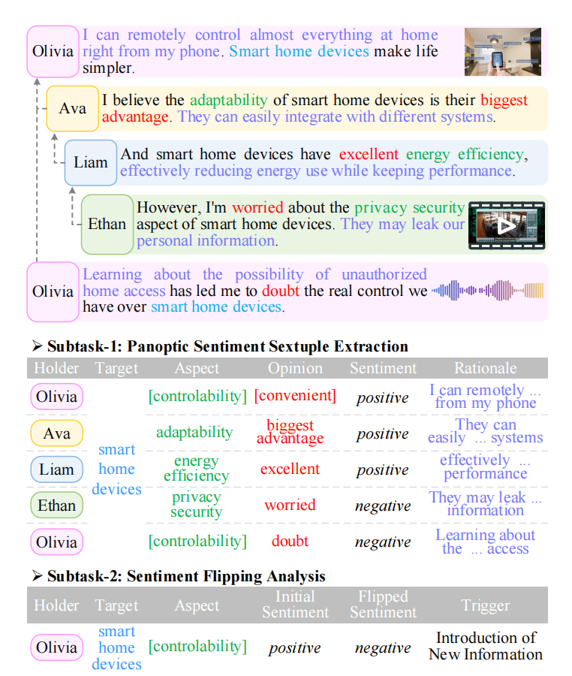
Dataset format
DiaASQ: A Benchmark of Conversational Aspect-based Sentiment Quadruple Analysis. arXiv preprint arXiv:2211.05705. https://doi.org/10.48550/arXiv.2211.05705​
Notes:
What records does the RDA apply to?
The RDA applies to University records only. A University record is defined as “…any record comprised of recorded information, in any format, created or received by staff of the University in the course of conducting their University duties…”
(Records Management Policy MPF1106)

Slide 6
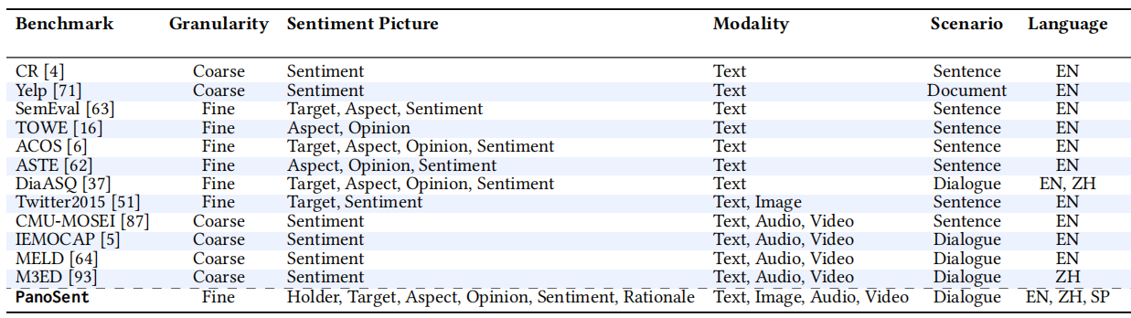
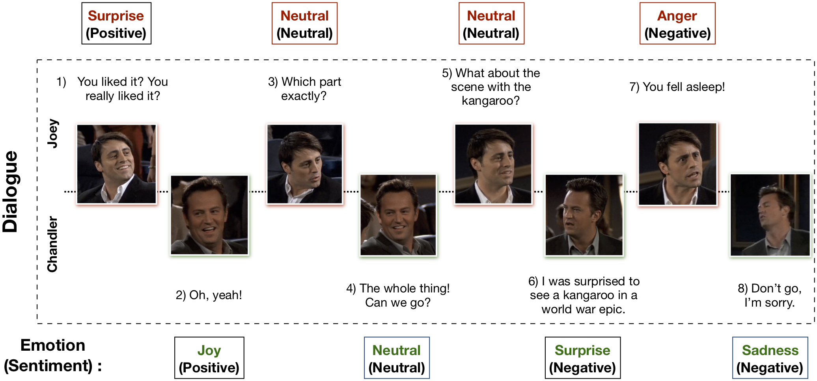
Dataset format
Notes:
So what about records of semi-autonomous bodies or subsidiary companies?
Records of University business operations (or semi-autonomous bodies – these are listed in the Annual Report & include the Melbourne Theatre Company, Asialink, Melbourne University Sport etc) are University records.
Records of University subsidiaries, i.e. University controlled entities (listed in the Annual Report & include Melbourne University Publishing, Melbourne University Student Union etc), are not University records & the RDA does not apply. Subsidiaries are responsible for managing their own records in accordance with any relevant legislation.
However, all records created by or provided by the University in connection with its dealings with semi-autonomous bodies and subsidiaries are University records.

Slide 7
Evaluate
Phase One: Emotion Recognition and Tracking Evaluation
Emotion Classification Accuracy (ECA):
Definition: Measures the system's ability to accurately classify emotions from input data.​
Emotion Transition Detection Accuracy (ETDA):
Definition: Evaluates the system's proficiency in detecting changes or transitions between emotional states.​
Phase Two: Strategy Selection Effectiveness Evaluation
Strategy Selection Accuracy (SSA):
Definition: Determines the correctness of the system's chosen response strategies based on detected emotional transitions.​
User Feedback Satisfaction (UFS):
Definition: Measures user satisfaction with the system's responses, typically through surveys or feedback mechanisms.​

Slide 8


© Copyright The University of Melbourne 2011

