Slide 1
Audio LLM research weekly report – Week 4
Hongyu Jin
Notes:
Most of what I am talking about is covered in the guidelines for use, found at the front of the RDA.

Slide 2
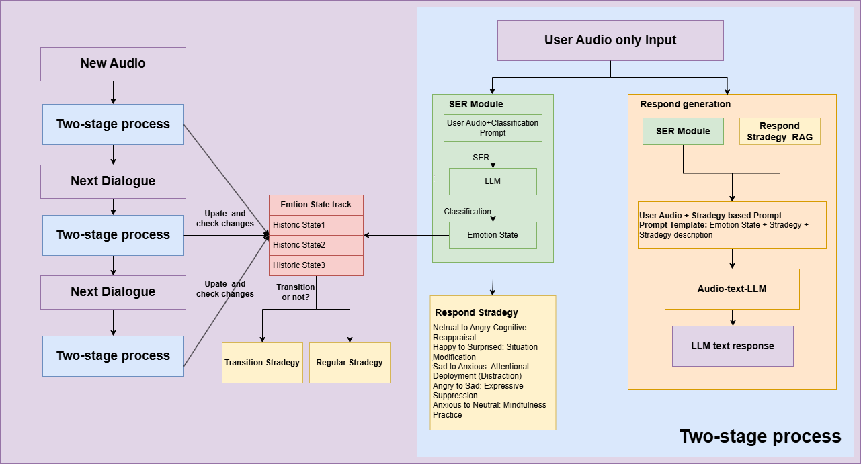
Model Structure
Notes:
The purpose of the RDA is to provide a legal mechanism for the retention & disposal of university records in accordance with legislative instruments and regulations issued under the Public Records Act 1973.
The Authority also -
identifies records which are required to be preserved permanently as part of the University’s archival heritage;
prevents the premature destruction of records which need to be retained for a specified period to satisfy legal, financial and other requirements of public administration;
specifies the minimum, and in some cases maximum, periods for which records are required to be retained;
authorises the destruction of those records not required permanently; and
mandates the prompt destruction of records as required under the Information Privacy Act 2000 and other instruments

Slide 3
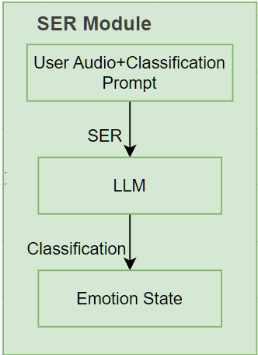
SER module
system prompt:
"You are an emotion detection assistant. Analyze the audio and determine the primary emotion expressed. Only respond with a single emotion word from this list: [Neutral, Frustration, Anger, Happiness, Excited, Sadness, Fear, Surprise, Disgust.]"
For GPT, prompt engineering can enforce single word response.

Slide 4
SER module performance
"timestamp": "2025-04-01T19:38:50.202250",
"response": "Disgust.",
"choices": [
{
"finish_reason": "stop",
"index": 0,
"logprobs": null,
"message": {
"content": "Disgust.",
"refusal": null,
"role": "assistant",
"audio": null,
"function_call": null,
"tool_calls": null,
"annotations": []
}
SER task on IEMOCAP:
"total_evaluated": 100,
"correct_predictions": 53,
"accuracy": 0.53,
{
"id": "Ses01F_impro01_F000",
"audio_path":
"true_emotion": "Neutral state",
"predicted_emotion": "angry.",
"true_emotion_mapped": "neutral",
"predicted_emotion_mapped": "angry",
"is_correct": false
},

Slide 5
IEMOCAP Dialogue
Original data format
[6.2901 - 8.2357]
Ses01F_impro01_F000 neu
[2.5000, 2.5000, 2.5000]
C-E2: Neutral; ()
C-E3: Neutral; ()
C-E4: Neutral; ()
C-F1: Neutral; (curious)
A-E3: val 3; act 2; dom 2; ()
A-E4: val 2; act 3; dom 3;
(mildly aggravated but staying polite, attitude)
A-F1: val 3; act 2; dom 1; ()
Formated Dialogue data
"id": "Ses01F_impro01_F000",
"start_time": 6.2901,
"end_time": 8.2357,
"emotion_code": "neu",
"emotions": [
"Neutral",
"Neutral",
"Neutral",
"Neutral"
],
"majority_emotion": "Neutral",
"audio_path": "Session1\\segments\\Ses01F_impro01_F000.wav"
Notes:
The University of Melbourne Records Retention and Disposal Authority (RDA) is
“…the University document that sets out requirements for retention and disposal of all types of records, in line with legislative requirements and University business needs…”
(Records Management Policy MPF1106)
Records Services is responsible for developing the RDA
The University Archivist, Legal Services and the Director, Internal Audit are also consulted
The final document is approved by the University Secretary
(Records Management Policy MPF 1106, Records Retention and Disposal Procedure MPF1109)

Slide 6
RAG for instruction pool
Transition State
No
Yes
Regular Stradegt
Transition Stradegy
Retrieve by unique file id avoiding concept confused
Vectorized File In RAG system
Notes:
What records does the RDA apply to?
The RDA applies to University records only. A University record is defined as “…any record comprised of recorded information, in any format, created or received by staff of the University in the course of conducting their University duties…”
(Records Management Policy MPF1106)

Slide 7


© Copyright The University of Melbourne 2011

