Slide 1
Data Analysis Using Python Getting Started
Centre for Advanced Research and Training (CART)

Slide 2
Outline
Why python ?
Where is it used?
History
Installation: Anaconda
Compiler Vs Interpreter
Spyder environment
Basic commands: Variables
Basic commands: Indices and splicing
Scripts

Slide 3
Why Python?
Concise and simple
Free and Open source
Large community (Over 600k question tagged as python on stack overflow)
Colossal documentation
Proliferated usage (used by Rackspace, Google, NASA etc.)
Multiple programming paradigms (procedural, object oriented, functional)
Readability (Pseudocode like syntax)
Availability of libraries like NumPy, SciPy, Pandas and Matplotlib makes Python a direct alternative to MATLAB and R.
When you learn Python, technically you can speak in Parseltongue(Take that Mr. Voldy).

Slide 4
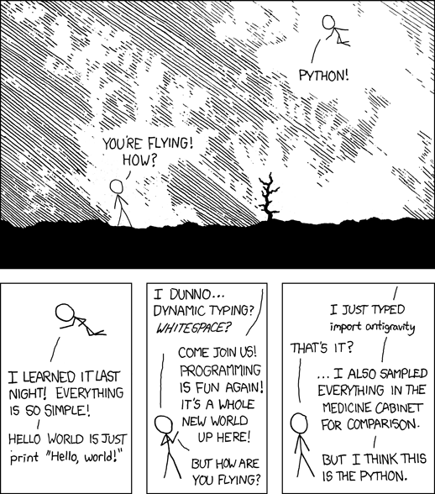
Image Source:
http://xkcd.com/353/

Slide 5
Where is it used?
Web applications (YouTube, Dropbox, Quora, Firefox, Instagram, NASA etc.)
Network monitoring
Data Analysis (Pandas, Scipy, Astropy, Numpy, matplotlib etc)
Web Crawling (Google's search engine is based on Python)
Scientific computing. (Most users are scientists first and programmers later.)
Embedded Systems (one of the most prominent language in IoT, notably in Raspberry Pi)
Majority of users of python are non programmers.

Slide 6
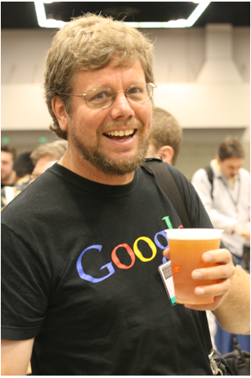
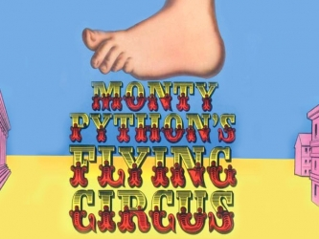
History
Christ University
History of Python started with ABC programming language (or with the end of ABC)
Guido Van Rossum, a dutch programmer who worked at CWI (Centrum Wiskunde & Informatica) was stuck with ABC.
"I remembered all my experience and some of my frustration with ABC. I decided to try to design a simple scripting language that possessed some of ABC's better properties, but without its problems.” –Guido Van Rossum(January 2003)
name has something to do with excellent Britisch humour. Guido van Rossum, the creator of Python, wrote in 1996 about the origin of the name of his programming language
Was not named after the snake species rather after the Monty Python Circus
Guido Van Rossum at OSCON 2006 Source: en.wikipedia.org
Excellence and Service

Slide 7
The Zen of Python – Tim Peters
Beautiful is better than ugly.
Explicit is better than implicit.
Simple is better than complex.
Complex is better than complicated.
Flat is better than nested.
Sparse is better than dense.
Readability counts.
Special cases aren't special enough to break the rules.
Although practicality beats purity.
Errors should never pass silently.
Unless explicitly silenced.
In the face of ambiguity, refuse the temptation to guess.
There should be one-- and preferably only one --obvious way to do it.
Although that way may not be obvious at first unless you're Dutch.
Now is better than never.
Although never is often better than right now.
If the implementation is hard to explain, it's a bad idea.
If the implementation is easy to explain, it may be a good idea.
Namespaces are one honking great idea -- let's do more of those!

Slide 8
Beautiful is better than ugly
Comparison of the traditional “Hello world” program between Python, Java and C/C++
Java
C/C++
Python
import java.io.*;
class hello
{
public static void main(String args[])
{
System.out.println("Hello World!")
}
}
#include<stdio.h>
int main()
{
printf("Hello World!") ;
return 0;
}
print("Hello World!")

Slide 9
Installation
Christ University
Linux:
The interpreter is preinstalled. To access the command line interface of python, just type “python” in the terminal.
Windows
Mac
Excellence and Service

Slide 10
Compiler Vs Interpreter
All of the code is converted to machine code.
Generally, faster than interpreted languages.
Debugging is comparatively harder.
Example: C/C++, Haskell
Code is converted to machine language one line at a time.
Slower than compiled languages.
Debugging is easier.
Example: Python, R, Lisp

Slide 11
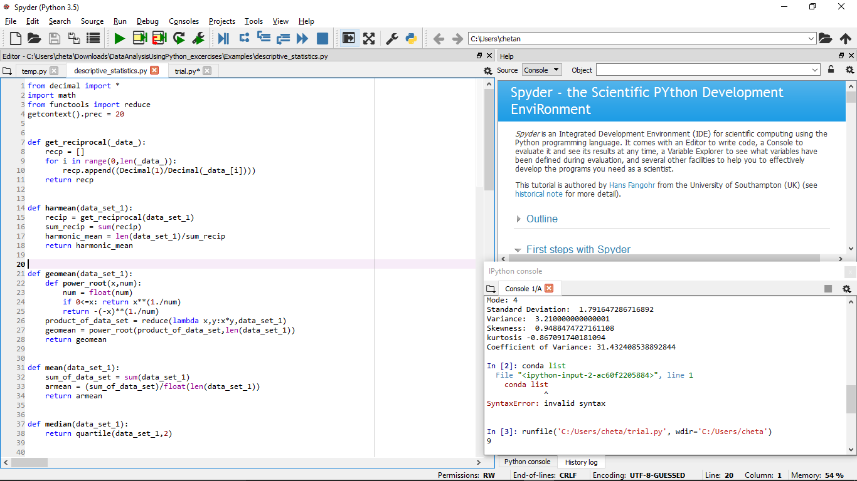
Spyder Environment

Slide 12
Basic Commands : Variables
Variables
var1 = 5
var2 = “abc”
var3 = 535.67
var4 = True
print(type(var1))
print(type(var2))
print(type(var3))
print(type(var4))

Slide 13
Basic Commands : Indexing and slicing
mystring = “I am a string”
print(mystring)
print(mystring[0])
print(mystring[3:8])
print(mystring[0:11:2])

Slide 14
Python Scripts
Saved as .py files
Can be run over an interpreter(via a terminal or in an IDE)
Try running a script.

