Slide 1
Intrusion Prevention System
for Live IoT Network
A Hybrid Machine Learning Approach
Presented by Andrew Banda, James Ivy, & Emmanual Mehn
Advisor: Joseph Meier
Raspberry Pi 4 · IsolationForest · BiLSTM · LoRa Radio
IsolationForest
BiLSTM
Raspberry Pi 4
IoT Security
LoRa

Slide 2
Background & Problem Statement
BG
What is an Intrusion Prevention System (IPS)?
An IPS is a network security system that monitors live traffic, detects malicious activity, and automatically blocks threats in real time, without human intervention. Unlike an Intrusion Detection System (IDS) which only raises alerts, an IPS takes immediate action by dropping packets, resetting connections, or banning offending IP addresses.
The IoT Security Problem
Our Solution
Growing Attack Surface
IoT devices are projected to exceed 30 billion by 2030, yet most ship with no built-in security controls.
Resource-Constrained Hardware
Traditional IDS/IPS solutions require processing power unavailable on embedded hardware like the Raspberry Pi.
No Real-Time Protection
Existing solutions rely on cloud-based analysis, introducing unacceptable delays in threat response.
“A lightweight hybrid ML-based IPS running directly on a Raspberry Pi 4, detecting and blocking threats in real time with no cloud dependency.”
Isolation Forest
Unsupervised HTTP anomaly detection. Automatically bans malicious IPs after 3 strikes.
BiLSTM
Temporal pattern recognition over a 10-packet window catches slow-rate and time-based attacks.
LoRa Radio Layer
Extends detection to replay, join flooding, and timestamp manipulation at the radio layer.
Notes:
Open with the IPS definition to make sure the audience understands the distinction, an IDS just alerts, but IPS actually blocks. Our system is a true IPS: it bans the offending IP automatically. Hit the three problem points concisely: the IoT attack surface is exploding (30 billion devices by 2030), embedded hardware can't run traditional tools, and cloud-based solutions introduce too much latency for real-time response. Then pivot to our thesis: we solved all three problems with a single lightweight system running directly on a $35 Raspberry Pi 4. Briefly mention each of the three components, IsolationForest for HTTP, BiLSTM for temporal sequences, and the LoRa layer for radio-frequency attacks and how they complement each other.

Slide 3
Research Phase
RP
Supporting Research
Restraints:
Credible research documents have established Random Forest and LSTM as two of the most effective approaches for intrusion detection on IoT networks. Evaluating public datasets such as CICIDS2017 and UNSW-NB15 identified Random Forest as a strong baseline, achieving 94-99% accuracy. Demonstrating its ability to capture complex feature-level relationships in network traffic without requiring extensive preprocessing.
While the reviewed research demonstrates strong results when implementing both models. Our deployment introduced constraints that required a different approach. Running on a Raspberry Pi 4 with a live IoT sensor network, we required a model that could train without labelled attack data. Since collecting real-world attack traffic is impractical on a live network, we opted to implement an Isolation Forest model, which is an unsupervised anomaly detection model that trains exclusively on normal traffic. This is significantly more practical for deployment on environments where attack data is scarce or unknown.
While Random Forest provided a good baseline, LSTM excelled at analyzing sequential data with 92% accuracy. These models greatly complement each other, with the Random Forest’s strength lying in feature-level patterns and the LSTM’s strength lying in temporal sequences. This dynamic motivated us to explore a hybrid approach playing to both models’ strengths.
For the temporal layer, we selected Bidirectional LSTM over the standard unidirectional LSTM. BiLSTM processes sequences in both forward and backward directions simultaneously, capturing context from both past and future requests. We chose this model because this feature is particularly valuable for detecting slow-rate attacks where anomalous patterns only become apparent when a sequence is examined rather than individually.

Slide 4
Project Management
PM
Project Timeline (Gantt Chart)
Task Week 1-2 Week 3-4 Week 5-6 Week 7-8 Week 9-10 Week 11-13 Week 14-15
Data Collection
Live Network Deployment
Isolation Forest Model
BiLSTM Model
LoRa Implementation
Attack Simulation & Testing
Responsibility Matrix
Task Andrew (IF Module) Emmanuel (LSTM Model) James (LoRa)
Data Collection R R R
Isolation Forest Model R S S
LSTM Model Development S R S
LoRa Implementation S S R
Live Deployment & Attack Simulation R R R
R = Responsible (Lead) S = Supporting All members participated in testing, documentation, and final presentation
Notes:
Walk through the Gantt briefly, the project ran 15 weeks. Data collection started early and overlapped with all development phases since we needed live traffic to train on. Attack simulation came last once the models were deployed. For the responsibility matrix, be direct: Andrew led IsolationForest, Emmanuel led the LSTM model, James led LoRa implementation. All three members shared data collection, live deployment, and attack simulation equally. This is a good moment to note that the three modules were designed to be independent, each could be developed and tested in parallel, which is reflected in how the Gantt bars overlap.

Slide 5
Cybersecurity Practice & Standards
CS
Ethics & Code of Professional Practice
Relevant Standards & Frameworks
Responsible Disclosure
All attack simulations were conducted in an isolated lab network. No attacks were launched against production or third-party systems.
Data Privacy
Sensor data collected for research purposes only. No personally identifiable information was captured or stored.
Dual-Use Awareness
Attack simulation scripts were developed solely for evaluating IDS effectiveness. Tools such as Metasploit and hping3 were used with full awareness of their dual-use implications.
NIST SP 800-82 (ICS/IoT Security)
Guide to Industrial Control Systems Security. Informs our network segmentation approach and anomaly detection thresholds.
ETSI EN 303 645 (IoT Cybersecurity)
European standard for consumer IoT cybersecurity. Supports our IPS design principle of no default credentials and real-time monitoring.
IEEE 802.15 / LoRaWAN Specification
LoRaWAN security architecture informed our LoRa attack simulation, including OTAA join flood and replay attack scenarios.
OWASP IoT Attack Surface Areas
Our 5 attack types were selected to cover OWASP’s key IoT attack vectors, including network service attacks, firmware exploitation, and traffic interception.

Slide 6
Data Collection
01
The IoT network centers on a Raspberry Pi 4 hosting a wireless network server, with 3 Pico W sensor nodes transmitting data over HTTP. Two additional Pico W nodes were equipped with LoRa hats to handle radio-frequency communication. The Pi passively captured HTTP sensor traffic into sensor_data.json, while the attack data was simulated and stored in attack_data.json. Both JSON files were used for offline training of the modules. During real-time detection the Pi switches to active IPS mode, intercepting and scoring every inbound HTTP request
Pico-1
10.42.0.215
Pico-2
10.42.0.71
Pico-3
10.42.0.211
Temp / Humidity
Motion / Light
Soil / Humidity
Raspberry Pi 4 — 10.42.0.1 (Flask HTTP Server + IPS)
Collection Details
HTTP POST/GET every 5-10s
5 features extracted per request
sensor_data.json
attack_data.json
Endpoints: /sensor /status /diagnostics
140,000+ normal records
26,750 attack records
Pi acts as Wi-Fi AP (10.42.0.x)
Kali Purple 10.42.0.99 — Attack simulation machine on same subnet
serversniff.py for baseline capture

Slide 7
Attack Simulation
02
HTTP DoS Flood
Slow Loris
SYN Flood
What it is
A flood of HTTP GET requests sent at high rate from a single IP, targeting all endpoints to exhaust server resources and deny service to legitimate sensors.
How IPS prevents it
IsolationForest flags the abnormal packet rate after 3 anomalous requests. The source IP is automatically banned for 120 seconds, blocking all further traffic.
What it is
Opens up to 1,000 simultaneous HTTP connections but never completes the requests, holding them open to exhaust the server’s connection pool at very low bandwidth.
How IPS prevents it
The abnormal connection pattern and low byte rate are scored as anomalous by IsolationForest. The IP is banned, and the server’s raised file descriptor limit prevents connection exhaustion.
What it is
Floods the target with spoofed TCP SYN packets from random source IPs using hping3 and Metasploit, exhausting the connection state table without completing any handshake.
How IPS prevents it
A global SYN counter detects the volume spike regardless of spoofed source IPs. The flood is identified and the server raises an alert while continuing to serve legitimate sensor traffic.
LoRa Replay Attack
LoRaWAN Join Flood
What it is
Previously captured LoRa sensor payloads are retransmitted rapidly from a spoofed node, injecting stale or duplicate data into the network at abnormal rates.
How IPS prevents it
The BiLSTM model detects the abnormal inter-packet delay (IPD) pattern. The transmitter Pico encodes delta_t in each payload, exposing timestamp manipulation to the model.
What it is
A large volume of fake OTAA (Over-the-Air Activation) join requests with randomised DevEUIs floods the /join endpoint, attempting to exhaust available network slots.
How IPS prevents it
IsolationForest detects the abnormal packet rate on /join. The source IP accumulates strikes and is banned, blocking further join requests within seconds.
Red border = HTTP-layer attacks (IsolationForest) Teal border = LoRa radio-layer attacks (CNN-LSTM) Tools: hping3, Metasploit, slowhttptest, t_pico_lora.py

Slide 8
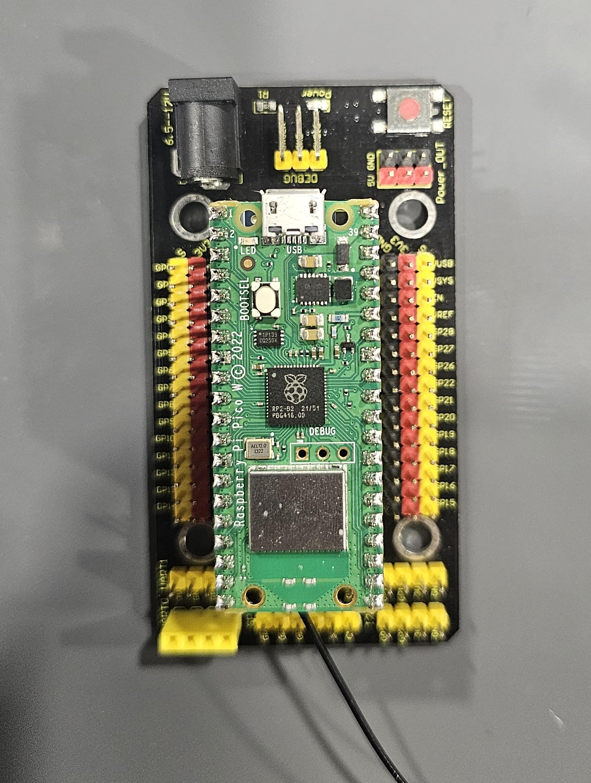
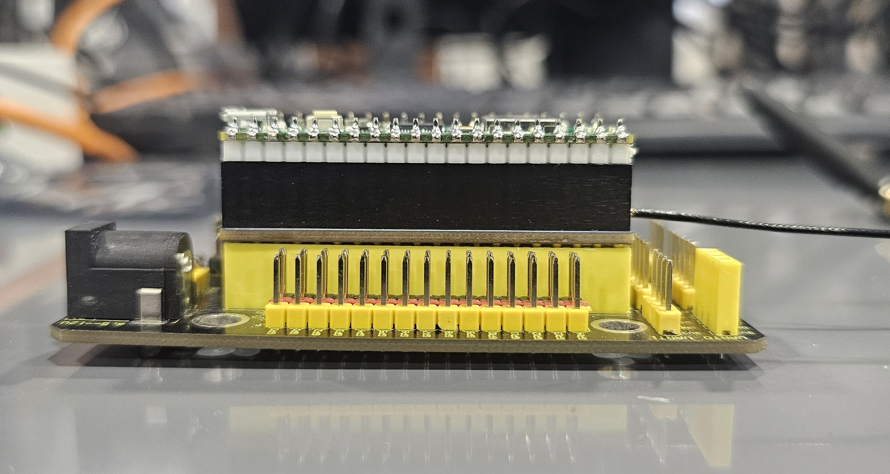
LoRa implementation Overview
03
What is a Lora Hat
Why LoRa Matters for our IoT
LoRa = Long Range, low‑power wide‑area radio modulation
Built on chirp spread spectrum for long‑distance, low‑energy IoT communication
Optimised for small payloads, battery‑powered nodes, and infrastructure‑limited environments
Ideal for agriculture, industrial monitoring, and smart‑city deployments
In our system: Raspberry Pi Pico W + SX1262 LoRa Hat
Same hardware platform as HTTP nodes → demonstrates IPS flexibility
LoRa nodes are not specialised devices — they are Pico W units using radio instead of Wi‑Fi
Shows that the IPS supports multiple communication layers
Each layer (HTTP vs LoRa) introduces different threat models
LoRa parameters used:
Frequency: 923 MHz
Bandwidth: 125 kHz
Spreading Factor: SF9
Coding Rate: 4/8
Sync Word: 0x12
Hardware CRC provides integrity but no authentication → intentional realism

Slide 9
LoRa Implementation
04
Data Pipeline
Feature Mapping into Modules
1
Transmitter Pico
LoRa fields mapped to the same 5-column feature space as HTTP:
Sends LoRa packets every 10s (normal) or 0.5s burst (attack). Payload includes ID, TS, M label
rssi
packet_size
Signal strength proxy
2
Receiver Pico
1/dt
packet_rate
Burst rate detection
Captures via SX1262. Reads RSSI, SNR, computes DT (inter-packet interval)
snr
byte_rate
Signal quality proxy
3
HTTP Forward
Receiver POSTs JSON to Pi /lora endpoint via urequests on the Wi-Fi network
0
src_port
No TCP port in LoRa
4
lora_server.py
7
endpoint_code
/lora endpoint
Pi splits into lora_normal_data.json and lora_attack_data.json by M label
Attack types: Timestamp Replay | LoRa Join Flood | Replay Attack

Slide 10
Unique security challenges only for LoRa's
05
Reasons LoRa's are unique
No built‑in authentication or encryption at the physical layer
Any device in range can transmit with correct radio parameters
Vulnerabilities arise that do not exist in HTTP‑based systems
IPS must detect anomalies using timing, signal characteristics, and payload metadata
Types of attacks
Timestamp attacks:
Transmitter embeds its local timestamp in each payload
Attacker skews timestamp forward/backward
Simulates clock drift or stale‑data injection
IPS detection method:
Compute delta_t = arrival_time – claimed_send_time
Model learns what “plausible timing” looks like
Implausible deltas → flagged as malicious
Replay Attacks:
Attacker captures legitimate packets and retransmits them rapidly
LoRa has no sequence numbers or timestamp validation
Replayed packets appear valid at the protocol level
IPS detection method:
Monitor inter‑packet delay (IPD)
Legitimate nodes: 5–10 seconds
Replay bursts: milliseconds
CNN‑LSTM flags abnormal IPD patterns as malicious

Slide 11
Isolation Forest Model
06
Why Isolation Forest:
Features:
Unsupervised anomaly detection, no labelled training data required
packet_size: distinguishes large payload attacks from normal sensor POSTs
Builds random isolation trees; anomalies are isolated in fewer splits
packet_rate: flood attacks generate abnormally high requests per second
Each HTTP request scored, scores < -0.3 flagged as anomalous
byte_rate: byte throughput catches both high-rate and large-payload anomalies
Multiple strikes trigger an automatic 120-second IP ban; subsequent requests are dropped with a 403 response.
src_port: attackers often use ephemeral high ports in rapid succession
endpoint_code: probing unknown endpoints like /admin or /reset is a strong attack signal.
contamination=0.2 | n_estimators=100 | random_state=42
Trained on 140,000+ HTTP records
Notes:
Explain why Isolation Forest was chosen: it's unsupervised, meaning it only needs normal traffic to train on, no labelled attack data required. It learns what normal looks like and flags anything that deviates. The intuition behind it: anomalies are easier to isolate in a random tree structure because they sit far from the dense clusters of normal data, so they get separated in fewer splits. Normal traffic needs many splits to isolate. Walk through the detection pipeline: every HTTP request is scored, anything below −0.3 is flagged as anomalous, three strikes and the IPS is automatically banned for 120 seconds. The five features: packet size, packet rate, byte rate, source port, and endpoint code, were chosen because they capture both volumetric attacks like DoS floods and behavioral anomalies like probing unknown endpoints.

Slide 12
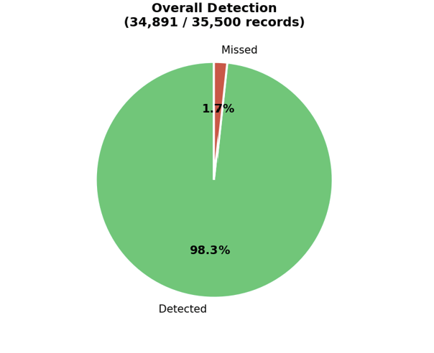
Isolation Forest Results
07
Detection Results
34,891
records detected
609
records missed
35,500
Total Attack records
98.3%
detection rate
Attack Type | Detection Rate
HTTP DoS Flood | 100%
SYN Flood | 100%
Slow Loris | 95%
Port Scan | 93%
LoRa Attacks | ~82%
Notes:
Explain why Isolation Forest was chosen: it's unsupervised, meaning it only needs normal traffic to train on, no labelled attack data required. It learns what normal looks like and flags anything that deviates. The intuition behind it: anomalies are easier to isolate in a random tree structure because they sit far from the dense clusters of normal data, so they get separated in fewer splits. Normal traffic needs many splits to isolate. Walk through the detection pipeline: every HTTP request is scored, anything below −0.3 is flagged as anomalous, three strikes and the IPS is automatically banned for 120 seconds. The five features: packet size, packet rate, byte rate, source port, and endpoint code, were chosen because they capture both volumetric attacks like DoS floods and behavioral anomalies like probing unknown endpoints.

Slide 13
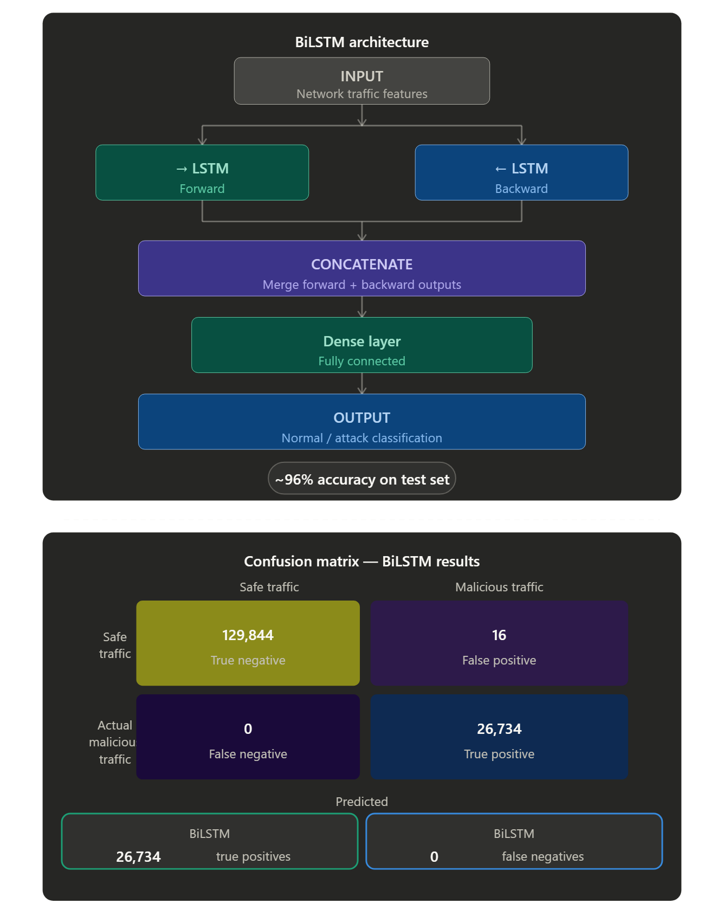
Bidirectional Long Short-Term Memory (BiLSTM)
08
What is BiLSTM?
A deep learning supervised model that processes sequences of packets both forward and backward, capturing full context from network traffic patterns.
Forward: reads input sequence start to finish
Backward: reads input sequence finish to start
Why BiLSTM for IDS/IPS?
Unlike rule-based IDS that rely on static signatures, the model learns behavioral patterns from data and detects attacks that don't even match known signatures. Example dealing with time-dependent attack patterns (DoS, DDoS, port scans,slow loris) that rule-based systems miss, BiLSTM is able to detect that.
How it works
Two LSTM layers run in parallel, one reads input left→right, one right→left, then the outputs are merged. Dense layer: model extracts sequential patterns and map output.
Implementation
Trained on normal and attack data, with features normalized. The model was built with TensorFlow/Keras for binary & multi-class classification. The model is not fed raw packets. But instead, it extracts features like packet length, duration, protocol type, flag counts, byte size, and normalizes them. These features become sequential input. Each time step in the sequence correlates with a flow record. Classify them as attack or normal.
..
Performance
Achieved 96% accuracy on test set; outperformed standard LSTM and traditional ML baselines. Limitations include the model being highly dependent on the data it was trained on to recognize patterns. Because it analyzes packets sequential it can be at times hard to detect what the model is flagging.
Real-world use
Used in academic IDS research, financial fraud detection, and network anomaly detection at an enterprise scale
Notes:
SPEAKER NOTES — BiLSTM Slide WHAT IS BiLSTM? BiLSTM stands for Bidirectional Long Short-Term Memory. It is a type of recurrent neural network (RNN) that extends the standard LSTM by processing input sequences in both directions — forward (past to future) and backward (future to past) — simultaneously. This gives the model access to full context from both sides of a sequence, which is critical when detecting attacks that unfold over time. WHY IS BiLSTM GOOD FOR IDS/IPS? Network intrusion attacks are not single events — they are sequences of packets and connections that evolve over time. A DoS attack, for example, shows a pattern of increasing traffic volume over multiple time steps. Standard rule-based systems miss these patterns. BiLSTM captures temporal dependencies in both directions, meaning it can recognize the buildup of an attack before it fully materializes, as well as patterns that only make sense when viewed in reverse context. WHY DID WE CHOOSE BiLSTM? We chose BiLSTM over a standard LSTM because bidirectional processing significantly improves the model's ability to capture context in network traffic sequences. We also compared it against traditional ML approaches — the sequential, time-dependent nature of intrusion data makes deep learning models like BiLSTM a natural fit. Studies such as Cho et al. (2014) on sequence modeling and research published in IEEE on LSTM-based IDS systems supported our choice. HOW DID WE IMPLEMENT IT? We used the NSL-KDD dataset, a widely accepted benchmark for intrusion detection research. Features were normalized and encoded. We built the model using TensorFlow and Keras — two LSTM layers (forward and backward) whose outputs were concatenated and passed through a dense fully connected layer, then to a softmax/sigmoid output layer for classification. We trained for multiple epochs with early stopping to prevent overfitting. HOW DOES IT WORK? (explain the diagram) Looking at the architecture on the right: 1. Input layer receives the normalized network traffic features 2. Two LSTM layers process the same input simultaneously — one forward, one backward 3. Their outputs are concatenated into a single merged vector 4. A dense layer reduces dimensionality and extracts high-level features 5. The output layer classifies the traffic as Normal or one of several Attack categories RELEVANT STUDIES AND REAL-WORLD USE: - Hochreiter & Schmidhuber (1997) — original LSTM paper - Schuster & Paliwal (1997) — introduced BiLSTM architecture - NSL-KDD benchmark dataset — Tavallaee et al. (2009) - IEEE papers on LSTM-based network intrusion detection (2019–2023) Real-world applications: enterprise network monitoring, financial fraud detection, malware traffic classification, and anomaly detection in cloud environments.

Slide 14
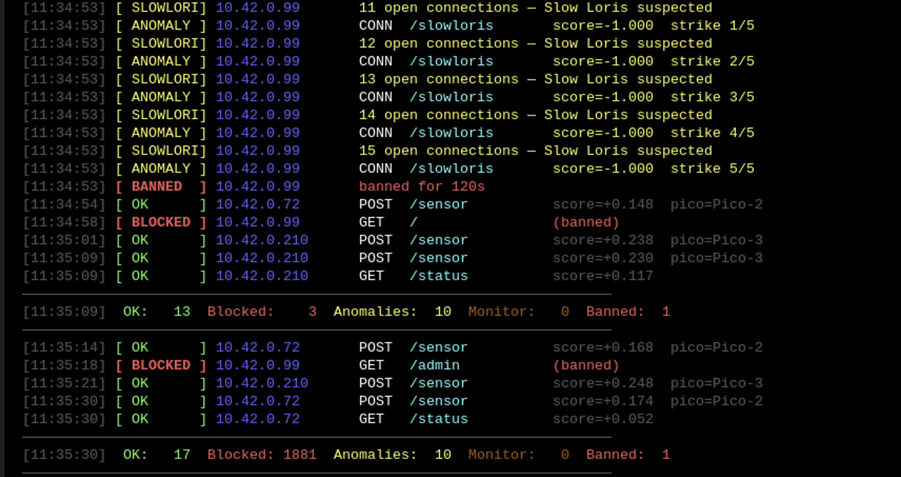
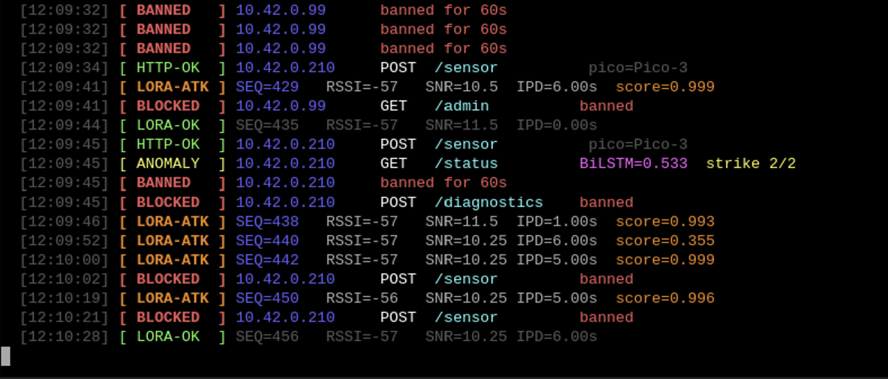
Live Demo
09
IsolationForest
BiLSTM

Slide 15
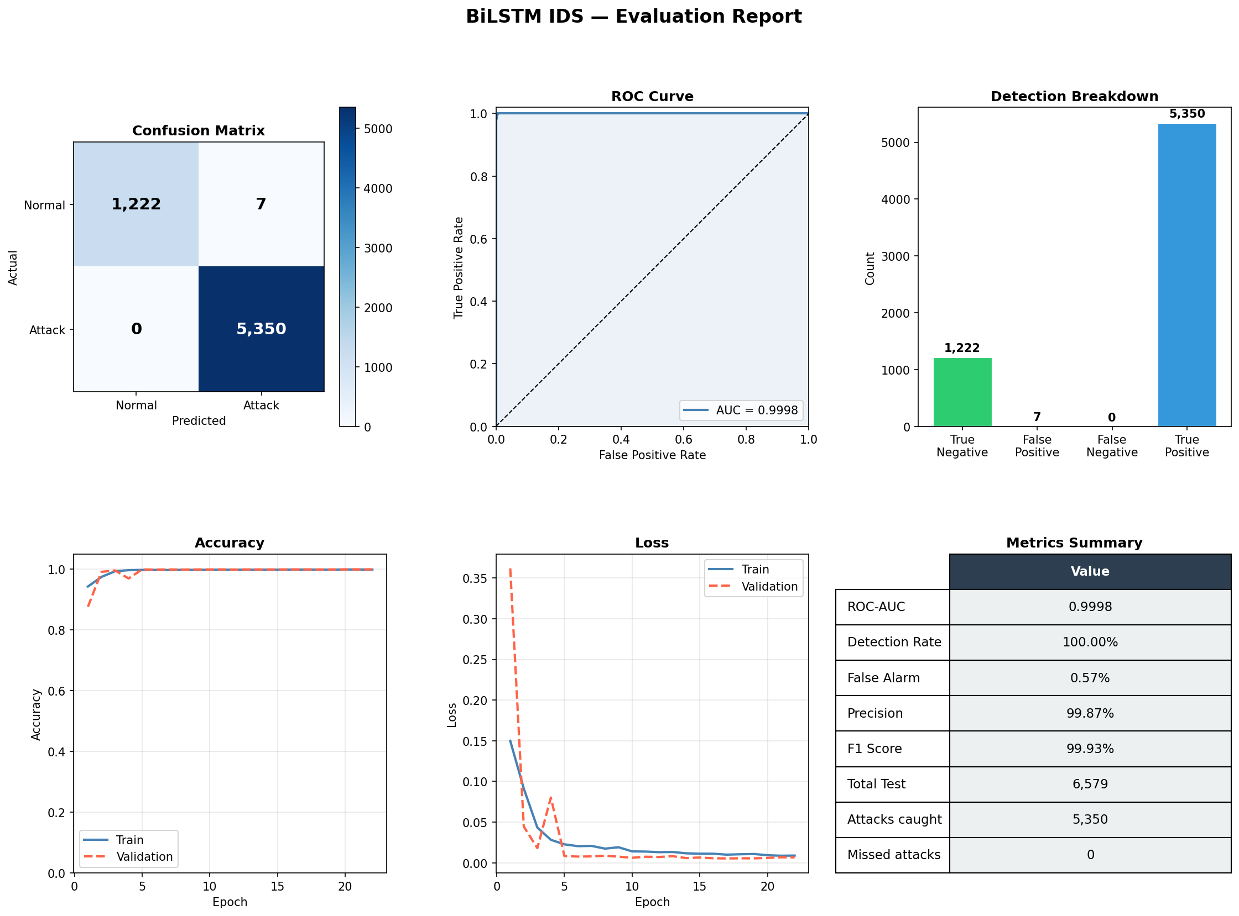
Bidirectional Long Short-Term Memory (BiLSTM) Results
10
Notes:
SPEAKER NOTES — BiLSTM Slide WHAT IS BiLSTM? BiLSTM stands for Bidirectional Long Short-Term Memory. It is a type of recurrent neural network (RNN) that extends the standard LSTM by processing input sequences in both directions — forward (past to future) and backward (future to past) — simultaneously. This gives the model access to full context from both sides of a sequence, which is critical when detecting attacks that unfold over time. WHY IS BiLSTM GOOD FOR IDS/IPS? Network intrusion attacks are not single events — they are sequences of packets and connections that evolve over time. A DoS attack, for example, shows a pattern of increasing traffic volume over multiple time steps. Standard rule-based systems miss these patterns. BiLSTM captures temporal dependencies in both directions, meaning it can recognize the buildup of an attack before it fully materializes, as well as patterns that only make sense when viewed in reverse context. WHY DID WE CHOOSE BiLSTM? We chose BiLSTM over a standard LSTM because bidirectional processing significantly improves the model's ability to capture context in network traffic sequences. We also compared it against traditional ML approaches — the sequential, time-dependent nature of intrusion data makes deep learning models like BiLSTM a natural fit. Studies such as Cho et al. (2014) on sequence modeling and research published in IEEE on LSTM-based IDS systems supported our choice. HOW DID WE IMPLEMENT IT? We used the NSL-KDD dataset, a widely accepted benchmark for intrusion detection research. Features were normalized and encoded. We built the model using TensorFlow and Keras — two LSTM layers (forward and backward) whose outputs were concatenated and passed through a dense fully connected layer, then to a softmax/sigmoid output layer for classification. We trained for multiple epochs with early stopping to prevent overfitting. HOW DOES IT WORK? (explain the diagram) Looking at the architecture on the right: 1. Input layer receives the normalized network traffic features 2. Two LSTM layers process the same input simultaneously — one forward, one backward 3. Their outputs are concatenated into a single merged vector 4. A dense layer reduces dimensionality and extracts high-level features 5. The output layer classifies the traffic as Normal or one of several Attack categories RELEVANT STUDIES AND REAL-WORLD USE: - Hochreiter & Schmidhuber (1997) — original LSTM paper - Schuster & Paliwal (1997) — introduced BiLSTM architecture - NSL-KDD benchmark dataset — Tavallaee et al. (2009) - IEEE papers on LSTM-based network intrusion detection (2019–2023) Real-world applications: enterprise network monitoring, financial fraud detection, malware traffic classification, and anomaly detection in cloud environments.

Slide 16
CNN-LSTM for LoRa
11
Reasons for CNN-LSTM
How CNN-LSTM detects LoRa attacks
LoRa attacks = local burst patterns + forward‑moving temporal drift
BiLSTM reads sequences forward & backward → unnecessary for real‑time radio streams
CNN‑LSTM advantages:
Conv1D detects short, abrupt changes (burst attacks)
LSTM models temporal drift (timestamp manipulation, slow anomalies)
Lower parameter count → faster inference on Pico‑scale hardware
Complements partner’s BiLSTM used for HTTP → hybrid IPS architecture
Input features:
Inter‑packet delay (IPD)
delta_t (timestamp vs arrival)
RSSI & SNR
Conv1D (kernel size 3):
Detects 3–5‑packet bursts
LSTM:
Tracks evolving timing drift
Output:
Binary classification: normal vs malicious
Packet flow for our project
LoRa Node → Receiver Pico → IoT Pipeline → IPS → Normal/Malicious Classification
Sender Pico transmits sensor packets or attack simulations
Receiver Pico forwards packets to IoT backend
IPS extracts timing + signal features
CNN‑LSTM classifies traffic
Output used for:
Logging
Alerting
Model retraining
System hardening

Slide 17
LoRa CNN-LSTM Results
12
Confusion Matrix (threshold = 0.35)
60%
Model Analysis
Normal
Attack
What the model learned
Normal
4,223
200
Attack Detection
Rate
The CNN-LSTM successfully detects burst and replay attacks through abnormal inter-packet delay (IPD) and large delta_t values.
True Negative
False Positive
4.5%
AUC ceiling at 0.80
Actual
Attack
2,491
3,781
False Positive
Rate
Slow drift attacks produce delta_t values that overlap with normal traffic in early stages, limiting separation.
False Negative
True Positive
0.80
Threshold set to 0.35
Predicted
Optimized via F1 sweep. Below 0.30 produces excessive false positives. Above 0.40 misses too many attacks.
AUC Score
0.74
Path to improvement
Training: 30 epochs · Window: 20 packets · Scaler: RobustScaler
More training data with longer drift sequences and extended observation windows would push AUC beyond 0.80.
F1 Score

Slide 18
Conclusion
98.3%
~0%
166,750
5
IsolationForest
Detection Rate
LSTM False
Negative Rate
Total Records
Collected
Attack Types
Simulated
Developed an IPS on a live network with real sensors. Using two models, Isolation Forest & BiLSTM, to catch what the other missed. With LoRa implementation for additional coverage to the radio layer.
The system is fully functional on a $35 Raspberry PI with real-time autonomous prevention. Proving that limited hardware can still be properly secured.
Future development would include implementing our system on different IoT devices, such as smart home and wearable devices that collect and exchange data over the internet, providing on-system security.
Other future works include scaling the system schema to larger networks and implementing detection and prevention for other forms of connections, such as incomplete HTTP requests. As well as implementing a lighter version of Scapy to inspect TCP, UDP, and ICMP traffic.

Slide 19
References
S, Snehaa, et al. “Network Intrusion Detector Based on Isolation … Forest Algorithm, IEEE Xplore, IEEE, 14 Feb. 2023, ieeexplore.ieee.org/document/10040395​
​
Schuster, M., & Paliwal, K. K. (1997). Bidirectional recurrent neural networks. IEEE Transactions on Signal Processing, 45(11), 2673-2681, ieeexplore.ieee.org/stamp/stamp.jsp?tp=&arnumber=650093​
R., Panneerslevi, and Visumathi J. “Temporal Intrusion Detection for MQTT-Based IoT Networks Using LSTM Sequence Modeling.” IEEE Xplore, 23 Mar. 2026, ieeexplore.ieee.org/document/11438310.
Hamza, Kaddour, and Das Shaibai. “Evaluating the Performance of Machine Learning-Based Classification Models for IOT Intrusion Detection.” IEEE Xplore, 2 Oct. 2024, ieeexplore.ieee.org/document/10697949/.
​

