Slide 1
Chapter 1
Database Systems

Slide 2
Learning Objectives
The difference between data and information
What a database is, the various types of databases, and why they are valuable assets for decision making
The importance of database design
How modern databases evolved from file systems
About flaws in file system data management
The main components of the database system
The main functions of a database management system (DBMS)

Slide 3
Why Databases?
Databases solve many of the problems encountered in data management
Used in almost all modern settings involving data management:
Business
Research
Administration
Important to understand how databases work and interact with other applications

Slide 4
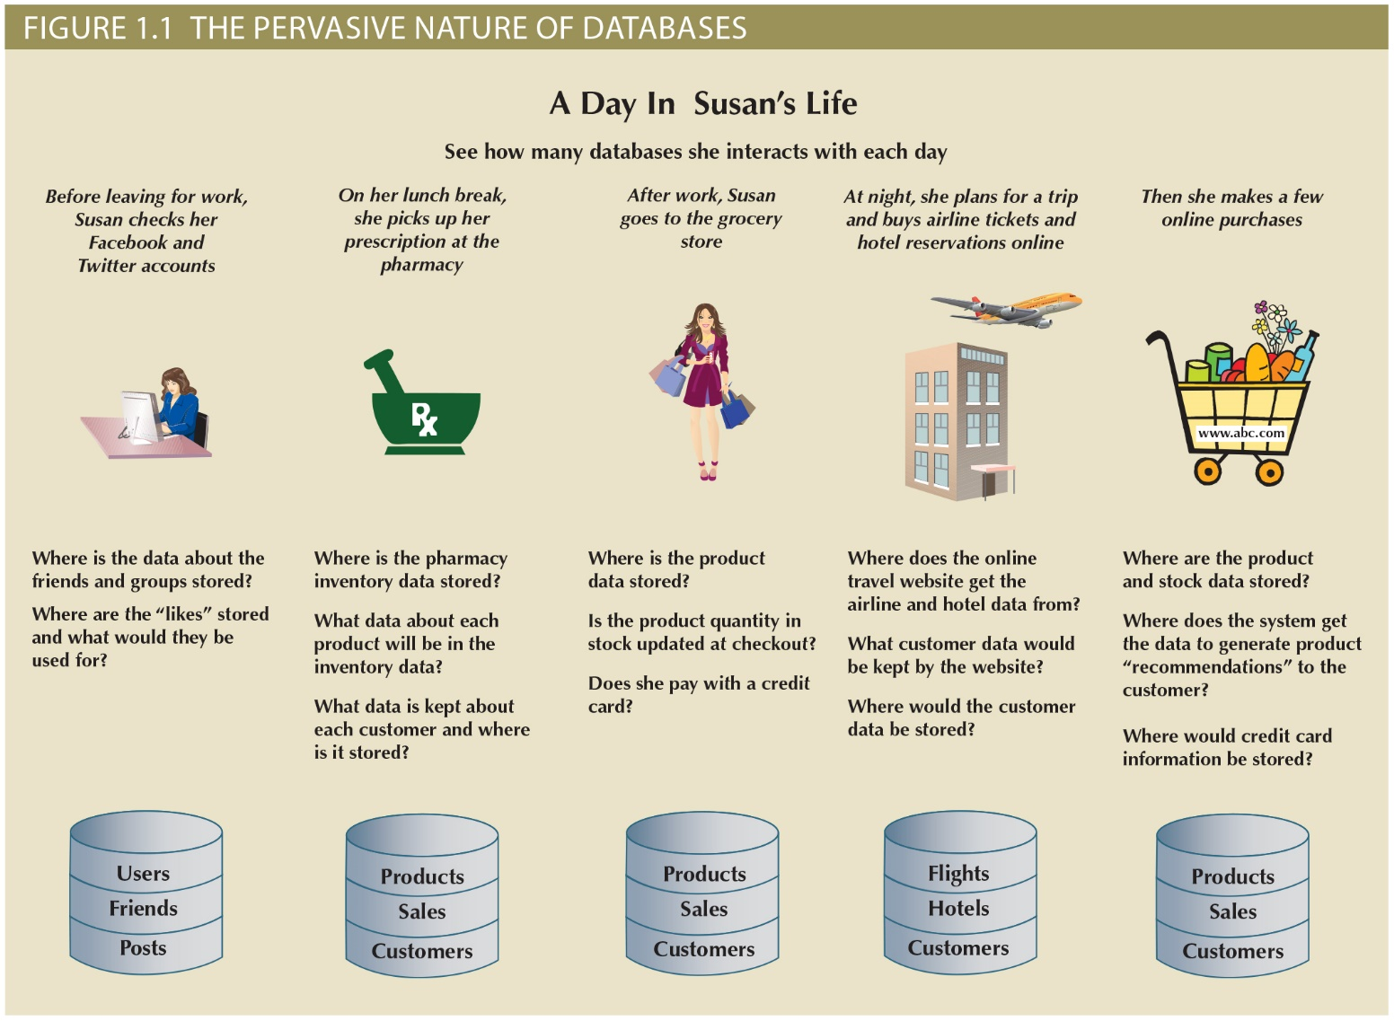

Slide 5
Data vs. Information
Data, Information, Knowledge
Data (raw facts)
Information (processed data with meaning)
Knowledge (the body of information and facts about a specific subject)
Example
I have access to data, so I can check the last name of customer with ID 10001
I have access to information: I can find the customer who has paid the most among all services in year 2015.
I can extract knowledge: by applying data analytics, I can find correlations between products and use these correlations for recommendation.
Notes:
To reveal meaning, information requires context.

Slide 6
Data versus Information
Data
Information
Raw facts
Have not yet been processed to reveal their meaning to the end user
Building blocks of information
Data management
Generation, storage, and retrieval of data
Produced by processing raw data to reveal its meaning
Requires context
Bedrock of knowledge
Should be accurate, relevant, and timely to enable good decision making
Notes:
Raw data must be properly formatted for storage

Slide 7
Database & Management Systems (DBMS)

Slide 8
Introducing the Database
Database: shared, integrated computer structure that stores a collection of:
End-user data: raw facts of interest to end user
Metadata: data about data
Provides description of data characteristics and relationships in data
Complements and expands value of data
Database management system (DBMS): collection of programs
Manages structure and controls access to data

Slide 9
Role and Advantages of the DBMS
DBMS is the intermediary between the user and the database
DBMS enables data to be shared
DBMS integrates many users’ views of the data
Receives and translates application requests into operations required to fulfill the requests
Hides database’s internal complexity from the application programs and users

Slide 10
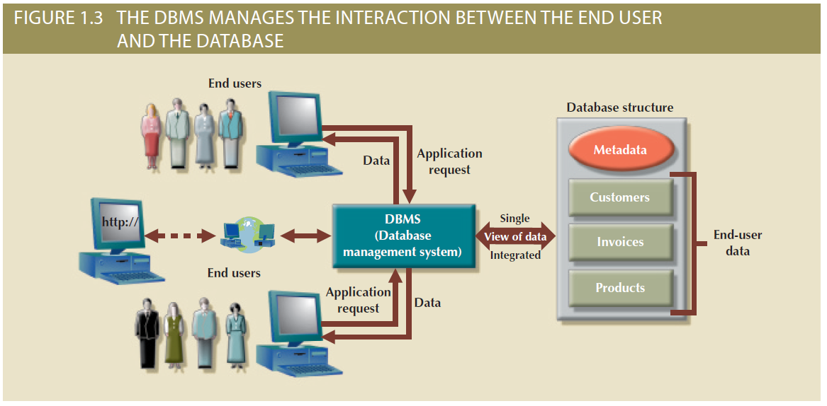
Figure 1.3 - The DBMS Manages the Interaction between the End User and the Database

Slide 11
Role and Advantages of the DBMS (cont’d.)
Advantages of a DBMS:
Improved data sharing
Improved data security
Better data integration
Minimized data inconsistency
Improved data access
Improved decision making
Increased end-user productivity

Slide 12
Types of Databases
Databases can be classified according to:
Number of users
Database location(s)
Expected type and extent of use
Number of users:
Single-user database supports only one user at a time
Desktop database: single-user; runs on PC
Multiuser database supports multiple users at the same time
Workgroup databases: Supports a small number of users or a specific department
Enterprise database: Supports many users across many departments

Slide 13
Types of Databases (cont’d.)
Database location
Centralized database: Data is located at a single site
Distributed database: Data is distributed across different sites
Cloud database: Created and maintained using cloud data services that provide defined performance measures for the database

Slide 14
Types of Databases (cont’d.)
Database uses
Production or Transaction processing
Supports day-to-day operations
Decision Support
Information for tactical or strategic decision making
Data Warehouse
Historical data for analytical purposes

Slide 15
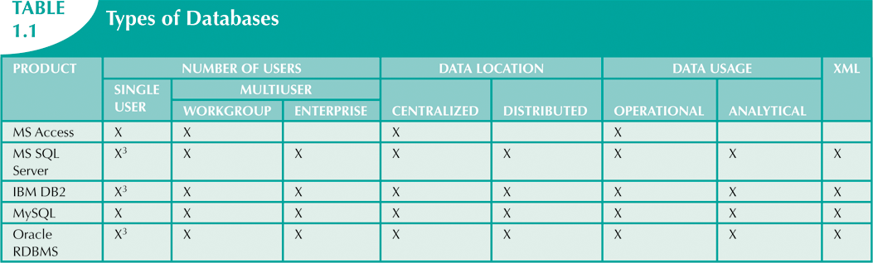

Slide 16
Before the Age of Databases? File Systems!

Slide 17
Before the Age of Databases? File Systems!
Manual File Systems
Papers and pencils
File cabinets
Keeping books and records
Computerized File Systems
Data processing (DP) specialist converted computer file structure from manual system
Wrote software that managed the data
Designed the application programs

Slide 18
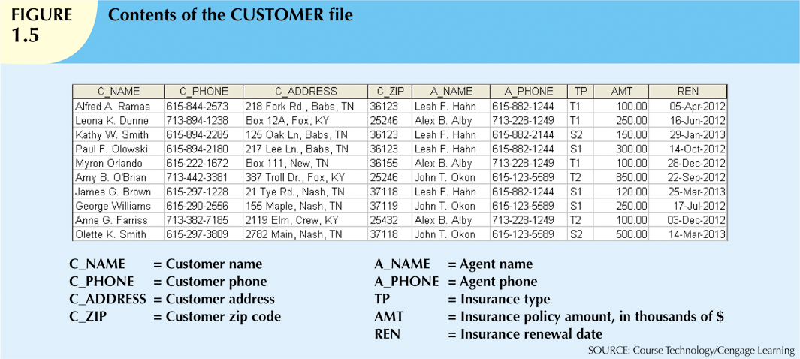
Notes:
Matching the manual file system

Slide 19
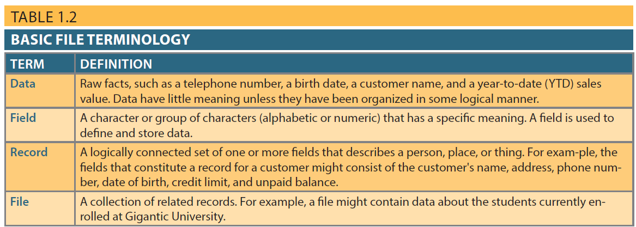
Table 1.2 - Basic File Terminology

Slide 20
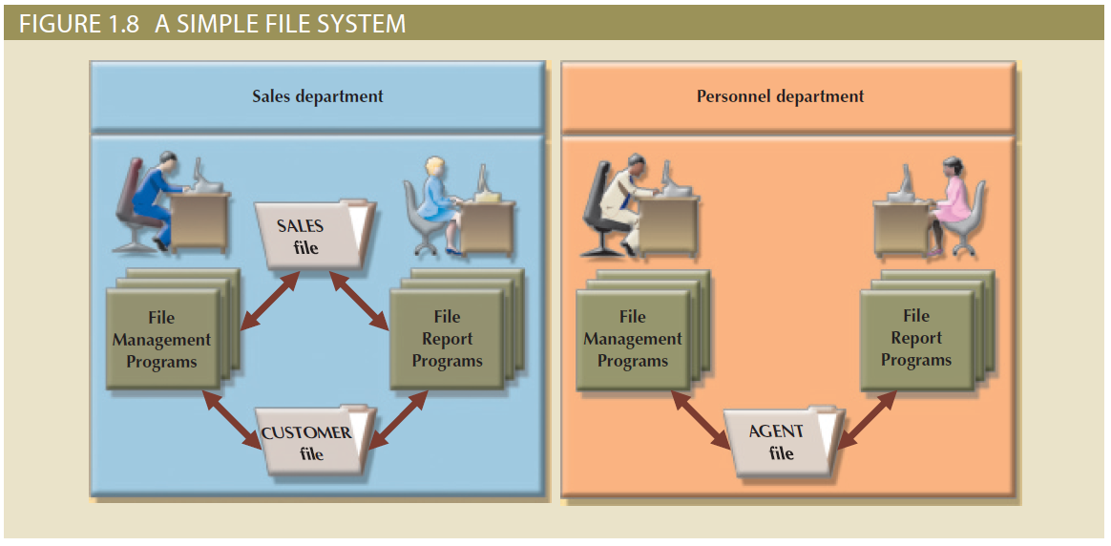
Figure 1.8 - A Simple File System

Slide 21
Before the Age of Databases? File Systems! (cont.)
File System Redux: Modern Tools
Microsoft Excel
Widely used by business users
Users have become so adept at working with spreadsheets, they tend to use them to complete tasks for which spreadsheets are not appropriate – database substitute
Notes:
Redux: means revived, brought back

Slide 22
Evolution of File System Data Processing
Manual File Systems
Accomplished through a system of file folders and filing cabinets
Computerized File Systems
Data processing (DP) specialist: Created a computer-based system that would track data and produce required reports
File System Redux: Modern End-User Productivity Tools
Includes spreadsheet programs such as Microsoft Excel

Slide 23
Problems with File System Data Processing
Lengthy development times
Difficulty of getting quick answers
Complex system administration
Lack of security and limited data sharing
Extensive programming

Slide 24
More problems: (a) Structural and Data Dependence
Structural dependence: access to a file is dependent on its own structure
All file system programs must be modified to conform to a new file structure
Versus Structural Independence: change file structure without affecting data access
Data dependence: data access changes when data storage characteristics change
Versus Data Independence: data storage characteristics do not affect data access

Slide 25
More problems: (b) Data Redundancy
Organizational structure promotes storage of same data in different locations
Islands of information: Scattered data locations
Data redundancy: same data stored unnecessarily in different places
Results in:
Poor data security
Data inconsistency: different and conflicting versions of same data occur at different places
Data-entry errors
Data integrity problems

Slide 26
More problems: (c) Data Anomalies
Data anomalies: abnormalities when all changes in redundant data are not made correctly
Update anomalies
Insertion anomalies
Deletion anomalies
Update Anomalies
Insertion Anomalies
Deletion Anomalies

Slide 27
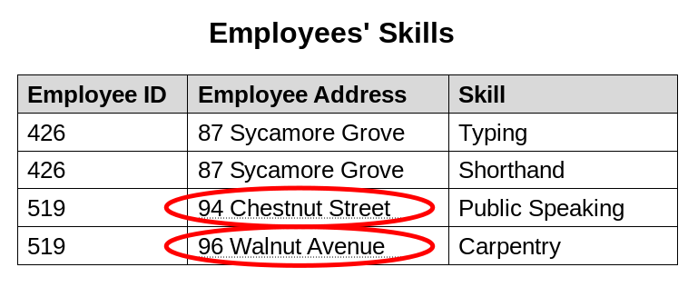
Data Anomalies
Modification anomaly
- Change the address for employee 519 – has to be done for all rows
- What if this employee address is in another table – has to be done for all tables

Slide 28
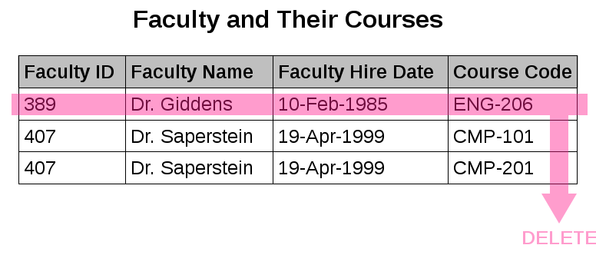
Data Anomalies
Deletion anomaly
- Dr. Giddens is not teaching ENG-206 this semester
- We could lose the hire date if we remove this row to reflect current faculty and their courses

Slide 29
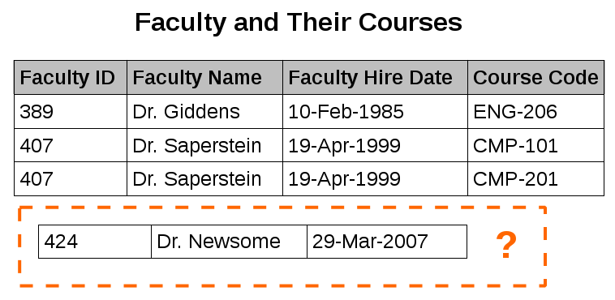
Data Anomalies
Insertion anomaly
- We can record the details of any faculty member who teaches at least one course in 2007
- We cannot record the details of a newly hired faculty member who has not yet been assigned to teach any courses

Slide 30
Database Systems
Database system consists of logically related data stored in a single logical data repository
May be physically distributed among multiple storage facilities
DBMS eliminates most of file system’s problems
Current generation stores data structures, relationships between structures, and access paths
Also defines, stores, and manages all access paths and components

Slide 31
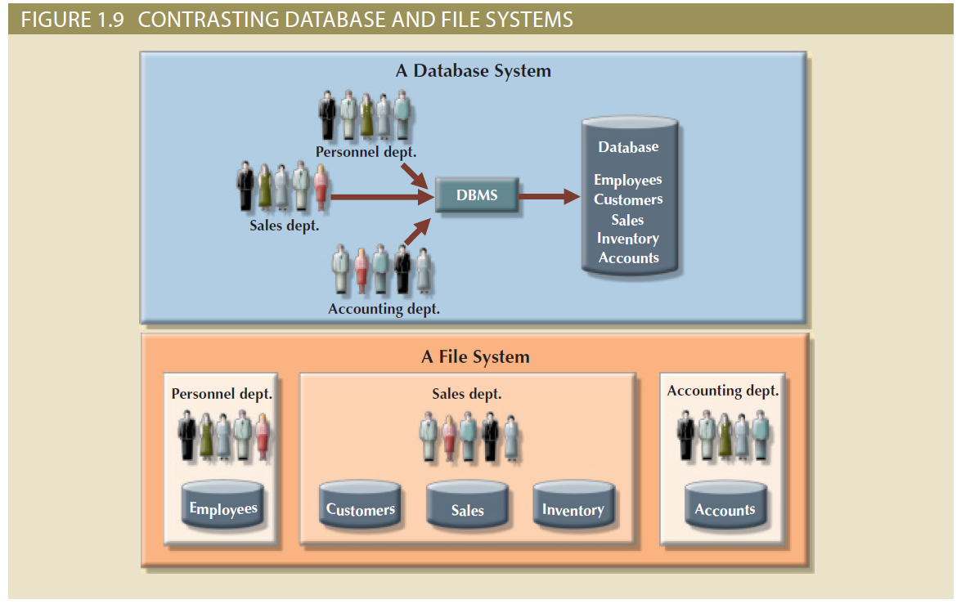
Figure 1.9 - Contrasting Database and File Systems

Slide 32
The Database System Environment
Database system: defines and regulates the collection, storage, management, use of data
Five major parts of a database system:
Hardware
Software
People
Procedures
Data

Slide 33
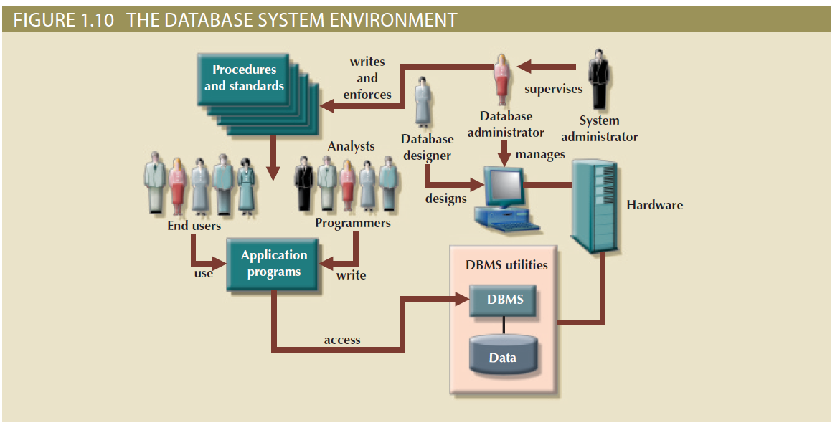
Figure 1.10 - The Database System Environment

Slide 34
The Database System Environment
Hardware: all the system’s physical devices
Software: three types of software required
Operating system software
DBMS software
Application programs and utility software
People: all users of the database system
System and database administrators
Database designers
Systems analysts and programmers
End users
Procedures: instructions and rules that govern the design and use of the database system
Data: the collection of facts stored in the database

Slide 35
DBMS Functions
Most functions are transparent to end users
Can only be achieved through the DBMS
Functions:
Data dictionary management
Data storage management
Data transformation and presentation
Security management
Multiuser access control
Backup and recovery management
Data integrity management
Database access language and application programming interfaces
Database communication interfaces

Slide 36
DBMS Functions
Data dictionary management
Data dictionary: Stores definitions of the data elements and their relationships
Data storage management
Performance tuning: Ensures efficient performance of the database in terms of storage and access speed
Data transformation and presentation
Transforms entered data to conform to required data structures
Security management
Enforces user security and data privacy

Slide 37
DBMS Functions
Multiuser access control
Sophisticated algorithms ensure that multiple users can access the database concurrently without compromising its integrity
Backup and recovery management
Enables recovery of the database after a failure
Data integrity management
Minimizes redundancy and maximizes consistency

Slide 38
DBMS Functions
Database access languages and application programming interfaces
Query language: Lets the user specify what must be done without having to specify how
Structured Query Language (SQL): De facto query language and data access standard supported by the majority of DBMS vendors
Database communication interfaces
Accept end-user requests via multiple, different network environments

Slide 39
Disadvantages of Database Systems
Increased costs
Management complexity
Maintaining currency
Vendor dependence
Frequent upgrade/replacement cycles

Slide 40
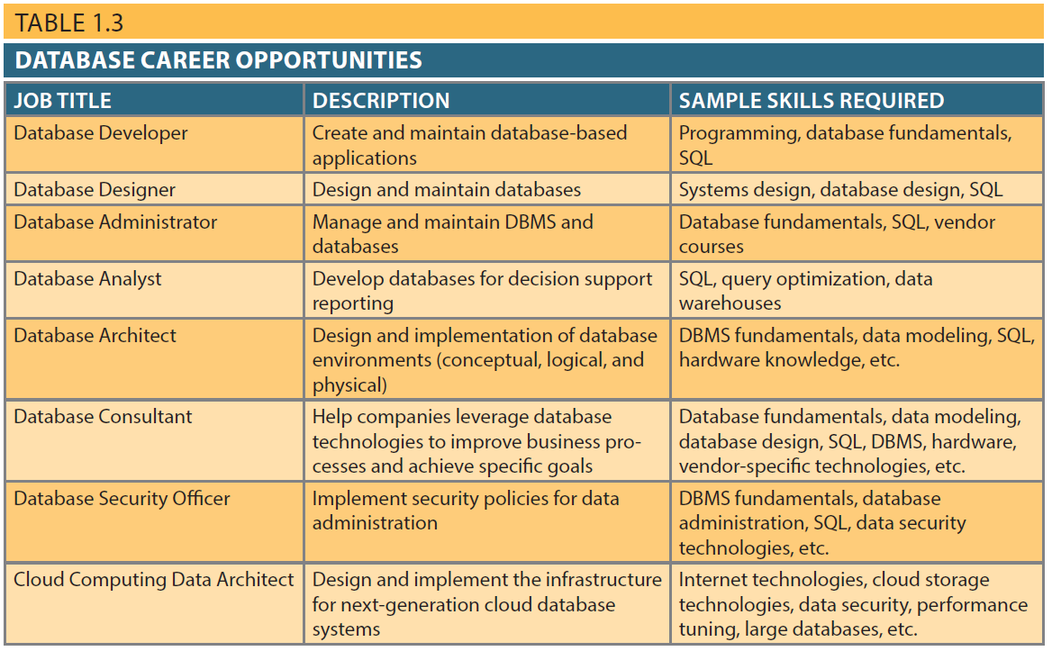
Table 1.3 - Database Career Opportunities
31

