Slide 1




Certifying the Fairness of KNN in the Presence of Dataset Bias
CAV | July 19, 2023
Yannan Li, Jingbo Wang, Chao Wang
Notes:
This is joint work with students who couldn’t be here and that’s why I am presenting.

Slide 2

Outline
1. Background
Individual fairness of machine learning models
1
2. Motivation
The K-nearest neighbors (KNN) algorithm
3. Our Method
2
3
Abstracting the neighbors, prediction, and learning
4. Evaluation
Benchmarks, and experiments
4
Notes:
My presentation consists of four parts. First, I will explain what kind of fairness properties that we want to certify. Next, I will explain the machine learning algorithm that we want to certify. After that, I will present our method, which is based on abstract interpretation. Finally, I will present the evaluation results.

Slide 3


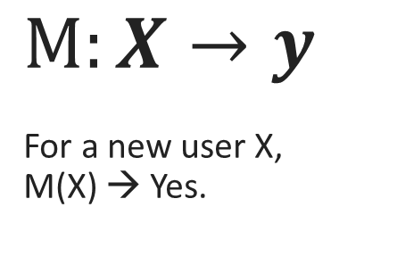
Introduction – machine learning pipeline
Loan ?
Attribute X (age, job, education, …) | Label y (loan ?)
58, management, tertiary, … | No
41, technician, secondary, … | Yes
59, blue-collar, secondary, … | No
33, services, secondary, … | No
$$M:X→y$$
For a new user X,
M(X) → Yes.
Training Data
Learned Model
Application
Notes:
Let’s start with the typical “machine learning pipeline” where you first use training data to create a learned model, and then deploy the model into an application.
The application may be a bank that decides whether to offer a loan to a customer. In this case, the training data may have age, job, education – the so-called input attributes, and output label, indicating if a loan has been offered.
The learned model is a function from input attribute to output label.

Slide 4

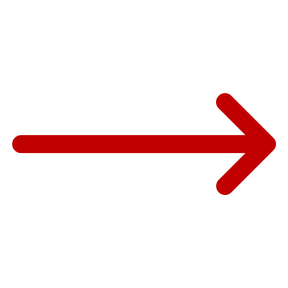





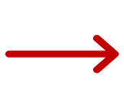
Introduction – bias and what to do about it
Topic #1: Detect and remove bias?
Topic #2: Certify the fairness of prediction result for each individual
This Work
?
Training Data
Learned Model
Application
Applications
Notes:
The system may not treat a certain group of people fairly because of bias in training data, or bias introduced by the machine learning algorithm. Generally speaking, there are two ways of mitigating such bias.
The first option is to find a way to detect and then remove bias from the model. However, this is not always easy. An alternative, which is also the focus of this work, is to still use the model but, for each prediction result, certify that the prediction result is indeed fair, in spite of the potential bias in the model.

Slide 5
Introduction – Problem statement
Certify fairness
for all possible cases, predicted label of test input x remains the same.
Notes:
There are two related problems. The first one, called fairness certification, is to prove that for all possible cases, the predicted label of a given test input x remains the same. The second problem, called fairness falsification, is to find a counterexample, a possible scenario where predicted label of the test input x may be different.
In this paper, we focus on the fairness certification problem.

Slide 6
Introduction – individual fairness
“My loan application is declined – is this decision fair?”
Intuition behind “Individual Fairness”:
Similar people should be treated similarly
Even if the model is trained using data with historical bias
Notes:
More specifically, we focus on “individual fairness”, which requires that similar people should be treated similarly. This can be practically useful because, imagine that you are applying for a bank loan but get declined. You would like to know if this particular decision is fair.

Slide 7
Similar people should be treated similarly,
no matter their protected attributes.
age | education | occupation | race | gender | capital­gain | hours- ­per­week
39 | Bachelors | Adm-clerical | White | Male | 2174 | 40
x
39 | Bachelors | Adm-clerical |  |  | 2174 | 40
“Another Me”
x’
??? ???
Individual Fairness: x and x’ have same prediction result
Notes:
Consider an example where the protected attribute is either race or gender. To find out whether the person x is treated fairly, we may construct a "similar" input x', which has the same input values, except for the protected attributes. What we want to see that both x and x’ have the same prediction result. This is the essence of “individual fairness”.
While this is useful, it may be overly restrictive.

Slide 8
Similar people should be treated similarly,
no matter their protected attributes.
age | education | occupation | race | gender | capital­gain | hours- ­per­week
39 | Bachelors | Adm-clerical | White | Male | 2174 | 40
x
a group of “Another Me”
38~40
2074~2274
38~42
 | Bachelors | Adm-clerical
x’
??? ???
Individual $ε$-fairness: x and all x’ have same prediction result
Notes:
To overcome the limitation, we can define a group of people, who differ from x on the protected attributes and, in addition, have small perturbation on the unprotected attributes. Again, we expect that x and all these x’ have the same prediction result. This is called individual epsilon fairness.

Slide 9
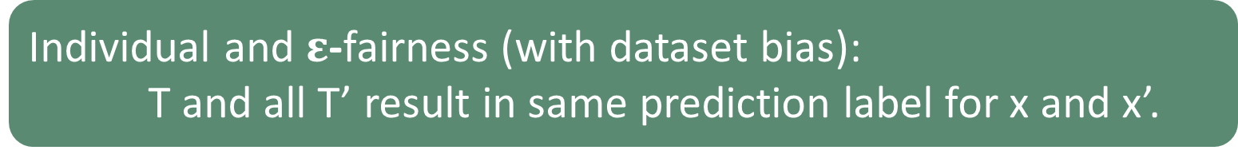

Training data may have historically-biased labels,
e.g., qualified women marked as “not hired” for a job.
Attribute 1 | Hired
Attribute 2 | Not
Attribute 3 | Hired
Attribute 1 | Not
Attribute 2 | Hired
Attribute 3 | Hired
Attribute 1 | Hired
Attribute 2 | Hired
Attribute 3 | Hired
Attribute 1 | Hired
Attribute 2 | Not
Attribute 4 | Not
…
Training Set T
Possible Clean Training Sets T’
(has $≤n$ flipped labels)
Individual and $ε$-fairness (with dataset bias):
T and all T’ result in same prediction label for x and x’.
Notes:
On the previous slides, the notion of fairness was for a fixed model and a fixed training dataset. However, if the training set has historically-biased labels, then it’s often difficult to know what should be the clean dataset. Each of the possible clean dataset may lead to a different learned model.
To account for this, we can the definition by requiring that T and all these T’s result in the same prediction label.

Slide 10
Introduction – Limitations of Prior Work
Testing individual fairness
Galhotra et al, Fairness testing: testing software for discrimination, FSE 2017.
Certifying individual fairness
John et al, Verifying individual fairness in machine learning models, PMLR 2020.
Biswas et al, Fairify: Fairness verification of neural networks, ICSE 2023.
Certifying dataset-bias fairness
Meyer et al., Certifying robustness to programmable data bias in decision trees. NeurIPS 2021.
Meyer et al., Certifying data-bias robustness in linear regression. CoRR 2022.
Not for certifying KNN
Cannot handle (individual fairness + dataset bias)
Notes:
There are prior work on testing individual fairness, certifying individual fairness, and certifying dataset bias fairness. However, they are not for KNN, which is the machine learning technique that we focus on. Also, we cannot handle both individual fairness and dataset bias at the same time.

Slide 11
Outline
1. Background
Individual fairness of machine learning models
1
2. Motivation
The K-nearest neighbors (KNN) algorithm
3. Our Method
2
3
Abstracting the neighbors, prediction, and learning
4. Evaluation
Benchmarks, and experiments
4
Notes:
Next, we will briefly explain KNN, the machine learning techniques that we want to certify.

Slide 12



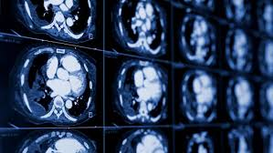
Motivation – KNN ( k-nearest neighbors )
Video Recommendation
Document Search
Fraud Detection
Medical Diagnosis
Notes:
KNN stands for k nearest neighbors. It is a popular supervised learning algorithm widely used in real-world applications, including video recommendation, document search, fraud detection, and medical diagnosis.

Slide 13
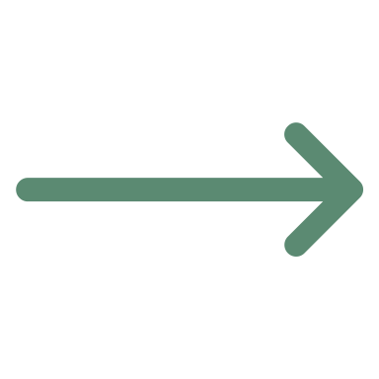

Motivation – KNN (how it works)
Error
location
shape
Attribute X (age, education) | Label y (subscribe?)
58, tertiary | No
41, secondary | Yes
59, secondary | No
33, secondary | No
?
Opt K
min
1 3 5 7 9
K = 3
NN = {square*2, star*1}
Prediction = square
Candidate K Values
Parameter Tuning
Label Prediction
Notes:
To understand how it works, think of the “training data elements in the table” as “points in the Attribute space”. Different locations represent different inputs, and different shapes represent different outputs. If the question mark is a new input for which we want to predict the output label, KNN works as wells.
(click) Assuming “K equals 3”, which means KNN will check the 3 nearest neighbors of x.
(click) since the 3 nearest neighbors have 2 squares and 1 star.
(click) the most frequent label, which is square, will be the predicted label.
In this example, we have assumed K = 3 but, in general,
(click) the k value must be computed during parameter tuning.
(click) Here is how the parameter tuning step works:
(click) given some candidate k values, we will calculate the classification error on the training set for each k value, and then we will pick (click) K value with the minimal error.

Slide 14
Motivation – The KNN process
Test input x
Parameter Tuning
Label Prediction
Training dataset T
Opt K
predicted
label of x
Notes:
Here is a summary of the KNN process.
(click) giving a training set, first compute the optimal K and
(click) then use the optimal K and (click) the training data to predict the label of test input X (click)

Slide 15
Motivation – How does dataset bias affect predicted label?
Biased
Direct: change neighbors of test input x
?
Only need to check biased element near x
(2) Indirect: change the optimal K value
K = 3
Under injection attack
Biased
Need to check all biased elements globally
?
K = 3 → 5
Under injection attack
Notes:
There are two ways that dataset bias may affect the predicted labels. The first one is called direct influence, which means the biased element may change the majority vote of the neighbors of the test input.
The second one is called indirect influence, which means the biased element is so far away that it’s not one of the closest neighbors, but its existence changes the value of the parameter K, from 3 to 5, for example, which indirectly changes the majority vote.

Slide 16






Motivation – baseline method for deciding fairness
Test input x
$$T_{1}^{′}$$
Parameter Tuning
K₁
Label Prediction
$${label}_{1}(x)$$
$$T_{2}^{′}$$
Parameter Tuning
K₂
Label Prediction
$${label}_{2}(x)$$
$$T_{3}^{′}$$
Parameter Tuning
K₃
Label Prediction
$${label}_{3}(x)$$
…
…
…
…
All possible clean training datasets
Same?
Combinatorial explosion!
Notes:
In order to account for all the possible cases where the predicted label may be affected, a naïve solution is to enumerate all the possible clean training datasets. For each of the dataset T’, lean an optimal K value, and then predict the output label for x. If all of the predicted labels are the same, then we can say the result is fair. However, this leads to combinatorial explosion.

Slide 17
Outline
1. Background
Individual fairness of machine learning models
1
2. Motivation
The K-nearest neighbors (KNN) algorithm
3. Our Method
2
3
Abstracting the neighbors, prediction, and learning
4. Evaluation
Benchmarks, and experiments
4
Notes:
Next, we explain how our method works.

Slide 18


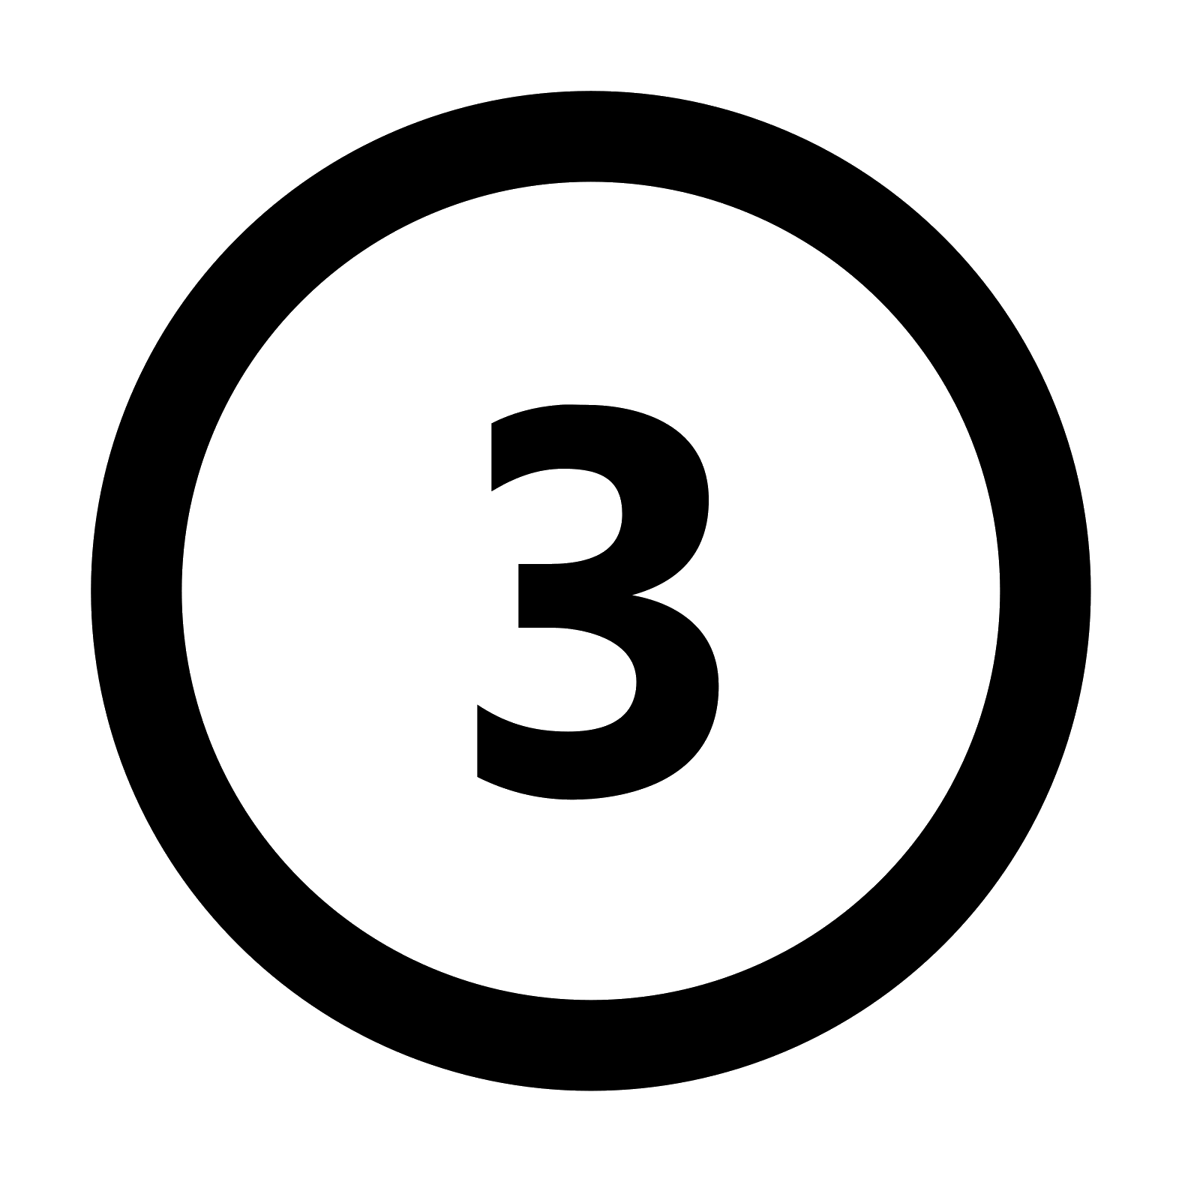
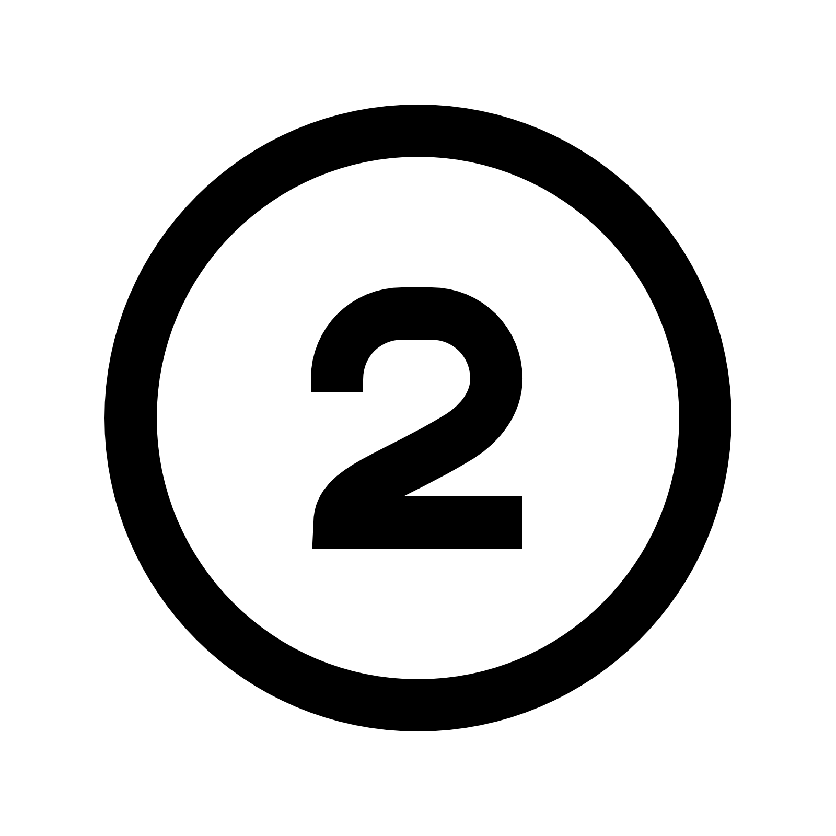
Method in a Nutshell
Abstracting the neighbors
Which are the K-nearest neighbors
Abstract Interpretation
Abstracting the learning step
Possible optimal K values
Abstracting the prediction step
Same output label?
Our Method
Notes:
Our method relies on “abstract interpretation” to soundly approximate the entire KNN algorithm.
First, we approximate the set of nearest neighbors for a given K value.
Second, we approximate the set of possible output labels.
Third, we approximate the computation of the optimal K values.
These three components are our main contributions.

Slide 19
Highlights of our method
Test input x + ε-perturbation
Abstract
Parameter Tuning
Abstract
Label Prediction
Training set T,
Max label flip n
Opt KSet
Certfied or not?
Notes:
Here is the overview of our proposed method, where the three innovative components are clearly marked.

Slide 20
Abstracting the neighbors
Abstracting the neighbors
Abstract Interpretation
Abstracting the learning step
Abstracting the prediction step
Notes:
Now, let’s take a closer look at our method for “abstracting the neighbors”.

Slide 21


Original KNN – find the nearest neighbors (of input x)
Distance to test input x
x
3rd minimal
distance
Training data
K = 3
NN = {triangle*2, star*1}
Prediction = triangle
(Original) “3” nearest neighbors
Notes:
First, recall how the original KNN finds the nearest neighbors of a test input x.
Assuming that K equals to 3, the predicted label of x should be the most frequent label of the 3 nearest neighbors. Since there are two triangles and one star, the predicted label is triangle.
To find the three nearest neighbors, we compute the Euclidian distance between X and elements in the dataset T, and pick the three with the smallest distances.

Slide 22

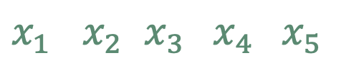
Abstract KNN – find the nearest neighbors (of input x)
Distance to any x’
at least 4th nearest or further
x
3rd minimal UB
x’
$x_{1}$ $x_{2}$ $x_{3} x_{4} x_{5}$
Training data
K = 3
x NN = {triangle*2, star*1}
x’ NN = {triangle*1, star*2}
(Over-approx) “3” nearest neighbors
Notes:
When considering ε-fairness, the input X' may be slightly different from X, leading to different neighbors and different predicted labels. Since there are potentially infinite many such X’, we cannot enumerate all of them.
Instead, we approximate the Euclidean distance between X’ and every data element in T. Due to approximation, in the right figure, a single point becomes an interval, with an upper bound and a lower bound.
Since K equals 3, we pick the third minimal upper bound. Since X5’s lower bound is larger than the third minimal upper bound, we can safely say that X5 is definitely not among the 3-nearest neighbors.
After excluding these elements that are too far away, we get a superset of the three nearest neighbors. In this case, the superset has four elements.

Slide 23
Abstracting the prediction step
Abstracting the neighbors
Abstract Interpretation
Abstracting the learning step
Abstracting the prediction step
Notes:
Next, we use the superset of the K nearest neighbors to compute the predicted label and then check if the label is unique.

Slide 24
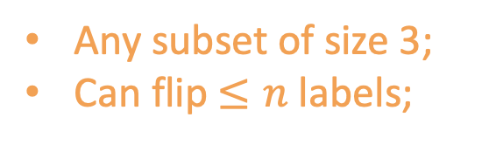

Original/Abstract KNN – find the most frequent label
K = 3
Exact NN = { triangle*2, star*1 }
Prediction = triangle
K = 3
OverNN = { triangle*2, star*2 }
Prediction = ???
Any subset of size 3;
Can flip $≤n$ labels;
Individual $ε$
Label-bias
(Original) KNN Prediction
(Over-approx) Abstract KNN Prediction
Notes:
In the original KNN, the predicted label is the most frequent label of the neighbors. However, the overapproximated nearest neighbors, we need to consider all possible scenarios, since any subset of size 3 could be the actual nearest neighbors. In addition, we must assume that up-to-n elements may have the labels flipped, due to dataset bias.
Only when all of the scenarios lead to the same predicted label, we can say that the prediction result is fair.

Slide 25
Abstracting the learning step
Abstracting the neighbors
Abstract Interpretation
Abstracting the learning step
Abstracting the prediction step
Notes:
Finally, we explain how our method abstracts the learning step, to compute a superset of the optimal K values.

Slide 26
Original/Abstract KNN – compute the optimal K value
Error
Error
min
minUB
1 3 5 7 9
1 3 5 7 9
Candidate K Values
Candidate K Values
(Original) Parameter Tuning
(Over-approx.) Parameter Tuning
Notes:
Recall that, in the original KNN, the optimal K value is the one that minimizes the classification error. However, due to approximation, the single point now becomes an interval, with an upper bound and a lower bound. To compute the superset of optimal K values, we first find the minimal upper bound, and then use it to exclude the obviously non-optimal K values .
Here, an obviously non-optimal K value is one whose lower bound error is large than the minimal upper bound.

Slide 27
Highlights of our method
Test input x + ε-perturbation
Abstract
Parameter Tuning
Abstract
Label Prediction
Training set T,
Max label flip n
Opt KSet
Certified or not?
Notes:
Again, here are highlights of the three key components of our method. For more information, please refer to our paper.

Slide 28
Outline
1. Background
Individual fairness of machine learning models
1
2. Motivation
The K-nearest neighbors (KNN) algorithm
3. Our Method
2
3
Abstracting the neighbors, prediction, and learning
4. Evaluation
Benchmarks, and experiments
4
Notes:
Now, let’s see how our method works in practice.

Slide 29
Evaluation
Name | #Training | #Attribute | Protected Attributes
Salary | 52 | 16 | Gender
Student | 649 | 33 | Gender
German | 1,000 | 20 | Gender
Compas | 10,500 | 16 | Race, Gender
Default | 30,000 | 36 | Gender
Adult | 48,842 | 14 | Race, Gender
Fairness Benchmarks
2 small datasets
4 larger datasets
Research Questions
RQ1: Accuracy in certifying individual fairness:
Compared to the baseline (to obtain ground truth on small datasets)
RQ2: Efficiency in handling the datasets:
Evaluated using the larger datasets
Notes:
We evaluate our method on six popular datasets in the fairness literature. Two of them are small, and the other four are larger.
The small datasets are useful in the sense that even the baseline enumerative method can finish and therefore obtain the ground truth. Here, ground truth means whether a prediction result is indeed fair.
What we want to know is, first, whether our method is accurate in certifying individual fairness, and second, whether our method is efficient in handling the datasets.

Slide 30
Result – Accuracy
On small datasets (compare with ground truth obtained by baseline enumeration):
Accuracy > 76.2%
Run time: 0.2 s per test input
Our Method
Name | Ground Truth | Time | Certified | Time | Accuracy | Speedup
Salary (gender) | 33.3% | 1.5 s | 33.3% | 0.3 s | 100% | 7.5X
Student (gender) | 58.5% | 25.2 s | 44.6% | 0.2 s | 76% | 106X
Notes:
Here are the results on small datasets. In terms of speed, our method is many times faster than the baseline. In terms of accuracy, our method is close to the baseline. For salary, the certified rate is the same as the ground truth. For student, the accuracy is 76 percent.

Slide 31
Result – Accuracy and Efficiency
On larger datasets:
Run time: <6 s per test input
Name | Certified | Time | Protected Attribute
German | 43.0% | 0.2s | Gender
Compas | 54.4% | 1.1s | Race, Gender
Default | 59.4% | 3.5s | Gender
Adult | 35.6% | 5.3s | Race, Gender
Notes:
On the larger datasets, we no longer have the ground truth, but since our method is sound, the certified rate serves as a lower bound of the actually fair prediction results.
Furthermore, the efficiency of our method is high in the sense that the run time is less than 6 seconds per test input, even for large datasets such as Adult.

Slide 32
Result – Difference in “Certified” Rates
 | White | Other | Wt. Avg
Male | 61.9% | 52.2% | 52.8%
Female | 100% | 60.0% | 63.7%
Wt. Avg | 63.6% | 53.7% | 54.4%
 | White | Other | Wt. Avg
Male | 35.3% | 33.3% | 35.1%
Female | 33.3% | 66.7% | 37.0%
Wt. Avg | 34.7% | 44.4% | 35.6%
Compas
(recidivism risk prediction)
Adult
(income prediction)
Notes:
We also looked at the certified rate for different subgroups and here are the results for Compas and Adult. An interesting observation is that the rate various among different subgroups. For example, While female has the highest certified rates in Compas, while other female has the highest certified rates in Adult.
There may be both social and technical reasons for such differences. While figuring out the reason why there are such differences is an interesting research problem on its own, it’s out of the scope of this particular work.

Slide 33
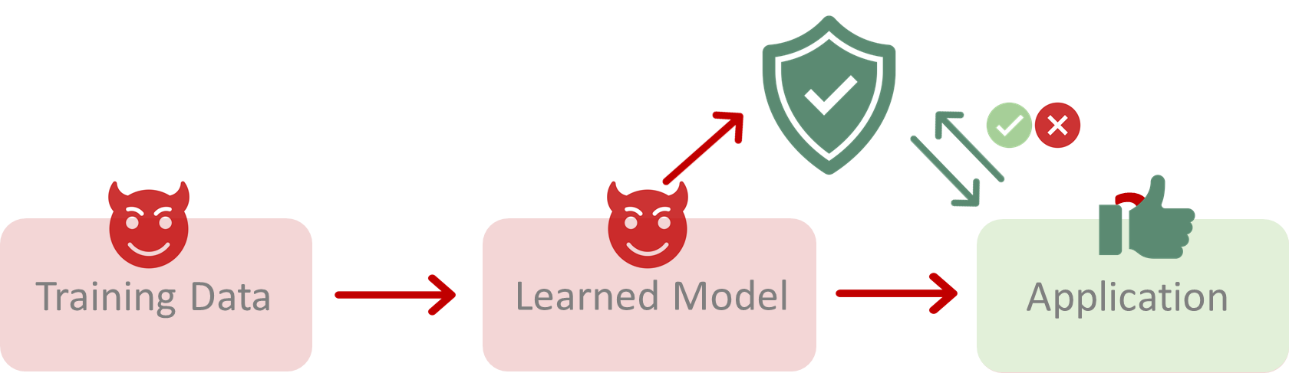
Conclusion
A method for certifying (efficiently and accurately) the fairness of KNN prediction results under dataset bias
Questions?
Notes:
To conclude, we propose a sound formal analysis techniques for certifying the fairness of KNN prediction results under dataset bias. The method is useful in that, even if training data is potentially biased, the prediction result for a given individual may still be fair, and if we can formally certify the fairness, the result can still be considered trustworthy.
That’s all, and I will be happy to answer your questions.

Slide 34
Reason1: Minor group has sparse neighbors.
Result
x
x
 | White | Other | Wt. Avg
Male | 61.9% | 52.2% | 52.8%
Female | 100% | 60.0% | 63.7%
Wt. Avg | 63.6% | 53.7% | 54.4%
Female
Male
Compas (recidivism risk prediction)
Reason2: Internal difference within group.
x
 | White | Wt. Avg
Male | 35.3% | 35.1%
Female | 33.3% | 37.0%
Wt. Avg | 34.7% | 35.6%
65%
x’
Adult (income prediction)
Female
Male
prob(label change)
= 0.35*0.65 + 0.65*0.35
= 0.46
prob(label change) =
=0.485*0.515+ 0.515*0.485
= 0.5
Notes:
An interesting observation during our experiments is that the certification rate varies among different demographic groups. For example, in our findings, females had a higher certification rate than males. We have attempted to explain this phenomenon,:
One explanation is that minority groups may have sparser neighbors, making them less influenced by delta changes. When there are fewer neighbors, it's less likely that the prediction will be significantly affected by label flipping or other adversarial manipulation.
Another explanation is related to the internal differences within groups. In this example, let's say blue and orange represent different labels, and the percentages represent the classification of a person. For females, if we want to change the classification from "yes" to "no" or from "no" to "yes," the probability is lower than for males

Slide 35
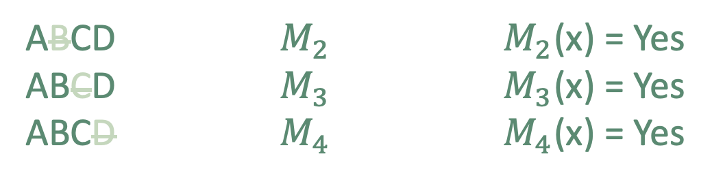
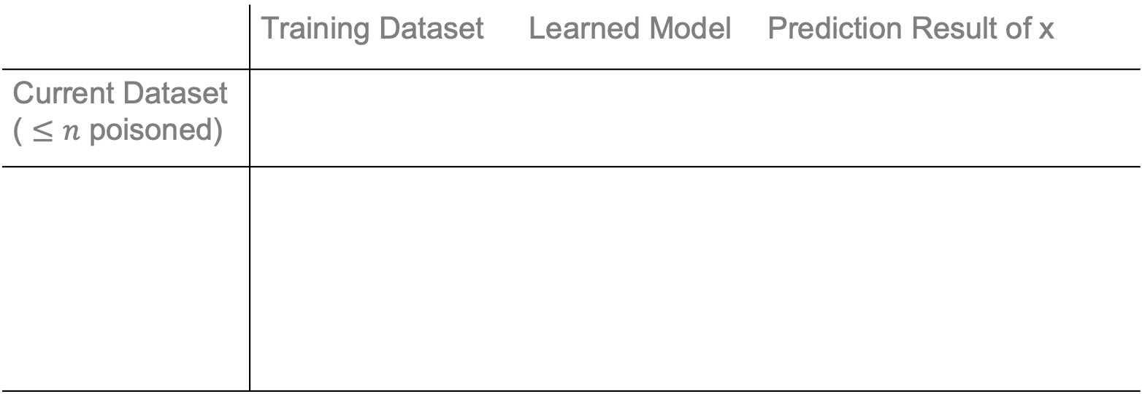

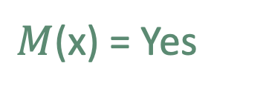
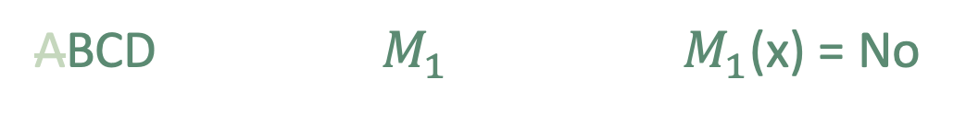

Introduction – challenge (combinatorial explosion)
 | Training Dataset | Learned Model | Prediction Result of x
Current Dataset ( $≤n$ poisoned)
ABCD
$$M$$
$M$(x) = Yes
ABCD ABCD ABCD ABCD
ABCD ABCD ABCD ABCD
ABCD ABCD ABCD
ABCD ABCD ABCD 14 situations
ABCD ABCD ABCD
ABCD ABCD ABCD
ABCD ABCD
ABCD ABCD 10 situations
???
???
???
???
ABCD $M_{1}$ $M_{1}$(x) = No
(n = 3)
Possible
Clean
Dataset
(n = 1)
Possible
Clean
Dataset
(n = 2)
Possible
Clean
Dataset
ABCD $M_{2}$ $M_{2}$(x) = Yes
ABCD $M_{3}$ $M_{3}$(x) = Yes
ABCD $M_{4}$ $M_{4}$(x) = Yes
fairness Definition: $∀i, M_{i}(x′)=M(x)$
Notes:
What we want to prove is a security property called “n-poisoning robustness”. Here we use an example dataset under injection attack to explain what it is.
(click).
Assume that the current training set has four elements “ABCD”. If we use it to learn a model, we will get “M”.
(click) and if we use the model on the test input “x”, it will predict x as “Yes”.
(click) Now, assume that “n equals one”, which means at most one elements has been injected in current training set T .
Depending on which element is the poisoned element, there are four possible cases.
(click) If the clean data are “BCD” then the model should have been “M1” instead of “M”. Let’s assume that “M1” will predict x as “No”.
(click) In other words, the injected malicious data have caused a misclassification error.
(click) If the clean data are ACD or ABD or ABC, the learned models should have been M2, M3, M4 but they may still predict x as a “Yes”.
We found that in some cases the prediction result may change, and in some cases not.
(click) But the bad thing is that we don’t know which one is the real clean dataset, we have to conservatively assume it can be any of them. Therefore, only when all of these models return the same prediction results, we say the default prediction result dog satisfies n-poisoning robustness.
(click) However, proving is not easy because, when n = 2, which means there are at most two poisoned elements, we will have 10 possible cases.
(click) When n=3, there will be 14 possible cases.
(click) In general, this leads to combinatorial explosion.

