Slide 1
Pushbroom satellite image super-resolution using generative adversarial networks
XU Chao
1155160618@link.cuhk.edu.hk
20/05/2021
1

Slide 2
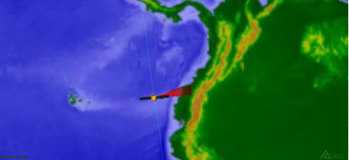
Background
Pushbroom satellite imaging
1
What is Pushbroom Imaging (PBI)?
Satellite sensor scans nadir trace along the orbit.
Features:
High manoeuvring, low cost, extended coverage; while vulnerable to image degradation.
How to improve image resolution?
Conventionally, reduce pixel size of CCD, or increase pixel density .
Hard to manufacture
& quite Expensive!
Nadir trace

Slide 3
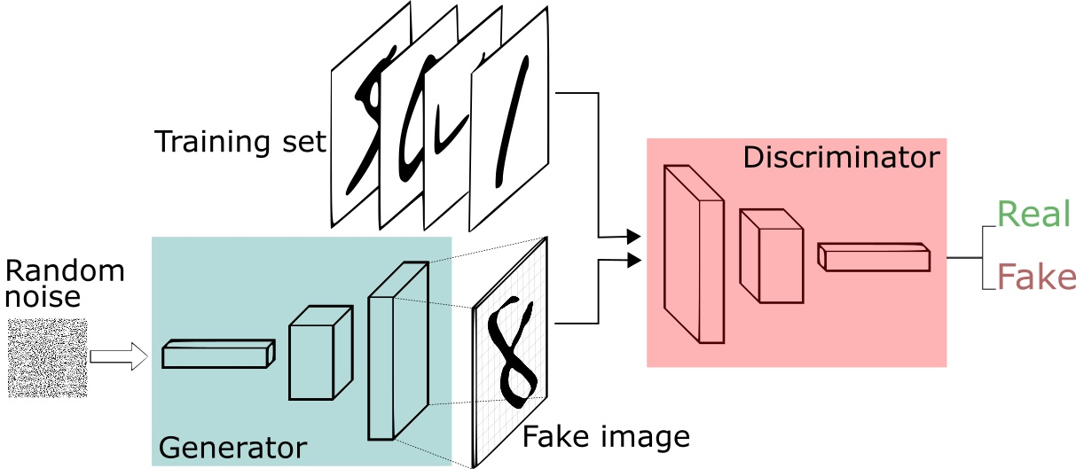
Background
Super-Resolution Generative Adversarial Networks
2
SRGAN
Use GAN to do super-resolution for pushbroom images (pbiSRGAN).
Generator：generate ‘HR images’ from input LR images
Discriminator: determine whether the input is generated ‘HR’ by generator or GT

Slide 4
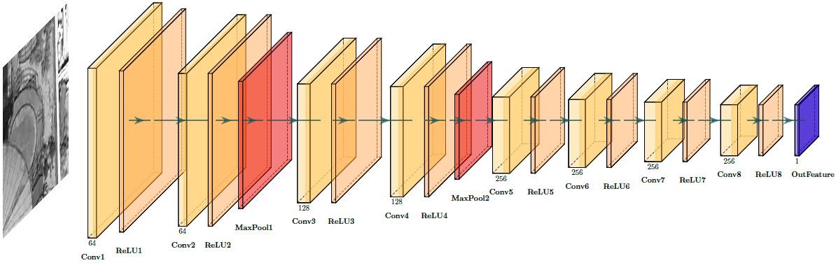
Research methods
pbiSRGAN network architecture
1
Feature extractor
VGG-19: originally proposed for feature extraction of colorful images
Improvement：Extract its former 18 layers, and modify its 1st layer fit to panchromatic remote sensing images
Feature extractor: obtains feature maps from GT and ‘HR’ images, and calculate loss

Slide 5
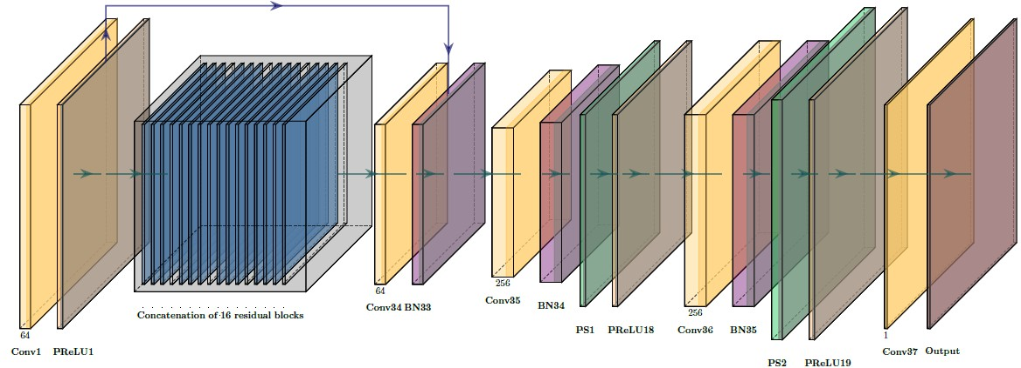
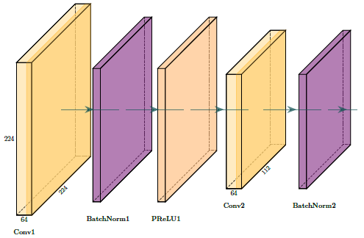
Research methods
pbiSRGAN network architecture
1
Two subpixel conv layers: upsample the input images
Core is PixelShuffle: convert (*, C×r×r, H, W) to (*, C, H×r, W×r)
Generator
Use 16 residual blocks to alleviate the optimization problem of a deep forward network.

Slide 6
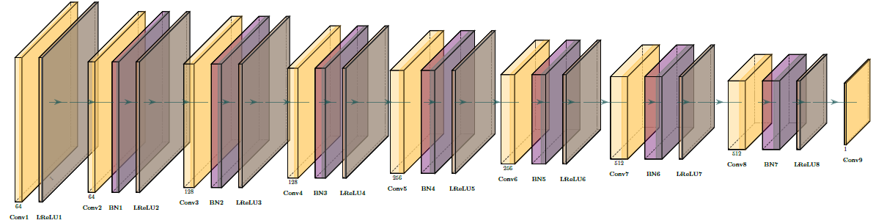
Research methods
pbiSRGAN network architecture
1
Discriminator
Discriminator: combat with generator，strengthen the image generation capability of G；

Slide 7
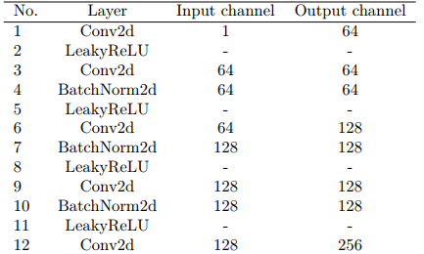
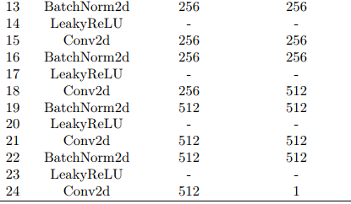
Research methods
pbiSRGAN network architecture
1
Discriminator
24 layers, number of input and output channel is 1
Conv layers with 64、128、256、512 channels: enhance the feature extraction ability.

Slide 8
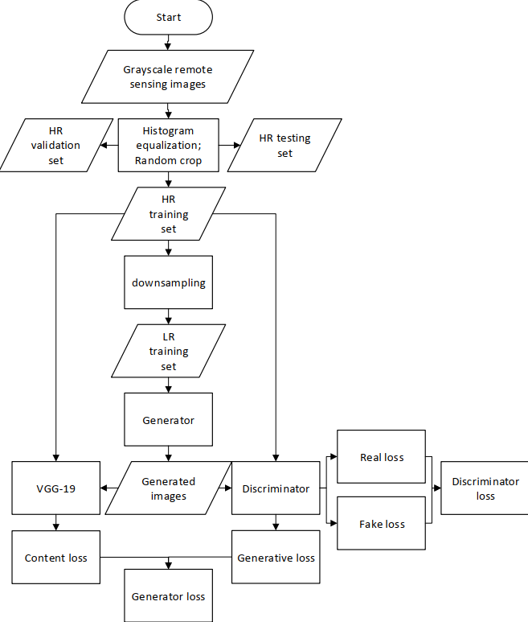
Research methods
pbiSRGAN training flow
2
Improve 1: extract former 18 layers of VGG-19, add a single channel conv layer.
Improve 2: Update content loss, use L1 norm (shows higher degree of confidence than L2 norm when non-gaussian errors are in the images.)

Slide 9
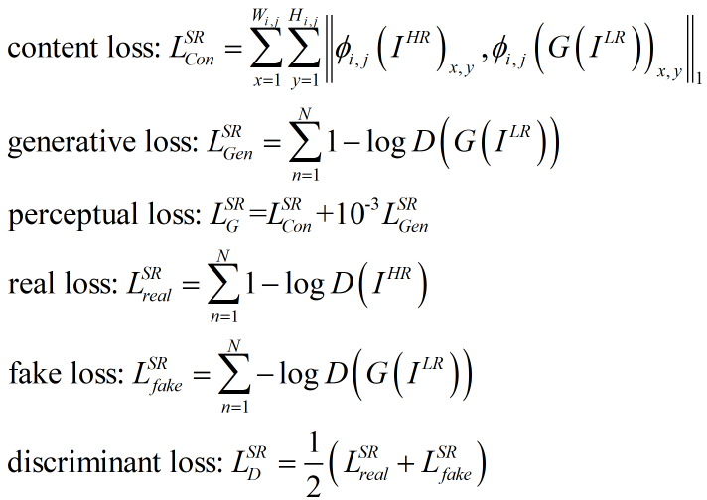
Research methods
pbiSRGAN training flow
2

Slide 10
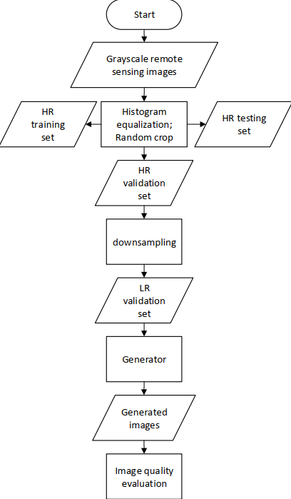
Research methods
pbiSRGAN reconstruction flow
3
Freeze the generative network, all parameters are fixed
Validate the performance of trained model

Slide 11
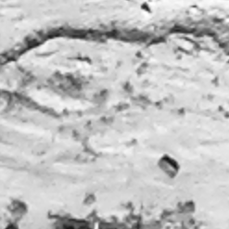
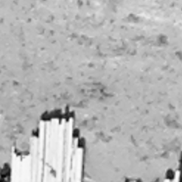
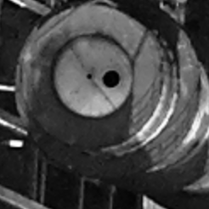
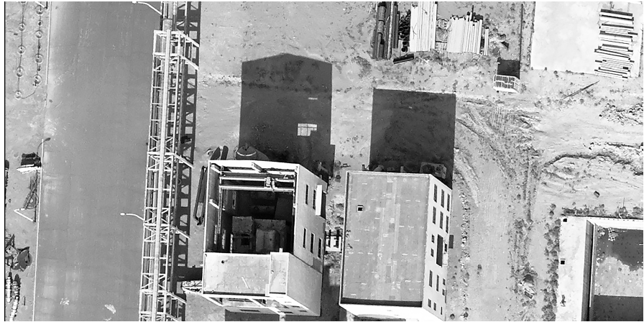
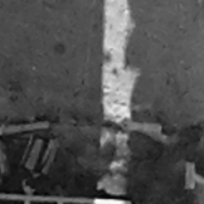
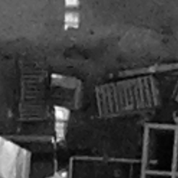
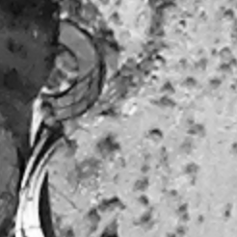
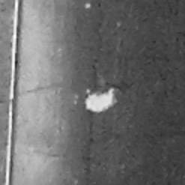
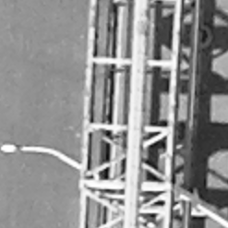
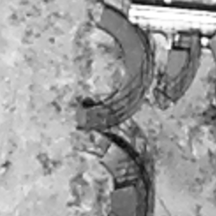
Simulation
Create dataset
1
Training set,96000
Validation set,3000
Testing set,1000
Part of source pushbroom image with size of 1197x50500

Slide 12
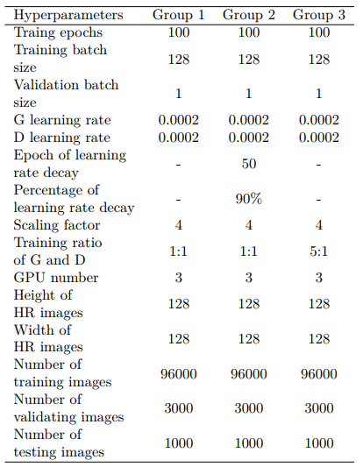
Simulation
Experimental schemes
2

Slide 13
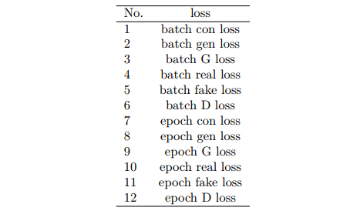
Simulation
Loss metrics
3
Two kinds of loss metrics: batch loss and epoch loss.
In one epoch:
96000 pcs = 750 batches x 128 pcs/batch

Slide 14
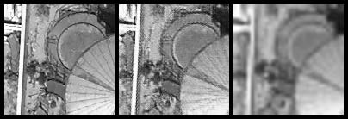
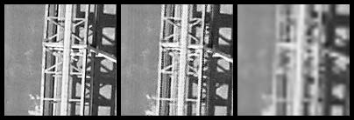
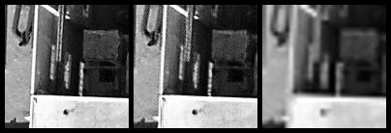
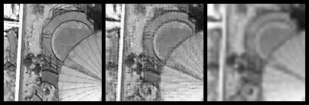
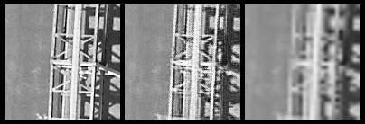
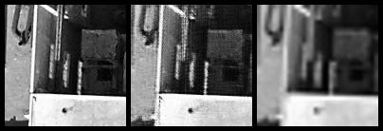
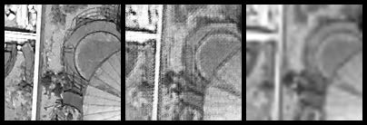
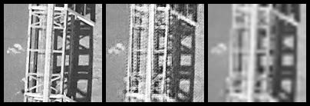
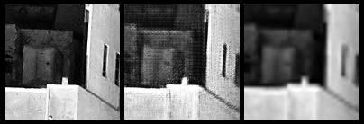
Simulation
Reconstructed images comparison
4
Top-down: group1, 2, 3;
Left-right: oil tank, steel, roof, representing circular, linear, contrast features;
Inset left-right: ground truth, pbiSRGAN, Bicubic results.

Slide 15
Simulation
Reconstructed images comparison
4

Slide 16
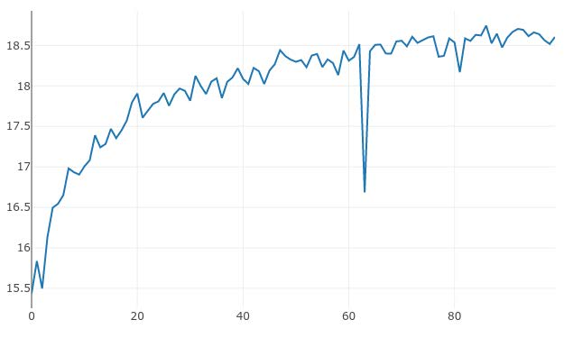
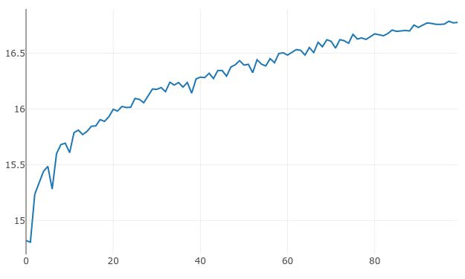
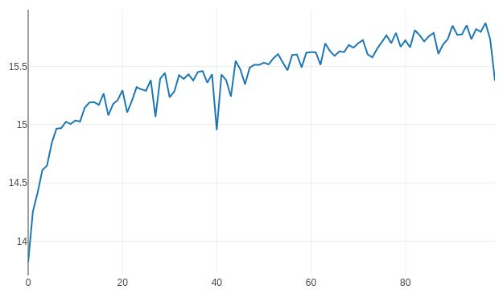
Simulation
Reconstructed indicators comparison
5
18.6049
16.7754
Group1
15.3766
Group 2
Group 3
PSNR on validation set

Slide 17
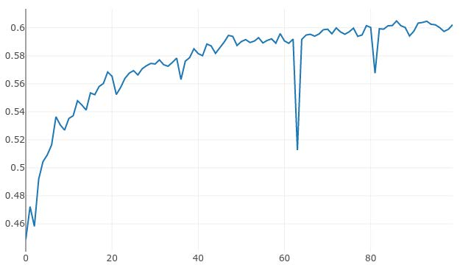
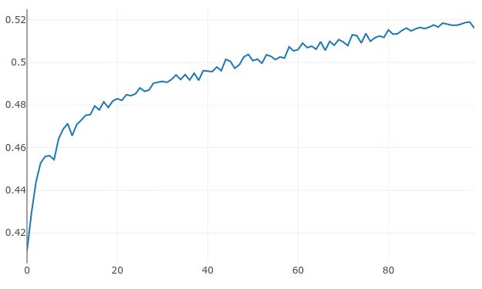
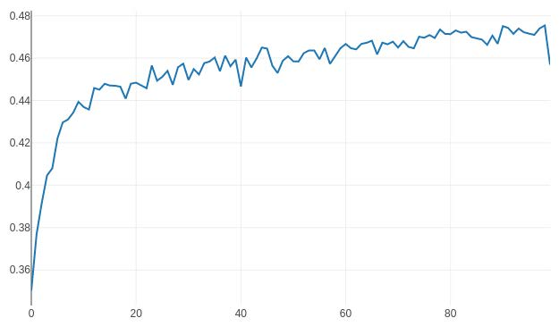
Simulation
Reconstructed indicators comparison
5
0.6045
0.5178
Group1
0.4575
Group 2
Group 3
SSIM on validation set

Slide 18
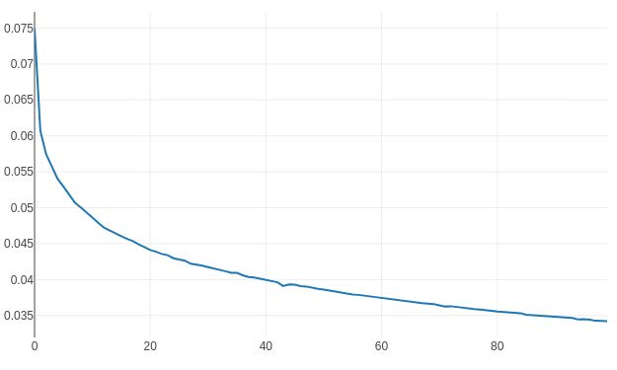
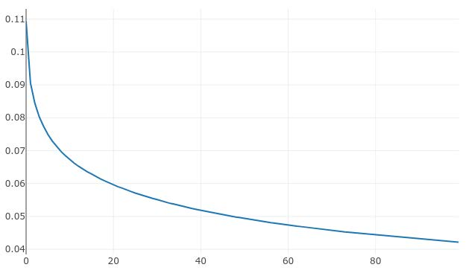
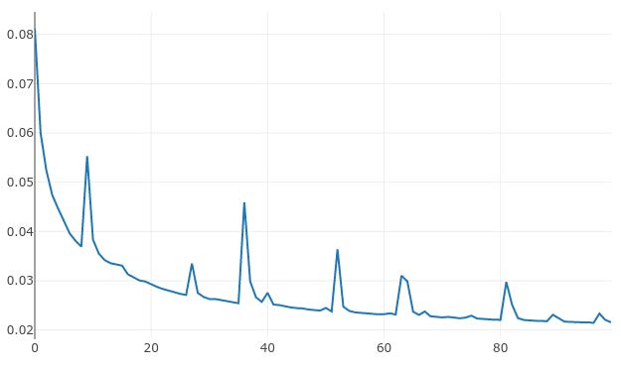
Simulation
Loss curve comparison
6
Group 3
Group 2
0.034
Group 1
0.042
0.022
Epoch perceptual loss on training set

Slide 19
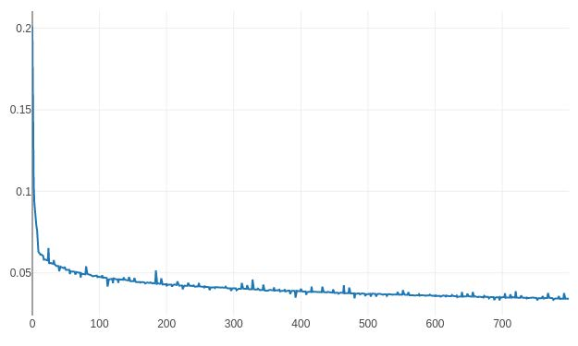
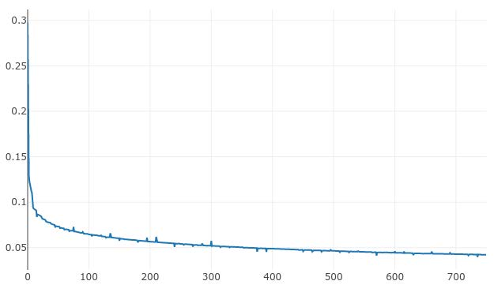
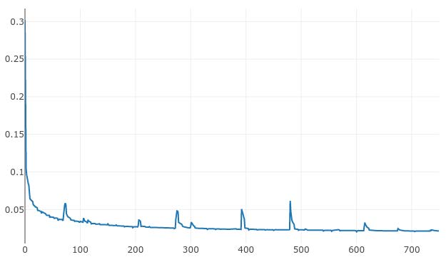
Simulation
Loss curve comparison
6
Group 3
Group 2
0.025
Group 1
0.040
0.024
Batch perceptual loss on training set

Slide 20
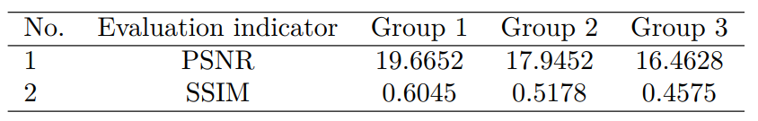
Simulation
Reconstructed results on testing set
7
Mean PSNR & SSIM on testing set

Slide 21
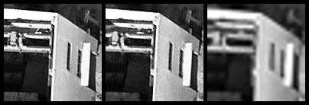
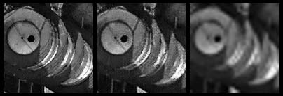
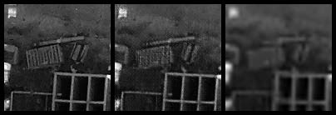
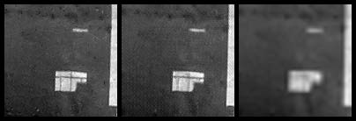
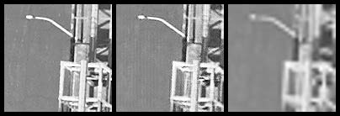

Simulation
Reconstructed results on testing set
7
Inset left-right: ground truth, pbiSRGAN, Bicubic results.
Reconstructed results on testing set using Group 1

Slide 22
Thank you!
XU Chao
1155160618@link.cuhk.edu.hk
20/05/2021
Please find the code for this project here:
https://github.com/chaoxu0512/Pushbroom-satellite-image-SRGAN.
22

