Slide 1
Javo – a simplified JVM
Chao Yang
29/09/2017

Slide 2
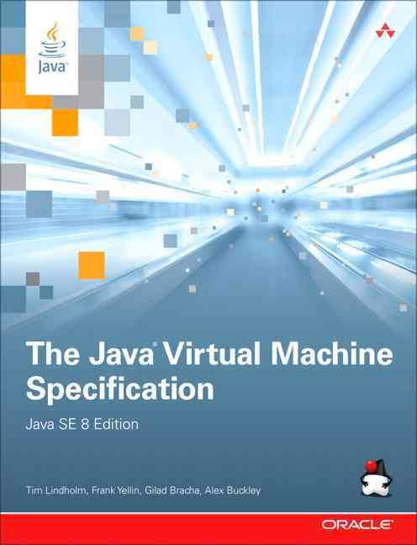
What is Javo?
A simplified Java virtual machine written in Go programming language.
To learn JVM specification in depth and explore how a Java program runs in a managed environment.
HelloWorld!
Notes:
What the name comes from
In the past, every time I run a Java program, I image how it is like to be in the JVM. But now I have an opportunity to implement a JVM on my own.
These are some principles to guide my design:
simplified 🡪 ignore unnecessary features
keep modular
General impression about what it is like

Slide 3
Features
Java class file parser
Interpreter engine
Class loader delegation
multi-threading and concurrency support
monitor/synchronized, sleep, wait/notify support
Bridge JDK native methods
Execution Engine
Method Area
Heap
Notes:
Constant pool, super classes, interface, fields, methods, method code,

Slide 4
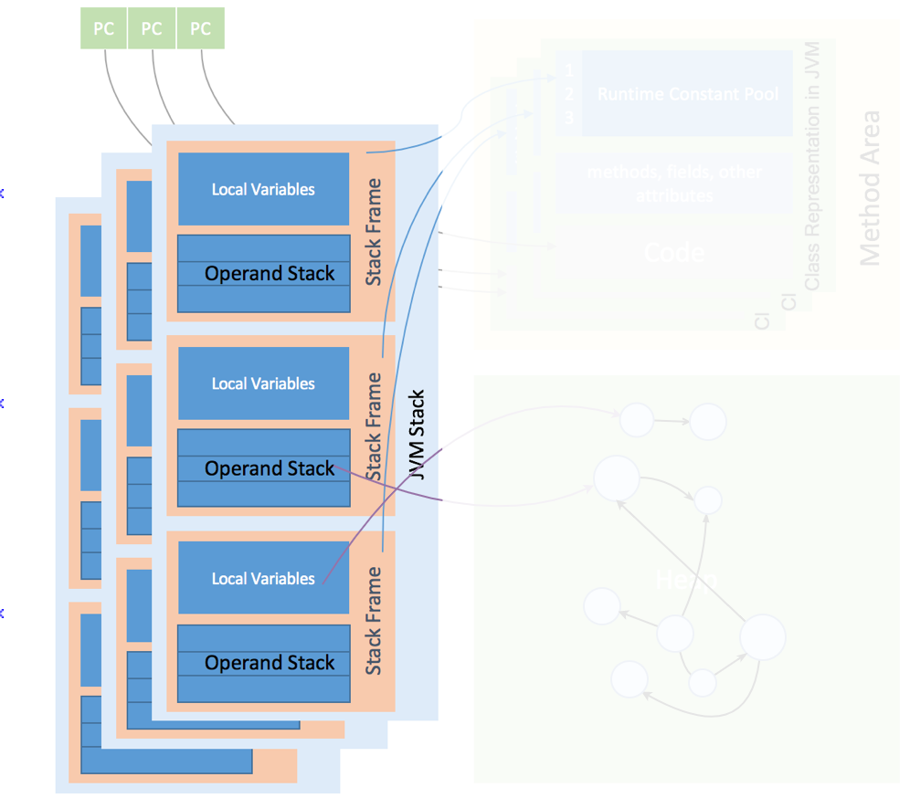
Execution Engine
Execution Engine
Manage threads and its lifecycle
Mange per thread structure
instruction interpretation: 203 instructions
Method invocation
Exception handling
Object monitor semantics: entermonitor, exitmonitor

Slide 5
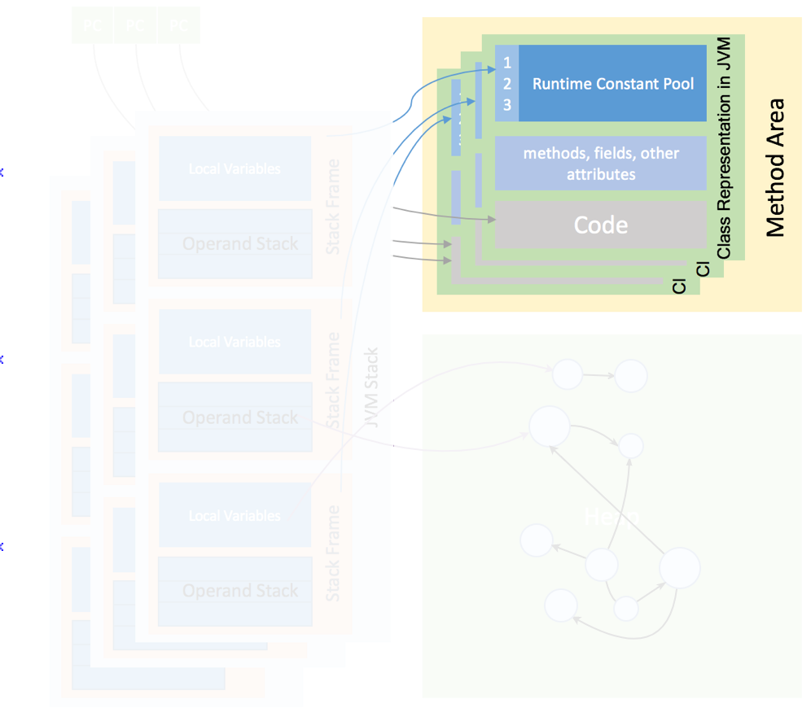
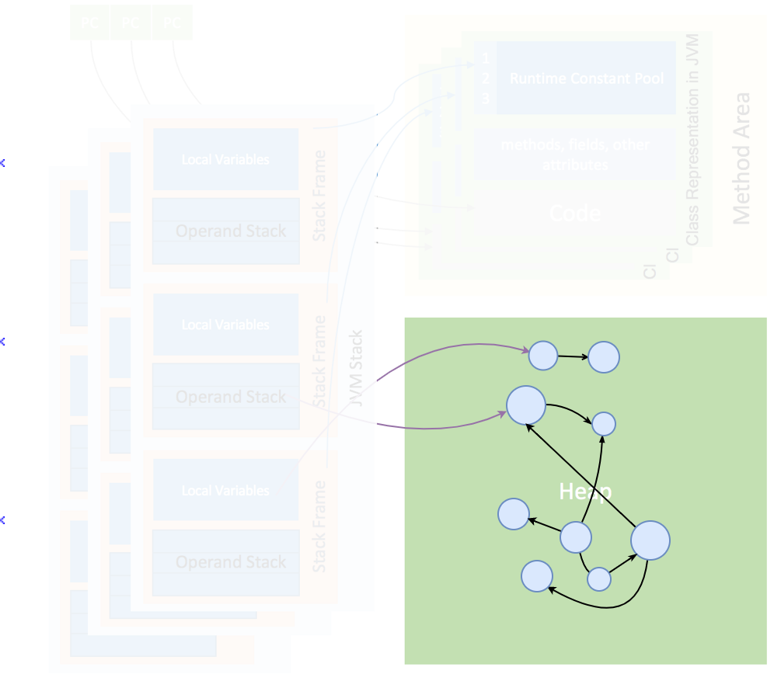
Method Area and Heap
Method Area
Defined classes cache
Initiated classes cache
String Pool
Bootstrap ClassLoader
Heap
A number of object factories
create common objects: j.l.Object, String, Class, Thread, Throwable, array

Slide 6
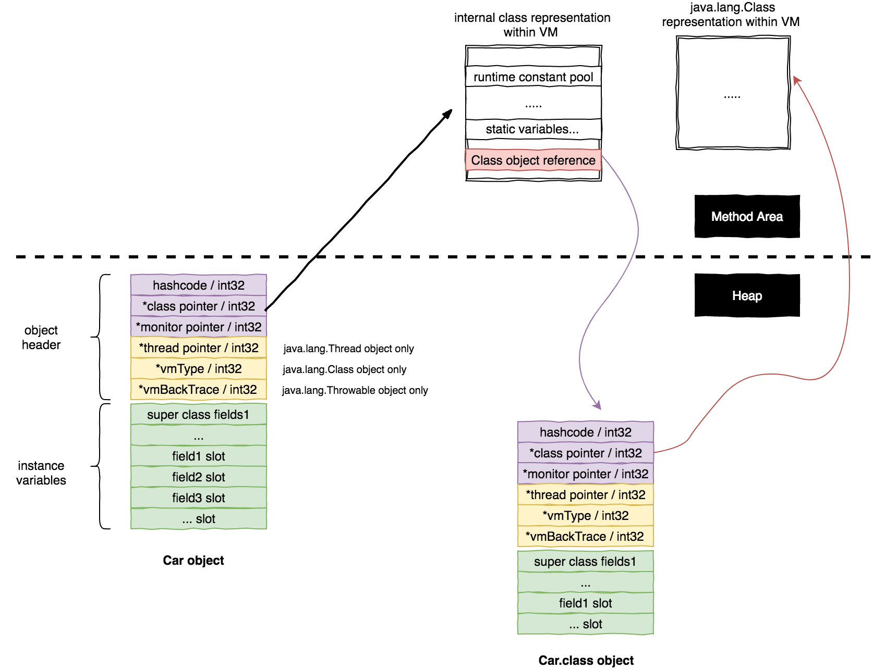
Method Area and Heap
Object representation / memory layout
Notes:
Just like the object layout in the HotSpot, every object in Javo has a header.

Slide 7
Tools, technologies used
Programming language: Go. but why?
pointers
abundant primitive types
built-in concurrency support (co-routine, synchronization primitives)
IDE: Gogland
Early preview, no official release
Buggy debugger
OpenJDK
Reference for native method implementations

Slide 8
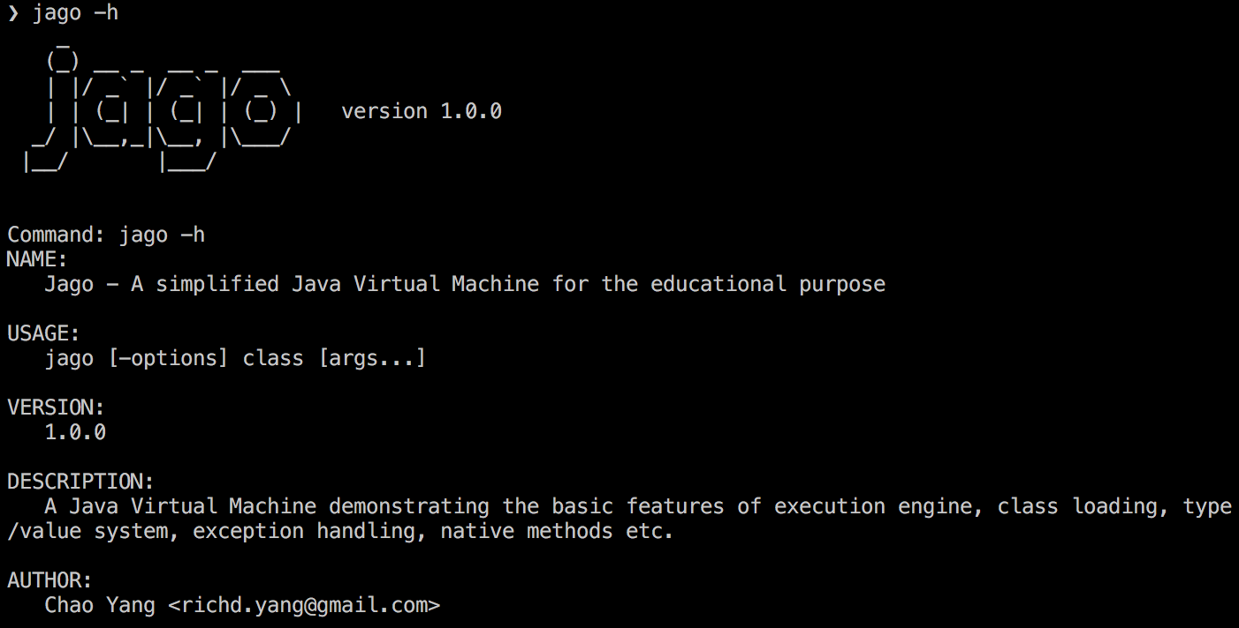
Demo moment
Trivial programs: Calendar
multi-thread: Counter
Concurrency: ProducerConsumer
logs

Slide 9
Future work
Add a GC and a JIT for performance
Implement much more native methods in JDK standard library
Run non-trivial Java programs, like Swing desktop application, or a servlet-based web application

Slide 10


Wrap-up
Learnt a new programming language by doing not by reading books
More solid understanding of Java programming language

Slide 11
The End
https://github.com/chaoyangnz/javo
https://www.gitbook.com/book/chaoyangnz/go-my-jvm

