Slide 1
Internship Summary Chaoyang Yu May, 2016

Slide 2
Accomplishments
AARP smoothing
Preparing statistics lecture for analytics team
UT80 Model review
R learning material collection
GLT multivariate test review
Acxiom variable selection(summer intern)

Slide 3
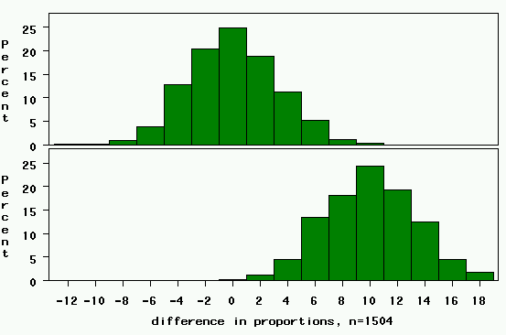
Statistics lecture example
Rejection region. Any value >= 6.5 (0+3.3*1.96)
Null Distribution: difference=0.
For 5% significance level, one-tail area=2.5%
(Z_{α/2} = 1.96)
Power= chance of being in the rejection region if the alternative is true=area to the right of this line (in yellow)→
Clinically relevant alternative: difference=10%.

Slide 4
UT80 Model Review
Current UT-80 models work well in prediction
Notes:
The whole year data trend looks good, but there are bumps in months data
By observing the whole year data, I find that groups in 30-44 model have similar performance. While in 45+ group, 45-49 has obviously higher performance than other groups.

Slide 5
UT80 Model Review
Notes:
If we break the whole year data into months, the bumpiness exists. However, I think it is caused by lack of data (buys number is not enough). So is the bumpiness in group 18-24.

Slide 6
UT80 Model Review
The current model segmentation (age) still works. Income could be another segmentation standard potentially.
Notes:
Income could be a candidate for segmentation

Slide 7
UT80 model review
Dorothy and me pulled out 2 months data, rebuilding the model with logistic regression. The logit model has some similarity to boosted tree model (the current model we are using) but not exactly same. I am trying to compare the logit one with previous model before our current boosted tree model.

Slide 8
GLT multivariate test review
“Our goal is to identify combination of variables that will reduce cost and increase response. We identified the cost impacts and will be testing these elements to determine appropriate levels of investment.”

Slide 9
GLT multivariate test review
Notes:
The following A/B test had opposite result to the original multivariate test. Therefore, I re-run the analysis with logistic regression to test variable effects. Change in BRE and Letter Copy will have positive effect.

Slide 10
GLT multivariate test review
Suggestion:
Change in BRE and Letter Copy will lead to an increase in response
However, if we change BRE and Letter Copy at the same time, the interaction will lead to less increase than change BRE and Letter Copy separately
For future study, we need to understand the primary goal for our test clearly at the experimental design stage: Do we want to see the influence caused by each factor, or just by given kits?

