Slide 1


Slide 2
Analysis for Better Business Decisions
Group 9 April 21, 2023
Group Members:
Tan, Haosen htan68@uwo.ca
Wang, Chaoyu cwan287@uwo.ca
Wen, Xuan xwen88@uwo.ca
Zhang, Tianze tzhan648@uwo.ca
Zhou, Shuang szhou379@uwo.ca

Slide 3
April 21, 2023
Contents
Project Introduction
Operational Database
Multi-dimensional Model
Data integration process with SSIS
Multi-dimensional cube with SSAS
Data Mining with Machine learning algorithms
ECE9017 - Advanced Databases

Slide 4

Project Introduction
ECE9017 - Advanced Databases

Slide 5
Project Introduction
1.1 Project ideas and Objectives:
Exploring Sales Performance and Customer Behavior Patterns in AdventureWorks Database:
An Analysis for Better Business Decisions.
1.2 Business and Technical Requirements:
Reliability and availability
Data integrity protection
Reporting and analytics
Operational Database design
Data Mart ETL process
Multi-dimensional data operations
ECE9017 - Advanced Databases

Slide 6
Operational Database
ECE9017 - Advanced Databases

Slide 7
Operational Database
In order to extract more meaningful information and data, we mainly selected some of the tables from the original database as followings:
Sales.SalesOrderHeader
Sales.SalesOrderDetails
Production.Production
Sales.Customer
Person.Person
Sales.SalesPerson
Sales.SpecialOffer
ECE9017 - Advanced Databases

Slide 8
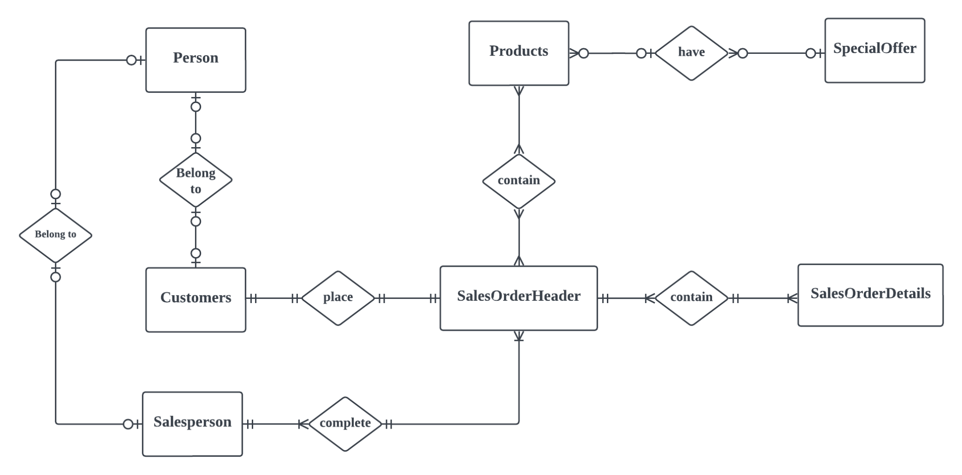
ER-Diagram
Operational Database Schema in 3rd NF
Here are the Relations among enetities
ECE9017 - Advanced Databases

Slide 9
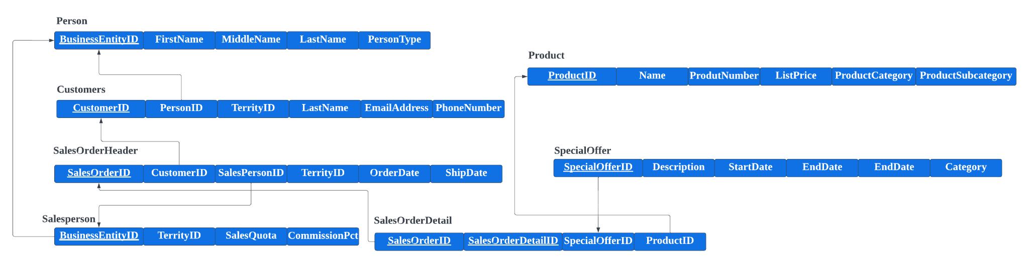
ER-Diagram
Relations and junction tables have been created as followings
Constraints have been applied to the relationships between different tables.
ECE9017 - Advanced Databases

Slide 10
Multidimensional Model
ECE9017 - Advanced Databases

Slide 11
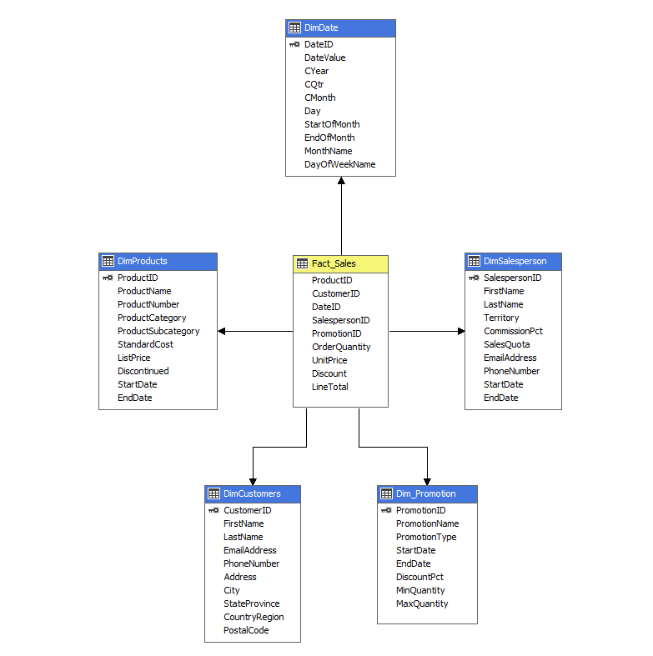
Star Schema Dimensional Model Data Warehouse
Fact_Sales is the central fact table that records each sale.
With foreign keys (FK) linking to the relevant dimensions.
The dimensions provide detailed information about products, customers, dates, salespeople, and promotions.
ECE9017 - Advanced Databases

Slide 12
Data integration process
ECE9017 - Advanced Databases

Slide 13
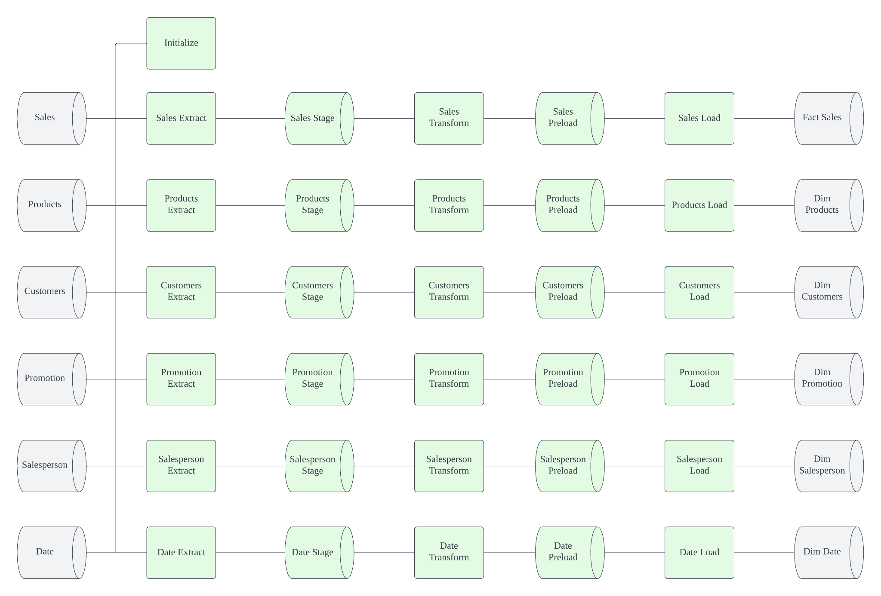
Practical ETL using SSIS and T-SQL
ECE9017 - Advanced Databases

Slide 14
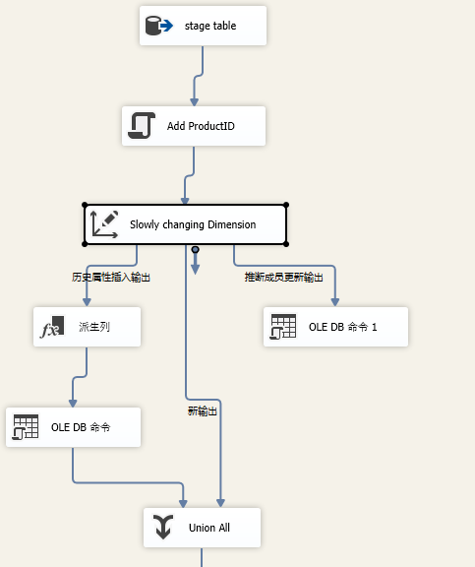
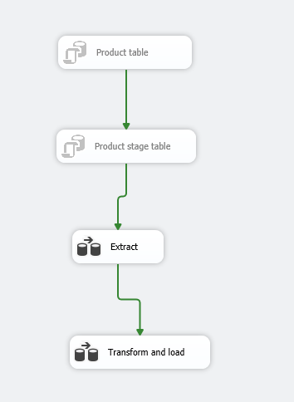
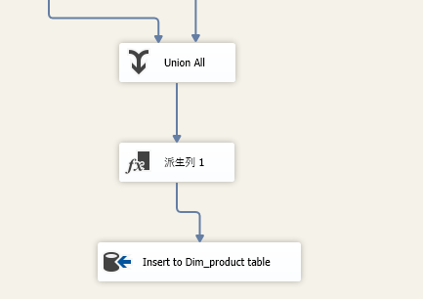
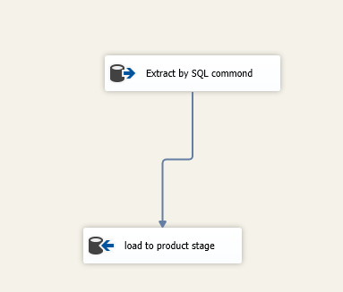
SSIS Product table
Control Flow for Product Table:
Transform and Load data flow:
Extract data flow:
ECE9017 - Advanced Databases

Slide 15
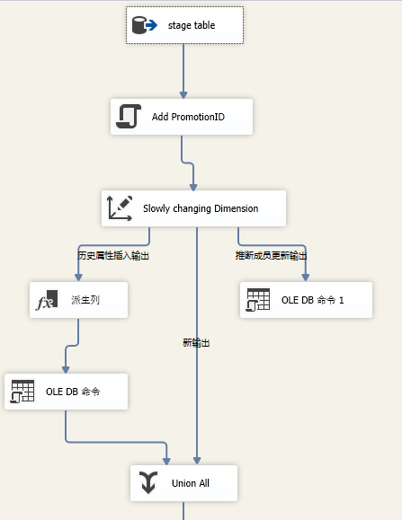
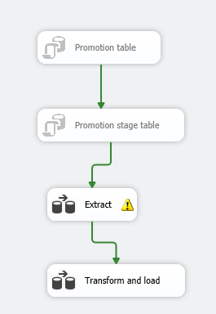
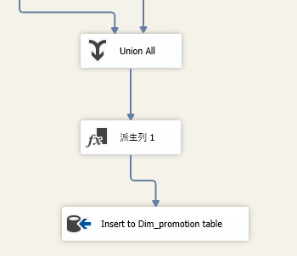
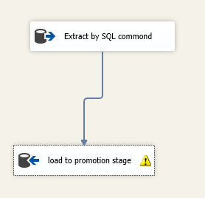
SSIS Promotion table
Transform and Load data flow:
Control Flow for Promotion Table:
Extract data flow:
ECE9017 - Advanced Databases

Slide 16
Multi-dimensional cube
ECE9017 - Advanced Databases

Slide 17
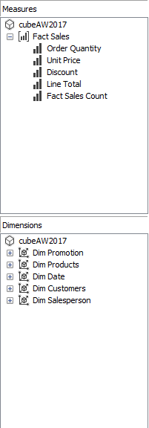
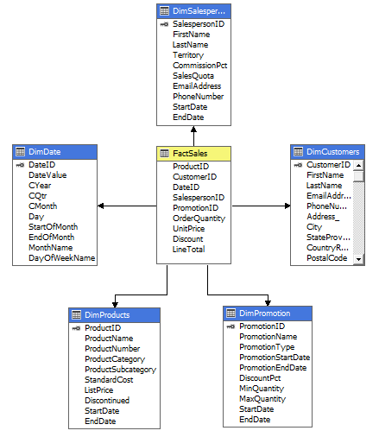
SSAS Project
Measures and Dimensions:
Data Source View:

Slide 18
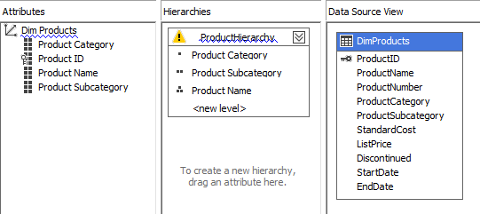
Hierarchy for Dim Product

Slide 19
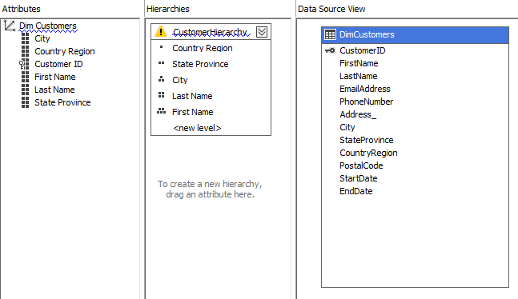
Hierarchy Dim Customer

Slide 20
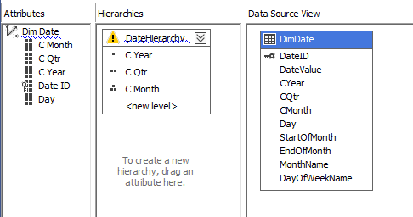
Hierarchy for Dim Date

Slide 21
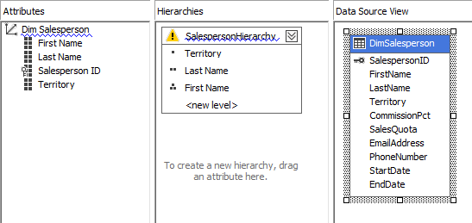
Hierarchy for Dim Salesperson

Slide 22
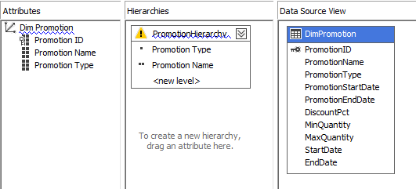
Hierarchy for Dim Promotion

Slide 23
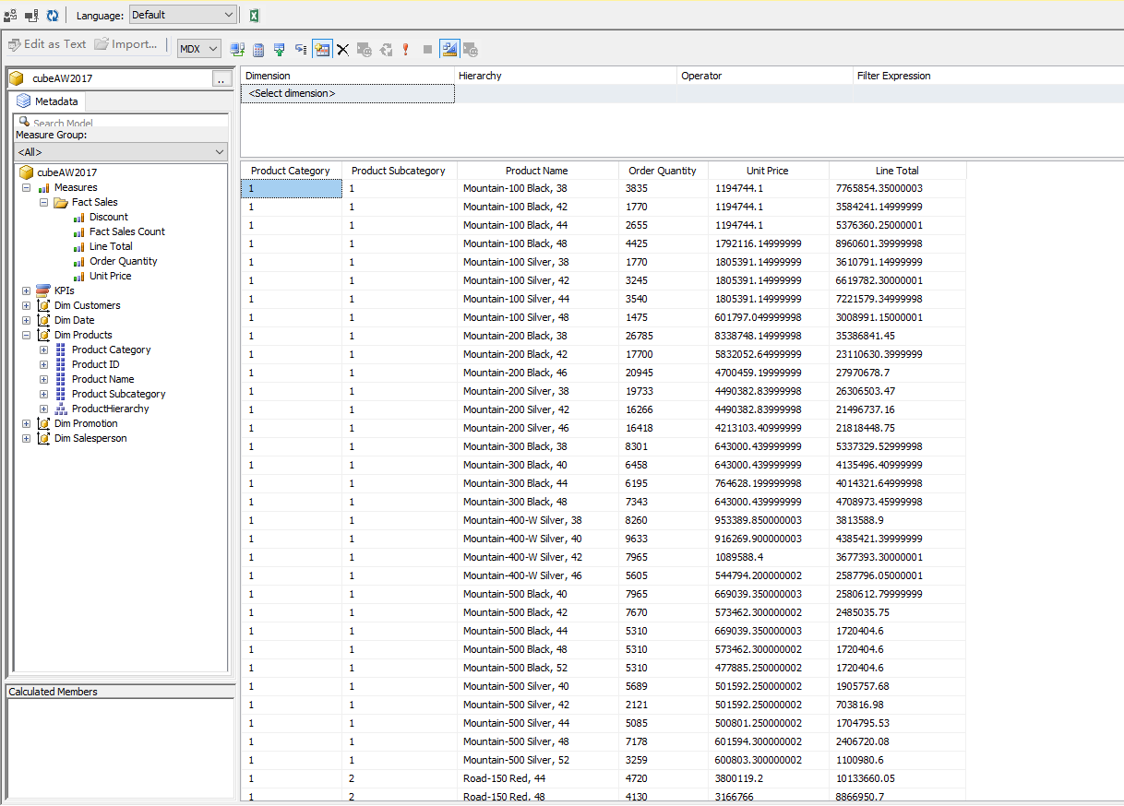
Browse Cube Data by MDX command

Slide 24
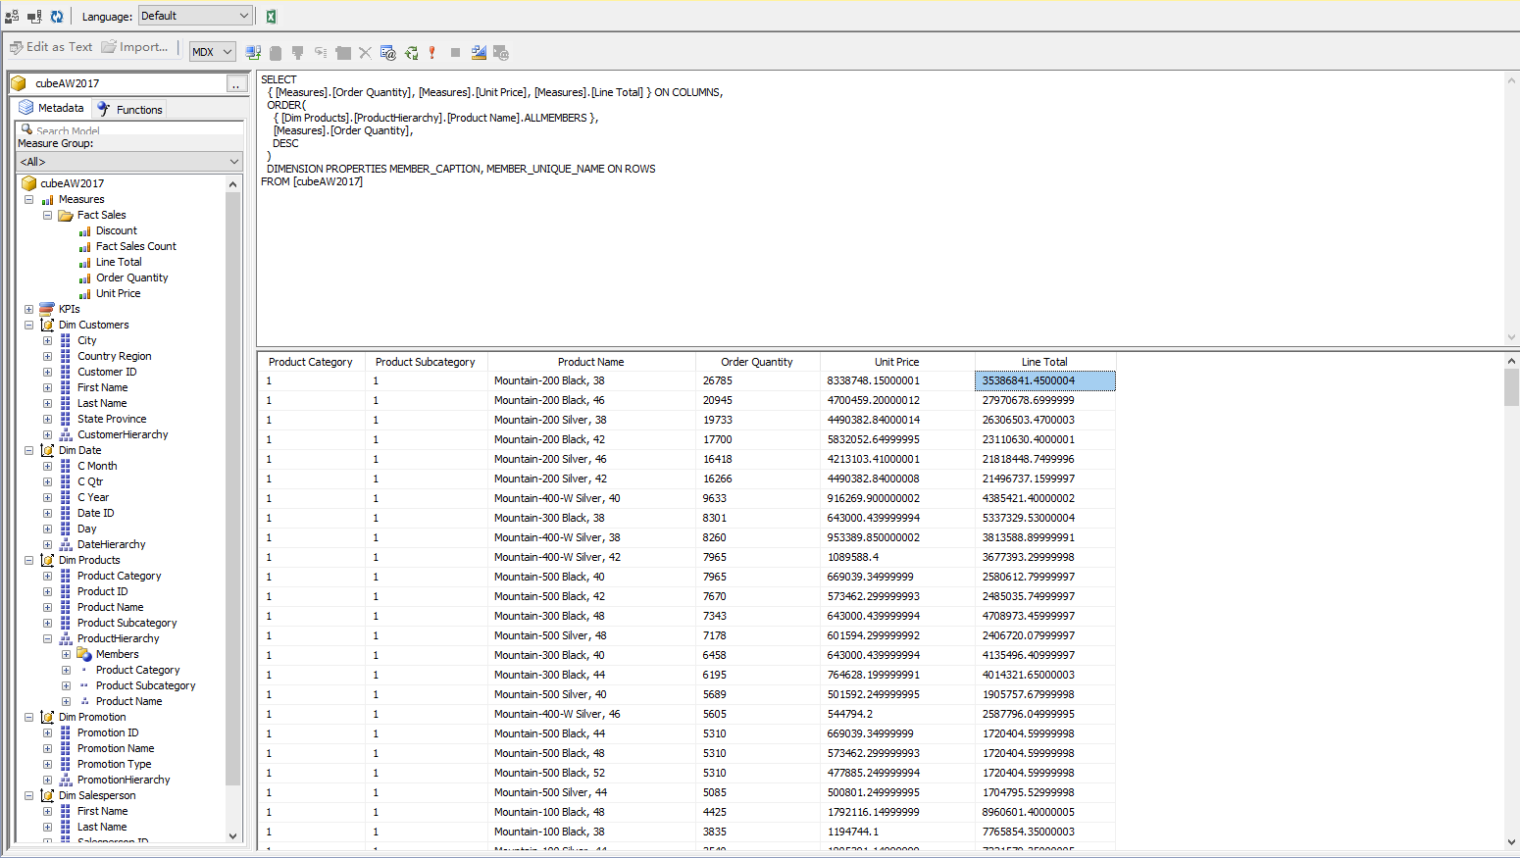
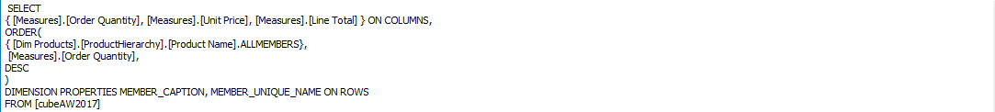
Browse Cube Data by MDX command

Slide 25
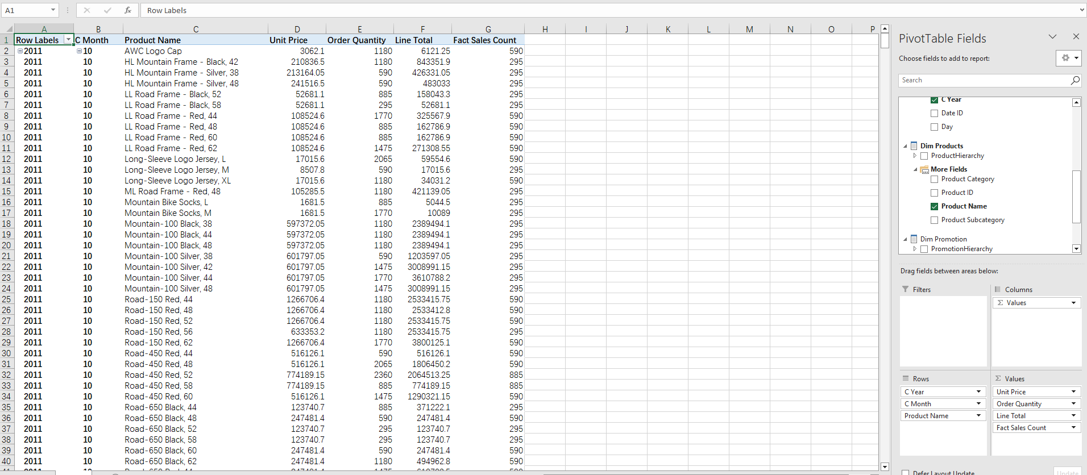
Browse Cube Data using Excel
Pivot Table Fields:
Saving the Excel table as .csv file and forecast the demand for product.

Slide 26
Machine learning algorithms
ECE9017 - Advanced Databases

Slide 27
Models
LinearRegression
Ridge
Lasso
Random Forest (RF)
Support Vector Regression (SVR)
K-Nearest Neighbors Regression (KNN)
ECE9017 - Advanced Databases

Slide 28
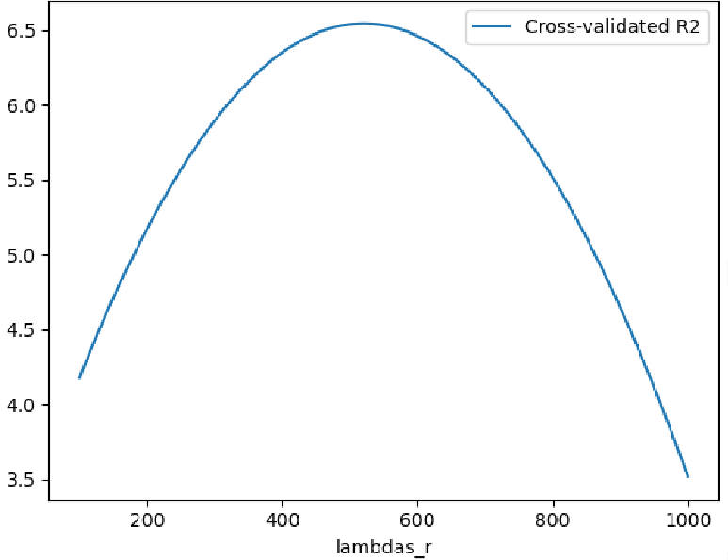
ECE9017 - Advanced Databases

Slide 29
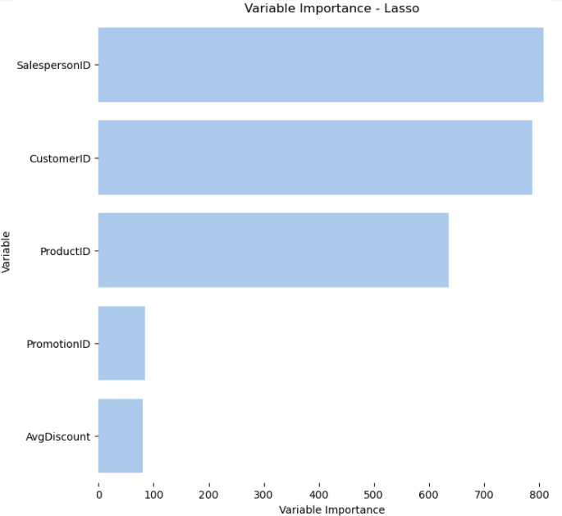
ECE9017 - Advanced Databases

Slide 30
Models Result RMSE
LinearRegression 7686
Ridge 7739
Lasso 7739
RF 136
SVR 8214
KNN 2761
ECE9017 - Advanced Databases

Slide 31
Thanks for listening!

