Slide 1
Fake Advertisements & Malvertising Attacks
Cybersecurity Threats, Attack Infrastructure, Detection & Prevention

Slide 2
What is Malvertising?
Malvertising uses online ads to spread malware, phishing pages, and scams.

Slide 3
Phishing Advertisements
Attackers create fake ads impersonating trusted brands and services.

Slide 4
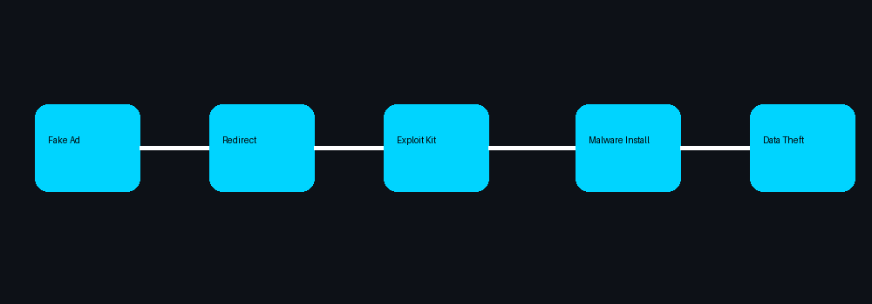
Malware Delivery Chain
Users click ads → redirect → exploit kits or malware download.

Slide 5
Social Engineering Techniques
Fear, urgency, rewards, and fake updates manipulate victims.

Slide 6
Technical Attack Infrastructure
Ad networks, redirectors, tracking scripts, exploit kits, and payload servers.

Slide 7
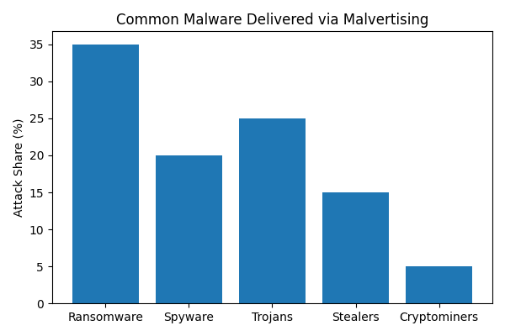
Common Malware Types
Ransomware, spyware, banking trojans, credential stealers, and cryptominers.

Slide 8
Detection Methods
Traffic analysis, endpoint protection, sandboxing, browser monitoring, and SIEM.

Slide 9
Prevention Strategies
Ad blockers, MFA, awareness training, secure browsers, and network filtering.

Slide 10
Conclusion
Cyber awareness and layered defenses reduce malvertising risks.

