Slide 1
Chapel TSC Meeting
November 12, 2026

Slide 2
Agenda
Recap of recent events / meetings + what’s next
Discussion Topics
  TSC Recruitment
  External-to-HPE Committers
  Security Vulnerability Reporting
Timing of Next Meeting?

Slide 3
Recap of past ~3 months

Slide 4
Since Our August Meeting
Released Chapel 2.10 on September 24th
  Release announcement: https://chapel-lang.org/blog/posts/announcing-chapel-2.10/
  HPSF announcement: https://hpsf.io/blog/2026/chapel-2-10-released/
Completed remaining program commitments
Moved most key testing configs from HPE to GitHub Actions w/ public mails
Published two quarterly newsletters listing many other highlights:
  August: https://chapel.discourse.group/t/chapel-newsletter-august-2026/
  November: https://chapel.discourse.group/t/chapel-newsletter-november-2026
Paul Hargrove (GASNet) retired in early October

Slide 5
What’s On Deck?
SC26 next week:
  Brad co-leading a BoF with Rosa Badia on GenAI and HPC programming (T @ 12:15pm)
  Brad staffing HPSF booth (T & W @ 2pm?)
  Brad & Jade co-authored a compiling Chapel to RISC-V workshop paper w/ Sandia, LANL, …
    Patrick Diehl (LANL) presenting
  Brad, Engin, Elliot, Daniel having a Chapel reunion breakfast
Planning to write a “So what happens now?” blog post
  Goals:
    Address the question that’s likely on peoples’ minds but that feels awkward to ask
    Assert that Chapel still exists, works, and can improve despite lack of full-time staff
      Time will tell how well it will, and for how long

Slide 6
What’s On Deck?
Planning to do a Chapel 2.11 release on December 10
  Goals:
    Make work completed since September available in a release
    See how a minimal-effort release will go in non-funded times
    Unlock “20 years of open-source releases” achievement
      First open-source release was v0.4 on Dec 15, 2006
  Happy for help/code contributions from anyone who’s interested in being involved
    Get your name in the CONTRIBUTORS.md list for this historical release! ;D
  Should we host some sort of social online celebration around this milestone?

Slide 7
Review of last TSC meeting

Slide 8
Discussion topics from last TSC meeting (Aug 27, 2026)
How candidates apply to the TSC
  Agreed on application questions to appear in a GitHub issue template
  Agreed on text about “things that would strengthen a TSC application”
  Agreed on text around expectations of TSC members
  Agreed on application process
Process of scheduling meetings
  For now, determine when we think we’ll want a next meeting at the end of each
  Agreed to create a GitHub issue template for proposing meeting topics
[Slides and notes available at: https://github.com/chapel-lang/TSC/tree/main/meetings]

Slide 9
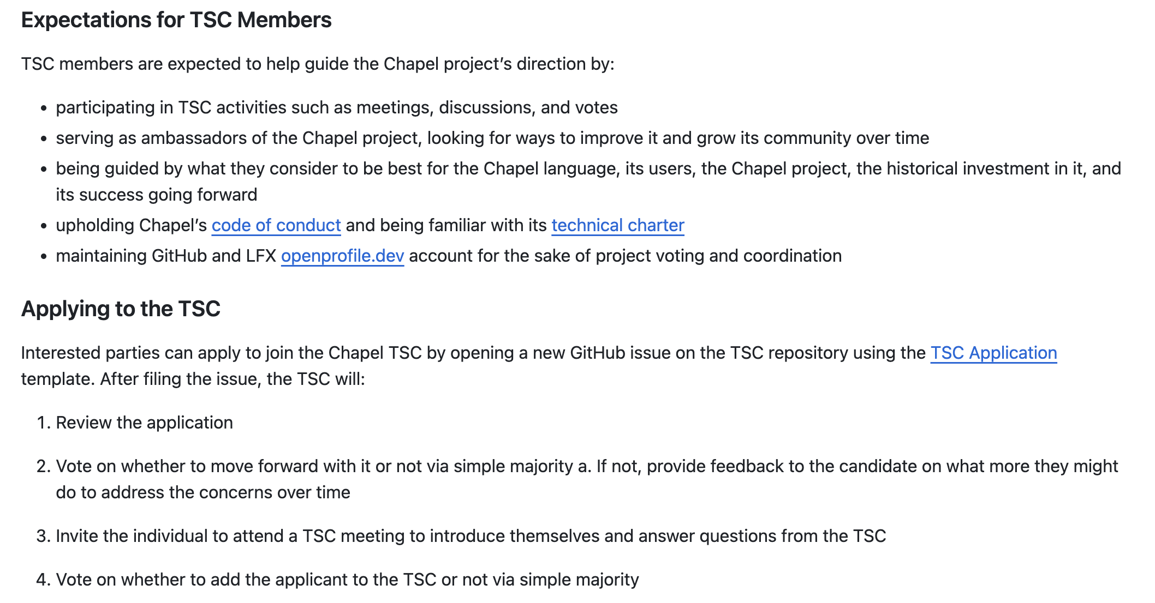
Implementing those Decisions
Opened a PR for GOVERNANCE.md, adding:
  Expectations for TSC members
  How to apply to the TSC
  Needs one or more reviewers

Slide 10
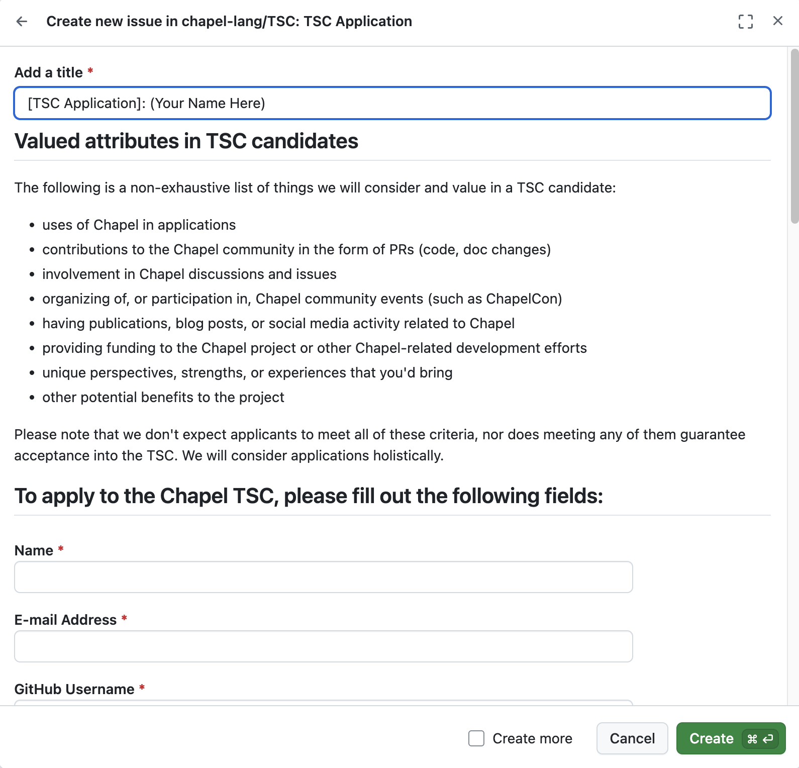
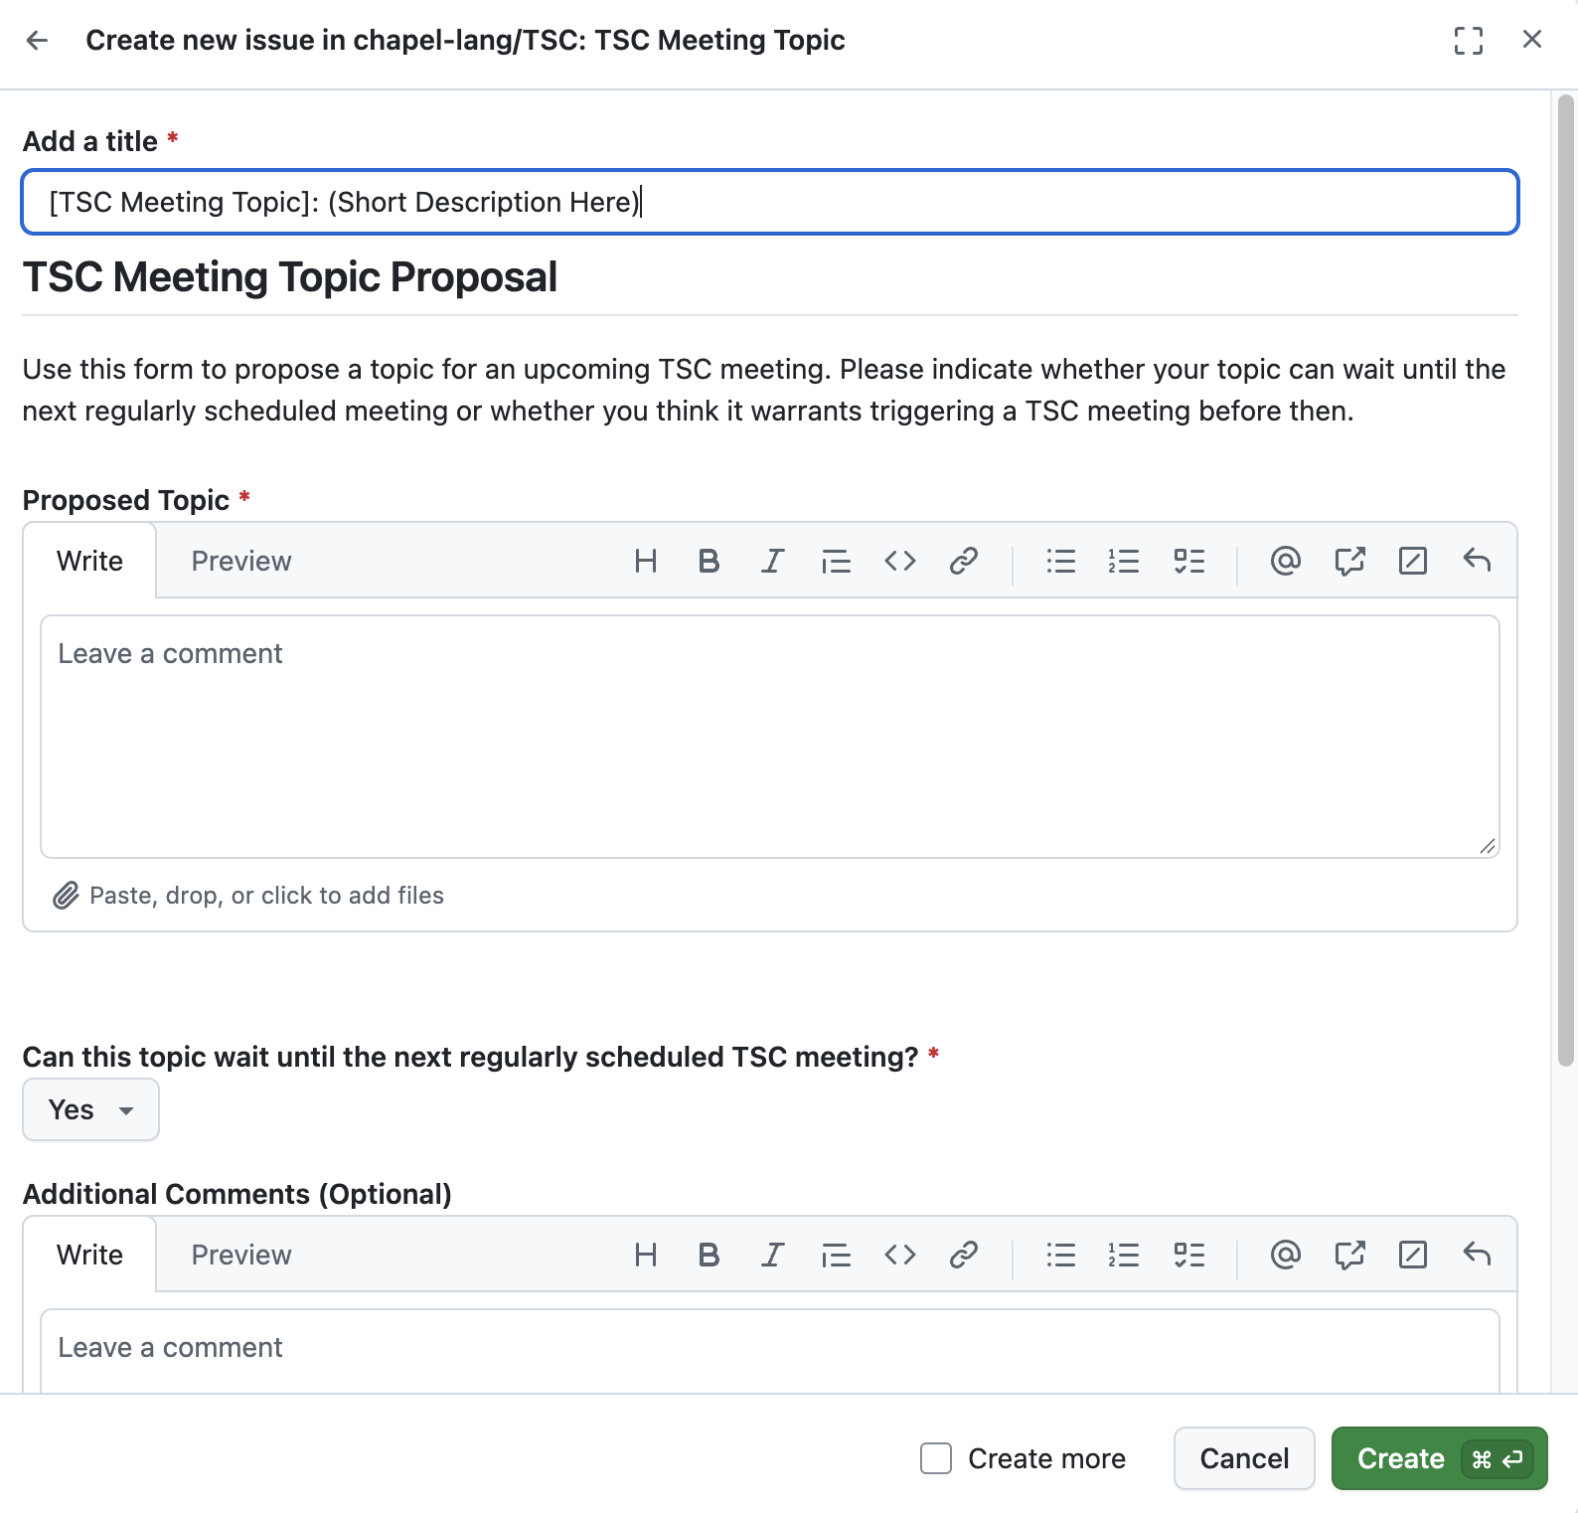
Implementing those Decisions
Opened GitHub issue templates for:
  Applying to the TSC
  Proposing a meeting topic

Slide 11
TSC Recruitment

Slide 12
TSC Recruitment
To what extent do we want to encourage specific people to join the TSC?
  argument against: Given current funding landscape, would it feel a bit weak?
  argument for: Broadening the TSC could be the healthiest thing to do for Chapel?
As discussed last time, if we do recruit, should brainstorm in safe space
  e.g., private meeting, emails explicitly Cc:ing all 13 TSC members, etc.
Independently of recruiting, do we want to advertise ability to join TSC?
  vs. letting motivated people find it themselves
  e.g., social media, web page, etc.

Slide 13
External-to-HPE Committers

Slide 14
External-to-HPE Committers (Merge Privileges)
Historically, haven’t granted these for security purposes
  source code is tested on HPE systems automatically, nightly
Have recently moved most testing to GitHub Actions
  however, still running HPE/Cray, GPU, and performance testing internally
Is our preference to…
  stop testing all internal-to-HPE testing to enable external mergers?
  maintain the status quo as long as HPE testing can be maintained?
  investigate what it would take to make HPE comfortable with external mergers?
What process would we define to give people merge privileges?
  TSC members would be no-brainers for me…
  What about other ex-Cray/HPE developers? Community members?

Slide 15
Security Vulnerability Reporting

Slide 16
Security Vulnerability Reporting
Seems like an obvious best practice to enable
  a requirement for “core” stage of HPSF
GitHub makes it pretty easy to opt in to via standard practices
A challenge is that SECURITY.md files usually promise a timely response
  obviously challenging for us to promise given lack of full-time Chapel employees
So: enable with a weak timeliness guarantee, or remain as-is?

Slide 17
Timing of Next Meeting?

Slide 18
Timing of Next Meeting?
February?
March?
May?
(assuming no new issues trigger one earlier)

Slide 19
HPSF Core-Level Requirements

Slide 20
Requirements for HPSF Core Level
governing body of 4+ members, with no more than 50% at any employer
documented public governance, decision-making, and release processes
healthy number of contributors (mergers) from at least two organizations
explicitly defined security reporting and incident mitigation process, as appropriate to the project’s risks
explicitly defined committer process
evidence of widespread adoption in the HPC ecosystem or some important component thereof

Slide 21
Thanks!

