Slide 1
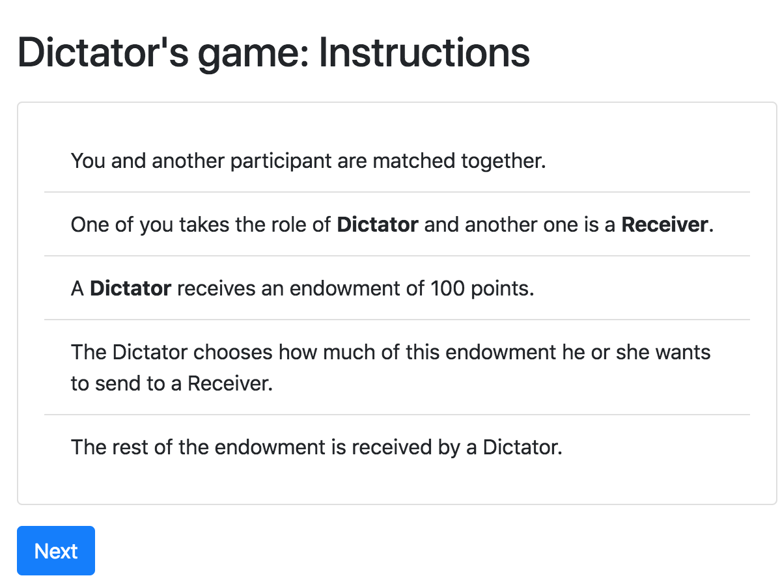
Dictator game – screen 1

Slide 2
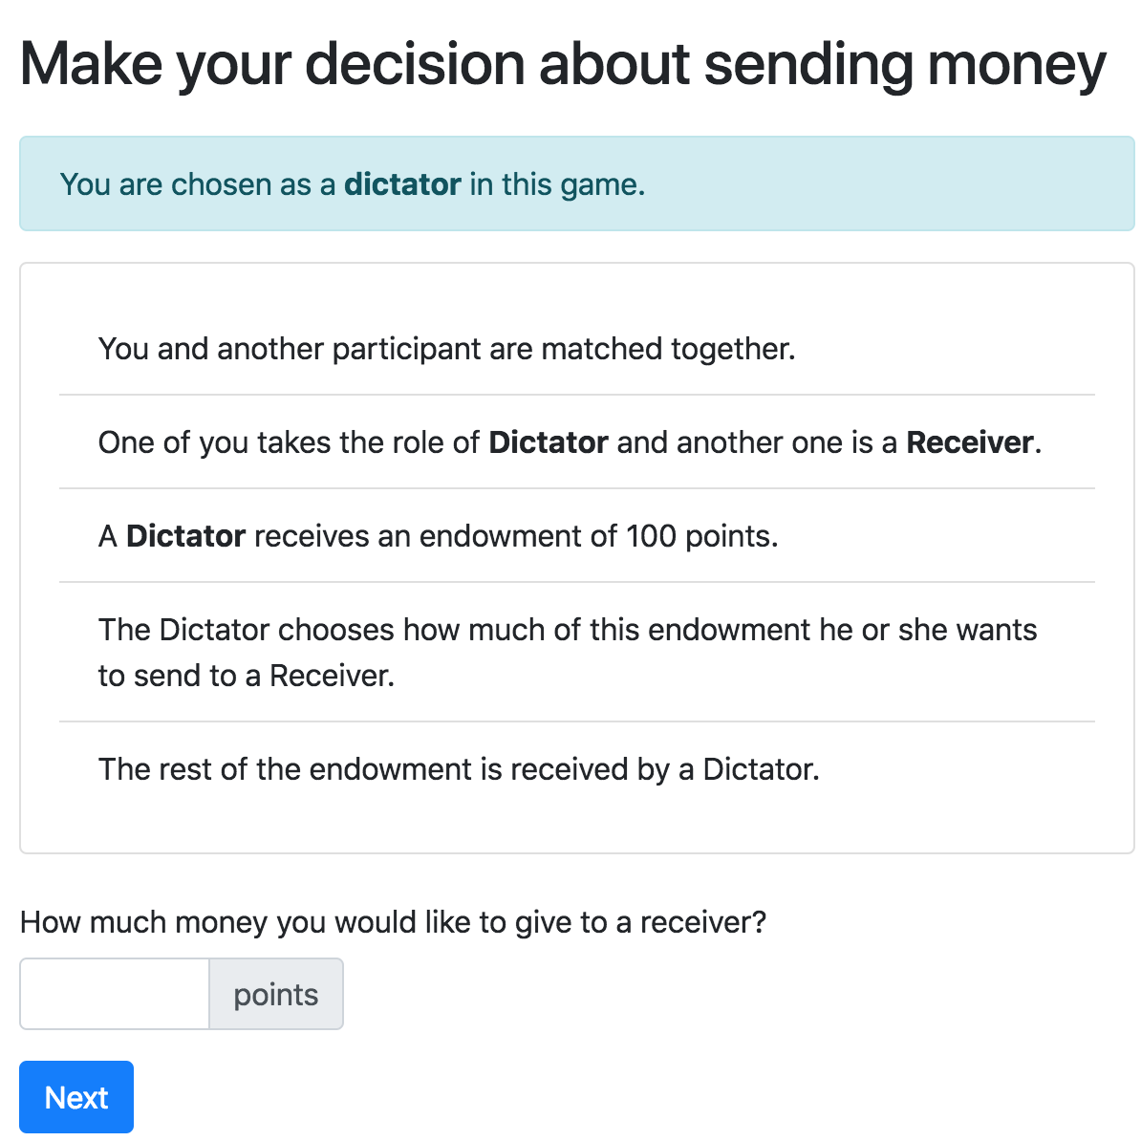
Dictator game – screen 2

Slide 3
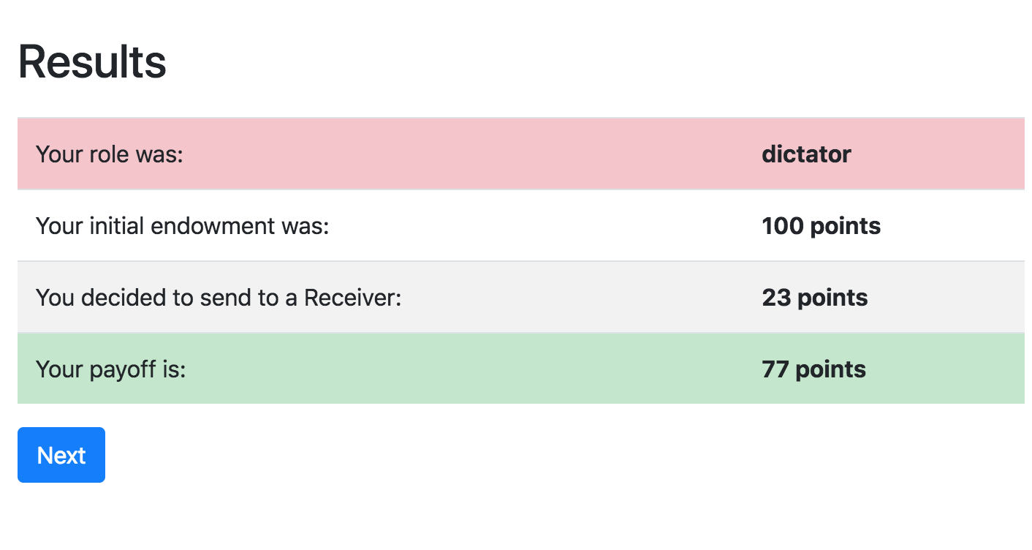
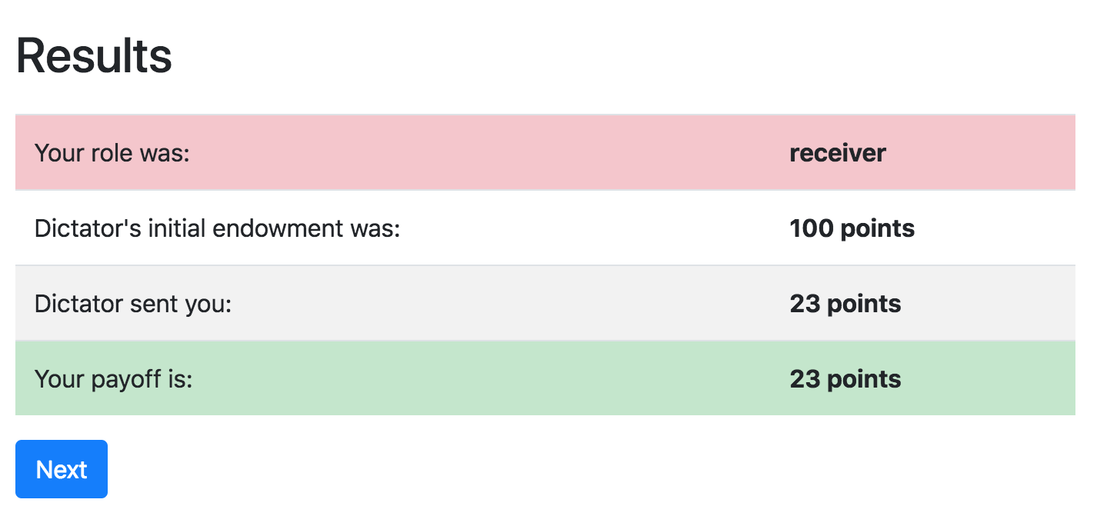
Dictator game – screen 3
DICTATOR:
RECEIVER:

Slide 4
Dictator game - blueprint
2 players
Two roles (Dictator and Receiver)
1 round
Roles are assigned before the game starts
Payoffs: after Dictator makes the decision
Receiver should wait for Dictator’s decision before proceeding further

Slide 5
Dictator game - roles
class Player(BasePlayer): def role(self): if self.id_in_group==1: return 'dictator' else: return 'receiver'
role() is a method of a Player’s model
we can use id of a player within a group to assign roles
…. or any other logic

Slide 6
Other players info
You can obtain information about other players, using their ids in group or roles:
self.group.get_player_by_role('ROLE_NAME')
self.group.get_player_by_id('ID')

Slide 7
Dictator game – models.py
class Constants(BaseConstants): players_per_group = 2 endowment = c(100) class Group(BaseGroup): dg_decision = models.CurrencyField(min=0, max=Constants.endowment,) def set_payoffs(self): dictator = self.get_player_by_role('dictator') receiver = self.get_player_by_role('receiver') dictator.payoff = Constants.endowment - self.dg_decision receiver.payoff = self.dg_decision

Slide 8
Dictator game – conditional view
class Decision(Page): form_model=group' form_fields = ['dg_decision'] def is_displayed(self): return self.player.role() == 'dictator'
is_displayed is a method built-in in a Page
by default it is shown to all players
if under certain condition it returns False, it is skipped

Slide 9
Dictator game – waitpage
WaitPage is a special class of pages
by default all members of a group wait until everyone reaches this stage
after that they proceed further along page_sequence
when players reach the waitpage, the after_all_players_arrive is executed
it can be skipped with is_displayed method (as normal Page)

Slide 10
Dictator game – pages.py
class Intro(Page): ... class Decision(Page): form_model = 'group' form_fields = ['dg_decision'] def is_displayed(self): return self.player.role() == 'dictator' class BeforeResultsWP(WaitPage): def after_all_players_arrive(self): self.group.set_payoffs() class Results(Page): ...` page_sequence = [ Intro, Decision, BeforeResultsWP, Results, ]

Slide 11
Templates: loops, conditions
You can use conditions and loops in templates:
{% if player.age < 30 %}
hi, dude!
{% else %}
Dear Mr. Player,
{% endif %}
You can also use methods:
{{ player.role }}

Slide 12
Dictator game – screen 2

Slide 13
Dictator game – screen 2
{% block title %} Make your decision about sending money {% endblock %} {% block content %} <div class="alert alert-info"> You are chosen as a <strong>
{{ player.role }}</strong> in this game. </div> {% include 'dg/instructions.html' %} {% formfield group.dg_decision %} {% next_button %} {% endblock %}

Slide 14
Dictator game – screen 3
DICTATOR:
RECEIVER:

Slide 15
Dictator game – screen 3
<tr> <td> {% if player.role == 'dictator' %} Your {% else %} Dictator's {% endif %} initial endowment was: </td> <th>{{ Constants.endowment }}</th> </tr>

Slide 16
Dictator game – gender treatment
The task:
Run two treatments
Baseline: a 'normal' DG as before, plus retrieving participants' gender
Gender treatments: Baseline + Dictator is informed about the gender of a Recipient

Slide 17
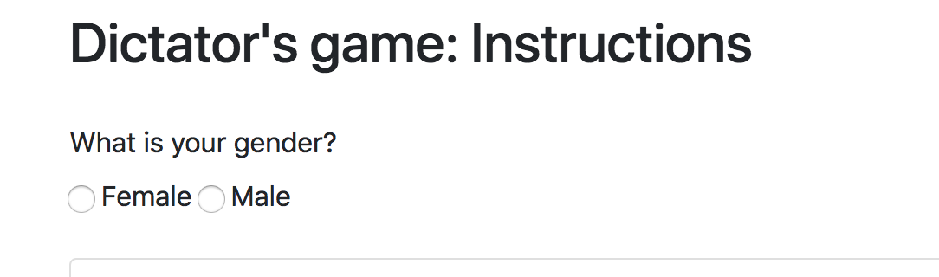
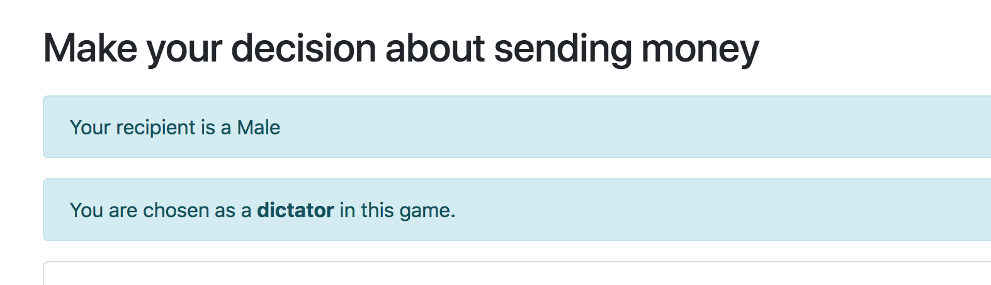
Gender: new screens:

Slide 18
Gender: gender field
class Player(BasePlayer): gender = models.IntegerField(choices= ((0, 'Female'), (1, 'Male')), widget=widgets.RadioSelectHorizontal, label='What is your gender?' )

Slide 19
Gender: updating pages.py
class Intro(Page): form_model = 'player' form_fields = ['gender'] class BeforeWaitPage(WaitPage): ... class Decision(Page): def vars_for_template(self): receiver = self.group.get_player_by_role('receiver') return {'gender': receiver.get_gender_display()} page_sequence = [ Intro, BeforeWaitPage, Decision, BeforeResultsWP, Results, ]

Slide 20
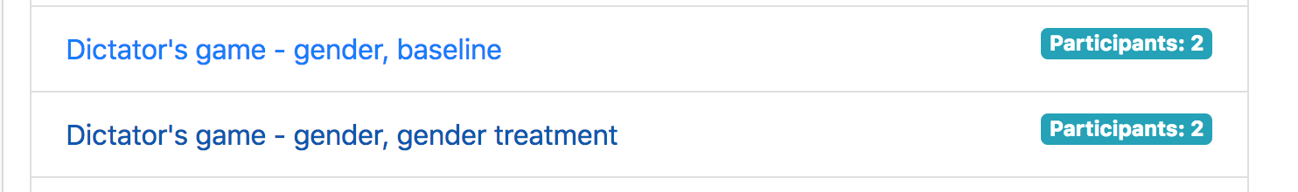
Assigning treatments: settings.py
We would like to have an option to run sessions under two different treatments:

Slide 21
Assigning treatments: settings.py
We would like to have an option to run sessions under two different treatments:
SESSION_CONFIGS = [ { 'name': 'dg_gender_off', 'display_name': "Dictator's game - gender, baseline", 'num_demo_participants': 2, 'app_sequence': ['dg_gender'], }, { 'name': 'dg_gender_on', 'display_name': "Dictator's game - gender, gender treatment", 'num_demo_participants': 2, 'app_sequence': ['dg_gender'], 'treatment_gender': True, },
]

Slide 22
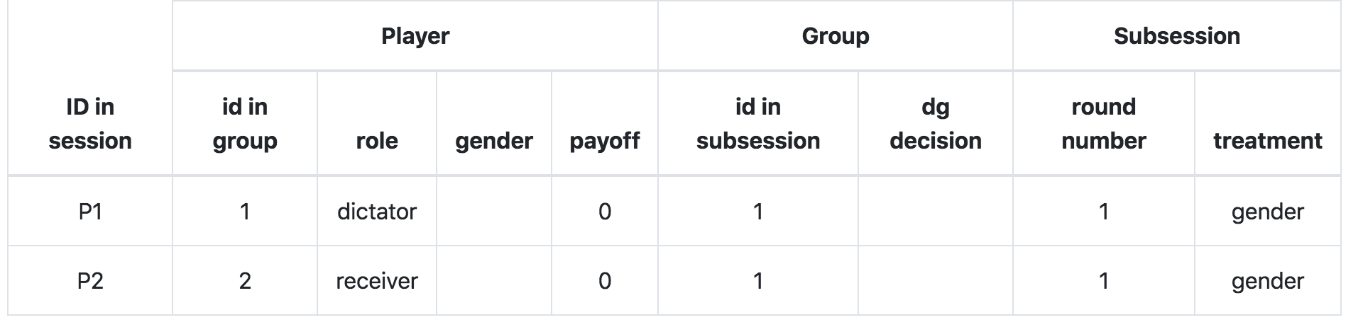
Assigning treatments: creating_session
class Subsession(BaseSubsession): treatment = models.StringField() def creating_session(self): if self.session.config.get('treatment_gender'): self.treatment = 'gender' else: self.treatment = 'baseline'

Slide 23
Gender: pages.Decision
class Intro(Page): form_model = 'player' form_fields = ['gender'] class BeforeWaitPage(WaitPage): ... class Decision(Page): def vars_for_template(self): receiver = self.group.get_player_by_role('receiver') return {'gender': receiver.get_gender_display()} page_sequence = [ Intro, BeforeWaitPage, Decision, BeforeResultsWP, Results, ]

Slide 24
Assigning treatments: decision.html
{% if subsession.treatment == 'gender' %} <div class="alert alert-info"> Your recipient is a {{ gender }} </div> {% endif %} <div class="alert alert-info"> You are chosen as a <strong>{{ player.role }}</strong> in this game. </div> {% include 'dg/instructions.html' %} {% formfield group.dg_decision %} {% next_button %}

Slide 25
Ultimatum game: blueprint
2 players per group
2 roles (Proposer-Responder //Sender-Receiver)
Sequential decision-making (Proposer first, Receiver observes Proposer's offer, makes the decision on accepting/rejecting an offer)
In contrast to DG: payoff depend on decisions of both players

Slide 26
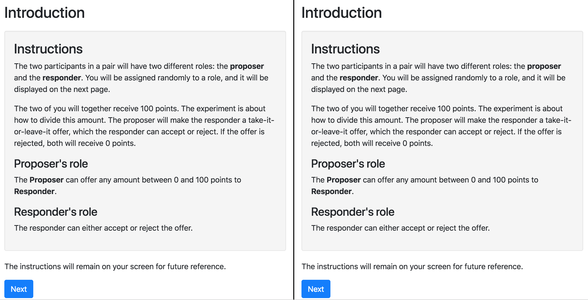
Ultimatum game: screens

Slide 27
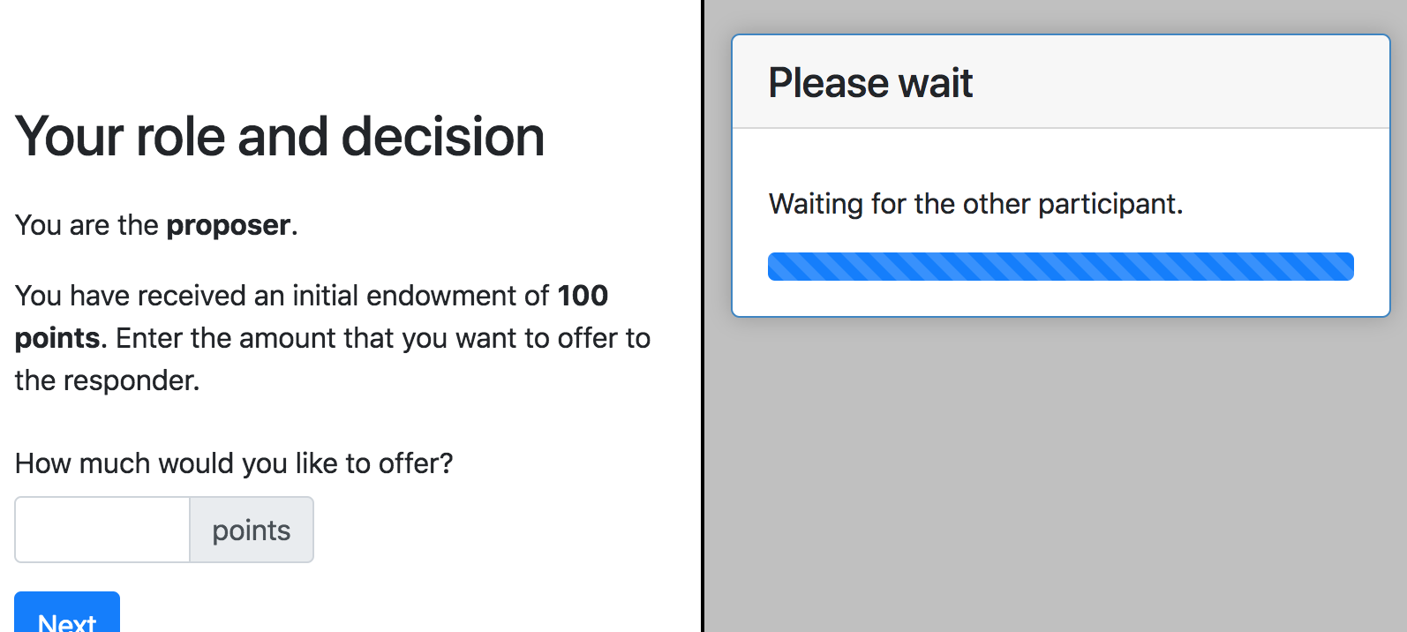
Ultimatum game: screens

Slide 28
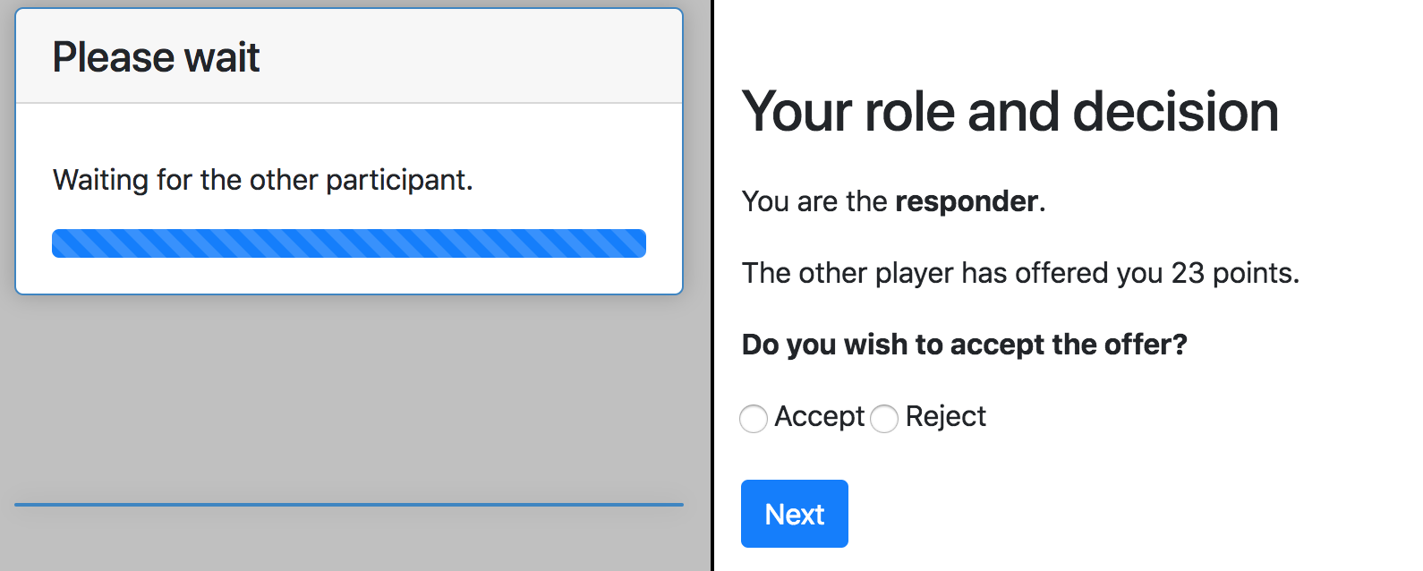
Ultimatum game: screens

Slide 29
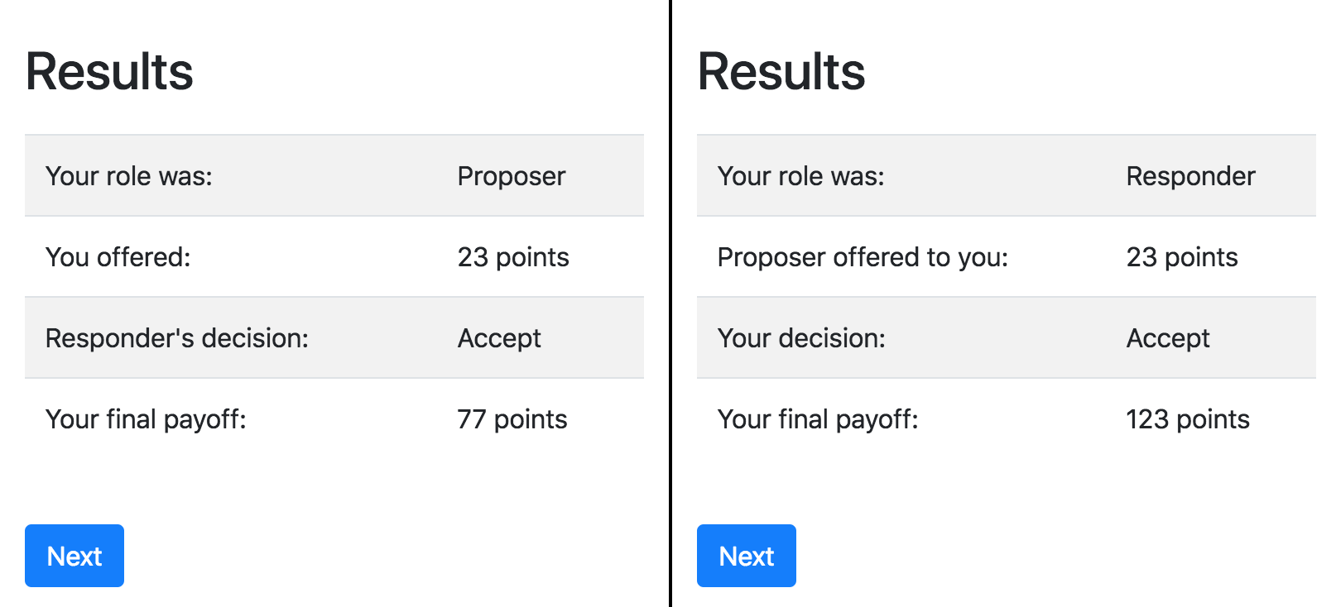
Ultimatum game: screens

Slide 30
Ultimatum game: models.py
class Group(BaseGroup): amount_offered = models.CurrencyField() offer_accepted = models.BooleanField( widget=widgets.RadioSelectHorizontal, choices = ((True, 'Accept'), (False, 'Reject'),) ) def set_payoffs(self): proposer = self.get_player_by_role('proposer') responder = self.get_player_by_role('responder') if self.offer_accepted: proposer.payoff = Constants.endowment - self.amount_offered responder.payoff = Constants.endowment + self.amount_offered else: proposer.payoff = Constants.payoff_if_rejected responder.payoff = Constants.payoff_if_rejected

Slide 31
Ultimatum game: pages.py
class Accept(Page): form_model = 'group' form_fields = ['offer_accepted'] def is_displayed(self): return self.player.role() == 'responder'
class ResultsWaitPage(WaitPage): def after_all_players_arrive(self): self.group.set_payoffs() class Results(Page): pass page_sequence = [Introduction, Offer, WaitForProposer, Accept, ResultsWaitPage, Results ]

