Slide 1
Creating new app
open terminal
change directory to my_first_project folder
type: otree startapp pgg
Open the PyCharm
add the pgg into settings.py:
SESSION_CONFIGS = [ { 'name': 'pgg', 'display_name': "Public Good Game", 'num_demo_participants': 3, 'app_sequence': ['pgg'], }, ]

Slide 2
Which pages do we need?
Intro page: the instructions are shown. We will show it only once, at the first round
Contribution page: where they will make their decisions on contributions to the common pool
BeforeResultsWP WaitPage: where they can see the results of a round
Results page: where they can see the results of a round
FinalResults page: the overall results across all n rounds are shown. We will show it only once at the final round.

Slide 3
Which pages do we need?
class Intro(Page): pass class Contribution(Page): pass class BeforeResultsWP(WaitPage): pass class Results(Page): pass class FinalResults(Page): pass

Slide 4
page_sequence in pages.py
page_sequence = [ Intro, Contribution, BeforeResultsWP, Results, FinalResults, ]

Slide 5
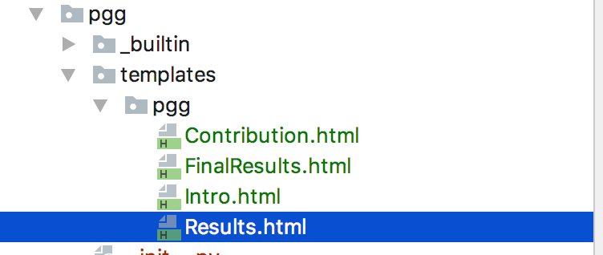
Templates
We need to create corresponding templates:

Slide 6
Conditions on showing pages
class Intro(Page): def is_displayed(self): return self.round_number == 1 ... class FinalResults(Page): def is_displayed(self): return self.round_number == Constants.num_rounds

Slide 7
Multi-round, multi-player game
class Constants(BaseConstants): name_in_url = 'pgg' players_per_group = 3 num_rounds = 2 endowment = 100 multiplier = 2

Slide 8
Fields
Each player has his/her own contribution.
The sum of contributions for the entire group
the share of total pie that will be distributed to each player in a group

Slide 9
Fields
class Group(BaseGroup): total_contribution = models.IntegerField() individual_share = models.IntegerField() class Player(BasePlayer): contribution = models.IntegerField()

Slide 10
Contribution decision
in pages.py:
class Contribution(Page): form_model = 'player' form_fields = ['contribution']
in template Contribution.html:
<h4>How much you would like to invest to a common group project:</h4> {% formfield player.contribution label='' %}

Slide 11
How do we calculate payoff?
class Group(BaseGroup): total_contribution = models.IntegerField() individual_share = models.IntegerField() def set_payoffs(self): self.total_contribution = sum([p.contribution for p in self.get_players()]) self.individual_share = self.total_contribution * Constants.multiplier / Constants.players_per_group for p in self.get_players(): p.payoff = Constants.endowment - p.contribution + self.individual_share

Slide 12
Payoff calculation line by line
self.total_contribution = sum([p.contribution for p in self.get_players()])
self.get_players() – is a method of a Group, that returns the list of all players in this group
we can loop through it obtaining or assigning values for each player in a group
so this line returns us a list of all contributions of players in a group
we assign a sum of these contributions to a group variable total_contribution

Slide 13
Payoff calculation line by line
self.individual_share = self.total_contribution * Constants.multiplier / Constants.players_per_group
we just calculated a total contribution of an entire group. Now we need to calculate how much each individual will get from the group project
this amount is the same for each player in a group. So we do it in a group level
we take a total contribution; we multiply it by multiplication factor; we divide it by total number of players in a group.

Slide 14
Payoff calculation line by line
for p in self.get_players(): p.payoff = Constants.endowment - p.contribution + self.individual_share
we loop through a list of all players in our group.
and for each player we calculate his payoff
it is:
the initial endowment
minus his/her contribution
plus the individual share from the pie

Slide 15
Calling payoff function
class BeforeResultsWP(WaitPage): def after_all_players_arrive(self): self.group.set_payoffs()
After you have create a function in a group that calculates payoffs, you need to actually call it somewhere.
It makes sense to do it when all players have made their decisions about contribution
So we do it in after_all_players_arrive function in a Waiting Page

Slide 16
Results
<table class="table"> <tr> <td>Your initial endowment:</td> <td>{{ Constants.endowment }}</td> </tr> <tr> <td>Your contribution in this round:</td> <td>{{ player.contribution }}</td> </tr> <tr> <td>Your share of the group project in this round:</td> <td>{{ group.individual_share }}</td> </tr> <tr> <td>Your payoff in this round:</td> <td>{{ player.payoff }}</td> </tr> </table>

Slide 17
Results: showing previous rounds
{% if player.round_number > 1 %} <h5>In previous rounds:</h5> <table class="table"> <thead> <tr> <th>Round</th> <th>Payoff</th> </tr> </thead> {% for i in player.in_previous_rounds %} <tr> <td>{{ i.round_number }}</td> <td>{{ i.payoff }}</td> </tr> {% endfor %} </table> {% endif %}

Slide 18
Average group contributions across rounds
{% if player.round_number > 1 %} <h5>In previous rounds:</h5> <table class="table"> <thead> <tr> <th>Round</th> <th>Payoff</th> </tr> </thead> {% for i in player.in_previous_rounds %} <tr> <td>{{ i.round_number }}</td> <td>{{ i.payoff }}</td> </tr> {% endfor %} </table> {% endif %}

Slide 19
Average group contributions across rounds
class Group(BaseGroup): total_contribution = models.IntegerField() individual_share = models.IntegerField()
average_contribution = models.IntegerField() def set_payoffs(self): self.total_contribution = sum([p.contribution for p in self.get_players()])
self.average_contribution = self.total_contribution / Constants.players_per_group self.individual_share = self.average_contribution * Constants.multiplier
for p in self.get_players(): p.payoff = Constants.endowment - p.contribution + self.individual_share

Slide 20
Average group contributions across rounds
{% if player.round_number > 1 %} <h5>In previous rounds:</h5> <table class="table"> <thead> <tr> <th>Round</th> <th>Payoff</th> <th>Average group contribution</th> </tr> </thead> {% for i in player.in_previous_rounds %} <tr> <td>{{ i.round_number }}</td> <td>{{ i.payoff }}</td> <td>{{ i.group.average_contribution }}</td> </tr> {% endfor %} </table> {% endif %}

Slide 21
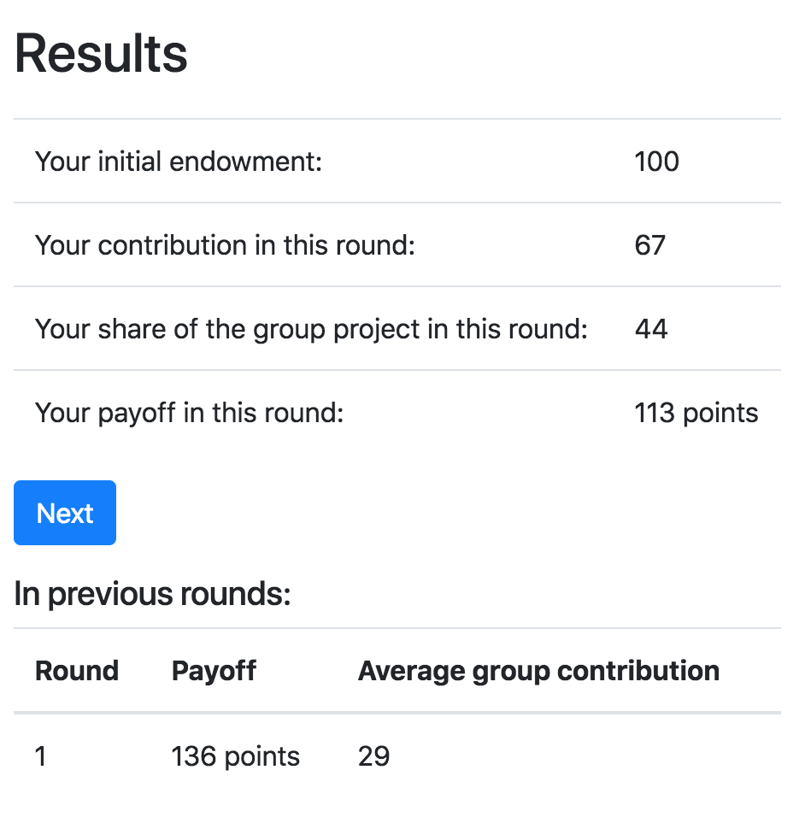
Results page:

Slide 22
Final results:
We need to show the payoffs of a particular player in each round.
And the total payoff for the entire game

Slide 23
Final results:
<h5>Your earnings:</h5> <table class="table"> <thead> <tr> <th>Round</th> <th>Average group contribution</th> <th>Payoff</th> </tr> </thead> {% for i in player.in_all_rounds %} <tr> <td>{{ i.round_number }}</td> <td>{{ i.group.average_contribution }}</td> <td>{{ i.payoff }}</td> </tr> {% endfor %} <tr class="table-success"> <td colspan="2">Your final payoff:</td> <td>{{ participant.payoff }}</td> </tr> </table>

Slide 24
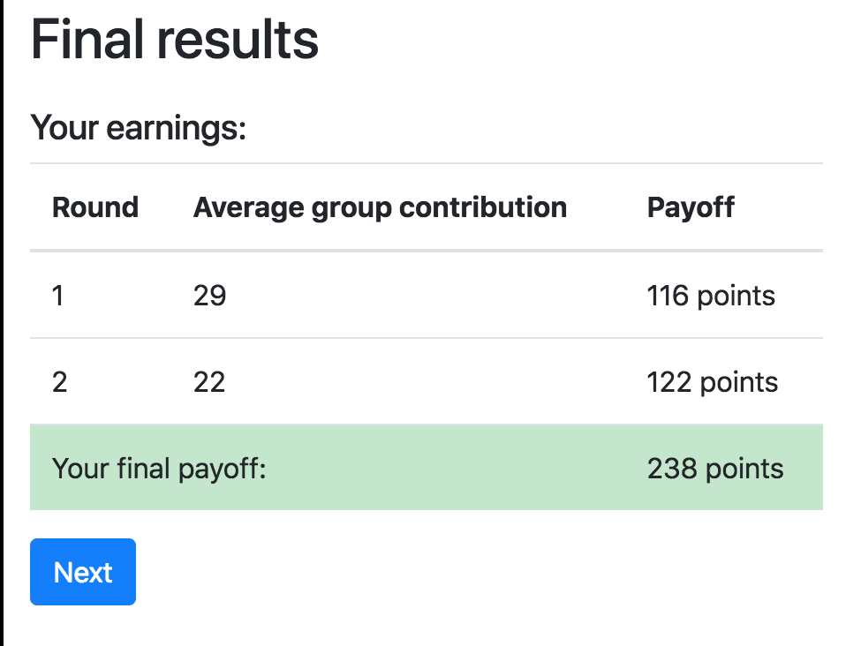
Final results:

Slide 25
Obtaining data from previous rounds
participant.get_players()
participant.payoff
player.in_all_rounds()
player.in_previous_rounds()
player.in_round(x)
player.in_rounds(x,y)
on template:
{{player.round_number}}
on page:
self.round_number

