Slide 1
Task:
Create two different treatments of Public Good game:
1. Baseline treatment
2. Treatment with heterogeneous endowments (each player has his/her own randomly generated endowment).

Slide 2
Updated constants:
class Constants(BaseConstants): name_in_url = 'pgg' players_per_group = 3 num_rounds = 2 endowment = 100 multiplier = 2 min_endowment = 10 max_endowment = 100

Slide 3
Updated Player model:
class Player(BasePlayer): endowment = models.IntegerField() contribution = models.IntegerField()

Slide 4
Creating session:
import random class Subsession(BaseSubsession): def creating_session(self): for p in self.get_players(): if self.round_number == 1: p.endowment = random.randint(Constants.min_endowment, Constants.max_endowment) else: p.endowment = p.in_round(1).endowment

Slide 5
Dynamic max contribution
class Contribution(Page): form_model = 'player' form_fields = ['contribution'] def contribution_max(self): return self.player.endowment

Slide 6
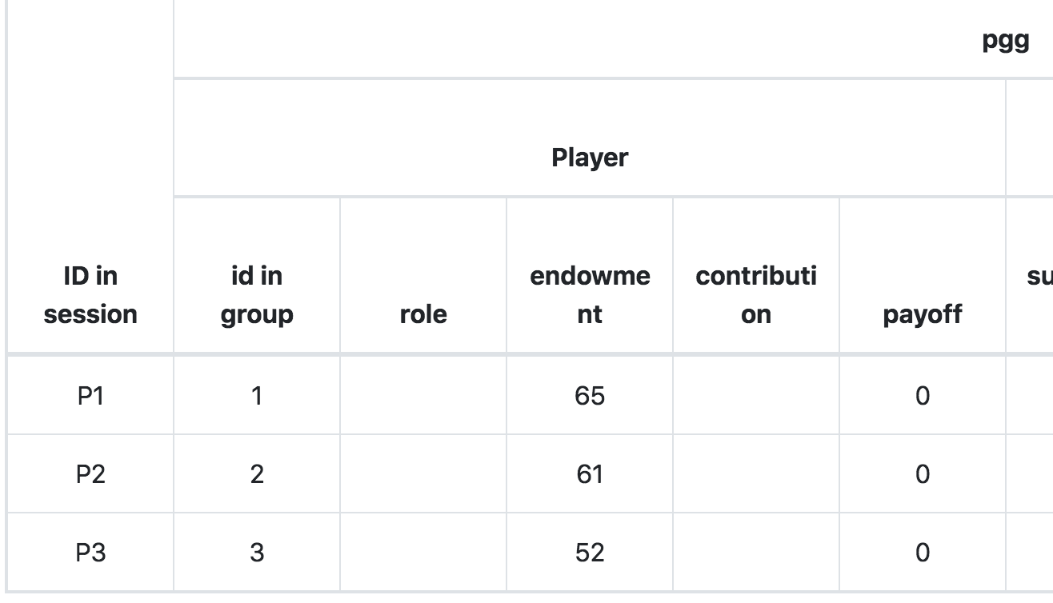
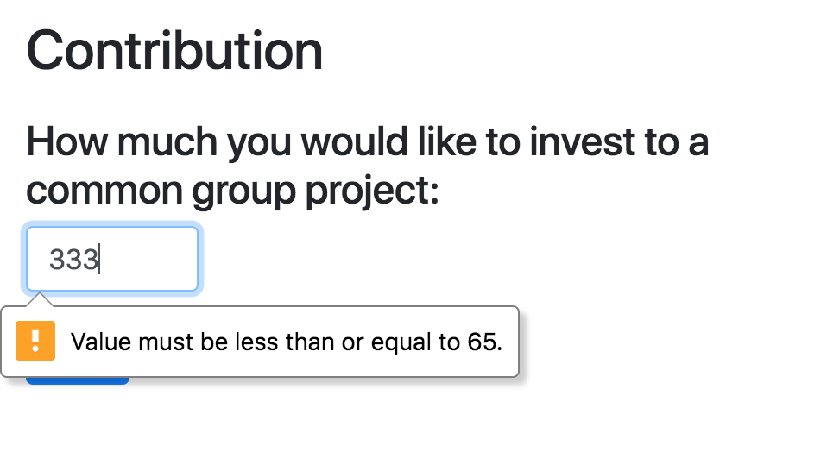
Resulting data

Slide 7
Updated results page
<h5>Other participants:</h5> <table class="table table-bordered"> <thead class="table-info"> <tr> <th>Id:</th> <th>Endowment:</th> <th>Contribution:</th> </tr> </thead> {% for i in player.get_others_in_group %} <tr> <td> {{ i.id_in_group }}</td> <td> {{ i.endowment }}</td> <td> {{ i.contribution }}</td> </tr> {% endfor %} </table>

Slide 8
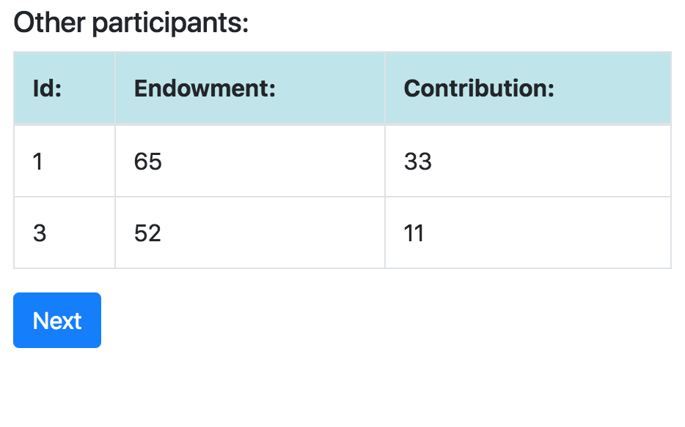
Updated results page

Slide 9
Creating different treatments
SESSION_CONFIGS = [ { 'name': 'pgg_baseline', 'display_name': "Public Good Game: baseline", 'num_demo_participants': 3, 'app_sequence': ['pgg'], }, { 'name': 'pgg_hetero', 'display_name': "Public Good Game: heterogeneous endowment", 'num_demo_participants': 3, 'app_sequence': ['pgg'], 'hetero': True, }, ]

Slide 10
Different treatments: updated code
import random class Subsession(BaseSubsession): def creating_session(self): if self.session.config.get('hetero'): for p in self.get_players(): if self.round_number == 1: p.endowment = random.randint(Constants.min_endowment, Constants.max_endowment) else: p.endowment = p.in_round(1).endowment else: for p in self.get_players(): p.endowment=Constants.endowment

Slide 11
Passing information between apps
Let’s create another app, where we collect info about a gender of participants.
We later on will show it in some treatments on Contribution page

Slide 12
Creating a ‘Gender’ app
otree startapp gender
creating a session config with ‘gender’:
{ 'name': 'pgg_gender', 'display_name': "Public Good Game: gender treatment", 'num_demo_participants': 3, 'app_sequence': ['gender', 'pgg'], },

Slide 13
Creating a ‘Gender’ app
in models.py of new ‘Gender’ app:
class Player(BasePlayer): gender = models.StringField(choices=['Male', 'Female'], widget=widgets.RadioSelectHorizontal)

Slide 14

Creating a ‘Gender’ app
templates:
{% block content %} {% formfield player.gender label='What is your gender?' %} {% next_button %} {% endblock %}

Slide 15
Creating a ‘Gender’ app
in pages.py of new ‘Gender’ app:
class Gender(Page): form_model = 'player' form_fields = ['gender'] def before_next_page(self): self.participant.vars['gender'] = self.player.gender page_sequence = [ Gender, ]

Slide 16
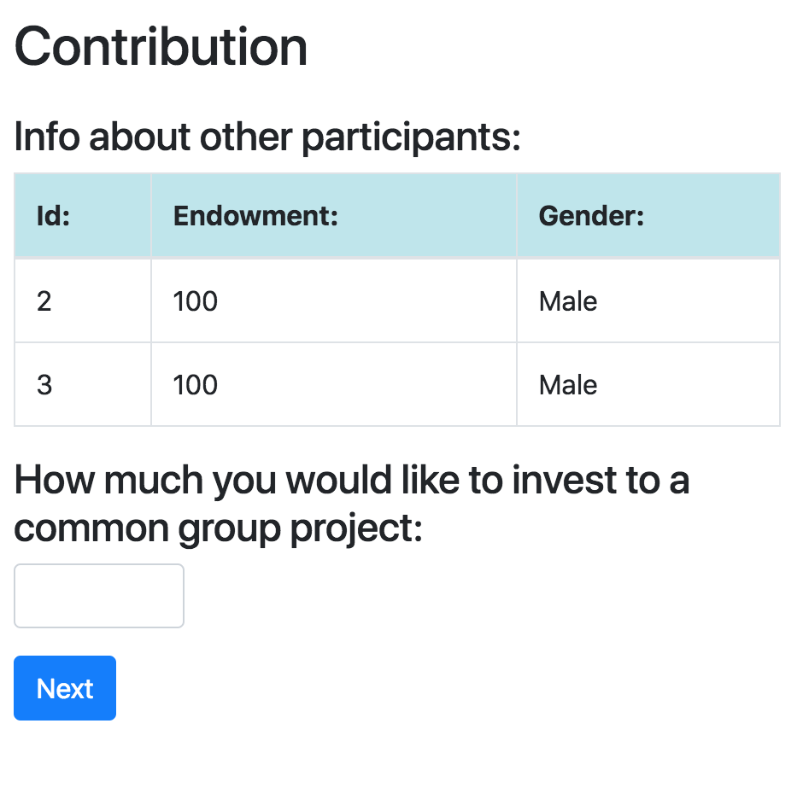
Showing gender info on Contribution

Slide 17
Showing gender info on Contribution
<h4>Info about other participants:</h4> <table class="table table-bordered"> <thead class="table-info"> <tr> <th>Id:</th> <th>Endowment:</th> <th>Gender:</th> </tr> </thead> {% for i in player.get_others_in_group %} <tr> <td> {{ i.id_in_group }}</td> <td> {{ i.endowment }}</td> <td> {{ i.participant.vars.gender }}</td> </tr> {% endfor %} </table>

