Slide 1
oTree
Filipp Chapkovski
April 3-4, 2017

Slide 2
Link to the games

Slide 3
Outline
April 3, Monday
Session 1 – main oTree components (views, models, templates)
Session 2 – multi player, multi-round games in oTree
April 4, Tuesday
Session 3 – Advanced oTree I: Channels and real-time
Session 4 – Advanced oTree II: mTurk. Discussion of participants’ projects

Slide 4
Python in 5 minutes
Preliminary fluff
So, you want to learn the Python programming language but can't find a concise and yet full-featured tutorial. This tutorial will attempt to teach you Python in 10 minutes. It's probably not so much a tutorial as it is a cross between a tutorial and a cheatsheet, so it will just show you some basic concepts to start you off. Obviously, if you want to really learn a language you need to program in it for a while. I will assume that you are already familiar with programming and will, therefore, skip most of the non-language-specific stuff. The important keywords will be highlighted so you can easily spot them. Also, pay attention because, due to the terseness of this tutorial, some things will be introduced directly in code and only briefly commented on.
Properties
Python is strongly typed (i.e. types are enforced), dynamically, implicitly typed (i.e. you don't have to declare variables), case sensitive (i.e. var and VAR are two different variables) and object-oriented (i.e. everything is an object).
Getting help
Help in Python is always available right in the interpreter. If you want to know how an object works, all you have to do is call help(<object>)! Also useful are dir(), which shows you all the object's methods, and <object>.__doc__, which shows you its documentation string:
>>> help(5) Help on int object: (etc etc) >>> dir(5) ['__abs__', '__add__', ...] >>> abs.__doc__ 'abs(number) -> number Return the absolute value of the argument.'
Syntax
Python has no mandatory statement termination characters and blocks are specified by indentation. Indent to begin a block, dedent to end one. Statements that expect an indentation level end in a colon (:). Comments start with the pound (#) sign and are single-line, multi-line strings are used for multi-line comments. Values are assigned (in fact, objects are bound to names) with the equals sign ("="), and equality testing is done using two equals signs ("=="). You can increment/decrement values using the += and -= operators respectively by the right-hand amount. This works on many datatypes, strings included. You can also use multiple variables on one line. For example:
>>> myvar = 3 >>> myvar += 2 >>> myvar 5 >>> myvar -= 1 >>> myvar 4 """This is a multiline comment. The following lines concatenate the two strings.""" >>> mystring = "Hello" >>> mystring += " world." >>> print(mystring) Hello world. # This swaps the variables in one line(!). # It doesn't violate strong typing because values aren't # actually being assigned, but new objects are bound to # the old names. >>> myvar, mystring = mystring, myvar
Data types
The data structures available in python are lists, tuples and dictionaries. Sets are available in the sets library (but are built-in in Python 2.5 and later). Lists are like one-dimensional arrays (but you can also have lists of other lists), dictionaries are associative arrays (a.k.a. hash tables) and tuples are immutable one-dimensional arrays (Python "arrays" can be of any type, so you can mix e.g. integers, strings, etc in lists/dictionaries/tuples). The index of the first item in all array types is 0. Negative numbers count from the end towards the beginning, -1 is the last item. Variables can point to functions. The usage is as follows:
>>> sample = [1, ["another", "list"], ("a", "tuple")] >>> mylist = ["List item 1", 2, 3.14] >>> mylist[0] = "List item 1 again" # We're changing the item. >>> mylist[-1] = 3.21 # Here, we refer to the last item. >>> mydict = {"Key 1": "Value 1", 2: 3, "pi": 3.14} >>> mydict["pi"] = 3.15 # This is how you change dictionary values. >>> mytuple = (1, 2, 3) >>> myfunction = len >>> print(myfunction(mylist)) 3
You can access array ranges using a colon (:). Leaving the start index empty assumes the first item, leaving the end index assumes the last item. Indexing is inclusive-exclusive, so specifying [2:10] will return items [2] (the third item, because of 0-indexing) to [9] (the tenth item), inclusive (8 items). Negative indexes count from the last item backwards (thus -1 is the last item) like so:
>>> mylist = ["List item 1", 2, 3.14] >>> print(mylist[:]) ['List item 1', 2, 3.1400000000000001] >>> print(mylist[0:2]) ['List item 1', 2] >>> print(mylist[-3:-1]) ['List item 1', 2] >>> print(mylist[1:]) [2, 3.14] # Adding a third parameter, "step" will have Python step in # N item increments, rather than 1. # E.g., this will return the first item, then go to the third and # return that (so, items 0 and 2 in 0-indexing). >>> print(mylist[::2]) ['List item 1', 3.14]
Strings
Its strings can use either single or double quotation marks, and you can have quotation marks of one kind inside a string that uses the other kind (i.e. "He said 'hello'." is valid). Multiline strings are enclosed in triple double (or single) quotes ("""). Python supports Unicode out of the box, using the syntax u"This is a unicode string". To fill a string with values, you use the % (modulo) operator and a tuple. Each %s gets replaced with an item from the tuple, left to right, and you can also use dictionary substitutions, like so:
>>>print("Name: %s\ Number: %s\ String: %s" % (myclass.name, 3, 3 * "-")) Name: Poromenos Number: 3 String: --- strString = """This is a multiline string.""" # WARNING: Watch out for the trailing s in "%(key)s". >>> print("This %(verb)s a %(noun)s." % {"noun": "test", "verb": "is"}) This is a test.
Flow control statements
Flow control statements are if, for, and while. There is no switch; instead, use if. Use for to enumerate through members of a list. To obtain a list of numbers, use range(<number>). These statements' syntax is thus:
rangelist = range(10) >>> print(rangelist) [0, 1, 2, 3, 4, 5, 6, 7, 8, 9] for number in rangelist: # Check if number is one of # the numbers in the tuple. if number in (3, 4, 7, 9): # "Break" terminates a for without # executing the "else" clause. break else: # "Continue" starts the next iteration # of the loop. It's rather useless here, # as it's the last statement of the loop. continue else: # The "else" clause is optional and is # executed only if the loop didn't "break". pass # Do nothing if rangelist[1] == 2: print("The second item (lists are 0-based) is 2") elif rangelist[1] == 3: print("The second item (lists are 0-based) is 3") else: print("Dunno") while rangelist[1] == 1: pass
Functions
Functions are declared with the "def" keyword. Optional arguments are set in the function declaration after the mandatory arguments by being assigned a default value. For named arguments, the name of the argument is assigned a value. Functions can return a tuple (and using tuple unpacking you can effectively return multiple values). Lambda functions are ad hoc functions that are comprised of a single statement. Parameters are passed by reference, but immutable types (tuples, ints, strings, etc) *cannot be changed in the caller by the callee*. This is because only the memory location of the item is passed, and binding another object to a variable discards the old one, so immutable types are replaced. For example:
# Same as def funcvar(x): return x + 1 funcvar = lambda x: x + 1 >>> print(funcvar(1)) 2 # an_int and a_string are optional, they have default values # if one is not passed (2 and "A default string", respectively). def passing_example(a_list, an_int=2, a_string="A default string"): a_list.append("A new item") an_int = 4 return a_list, an_int, a_string >>> my_list = [1, 2, 3] >>> my_int = 10 >>> print(passing_example(my_list, my_int)) ([1, 2, 3, 'A new item'], 4, "A default string") >>> my_list [1, 2, 3, 'A new item'] >>> my_int 10
Classes
Python supports a limited form of multiple inheritance in classes. Private variables and methods can be declared (by convention, this is not enforced by the language) by adding at least two leading underscores and at most one trailing one (e.g. "__spam"). We can also bind arbitrary names to class instances. An example follows:
class MyClass(object): common = 10 def __init__(self): self.myvariable = 3 def myfunction(self, arg1, arg2): return self.myvariable # This is the class instantiation >>> classinstance = MyClass() >>> classinstance.myfunction(1, 2) 3 # This variable is shared by all instances. >>> classinstance2 = MyClass() >>> classinstance.common 10 >>> classinstance2.common 10 # Note how we use the class name # instead of the instance. >>> MyClass.common = 30 >>> classinstance.common 30 >>> classinstance2.common 30 # This will not update the variable on the class, # instead it will bind a new object to the old # variable name. >>> classinstance.common = 10 >>> classinstance.common 10 >>> classinstance2.common 30 >>> MyClass.common = 50 # This has not changed, because "common" is # now an instance variable. >>> classinstance.common 10 >>> classinstance2.common 50 # This class inherits from MyClass. The example # class above inherits from "object", which makes # it what's called a "new-style class". # Multiple inheritance is declared as: # class OtherClass(MyClass1, MyClass2, MyClassN) class OtherClass(MyClass): # The "self" argument is passed automatically # and refers to the class instance, so you can set # instance variables as above, but from inside the class. def __init__(self, arg1): self.myvariable = 3 print(arg1) >>> classinstance = OtherClass("hello") hello >>> classinstance.myfunction(1, 2) 3 # This class doesn't have a .test member, but # we can add one to the instance anyway. Note # that this will only be a member of classinstance. >>> classinstance.test = 10 >>> classinstance.test 10
Exceptions
Exceptions in Python are handled with try-except [exceptionname] blocks:
def some_function(): try: # Division by zero raises an exception 10 / 0 except ZeroDivisionError: print("Oops, invalid.") else: # Exception didn't occur, we're good. pass finally: # This is executed after the code block is run # and all exceptions have been handled, even # if a new exception is raised while handling. print("We're done with that.") >>> some_function() Oops, invalid. We're done with that.
Importing
External libraries are used with the import [libname] keyword. You can also use from [libname] import [funcname] for individual functions. Here is an example:
import random from time import clock randomint = random.randint(1, 100) >>> print(randomint) 64
File I/O
Python has a wide array of libraries built in. As an example, here is how serializing (converting data structures to strings using the pickle library) with file I/O is used:
import pickle mylist = ["This", "is", 4, 13327] # Open the file C:\\binary.dat for writing. The letter r before the # filename string is used to prevent backslash escaping. myfile = open(r"C:\\binary.dat", "w") pickle.dump(mylist, myfile) myfile.close() myfile = open(r"C:\\text.txt", "w") myfile.write("This is a sample string") myfile.close() myfile = open(r"C:\\text.txt") >>> print(myfile.read()) 'This is a sample string' myfile.close() # Open the file for reading. myfile = open(r"C:\\binary.dat") loadedlist = pickle.load(myfile) myfile.close() >>> print(loadedlist) ['This', 'is', 4, 13327]
Miscellaneous
Conditions can be chained. 1 < a < 3 checks that a is both less than 3 and greater than 1.
You can use del to delete variables or items in arrays.
List comprehensions provide a powerful way to create and manipulate lists. They consist of an expression followed by a for clause followed by zero or more if or for clauses, like so:
>>> lst1 = [1, 2, 3] >>> lst2 = [3, 4, 5] >>> print([x * y for x in lst1 for y in lst2]) [3, 4, 5, 6, 8, 10, 9, 12, 15] >>> print([x for x in lst1 if 4 > x > 1]) [2, 3] # Check if a condition is true for any items. # "any" returns true if any item in the list is true. >>> any([i % 3 for i in [3, 3, 4, 4, 3]]) True # This is because 4 % 3 = 1, and 1 is true, so any() # returns True. # Check for how many items a condition is true. >>> sum(1 for i in [3, 3, 4, 4, 3] if i == 4) 2 >>> del lst1[0] >>> print(lst1) [2, 3] >>> del lst1
Global variables are declared outside of functions and can be read without any special declarations, but if you want to write to them you must declare them at the beginning of the function with the "global" keyword, otherwise Python will bind that object to a new local variable (be careful of that, it's a small catch that can get you if you don't know it). For example:
number = 5 def myfunc(): # This will print 5. print(number) def anotherfunc(): # This raises an exception because the variable has not # been bound before printing. Python knows that it an # object will be bound to it later and creates a new, local # object instead of accessing the global one. print(number) number = 3 def yetanotherfunc(): global number # This will correctly change the global. number = 3

Slide 5
MVC
Models
Views
Controller
Django
oTree is built upon it

Slide 6
Creating first project and first app
virtualenv mainzwp
cd mainzwp
otree startproject mainz
otree startapp guessquiz
settings.py:
SESSION_CONFIGS = [
{
'name': 'guess',
'display_name': 'Guess game',
'num_demo_participants': 1,
'app_sequence': ['guess'],
},

Slide 7
Guess game: planning
A player has an endowment.
Random number is generated within certain limits
A player has to guess. The closer is the guyess to a real number the larger is the profit.
Two fields: what is guessed, and a player’s decision
Three screens:
Intro: instructions
Decision with instructions
Results

Slide 8
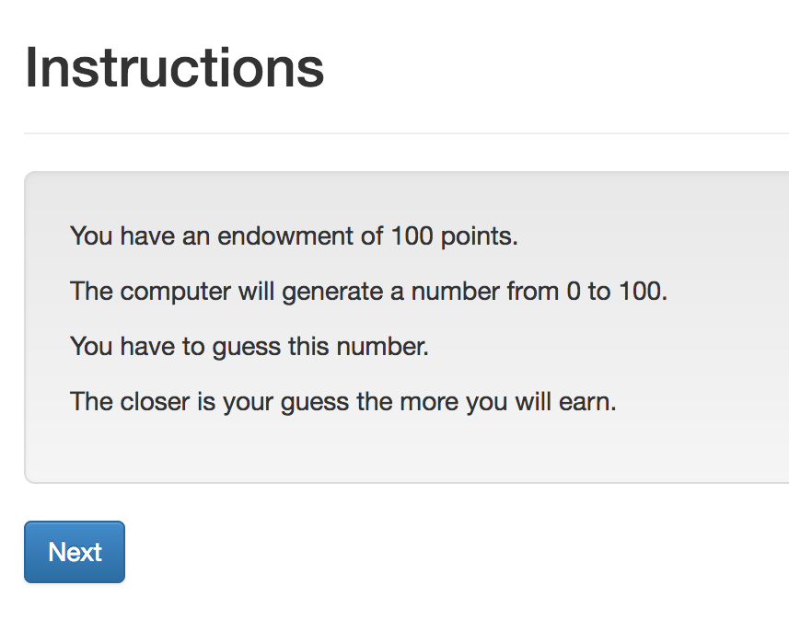
Guess game: screen 1

Slide 9
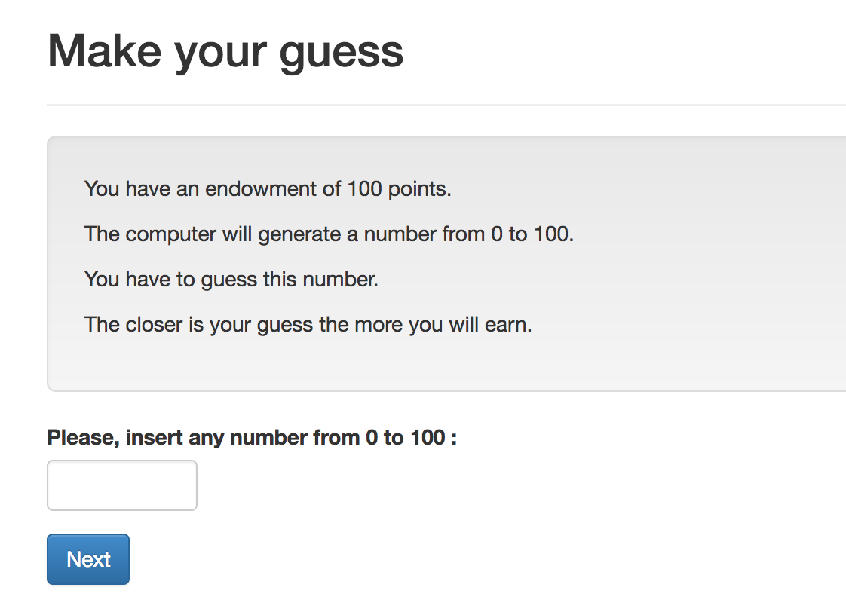
Guess game: screen 2

Slide 10
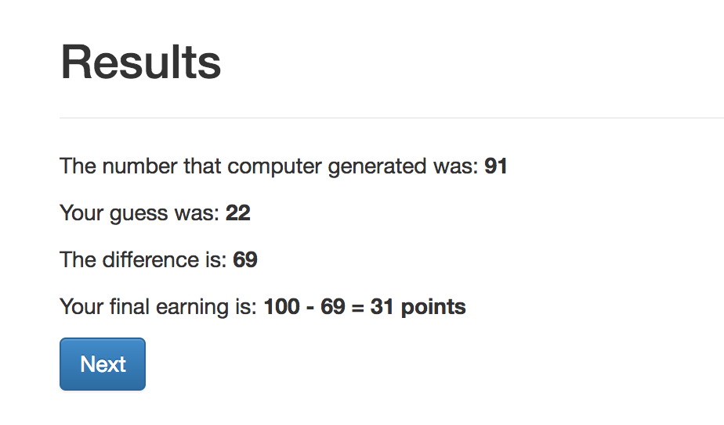
Guess game: screen 3

Slide 11
Guess game - Models
Creating new fields:
Field_Name = models.IntegerField()
Options:
Field_Name = models.IntegerField(
max=…,
min=…,
verbose_name=…,)

Slide 12
Guess game: Models. Result:
class Player(BasePlayer):
toguess = models.IntegerField(min=Constants.minguess,
max=Constants.maxguess,
doc='random number for a player to guess')
guess = models.IntegerField(min=Constants.minguess,
max=Constants.maxguess,
verbose_name="Please, insert \
any number from {} to \
{}".format(Constants.minguess,
Constants.maxguess,),
doc='guess of the player')

Slide 13
Guess game: Views
Creating new page
Class NameOfThePage(Page):
pass
Page_sequence
Page_sequence = [NameOfThePage]
By default name of the template should correspond to the page name!

Slide 14
Guess game: Views. Built-in functions
Built-in functions of pages:
”Normal” page:
def is_displayed(self):
return (True/False)
def vars_for_template(self):
return {‘var’: var}
def before_next_page(self):
…

Slide 15
Guess game - Templates
{% extends "global/Page.html" %}
{% load staticfiles otree_tags %}
{% block title %} YOUR TITLE HERE {% endblock %}
{% block content %}
YOUR CONTENT HERE
{% endblock %}

Slide 16
Guess game - Templates
to include another file (for example instructions):
{% include ‘path_to_file/name_of_file.html %}
to make ‘Next button’:
{% next_button %}

Slide 17
Guess game: Views. Intro

Slide 18
Intro: How to do it?
Models.py: Constants:
endowment
minguess
maxguess
Intro.html:
in {% block content %}:
to refer to the constant: {{Constants.endowment}}.
Case sensitive!
No calculations! It is not Python!

Slide 19
Intro: Results:
{% extends "global/Page.html" %}
{% load staticfiles otree_tags %}
{% block title %}Instructions{% endblock %}
{% block content %}
{% include 'guess/instructions.html' %}
{% next_button %}
{% endblock %}
WHY?

Slide 20
Views.Decision

Slide 21
Views.Decision. How to do it?
Referring to models. field in views.py:
class Decision(Page):
form_model = models.Player
form_fields = ['guess']
referring to a field in a template:
{% formfield player.guess %} OR {{form}}
Generating random number:
class Intro(Page):
def before_next_page(self):
toguess = random.randint(Constants.minguess, Constants.maxguess)
self.player.toguess = toguess

Slide 22
Views.Resuts

Slide 23
Views.Resuts. How to do it?
in views.py: Decision page:
class Decision(Page):
...
def before_next_page(self):
self.player.set_payoff()
in models.py :
class Player(BasePlayer):
…
def set_payoff(self):
self.diff = abs(self.guess - self.toguess)
self.payoff = Constants.endowment - self.diff

Slide 24
Running the app
otree resetdb
otree runserver
go to: http://127.0.0.1:8000

Slide 25
what is self?
otree resetdb
otree runserver
go to: http://127.0.0.1:8000

Slide 26
what runs when
otree resetdb
otree runserver
go to: http://127.0.0.1:8000

Slide 27
Hierarchy of objects
otree resetdb
otree runserver
go to: http://127.0.0.1:8000

Slide 28
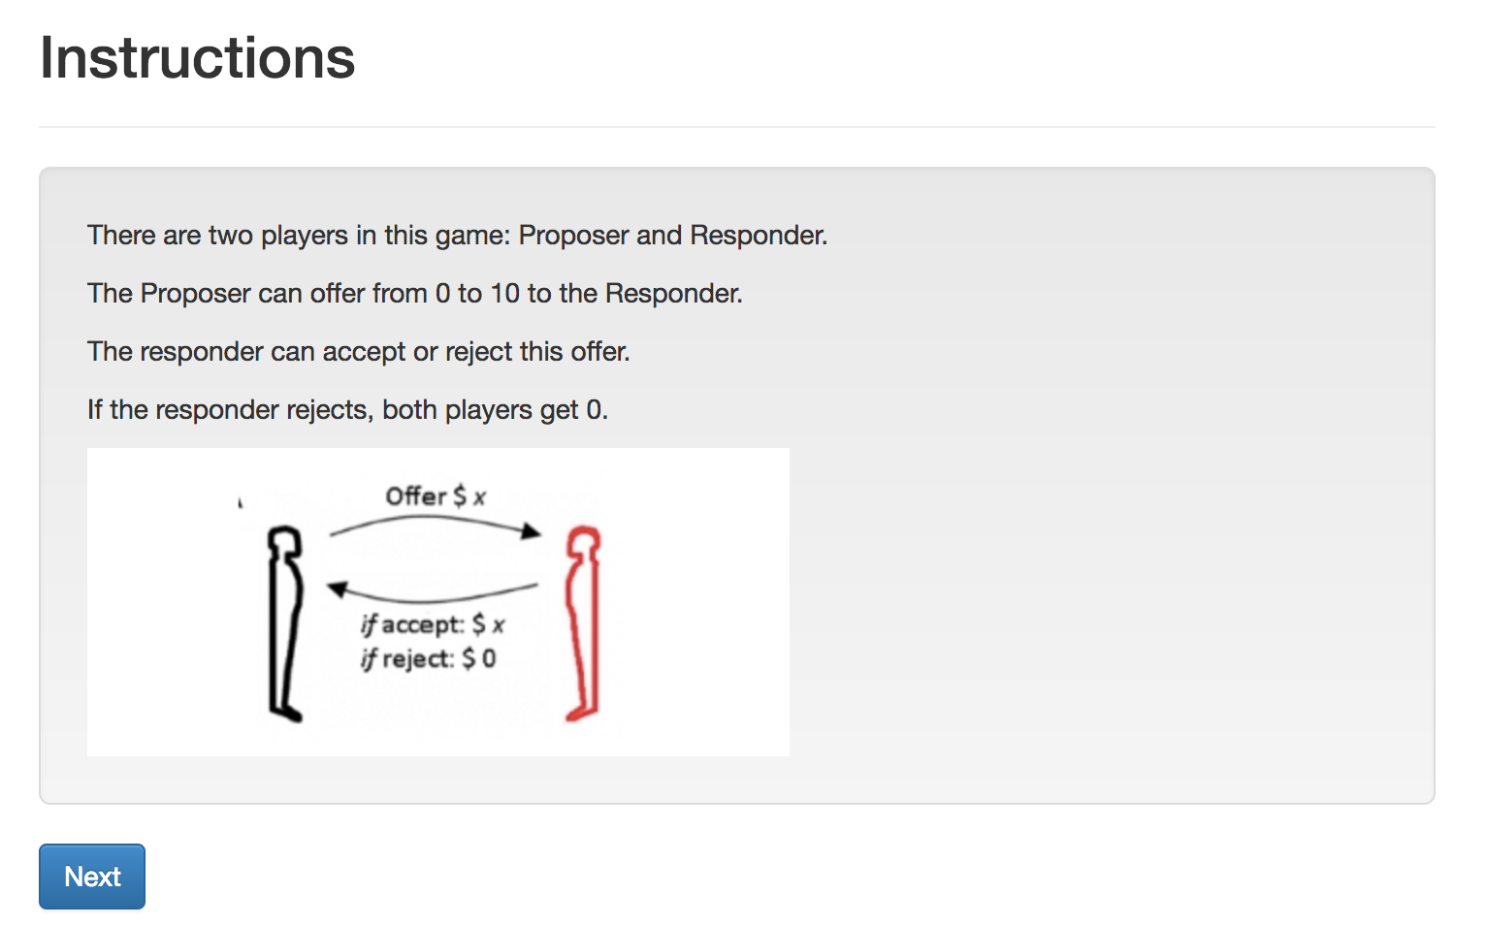
Ultimatum. Screen 1. Intro

Slide 29
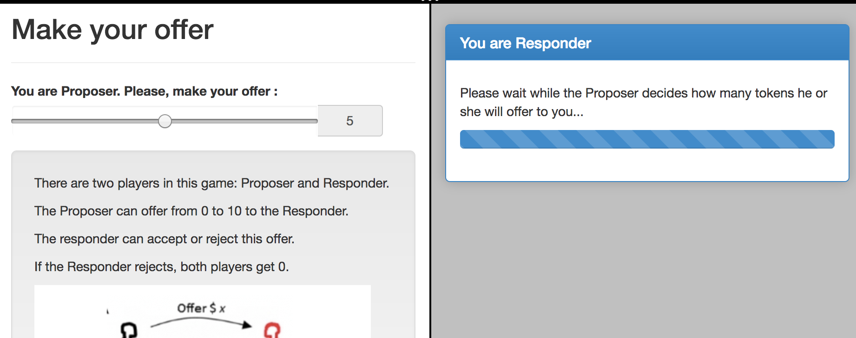
Ultimatum. Screen 2. Offer

Slide 30
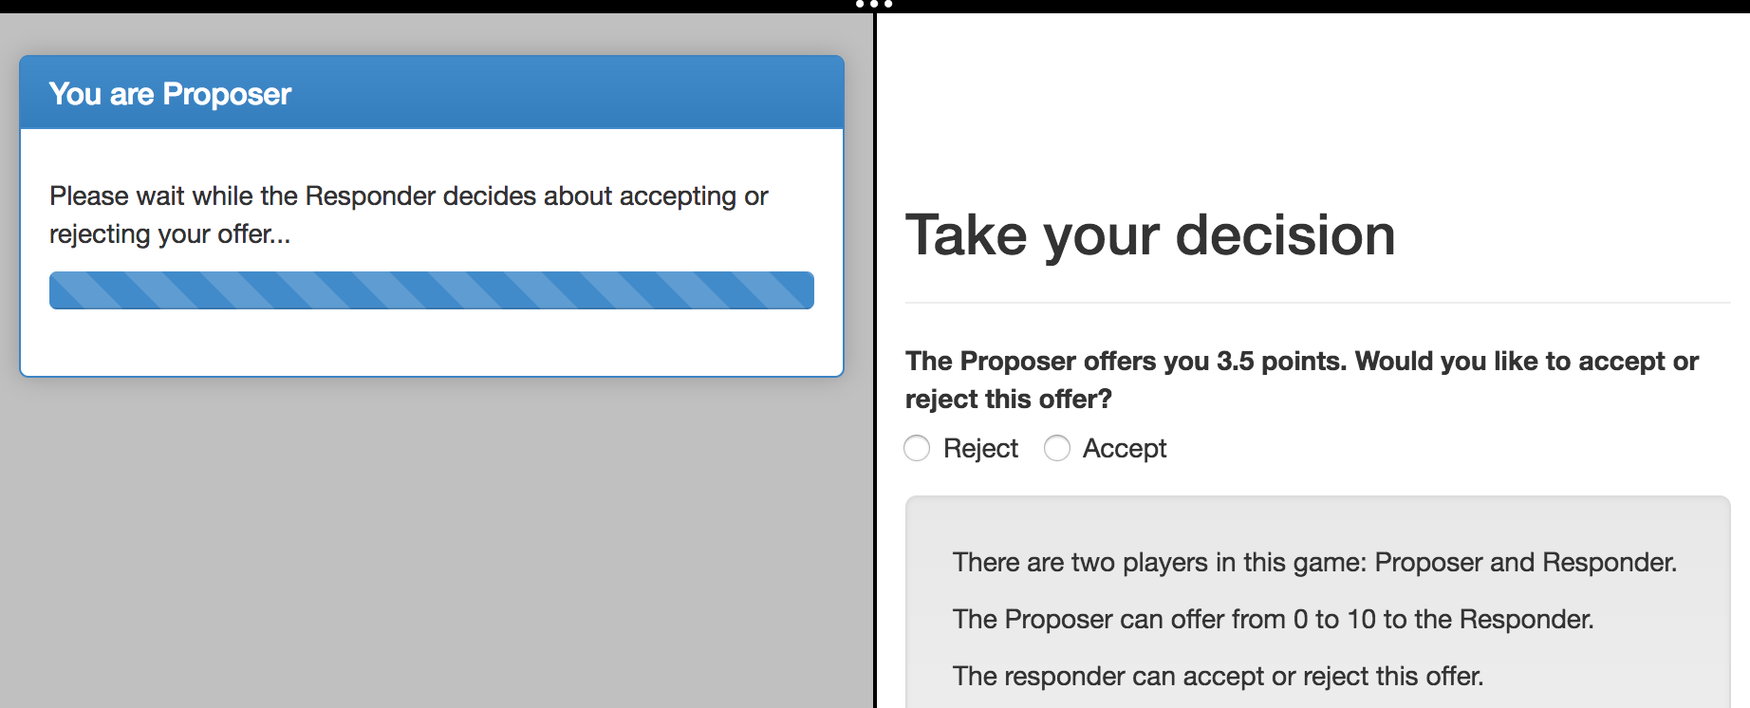
Ultimatum. Screen 3. Accept/Reject

Slide 31
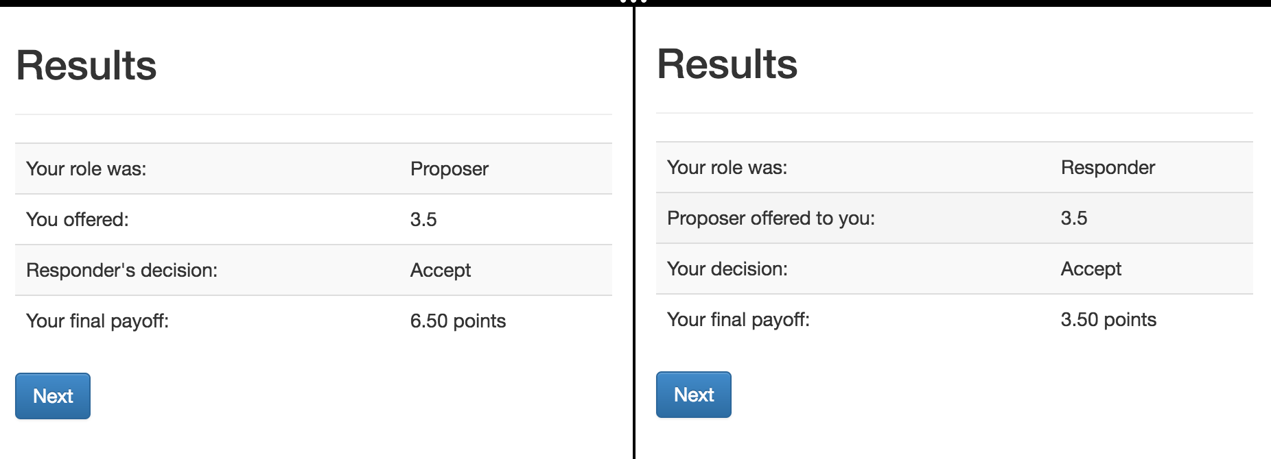
Ultimatum. Screen 4. Results

Slide 32
Ultimatum: some preliminary prep
Let’s run ‘otree startapp ultimatum’
and copy from our guess app: intro, decision, instructions
… rename in intro and decision the % include %:
TO: {% include 'ultimatum/instructions.html' %}
make a copy of decision.html
rename files to: Offer.html, Accept.html

Slide 33
Ultimatum: multi-player game
In models.py: Constants: players_per_group = 2
NB: when there is only one player then players_per_group = None, not 1!
In Player we define function that returns the role
class Player(BasePlayer):
def role(self):
if self.id_in_group == 1:
return 'Proposer'
if self.id_in_group == 2:
return 'Responder'

Slide 34
Ultimatum: planning I
The workflow:
1. Introduction
2. Player 1 decides about an offer, Player 2 waits
3. Player 2 decides whether accepting or not. Player 1 waits.
4. Both see the results.
We need 6 pages. For (2) and (3) we a set of (Page, WaitPage)
Page in (2) will be shown only to Proposer
Page in (3) will be shown only to Responder

Slide 35
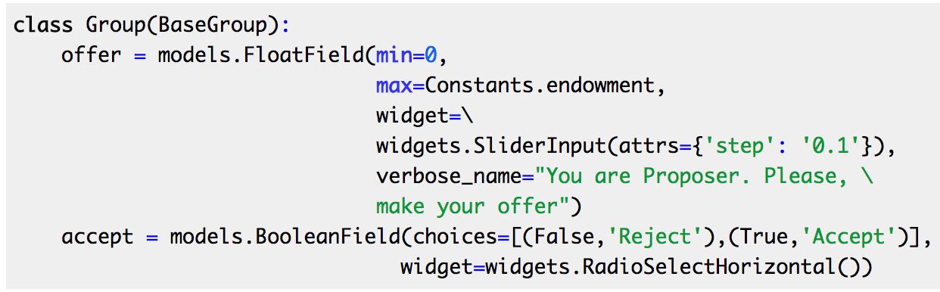
Ultimatum: models.py
Creating new fields in models.py:
We need fields in group, because these fields are the same for both players.
Notes:
class Group(BaseGroup):
offer = models.FloatField(min=0,
max=Constants.endowment,
widget=\
widgets.SliderInput(attrs={'step': '0.1'}),
verbose_name="You are Proposer. Please, \
make your offer")
accept = models.BooleanField(choices=[(False,'Reject'),(True,'Accept')],
widget=widgets.RadioSelectHorizontal())
def set_payoffs(self):
proposer = self.get_player_by_role('Proposer')
responder = self.get_player_by_role('Responder')
proposer.payoff = (Constants.endowment - self.offer) * self.accept
responder.payoff = self.offer * self.accept

Slide 36
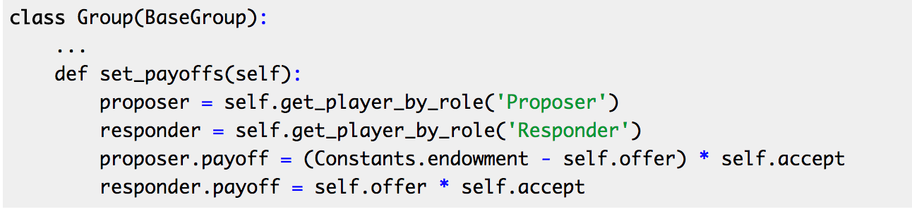
Ultimatum: models.py
Defining the function that will be able to set the payoffs of the players depending on their role in a group:
Notes:
class Group(BaseGroup):
offer = models.FloatField(min=0,
max=Constants.endowment,
widget=\
widgets.SliderInput(attrs={'step': '0.1'}),
verbose_name="You are Proposer. Please, \
make your offer")
accept = models.BooleanField(choices=[(False,'Reject'),(True,'Accept')],
widget=widgets.RadioSelectHorizontal())
def set_payoffs(self):
proposer = self.get_player_by_role('Proposer')
responder = self.get_player_by_role('Responder')
proposer.payoff = (Constants.endowment - self.offer) * self.accept
responder.payoff = self.offer * self.accept

Slide 37
Static files: how insert an image?
Create folder in an app:
…/static/ultimatum
Put your image there
insert in in the beginning of your instructions.html:
{% load staticfiles %}
and in the text:
<img src="{% static "ultimatum/ultimatum.png" %}"/>
Notes:
from otree.api import Currency as c, currency_range
from . import models
from ._builtin import Page, WaitPage
from .models import Constants
class Intro(Page):
pass
class Offer(Page):
form_model = models.Group
form_fields = ['offer']
def is_displayed(self):
return self.player.role() == 'Proposer'
def vars_for_template(self):
...
class OfferWaitPage(WaitPage):
title_text = "You are Responder"
body_text = "Please wait while the Proposer decides how many tokens he \
or she will offer to you..."
class Accept(Page):
form_model = models.Group
form_fields = ['accept']
def is_displayed(self):
return self.player.role() == 'Responder'
def vars_for_template(self):
return {'offer_text': "The Proposer offers you {} points. Would you like \
to accept or reject this offer?".format(self.group.offer)}
class ResultsWaitPage(WaitPage):
title_text = "You are Proposer"
body_text = "Please wait while the Responder decides about accepting \
or rejecting your offer..."
def after_all_players_arrive(self):
self.group.set_payoffs()
class Results(Page):
def vars_for_template(self):
return {'accept': 'Accept' if self.group.accept else 'Reject'}
page_sequence = [
Intro,
Offer,
OfferWaitPage,
Accept,
ResultsWaitPage,
Results
]

Slide 38
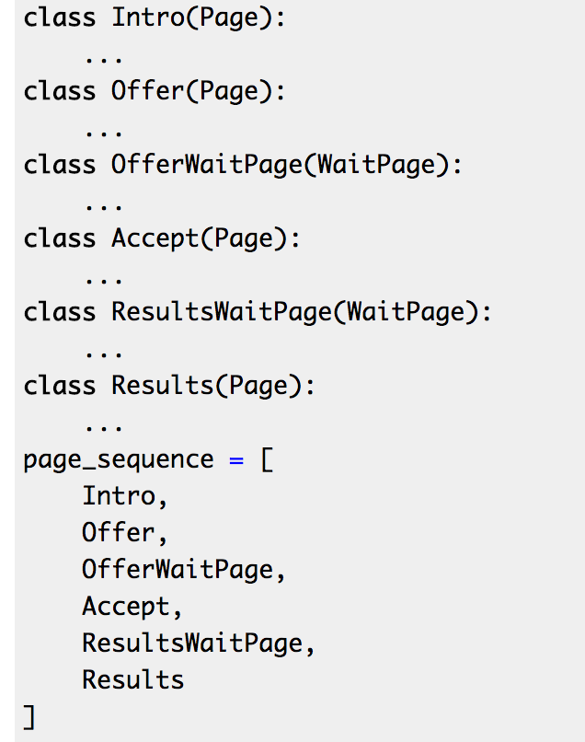
Ultimatum: views.py
class Offer(Page):
form_model = models.Group
form_fields = ['offer']
def is_displayed(self):
return self.player.role() == 'Proposer'
class OfferWaitPage(WaitPage):
title_text = "You are Responder"
body_text = "Please wait while the Proposer decides how many tokens he \
or she will offer to you...”
def is_displayed(self):
return self.player.role() == 'Responder'
Notes:
from otree.api import Currency as c, currency_range
from . import models
from ._builtin import Page, WaitPage
from .models import Constants
class Intro(Page):
pass
class Offer(Page):
form_model = models.Group
form_fields = ['offer']
def is_displayed(self):
return self.player.role() == 'Proposer'
def vars_for_template(self):
...
class OfferWaitPage(WaitPage):
title_text = "You are Responder"
body_text = "Please wait while the Proposer decides how many tokens he \
or she will offer to you..."
class Accept(Page):
form_model = models.Group
form_fields = ['accept']
def is_displayed(self):
return self.player.role() == 'Responder'
def vars_for_template(self):
return {'offer_text': "The Proposer offers you {} points. Would you like \
to accept or reject this offer?".format(self.group.offer)}
class ResultsWaitPage(WaitPage):
title_text = "You are Proposer"
body_text = "Please wait while the Responder decides about accepting \
or rejecting your offer..."
def after_all_players_arrive(self):
self.group.set_payoffs()
class Results(Page):
def vars_for_template(self):
return {'accept': 'Accept' if self.group.accept else 'Reject'}
page_sequence = [
Intro,
Offer,
OfferWaitPage,
Accept,
ResultsWaitPage,
Results
]

Slide 39
Ultimatum: views.py
class Accept(Page):
form_model = models.Group
form_fields = ['accept']
def is_displayed(self):
return self.player.role() == 'Responder'
def vars_for_template(self):
return {'offer_text': "The Proposer offers you {} points. Would you like \
to accept or reject this offer?".format(self.group.offer)}
class ResultsWaitPage(WaitPage):
title_text = "You are Proposer"
body_text = "Please wait while the Responder decides about accepting \
or rejecting your offer..."
def after_all_players_arrive(self):
self.group.set_payoffs()
Notes:
from otree.api import Currency as c, currency_range
from . import models
from ._builtin import Page, WaitPage
from .models import Constants
class Intro(Page):
pass
class Offer(Page):
form_model = models.Group
form_fields = ['offer']
def is_displayed(self):
return self.player.role() == 'Proposer'
def vars_for_template(self):
...
class OfferWaitPage(WaitPage):
title_text = "You are Responder"
body_text = "Please wait while the Proposer decides how many tokens he \
or she will offer to you..."
class Accept(Page):
form_model = models.Group
form_fields = ['accept']
def is_displayed(self):
return self.player.role() == 'Responder'
def vars_for_template(self):
return {'offer_text': "The Proposer offers you {} points. Would you like \
to accept or reject this offer?".format(self.group.offer)}
class ResultsWaitPage(WaitPage):
title_text = "You are Proposer"
body_text = "Please wait while the Responder decides about accepting \
or rejecting your offer..."
def after_all_players_arrive(self):
self.group.set_payoffs()
class Results(Page):
def vars_for_template(self):
return {'accept': 'Accept' if self.group.accept else 'Reject'}
page_sequence = [
Intro,
Offer,
OfferWaitPage,
Accept,
ResultsWaitPage,
Results
]

Slide 40
Ultimatum: dynamic label in Accept
{% block content %}
{% formfield group.accept with label=offer_text %}
{% include 'ultimatum/instructions.html' %}
<br>
{% next_button %}
{% endblock %}

Slide 41
Ultimatum. Results
<table class="table table-striped table-hover">
<tr>
<td>Your role was:</td>
<td>{{player.role}}</td>
</tr>
{% if player.role == "Proposer" %}
<tr>
<td>You offered:</td>
<td>{{group.offer}}</td>
</tr>
<tr>
<td>Responder's decision:</td>
<td>{{accept}}</td>
</tr>
{% else %}
<tr>
<td>Proposer offered to you:</td>
<td>{{group.offer}}</td>
</tr>
<tr>
<td>Your decision:</td>
<td>{{accept}}</td>
</tr>
{% endif %}
<tr>
<td>Your final payoff:</td>
<td>{{player.payoff}}</td>
</tr>
</table>
Notes:
{% extends "global/Page.html" %}
{% load staticfiles otree_tags %}
{% block title %}
Results
{% endblock %}
{% block content %}
<table class="table table-striped table-hover">
<tr>
<td>Your role was:</td>
<td>{{player.role}}</td>
</tr>
{% if player.role == "Proposer" %}
<tr>
<td>You offered:</td>
<td>{{group.offer}}</td>
</tr>
<tr>
<td>Responder's decision:</td>
<td>{{accept}}</td>
</tr>
{% else %}
<tr>
<td>Proposer offered to you:</td>
<td>{{group.offer}}</td>
</tr>
<tr>
<td>Your decision:</td>
<td>{{accept}}</td>
</tr>
{% endif %}
<tr>
<td>Your final payoff:</td>
<td>{{player.payoff}}</td>
</tr>
</table>
{% next_button %}
{% endblock %}

Slide 42
Ultimatum. Results
<table class="table table-striped table-hover">
<tr>
<td>Your role was:</td>
<td>{{player.role}}</td>
</tr>
{% if player.role == "Proposer" %}
<tr>
<td>You offered:</td>
<td>{{group.offer}}</td>
</tr>
<tr>
<td>Responder's decision:</td>
<td>{{accept}}</td>
</tr>
{% else %}
<tr>
<td>Proposer offered to you:</td>
<td>{{group.offer}}</td>
</tr>
<tr>
<td>Your decision:</td>
<td>{{accept}}</td>
</tr>
{% endif %}
<tr>
<td>Your final payoff:</td>
<td>{{player.payoff}}</td>
</tr>
</table>
class Results(Page):
def vars_for_template(self):
return {'accept': 'Accept' if self.group.accept else 'Reject'}
in settings.py:
POINTS_DECIMAL_PLACES = 2
Notes:
{% extends "global/Page.html" %}
{% load staticfiles otree_tags %}
{% block title %}
Results
{% endblock %}
{% block content %}
<table class="table table-striped table-hover">
<tr>
<td>Your role was:</td>
<td>{{player.role}}</td>
</tr>
{% if player.role == "Proposer" %}
<tr>
<td>You offered:</td>
<td>{{group.offer}}</td>
</tr>
<tr>
<td>Responder's decision:</td>
<td>{{accept}}</td>
</tr>
{% else %}
<tr>
<td>Proposer offered to you:</td>
<td>{{group.offer}}</td>
</tr>
<tr>
<td>Your decision:</td>
<td>{{accept}}</td>
</tr>
{% endif %}
<tr>
<td>Your final payoff:</td>
<td>{{player.payoff}}</td>
</tr>
</table>
{% next_button %}
{% endblock %}

Slide 43
Installing Heroku toolbelt

Slide 44
github
WINDOWS
git config --global credential.helper wincred
macOS
git credential-osxkeychain
git config --global user.name "YOUR NAME"
Tell Git the email address that will be associated with your Git commits. The email you specify should be the same one found in your email settings.

Slide 45
Guess game - Views
Built-in functions of pages:
Waiting page :
def is_displayed(self):
return (True/False)
def vars_for_template(self):
…
def after_all_players_arrive(self):
…

Slide 46
PGGFG - Models
Creating new fields

Slide 47
PGGFG - Views
Creating new page
Page_sequence
Refereing to models. field

Slide 48
PGGFG - Templates
Creating the first template
Referring to a form and or field in a template
Inserting next button

Slide 49
Mini-Ebay: Models
Creating new fields

Slide 50
Mini-Ebay: Views
Creating new page
Page_sequence
Refereing to models. field

Slide 51
Mini-Ebay: Templates
Creating the first template
Referring to a form and or field in a template
Inserting next button

Slide 52
Starting
Creating the first template

Slide 53
MVC - intro
Models
Resetdb
создавать темплейт
include template
вставлять field - field with labell
ooping through fields
passing variables
referring to player/group in a template
tags - abs/pluralizeвставлять next_buttonвставлять картинкисчитать прибыльделать таблицы в бутстрапеделать элементы choiceвставлять слайдер?min - maxdynamic form definitionseveral rounds of gamegithubcli — installationherokucli — installationtimeouttimeout on submissiontracing errors- second session — multi-player gamesconverting our game to multiplayersubsessiongoing through all groups!!!!participant.vars- rolescalling other players in a groupworking in a group level—advanced morning sectionhighchairs — previous roundsadmin reportchannels— don’t forget about ws vs wasenvironmental variables - including those in herokustudy debugreading and writing filesthink where to put:id vs id_in_groupmoney and pointsbotssettings - in the first section?sentryauth_levelroomsupdating otreeinstalling redis in herokupip freezepaper trailheroku run …heroku maintenanceadding new dynos/ new redis planheroku config setvirtual server - ethics committee, own data etcvirtualenv in windowsform validationget_form_fieldsverbose name for models fieldradio selectbuttons deliverytable of radio optionsform field with labelsession.configin_roundsin_previous_roundsin_roundetcget_player_by_roleget_plyaersget_player_by_roleget_other playersmatchinggroup_randomly(fixed_id_ingroup=true)self.group_liek_round(NROUND)get_group_matrixrearranging players inside one groupIMPORTANT - what runs when!!shuffling groups in a course of the gamepages:normal page is_displayed vars_for_template before_next_pagewaiting page is_displayed - important - if passed, they won’t wait for him!! after_all_players arriveparameters wait for all groups

Slide 54
mturk
Awd-key awd-secret
Environment variables

