Slide 1
Brief intro to Python
Variables
Logical operators
Lists
Dictionaries
Conditions
Loops
List comprehension
Functions
Class

Slide 2
Brief intro to Python
Running:
Create an empty my_first_python.py file anywhere in oTree project/app folder
Open it in PyCharm/editor
Type
print('Hello World!')
In PyCharm: menu 'Run' → 'Run…'

Slide 3
Variables, logical operators, conditions, indentation
a = 2
b = 3
a > b # False
a == 2 # True
if b > a:
print('B is Big')
else:
print('B is small')

Slide 4
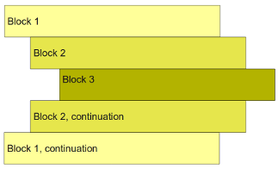
Indentation of code blocks
blocks of code (for loops, if conditions, functions, classes)
are indented!
usually by typing 'tab' or 4 spaces:
for i in range(10): if i < 5: print('Too little!') else: print('Too much!')

Slide 5
Lists, loops, random
a = [10, 12, 8, 3]
for i in a:
print(i)
print(a[1]) # what will be printed?
a.append(21)
# lists are mutable:
a[3] = 88
print(a) # what will be printed?
import random
random.shuffle(a) #result: for example: [8, 10, 3, 12]
b = random.choice(a) # result: for example 10
c = random.sample(a, 2) # result: for example [3, 12]

Slide 6
TODO: arithmetic operations
// - whole part of division
% - remainder of division
** - power
+=; -=; **= - variable increment
abs, len, round, sum, min, max – built-in functions
str, int, float – type conversion

Slide 7
Strings, type conversions
a = 1
print('a = ' + a)
print(f'a = {a}')
No difference between single and double quotation marks
You can also use .format() and other functions (.lower(), replace(), upper(), join() etc.)
conversion of types: int, bool, str, float

Slide 8
List comprehension
# choosing only odd numbers
a = [4, 3, 5, 15, 22, 28, 7]
b = []
for i in a:
if i % 2 == 1:
b.append(i)
print(b) # [3, 5, 15, 7]
# instead we can do it
a = [4, 3, 5, 15, 22, 28, 7]
b = [i for i in a if i % 2 == 1]
import random
c = [random.random() for i in range(10)]
squares = [i**2 for i in range(5)] # What’s an output?
# TASKS:
Generate list of 10 random values values between 0 and 20
Generate a list from previous list with the odd values less than 15

Slide 9
Dictionaries
a = {'name': 'Philipp', 'surname':'Chapkovski', 'height': 179}
print(a['name'])
a['height']=180
a['Nationality'] = 'Russian'
a.items(), a.keys(), a.values()
Dicts are mutable!

Slide 10
Functions
price_per_square = 100 garden_price = 1000 def house_price(length, width): space = length * width return space * price_per_square def elite_house_price(length, width): space = length * width return space * price_per_square + garden_price my_house_price = house_price(10,20)
trump_house_price = elite_house_price(100,200)
#Task: make one function instead of two

Slide 11
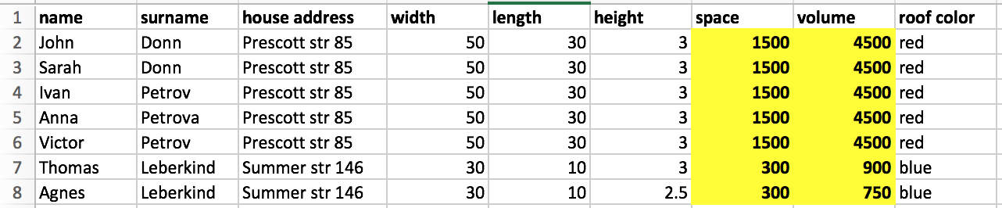
class, self, and relational databases
The same information is repeated multiple times
If somebody changes the address you need to change all house parameters for this person
If you changes the roof color, you need to change it as many times as there are inhabitants
the computational costs are multiplied X number of participants.

Slide 12
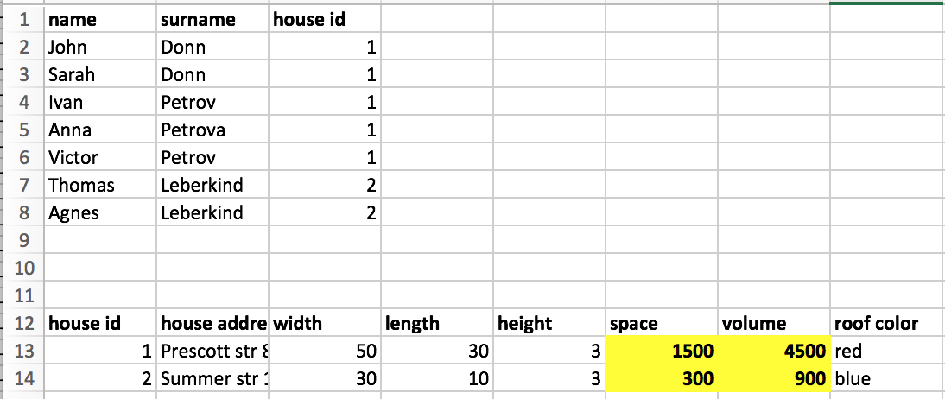
class, self, and relational databases
we can split the data sheet into two tables (Persons, Houses) and the information stops being redundant

Slide 13
class, self, and relational databases
class definition: structure of the data:
class instance: the specific ‘record’ of the data

Slide 14
class, self, and relational databases
# an example
class House(object):
roof = None
width = 0
length = 0
height = 0
def space(self):
return self.width * self.length
def volume(self):
return self.space() * self.heigth
# new instance:
prescott85 = House()
prescott85.width = 30
prescott85.length = 10
print(prescott85.space())

