Slide 1
Head-direction coding and exploration in retrosplenial cortex under light and dark
Freely-moving 2P imaging, q-rose maze — results summary

Slide 2
Setup
• Two-photon GCaMP imaging (~9.6 Hz, single plane) of retrosplenial cortex in freely-moving mice
• Two non-overlapping RSP populations: Penk+ and Penk-CamKII+ (12 vs 4 animals)
• q-rose maze; overhead lights cycle 1 min on / 1 min off
– Light off = total darkness = visual cues removed. Camera is infrared, so tracking is unaffected — only the mouse's vision changes
• Within-session light vs dark, paired. 23 sessions, 15 animals. Non-parametric throughout
• Question: how does removing vision change head-direction coding and spatial behaviour?

Slide 3
Starting observation: a counterintuitive effect
• Raw within-cell result: HD tuning (mean vector length) and spatial information are HIGHER in dark than light
– dF/F MVL p = 0.0010; spatial info p < 0.0001; preferred directions show no systematic drift
• This runs opposite to the classical expectation that darkness degrades head-direction tuning
• ~9.8% of soma ROIs are HD-tuned (dF/F)
• Too good to take at face value: MVL is biased by how the animal samples head direction

Slide 4
Why the raw effect is suspect
• MVL of a tuning curve rises when head-direction sampling is narrower or more uneven, with no change in the underlying code
• In the dark the mouse samples head direction differently (it explores a smaller, more repeated set of routes)
• So a higher dark MVL could be a sampling artefact, not a coding gain
• Test: equalise the behavioural sampling between light and dark, then recompute
– A1 — match the head-direction occupancy distribution
– A2 — match the joint speed x |angular head velocity| distribution
– Plus circular-shuffle debiasing of MVL; within-session paired

Slide 5
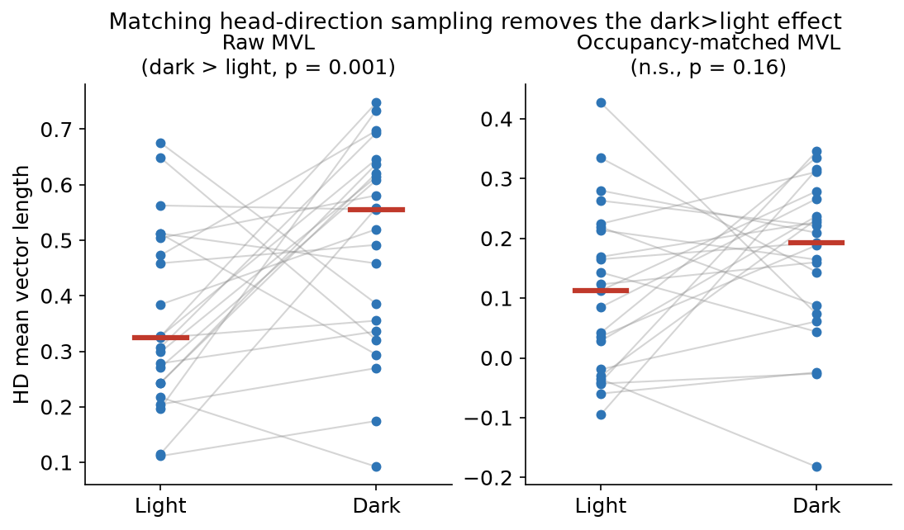
The effect does not survive matching
• Each line = one session (light → dark); red bars = condition medians
• Raw: dark > light (p = 0.001). After matching HD sampling: n.s. (A1 p = 0.16, A2 p = 0.25)
Sanity checks pass: matching disabled reproduces raw MVL exactly; occupancy matching equalises the HD histograms.

Slide 6
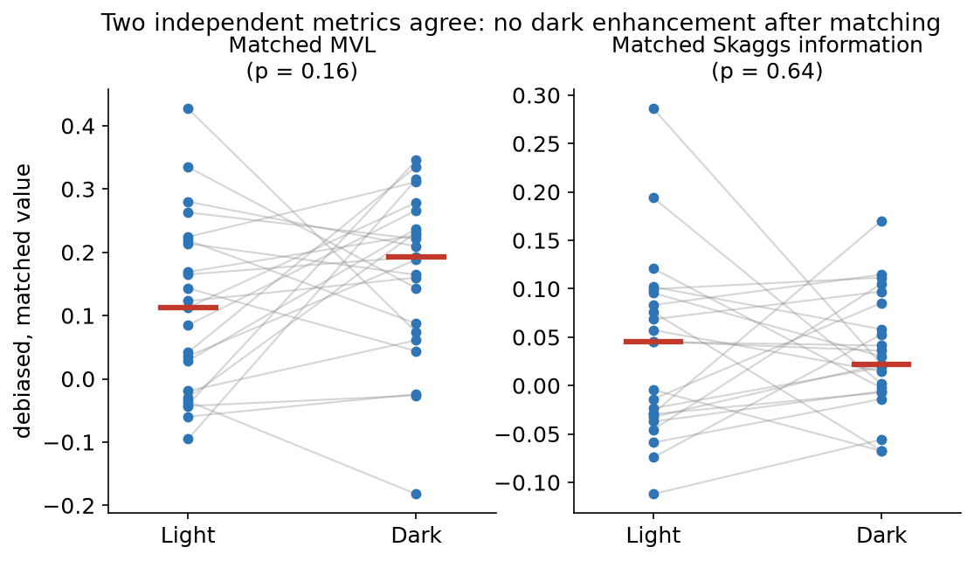
A second metric agrees: mutual information
• Skaggs HD information (bits/event; Voigts & Harnett 2020, Zong 2022) through the same matched gauntlet
– Matched HD-MI is null, more emphatically than MVL (A1 p = 0.64)
• Place information also dies under position-occupancy matching (p = 0.15)
• Secondary 'gain' and dark cell-recruitment signals also collapse under matching
• Two metrics, same answer: no dark enhancement of HD or place coding survives

Slide 7
Neural conclusion
• The RSP spatial / head-direction representation is preserved in the dark — neither enhanced nor degraded
• Every matched measure is null: HD MVL, HD mutual information, place information, and population-vector map consistency
• The naive 'darkness enhances HD coding' was a sampling artefact and is retired
• Cell-type contrast (Penk+ vs Penk-CamKII+) is null and underpowered: 12 vs 4 animals can only detect very large effects (d > 1.5)
– Controls held: tracking confidence is identical light vs dark (infrared camera assumption upheld)

Slide 8
Behaviour: locomotion is unchanged
Measure | Light | Dark | Test
Speed (cm/s) | 2.41 | 2.12 | p = 0.07 (ns)
Distance/epoch (m) | 2.26 | 2.03 | p = 0.03 raw, ns adj
Left-turn fraction | 0.50 | 0.50 | p = 0.99
Turn alternation | -0.16 | -0.18 | p = 0.54
Head angular velocity | same | same | p = 0.18
• Same speed, same distance, same turn choices, same head movement — the motor machinery is intact in the dark

Slide 9
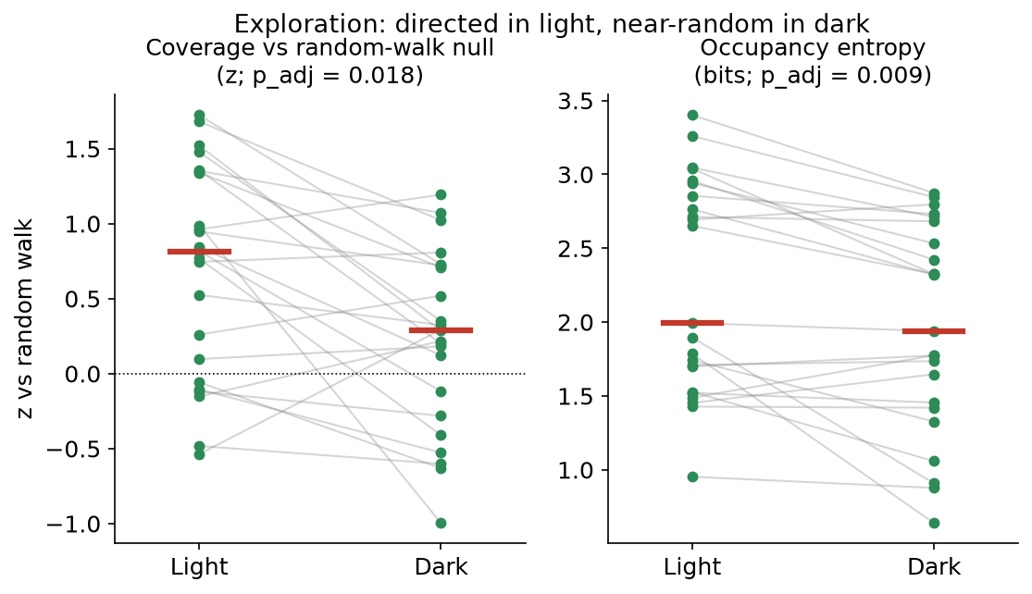
Behaviour: exploration changes
Measure | L | D | p_adj
Coverage (cells/min) | 0.41 | 0.35 | 0.001
Occupancy entropy | 2.24 | 1.96 | 0.009
Coverage vs null (z) | 0.69 | 0.23 | 0.018
Route LZ | 0.73 | 0.72 | 0.85
• In light, mice cover more of the maze than a random walk of the same length — directed search
• In dark they fall to near random-walk level, controlling for distance moved and maze shape
– Route patterns unchanged (LZ) — they stop steering toward new ground, not running tighter loops

Slide 10
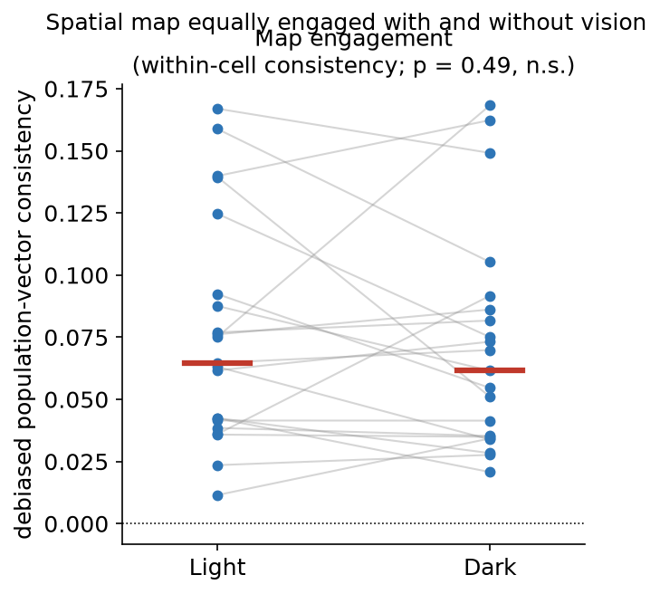
Is the map still engaged in the dark? Yes
• Does the same maze cell re-instantiate the same population state on each visit? (within- minus across-cell population-vector consistency, sampling matched, no decoding)
• Positive in nearly every session — a real spatial map exists
• Does NOT differ light vs dark: 0.065 vs 0.062, p = 0.49
• The spatial representation is equally engaged with or without vision
– Caveat: small/noisy (~20 ROIs, underpowered to prove equivalence); HD cells not excluded

Slide 11
Synthesis
• The map is intact in the dark; the animal stops using it to direct exploration
• Neural side: HD, place, and map consistency are all preserved without vision
• Behaviour side: same locomotion, but exploration goes from directed to random-walk-like
• The dissociation is between representation (intact) and its behavioural readout (changes) — not a change in the code itself
• This is a cleaner story than either 'darkness degrades' or 'darkness enhances' coding, both of which were ruled out

Slide 12
Caveats and next steps
• HD yield is ~9.8% (2-4 HD cells per session) — population decoding may not be viable; this bounds the neural claims
• Matched nulls are 'no detectable difference', not proven equivalence — would firm up with more shuffles / Bayesian framing
• Cell-type comparisons need more Penk-CamKII+ animals to be informative
• Next, if pursued:
– AHV / egocentric coding light vs dark (predicted preserved; currently unrun)
– Junction-choice predictability and per-epoch neural-behaviour coupling
– HD-excluded map-engagement and a symmetric-corridor version of the junction analysis

