Slide 1
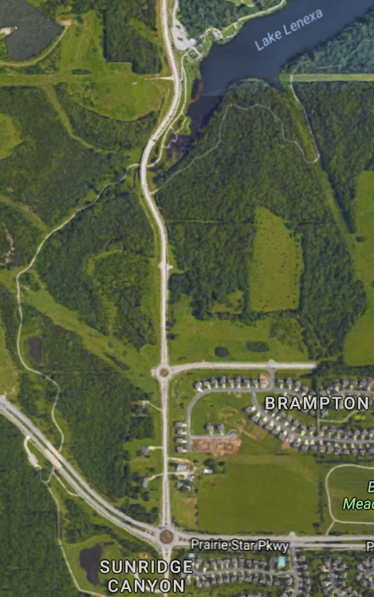
Outlet
Stream 2
Pond 2
Stream 1
Pond 1
Google Maps

Slide 2
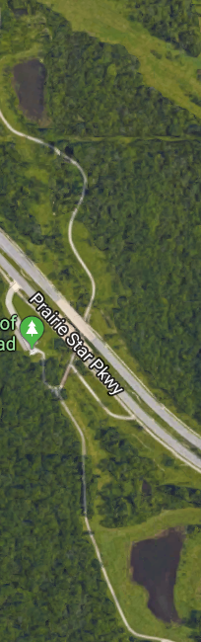
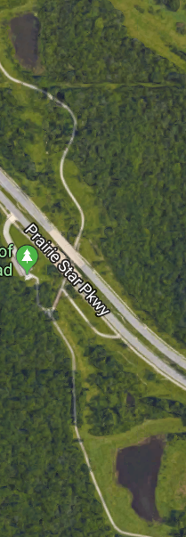
d
x₁
u₁
q₁
Z
x₂
q₂
d
x₃
Z
u₂
Outlet
Stream
Pond 2
Pond 1
q₃
Outlet
Pond 2
Google Maps
Pond 1

Slide 3
Outlet
Stream
Pond 2
Pond 1
Outlet
Google Maps

Slide 4
Google Maps
Outlet
Stream 1
Stream 2
Pond 2
d
u₁
Pond 1
x₁
q₁
Z
x₂
q₂
d
u₂
x₃
q₃
Z
x₄
q₄

Slide 5
d₁
x₁
u₁
q₁
Z
x₂
q₂
d₂
x₃
u₂
q₃
Z
x₄
q₄

Slide 7
d
u₁
x₁
q₁
Z
q₂
x₂
d
Y
u₂
x₃
q₃
Z

Slide 8
d₁
m
1
u₁
Geometry of stream cross-section
Side slope = 1/m
x₁
q₁
Z
Pond 1
q₂
d₂
x₂
Y
Stream
u₂
x₃
q₃
Z
Pond 2

Slide 9

$$h$$

Slide 10

$$h$$
Stream 1
Pond 2

Slide 11
Valve closed (u₁ = 0)
Valve open (u₁ = 1)
d₁ = 0cfs
Safe set at
time t ϵ [0, 4h]
Safe set at
time t ϵ [0, 4h]
Safe set
at time 0
Safe set at
time t ϵ [0, 4h]
d₁ = 2cfs
Safe set
at time 0
d₁ = 4cfs
Safe set
at time 0
Boundary of safe set at time 0
Boundary of safe set at time 20min
Boundary of safe set at time 40min

Slide 12
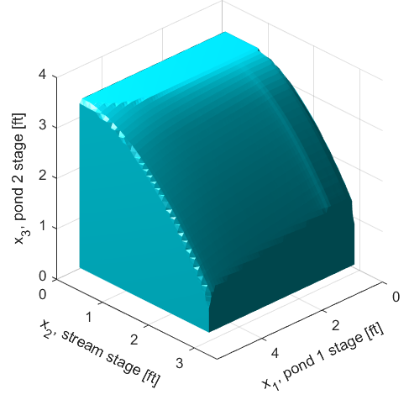
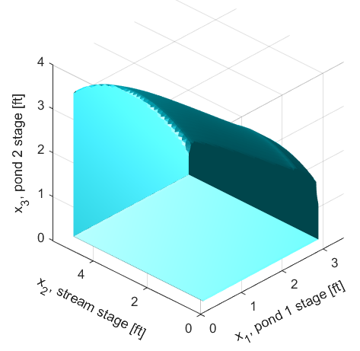
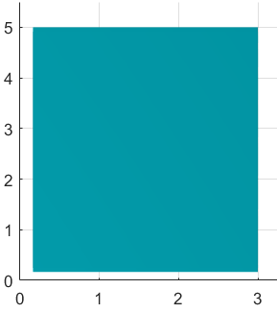
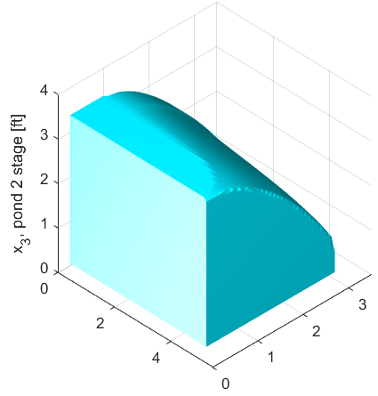
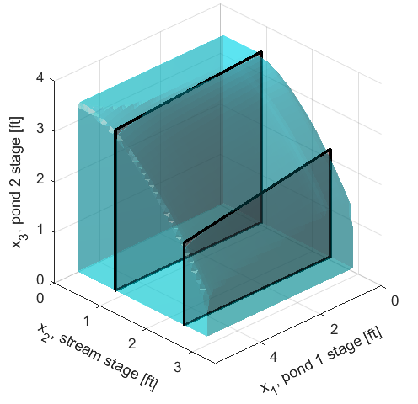
Top
Bottom face
x₁, pond 1 stage [ft]
Bottom
x₂, stream stage [ft]
Plane at x2 = 1ft
Plane at x2 = 2.5ft
Back
Bottom = Safe set at time 0 for Scenario II
Bottom
x₁, pond 1 stage [ft]
x₂, stream stage [ft]

Slide 13
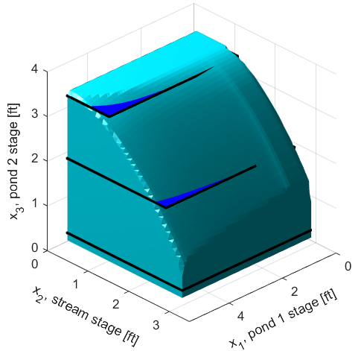
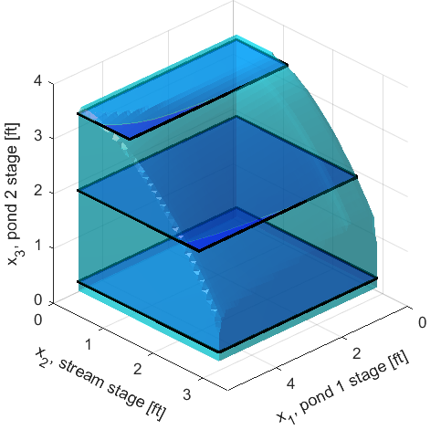
a)
Plane at x₃ = 3.4ft
1.2ft
Plane at x₃ = 2ft
2.6ft
Plane at x₃ = 1/3ft
3ft

Slide 14
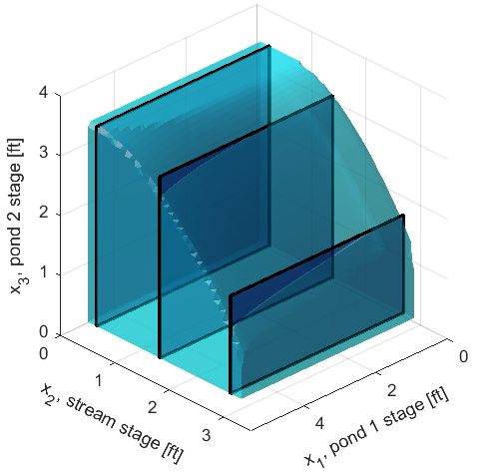
b)
Plane at x₂ = 1/3ft
Plane at x₂ = 1.5ft
3.5ft
Plane at x₂ = 2.8ft
3.2ft
1.8ft

Slide 15
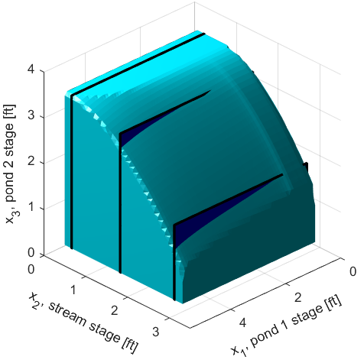
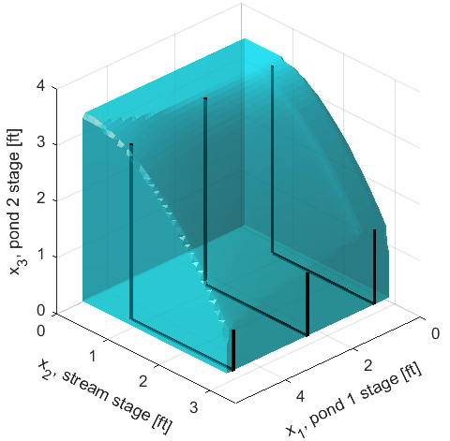
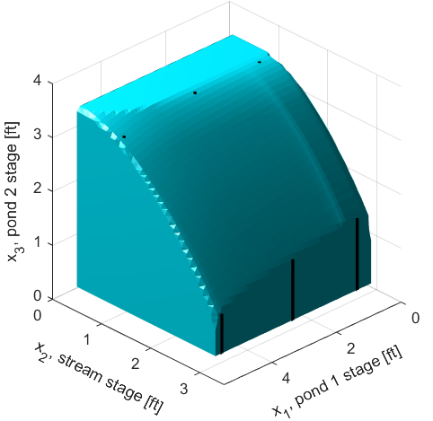
a)
Plane at x₃ = 3.4ft
1.2ft
Plane at x₃ = 2ft
2.6ft
Plane at x₃ = 1/3ft
3ft
b)
Plane at x₂ = 1/3ft
Plane at x₂ = 1.5ft
3.5ft
Plane at x₂ = 2.8ft
3.2ft
1.8ft
c)
wedge-like
3.5ft
3.5ft
3.3ft
1.5ft
1.3ft
0.9ft
0.6
2.6
4.8

Slide 16
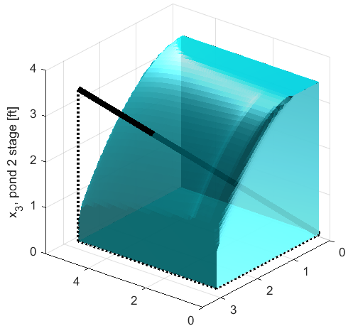
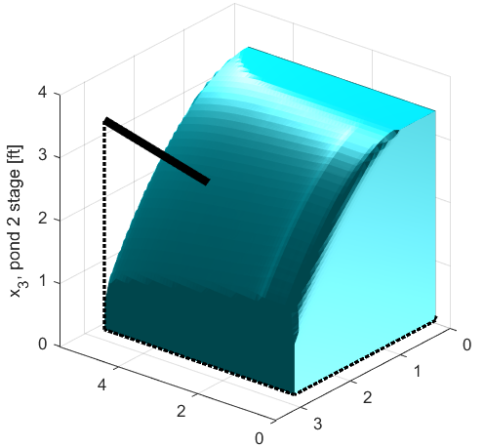
4.5ft
x₁, pond 1 stage [ft]
x₂, stream stage [ft]
x₁, pond 1 stage [ft]
x₂, stream stage [ft]

Slide 17
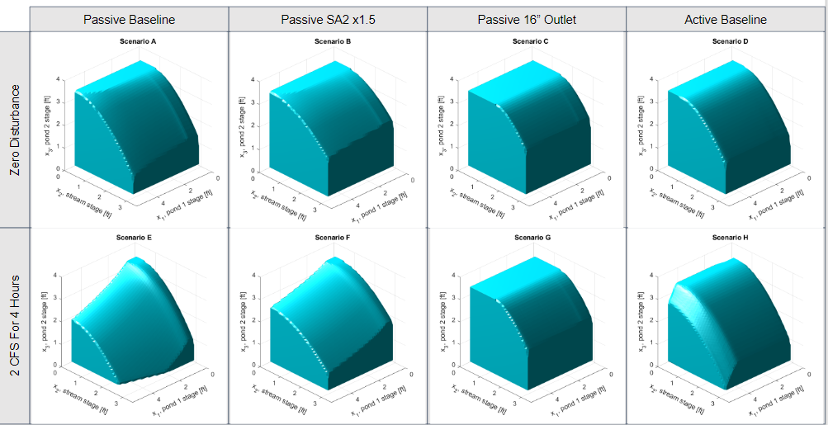
(i)
(ii)
(iii)
(iv)

Slide 18
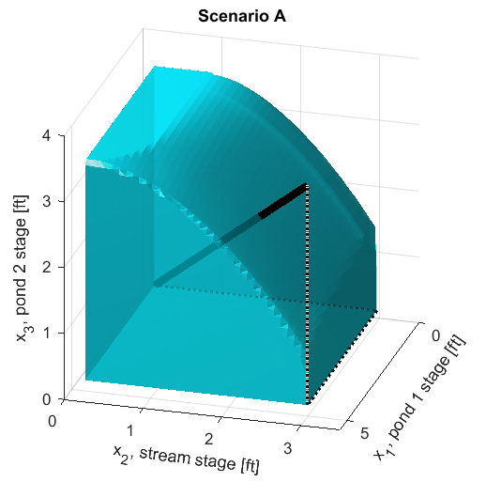
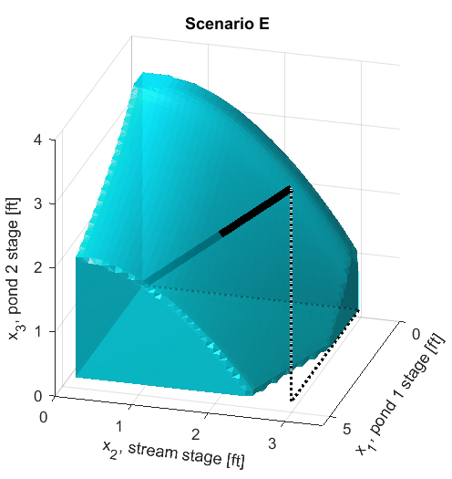
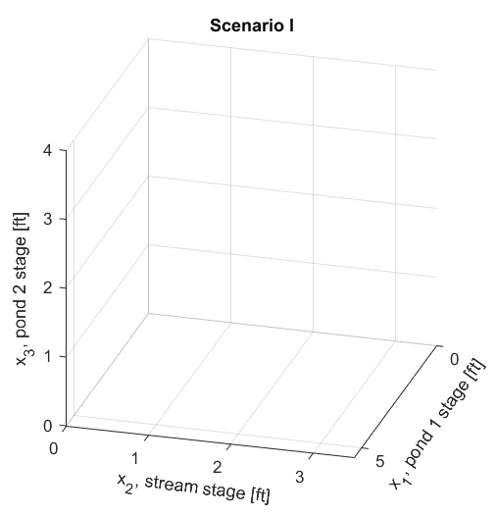
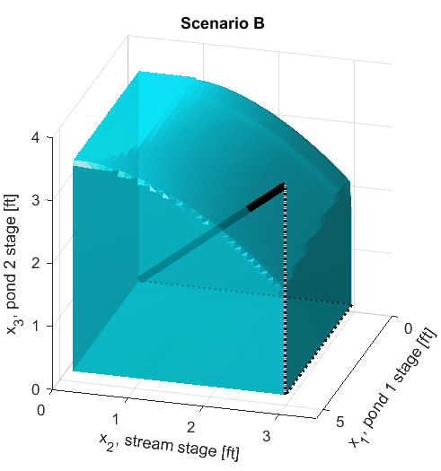
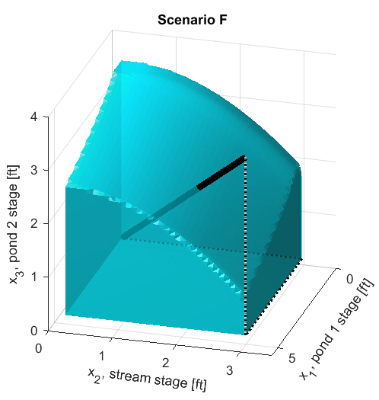

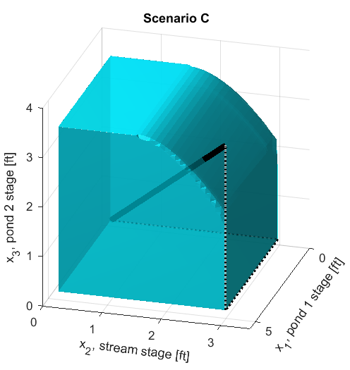
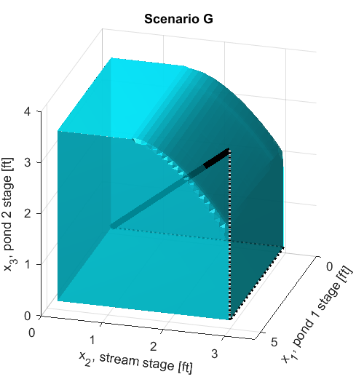

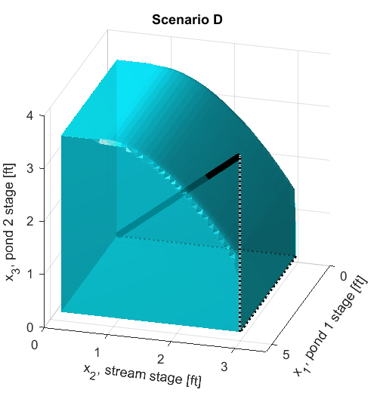
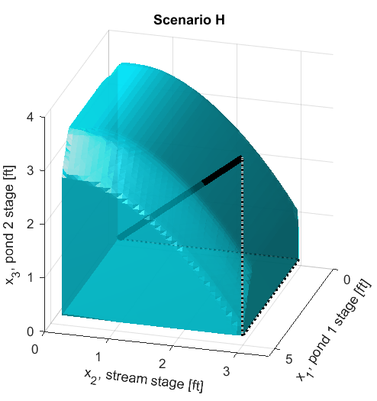
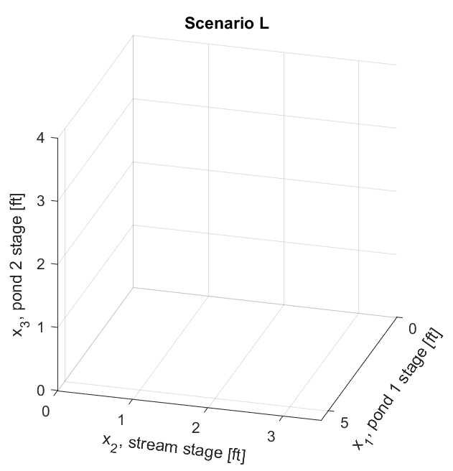
d₁ = d₂ = 0cfs
d₁ = d₂ = 2cfs
d₁(t) = r₁(t) d₂(t) = r₂(t)
(R, A₂, passive)
4.5ft
3.4ft
(R, 1.5A₂, passive)
4.9ft
4.0ft
(2R, A₂, passive)
5.3ft
5.1ft
(R, A₂, active)
4.7ft
4.5ft

Slide 19

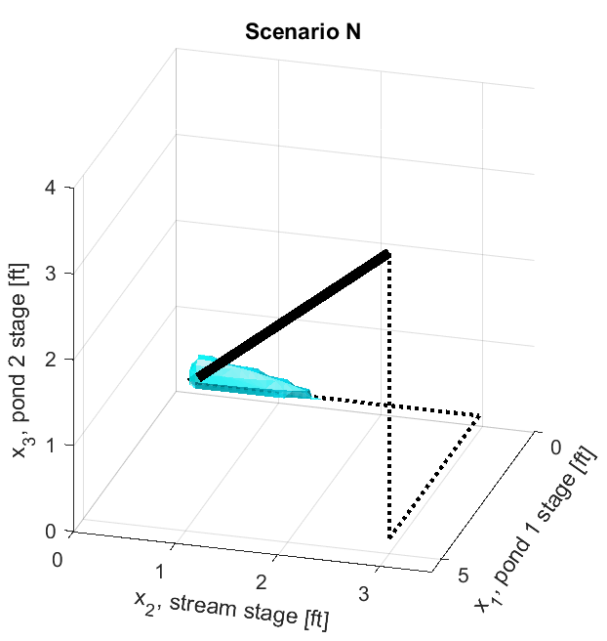
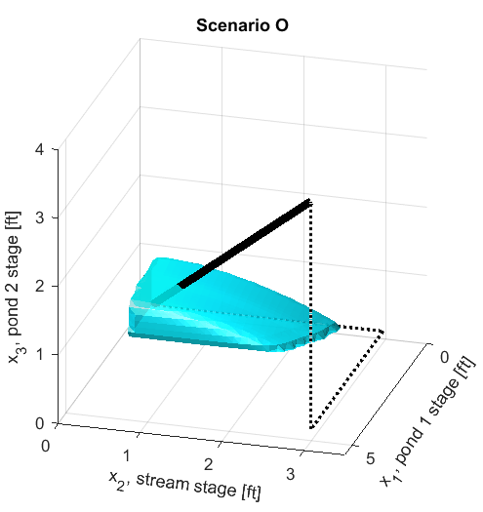
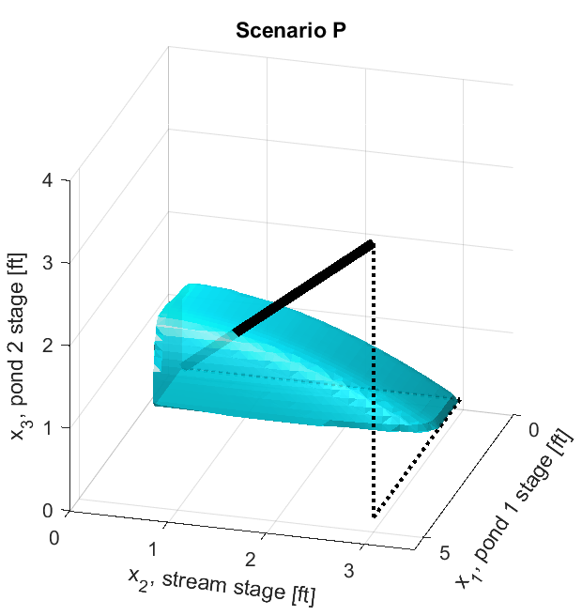
Passive
Active
(5A₁, 2A₂)
0.3ft
(7A₁, 2.5A₂)
1.2ft
1.8ft
d₁(t) = r₁(t), d₂(t) = r₂(t), Radius of each outlet = R

Slide 20
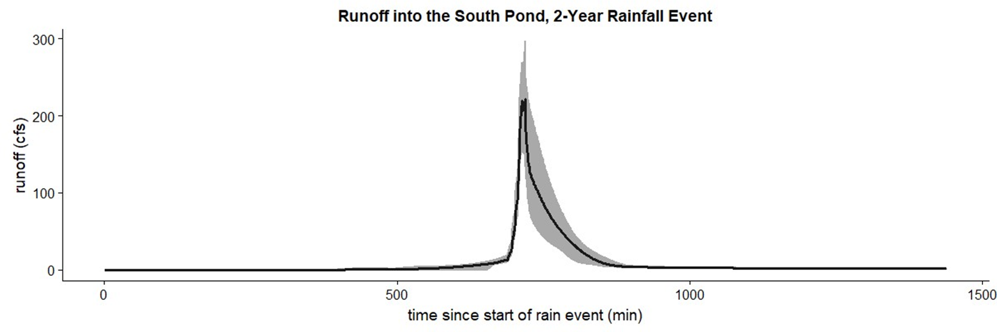
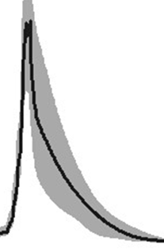
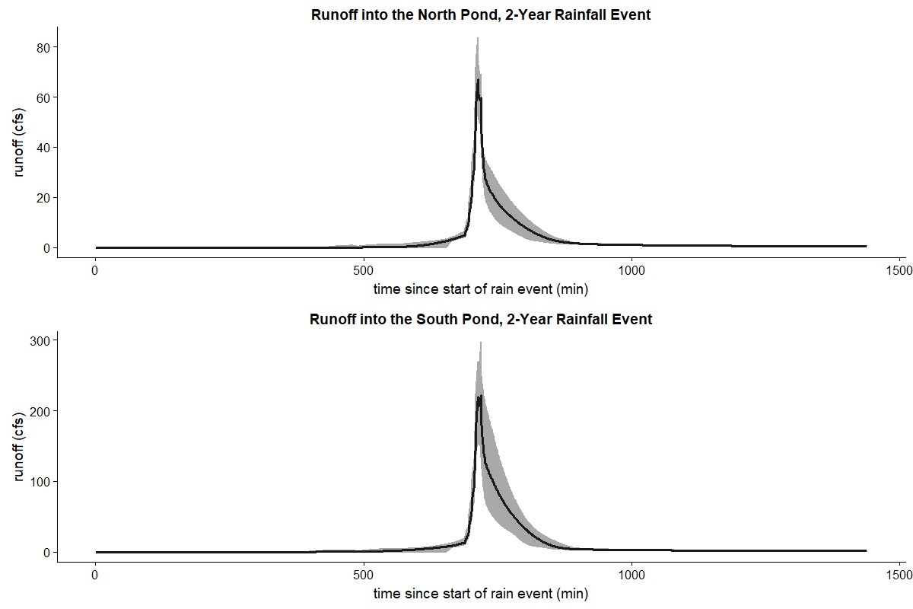
Runoff into Pond 1, 2-Year Rainfall Event
r₁(t)
0h
4h
time, t
Runoff into Pond 2, 2-Year Rainfall Event
r₂(t)
0h
4h
time, t

