Slide 1
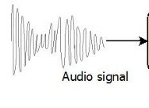
MFCC feature
extraction(using librosa)
CNN
output(sentence)

