Slide 1
AI Study Assistant
Final Year Project
Name : Rahul Kumar Koiri
Course :- Diploma
Branch :- Computer Science and Engineering
Q-ID :- 23070035
Year: 3rd
Semester :- 6th

Slide 2
Project Introduction
AI Study Assistant is a full-stack educational web application.
It helps students generate concise notes for any topic.
Users can save and revisit previous notes from dashboard history.
Project combines FastAPI, React, SQLAlchemy, and OpenRouter AI.

Slide 3
Problem Statement
Students spend too much time creating notes manually.
Generated content is often not stored in a structured way.
Most generic AI tools do not provide personal note history.
Need a simple system for secure, topic-wise, reusable notes.

Slide 4
Objectives
Implement secure signup and login using JWT authentication.
Generate AI-based notes from user-entered topics.
Store notes in a database linked to each user account.
Provide clean dashboard UI with notes history and quick access.

Slide 5
Technology Stack
Frontend: React + Vite
Styling: Tailwind CSS
API Calls: Axios
Routing: React Router
Backend: FastAPI (Python)
ORM: SQLAlchemy
Auth: JWT + OAuth2 form login
AI Provider: OpenRouter API

Slide 6
System Architecture
Frontend collects input topic and sends authenticated requests.
Backend validates token and identifies current user.
AI service module calls OpenRouter and receives generated notes.
Backend stores notes and returns response to dashboard.

Slide 7
Database Design
users table: id, email, password (hashed).
notes table: id, topic, content, user_id.
Each note is mapped to a specific authenticated user.
Design is simple, scalable, and easy to query.

Slide 8
Core API Endpoints
POST /auth/signup -> Create new account
POST /auth/login -> Return access token
POST /notes/generate -> Generate and save notes
GET /notes/history -> Fetch user note history

Slide 9
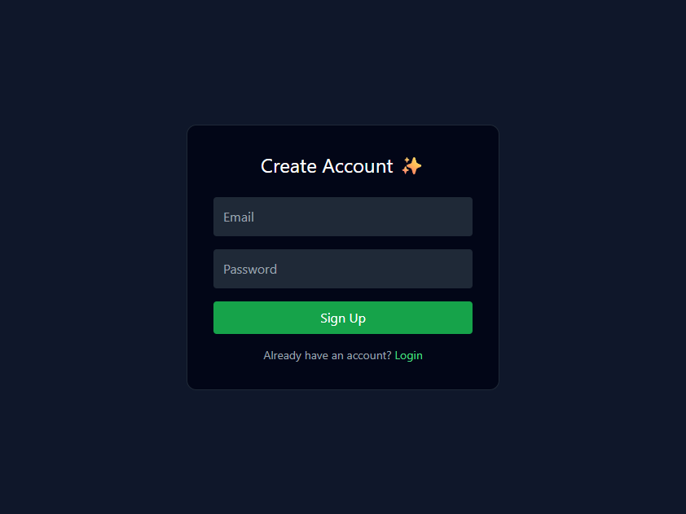
Screenshot: Signup Page
Figure: User registration page

Slide 10
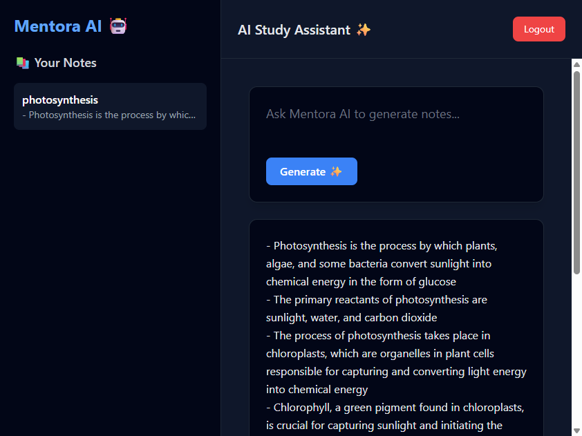
Screenshot: Dashboard with AI Output
Figure: Dashboard after generating notes on topic 'photosynthesis'

Slide 11
Testing and Results
Signup and login tested with valid and invalid credentials.
Protected routes validated with bearer token authentication.
Note generation tested with multiple topics.
History retrieval confirmed after successful note creation.

Slide 12
Conclusion and Future Scope
Project successfully delivers AI-assisted personalized note generation.
System is modular and suitable for academic demonstration.
Future scope: PDF export, search/filter, categories, streaming output.
Can be extended to a broader smart learning platform.

