Slide 1

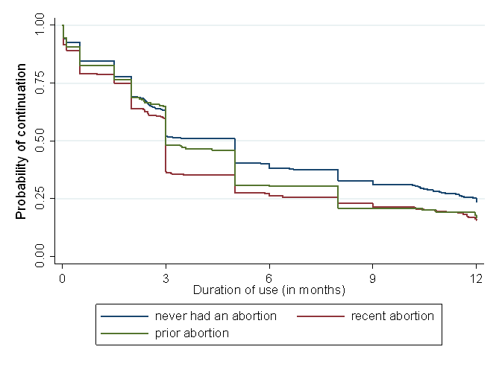

Undergoing an Abortion: A “Teachable Moment”?
Beth Brown, MA, MPA, Ushma Upadhyay, PhD, Abby Sokoloff, MPH, Tina Raine-Bennett, MD, MPH
University of California, San Francisco
Background
Results – Contraceptive Continuation
It is hoped that women undergoing an abortion will change their behavior and become more motivated to embrace a highly effective contraceptive regimen.
Following this belief we sought to test a basic tenet of “Teachable Moments Theory” – whereby a person experiences an unique situation (an unwanted pregnancy and a subsequent abortion) and in response attempts to modify behavior (initiate highly effective contraception) in hopes of avoiding the problem again in the future (repeat pregnancy and multiple abortions).
We examined whether young women having had a recent abortion would have better contraceptive adherence than women reporting a previous abortion and women reporting never having undergone an abortion - at least in the short term (6 months out) because, in theory, the abortion experience would be fresh on their minds.
At 6 months from contraceptive initiation the method continuation rate was low for all groups of women. However, compared to women who never had an abortion (37.7 per 100 person years), women who had a recent abortion had significantly lower continuation (25.6, p<0.001). Women who reported a previous abortion also had lower continuation than those who never had an abortion, although the difference did not reach significance (29.9, p=0.08).
At 12 months, contraceptive continuation was significantly lower for women who had a recent abortion compared to women who never had an abortion (14.5 vs. 21.6, p<0.001). Women who reported a previous abortion also had a lower continuation rate than those who never had an abortion (14.8, p=0.06).
Having a recent or a previous abortion was a risk factor for method discontinuation after controlling for age, race, education, and clinic site (Adjusted Hazard Ratio (AHR)=1.21, p<0.05).
Our analysis confirmed the results of other studies that have found that women having undergone an abortion are at greater risk for contraceptive discontinuation.
Methods and Sampling
1,387 non-married, English or Spanish-speaking females, 15-24 years of age, not seeking pregnancy for 1 year, who started pill, patch, ring or Depo-Provera for the first time were enrolled into the study and followed for 12 months. Participants were recruited after undergoing contraceptive counseling at a Planned Parenthood clinic located in one of four suburban communities of the San Francisco Bay Area.
“Recent abortion” are subjects who enrolled at time of the abortion.
“Prior abortion” are subjects who at enrollment reported having had an abortion previously.
“Never had” were subjects who at enrollment reported no abortion experience.
Conclusion
This analysis challenges the assumption that women who have an abortion will become better users of contraception. For patients in this study, an immediate abortion experience does not appear to be a “teachable moment” in and of itself, leading to improved uptake of contraception. Future research should continue to explore effective ways to inform and motivate patients to embrace contraception.
Better access to LARC methods is imperative as studies suggest that LARC may be beneficial for some women who have difficulty using contraception, although method selection bias may be a factor and thus needs to be explored.
Until effective interventions can be identified these women will be best served by working to preserve access to abortion services, especially as access becomes increasingly more restrictive.

