Slide 1
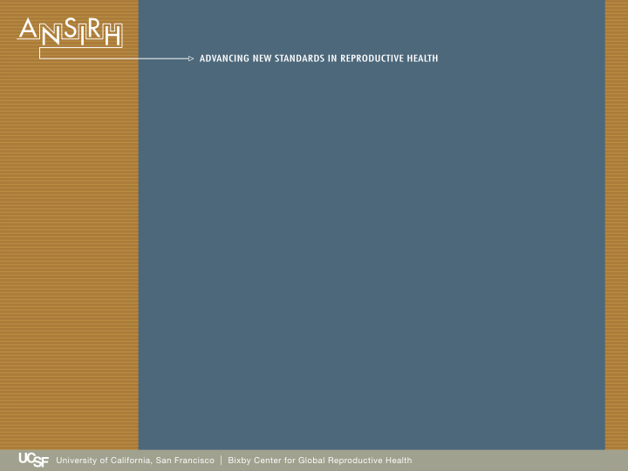
Abortion Stigma:
Strategies for Contact and Connection
Abortion Stigma Webinar Series
March 12, 2013
Kate Cockrill, MPH
Research Interns: Poonam Pai, Steph Herold and Becky Michelson
Notes:
Hi everyone. Thank you for showing up today for this conversation. I imagine that if you are on this call it’s because you are interested in abortion stigma.
You may be a woman who has had an abortion.
Or an abortion provider.
You may be an advocate who seeks to increase access to abortion…or reduce stigma related to abortion
You may be like me: a researcher examining the effects of abortion stigma on women, on providers on access
However, if you are on this call I would venture to guess that the stigma of abortion has touched you in some way.
My interest in abortion stigma is both academic and personal. When I was a young person, I did have a pregnancy scare that led me to a crisis pregnancy center. Not knowing if I was pregnant, I told the cpc staff that I was seeking an abortion. I received misinformation, was not listened to, and was lectured. The experience stayed in the background until I was in a health class my junior year of college. After I wrote about my experience, my professor took me aside and told me that what had happened “was not okay.”
Later I worked with women seeking abortions through the National Abortion Federation hotline. I spoke with women who were entangled in multiple stigmas related to their age, race, income-level and family size. I also worked in two abortion clinics in the US South and have long-time relationships with abortion providers who are strained by stigma personally, financially and politically.
I now run a research program on abortion stigma (and other reproductive stigmas) at ANSIRH (a research program at the University of California San Francisco). I have conducted qualitative interviews with Midwestern women having abortions and women who call post-abortion talk lines. It’s also included quantitative research in which I surveyed 641 women about their abortion experiences…and the stigma they experienced. And I developed a psychometric scale (or a brief survey instrument) to assess the stigma women experience.
This research has brought me in touch with advocates, providers, and foundations who are interested in challenging stigma and changing stigmatizing attitudes. So that is what we are going to talk about today.

Slide 2
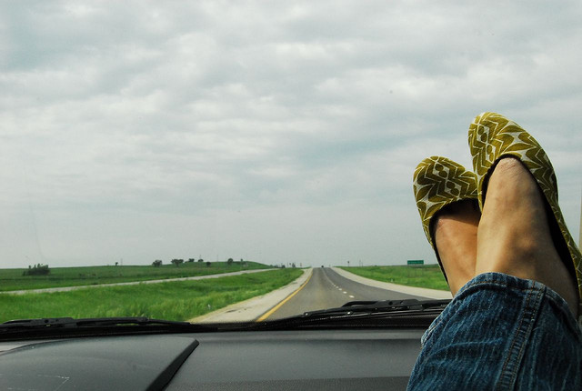
A Road Map
30 minutes
Theory
Design
Application
15 minutes
Questions
10 minutes
An example
Notes:
Theory: We’re going to start theoretical (exploring the problem and one possible solution). I’m going to invite you to think about stigma as interactional. Involving people with abortion experiences and people without experience. Then I’m going to introduce a theory “contact theory”. This is the idea that under appropriate conditions contact between people with a stigma and people without stigma…can reduce prejudices over time. It’s a pretty simple concept…and research shows it to be one of the most effective strategies for reducing prejudice and stigma.
Design: Next, we’re going to talk design. If (as I propose) contact is such an obvious and effective strategy for change. Why is it so rarely implemented? Why is it almost never studied?
Application: Finally we’re going to take the theory for a test run in a study that I designed using book clubs. I’m going to share with you the most up-to-date outcomes from the study.
Throughout the presentation, I’m going to ask a couple open-ended questions. Feel free to write your responses in the chat box. That will help to make the presentation more interactive. After I discuss the study part of the presentation, I’m going to take a 15 minute break for questions.
Then I’m going to end the webinar with a brief closing statement. Send me a smiley if you are ready to continue.

Slide 3
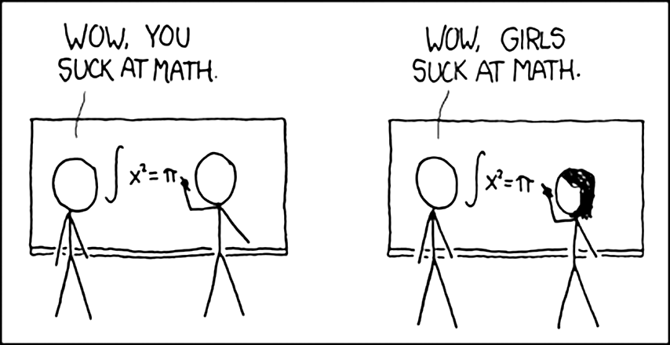
Stigma and Prejudice
No stigma
Stigma
Negative attitudes
Inferior status
Notes:
I’ll start with some definitions. Today we’re going to talk about stigma…but I also want us to start using the word prejudice.
Let’s start with this picture. On the left you see two people writing. One says to the other “you suck at math” On the right, we have the same image…but this time, the mathematician appears to be a girl. So the boy says to the girl “wow. Girls suck at math.”
This picture show some basic premises about stigma and prejduice. Stigma is considered a “discrediting attribute.” in this case, the girls gender discredits her as a mathematician. And the boy in the picture makes a generalization about gender based on this interaction that he applies to “all girls.”
Stigma can refer to the prejudicial attitudes and behaviors…as well as inferior status experienced by those who bear the stigma.
I think that linking prejudice and stigma is an important theoretical shift… because it reminds us that stigma is interactional. We all possess stigma in one way or another… and that gives us all a role in reducing it.

Slide 4
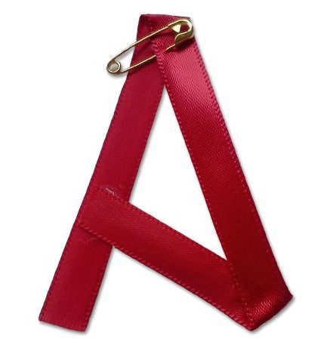
What is Abortion Stigma?
Inferior status experienced by women who have had abortions, abortion providers, and others involved in abortion
Prejudicial attitudes toward women who have had abortions, abortion providers and others who are involved in abortion
Notes:
So let’s narrow now to abortion stigma.

Slide 5
Abortion Stigma is Harmful
Negatively affects women’s mental and emotional health ¹
Negatively affects relationships ¹
Silences women’s real experiences ²
Contributes to social conflict, ideological entrenchment and political polarization ³
Stymies efforts to improve public health ³
Notes:
Research has shown that Abortion Stigma will negatively affect women’s mental health following an abortion. It also may affect women’s health seeking behavior. In many places around the world, stigma leads to unsafe abortion and major risks to women’s health.
Stigma can negatively affect relationships by preventing women from seeking support from the people they normally trust in their lives.
Stigma around abortion makes it difficult for women to speak up or come forward about their experiences.
Stigma both contributes to and is a product of social conflict, entrenchment and polarization. Stigma dissuades people with lived experiences from participating in public discourse.
Finally, abortion stigma creates constant challenges in improving public health. Whether its affecting the organization’s funding stream or drawing attention away from other important issues.
It is because of these harms that we are looking for strategies for change.

Slide 6
Contact Theory
Under appropriate conditions interpersonal contact is one of the most effective ways to reduce stigma and prejudice between majority and minority group members.
Notes:
Over the last several years, I have begun to look at the literature around stigma and prejudice to find which programs have been most successful. What I found was contact theory. Contact theory is actually theory that suggests…
It means bringing together people who have prejudices about abortion into contact with people who are stigmatized by their experiences with abortion.
There are hundreds of social scientists who have written about contact theory. It’s been applied in many circumstances where stigma or prejudice exist between groups. But much of the initial exploration of the theory was conducted by Gordon Allport, a social psychologist who studied prejudice toward Jews, Black people and communists.

Slide 7
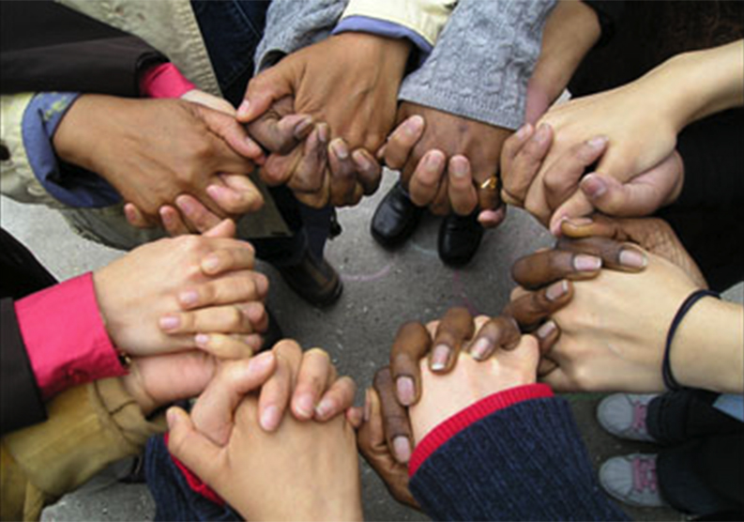
The Optimal Conditions for Contact
Equal status
Common goals
Intergroup cooperation
Support of authorities, law or customs
Notes:
Allport and other social scientists were aware that there were many types of contact that would not reduce prejudice. Indeed, there is a lot of evidence that groups can live near each other and carry on with stereotypes and animosity just fine.
Allport’s research suggested that there are optimal conditions in which contact could reduce prejudice between groups.
Optimal Conditions were: equal status between groups in the situation, common goals, intergroup cooperation and the support of authority, law or custom.

Slide 8
Some Examples
Gay student and heterosexual students at a US college⁴
Muslims and Non-Muslims neighbors in the Netherlands⁵
Racial attitudes toward between Black and white teammates on sports teams.⁶
Notes:
Allport and other social scientists were aware that there were many types of contact that would not reduce prejudice. Indeed, there is a lot of evidence that groups can live near each other and carry on with stereotypes and animosity just fine.
Allport’s research suggested that there are optimal conditions in which contact could reduce prejudice between groups.
Optimal Conditions were: equal status between groups in the situation, common goals, intergroup cooperation and the support of authority, law or custom.

Slide 9
Evidence about Contact Theory
80 years of evidence
Meta-analytic study of 515 studies ⁷
Across multiple stigmas, contact reduces prejudice
Greatest reductions were found around LGBT stigma
Reductions in prejudice are generalizable
*Pettigrew and Tropp. 2011. Meta-Analytic Test of Intergroup Contact Theory. Interpersonal Relationships and Group Processes.
Notes:
This study examined 515 studies which included 713 samples, and 1383 tests. Intergroup contact generally relates negatively and significantly to prejudice. The more rigorous the study, the larger the effect.
Another question often asked is…okay so we reduce prejudice in the experimental group…but is there an effect beyond the experiment? Yes. . Immediate attitudes become more favorable, as do attitudes toward the out group, out group members in other situations.
So let’s take a moment now, if you have questions about contact theory… or how it works. Why don’t you type them in the chat box. I’ll take one or two before we move on to Design.

Slide 10
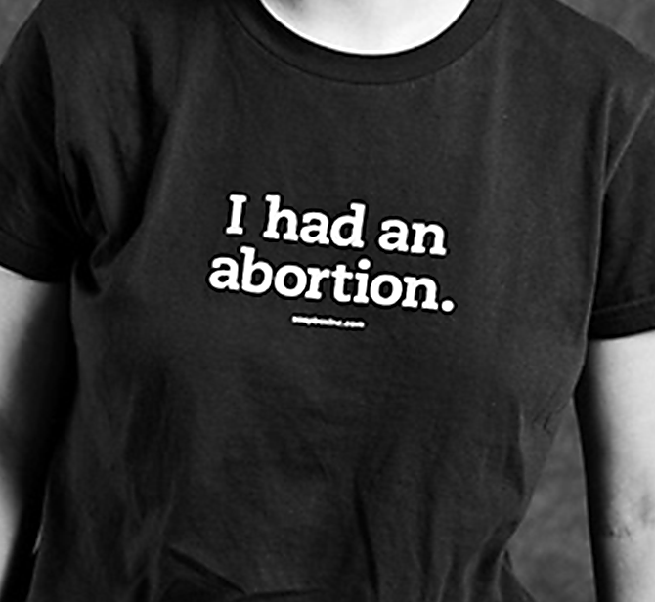
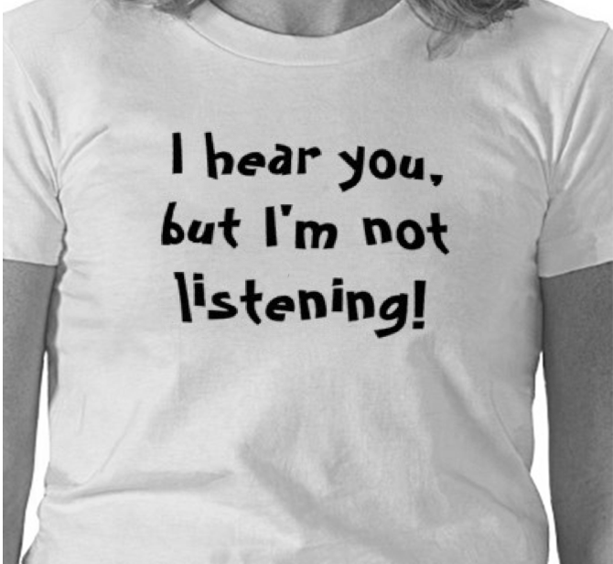
Contact Requires Some People to Talk and Others to Demonstrate a Willingness Listen
Notes:
So now that we’ve considered some of the theory behind stigma and behind contact. I want to talk about Design.
Specifically…if contact theory is such an obvious way to reduce abortion stigma:
Why is it so rarely implemented? Why is it almost never studied?
It’s an issue of visibility. In our daily lives, abortion experience…and even abortion prejudice are not often expressed by what we wear, the color of our skin, our gender presentation or any other aspect of our visible selves. There are certainly visual cues that might suggest prejudice…such as wearing a cross…but even that can be misleading since lots of Christians are not prejudiced about abortion.
In order for contact to happen around abortion, there will be a requirement for some to talk and others to show they are willing to listen.
What needs to happen to bring women who have had abortions into conversation with women who have not?
Are there issues on both sides which prevent these exchanges from happening?
How do we create an intervention which supports both speaking and listening?

Slide 11

The Experience of Abortion Stigma
Worries about judgment
“I’m afraid I will lose an important relationship.”
“My abortion discredits me.”
Isolation
“I can’t talk with the people I’m closest to about my abortion.”
Self-judgment
“I feel like a bad person”
“I’m such a mess.”
Community condemnation
“Most of my community thinks abortion is murder.”
Notes:
First, we have to understand the experience of being stigmatized by abortion.
At ANSIRH we’ve conducted both qualitative and quantitative research with women who have previously had abortions. We have seen that stigma manifests in four main ways for women who have abortions.
It manifests as worries about judgment from others.
It manifests as isolation.
It manifests as self-judgment.
Manifests as perceptions of community condemnation…or an assessment of how negatively your community feels about abortion.

Slide 12
Common Responses to Stigma
Excusing and justifying
Condemning the condemners
Transferring the blame
Selectively disclosing and supporting others
Secrecy, passing & covering
Notes:
When stigma manifests, women respond in the following ways.
If women experience a negative judgment, perceive a negative judgment, or feel judgmental of themselves. They begin to think of excuses or justifications for their abortion. This can be both an internal process…and an external one.
Also, in response to judgment, some women may transfer the blame for the abortion to someone else. Again, not really thinking abortion is okay…but not feeling entirely responsible for it either.
Research shows that telling an unsupportive person about your abortion is bad for coping.
Research also shows that if your first experience with disclosure is negative, you are less likely to tell additional people about your abortion.
Another response is to keep the abortion secret to avoid negative judgments from others. This might include passing as someone who has not had an abortion…even when the topic comes up in conversation. Or covering for the abortion by telling a deceptive story.
Some women respond to stigma by seeking support from other people…these women will selectively disclose to people that they think will support them. Or support other women who disclose to them that they are having or have had an abortion.
A final common response is to condemn the condemners. We see this all the time in our movement. Abortion isn’t wrong. Or “my abortion isn’t wrong”…it’s that the people who think abortion is wrong have the wrong values and motives. They, are the bad people.

Slide 13
How Women Manage Stigma
Excusing and justifying
DO NOT disrupt stigmatizing attitudes
Condemning the condemners
Transferring the blame
Selectively disclosing and supporting others
Secrecy, passing & covering

Slide 14
How Women Manage Stigma
Excusing and justifying
Condemning the condemners
Transferring the blame
Selectively disclosing and supporting others
Secrecy, passing & covering
Increase cultural silence and secrecy

Slide 15
How Women Manage Stigma
Excusing and justifying
Increases polarization and perception of “difference” between group
Condemning the condemners
Transferring the blame
Selectively disclosing and supporting others
Secrecy, passing & covering
Notes:
…
Now we’re going to move on to prejudice

Slide 16
Different Levels of Prejudice
Total prejudice
Concealed prejudice
Aversion
Ambivalence
Context-specific
compassion
Not at all prejudiced
Notes:
Though this has not been studied well. Polling research suggests that very few people are totally prejudiced about abortion. Likewise, there are very few people who are not at all prejudiced. Most fall somewhere in the middle.
But these levels that are expressed on this scale will interactions about the experience of abortion.
The most prejudiced people are the least likely to receive a direct disclosure of an abortion experience from someone else.
Those individuals who have concealed prejudice are likely the most damaging to the stigmatized, because they are more likely to receive a disclosure and then say or do something that is hurtful. In our studies, women who have abortions have experienced disclosing their abortions to people they thought might be supportive only to lose a friendship, a romantic relationship or a family relationship.
For those who have feelings of aversion or ambivalence about women who have abortions, contact with women who have abortions may create anxiety. This aversion may be expressed nonverbally on their face or in their posture or in what they say.
For those who have context-specific compassion, listening may be impaired because they are listening for excuses or justifications that ease discomfort around abortion.
And as I mentioned, though the “not all prejudiced” may be the best listeners….but they are few and far between. And we don’t have very many cultural symbols which would make these people visible to women who have abortions or one another.

Slide 17

What are the conditions?
Notes:
Since we know that talking and listening are necessary to creating contact. We had to consider, what are the conditions which reduce the need for the women who have had abortions to actively manage their stigma….and which demonstrate a willingness to listen nonjudgmentally to women who have abortions.

Slide 18
Revisiting the Optimal Conditions for Contact
Equal status
Common goals
Intergroup cooperation
Support of authorities, law or customs
Notes:
My hypothesis is that the same conditions which facilitate reductions in prejudice…will also facilitate disclosure and signal a willingness to listen.
So I tried to think of intergroup situations between women, where some would have had abortions and some would have not….and where the group itself would meet the optimal conditions for contact.

Slide 19

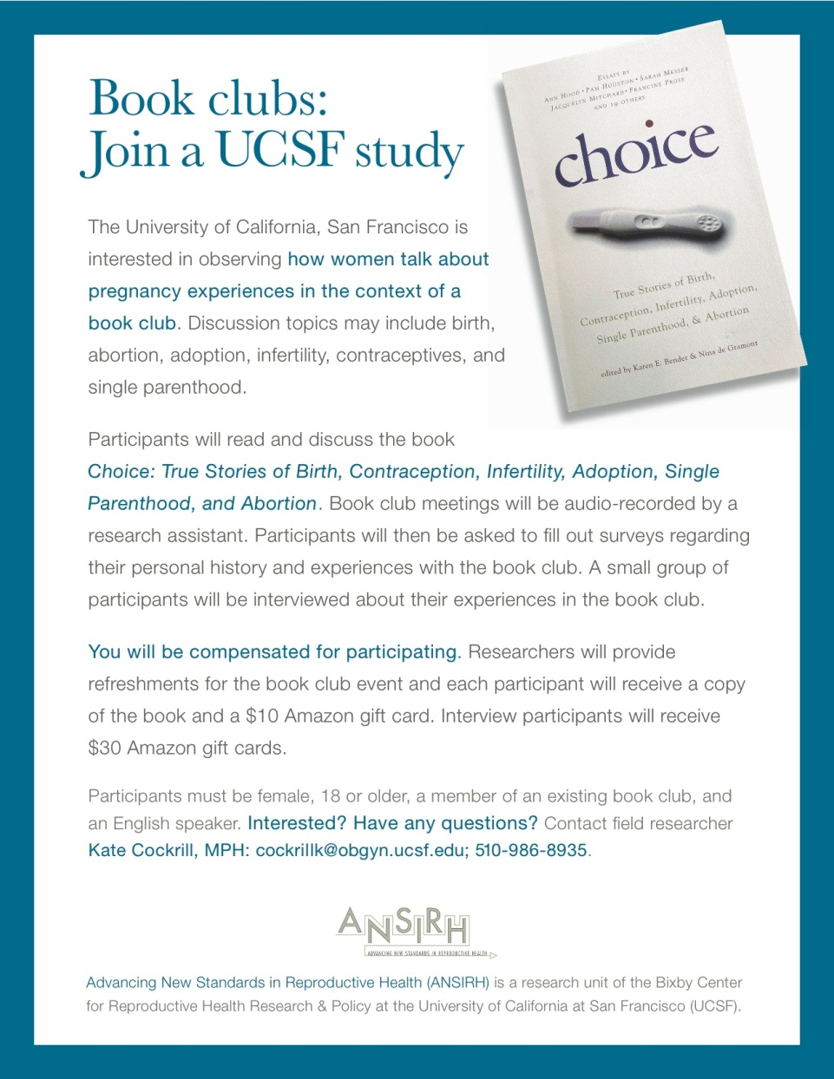
The Reading Women’s Lives Study
Notes:
The group that seemed to be the best fit for all of the goals of this study was women’s book clubs. Book clubs are places where women are in equal status relationships, they have a common goal of reading books for fun and discussion, members cooperate on choosing books and places to meet, and groups generally establish certain ground rules for discussion…emphasizing open-mindedness and curiosity.
My study entails recruiting pre-existing book clubs to participate in a study which “explores how women talk about pregnancy in the context of a book club.” As a discussion piece, I chose the book “Choice” which includes 23 true stories of pregnancy. The book editors had set out to write a book about abortion stories. However, in their quest for stories they decided to broaden the set of experiences in the book to include: birth, abortion, adoption, infertility, pregnancy loss and others.
Reflecting on the Optimal Condition of “equal status.” I was glad to find a book which supported the notion that each woman has a story. Whether she’s been pregnant or not. Become a mother or not.

Slide 20
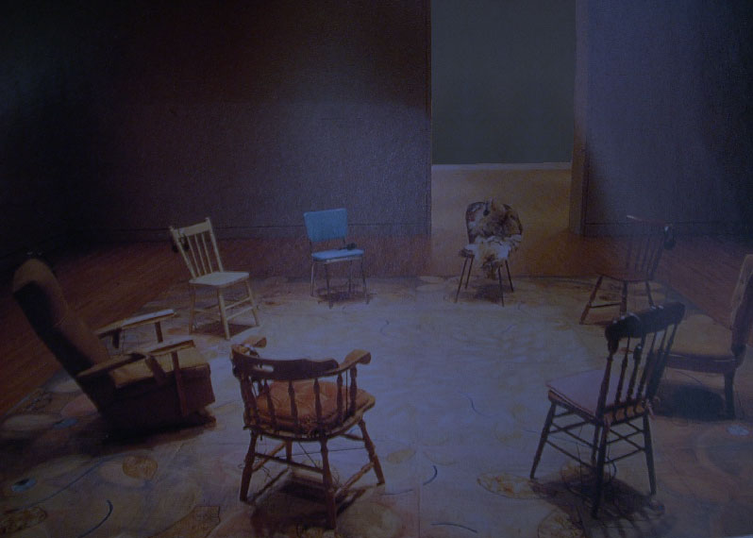
Reading Women’s Lives
Mixed methods
Group observation
Surveys
Interviews
Pre- and post-Book Club evaluation
Connected observation data with survey and interview data
Notes:
The study combines qualitative and quantitative methods. We use group observation and interviews to explore disclosure. We observe whether women disclose their abortion or other pregnancy experiences in the book clubs. We also conduct interviews after the book clubs to better understand reasons for disclosure or non disclosure. Our confidential surveys record pregnancy history and pregnancy attitudes (our measure of prejudice). We measure attitudes at three time periods. Before they read the book, after the book club discussion and three months later. We are also evaluating the book club experience to see whether it was a good experience for the participants.
This was a national tour. There was a researcher attending each of these meetings, recording the conversation, passing out surveys. We also purchased dinner for the participants on the evening of the study. Each participant received a book, and $10 in gift certificates for each survey they filled out. Those who conducted interviews later received $30 in gift certificates for a 1 hour interview.

Slide 21
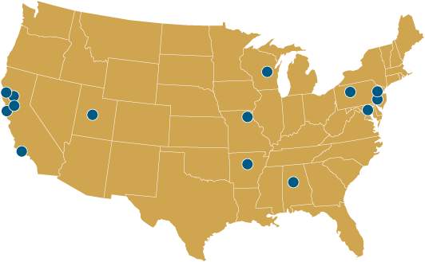
Reading Women’s Lives: 14 Book Clubs Enrolled
Notes:
We enrolled 14 book clubs.
Alabama
Arkansas
California (5)
Maryland
Missouri
New Jersey
New York (3)
Wisconsin
Utah

Slide 22

Reading Women’s Lives
121 participants
14 book clubs enrolled and observed
Age range: 23-76 years old women (median age 47) , 7 men (50’s and 60’s)
Race/ethnicity: 92 White, 12 Asian, 8 African American women, 2 Middle Eastern
Notes:
Studies of book clubs show that most are middle aged, upper middle class, white women. If you get variation, you typically get it along one of these demographic lines. But not all three. This has been our finding as well.
We observed 14 book clubs. At the suggestion of basically every all-female book club we observed…we did invite one all-male book club to participate.
We’ll be including them in some of our analysis. But they have been excluded from the analyses below.

Slide 23
Religious Background
Notes:
However the group is very diverse religiously.
Religion: 30 Not Religious, 39 Protestant, 17 Catholic, 12 Jewish, 7 Hindu, 1 Buddhist

Slide 24
Pregnancy Experiences from Survey
 | Women reporting (#) | Percentage of total
Pregnancies | 81 | 75%
Births | 73 | 68%
Miscarriages/still births | 32 | 30%
Abortions | 19 | 18%
Adoptive mothers | 2 | 2%
Birth mothers | 1 | 1%
Notes:
We don’t survey about their pregnancy histories until after they have participated in the book club event. Which felt pretty risky. We weren’t sure what mix of pregnancy experiences we would see or what proportion of the clubs would have a woman or women who had previously had an abortion.
Thought 18% seems low compared to the one in three statistic, remember that’s a lifetime incidence. For this group of women, the proportion seems about right.

Slide 25
77% of Book Clubs Contained an Abortion Experience
5
3
3
0
Number of women reporting abortions on confidential survey
2
1
1
0
0
1
1
1
1
Notes:
So now I’m going to talk about some of the findings that stemmed from our “observation” of the book club event.
We often talk about how abortion is so common, yet we never hear about it. Here is a statistic that I want you to remember. 77% of the book clubs we chose for this study contained at least one woman who had previously had an abortion. Though I can’t say that this is nationally representative…I think it’s an important image. If you want to find women who have experienced abortion… you do not have to go to high schools, colleges or planned parenthood. Go to a book club.
10 out of 13 of our book clubs included at least one member who had an abortion. The highest number of women with abortion experience was in our first book club. Where 5 out of 6 of the women had previously had an abortion.
Two of the groups with out abortion experience were in our youngest age range. The other had a low number of women show up on the day of the meeting due to the Thanksgiving Holiday.

Slide 26
15 out of 19 (79%) Women shared their abortion with their Book Club
5
5
3
1
1
1
1
1
Confidential survey disclosure only
1
1
Number of women who disclosed/ Confidential disclosure
Notes:
Not only do book clubs have women who have previously had abortions…but by and large, those women were willing to tell their stories.
These were all first time disclosures to their book club group. In a couple of situations, another member may have known. But in all of the cases of disclosure there were multiple people in the room who did not know

Slide 27
Abortion Disclosure
“I really identified with so many of those stories … they triggered a lot of memories. At one point I started crying and I don’t even remember which story — I think it was the story about the miscarriage … I’ve had five miscarriages. And I’ll put it out there, I had an abortion when I was 22. So, there were two or three little touchstones for me … so many moments when I thought, “Oh, my god, that’s me.”

Slide 28
The Importance of Visibility
“I’m a really private person; I don’t really share a lot with anyone. But this sort of showed me the benefit of putting yourself out there because you don’t know who you would end up connecting with or what similar experience you might share with someone that least expects it. And so it made me be more cautious of how I look at people and what I assume about people and what their experiences are.”

Slide 29
Sharing and Listening
“We have all told our stories to each other … it feels really good. It builds relationships, it makes you understand each other more, it makes you feel more connected.”
—A participant who had previously had an abortion
“This was different than other experiences I have had talking about abortion … because there was someone there who had had one … Abortion is not black/white. You can’t just dismiss someone who has had one.”
—A participant who identified as “pro-life”
Notes:
Not only did the book club discussion prompt disclosure and story-sharing with a new group. It was a positive and transformative experience for both groups.

Slide 30
Contact Theory: Feeling Thermometer
0
50
100
Notes:
Between 0 and 50 degrees mean that you do not feel favorably toward that person and you don’t care too much for that person.
Ratings between 50 and 100 mean you feel favorably or warm toward that person.
You would rate a person as 50 if you don’t feel particularly warm or cold toward that person.

Slide 31
Contact Theory: Feeling Thermometer
A Mother
92
Women in General
91
0
50
100
Notes:
Unsuprisingly our first two descriptions “moms”

Slide 32
Average Pre-Test Scores
Abortion Fetal Anomaly
74
Inconsistent Birth Control
41
A mother
92
Pregnant Teen
66
Women in General
91
Three Abortions
48
One Abortion
75
Pregnant Smoker
23
Reduced Pregnancy
59
0
100
Stigma
Notes:
Remember that stigma is something that devalues a person. So these scores on the feeling thermometer give us an understanding of how “generally positive” attitudes toward women and mothers are degraded when we add other descriptors. So reading backward from right to left we have the average scores for “women in general” and “mom”….and so on.

Slide 33
Average Pre-Test Scores
Abortion Fetal Anomaly
74
Inconsistent Birth Control
41
A mother
92
Pregnant Teen
66
Women in General
91
Three Abortions
48
One Abortion
75
Pregnant smoker
23
Reduced Pregnancy
59
Room for Change
Notes:
At the very high end of the scale we can see that there is not much room for increases in positive attitudes. But when we see scores that are at the mid-high to very low end of the scale…there’s room for increasing positive attitudes.

Slide 34
Did Scores Increase Post-Intervention?
Description | Increase in Score Post-Intervention*
Inconsistent Birth Control | 0
One Abortion | 3
Pregnant Smoker | 4
Pregnant Teen | 4
Abortion for Abnormal Fetus | 5
Reduced Triplet Pregnancy | 5
Three Abortions | 12
Yes
* All values statistically significant at p<0.05
Notes:
So that’s where we saw changes. This slides shows the average change in attitudes post-intervention. There are a lot of descriptions not on this list. I chose the descriptions that were the most related to our discussion about abortion.
We didn’t see any change in attitudes toward inconsistent birth control users. But we did see modest (statistically significant) improvements in attitudes toward most of our abortion-related descriptions. And a larger change for the most unacceptable description 3 abortions.
But I felt somewhat unsatisfied with these scores. I was curious if the trend toward increasing positive attitudes held for those with the most negative attitudes…and whether the effect was larger. So I did tested the effect again…but this time I looked for the change in score among those whose answers fell lowest range (0-50).

Slide 35
Biggest Difference Among Most Prejudiced
Description | Average Increase in Score* | Average Increase Among Most Prejudiced* | % of people scoring under 50
Inconsistent Birth Control | 0 | 8 | 45%
One Abortion | 3 | 27 | 7%
Pregnant Smoker | 4 | 8 | 73%
Pregnant Teen | 4 | 18 | 11%
Abortion for Abnormal Fetus | 5 | 29 | 11%
Reduced Triplet Pregnancy | 5 | 22 | 45%
Three Abortions | 12 | 22 | 55%
* All values statistically significant at p<0.05
Notes:
I found the average increase in scores was substantially higher among the most prejudiced people. Whereas there was no change in attitudes toward women who were inconsistent birth control users in the full sample test….in the test using only folks with scores lower than 50 I found that there was a statistically significant increase of 8 points.
In some cases…the effect was more than quadrupled for the individuals in the most prejudiced group.
This substantiates the claim that contact works and that the effect is larger for those who have the most room for change.

Slide 36
Limitations and Caveats
Sample lacks diversity
No control group
Book lacks diversity
Stigma still exists
Doesn’t work for everyone
A lot of data left unexplored
Notes:
We recruited book clubs via facebook and over the phone. It was difficult to sample for diversity. As we started to observe clubs we realized that there was a lack of racial/ethnic diversity and intentionally enrolled two book clubs where no members were white.
Also, all members were heterosexual. There was a male group…but the data aren’t show in this presentation. Future work will need to recruit very intentionally…and also should explore non-book group settings that might meet the contact criteria.
Book is great. Very diverse by pregnancy experiences, age, race (to some extent). But many women in the clubs wished it had been more diverse by economic status or sexual orientation…and that men’s perspectives had been more visible.
Stigma still exists. As I mentioned, there were 4 book clubs in which only a single. I interviewed two of these women who were the only disclosers in their group. Both still felt that disclosing was the right decision. But both expressed feeling concerned about potential judgments following their disclosure (from other members in their group). They experienced a heightened sense of vulnerability as compared with women in groups with multiple disclosures. I think this is really important to pay attention to in future work and in the development of future interventions.
One group really disliked the book. Couldn’t identify with the stories. And did not trust the research process. I’ve interviewed at least one of the members since and I don’t think the study did any harm. It just wasn’t their bag.
Finally, I’m limited in how much of this data I can show today. But we are continuing to analyze and there will be a lot more coming.

Slide 37
Questions?
Notes:
Ok. I’m going to break for questions.
You can type questions into the chat box and Kristen will moderate the question period.
I think you can also “raise your hand by…” and we’ll try to unmute you and let you ask your question out loud.

Slide 38
A Final Example
Notes:
So before we go I wanted to leave you with an example of what I consider the power of contact theory. Because there are other strategies for change: education, raising awareness, public service, storytelling. But this example, helps to illustrate how the book club idea is larger than the book alone.
I visited a small town in upstate New York. There in a public library I met with 8 women. In most book clubs, the stories came out organically…in the context of discussing the book itself. But in this book club, someone made a recommendation at the start of the club for each woman to go around and state 1) whether she liked the book and 2) what her pregnancy experiences had been.
Let me remind you that as researchers we were ONLY observing. And so they started….

Slide 39
A Lot of Experience
I have two children and several miscarriages.
Miscarriage and IVF. No kids.
…And I have two sons
I have had three pregnancies: three daughters.
A son. Never got pregnant again.
Two stepsons, two biological daughters and a son who I gave up for adoption when I was in high school.
Two children; a son and his wife just went through IVF
Notes:
So I’ll read these with you, starting at the top…and moving counter-clockwise.

Slide 40
An Abortion Disclosure
I have two children, I’ve been through infertility treatment, I have also been a single parent...but I’ve also had an abortion.
Notes:
The last person to go held up the book and pointed to the cover. She said “I’ve had almost every experience listed on this cover.”
What came next was a complete surprise.

Slide 41
Reciprocal Disclosures
I’ve had three abortions.
I’ve had two.
Notes:
Two women who already shared their pregnancy and parenting experiences in the circle…shared their abortions as well.
And then, they thanked the woman who had been the first to share.

Slide 42
What happened next…
A
C
B
Notes:
After the book groups, I interviewed all three women in this book club. They each told me, from their own perspective, what it had been like to be in that room and share their stories.
A was the first to share. I asked her what it was like to be in the circle that day.
When the conversation came around she realized she had to make a decision about whether to do it or not. I’m glad I did, she said, because I wasn’t alone. She felt immediately relieved and thought “I did that. It’s out.” When other people started to speak up…it was even more relief that she wasn’t the only person.
Later in the interview I asked who else she had shared with. I was surprised to find out that she’s not shared with any family members. Parents are the only people who know…and they were there when she got her abortion. There is no real purpose to revealing it to anyone else in her family. In fact, she’d never spoken of her abortion since it happened. Not even with her spouse.
B: I called B and told me:
The three of us who revealed having abortions. We don’t usually talk personally. The night of the book club…she was up half the night. Rethinking what the discussion was about. She emailed the other women to see if they were okay.
She called the experience: profound and mind-altering. A lot of people opened their eyes. These are all people we know pretty well. Each of us gained tolerance for a new situation.” She thinks it opened minds. It’s an experience that’s hard to describe if you weren’t actually there.
C: I called C and she told me:
That she had been excited to participate once she knew what the book was about. She thought: Maybe a chance for “growth” for me. Maybe I could share my story and I could grow…and by doing so other people would grow as well.
Since the book club she’s shared the book with friends. She said that it was “fun” to participate in… and felt she was contributing to something larger than the local book club. She felt enriched by hearing the stories in her group.

Slide 43

A Sea Change
Connection
Visibility
Transformation
Notes:
I think I mentioned that the stigma research program here at ANSIRH is called the Sea Change program.
I think that this example illustrates the possibility for destigmatization around abortion.
Theory-based, well-designed projects can create the optimum conditions for raising visibility, increasing connection, and fostering the transformation we need to destigmatize abortion.
Repeated over time, I think that this work can create a sea change in attitudes toward abortion, pregnancy, parenting and reproduction.

Slide 44
Acknowledgements
Funder:
The William and Flora Hewlett Foundation
Editors of Choice:
Karen Bender & Nina de Gramont
All the Essayists in Choice
Research Interns:
Poonam Pai
Steph Herold
Becky Michelson
All the study participants
Notes:
I want to acknowledge the Hewlett foundation for their support of this project. And specifically my program officer Peter Belden.
Editors of the book choice. And all the women who took risks and told their stories in the book.

Slide 45
Let’s Connect
Kate Cockrill
Director
Sea Change Program
ANSIRH
cockrillk@obgyn.ucsf.edu
Notes:
I’m really excited to hear from you off line about your ideas about the project, stigma and how you want to see this work move forward.

Slide 46
References
Major, B., and R. H. Gramzow. 1999. Abortion as stigma: cognitive and emotional implications of concealment. Journal of Personality and Social Psychology 77 (4):735-45.
Ellison, M. A. 2003. Authoritative knowledge and single women's unintentional pregnancies, abortions, adoption, and single motherhood: Social stigma and structural violence. Medical Anthropology Quarterly 17 (3):322-47.
Joffe, Carole. 2010. Dispatches from the abortion wars: The costs of fanaticism to doctors, patients, and the rest of us. Boston: Beacon Press.
Herek, G. M. (1987) The instrumentality of attitudes: Toward a neofunctional theory. Journal of Social Issues, 42, 99–114.
Savelkoul, Scheepers, P., Tolsma, J., Hagendoorn, L. (2011) "Anti-Muslim Attitudes in The Netherlands…" European Sociological Review, 27, 6, 741-758.
Brown, K.T, Brown, T.N., Jackson, J.S., et al. (2003). Teammates on and off the field? …. Journal of Applied Social Psychology, 33, 1379-1403
Pettigrew and Tropp. 2011. Meta-Analytic Test of Intergroup Contact Theory. Interpersonal Relationships and Group Processes.

