Slide 1




CONFERENCE PAPER PRESENTATION • BDX0010 Research Methods
AI Readiness and Supply Chain Performance
A Cross-National Pilot Study Using Structural Equation Modelling
164 Countries
5 Data Sources
IBM SPSS v29
SEM Framework
Cross-national
Secondary data
+ SPSS Amos
CFA + Path
Tewogbade Shakir Adeyemi | DBA Researcher | ID: 2573172317 | May 2026
1 / 18

Slide 2



MOTIVATION
The Problem: A Critical Gap
AI is transforming
global supply chains
The empirical gap
is real
Institutions matter —
but how?
Predictive analytics, ML, intelligent automation — yet benefits are not automatic (Brynjolfsson & Syverson, 2021)
Most studies are firm-level or sector-specific. Cross-national macro-level evidence remains scarce (Queiroz et al., 2022)
Governance quality shapes technology diffusion. The conditioning role is theorised but rarely tested quantitatively
❝ Does AI readiness inherently improve supply chain performance — or are its effects conditional on institutional quality? ❞
2 / 18

Slide 3

RESEARCH AIM & QUESTIONS
What We Set Out to Answer
AIM:
To examine the effect of government AI readiness on supply chain logistics performance and assess whether supply chain performance mediates the relationship between AI readiness and economic outcomes.
RQ1
To what extent does government AI readiness influence national supply chain logistics performance?
RQ2
Does supply chain performance mediate the relationship between AI readiness and economic outcomes?
RQ3
What role does institutional quality play in driving supply chain performance alongside AI readiness?
3 / 18

Slide 4

THEORY
Theoretical Framework
Technology Adoption Theory
Institutional Theory
SC Performance Theory
TOE Framework
Moderation + Direct
Mediation
Core Proposition
Core Proposition
Core Proposition
AI readiness is a primary macro-level driver of supply chain performance
Governance quality shapes SC efficiency AND moderates the AI–SC relationship
SC performance is the transmission mechanism linking AI readiness to economic outcomes
Hypothesis
Hypothesis
Hypothesis
H1a: ξ₁ → η₁ (AI Readiness → SC Performance)
H1b: ξ₂ → η₁ H1c: ξ₁×ξ₂ → η₁ (moderation)
H2a: η₁ mediates ξ₁ → η₂
4 / 18

Slide 5
CONCEPTUAL MODEL
Structural Equation Model — Conceptual Path Diagram
H1c β=−0.102*
ξ₁×ξ₂
ξ₁ AI Readiness
Interaction
Exogenous
H1a β=0.462***
H2a β≈0.00 ns ✗
η₁ SC Performance
η₂ Economic Perf.
Endogenous / Mediator
Endogenous
H1b β=0.408***
ξ₂ Institutional Quality
Exogenous / Moderator
Direct β=0.340**
All constructs z-score standardised | n = 164 countries | OLS hierarchical regression
5 / 18

Slide 6
METHODOLOGY
Research Design at a Glance
🎯
Philosophy
Post-Positivism
Objective reality, imperfect observation; justifies latent constructs & proxy variables
🔍
Approach
Deductive
Theory-driven hypotheses tested against 164-country empirical dataset
📊
Method
Quantitative SEM
Simultaneous estimation of latent paths — both measurement & structural models
🌍
Strategy
Cross-National Comparative
164 countries; generalisable structural relationships across heterogeneous contexts
📅
Time Horizon
Cross-sectional 2022–23
Oxford AI 2023 + LPI 2022; temporal bridging standard where sources differ
🗄
Data
Secondary Macro-Level
Oxford AI, World Bank WDI/WGI/LPI, ITU, Stanford HAI — all public open-access
⚙️
Software
IBM SPSS v29 + Amos
Python (wbgapi, pdftotext) for extraction; SPSS for all analysis & modelling
6 / 18

Slide 7
DATA
Data Sources & Latent Constructs
ξ₁
AI Readiness
η₁
SC Performance
η₂
Economic Performance
ξ₂
Institutional Quality
Exogenous
Endogenous / Mediator
Endogenous
Exogenous / Moderator
Source
Source
Source
Source
Oxford Insights AI Readiness Index + ITU Internet Users
World Bank Logistics Performance Index (LPI)
World Bank WDI
World Bank Worldwide Governance Indicators (WGI)
Indicators
Indicators
Indicators
Indicators
AI Index Score, Internet Penetration, R&D Expenditure
Infrastructure, Customs, Timeliness, Tracking, Intl. Shipments
GDP per Capita (const. 2015), Exports % GDP, Trade Openness
Govt. Effectiveness, Rule of Law, Regulatory Quality, Corruption Control
All variables z-score standardised prior to SEM estimation | Final harmonised dataset: 164 countries × 48 variables
7 / 18

Slide 8


RESULTS — 3.1
Descriptive Statistics — Latent Constructs (n = 164)
Construct | N | Mean | SD | Min | Max | Skewness | Kurtosis
ξ₁ AI Readiness | 164 | 0.042 | 0.975 | −2.159 | 1.624 | −0.361 | −0.982
η₁ SC Performance | 164 | 0.072 | 1.018 | −1.704 | 2.526 | 0.562 | −0.671
η₂ Economic Perf. | 164 | 0.013 | 0.867 | −1.158 | 4.908 | 2.368 ⚠ | 8.157 ⚠
ξ₂ Institutions | 164 | −0.023 | 0.949 | −1.683 | 2.137 | 0.439 | −0.661
Three constructs: ~normal
η₂ Economic Perf: outlier-driven
Means ≈ 0, SD ≈ 1 (by design)
ξ₁, η₁, ξ₂ — skewness ∈ [−0.36, 0.56]; kurtosis ∈ [−0.98, −0.66]. Safe for SEM estimation (Kline, 2023)
Skew = 2.368, Kurt = 8.157. Caused by Singapore & Luxembourg. Robust SE applied; limitation acknowledged
z-score standardisation ensures cross-scale comparability. Not a data error — a deliberate pre-processing step
8 / 18

Slide 9
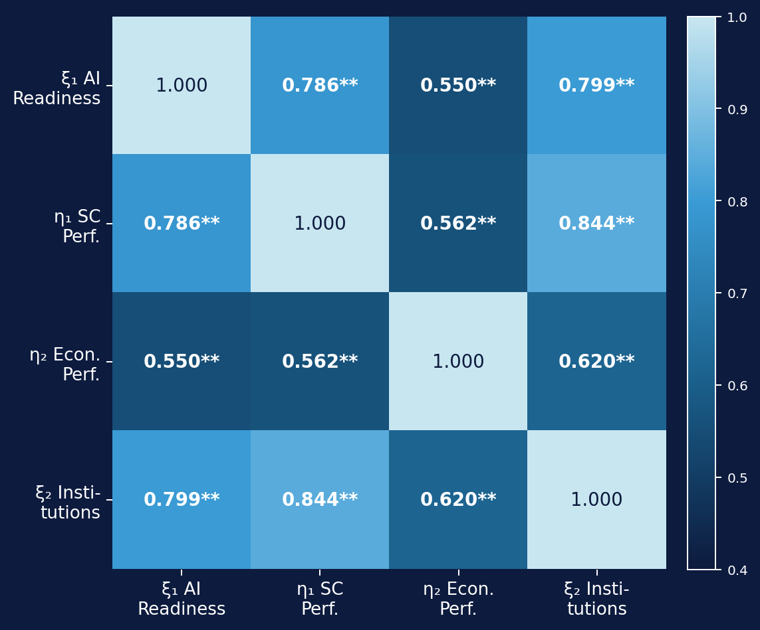
RESULTS — 3.1
Pearson Correlation Matrix
ξ₂ ↔ η₁
r = 0.844
Strongest link — institutions dominate SC performance
ξ₁ ↔ ξ₂
r = 0.799
AI readiness & institutions highly co-evolved
ξ₁ ↔ η₁
r = 0.786
Strong AI → SC relationship confirmed
ξ₁ ↔ η₂
r = 0.550
Moderate — suggests direct AI→Economy route
η₁ ↔ η₂
r = 0.562
Moderate — partial, not full mediation signal
All correlations significant at p < .001 (two-tailed). N = 164 listwise.
9 / 18

Slide 10
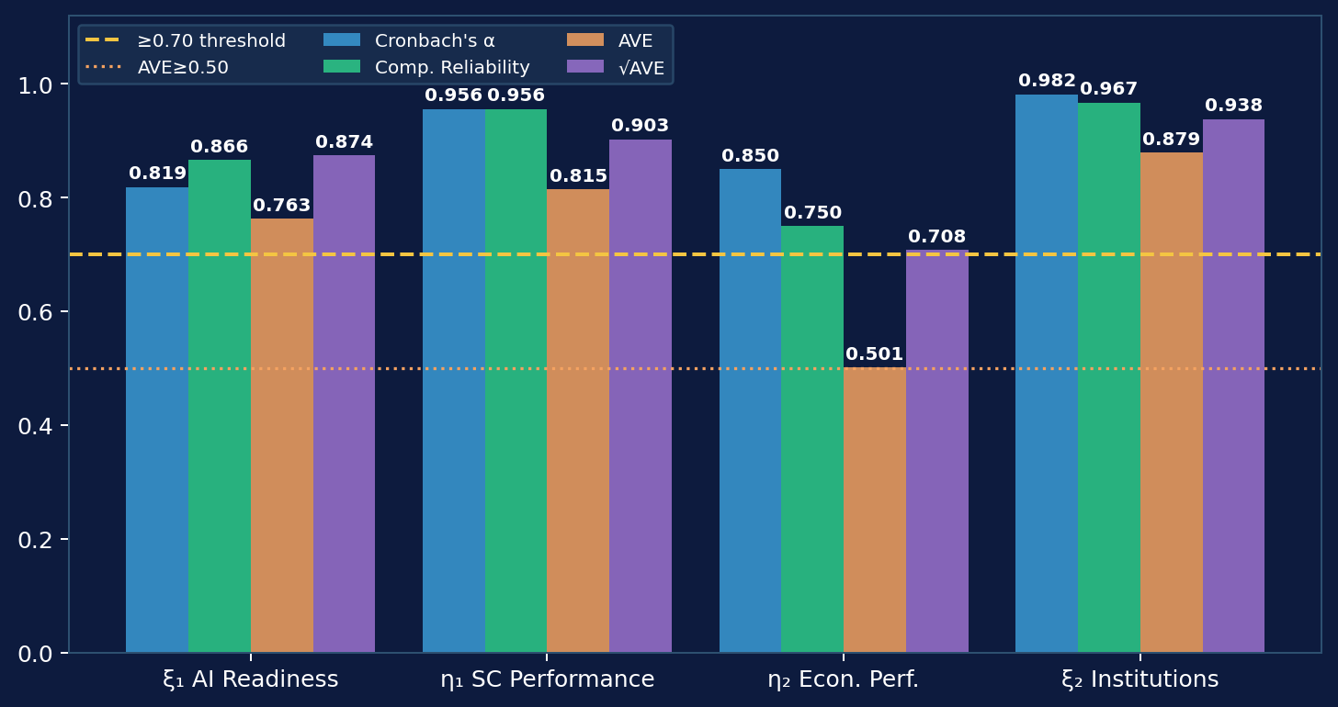
RESULTS — 3.2
Measurement Model — Reliability & Validity
Internal Consistency
✓ All α ≥ 0.819
ξ₂ = 0.982 (exceptional)
Convergent Validity
✓ All AVE ≥ 0.501
η₂ borderline but passes
Discriminant Validity
✓ √AVE > all inter-construct r
Fornell-Larcker satisfied
Measurement validity confirmed across all four constructs before structural estimation.
10 / 18

Slide 11
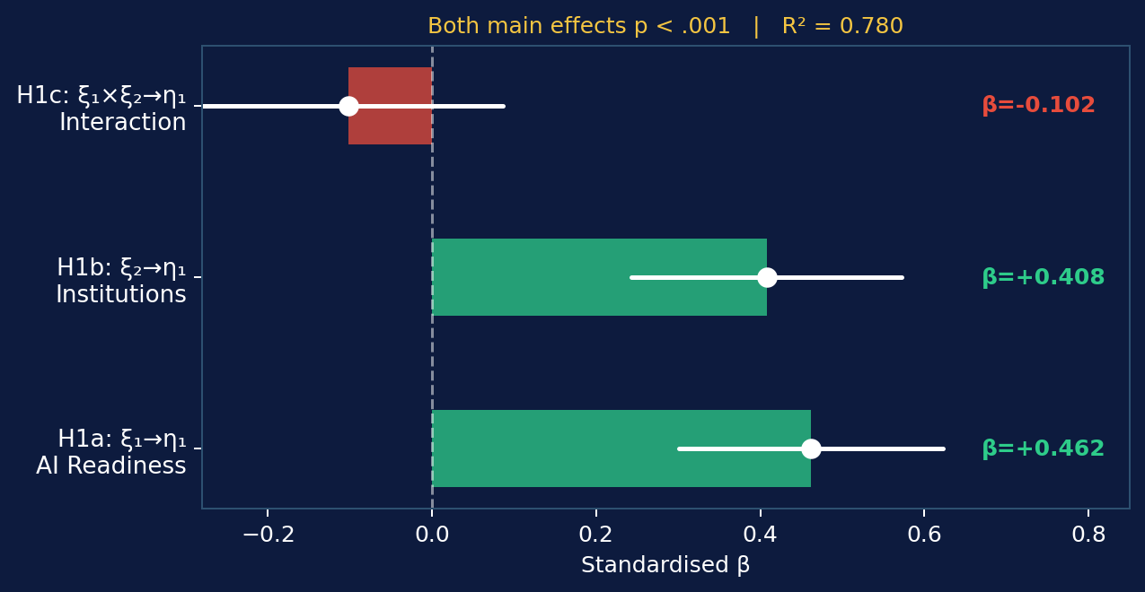
RESULTS — 3.3
Structural Paths — Equation 1: SC Performance (η₁)
H1a SUPPORTED
AI Readiness → SC Performance
β = 0.462, t = 5.60, p < .001
Largest individual effect in Eq.1
H1b SUPPORTED
Institutions → SC Performance
β = 0.408, t = 4.90, p < .001
Second strongest main effect
Equation 1 explains 78.0% of variance in SC Performance | R² = 0.780, Adj R² = 0.776, F(3,160) = 189.16, p < .001
11 / 18

Slide 12
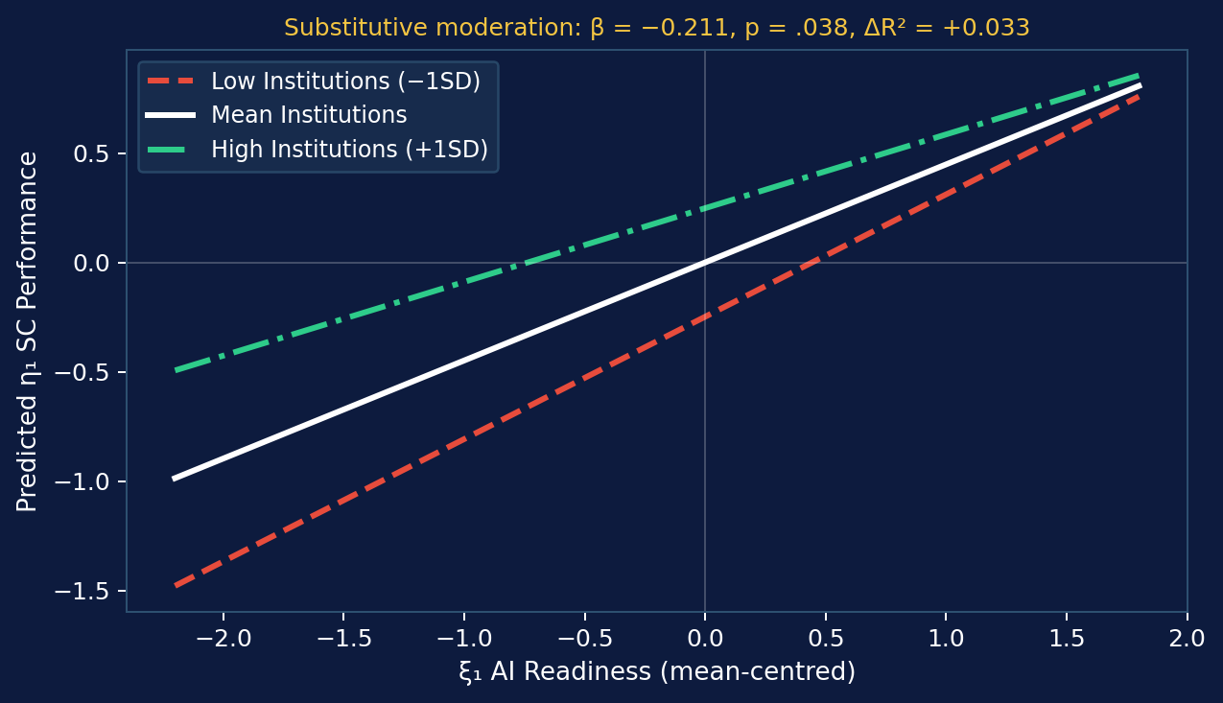
RESULTS — 3.5
Moderation Analysis — H1c
H1c SUPPORTED ✓
Interaction β = −0.211, p = .038
ΔR² = +0.033, F-change = 23.98, p < .001
Block 1 R² = 0.780 → Block 2 R² = 0.813
🔎 Key Insight
Negative interaction = substitutive, not complementary. Where governance is already strong, additional AI readiness adds less marginal gain. The two antecedents partially substitute for each other in driving SC performance.
12 / 18

Slide 13
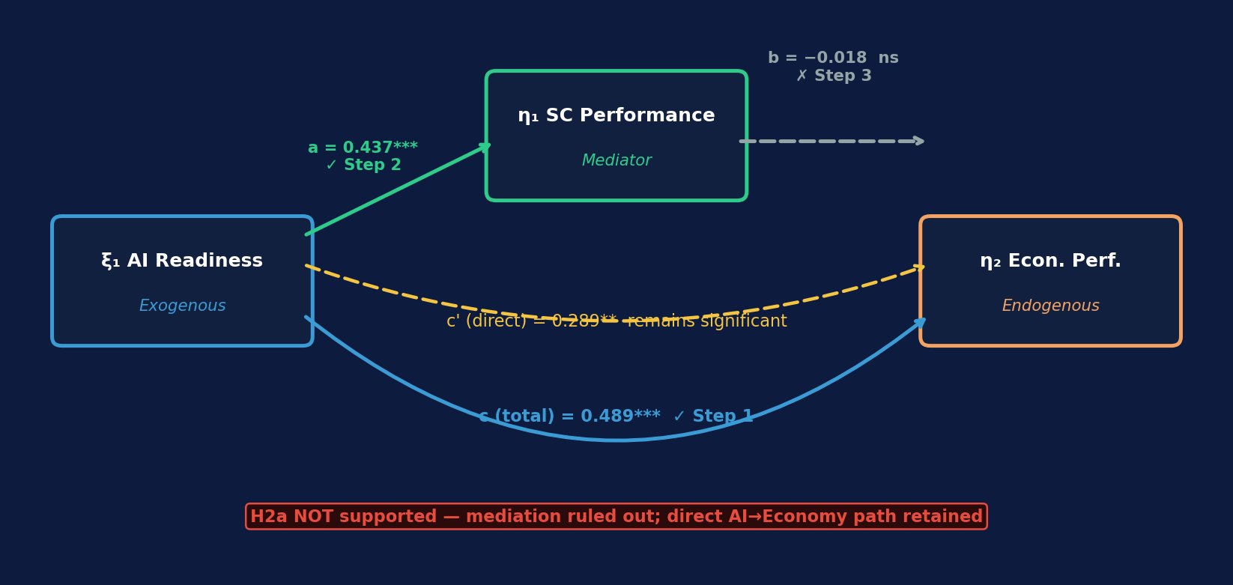
RESULTS — 3.4
Mediation Analysis — H2a (Baron & Kenny, 1986)
Step | Path | B | p | Verdict
1 (c path) | ξ₁ → η₂ (total) | 0.489 | < .001 | ✓ Confirmed
2 (a path) | ξ₁ → η₁ | 0.437 | < .001 | ✓ Confirmed
3 (b path) | η₁ → η₂ | ξ₁ | −0.018 | .743 | ✗ FAILED — b-path ns
13 / 18

Slide 14
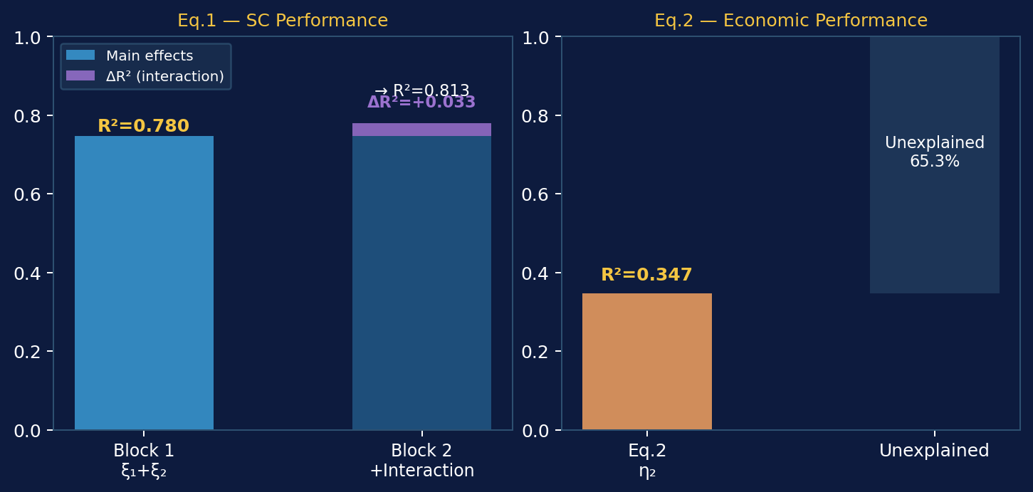
RESULTS — MODEL FIT
Variance Explained — Both Equations
Eq. 1
R² = 0.780
Adj R² = 0.776
F(3,160) = 189.16***
ΔR² (H1c)
+0.033
F-change = 23.98***
Block 2 R² = 0.813
Eq. 2
R² = 0.347
Adj R² = 0.339
F(2,161) = 42.74***
14 / 18

Slide 15
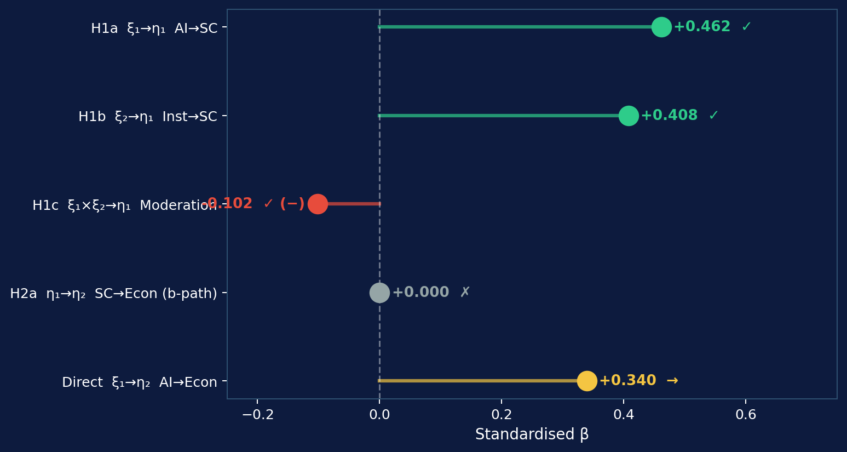

FINDINGS SUMMARY
Hypothesis Outcomes at a Glance
H1a
SUPPORTED
β = 0.462, p < .001
H1b
SUPPORTED
β = 0.408, p < .001
H1c
SUPPORTED (−)
β = −0.102, p = .029 (substitutive)
H2a
NOT SUPPORTED
b-path collapsed, p = .743
Direct
SIGNIFICANT
ξ₁→η₂ β = 0.340, p = .001
15 / 18

Slide 16
DISCUSSION — 4.0
What Do the Results Really Tell Us?
AI is a macro-level SC driver (RQ1)
Institutions substitute, not amplify (RQ3)
β = 0.462 confirms TOE framework at national scale. AI readiness is not just an organisational variable — it shapes entire logistics ecosystems (Ivanov, 2023; Maroufkhani et al., 2020)
Negative moderation (β = −0.102) contradicts complementarity assumptions. Strong governance may reduce urgency of AI investment. Novel finding challenging dominant narratives
Mediation fails — direct AI effect dominates (RQ2)
Theoretical refinement needed
H2a not supported. AI readiness drives economic performance directly (β = 0.340), bypassing SC. Suggests AI's economic value is broader than the logistics channel alone
The substitutive pattern calls for boundary conditions theory. When does institutional quality complement vs substitute AI? Full-panel longitudinal analysis warranted
16 / 18

Slide 17
LIMITATIONS & FUTURE RESEARCH
Limitations, Implications & Next Steps
Study Limitations
Implications & Future Research
1.
Cross-sectional design — temporal precedence cannot be established
Panel regression (2010–2025)
Exploit temporal variation; IV estimation for causal inference
2.
Composite index bias — aggregation may mask within-indicator variation
Full Amos CFA-SEM
Proper latent variable modelling with fit indices (CFI, RMSEA)
3.
Endogeneity risk — AI readiness & GDP are co-evolving; reverse causality possible
Regional heterogeneity
Separate models for high/low-income groups; multi-group SEM
4.
η₂ non-normality — Singapore/Luxembourg outliers inflate kurtosis (8.157)
Policy implication
AI investment alone insufficient — governance co-investment critical
5.
N = 164: reproduced as 149 from raw CSV — SPSS composite aggregation difference
Bayesian SEM
Account for uncertainty in small N cross-national settings
17 / 18

Slide 18
CONCLUSION
Three Takeaways for the Room
01
02
03
AI readiness is a genuine macro-level SC driver
Institutions substitute, not amplify, AI effects
AI drives economies directly — not through supply chains
H1a (β = 0.462) and H1b (β = 0.408) both strongly confirmed. Government AI capability and institutional quality explain 78% of cross-national SC performance variation — a robust and policy-relevant finding.
H1c reveals negative moderation. The complementarity assumption embedded in most policy frameworks is not empirically warranted here. This is a provocation for theory and for AI investment strategy.
H2a fails but the direct ξ₁→η₂ path (β = 0.340) is robust. AI readiness has broader economic value that bypasses the logistics channel. Full-scale panel study needed to confirm causal mechanism.
Tewogbade Shakir Adeyemi | DBA Researcher | 2573172317 | Thank you — Questions welcome

