Slide 1

SBEL CONFERENCE PAPER PRESENTATION • June 2026
AI Readiness and Supply Chain Performance
A Cross-National Pilot Study Using Structural Equation Modelling
164
5
SEM
IBM SPSS
Countries
Data Sources
Framework
Analysis
Tewogbade Shakir Adeyemi | DBA Researcher | Student ID: 2573172317
1

Slide 2

MOTIVATION
The Problem: A Critical Gap
AI is Transforming
Global Supply Chains
The Empirical Gap
Is Real
Institutions Matter —
But How?
Predictive analytics, ML, and intelligent automation are reshaping logistics. Yet the benefits are not automatic — returns depend on context (Brynjolfsson & Syverson, 2021)
Most research is firm-level or sector-specific. Cross-national macro-level evidence on AI → SC performance remains scarce (Queiroz et al., 2022)
Governance quality shapes technology diffusion. The conditioning role of institutions is theorised but rarely tested quantitatively at this scale
❝ Does AI readiness inherently improve supply chain performance — or are its effects conditional on institutional quality? ❞
2

Slide 3

RESEARCH AIM & QUESTIONS
What We Set Out to Answer
AIM
To examine the effect of government AI readiness on supply chain logistics performance and assess whether supply chain performance mediates the relationship between AI readiness and economic outcomes.
To what extent does government AI readiness influence national supply chain logistics performance?
RQ1
Does supply chain performance mediate the relationship between AI readiness and economic outcomes?
RQ2
What role does institutional quality play in driving supply chain performance alongside AI readiness?
RQ3
3

Slide 4

THEORETICAL FRAMEWORK
Theoretical Framework
Technology Adoption Theory
Institutional Theory
SC Performance Framework
TOE Framework • Tornatzky & Fleischer, 1990; Baker, 2012
Scott, 2014; North, 1990
Gunasekaran et al., 2004; Chan & Qi, 2003; Beamon, 1999
THEORY SAYS
THEORY SAYS
THEORY SAYS
Technology adoption and performance are shaped by three contexts: technological capability, organisational readiness, and the external environment. Government AI readiness represents national technological capability, while the institutional and policy environment determines whether that capability translates into better supply chain performance.
Organisational and national performance are shaped not only by internal resources or technology, but also by the wider institutional environment — rules, regulations, governance quality, norms, and enforcement systems.
Effective supply chain performance is a multidimensional construct measured through logistics capabilities, efficiency, responsiveness, and reliability. Improvements in these dimensions contribute to superior organisational and economic outcomes.
PROPOSITION
PROPOSITION
PROPOSITION
AI readiness is a primary macro-level driver of supply chain performance
Governance quality shapes SC efficiency AND moderates the AI–SC relationship
SC performance is the transmission mechanism linking AI readiness to economic outcomes
HYPOTHESIS
HYPOTHESIS
HYPOTHESIS
H1a: ξ₁ → η₁ (AI Readiness → SC Performance)
H1b: ξ₂ → η₁ | H1c: ξ₁×ξ₂ → η₁ (moderation)
H2a: η₁ mediates ξ₁ → η₂
4

Slide 5

CONCEPTUAL MODEL
Structural Equation Model — Path Diagram
ξ₁×ξ₂
Interaction
ξ₁
AI Readiness
Exogenous
η₁
η₂
SC Performance
Economic Perf.
Endogenous / Mediator
Endogenous
ξ₂
Institutional Quality
STRUCTURAL PATHS
Exogenous / Moderator
ξ₁ → η₁ AI → SC Performance
LATENT CONSTRUCTS
ξ₂ → η₁ Institutions → SC
ξ₁ AI Readiness
ξ₁×ξ₂→η₁ Interaction → SC
ξ₂ Institutional Quality
η₁ → η₂ SC → Economy
η₁ SC Performance
ξ₁ → η₂ AI → Economy (direct)
η₂ Economic Performance
5
All constructs z-score standardised | n = 164 countries | OLS hierarchical regression

Slide 6

METHODOLOGY
Research Design
A cross-national post-positivist pilot study drawing on secondary macro-level data from five open-access databases. Constructs are operationalised as z-standardised composites across 164 countries, estimated via OLS hierarchical regression — a deliberate pilot approximation of full latent-variable SEM — to validate structural relationships prior to full-scale Amos estimation.
164 Countries
5 Databases
Cross-national scope
Oxford · ITU· WB-LPI · WB-WGI WB-WGI
2022 – 23
IBM SPSS v29
Cross-sectional horizon
+ Python pipeline
PHILOSOPHY
APPROACH
STRATEGY
DATA
Post-Positivist
Deductive
Comparative SEM
Secondary Macro
Objective reality · latent constructs · proxy variables
Theory → Hypotheses → Empirical test → Revision
Structural paths across heterogeneous national contexts
Open-access · 48 variables · Harmonised composites
6

Slide 7

DATA SOURCES
Data Sources & Latent Constructs
ξ₁
AI Readiness
η₁
SC Performance
η₂
Economic Perf.
ξ₂
Institutional Quality
Exogenous
Endogenous / Mediator
Endogenous
Exogenous / Moderator
Source
Source
Source
Source
Oxford Insights AI Index + ITU
World Bank LPI
World Bank WDI
World Bank WGI
Indicators
Indicators
Indicators
Indicators
AI Index Score
Internet Penetration
R&D Expenditure
Infrastructure
Customs
Timeliness, Tracking
Intl. Shipments
GDP per Capita
Exports % GDP
Trade Openness
Govt. Effectiveness
Rule of Law
Regulatory Quality
Corruption Control
All variables z-score standardised prior to SEM | Final harmonised dataset: 164 countries × 48 variables
7

Slide 8

RESULTS — DESCRIPTIVE STATS
Descriptive Statistics — Latent Constructs (n = 164)
Construct
N
Mean
SD
Min
Max
Skewness
Kurtosis
ξ₁ AI Readiness
164
0.042
0.975
−2.159
1.624
−0.361
−0.982
η₁ SC Performance
164
0.072
1.018
−1.704
2.526
0.562
−0.671
η₂ Economic Perf.
164
0.013
0.867
−1.158
4.908
2.368 ⚠
8.157 ⚠
ξ₂ Institutions
164
−0.023
0.949
−1.683
2.137
0.439
−0.661
Three Constructs ~Normal
η₂ Outlier-Driven
Means ≈ 0, SD ≈ 1
All r Significant
ξ₁, η₁, ξ₂ — skewness ∈ [−0.36, 0.56]. Safe for SEM estimation (Kline, 2023)
Skew = 2.368, Kurt = 8.157. Singapore & Luxembourg pull the right tail. HC3 robust SE applied.
z-score standardisation by design — not a data error. Ensures cross-scale comparability.
All 6 pairwise correlations: p < .001. Strong empirical foundations for structural model.
8

Slide 9

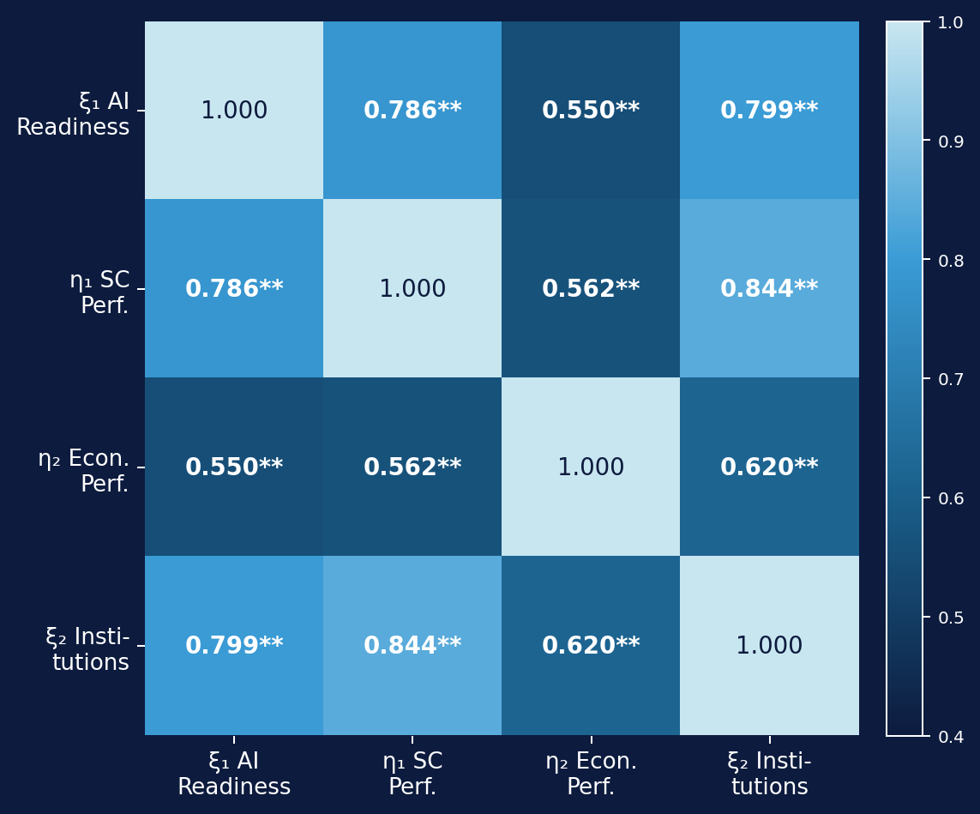
RESULTS — CORRELATIONS
Pearson Correlation Matrix
ξ₂ ↔ η₁
r = 0.844
Strongest link — institutions dominate SC performance
ξ₁ ↔ ξ₂
r = 0.799
AI readiness & institutions highly co-evolved globally
ξ₁ ↔ η₁
r = 0.786
Strong AI readiness → SC relationship confirmed
ξ₁ ↔ η₂
r = 0.550
Moderate — suggests direct AI → Economy route
η₁ ↔ η₂
r = 0.562
Moderate — partial, not full mediation signal
All 6 pairwise correlations significant at p < .001 (two-tailed). N = 164 listwise.
9

Slide 10

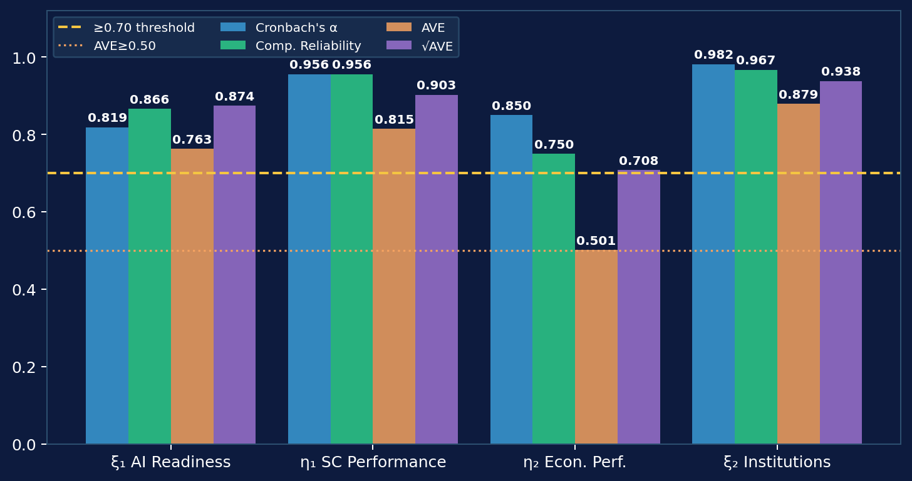
RESULTS — MEASUREMENT MODEL
Measurement Model — Reliability & Validity
✓
Internal Consistency
All α ≥ 0.819
ξ₂ = 0.982 (exceptional)
✓
Convergent Validity
All AVE (Average Variance Extracted) ≥ 0.501
η₂ borderline — passes threshold
✓
Discriminant Validity
√AVE > all r
Fornell-Larcker fully satisfied
Measurement validity confirmed across all four constructs — structural estimation proceeds.
10

Slide 11

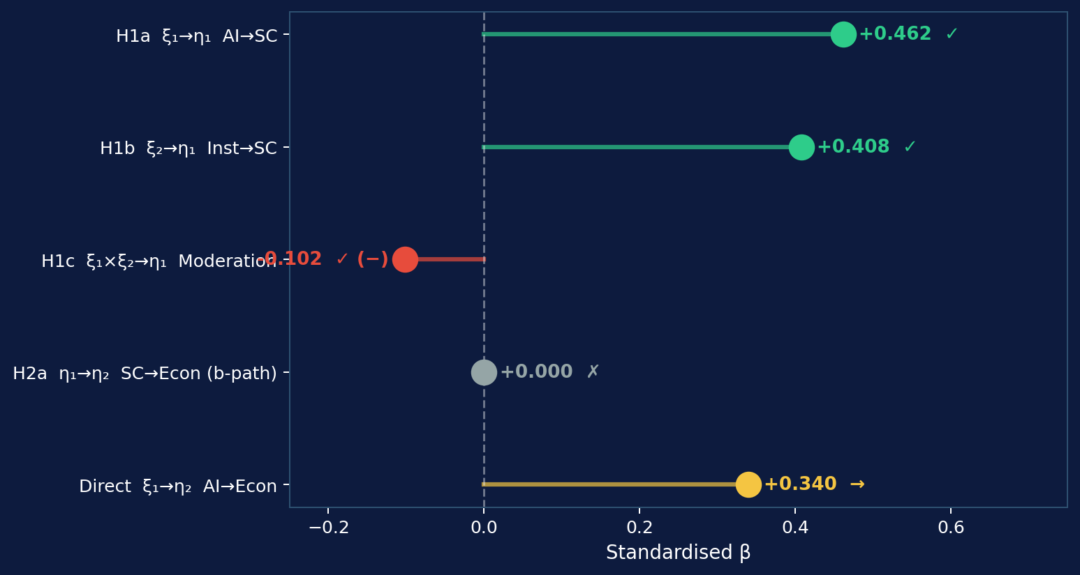
FINDINGS SUMMARY
Hypothesis Outcomes at a Glance
H1a
SUPPORTED
β = 0.462 | p < .001
H1b
SUPPORTED
β = 0.408 | p < .001
H1c
SUPPORTED (−)
β = −0.102 | p = .029 | substitutive
H2a
NOT SUPPORTED
b-path collapsed | p = .743
Direct
SIGNIFICANT
ξ₁→η₂ β = 0.340 | p = .001
11

Slide 12

DISCUSSION
What Do the Results Really Tell Us?
AI is a Macro-Level SC Driver (RQ1)
Institutions Substitute, Not Amplify (RQ3)
β = 0.462 confirms TOE framework at national scale. AI readiness shapes entire logistics ecosystems, not just firm-level processes.
Negative moderation (β = −0.102) contradicts complementarity assumptions. Strong governance reduces urgency of AI investment in SC — a novel finding challenging dominant narratives.
Mediation Fails — Direct AI Effect Dominates (RQ2)
Theoretical Refinement Needed
H2a not supported. AI readiness drives economic performance directly (β = 0.340), bypassing SC. AI's economic value is broader than the logistics channel alone.
The substitutive pattern calls for boundary conditions theory. When does governance complement vs. substitute AI? Full-panel longitudinal analysis is the necessary next step.
12

Slide 13

LIMITATIONS & FUTURE RESEARCH
Limitations & Future Research
LIMITATIONS
FUTURE RESEARCH
1
Secondary Data Only
1
Full Covariance-Based SEM
Entirely reliant on publicly available databases — limited to pre-existing variables.
Estimate the model using AMOS or LISREL and report global fit indices (CFI, RMSEA, SRMR).
Only analysed information already available; no bespoke data collection was possible.
The next step is a complete SEM model to evaluate how well the full structure fits the data.
2
AI Readiness Measurement
2
Include Additional Variables
Composite national indices may not capture every dimension of a country's AI capability.
Future studies could incorporate digital skills, innovation capacity, cybersecurity, or AI investment.
AI readiness is broad — no single index measures everything about it.
Other factors influence how AI improves supply chains — future models should capture them.
3
Pilot OLS-SEM Approach
3
Extend to Industries & Regions
Hierarchical OLS regression approximates SEM; global fit indices (CFI, RMSEA, SRMR) were not assessed.
Examine whether findings differ across industries, regions, or income groups.
This was a first-pass test. A full SEM analysis would give a more rigorous model evaluation.
AI may work differently in manufacturing vs. healthcare, or high-income vs. low-income countries.
Tewogbade Shakir Adeyemi | DBA Researcher | 2573172317
13

Slide 14

CONCLUSION
Three Takeaways for the Room
01
02
03
AI readiness is a genuine macro-level SC driver
Institutions substitute, not amplify, AI effects
AI drives economies directly — not through supply chains
H1a (β = 0.462) and H1b (β = 0.408) both strongly confirmed. AI capability and governance quality jointly explain 78% of cross-national SC performance variation — robust and policy-relevant.
H1c reveals negative moderation. The complementarity assumption in most policy frameworks is not empirically warranted. This is a provocation for theory and AI investment strategy.
H2a fails but the direct ξ₁→η₂ path (β = 0.340) is robust. AI readiness has broader economic value bypassing logistics. Full-scale panel study needed to confirm causal mechanism.
Tewogbade Shakir Adeyemi | DBA Researcher | 2573172317 | Thank you — Questions welcome

Slide 15
REFERENCES
Key Sources
Baker, J. (2012). The technology–organization–environment framework. In Dwivedi et al. (Eds.), Information systems theory (Vol. 1, pp. 231–245). Springer. https://doi.org/10.1007/978-1-4419-6108-2_12
Martí, L., Puertas, R., & García, L. (2014). The importance of the Logistics Performance Index in international trade. Applied Economics, 46(24), 2982–2992. https://doi.org/10.1080/00036846.2014.916394
Beamon, B. M. (1999). Measuring supply chain performance. International Journal of Operations & Production Management, 19(3), 275–292. https://doi.org/10.1108/01443579910249714
North, D. C. (1990). Institutions, institutional change and economic performance. Cambridge University Press.
Chan, F. T. S., & Qi, H. J. (2003). An innovative performance measurement method for supply chain management. Supply Chain Management: An International Journal, 8(3), 209–223. https://doi.org/10.1108/13598540310484618
Scott, W. R. (2014). Institutions and organizations: Ideas, interests, and identities (4th ed.). SAGE Publications.
Gunasekaran, A., Patel, C., & McGaughey, R. E. (2004). A framework for supply chain performance measurement. International Journal of Production Economics, 87(3), 333–347. https://doi.org/10.1016/j.ijpe.2003.08.003
Tornatzky, L. G., & Fleischer, M. (1990). The processes of technological innovation. Lexington Books.
Tewogbade Shakir Adeyemi | DBA Researcher | 2573172317

