Slide 1

CONFERENCE PAPER PRESENTATION • BDX0010 • May 2026
AI Readiness and Supply Chain Performance
A Cross-National Pilot Study Using Structural Equation Modelling
164
5
SEM
IBM SPSS
Countries
Data Sources
Framework
Analysis
Tewogbade Shakir Adeyemi | DBA Researcher | Student ID: 2573172317
1

Slide 2

MOTIVATION
The Problem: A Critical Gap
AI is Transforming
Global Supply Chains
The Empirical Gap
Is Real
Institutions Matter —
But How?
Predictive analytics, ML, and intelligent automation are reshaping logistics. Yet the benefits are not automatic — returns depend on context (Brynjolfsson & Syverson, 2021)
Most research is firm-level or sector-specific.
Cross-national macro-level evidence on AI → SC performance remains scarce (Queiroz et al., 2022)
Governance quality shapes technology diffusion. The conditioning role of institutions is theorised but rarely tested quantitatively at this scale
❝ Does AI readiness inherently improve supply chain performance — or are its effects conditional on institutional quality? ❞
2

Slide 3

RESEARCH AIM & QUESTIONS
What We Set Out to Answer
AIM
To examine the effect of government AI readiness on supply chain logistics performance and assess whether supply chain performance mediates the relationship between AI readiness and economic outcomes.
To what extent does government AI readiness influence national supply chain logistics performance?
RQ1
Does supply chain performance mediate the relationship between AI readiness and economic outcomes?
RQ2
What role does institutional quality play in driving supply chain performance alongside AI readiness?
RQ3
3

Slide 4

THEORETICAL FRAMEWORK
Theoretical Framework
Technology Adoption Theory
Institutional Theory
SC Performance Theory
TOE Framework
Moderation + Direct
Mediation
Proposition
Proposition
Proposition
AI readiness is a primary macro-level driver of supply chain performance
Governance quality shapes SC efficiency AND moderates the AI–SC relationship
SC performance is the transmission mechanism linking AI readiness to economic outcomes
Hypothesis
Hypothesis
Hypothesis
H1a: ξ₁ → η₁
(AI Readiness → SC Performance)
H1b: ξ₂ → η₁
H1c: ξ₁×ξ₂ → η₁ (moderation)
H2a: η₁ mediates ξ₁ → η₂
4

Slide 5

CONCEPTUAL MODEL
Structural Equation Model — Path Diagram
ξ₁×ξ₂
Interaction
H1c β = −0.102*
ξ₁
H1a β = 0.462***
AI Readiness
Exogenous
η₁
H2a β ≈ 0.00 ns ✗
η₂
SC Performance
Economic Perf.
Endogenous / Mediator
Endogenous
H1b β = 0.408***
ξ₂
Institutional Quality
Exogenous / Moderator
Direct β = 0.340**
All constructs z-score standardised | n = 164 countries | OLS hierarchical regression
5

Slide 6

METHODOLOGY
Research Design at a Glance
Philosophy
Post-Positivism
Objective reality, imperfect observation; justifies latent constructs & proxy variables
Approach
Deductive
Theory-driven hypotheses tested against 164-country empirical dataset
Method
Quantitative SEM
Simultaneous estimation of latent paths — both measurement & structural models
Strategy
Cross-National Comparative
164 countries; generalisable structural relationships across heterogeneous contexts
Time Horizon
Cross-sectional 2022–23
Oxford AI 2023 + LPI 2022; temporal bridging standard where sources differ
Data
Secondary Macro-Level
Oxford AI, World Bank WDI/WGI/LPI, ITU, Stanford HAI — all public open-access
Software
IBM SPSS v29 + Amos
Python (wbgapi, pdftotext) for extraction; SPSS for all analysis & modelling
6

Slide 7

DATA SOURCES
Data Sources & Latent Constructs
ξ₁
AI Readiness
η₁
SC Performance
η₂
Economic Perf.
ξ₂
Institutional Quality
Exogenous
Endogenous / Mediator
Endogenous
Exogenous / Moderator
Source
Source
Source
Source
Oxford Insights AI Index + ITU
World Bank LPI
World Bank WDI
World Bank WGI
Indicators
Indicators
Indicators
Indicators
AI Index Score
Internet Penetration
R&D Expenditure
Infrastructure
Customs
Timeliness, Tracking
Intl. Shipments
GDP per Capita
Exports % GDP
Trade Openness
Govt. Effectiveness
Rule of Law
Regulatory Quality
Corruption Control
All variables z-score standardised prior to SEM | Final harmonised dataset: 164 countries × 48 variables
7

Slide 8

RESULTS — DESCRIPTIVE STATS
Descriptive Statistics — Latent Constructs (n = 164)
Construct
N
Mean
SD
Min
Max
Skewness
Kurtosis
ξ₁ AI Readiness
164
0.042
0.975
−2.159
1.624
−0.361
−0.982
η₁ SC Performance
164
0.072
1.018
−1.704
2.526
0.562
−0.671
η₂ Economic Perf.
164
0.013
0.867
−1.158
4.908
2.368 ⚠
8.157 ⚠
ξ₂ Institutions
164
−0.023
0.949
−1.683
2.137
0.439
−0.661
Three Constructs ~Normal
η₂ Outlier-Driven
Means ≈ 0, SD ≈ 1
All r Significant
ξ₁, η₁, ξ₂ — skewness ∈ [−0.36, 0.56]. Safe for SEM estimation (Kline, 2023)
Skew = 2.368, Kurt = 8.157. Singapore & Luxembourg pull the right tail. HC3 robust SE applied.
z-score standardisation by design — not a data error. Ensures cross-scale comparability.
All 6 pairwise correlations: p < .001. Strong empirical foundations for structural model.
8

Slide 9

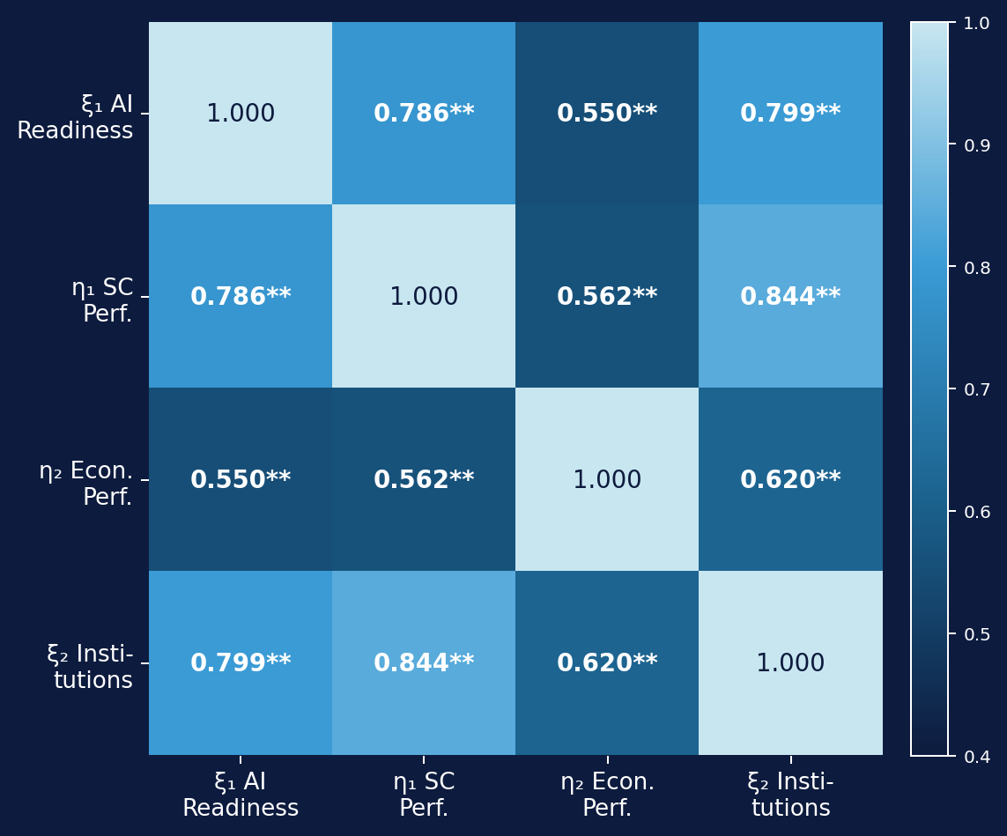
RESULTS — CORRELATIONS
Pearson Correlation Matrix
ξ₂ ↔ η₁
r = 0.844
Strongest link — institutions dominate SC performance
ξ₁ ↔ ξ₂
r = 0.799
AI readiness & institutions highly co-evolved globally
ξ₁ ↔ η₁
r = 0.786
Strong AI readiness → SC relationship confirmed
ξ₁ ↔ η₂
r = 0.550
Moderate — suggests direct AI → Economy route
η₁ ↔ η₂
r = 0.562
Moderate — partial, not full mediation signal
All 6 pairwise correlations significant at p < .001 (two-tailed). N = 164 listwise.
9

Slide 10

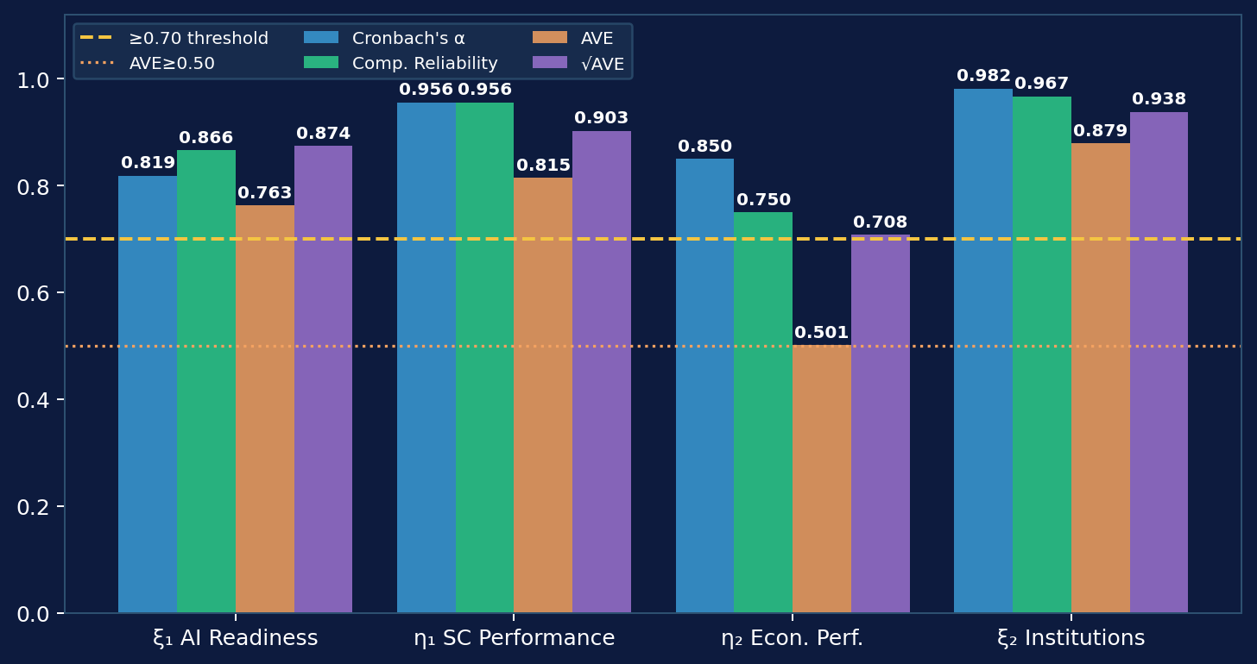
RESULTS — MEASUREMENT MODEL
Measurement Model — Reliability & Validity
✓
Internal Consistency
All α ≥ 0.819
ξ₂ = 0.982 (exceptional)
✓
Convergent Validity
All AVE ≥ 0.501
η₂ borderline — passes threshold
✓
Discriminant Validity
√AVE > all r
Fornell-Larcker fully satisfied
Measurement validity confirmed across all four constructs — structural estimation proceeds.
10

Slide 11

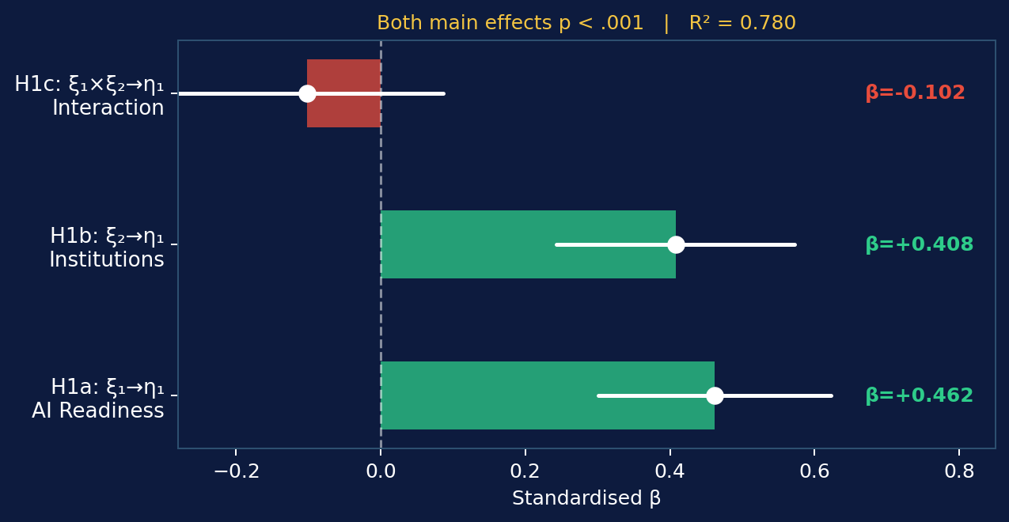
RESULTS — EQUATION 1
Structural Paths — SC Performance (η₁)
H1a SUPPORTED ✓
AI Readiness → SC Performance
β = 0.462 | t = 5.60 | p < .001
Largest individual effect in Eq. 1
H1b SUPPORTED ✓
Institutions → SC Performance
β = 0.408 | t = 4.90 | p < .001
Governance rivals AI in impact magnitude
Equation 1 explains 78.0% of variance in SC Performance | R² = 0.780 | Adj R² = 0.776 | F(3,160) = 189.16 | p < .001
11

Slide 12

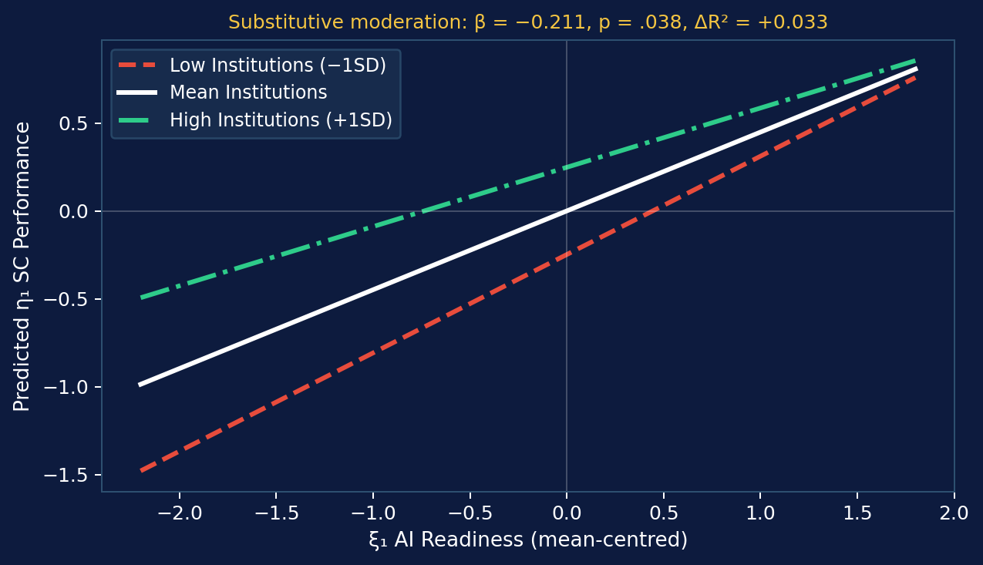
RESULTS — MODERATION
Moderation Analysis — H1c
H1c SUPPORTED ✓
Interaction β = −0.211 | p = .038
ΔR² = +0.033 | F-change = 23.98***
Block 1 R² = 0.780 → Block 2 R² = 0.813
Key Insight
Negative interaction = substitutive moderation. Strong governance reduces AI's marginal contribution to SC performance. Context-dependent, not universally amplifying.
12

Slide 13

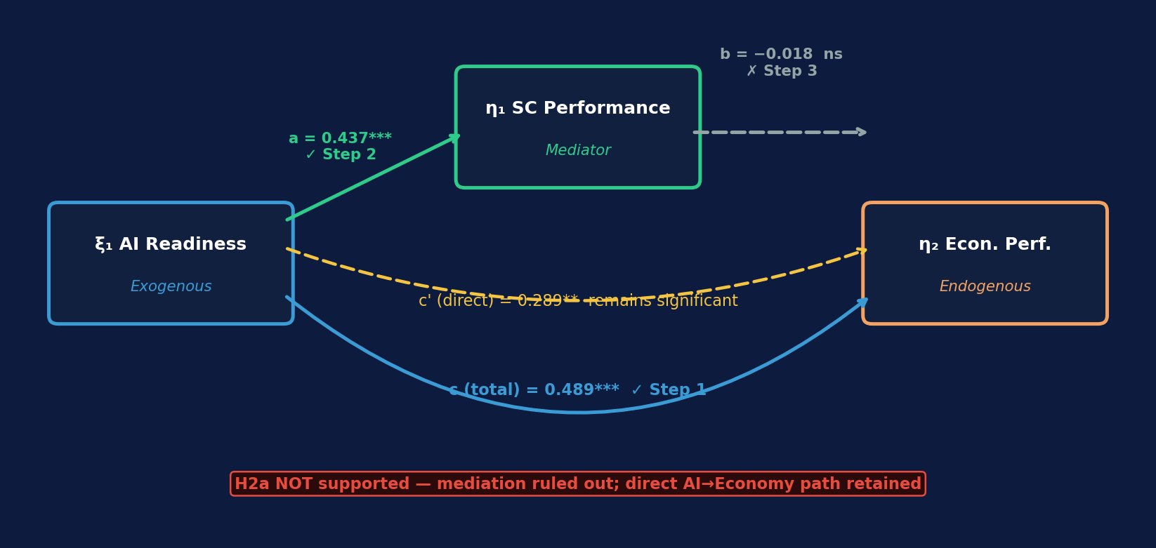
RESULTS — MEDIATION
Mediation Analysis — H2a (Baron & Kenny, 1986)
Step
Path
B
p
Decision
Step 1 (c path)
ξ₁ → η₂ (total)
0.489
< .001
✓ Confirmed
Step 2 (a path)
ξ₁ → η₁
0.437
< .001
✓ Confirmed
Step 3 (b path)
η₁ → η₂ | ξ₁
−0.018
.743
✗ FAILED
Direct (c′ path)
ξ₁ → η₂ | η₁
0.289
.001
13
→ Remains sig.

Slide 14

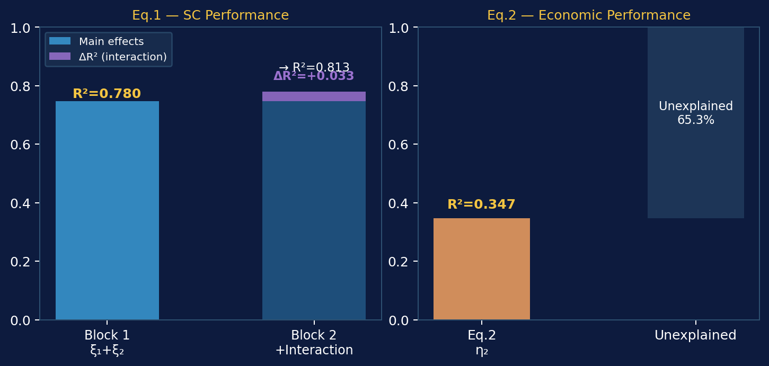
RESULTS — MODEL FIT
Variance Explained — Both Equations
Equation 1
R² = 0.780
Adj R² = 0.776 | F(3,160) = 189.16***
Interaction ΔR²
+0.033
F-change = 23.98*** | Block 2 R² = 0.813
Equation 2
R² = 0.347
Adj R² = 0.339 | F(2,161) = 42.74***
14

Slide 15

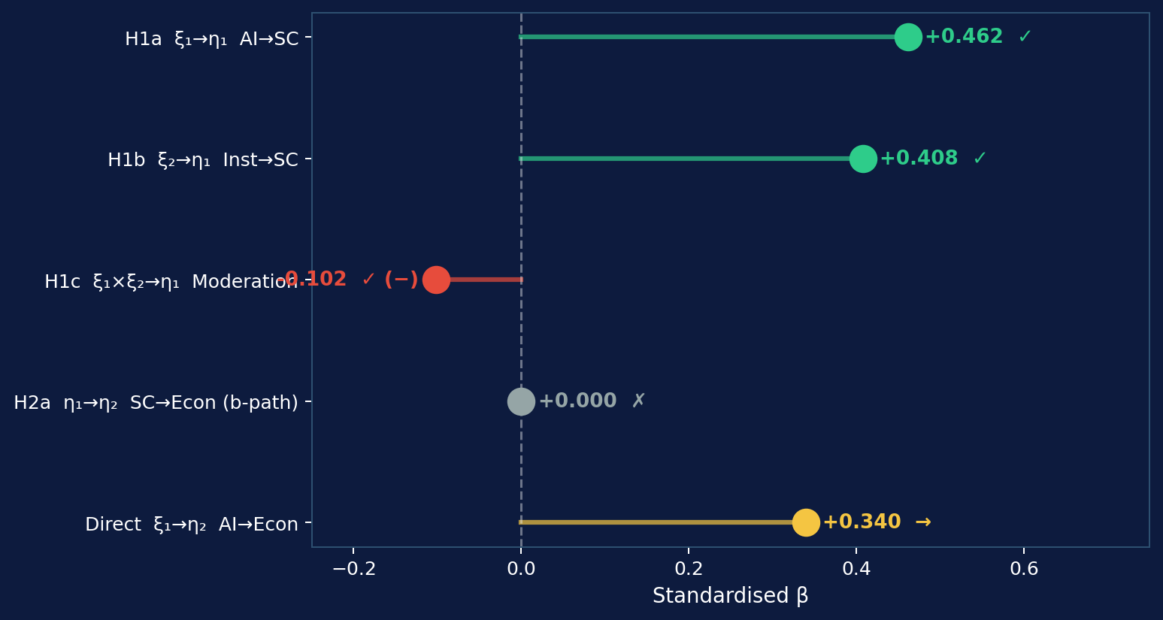
FINDINGS SUMMARY
Hypothesis Outcomes at a Glance
H1a
SUPPORTED
β = 0.462 | p < .001
H1b
SUPPORTED
β = 0.408 | p < .001
H1c
SUPPORTED (−)
β = −0.102 | p = .029 | substitutive
H2a
NOT SUPPORTED
b-path collapsed | p = .743
Direct
SIGNIFICANT
ξ₁→η₂ β = 0.340 | p = .001
15

Slide 16

DISCUSSION
What Do the Results Really Tell Us?
AI is a Macro-Level SC Driver (RQ1)
Institutions Substitute, Not Amplify (RQ3)
β = 0.462 confirms TOE framework at national scale. AI readiness shapes entire logistics ecosystems, not just firm-level processes (Ivanov, 2023; Maroufkhani et al., 2020).
Negative moderation (β = −0.102) contradicts complementarity assumptions. Strong governance reduces urgency of AI investment in SC — a novel finding challenging dominant narratives.
Mediation Fails — Direct AI Effect Dominates (RQ2)
Theoretical Refinement Needed
H2a not supported. AI readiness drives economic performance directly (β = 0.340), bypassing SC. AI's economic value is broader than the logistics channel alone.
The substitutive pattern calls for boundary conditions theory. When does governance complement vs. substitute AI? Full-panel longitudinal analysis is the necessary next step.
16

Slide 17

LIMITATIONS & FUTURE RESEARCH
Limitations, Implications & Next Steps
Study Limitations
Future Research
1.
Cross-sectional design — temporal precedence cannot be fully established
Panel Regression (2010–2025)
Exploit temporal variation; IV estimation for causal inference
2.
Composite index bias — aggregation may mask within-indicator variation
Full Amos CFA-SEM
Proper latent variable modelling with fit indices (CFI, RMSEA)
3.
Endogeneity risk — AI readiness & GDP are co-evolving; reverse causality possible
Regional Heterogeneity
Separate models for high/low-income groups; multi-group SEM
4.
η₂ non-normality — Singapore/Luxembourg outliers inflate kurtosis to 8.157
Policy Implication
AI investment alone insufficient — governance co-investment critical
Bayesian SEM
Account for uncertainty in small-N cross-national settings
17

Slide 18

CONCLUSION
Three Takeaways for the Room
01
02
03
AI readiness is a genuine macro-level SC driver
Institutions substitute, not amplify, AI effects
AI drives economies directly — not through supply chains
H1a (β = 0.462) and H1b (β = 0.408) both strongly confirmed. AI capability and governance quality jointly explain 78% of cross-national SC performance variation — robust and policy-relevant.
H1c reveals negative moderation. The complementarity assumption in most policy frameworks is not empirically warranted. This is a provocation for theory and AI investment strategy.
H2a fails but the direct ξ₁→η₂ path (β = 0.340) is robust. AI readiness has broader economic value bypassing logistics. Full-scale panel study needed to confirm causal mechanism.
Tewogbade Shakir Adeyemi | DBA Researcher | 2573172317 | Thank you — Questions welcome

