Slide 1
https://github.com/char-ptr/acm-directx/
If you have git, clone/fork away!
If not, there’s a button on the bottom right of the page “Download ZIP”.
Backup plan: Create a new VS Project from the online sample – Direct3D Tutorial – I used it as a base for the demo.
Drew will be giving a workshop on DirectX Audio at some point, and he’ll be reusing the code.
The repo contains all the codes and all the slides from tonight.

Slide 2
Direct3D
Nicholas Dyszel

Slide 3
DirectX
Direct3D
Direct2D
DirectSound3D
DirectX Media
DirectAnimation
DirectWrite
DirectCompute
DirectShow
DirectX Transform
DirectX Media Objects

Slide 4
What We’ll Cover
Initializing a window handle
Creating a D3D11 Device
Creating a D3D11 Device Swap Chain
D3D11 Device Contexts
Implementing WndProc()
Drawing triangles
D3D11 Resources (maybe)

Slide 5
FYI…
DirectX ≠ Direct3D ( = D3D ) – catch me if I mix them up
Current version is D3D11
“Hello, World!” draws a triangle to the display
“Once you can draw a triangle, you can do anything.” – Andy Glaister
Fun fact: The X in Xbox comes from DirectX

Slide 6
Direct3D
Geometry – vertex buffers, primitives
Animation – transforms using DirectX Math
Texturing – Map(), Resources
Shading – HLSL (High-Level Shading Language) programs
Rendering – Draw(), DrawIndexed()

Slide 7

Some Geometry
Local
Global
Screen
Camera
Object geometry
Transforms of objects in world
World aligned with camera
Projective transform from cone to view box
Flattens 3D box to 2D rectangle
View

Slide 8
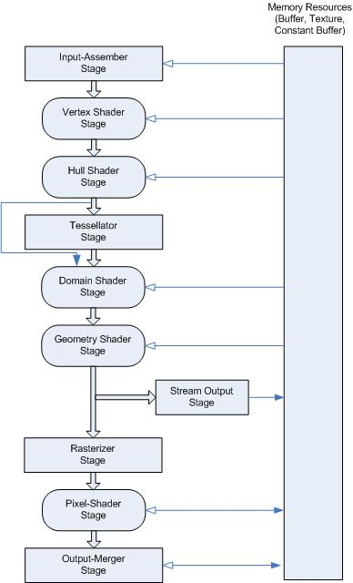
Rendering Pipeline
Vertex Shader
Processes each vertex individually
Tessellation
Generates geometry from compressed patterns
Geometry Shader
Processes primitives and can generate new ones
Rasterization
Clips primitives, generates fragments
Pixel Shader
Receives fragments with interpolated pixel values and computes colors per pixel

Slide 9
With that, let’s begin…

