Slide 1


GREEN PaCE
Security policy PRESENTATION
Developer: Carlos aguirre

Slide 2
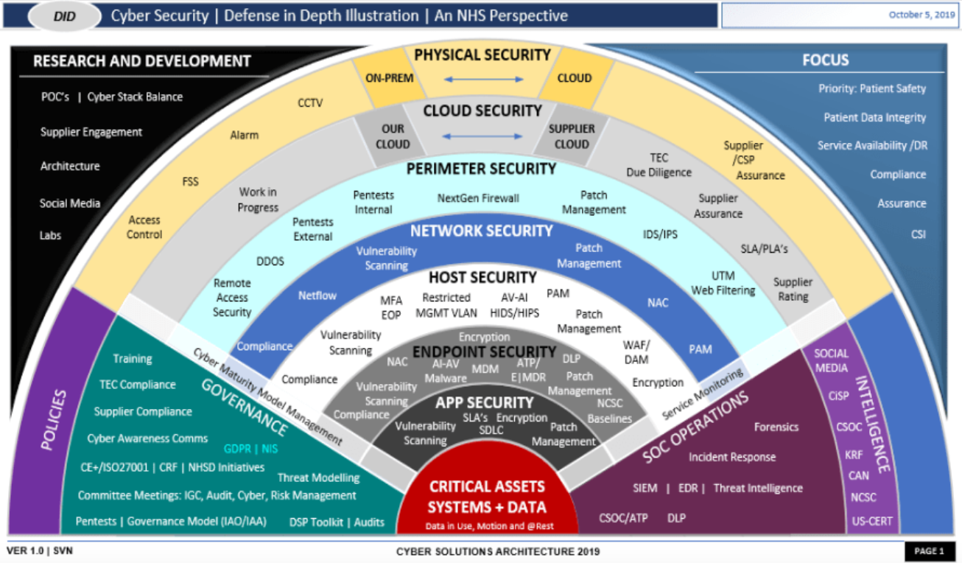
Defense in depth
We can see an overview of the different ways of protection in this graphic, which we can utilize in our efforts to maintain a strong design for developing secure code.

Slide 3
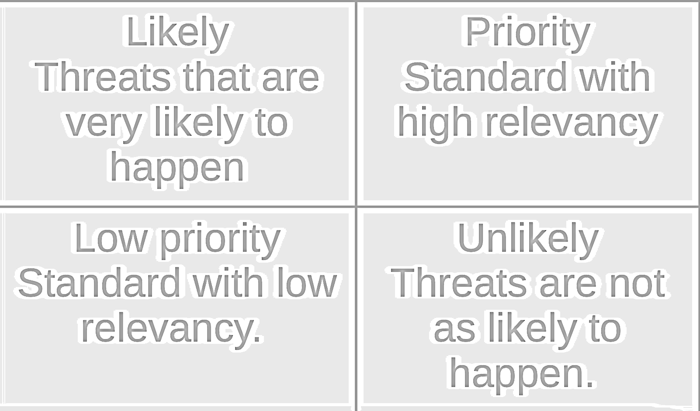
Threats Matrix
Secure coding standards include several degrees of susceptibility to measure the standard's influence. Here are a chart to help you evaluate those levels.

Slide 4

10 Principles
Validate input data.
Heed compiler warnings.
Architect and design for security policies.
Default deny,
Keep it simple.
Adhere to the principle of least privilege.
Sanitize data sent to other systems.
Practice defense in depth.
Use effective quality assurance techniques.
Adopt a secure code standard.

Slide 5
Coding Standards
1. Do not cast to an enumeration value that is out of range.
2. To refer to elements of a container, use valid references, pointers, and iterators.
3. Never try to make a std::string out of a null reference.
4. Do not save the value of an already-owned smart pointer in an unrelated smart pointer.
5. Deallocate dynamically allocated resources correctly.
6. To test the value of a constant expression, use a static assertion.
7. Handle any exceptions thrown before calling main().
8. Never switch input and output from a file stream without a positioning call in between.
9. Virtual functions should not be called from constructors or destructors.
10. All exit pathways must return a value for value returning functions.

Slide 6

ENCRIPTION POLICIES
Encryption at rest - Encryption at rest prevents an attacker from obtaining unencrypted data by guaranteeing that the data is encrypted when it is stored on disk. If an attacker acquires a hard disk containing encrypted data but not the encryption keys, he or she must decrypt the data in order to read it.
• Encryption in Flight - This is the process of encrypting data while it is sent. Data may be unencrypted when at rest on disk arrays in some applications, such as remote replication, but encrypted while being sent to ensure protection.
Encryption in Use - By compromising data in use, it is possible to get access to encrypted data in transit and at rest. Someone having access to random access memory, for example, can parse it to get the encryption key for data at rest. They can decode encrypted data at rest once they get that encryption key.

Slide 7
Triple A POLICIES
• Authentication - Authentication is the process of confirming a user's identity as a legitimate user of the system. This can include information such as a user's username and password so that they can access certain areas of the system. Some contemporary authentication systems employ two-step or multi-tier authentication.
• Authorization - Authorization refers to a user's level of access to the system. This might include whether or not the user has permission to read, create, remove, or edit files in the database. This can also lead to a user's ability to add or remove files and users from the system.
Accounting - Accounting is the process of keeping track of what a user does with their degree of system access. This will record which databases are visited, what was done when they were accessed, and who first accessed the system.

Slide 8
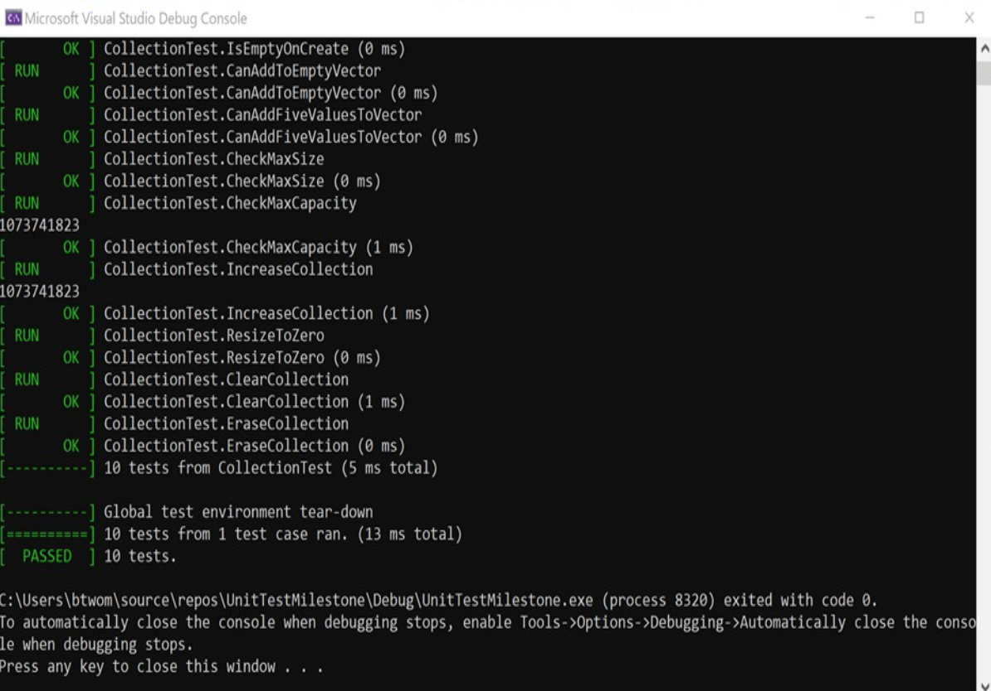
Unit testing
To guarantee that we have secure functional code, we use unit testing procedures early and regularly throughout the development process. To avoid buffer overflow, limit the number of characters in a user input string.

Slide 9
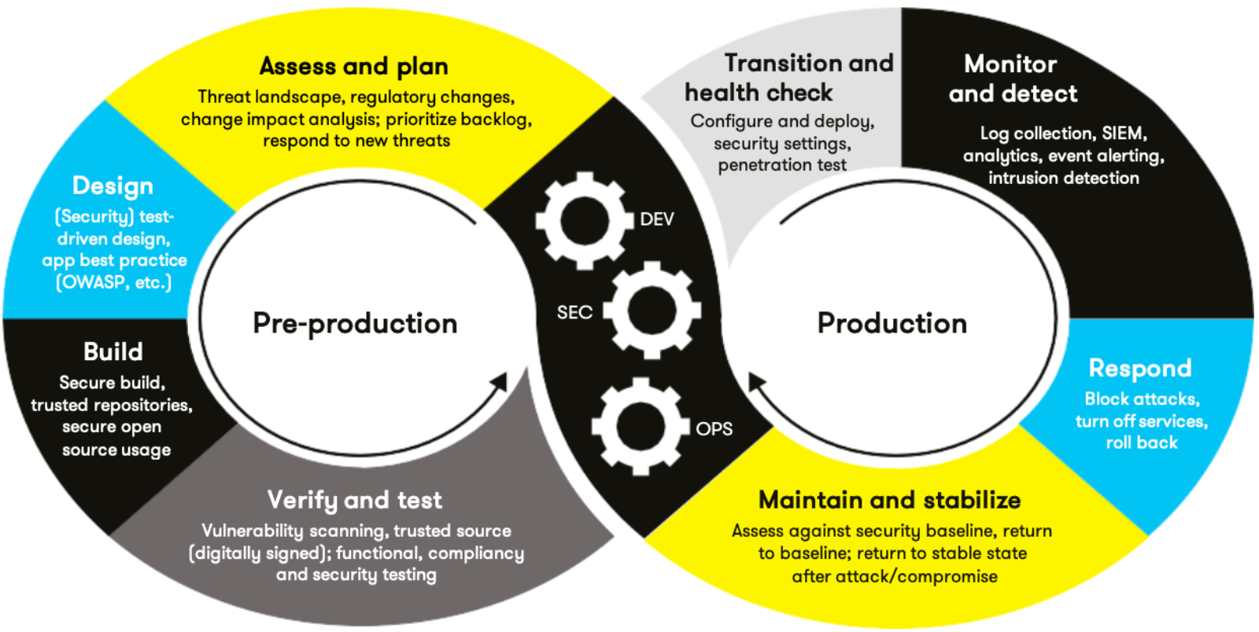
AUTOMATION SUMARRY

Slide 10
tools
The DevSecOps pipeline is a secure coding strategy that takes a full-circle approach to enforcing a policy with an infrastructure designed to keep code safe.
This is a good system structure; but I would always remember defense in depth and make sure that you test early and regularly to discover any faults or vulnerabilities so that we may find defects and errors early.

Slide 11
RISKS AND BENEFITS
• When coding, there will always be a risk because nothing is completely safe. Always anticipate that there are threats and holes in the system and remain on top of all of today's prevalent threats and preventive strategies, thus continual education is important to the policy's effectiveness.

Slide 12
recommendations
Trying to keep up with all the latest security risks and trends is essential for us to deliver the level of protection we guarantee. To get the job done, we keep things simple yet effective.

Slide 13
conclusions
•Finally, based on the concepts and standards discussed in this presentation, we can conclude that most of the relevant subjects were addressed in order to demonstrate our strategy for developing and maintaining a secure and competent programming.
We've also implemented a zero-trust policy for accessing items both within and outside the corporate network, in order to protect security and privacy and keep all sensitive data safe and secure for all parties concerned.

Slide 14
REFERENCES
Seacord, R. (2020, November 18). Confluence. Retrieved from SEI External Wiki Home: https://wiki.sei.cmu.edu/confluence/

