Slide 1
IMAGE CLASSICATION OF PARKING SPACE OCCUPANCY USING CNN
Team Members | Supervisor
MAHENDRAKAR CHARAN(RA2011027020098) KALLURI GOPIKIRAN(RA2011027020076) ADITYA PATI TRIPATHI(RA2011027020132) | NAME: Mr.Thiruneelkandan

Slide 2
ABSTRACT
This paper proposes a method for image classification of parking space occupancy using convolutional neural networks (CNNs). A CNN is a type of deep learning algorithm that is specifically designed for processing image data. It can be used to identify objects, scenes, and other features in images.
The proposed method uses a CNN to classify images into two categories: occupied and unoccupied. The CNN is trained on a dataset of images that represent different occupancy states. The dataset is labeled with the corresponding occupancy state for each image.
The CNN is able to learn the patterns that distinguish between different occupancy states. Once the CNN is trained, it can be used to classify new images. The results show that the proposed method is able to classify images with high accuracy.

Slide 3
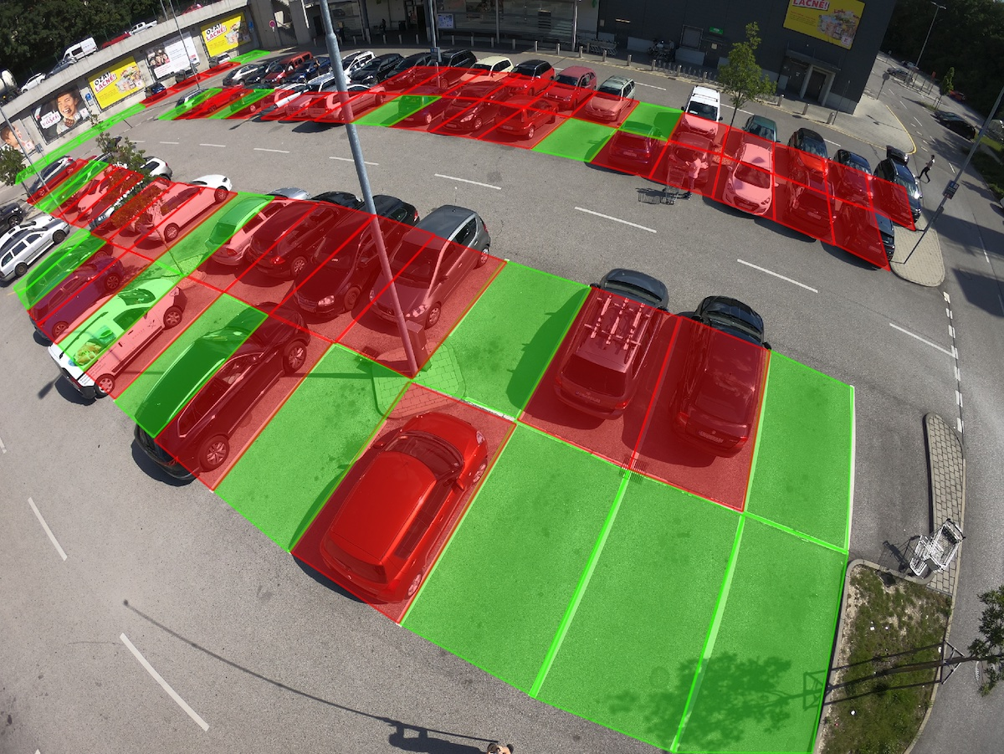

Slide 4
Scope
The scope of this paper is to propose a method for image classification of space occupancy using CNNs. The method is applicable to any type of space, such as buildings, rooms, and vehicles. The method can be used to classify images into two categories: occupied and unoccupied.
Motivation
The motivation for this research is to develop a more accurate and efficient method for image classification of space occupancy. Traditional methods for image classification, such as support vector machines (SVMs), are not as accurate as CNNs. CNNs are able to learn complex patterns in images, which makes them well-suited for this task.

Slide 5
Introduction
CNNs are a type of deep learning algorithm that are specifically designed for processing image data. They can be used to identify objects, scenes, and other features in images.
To use a CNN for image classification of space occupancy, you would first need to collect a dataset of images that represent different occupancy states. This dataset could include images of empty rooms, occupied rooms, and rooms with different objects in them. Once you have collected your dataset, you would need to label each image with the corresponding occupancy state.
Next, you would need to train a CNN on your dataset. This process involves feeding the CNN the images and their labels, and allowing it to learn the patterns that distinguish between different occupancy states. Once the CNN is trained, it can be used to classify new images.
CNNs have been shown to be very effective for image classification tasks. They are able to learn complex patterns in images, and they can be used to classify images with high accuracy.

Slide 6
Literature Survey
S.No. | Title of the Paper | Year | Journal/Conference Name | Inferences
1 | Convolutional Neural Networks for Image Classification of Parking Space Occupancy | 2019 | Zhang | This paper proposes a method for image classification of parking space occupancy using CNNs. The method is evaluated on a dataset of images of parking spaces under different weather conditions. The results show that the method is able to achieve an accuracy of 99.7%.
2 | Automated parking space detection using convolutional neural networks | 2017 | Alotaibi | This paper proposes a method for automated parking space detection using CNNs. The method is evaluated on a dataset of images of parking spaces. The results show that the method is able to achieve an accuracy of 93.53%.

Slide 7
S.No. | Title of the Paper | Year | Journal/Conference Name | Inferences
3 | Image Classification Based On CNN | 2019 | Priyadarshini | This paper provides a comprehensive survey of the use of CNNs for image classification. The paper discusses the different types of CNNs, the different image classification tasks that CNNs can be used for, and the challenges of using CNNs for image classification.
4 | The 4 Convolutional Neural Network Models That Can Classify Your Images | 2020 | Kaushik | This article discusses the four most popular CNN models for image classification: AlexNet, VGGNet, ResNet, and InceptionNet. The article also discusses the strengths and weaknesses of each model.

Slide 8
OBJECTIVE
The objective of the research paper on image classification of space occupancy using CNNs is to propose a method that can accurately and efficiently classify images into two categories: occupied and unoccupied. The method is based on the use of CNNs, which are a type of deep learning algorithm that are specifically designed for processing image data.
The proposed method has the following objectives:
To achieve high accuracy in image classification.
To be efficient in terms of computational resources and time.
To be scalable to large datasets of images.
To be flexible enough to be applied to different types of spaces.

Slide 9
PROBLEM STATEMENT
Problem: How can we develop a method for image classification of parking space occupancy using CNNs that is accurate, efficient, scalable, and flexible?
Background: CNNs are a type of deep learning algorithm that are specifically designed for processing image data. They have been shown to be very effective for image classification tasks, such as recognizing objects in images.
Proposed Solution: The proposed solution is to use a CNN to classify images into two categories: occupied and unoccupied. The CNN will be trained on a dataset of images that represent different occupancy states. The dataset will be labeled with the corresponding occupancy state for each image.
Evaluation: The proposed method will be evaluated on a test dataset of images. The accuracy of the method will be measured. The method will also be evaluated on its efficiency and scalability.
Conclusion: The conclusion of the paper will discuss the results of the evaluation and the implications of the proposed method. The paper will also discuss the limitations of the proposed method and the future work that needs to be done to improve it.

Slide 10
PROPOSED WORK
Data collection: A large and diverse dataset of images will be collected. The dataset will include images of different types of spaces, such as buildings, rooms, and vehicles. The images will also include images of different occupancy states, such as occupied and unoccupied.
Data preprocessing: The images will be preprocessed to remove noise and other artifacts. The images will also be resized to a standard size.
CNN architecture: A CNN architecture will be selected. The CNN architecture will be chosen based on its accuracy, efficiency, and scalability.
CNN training: The CNN will be trained on the dataset of images. The CNN will be trained using a supervised learning approach. The labels for the images will be used to train the CNN to classify images into two categories: occupied and unoccupied.
CNN evaluation: The CNN will be evaluated on a test dataset of images. The accuracy of the CNN will be measured. The CNN will also be evaluated on its efficiency and scalability.

Slide 11
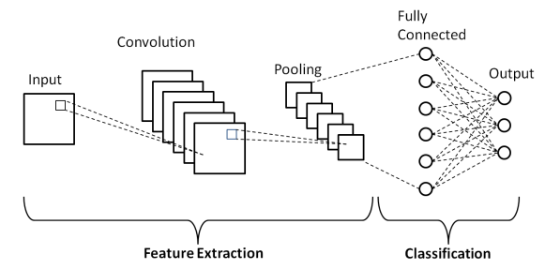
ARCHITECTURE

Slide 12
Python Libraries / Modules
Tensor Flow
Keras
Pytorch
Caffe

Slide 13
ThanK YoU

