Slide 1
HELLO FOLKS
INTRODUCING LEXICAL ANALYSIS IN C

Slide 2

Presented by
M Charan
U Likhith
KottaKota Asish
Narra Naga Nitin
Sarath Teja
Guided by
Dr.Shiny Irene
SRM INSTITUTE OF TECHNOLOGY
RAMAPURAM
LEXICAL ANALYSIS USING C PROGRAM
DEPT. Of Computer Science and Engineering-BDA

Slide 3
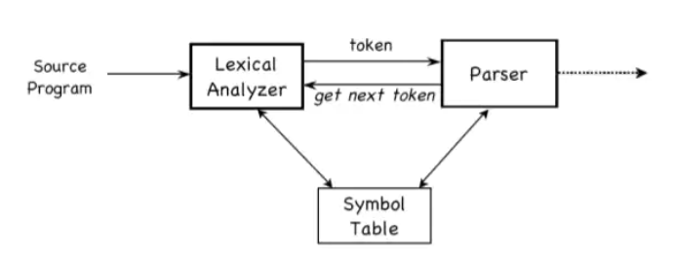
Introduction of Lexical Analysis
Lexical Analysis is the first phase of the compiler also known as a scanner. It converts the High level input program into a sequence of Tokens.
Lexical Analysis can be implemented with the Deterministic finite Automata.
The output is a sequence of tokens that is sent to the parser for syntax analysis

Slide 4
What is a token?
A lexical token is a sequence of characters that can be treated as a unit in the grammar of the programming languages.
Example of tokens :
Type token (id, number, real, . . . )
Punctuation tokens (IF, void, return, . . . )
Keywords (for, while, if etc.)
Identifier (Variable name, function name, etc.)
Operators ( '+', '++', '-' etc.)
Constants (number ,strings ,etc .)
Example of Non-Tokens:
Comments
Macros
Blanks
Tabs
Newline
Pre-processor directive , etc.

Slide 5
What is Lex Code
Lex is a program that generates lexical analyzer. It is used with YACC parser generator and written by Mike Lesk and Eric Schmidt.
The lexical analyzer is a program that transforms an input stream into a sequence of tokens.
It reads the input stream and produces the source code as output through implementing the lexical analyzer in the C program
In addition to C, some old versions of Lex could also generate a lexer in Ratfor
Some popular Lex compilers are flex ,YACC and etc.

Slide 6
The function of Lex is as follows:
Firstly lexical analyzer creates a program lex.1 in the Lex language. Then Lex compiler runs the lex.1 program and produces a C program lex.yy.c.
Finally C compiler runs the lex.yy.c program and produces an object program a.out.
a.out is lexical analyzer that transforms an input stream into a sequence of tokens.

Slide 7

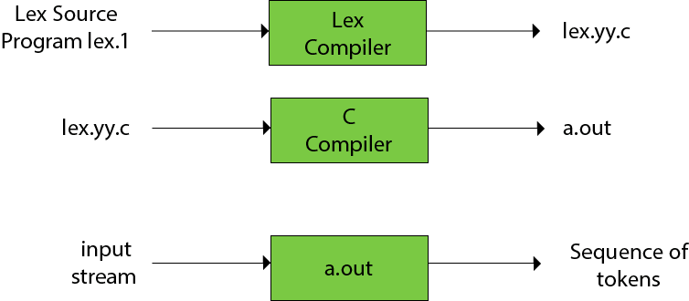

Slide 8
Working Demo of Lex using flex on Ubuntu

Slide 9
WE TOOK LEX CODE AS A REFERENCE … AND WE DESIGNED A C CODE TO ANALYZE TOKENS WITH OUT THE HELP OF LEX

Slide 10
In Our Code :
We used these below topic:
File Handling
Strings
Structures
Functions
Control Statements
Our code contains approx. 611 lines, 12 Functions and 3 structures to store token count information.

Slide 11
Working Demo of our code using MingW C compiler on VSCode

Slide 12

DIFFERENCE BETWEEN
LEX CODE AND OUR CODE

Slide 13
Lex Code
Our Code
Our code is developed using C, which is compiler language.
Easy when compared to lex
Compiles and runs directly since its developed using C
Time saving.
Better Efficient when compared to lex.
Calculate specific token type count too.
Lex is a Token analyser.
Hard to program and to understand
Compile lex file(.l extension) into c code and generates out
Time consuming.
Efficiency depends on the logic that one who programmed the code.

Slide 14
REFERENCES
WEBSITES:
GeekForGeeks
TutorialsPoint
Stack Overflow
BOOKS:
Programming in C by Remma Thareja……

Slide 15


Slide 16

THANK YOU

