Slide 1




CMR UNIVERSITY
JAVA SWING / AWT · MINI PROJECT
HD Suite
Railway Reservation Form + Online Shopping Cart Simulation
PRESENTED BY
Hemashree T N 25BBTCS093
Divya Reddy 25BBTCS067
B Tech CSE · 2nd Year · CMR University
Notes:
Introduce the project: HD Suite is one Java Swing desktop application with two modules - HD Rail, a railway reservation form, and HD Cart, an online shopping cart simulation. Introduce both team members with their USN.

Slide 2

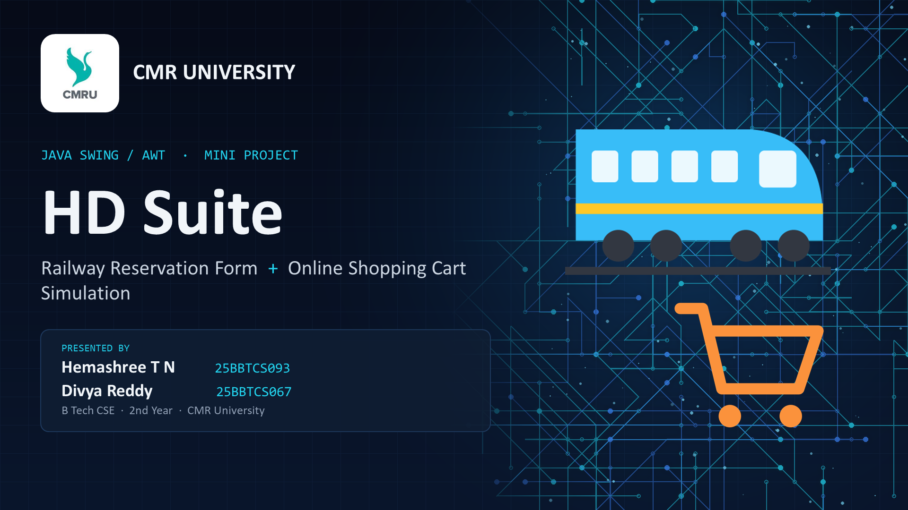
// 01 · AGENDA
What we will cover
01
Problem & Objectives
Why we built it
05
Event Handling
The delegation event model
02
Solution Overview
HD Rail + HD Cart
06
HD Rail
Booking, waiting list, refunds
03
Tools & Architecture
Java, Swing, layered design
07
HD Cart
Cart, coupons, checkout
04
OOP Concepts
Classes, inheritance, polymorphism
08
Testing & Conclusion
Results and future scope
02 / 17
Notes:
Walk through the agenda: the problem, our solution, the tools and design, the OOP concepts, event handling, a tour of both modules, and finally testing and conclusion.

Slide 3
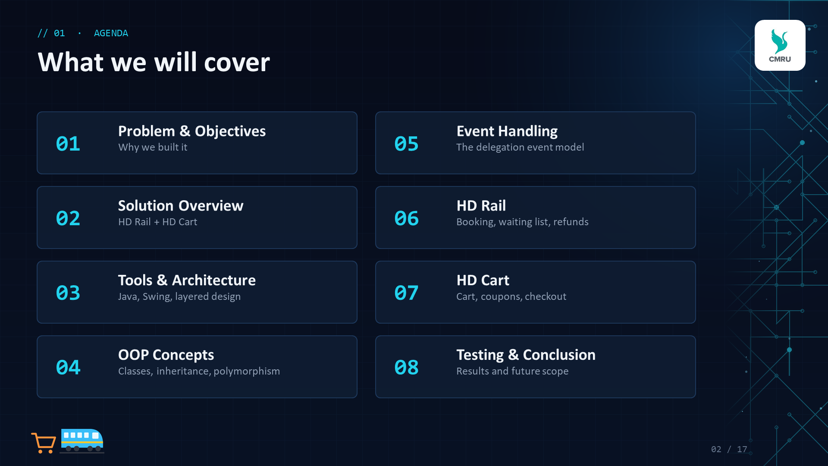
// 02 · PROBLEM & OBJECTIVES
Real-world forms, done right
OBJECTIVES
THE PROBLEM
Booking a train ticket and shopping online both mean long forms, prices that depend on many rules, and plenty of user mistakes.
We set out to build both as working desktop simulations that show how a GUI program takes input, checks it and produces the correct result.
1
Build two complete GUI applications with Java Swing / AWT under one home screen
2
Apply OOP: classes, encapsulation, inheritance and polymorphism
3
Respond to every user action using the delegation event model
4
Validate all input and handle exceptions with clear messages
5
Deliver a tested build that compiles, runs and gives correct output
03 / 17
Notes:
Explain the problem: both booking and shopping need lots of input, rule-based pricing and error handling. Then read out the five objectives, which match the experiment's requirements.

Slide 4

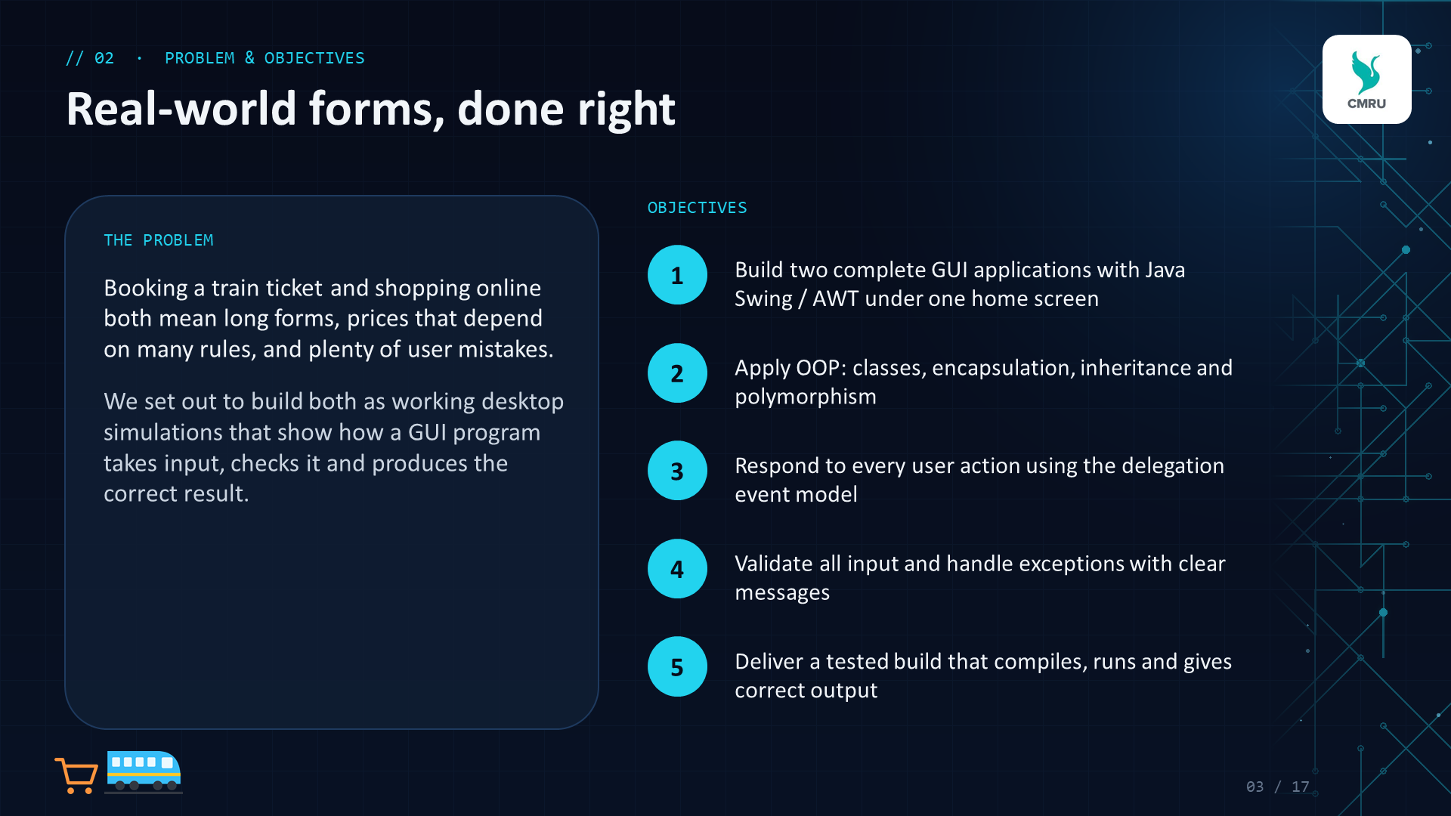
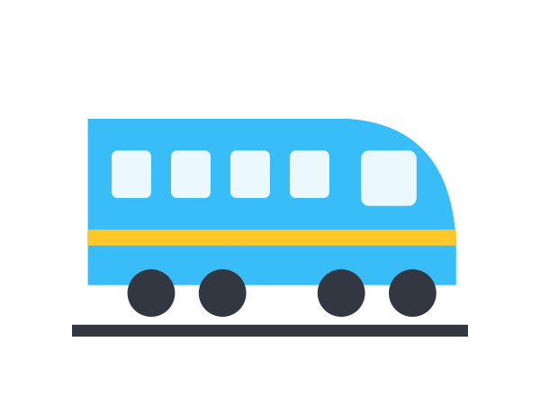

// 03 · SOLUTION OVERVIEW
One suite, two applications
HD Rail
Railway Reservation Form
HD Cart
Online Shopping Cart Simulation
Search trains between 6 cities
Fare breakup with concession & GST
Berth allotment + waiting list
Cancel by PNR with refund
13 products with pictures & ratings
Category tax, coupons, delivery
Live cart with - / + steppers
Checkout, payment, order receipt
Both open from one home screen, HD Suite, and share the same validation and utility classes
04 / 17
Notes:
Both modules open from one home screen called HD Suite. HD Rail handles train booking and cancellation; HD Cart simulates an online store from browsing to the order receipt. They share the same validation and utility classes.

Slide 5
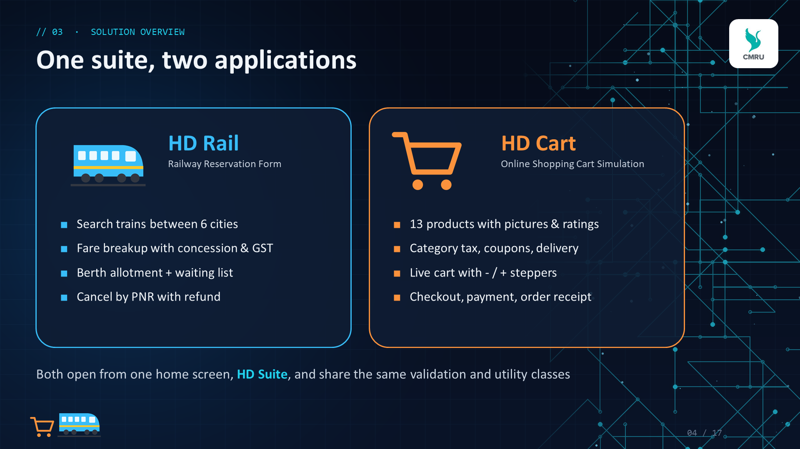
// 04 · TOOLS & TECHNOLOGIES
Built with core Java only
JAVA
JDK 17
Compiled with --release 8, so it also runs on older lab PCs
SWING
javax.swing
JFrame, JButton, JComboBox, JRadioButton, JCheckBox, JTable, JMenuBar
AWT + JAVA 2D
java.awt
Layout managers, events, Graphics2D drawings of every picture
JAVA.TIME
LocalDate
Parses and checks journey dates in dd-MM-yyyy format
COLLECTIONS
java.util
ArrayList, TreeSet and Comparator for bookings, cart and sorting
TOOLING
javac + java
Any editor; run.bat compiles and starts the app in one click
0 external libraries 0 image files 29 Java source files 4,859 lines of code
05 / 17
Notes:
Everything is plain Java: Swing for components, AWT for layouts and events, Java 2D for the drawings, java.time for dates and the Collections framework for data. No external libraries and no image files - even the product pictures are drawn in code.

Slide 6
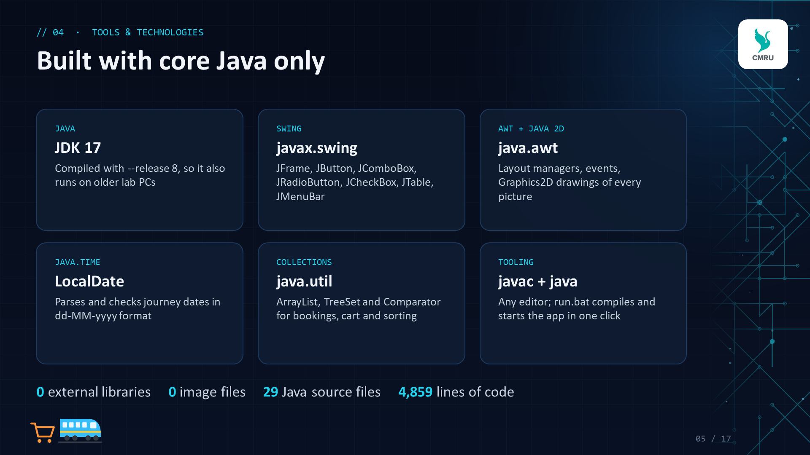
// 05 · SYSTEM ARCHITECTURE
Three clean layers
PRESENTATION (GUI)
What the user sees and clicks
MainApp
RailwayReservationFrame
JourneyPanel
ShoppingCartFrame
ProductCard
CartRow
CheckoutDialog
LOGIC & MODEL
Rules, data and calculations
ReservationSystem
Ticket + 3 types
Train
Passenger
Store
ShoppingCart
CartItem
Product + 4 types
Coupon
COMMON UTILITIES
Shared helpers for both modules
Validator
ValidationException
Money
Art
UiUtil
FlatButton
06 / 17
Notes:
The code is split into three layers. The GUI classes only show things and react to clicks. The logic and model classes hold the rules - fares, waiting list, cart totals - and have no GUI code, which is why we could test them separately. The utility layer is shared by both modules.

Slide 7
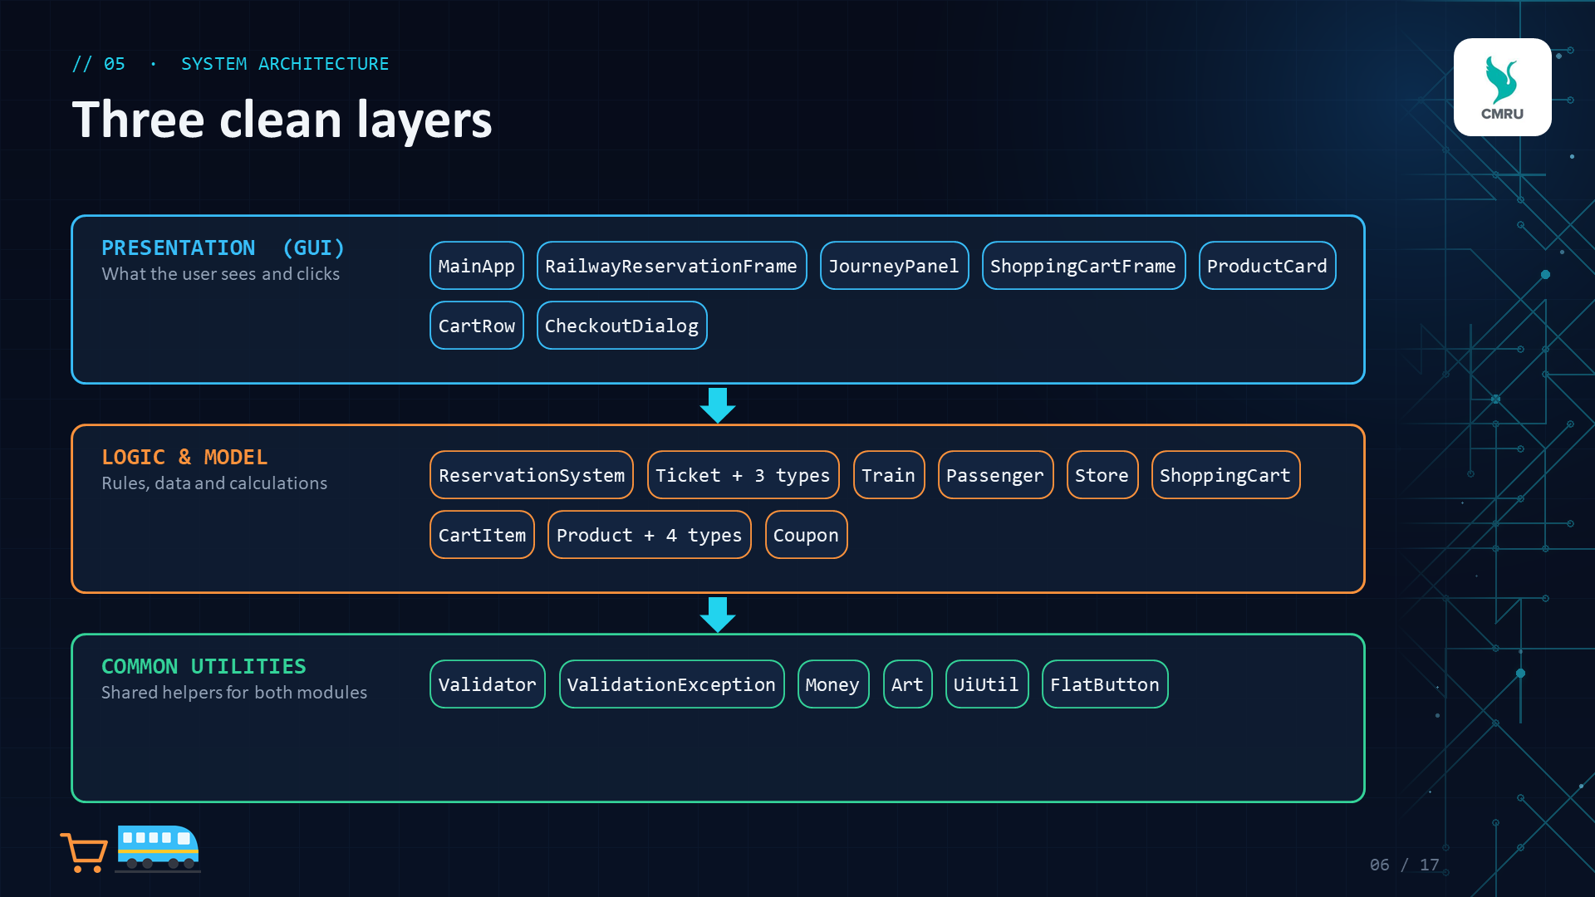
// 06 · OOP CONCEPTS
Inheritance and polymorphism at work
Ticket (abstract)
Encapsulation
Fields are private; changed only through methods like confirm(), add(), applyCoupon()
SleeperTicket
AcThreeTierTicket
AcTwoTierTicket
Inheritance
3 ticket classes extend Ticket, 4 product classes extend Product, FlatButton extends JButton
Product (abstract)
Abstraction
Abstract getRatePerKm() and getTaxPercent() force each subclass to define its own rule
Electronics
Clothing
Book
Grocery
Polymorphism
One call, ticket.getTotalFare(), gives the right fare for SL, 3A or 2A
double fare = ticket.getTotalFare(); // any class
07 / 17
Notes:
Ticket and Product are abstract classes. Each travel class and each product category is a subclass that overrides the rules - rate per km, GST, berth layout, tax rate. The fare is calculated once in Ticket.getTotalFare(), which calls the overridden methods: that is runtime polymorphism.

Slide 8
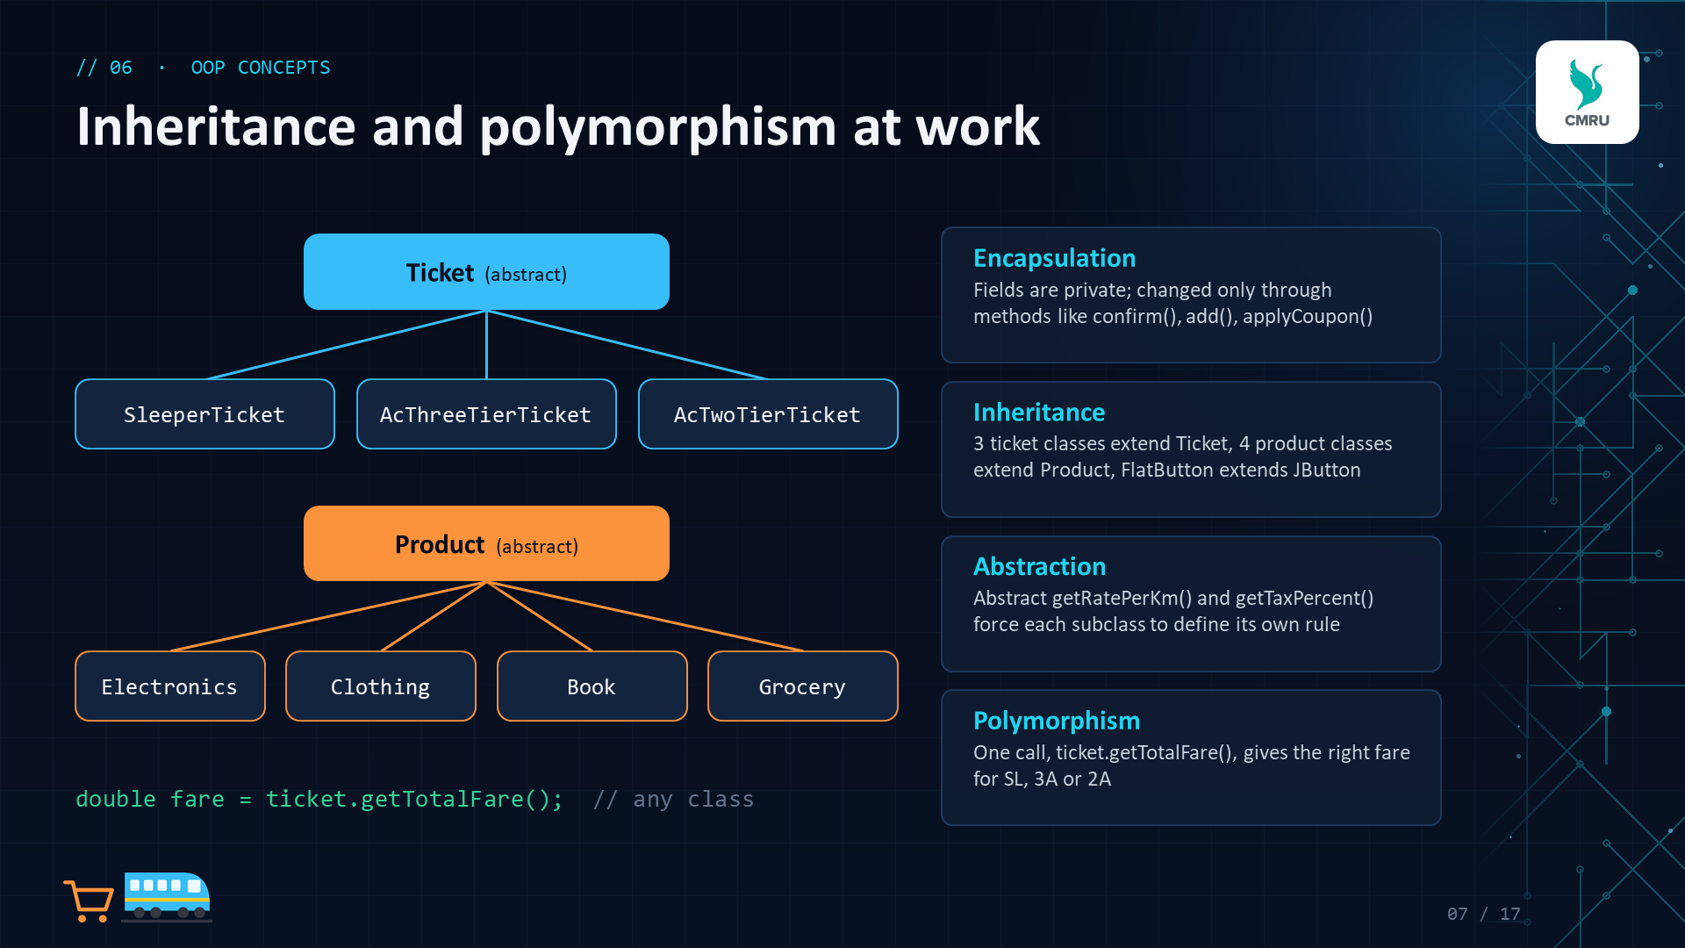
// 07 · EVENT HANDLING
The delegation event model
1
User acts
clicks, types, selects
2
Event source
JButton, JComboBox, JCheckBox
3
Event object
ActionEvent, ItemEvent, MouseEvent
4
Listener runs
actionPerformed(), itemStateChanged()
5
Screen updates
model changes, GUI refreshes
ActionListener
Buttons, menu items, Enter key
ItemListener
Combo boxes, check boxes, radio buttons, chips
MouseAdapter
Card hover, picture click, double-click a booking
KeyAdapter
Digits-only fields, live search while typing
FocusAdapter
Re-check seats when leaving the date field
WindowAdapter
Ask before exiting the application
Swing Timer
Live clock, toast messages, payment animation
Custom events
ProductCard and CartRow send ActionEvents to the window
08 / 17
Notes:
Swing uses the delegation event model: a component is the event source, it creates an event object, and passes it to a registered listener. Our frames implement ActionListener and ItemListener, and we use adapter classes - MouseAdapter, KeyAdapter, FocusAdapter, WindowAdapter - so we only override the methods we need.

Slide 9
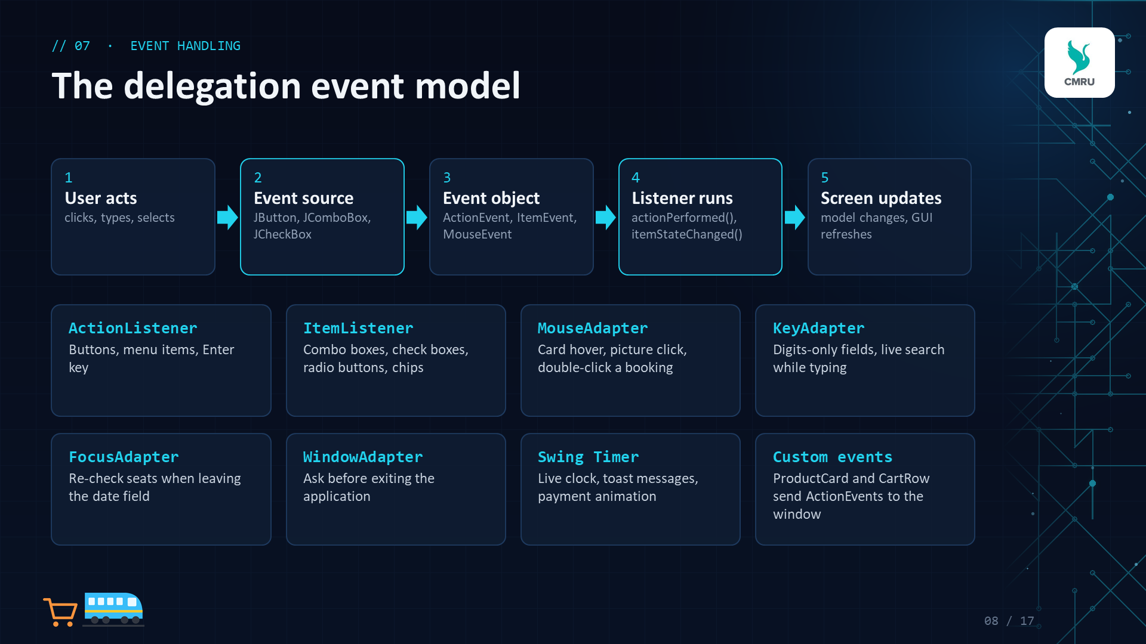
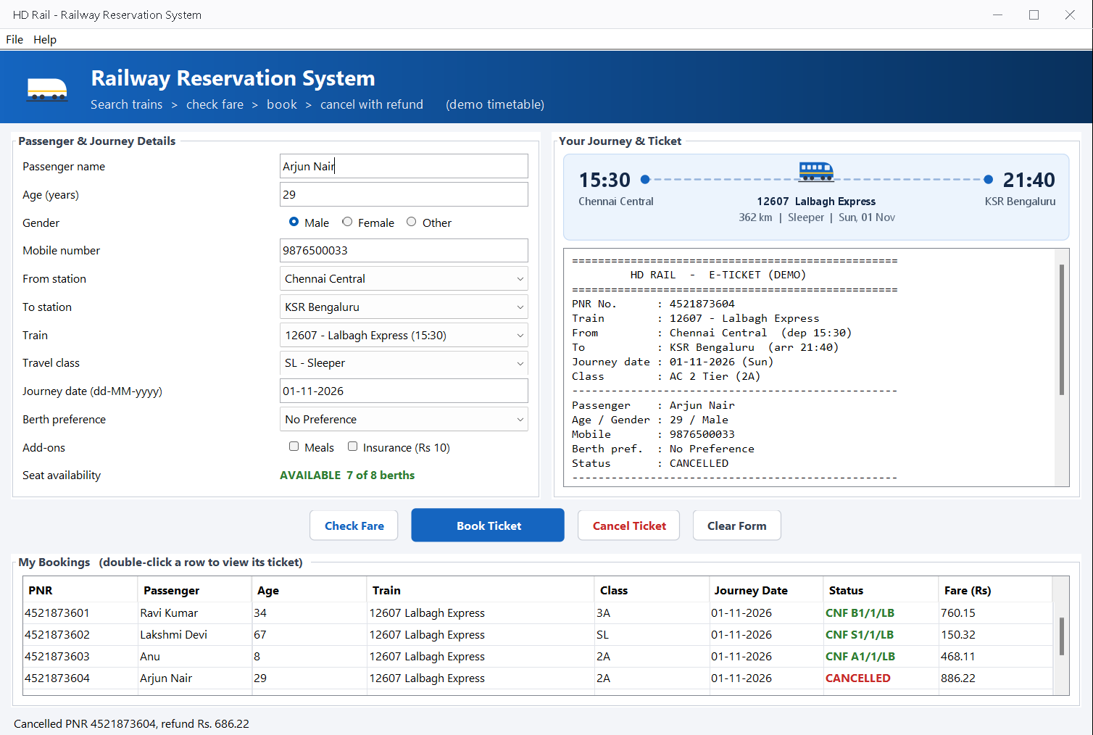
// 08 · MODULE 1 · HD RAIL
Railway Reservation Form
16 trains between 6 cities
Sleeper, AC 3 Tier, AC 2 Tier
Fare breakup with concession and GST
Berth by preference; seniors get a lower berth
Waiting list (WL) with auto-confirm
Cancel by PNR with refund
Colour-coded bookings table
09 / 17
Notes:
This is HD Rail after a cancellation. On the left is the passenger and journey form with text fields, radio buttons, combo boxes and check boxes. On the right, the journey strip and the e-ticket. The bookings table shows CNF in green, WL in orange and CANCELLED in red.

Slide 10
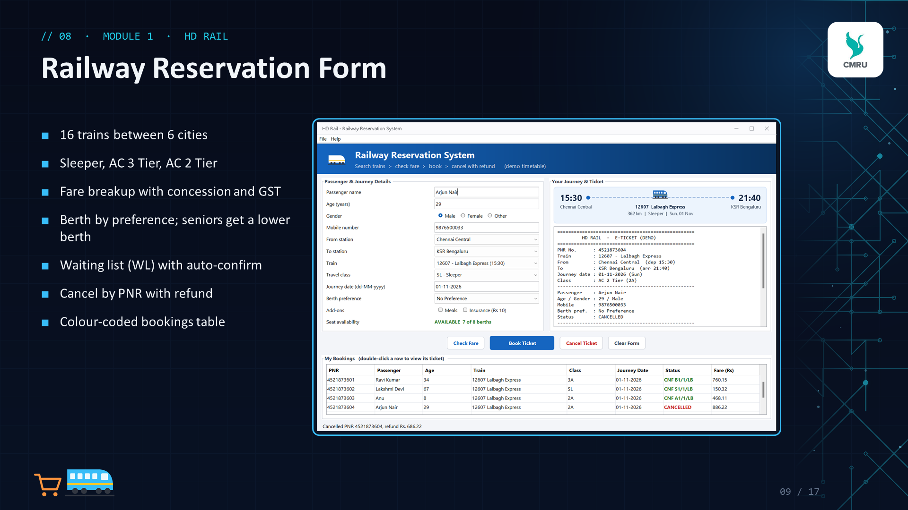
// 09 · HD RAIL · LOGIC
Fare engine and booking lifecycle
FARE FORMULA
Total = Base − Concession
+ Reservation + GST + Add-ons
Base = km × rate · Senior 60+: 40% off · Child 5-11: 50% off
1
Book
PNR generated
2
Seat free?
Yes: CNF + berth · No: WL 1..5
Class | Rate/km | Reservation | GST | Cancel fee
SL Sleeper | 0.60 | 20 | 0% | 120
3A AC 3 Tier | 1.50 | 40 | 5% | 180
2A AC 2 Tier | 2.20 | 50 | 5% | 200
3
Cancel
Refund = fare − cancel fee
EXAMPLE
Chennai → Bengaluru, 362 km, AC 3 Tier, adult
543.00 + 40.00 + 27.15 GST = Rs 610.15
4
Auto-confirm
WL 1 gets the freed berth
10 / 17
Notes:
The fare is computed by one formula; only the rate, reservation charge and GST change by class - that is where the subclasses come in. Booking first tries to give a berth; when the class is full the ticket goes on the waiting list. When a confirmed ticket is cancelled, WL 1 is confirmed automatically and everyone else moves up.

Slide 11
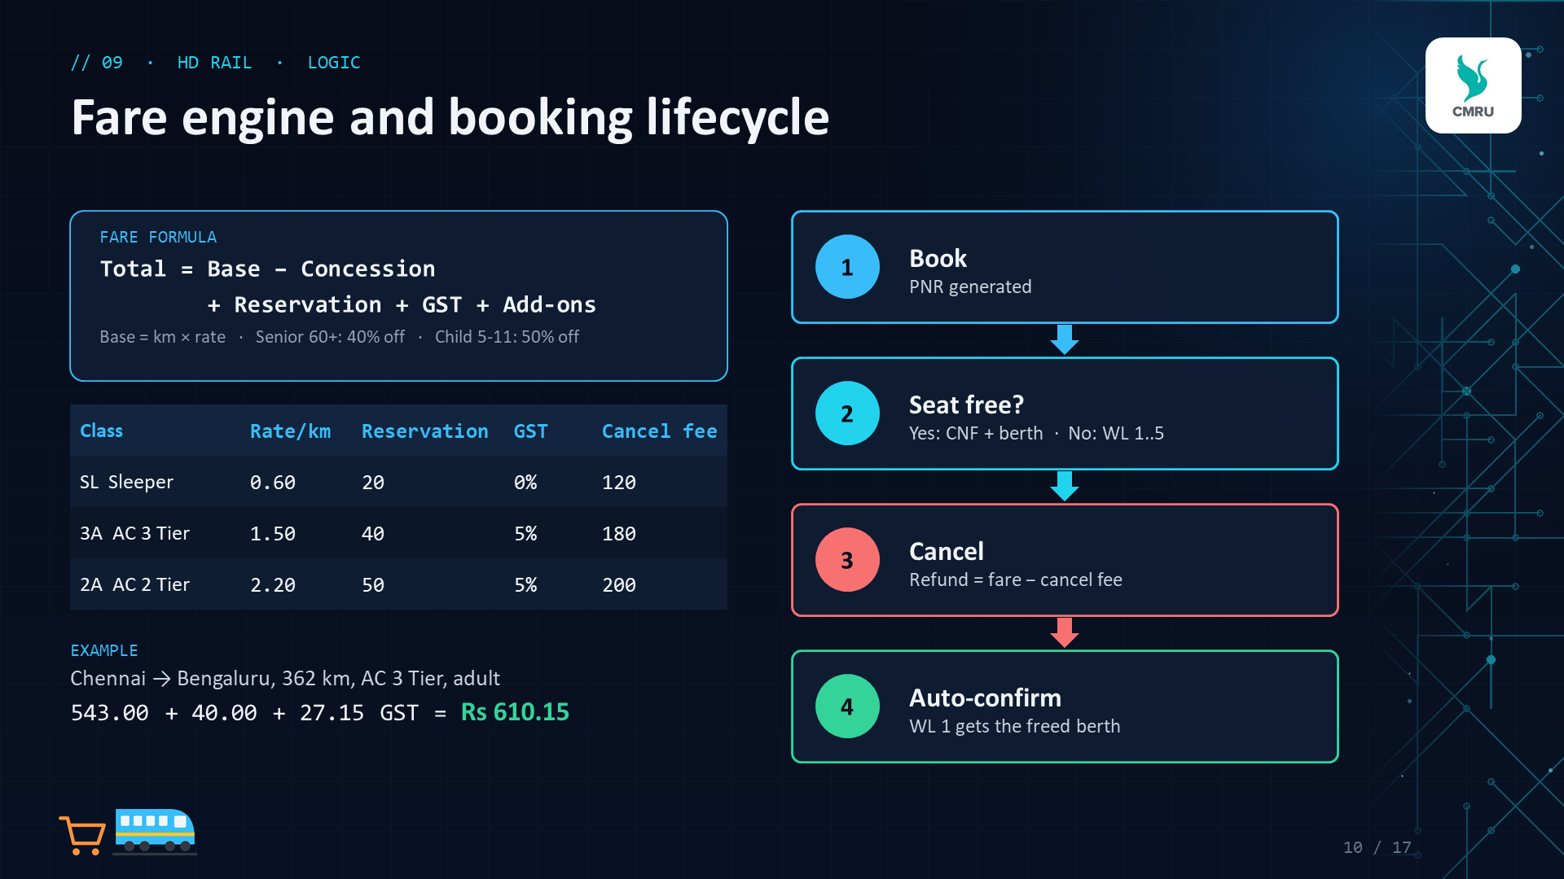
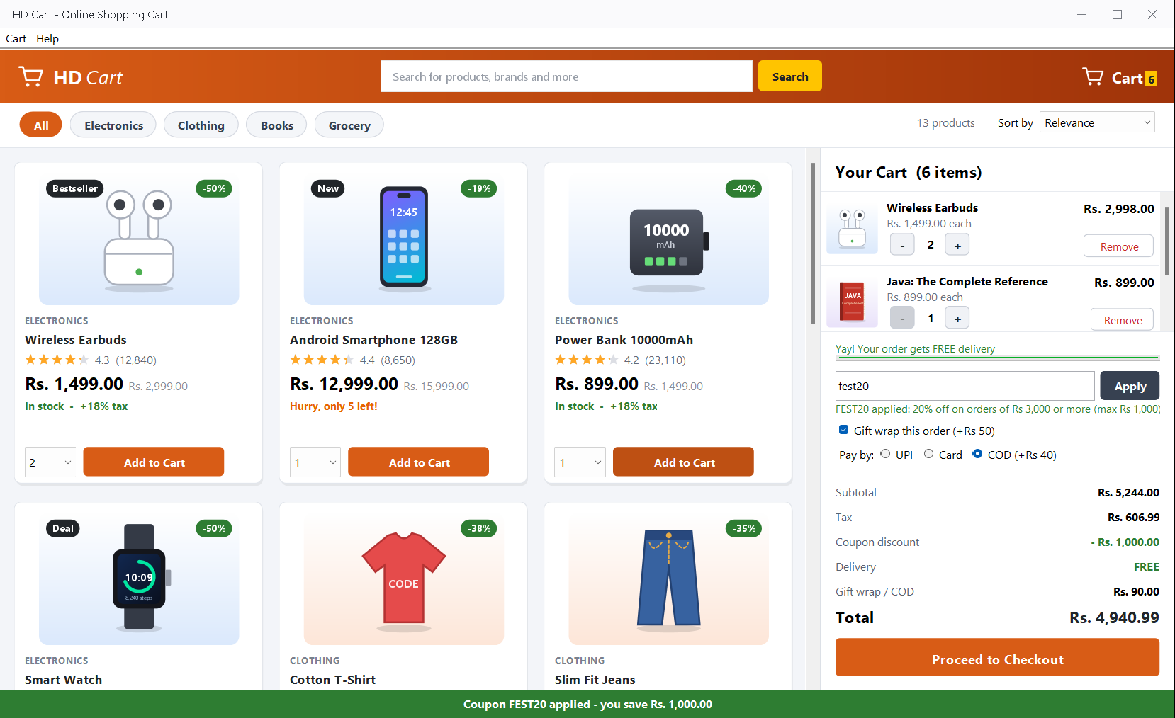
// 10 · MODULE 2 · HD CART
Online Shopping Cart Simulation
13 products, 4 categories, drawn pictures
Ratings, MRP and % off on every card
Category chips, live search, 5 sort options
Cart with - / + steppers and stock limits
Coupons SAVE10, FLAT200, FEST20
Gift wrap; UPI, Card or COD
Free delivery above Rs 999
11 / 17
Notes:
HD Cart looks like a real shopping site: a search bar and cart badge on top, category chips, product cards with ratings and discounts, and a cart sidebar. The cart updates live - quantity steppers, free-delivery progress bar, coupon and payment mode all change the total immediately.

Slide 12
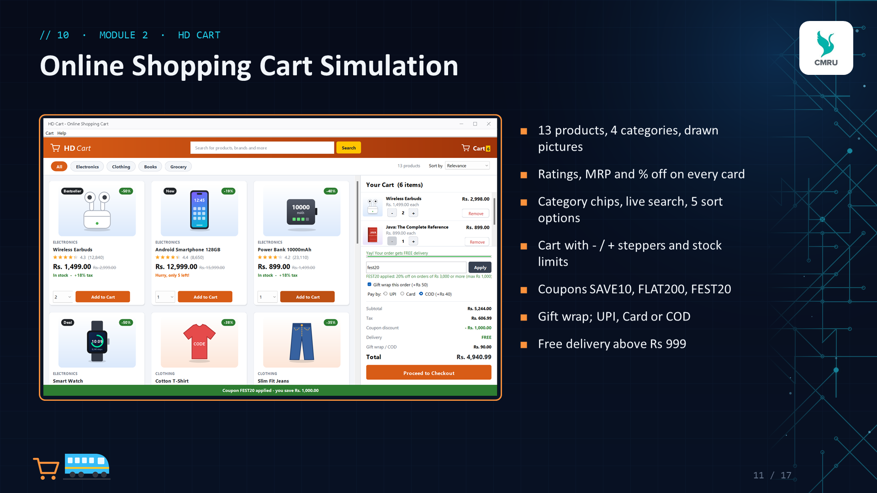
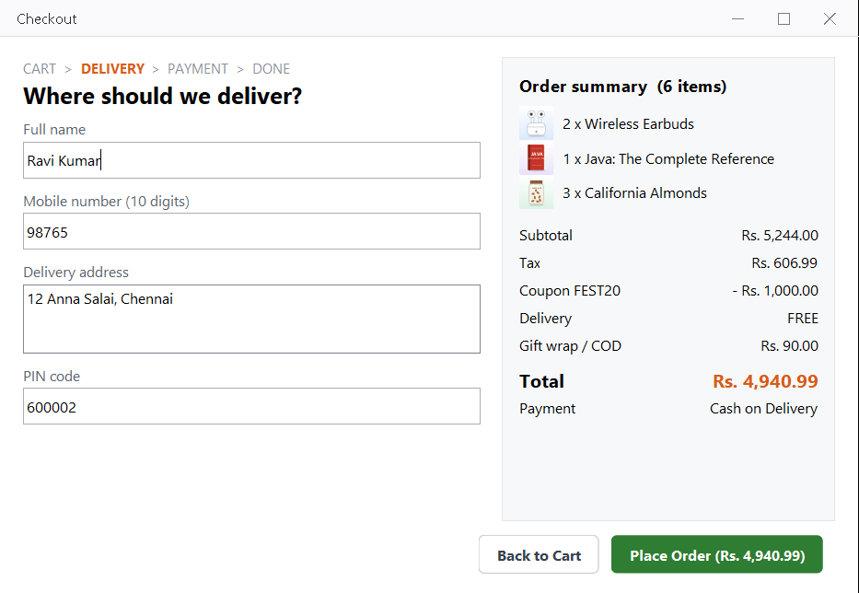
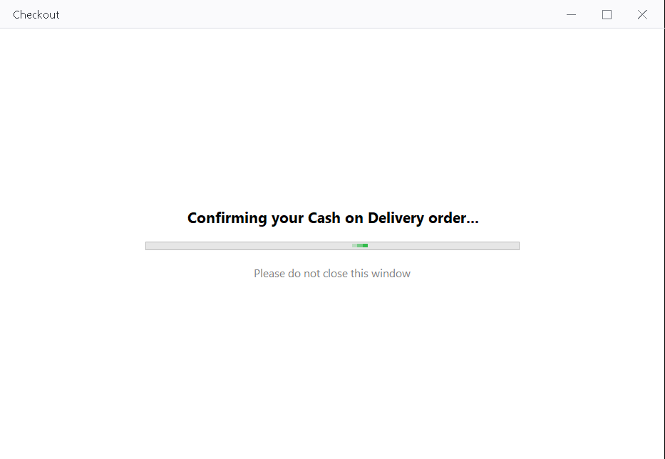
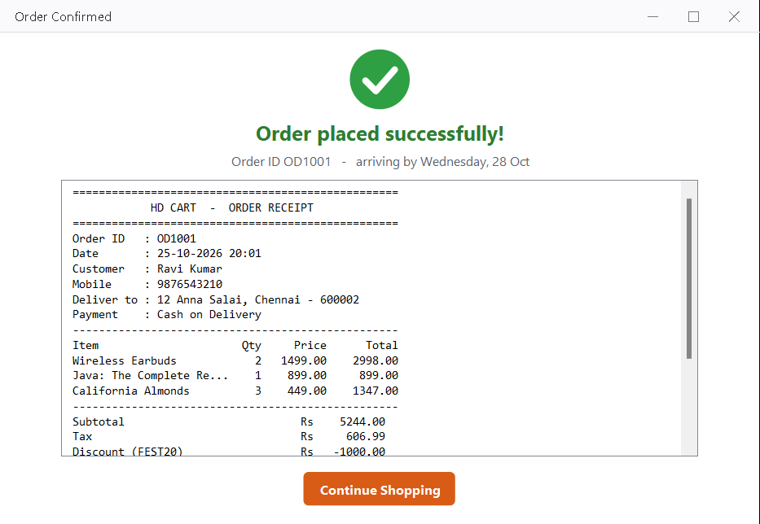
// 11 · HD CART · CHECKOUT
From cart to confirmed order
1 DELIVERY DETAILS
2 PAYMENT
3 ORDER CONFIRMED
PRICE CALCULATION
Grand Total = Subtotal + Tax − Coupon + Delivery + Gift wrap / COD
Example: 5,244.00 + 606.99 − 1,000.00 + 0 + 90.00 = Rs 4,940.99
12 / 17
Notes:
Checkout uses a CardLayout with three steps. First the delivery form, validated on the spot; then a payment animation driven by a Swing Timer; then the confirmation with the full receipt. The example shows how the grand total is built: tax per category, the FEST20 coupon capped at Rs 1,000, free delivery, and gift wrap plus Cash on Delivery charges.

Slide 13
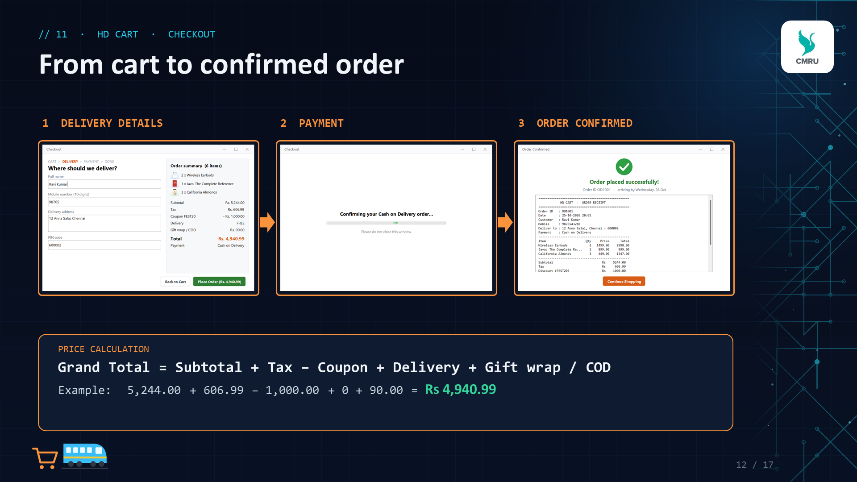
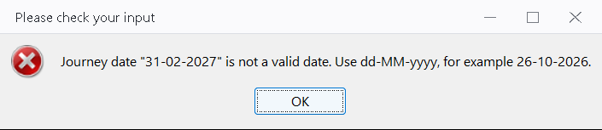
// 12 · VALIDATION & EXCEPTIONS
Every input is checked
Name
Letters and spaces, 2-40 characters
Age
Whole number; under 5 travel free
Mobile
10 digits starting with 6, 7, 8 or 9
try {
value = Integer.parseInt(text);
} catch (NumberFormatException e) {
throw new ValidationException(
field + " must be a whole number");
}
Journey date
dd-MM-yyyy, today to 120 days ahead
PIN code
6 digits, cannot start with 0
Quantity
Never more than the stock left
A custom checked ValidationException carries a clear message to an error dialog, or to a red inline note at checkout.
Coupon
Must exist and meet its minimum order
13 / 17
Notes:
All checks live in one Validator class. It catches NumberFormatException and DateTimeParseException and rethrows our own checked ValidationException with a message the user can act on. Digit-only fields also block letters while typing, using a KeyAdapter.

Slide 14
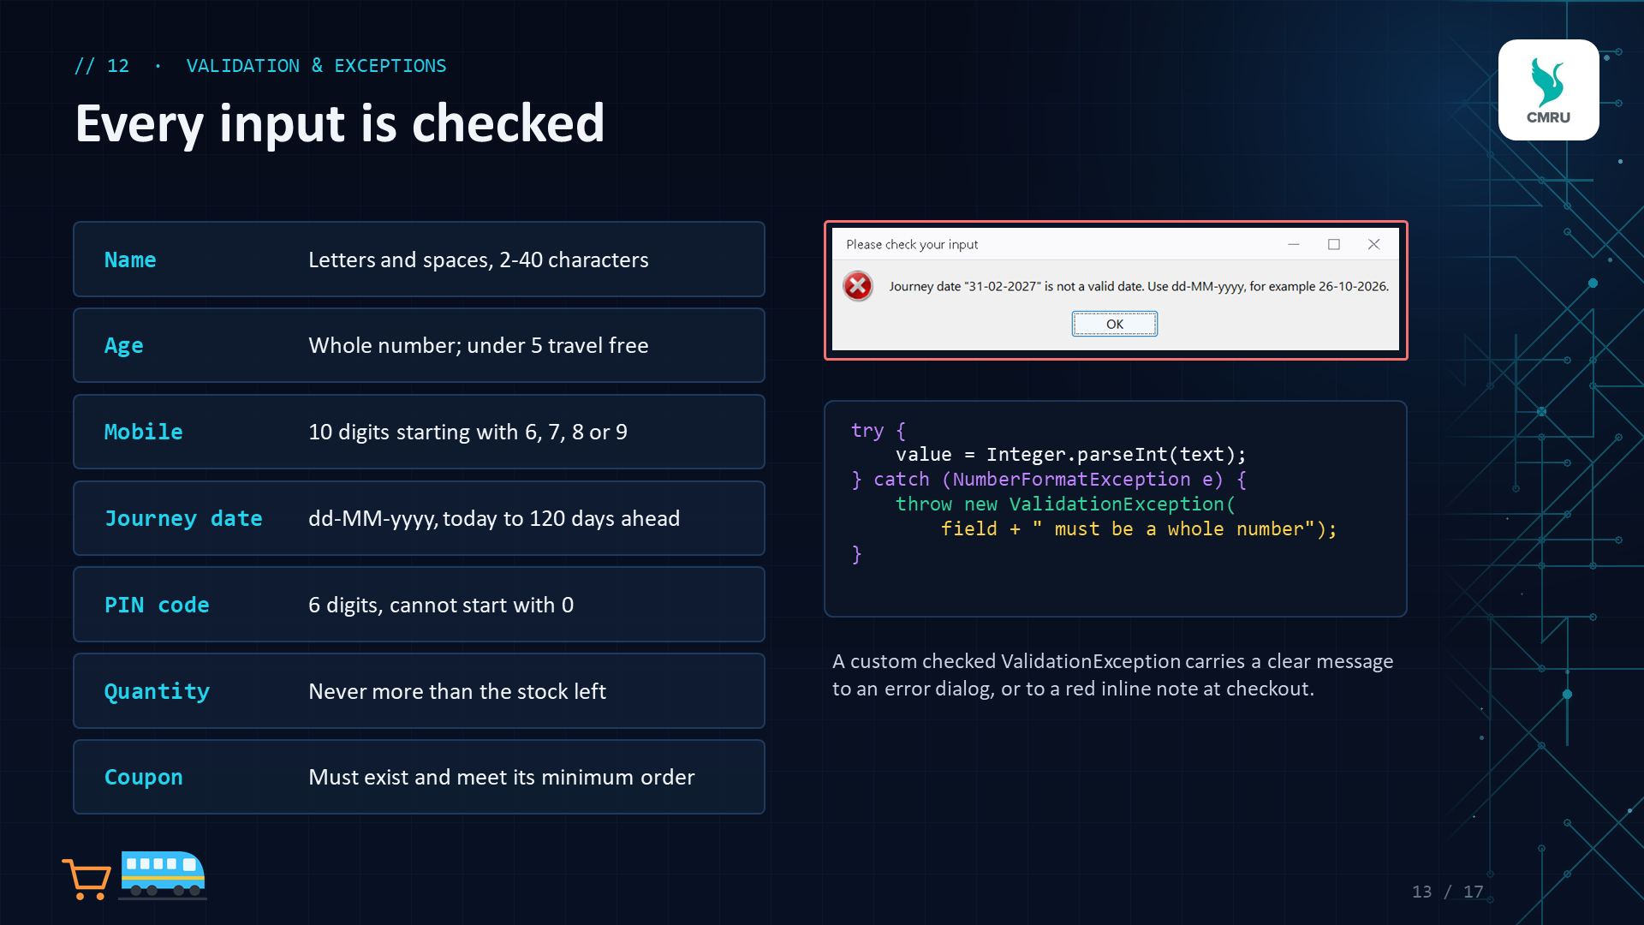
// 13 · TESTING & RESULTS
Tested end to end
98
31
3
0
logic checks passed
screens driven by an automated GUI test
bugs found and fixed
failures in the final run
Test case | Expected | Result
Book with empty name | Error dialog, no booking | Pass
Journey date 31-02-2027 | "not a valid date" message | Pass
5th booking in full AC 2 Tier | Ticket goes to WL 1 | Pass
Cancel a confirmed ticket | Refund shown; WL 1 confirmed | Pass
4 almonds when 3 in stock | Stock limit error | Pass
FEST20 on a Rs 5,244 cart | Discount capped at Rs 1,000 | Pass
Mobile 98765 at checkout | Red inline error | Pass
14 / 17
Notes:
We tested in two ways. 98 automatic checks test the logic classes with exact expected values. Then a GUI test clicked through every screen of both modules - 31 screens - checking the results. Testing found three real bugs, which we fixed: the bookings table was hidden on small screens, add-ons carried over to the next passenger, and the payment progress bar was stretched.

Slide 15
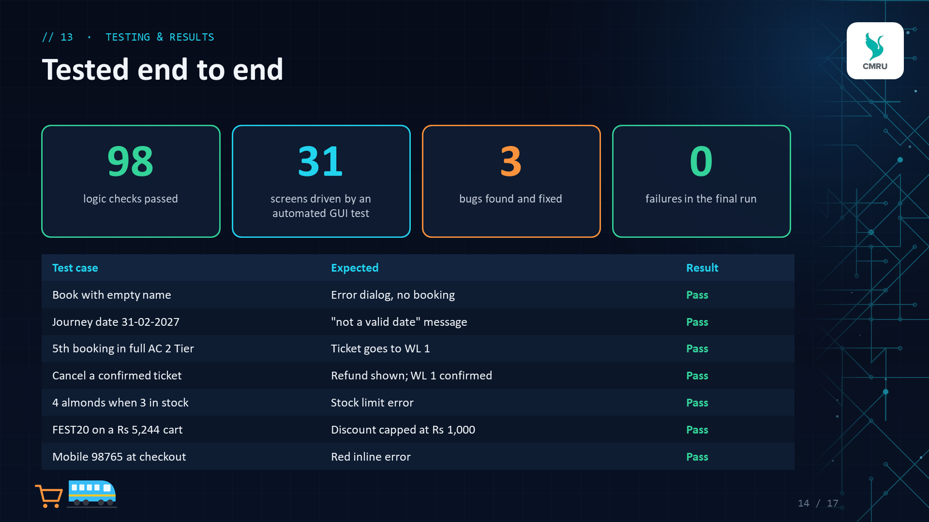
// 14 · CONCLUSION & FUTURE SCOPE
What we achieved, and what's next
01
Database storage
Save bookings and orders with JDBC + MySQL
CONCLUSION
HD Suite meets every requirement of the experiment: a well laid-out Swing GUI, OOP design, delegation event handling, input validation with exceptions, and a working build.
Building two real-world simulations taught us how GUI, rules and data fit together - and why testing matters.
02
User accounts
Login with booking and order history
03
PDF export
Download e-tickets and invoices
04
Seat map
Pick a berth on a visual coach layout
05
Payment gateway
Connect a real gateway in sandbox mode
15 / 17
Notes:
Summarise: all five requirements are met and tested. For future work, the most useful next step is a database so data survives restarts, followed by user accounts, PDF tickets, a seat map and a real payment gateway in sandbox mode.

Slide 16
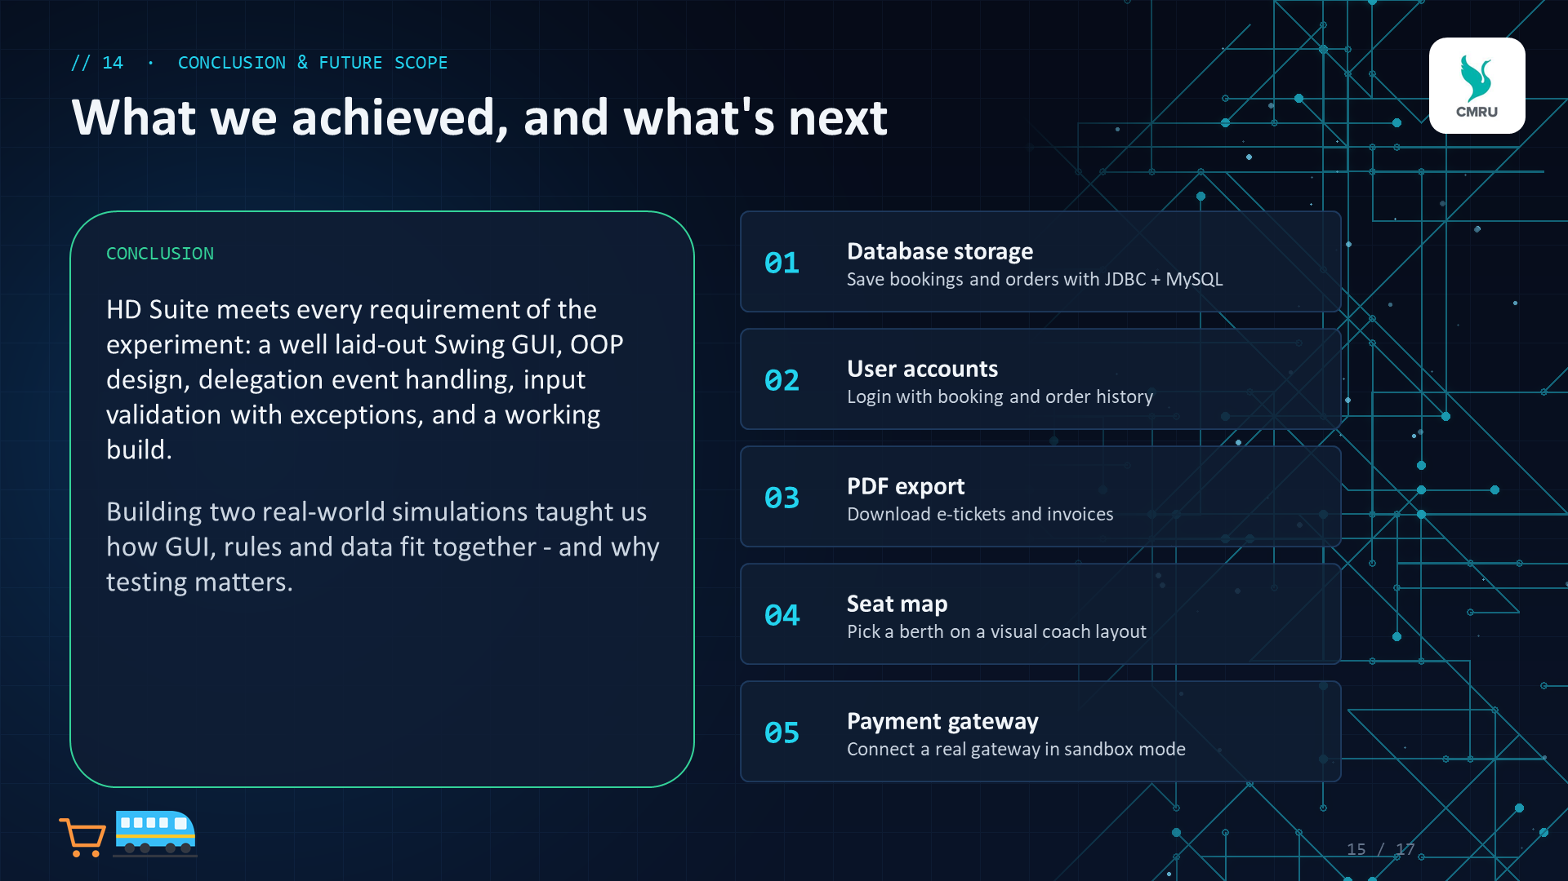



// 15 · TRY IT LIVE
Scan and use both apps on your phone
HD Rail
Book, check fare, cancel by PNR
HD Cart
Shop, coupons, checkout, receipt
JAVA PROJECT
The same site has the Java project (.zip), this PPT and the report.
On a laptop: unzip, then double-click run.bat
Scan with your phone camera
Opens both apps - nothing to install
16 / 17
Notes:
Invite everyone to scan the big QR code with their phone camera. It opens the HD Suite site, where both apps run in the browser on phone or computer - same rules as the Java version. The two small codes open HD Rail and HD Cart directly. The Java project itself can be downloaded from the same site.

Slide 17
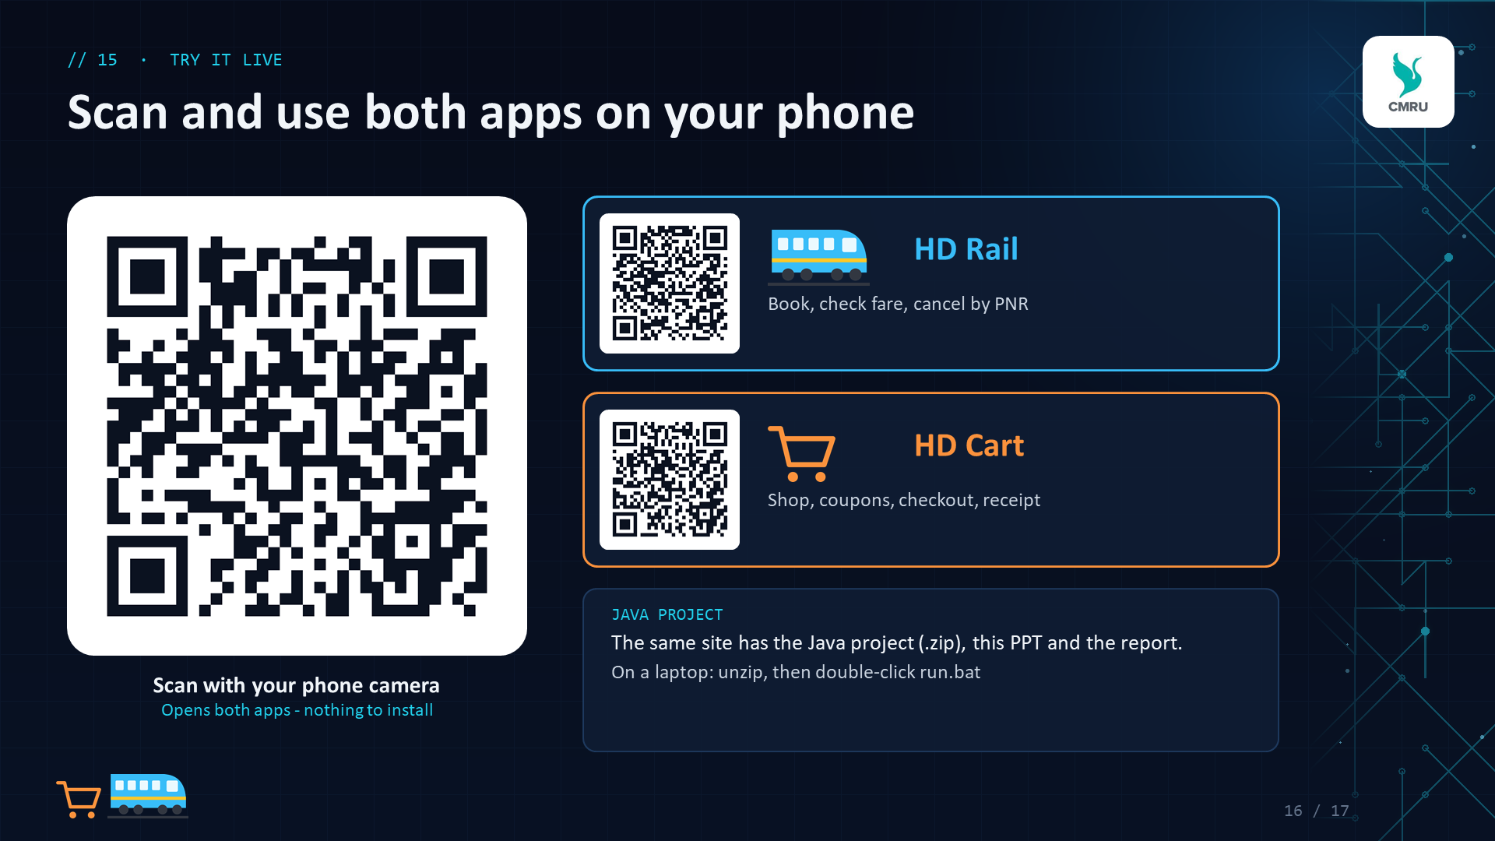
CMR UNIVERSITY
Thank You
Questions?
Hemashree T N · 25BBTCS093
Divya Reddy · 25BBTCS067
Scan to try it
Notes:
Thank the audience and invite questions. Be ready to show the live demo: run.bat starts the app.

