Slide 1
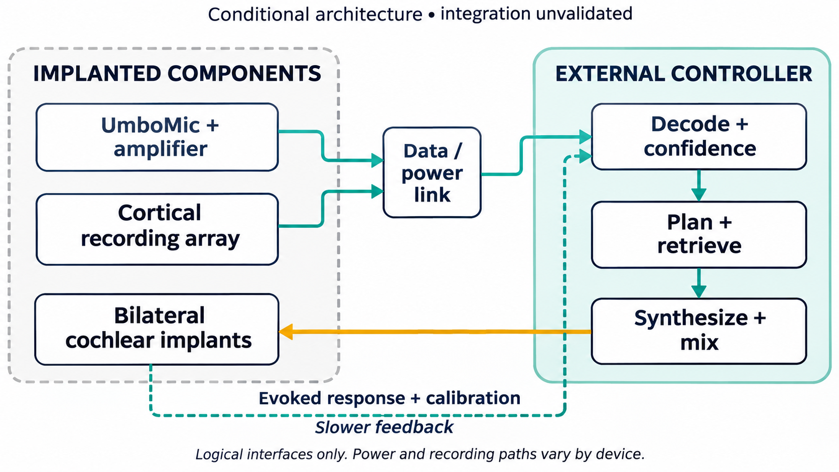
Coordinate the loop from an external controller
System 6 • Hypothetical intracortical speech-decoding and bilateral cochlear-implant loop
Proposed combination
Acoustic + neural inputs
External control
Bilateral output
Utah or Connexus
UNICO or conventional Nucleus
Cortical feedback requires separate recording.
Component evidence exists. The combined system and proposed clinical use remain unvalidated.
Conditional system diagram. Sources and interface limits in speaker notes.
01
Notes:
SYSTEM 6 • TECHNICAL REVIEW • 2 NOVEMBER 2026
Purpose: evaluate a conditional engineering architecture, not establish device presence in any person, concealed implantation, causation, or a clinical indication. Utah and Connexus are alternative neural routes. MED-EL UNICO and conventional Cochlear Nucleus are distinct auditory-output routes. No interoperability between the listed products and UmboMic is established. The central data/power box is a logical abstraction, not a demonstrated shared bus. UmboMic acoustic input is separate from intracortical neural input. Evoked feedback requires appropriate cortical recording and artifact control, not an assumed direct readout from a cochlear stimulator. Semantic decoding, planning, memory, voice generation and audio mixing are allocated externally. Implant electronics still acquire signals and perform local stimulation coding and delivery. A totally implantable cochlear product does not necessarily accept the proposed external controller interface. The source scenario also mentioned a midbrain output alternative, but no midbrain device is specified in the selected System 6 bill of components; it is outside this deck. Sources: https://www.medel.pro/hearing-solutions/tici/ ; https://paradromics.com/connexus/ ; https://pmc.ncbi.nlm.nih.gov/articles/PMC11529819/
Figure: S01_System_Loop.png. Conditional system diagram. Sources and interface limits in speaker notes.

Slide 2
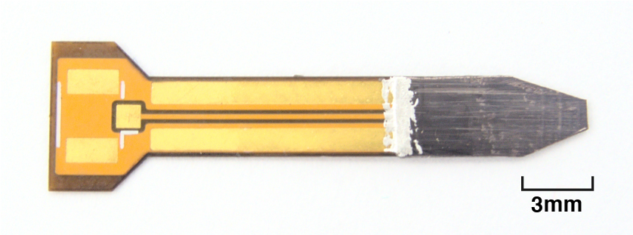
Capture umbo vibration as a separate acoustic input
UmboMic polyvinylidene difluoride (PVDF) bimorph cantilever middle-ear microphone research prototype
Function
Convert mechanical umbo motion into differential electrical charge.
Measured prototype
3 × 3 mm active tip; 32.3 dB SPL equivalent input noise over 100 Hz–7 kHz.
Integration boundary
Cadaver-ear evidence. Implant packaging and connection to the proposed loop remain unvalidated.
Requested 100 Hz–10 kHz coverage is a target, not the bandwidth of the reported noise result.
Image: Yeiser et al., Fig. 3d, CC BY 4.0. Original scale bar retained.
02
Notes:
SYSTEM 6 • TECHNICAL REVIEW • 2 NOVEMBER 2026
Searchable full name is in the subtitle. The 3 × 3 mm dimension refers to the sensing tip, not the entire assembly. The 2026 version is approximately 20 × 4 mm overall. The 2024 32.3 dB SPL result is A-weighted and includes modeled outer-ear gain, integrated over 100 Hz–7 kHz; it is not a 100 Hz–10 kHz noise measurement. Response was within approximately 10 dB over 100 Hz–6 kHz. The user's 100 Hz–10 kHz range is retained as a proposed target, not the validated flat bandwidth. The 2026 characterization still concerns cadaver ears and further biocompatibility, fixation and long-term work. Sources: https://pmc.ncbi.nlm.nih.gov/articles/PMC11529819/ ; https://pmc.ncbi.nlm.nih.gov/articles/PMC13020673/ . Image: https://arxiv.org/html/2312.14339v1/images/v2.0_finished_sensor2.jpg .
Figure: S02_UmboMic.png. Image: Yeiser et al., Fig. 3d, CC BY 4.0. Original scale bar retained.

Slide 3
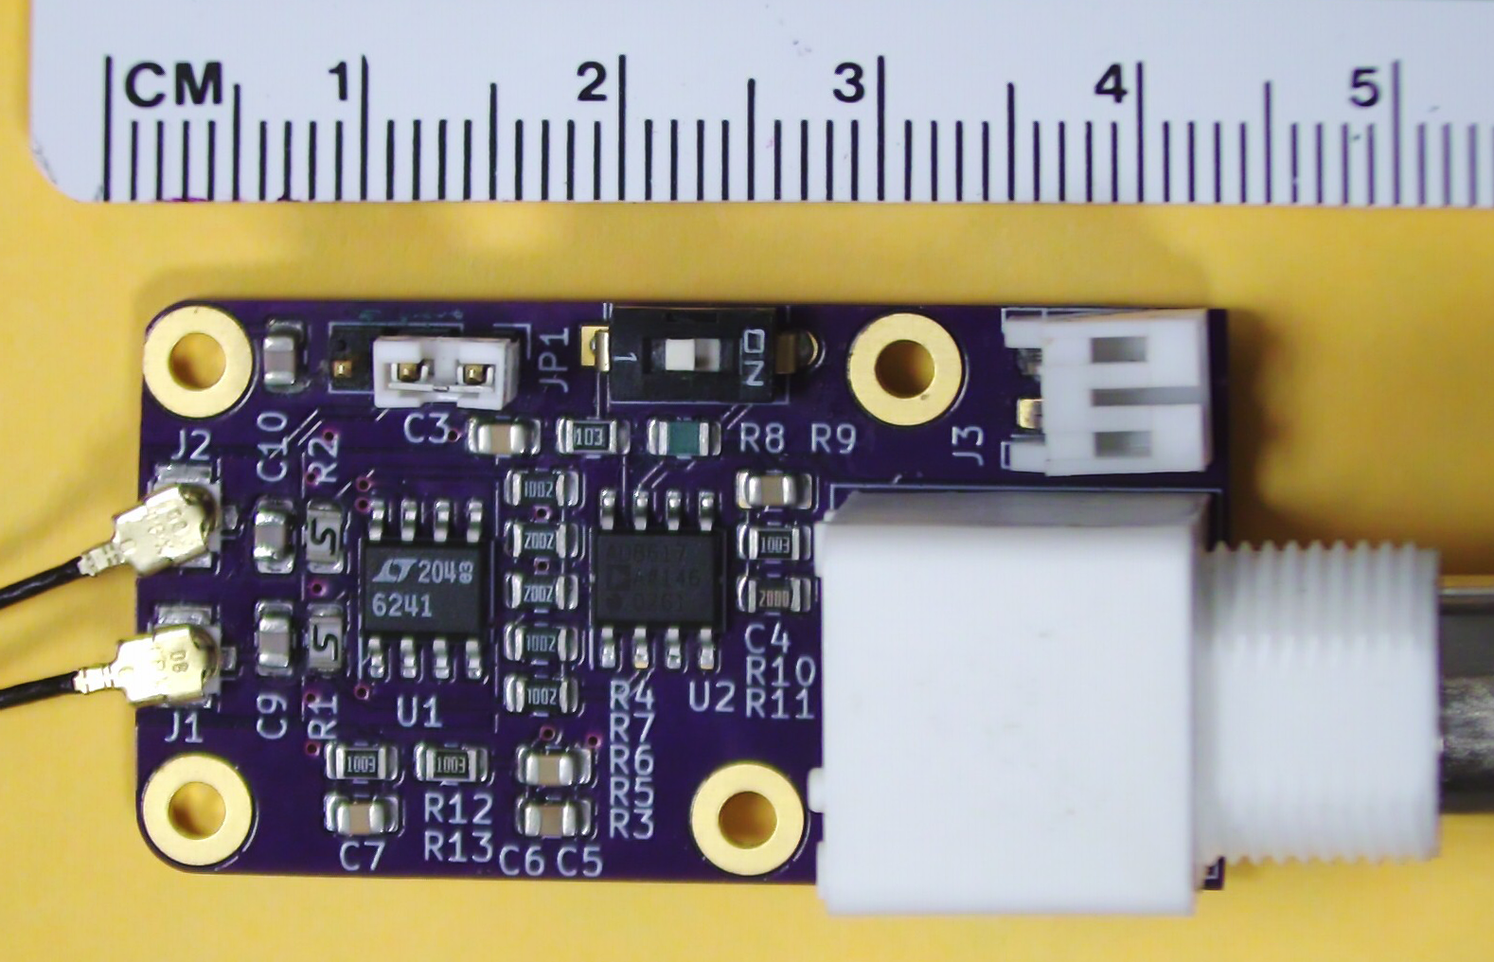
Convert the sensor’s small charge signal into a usable voltage
UmboMic custom low-noise differential charge-sensitive amplifier (CSA), Yeiser et al. research prototype
Function
Condition the PVDF signal before digitization and telemetry.
Reported performance
19.1 V/pC charge gain; −3 dB bandwidth of 160 Hz–50 kHz.
Integration boundary
The pictured board is a bench prototype. An implantable package, power budget and data link are still required.
The sensor’s size does not describe the size or readiness of the complete recording chain.
Image: Yeiser et al., Fig. 4, CC BY 4.0. Ruler shows the research-board scale.
03
Notes:
SYSTEM 6 • TECHNICAL REVIEW • 2 NOVEMBER 2026
The charge-sensitive amplifier is a discrete requested subcomponent and receives its own slide. It is not an identified finished medical-grade implant product. Digitization and telemetry are additional interface functions. Values follow the final journal paper, Section III-D, rather than an erroneous noise label in an earlier preprint figure. Source: https://pmc.ncbi.nlm.nih.gov/articles/PMC11529819/ . Image: https://arxiv.org/html/2312.14339v1/images/diffamp.png .
Figure: S03_Charge_Amplifier.png. Image: Yeiser et al., Fig. 4, CC BY 4.0. Ruler shows the research-board scale.

Slide 4
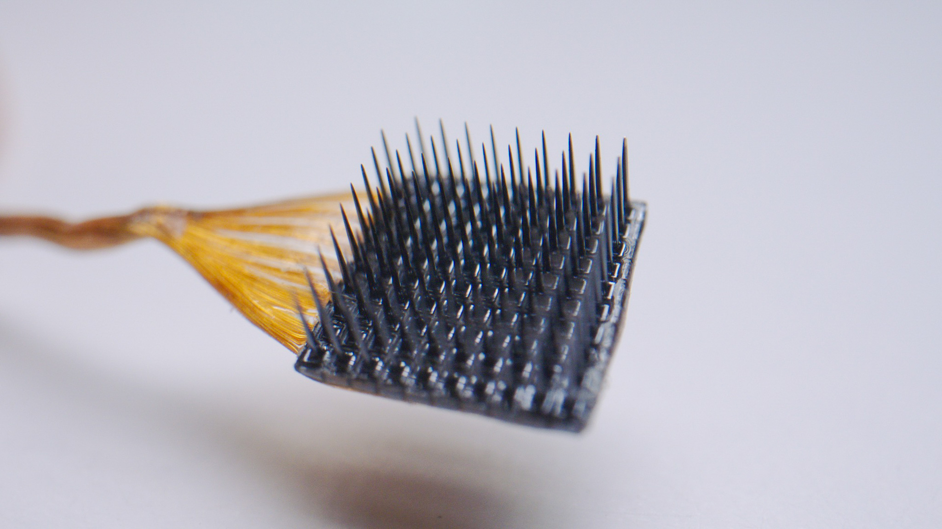
Record local cortical signals for a trained speech decoder
Blackrock Neurotech NeuroPort Electrode 96 intracortical microelectrode array / Utah Array product family
Function
Acquire local neural activity from surgically placed cortical arrays.
Speech-research configuration
Wairagkar 2025 used four arrays, 256 electrodes total, sampled at 30 kHz.
Integration boundary
Decoder results belong to a participant, task and model. They are not a general inner-monologue specification.
A 256-electrode study configuration is not the channel count of one standard Utah array.
Representative product-family photograph: Blackrock Neurotech. Experimental array configuration differs.
04
Notes:
SYSTEM 6 • TECHNICAL REVIEW • 2 NOVEMBER 2026
The photograph represents the Utah/NeuroPort family, not the exact four 64-electrode research arrays. In Wairagkar et al. 2025, one participant with ALS had arrays in ventral precentral regions including 6v, M1 and 55b. The acoustic model produced voice samples within 10 ms of acquisition, with playback adding latency. Product clearance does not establish an approved chronic speech-decoding or CBT indication. Source: https://blackrockneurotech.com/products/neuroport-electrode/ ; https://blackrockneurotech.com/products/utah-array/ ; https://www.nature.com/articles/s41586-025-09127-3 . Image: https://blackrockneurotech.com/wp-content/uploads/2023/04/Utah-Array-NeuroPort-2.jpg .
Figure: S04_Utah_Array.png. Representative product-family photograph: Blackrock Neurotech. Experimental array configuration differs.

Slide 5
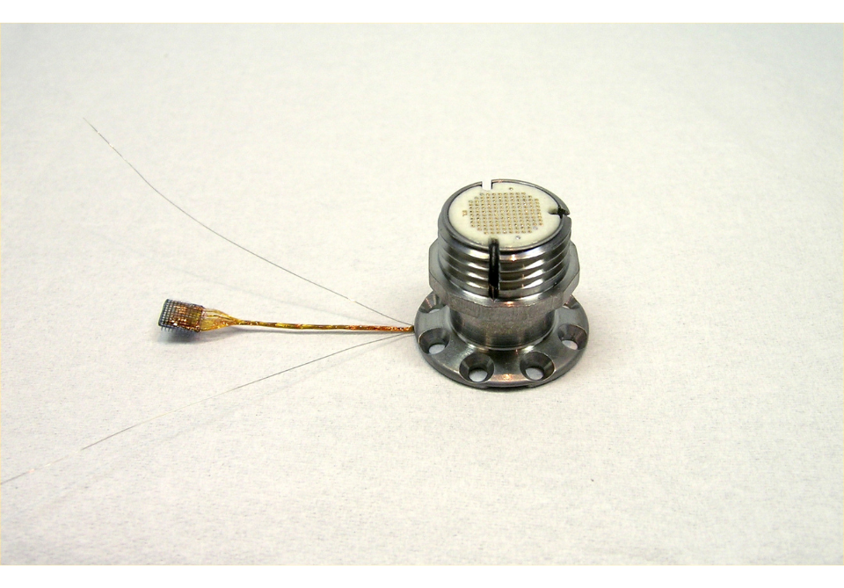
Route Utah-array signals through a percutaneous connection
Blackrock Neurotech Utah / NeuroPort array assembly with CerePort percutaneous pedestal connector
Function
Connect implanted electrodes to external acquisition hardware through the skin.
Physical architecture
The array, wire bundle and pedestal form a wired recording route.
Integration boundary
External acquisition and controller equipment remain necessary. This route is distinct from Connexus wireless telemetry.
The percutaneous route requires an exposed connection and cannot be depicted as fully internal.
Representative array–wire–pedestal assembly: Blackrock Neurotech.
05
Notes:
SYSTEM 6 • TECHNICAL REVIEW • 2 NOVEMBER 2026
Manufacturer lists CerePort connector variants including 128/256 connections. The image is a representative full assembly and does not uniquely identify a connector variant. Do not infer that 256 connector contacts equals one 256-electrode array. The slide covers the physical link, not surgical instructions or a recommended implantation. Source: https://blackrockneurotech.com/products/utah-array/ . Image: https://blackrockneurotech.com/wp-content/uploads/2023/04/Utah-Array.png .
Figure: S05_Percutaneous_Link.png. Representative array–wire–pedestal assembly: Blackrock Neurotech.

Slide 6
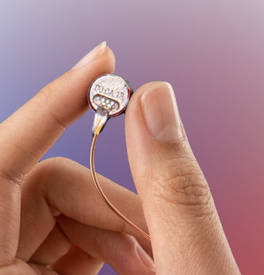
Acquire cortical activity with an implanted Connexus module
Paradromics Connexus Brain-Computer Interface (BCI), 421-microelectrode cortical recording module
Function
Record intracortical activity and send it through an implanted lead to the chest transceiver.
Current evidence
Investigational system. Paradromics reported real-time speech and text in its first participant in September 2026.
Integration boundary
That early-feasibility milestone does not establish the accuracy or latency of this auditory-feedback loop.
Connexus is an alternative recording route. Utah-study metrics do not transfer automatically.
Product photograph: Paradromics. Human speech milestone is manufacturer-reported.
06
Notes:
SYSTEM 6 • TECHNICAL REVIEW • 2 NOVEMBER 2026
421 microelectrodes is the manufacturer-described module count. The 14 September 2026 announcement reports the first Connect-One participant's real-time speech/text milestone; no universal quantitative accuracy or whole-loop latency follows. It does not establish commercial availability, normal-hearing use or integration with UNICO. Sources: https://paradromics.com/connexus/ ; https://paradromics.com/news/paradromics-achieves-real-time-speech-connexus-brain-computer-interface/ . Image: https://paradromics.com/wp-content/themes/paradromics/img/connexus/Hand-with-Product.png .
Figure: S06_Connexus_Array.png. Product photograph: Paradromics. Human speech milestone is manufacturer-reported.

Slide 7
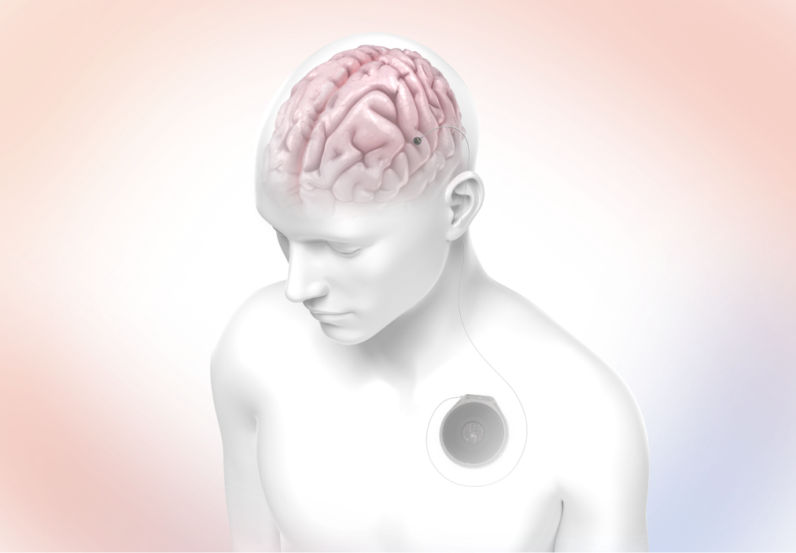
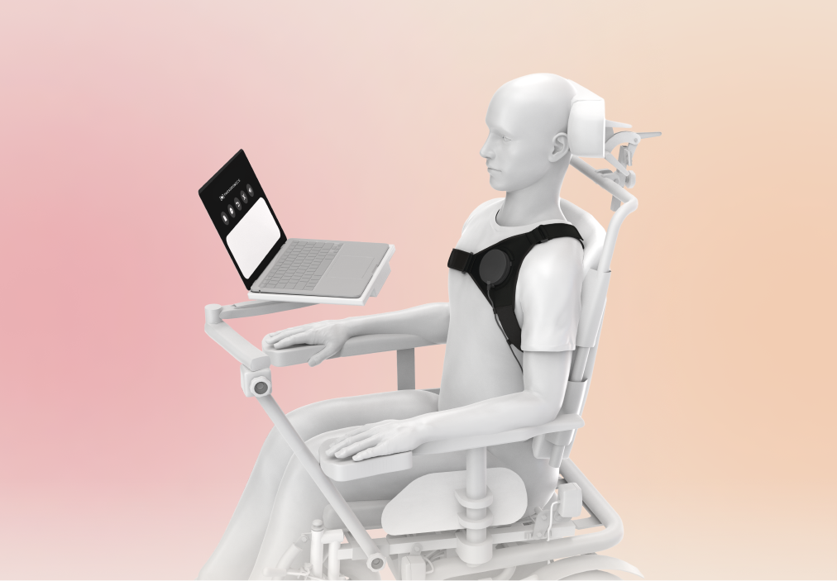
Transfer Connexus data and power across intact skin
Paradromics Connexus implanted chest transceiver, flexible lead and external wireless transceiver
Implanted path
The cortical module connects by a flexible lead to the chest transceiver.
Across-skin interface
Near-infrared optical data and inductive power connect to an external transceiver.
External path
A computer performs decoding. A remote clinician connection would be a separate network service.
External transceiver
Implanted assembly
“Fully implanted” internal hardware still depends on external power, communication and compute.
Official placement rendering: Paradromics. This is an anatomical product illustration.
07
Notes:
SYSTEM 6 • TECHNICAL REVIEW • 2 NOVEMBER 2026
The transcutaneous link is local to the body-worn equipment. It does not imply arbitrary distant direct implant access. The external computer and an optional healthcare backend are distinct. No common transceiver for Connexus, UmboMic and a cochlear implant has been demonstrated here. Source: https://paradromics.com/connexus/ . Image: https://paradromics.com/wp-content/uploads/2026/06/Surgical-Placement.png .
Figure: S07_Connexus_Link.png. Official placement rendering: Paradromics. This is an anatomical product illustration.

Slide 8
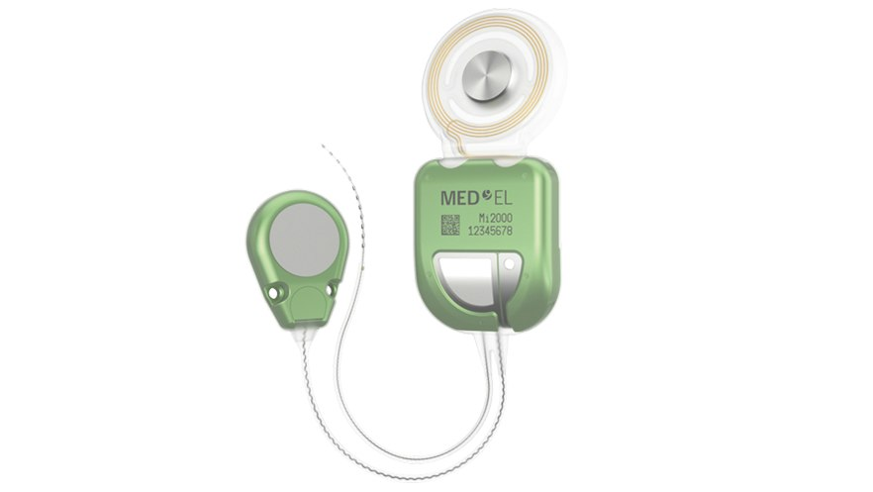
Deliver cochlear stimulation with a totally implantable candidate
MED-EL Mi2000 TICI UNICO totally implantable cochlear implant
with rechargeable battery and subcutaneous microphone
Product architecture
12 electrode channels, an implanted microphone, sound processor and rechargeable battery.
Current human-use status
CE Mark announced September 2026 for European markets. The U.S. release states it is not FDA approved.
Integration boundary
Bilateral coordination and an UmboMic/external-controller interface require separate validation.
The product’s hearing-loss indication does not establish use in normal-hearing adults or for CBT.
Product rendering: MED-EL. Status checked against the 29 September 2026 launch release.
08
Notes:
SYSTEM 6 • TECHNICAL REVIEW • 2 NOVEMBER 2026
The manufacturer describes severe-to-profound sensorineural hearing loss with little or no benefit from acoustic amplification as the indication, not healthy normal-hearing CBT. The product already includes its own subcutaneous microphone and stimulation coding. Substituting UmboMic or routing synthesized output through a novel interface is not demonstrated. Twelve channels differs from physical contact count and from 24 independent current sources. The user-requested 300–800 Hz and 5–8 kHz bands are evaluation targets, not proven percepts. Bilateral devices do not guarantee precise ILD/ITD or rear-left/rear-right localization. Sources: https://www.medel.pro/hearing-solutions/tici/ ; https://www.medel.com/en-us/press-room/press-list/2026/09/29/med-el-launches-tici-unico-world%27s-first-and-only-totally-invisible-cochlear-implant ; https://pmc.ncbi.nlm.nih.gov/articles/PMC9174346/ . Image: https://sfc01.cdn.medel.com/images/default-source/product-images/tici/tici-front.jpg?auto=format&sfvrsn=4096b241_5 .
Figure: S08_UNICO_TICI.png. Product rendering: MED-EL. Status checked against the 29 September 2026 launch release.

Slide 9
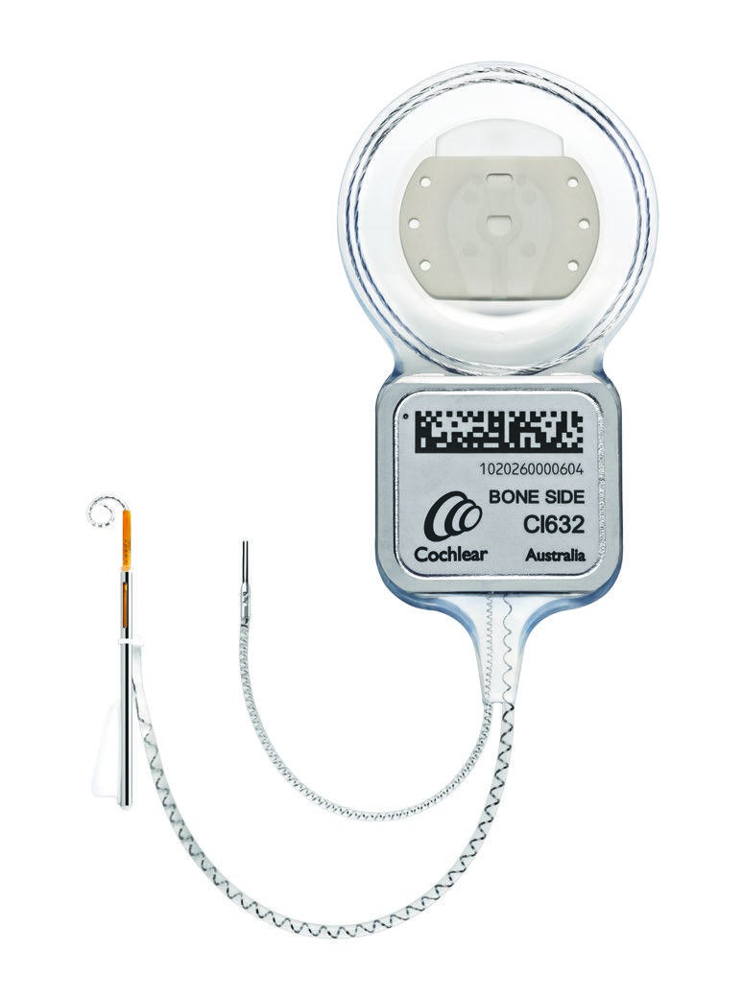
Use Nucleus as a conventional cochlear-implant comparator
Cochlear Nucleus Profile Plus CI632 implant with Slim Modiolar Electrode, 22 intracochlear electrodes
Function
Receive coded signals and deliver electrical stimulation through a cochlear electrode array.
System dependency
The conventional Nucleus pathway uses an external sound processor and transmitting coil.
Distinct research programme
Cochlear’s ELEVATE / ENTERPRISE TICI trials are separate from the CI632 product.
CI632’s internal receiver/stimulator still requires an external sound processor and coil.
CI632 bone-side view with insertion sheath: Cochlear Ltd., physician guide Figure 2.
09
Notes:
SYSTEM 6 • TECHNICAL REVIEW • 2 NOVEMBER 2026
The image is a manufacturer device illustration, not evidence of a bilateral installation. CI632 is the selected exact searchable comparator; the conventional family is used with external sound-processing hardware. Cochlear's 28 September 2026 TICI announcement reports research-trial progress, not conversion of a standard Nucleus implant into a TICI. Sources: https://www.cochlear.com/us/en/home/products-and-accessories/cochlear-nucleus-system/nucleus-implants ; https://assets.cochlear.com/api/public/content/0bc4c68475204819830c105f84bdef7d ; https://www.cochlear.com/au/en/corporate/media/media-releases/media-releases/2026/cochlear-reaches-more-than-1-million-hours-of-patient-experience-across-its-fully-implantable-hearing-technology-research-programme .
Figure: S09_Nucleus_CI632.png. CI632 bone-side view with insertion sheath: Cochlear Ltd., physician guide Figure 2.

Slide 10

Budget recharge time and energy for continuous availability
MED-EL GoPod charging device and Mi2000 TICI UNICO implanted rechargeable lithium-ion battery subsystem
Function
Recharge the implant across the skin and control implant on/off.
Manufacturer guidance
Approximately one hour of daily charging; up to 40 hours of use depending on conditions.
System boundary
Neural telemetry, external compute and any second implant have separate power requirements.
Round-the-clock availability requires an energy and recharge plan for every powered subsystem.
GoPod product image: MED-EL. The implanted battery is integrated into Mi2000, not a separate catalog part.
10
Notes:
SYSTEM 6 • TECHNICAL REVIEW • 2 NOVEMBER 2026
The GoPod is a charger, not the proposed AI controller. Its battery and the implanted battery are separate. Runtime is manufacturer guidance for the product, not a measured power budget for the integrated research loop. Thermal behavior, charging availability, telemetry duty cycle and stimulation load would need evaluation. Source: https://www.medel.pro/hearing-solutions/tici/ . Image: https://sfc01.cdn.medel.com/images/default-source/product-images/tici/gopod-front.png?auto=format&sfvrsn=2e8bb241_1 .
Figure: S10_GoPod_Power.png. GoPod product image: MED-EL. The implanted battery is integrated into Mi2000, not a separate catalog part.

Slide 11
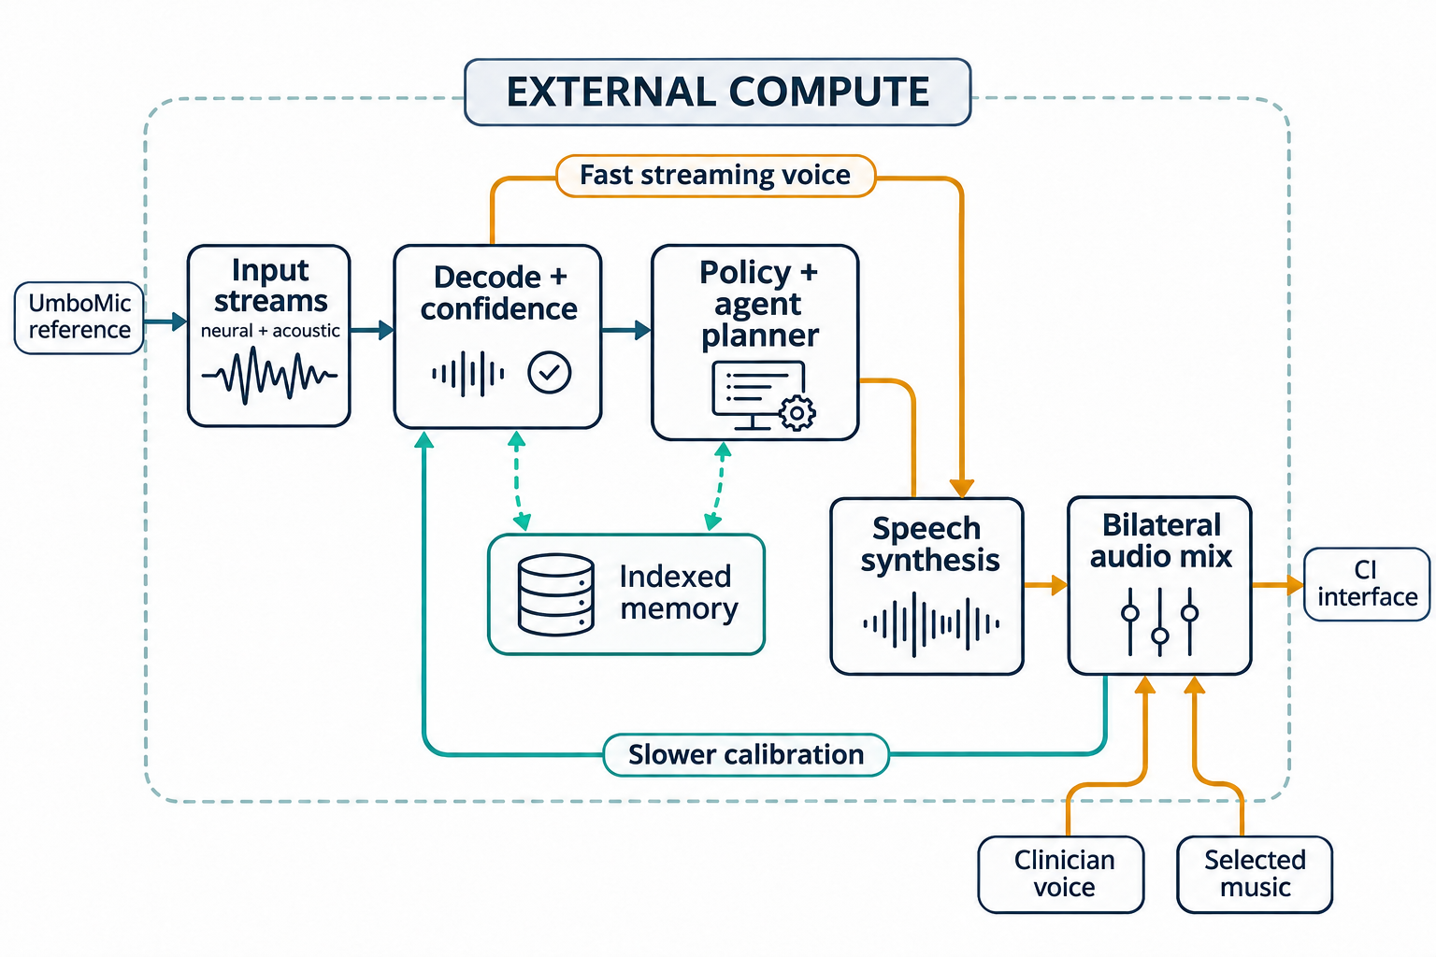
Keep decoding, planning, memory and audio control outside the body
Proposed neural-decoding, agent-orchestration and bilateral-audio controller
Conceptual software; no integrated medical product identified
Estimate and record
Store confidence-qualified speech estimates separately from confirmed labels.
Plan within policy
A domain model coordinates agent actions, retrieval and a finite response repertoire.
Render and mix
Combine synthetic voice, clinician audio and selected music under explicit level and mute controls.
Fast streaming bypasses slower agent planning. Model updates use separately reviewed feedback.
Conceptual software diagram. Embabel is an orchestration reference, not a clinical product.
11
Notes:
SYSTEM 6 • TECHNICAL REVIEW • 2 NOVEMBER 2026
All high-level processing, modulation, storage, retrieval, planning and agent management occurs on the external controller. Necessary acquisition and stimulation electronics remain with the relevant hardware. Input streams preserve neural and acoustic provenance. The illustrated calibration return includes logged events and separately measured participant/evoked responses; mixer output alone is not a neural label. Embabel-style goals, typed actions and domain objects are a design analogy. BERT and diffusion or reverse-embedding synthesis are user-proposed model choices with no validated latency or integration established here. A prediction such as 'He wants to...' or a typed-text read-back is an estimate, not ground truth or proof of thought access. Source for framework: https://github.com/embabel/embabel-agent .
Figure: S11_External_Controller.png. Conceptual software diagram. Embabel is an orchestration reference, not a clinical product.

Slide 12
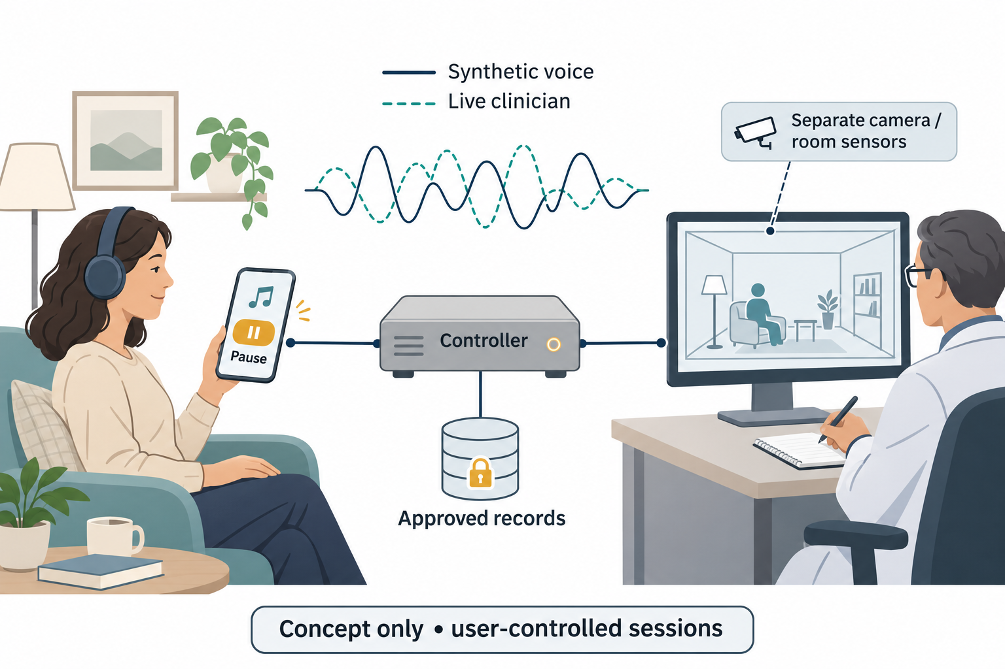
Separate optional assistance, media and provider monitoring
Participant-controlled behavioral-support research scenario with provider-managed controller access
Proposed care course
Overt speech first; a year or longer of calibration; a 1–5-year course tapering commentary to 0%.
Optional audio
Participant-approved familiar synthetic voices, finite response rules, live clinician audio and selected music.
Separate services
Monitoring has its own opt-in control. A home/avatar view requires separate camera, depth or authored-model data.
These are scenario assumptions. Clinical benefit, timing and tolerability have not been established.
Concept illustration. Auracast is an optional external transport requiring compatible receiving equipment.
12
Notes:
SYSTEM 6 • TECHNICAL REVIEW • 2 NOVEMBER 2026
The user described CBT as an illustrative indication. This deck calls it a proposed behavioral-support research scenario because the listed evidence does not establish CBT efficacy. A domain model would coordinate a panel of agents using a finite diction and psychology-informed policy. Familiar or authority-figure voice models would be participant-approved and explicitly synthetic, without implying the real person is present. Round-the-clock commentary is a user-specified scenario, not an evidence-based dose; a participant stop/mute control is retained. Conventional synthesis could be available at startup, but immediate function of the complete implanted loop is unproven. Calibration during ordinary speech and activities for a year or longer, high eventual accuracy, and a 1–5-year taper to 0% commentary are assumptions. Telemetry after taper remains a distinct, revocable mode. Music, including workout music, tonal fields or broadband background sound, enters the controller mixer. Auracast does not itself supply spatial rendering, neural telemetry or implant power. Clinician actual or modulated voice is a separate authenticated side-chain. A live 3D avatar or residence reconstruction needs independently supplied camera/depth/room data or an authored model; it cannot be inferred from these implants alone. Source for Auracast transport: https://www.bluetooth.com/auracast/how-it-works/ .
Figure: S12_Care_Concept.png. Concept illustration. Auracast is an optional external transport requiring compatible receiving equipment.

Slide 13
Measure the full loop before assigning accuracy or latency targets
Engineering validation priorities for the hypothetical System 6 architecture
Evidence item | What was demonstrated | What still requires validation
Within 10 ms | Acquisition to generated voice samples in one study | Playback, telemetry and total neural-to-percept delay
72.6% | Seven-word motoric-inner-speech classification | Continuous natural speech and unattended periods
P1 / N1 / P2 | Responses at roughly 50 / 100 / 180 ms | A slower calibration signal, not a same-event 10–25 ms loop
Test targets: 300–800 Hz speech, 5–8 kHz tones (~7.4 kHz), and binaural rear-left / rear-right cues.
Test interfaces, decoder generalization and end-to-end latency as separate engineering questions.
Primary studies: Wairagkar 2025; Kunz 2025; cortical auditory evoked-potential studies. Links in notes.
13
Notes:
SYSTEM 6 • TECHNICAL REVIEW • 2 NOVEMBER 2026
Within-10-ms acquisition-to-generated-voice samples in Wairagkar excludes audio-driver/playback and does not establish the proposed full neural-to-percept loop. Kunz's 72.6% result is one participant's seven-word motoric-inner-speech classification using a 500-ms window, with chance at 14.3%, not general inner-monologue accuracy. Separate real-time sentence results do not eliminate task/population limits. The 62 words/min number belongs to Willett 2023, a separate attempted-speech text study with 23.8% WER for a 125,000-word vocabulary. P1/P50, N1 and P2 are auditory responses, not automatically semantic-error or surprise labels, and may require repeated trials. A same-event 10–25 ms loop cannot await responses occurring tens to hundreds of milliseconds later. Requested 300–800 Hz speech, 5–8 kHz basal tones and approximately 7.4 kHz percept are stimulus/percept hypotheses; acoustic frequency, electrode place, pulse rate and perceived pitch differ. ILD/ITD control does not guarantee rear spatial localization. A healthy normal-hearing adult with musician/mix-engineer training is a proposed study profile, not a validated indication or proven calibration advantage. No subject exposure or reported experience is verified by this architecture. Sources: https://www.nature.com/articles/s41586-025-09127-3 ; https://pmc.ncbi.nlm.nih.gov/articles/PMC12360486/ ; https://www.nature.com/articles/s41586-023-06377-x ; https://pmc.ncbi.nlm.nih.gov/articles/PMC8755439/ ; https://pmc.ncbi.nlm.nih.gov/articles/PMC11570646/ .
Figure: Editable evidence-comparison table. Primary studies: Wairagkar 2025; Kunz 2025; cortical auditory evoked-potential studies. Links in notes.

