Slide 1
COMPUTER NETWORKS(A8519)
A8519.1. Identify the Reference models and Physical connections for establishing network.
A8519.2. Choose access control and error handling techniques for data link layer.
A8519.3. Examine the various routing and congestion control algorithms for packet transmission.
A8519.4. Choose a transport layer protocol to provide communication services.
A8519.5. Identify application layer protocol for interacting with user and user applications.

Slide 2
Unit 1 Syllabus
Introduction: Network hardware, Reference models: OSI, TCP/IP, Connection oriented network and connectionless network. The Physical Layer: Guided transmission media, wireless transmission media.

Slide 3
Unit 1 Overview
Introduction: Network Hardware
Network hardware includes devices like routers, switches, hubs, and network interface cards (NICs) that enable connectivity and data transfer. These devices are essential for creating and managing both wired and wireless networks.
Reference Models(OSI Model)(Open Systems Interconnection)
A 7-layer model that standardizes networking functions from physical transmission to application-level interaction.
Layers: Physical, Data Link, Network, Transport, Session, Presentation, Application.

Slide 4
Contd..
TCP/IP Model
A 4-layer protocol suite used in the Internet: Link, Internet, Transport, Application.
It is a practical and widely adopted model for real-world networking.
Connection-Oriented Network
Establishes a dedicated path between sender and receiver before data transfer (e.g., TCP).
Ensures reliable and ordered delivery of data.

Slide 5
Contd..
Connectionless Network
No dedicated path is established; packets are sent independently (e.g., UDP).
Faster but does not guarantee delivery or order.
The Physical Layer
Deals with the transmission of raw bits over a communication channel.
Defines hardware specifications, transmission techniques, and data rates.

Slide 6
Contd…
Guided Transmission Media
Data travels through a physical path such as twisted-pair cables, coaxial cables, or optical fiber. Offers higher security and reduced interference.
Wireless Transmission Media
Data is transmitted without physical conductors using radio waves, microwaves, or infrared.
Enables mobile and flexible communication but may suffer from interference and limited range.

Slide 7
INTRODUCTION TO COMPUTER NETWORKS

Slide 8
DEFINTION & APPLICATIONS
DEFINTION:
A computer network is defined as the interconnection of two or more computers. It is done to enable the computers to communicate and share available resources.
First computer network is ARPANET(Advanced Research Projects Agency Network

Slide 9
USE OF COMPUTER NETWORK
Business Applications
🞑 online buying
Home Applications
🞑 mail, chat
Mobile Users
🞑 wireless: laptops, mobile
Social Issues

Slide 10
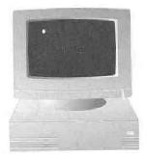

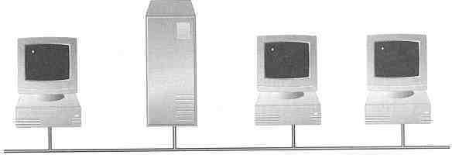
APPLICATIONS OF COMPUTER NETWORK
Sharing information — i.e. data communication
  Do you prefer these?
Or this?

Slide 11

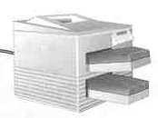
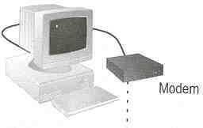
APPLICATIONS OF COMPUTER NETWORK
Sharing hardware or software
  E.g. print document
Centralize administration and support
  E.g. Internet-based, so everyone can access the same administrative or support application from their PCs

Slide 12
COMPONENTS OF COMPUTER NETWORK
Two or more computers
Cables as links between the computers
A Network Interfacing Card(NIC) on each computer
Switches
Software called operating system(OS)

Slide 13
BENEFITS OF COMPUTER NETWORK
Increased speed
Reduced cost
Improved security
Centralized software managements
Electronic mail
Flexible access

Slide 14
DISADVATAGES OF NETWORKS
High cost of installation
Requires time for administration
Failure of server
Cable faults

Slide 15






CLASSIFICATION COMPUTER NETWORK

Slide 16
PERSONAL AREA NETWORK(PAN)
A personal area network is a computer network organized around an individual person.
It generally consists of a mobile computer, a cell phone or personal digital assistant. PAN enables the communication among these devices.
It can also be used for communication among personal devices themselves for connecting to a digital level network and internet.
The PANs can be constructed using wireless or cables.

Slide 17
LOCAL AREA NETWORK(LAN)
LAN is a network which is designed to operate over a small physical area such as an office, factory or a group of buildings.
Exchange of information and sharing of resources becomes easy because of LAN.
In LAN all machines are connected to a single cable.
Different types of topologies such as star, tree, bus, ring, etc Can be used

Slide 18
WIDE AREA NETWORK(WAN)
When network spans over a large distance or when the computers to be connected to each other are at widely separated locations a local area network cannot be used. A wide area network(WAN) is installed.
The communication between different users of WAN is established using leased telephone lines, satellite links and similar channels.
It is cheaper and more efficient to use the phone network for the link.

Slide 19
METROPOLITAN AREA NETWORK(MAN)
It is interconnects with the computer resources in a geographic region of the size of metropolitan area(city)
MAN Devices
  Switch/hub
  Routers/bridges

Slide 20
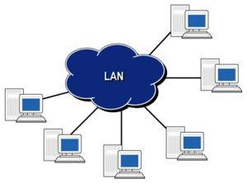
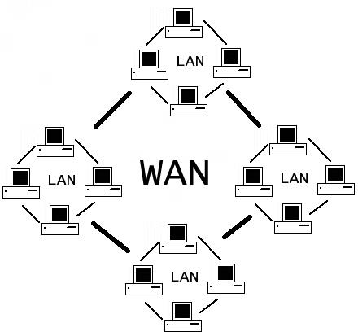
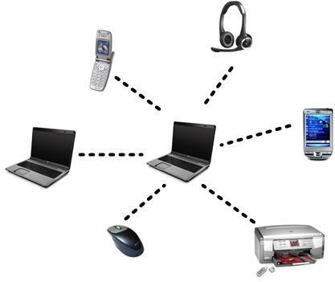
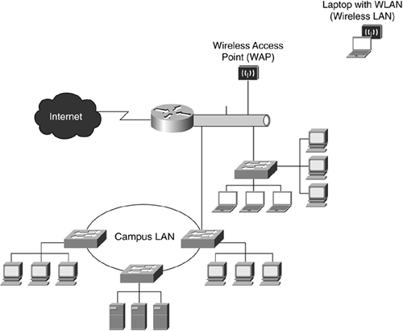
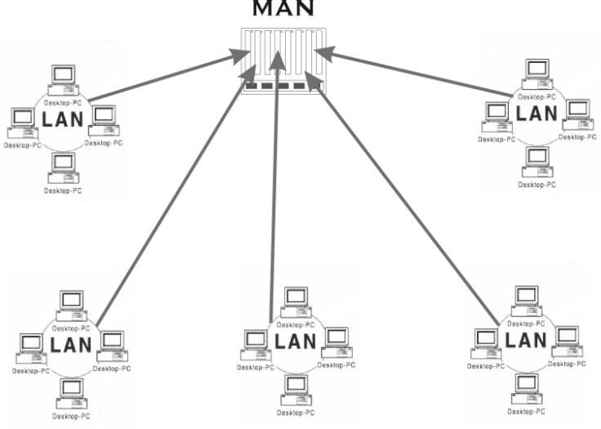
WAN
LAN
PAN
CAN
MAN

Slide 21
DISTINGUISH BETWEEN LAN,WAN,MAN
PARAMETERS | LAN | WAN | MAN
Ownership of network | Private | Private or public | Private or public
Geographical area covered | Small | Very large | Moderate
Design and maintenance | Easy | Not easy | Not easy
Communication medium | Coaxial cable | satellite links | Coaxial cables, optical fibre, cables, wireless
Bandwidth | Low | High | moderate
Data rates(speed) | High | Low | moderate

Slide 22
Characteristics of Computer N/W
Fault tolerance
Scalability
Quality of service
Security

Slide 23
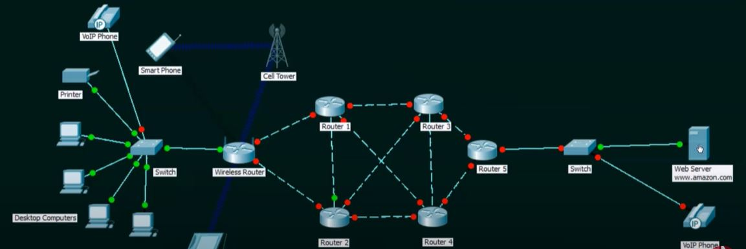
Fault tolerance
The ability to
  Continue working despite failures
  Ensure no loss of service

Slide 24
Scalability
The ability to
  Grow based on the needs
  Good performance after growth of the network

Slide 25
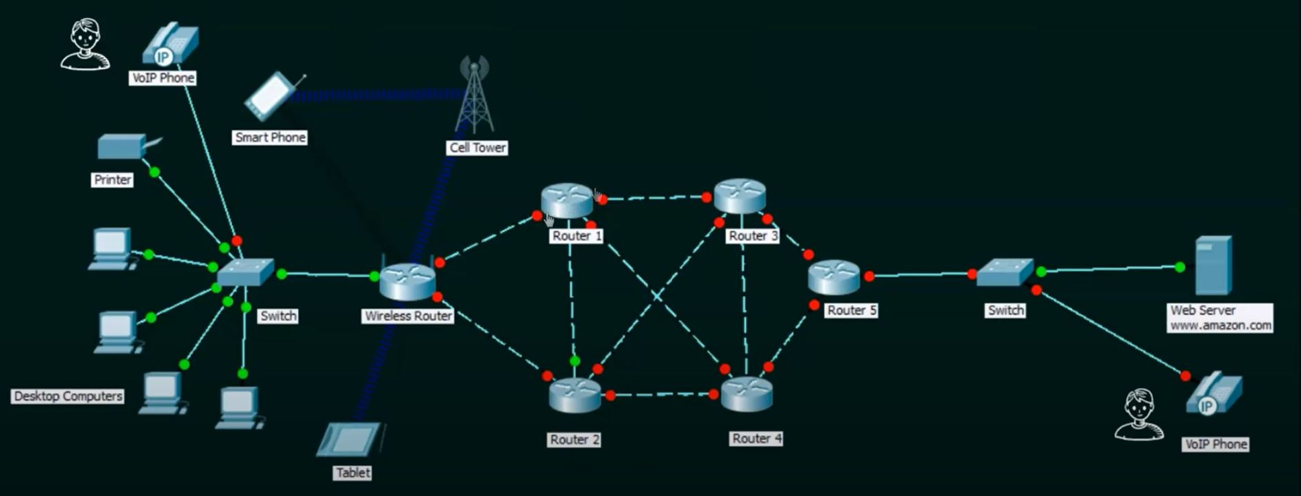
Quality of services
The ability to
  Set priorities
  Manage data traffic to reduce data loss , delay etc.,

Slide 26
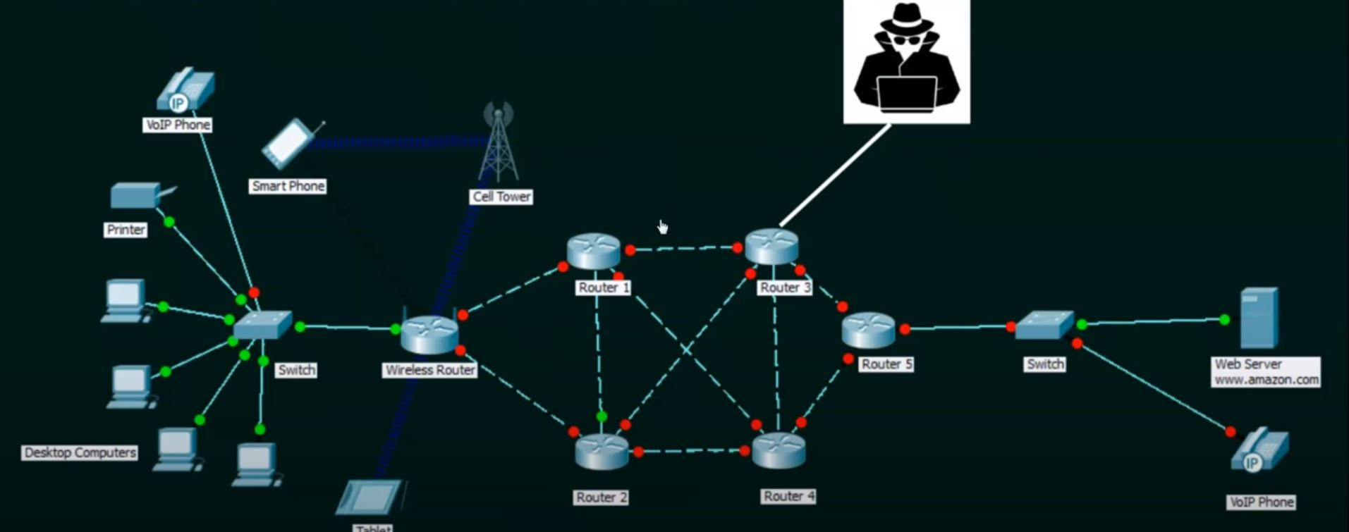
Security
The ability to
  Unauthorized access
  Confidentiality/integrity/availability

Slide 27
Data Communication
Data Communication:
  Data communications are exchange of data between two nodes via some form of links.
Data flow or Transmission Mode:
  Data flow means the data is going to flow from one node to another node

Slide 28
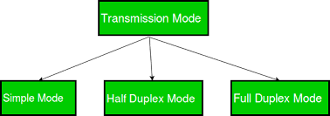
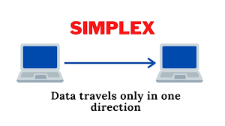
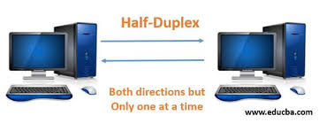
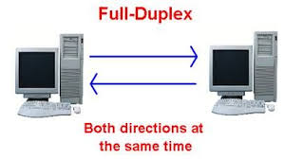

Slide 29
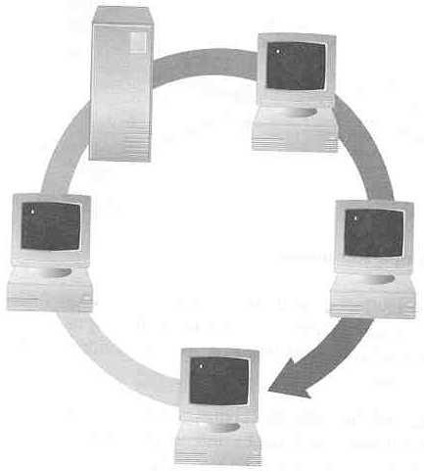
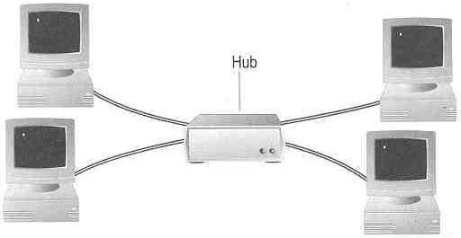
TOPOLOGY
How so many computers are connected together? Bus Topology Ring Topology
Star Topology
Hub

Slide 30
TOPOLOGY
Bus Topology
  Simple and low-cost
  A single cable called a trunk (backbone, segment)
  Only one computer can send messages at a time
  Passive topology - computer only listen for, not regenerate data
Star Topology
  Each computer has a cable connected to a single point
  More cabling, hence higher cost
  All signals transmission through the hub; if down, entire network down
  Depending on the intelligence of hub, two or more computers may send message at the same time

Slide 31
TOPOLOGY
Ring Topology
  Every computer serves as a repeater to boost signals
  Typical way to send data:
    Token passing
      only the computer who gets the token can send data
  Disadvantages
    Difficult to add computers
    More expensive
    If one computer fails, whole network fails

Slide 32
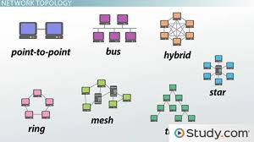
TOPOLOGY

Slide 33





NETWORK CLASSIFICATION BY THEIR COMPONENT ROLE
LOCAL AREA NETWORK
PEER TO PEER NETWORK
CLIENT SERVER NETWORK

Slide 34
PEER TO PEER NETWORK
No centralized administration
All peers are equal
Simple applications
No scalable

Slide 35
ADVANTAGES & DISADVANTAGES OF PEER TO PEER NETWORK
Advantages:
Use less expensive computer hardware
Easy to administer
More built in redundancy
Easy setup & low cost
Disadvantages:
Not very secure
No central point of storage or file archiving
Additional load on computer because of resource sharing
Hard to maintain version control

Slide 36
CLIENT/SERVER NETWORK
In client-server network relationships, certain computers act as server and other act as clients.
A server is simply a computer, that available the network resources and provides service to other computers when they request it.
A client is the computer running a program that requests the service from a server.
centralized administration
Request response model
Scalable
Server may be overloaded

Slide 37
ADVANTAGES AND DISADVANTAGES OF CLIENT-SERVER NETWORK
Advantages:
Very secure
Better performance
Centralized backup
very reliable
Disadvantages:
requires professional administration
More hardware- intensive
More software intensive
Expensive dedicated software

Slide 38
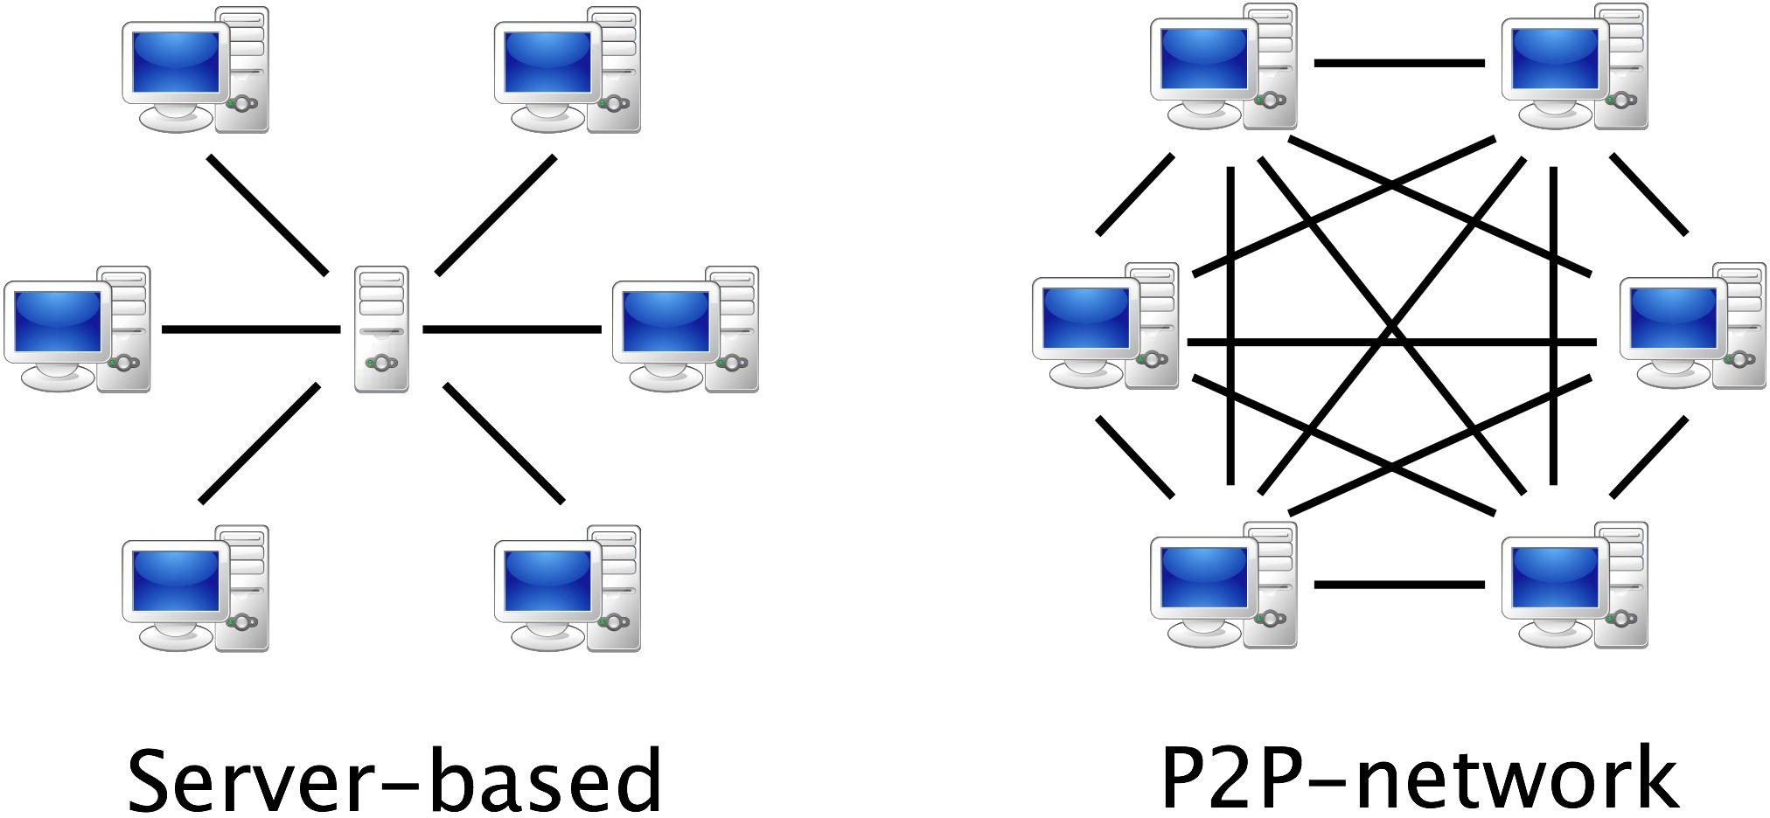

Slide 39
1.DEFINE COMPUTE NETWORK
2.COMPONENTS OF A CN
3.WHAT IS A TOPOLOGY
4.TYPES OF TOPOLOGY
5.LAN CLASSIFICATIONS
6.TYPES OF TRANSMODES
7.CHARACTERSTICS OF CN
8.CLASSIFICATION OF CN
9.ADV AND DIS ADV OF CN
10.DIFFERENCE BETWEEN LAN,WAN,MAN
11.DIFF BETWEEN SERVER BASED N P2P N/W
12.ADV N DISADV OF SERVER BASED N/W
13.ADV N DISADV OF P2P N/W

Slide 40
Protocols:
All communication schemes will have the following things in common:
    Source or sender
    Destination or receiver
    Channel or medium
Rules or protocols govern all methods of communication

Slide 41
Elements of Protocols:
Message encoding
Message formatting and encapsulation
Message timing
Message size
Message delivery option

Slide 42
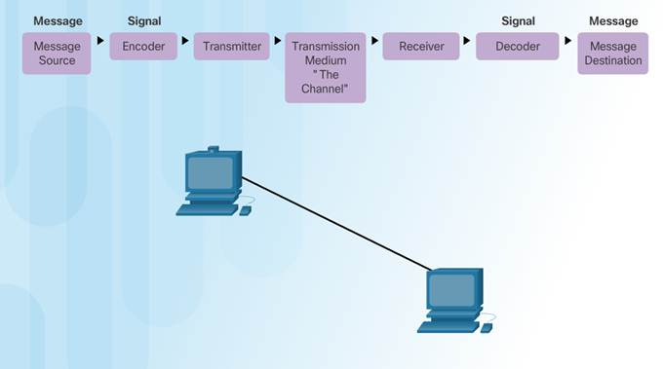
Message encoding

Slide 43
Message formatting and encapsulation
Agreed format
Encapsulate the information to identify the sender and receiver rightly
Message size
Break long message into smaller parts
Message timing
Flow control
Response timeout

Slide 44
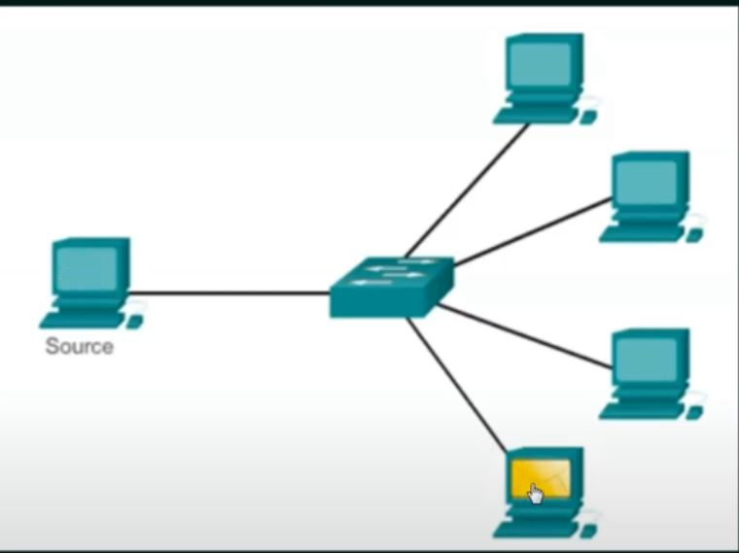
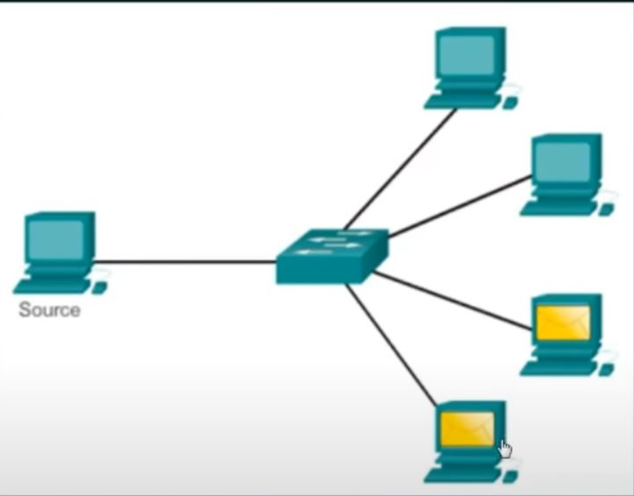
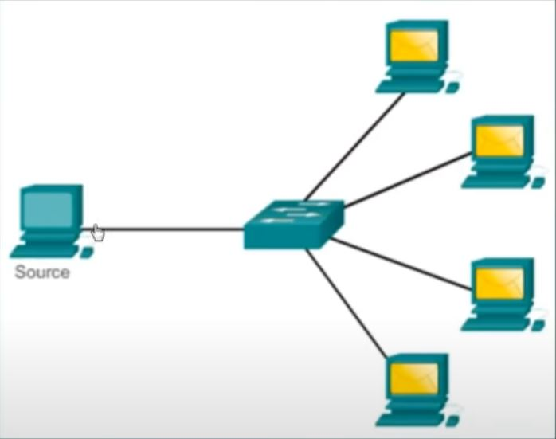
Message delivery options
Multicast
Unicast
Broadcast

Slide 45
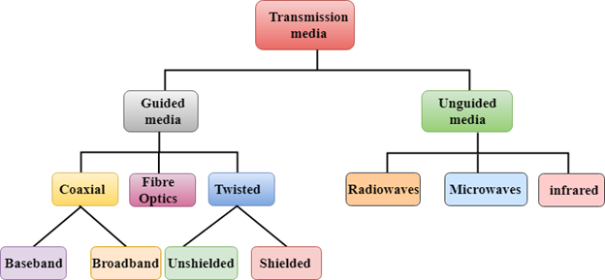
Classification Of Transmission Media:

Slide 46
TRANMISSION MEDIA
Two main categories:
🞑 Guided ― wires, cables
🞑 Unguided ― wireless transmission, e.g. radio, microwave, infrared, sound, sonar
We will concentrate on guided media here:
🞑 Twisted-Pair cables:
  Unshielded Twisted-Pair (UTP) cables
  Shielded Twisted-Pair (STP) cables
🞑 Coaxial cables
🞑 Fiber-optic cables

Slide 47
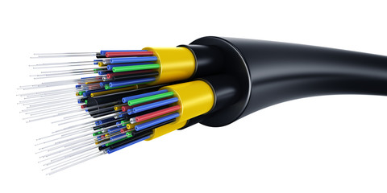
TRANMISSION MEDIA
Fiber-Optic Cables
Fiber Optics or Optical Fiber is a technology that transmits data as a light pulse along a glass or plastic fiber.
An Optical Fiber is a cylindrical fiber of glass that is hair-thin in size or any transparent dielectric medium.
The fiber which is used for optical communication is waveguides made of transparent dielectrics.

Slide 48
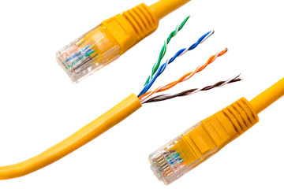
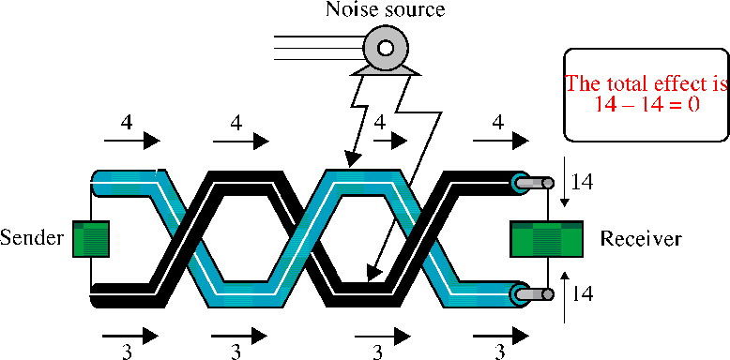
TRANMISSION MEDIA
Twisted-Pair Cables
If the pair of wires are not twisted, electromagnetic noises from, e.g., motors, will affect the closer wire more than the further one, thereby causing errors

Slide 49
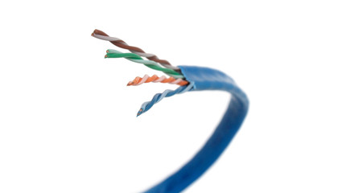
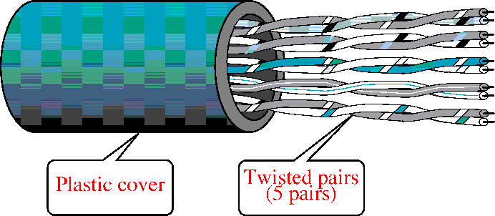
TRANMISSION MEDIA
Unshielded Twisted-Pair (UTP)
Typically wrapped inside a plastic cover (for mechanical
protection)
A sample UTP cable with 5 unshielded twisted pairs of wires
Insulator
Metal

Slide 50
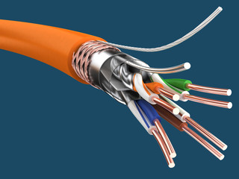
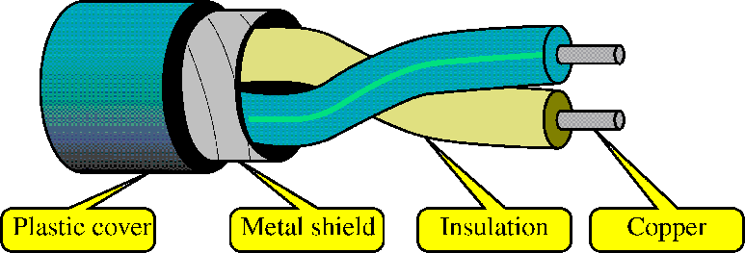
TRANMISSION MEDIA
Shielded Twisted-Pair (STP)
STP cables are similar to UTP cables, except there is a metal foil or braided-metal-mesh cover that encases each pair of insulated wires

Slide 51

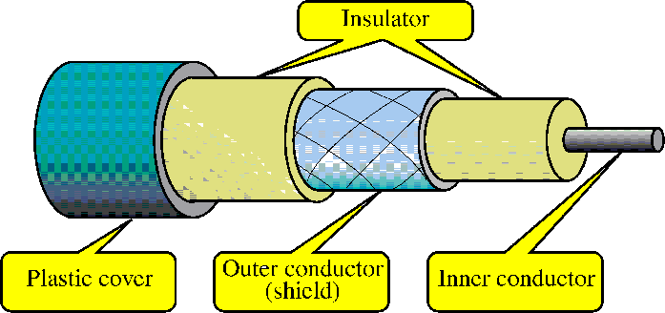
TRANMISSION MEDIA
Coaxial Cables
In general, coaxial cables, or coax, carry signals of higher freq (100KHz–500MHz) than UTP cables
Outer metallic wrapping serves both as a shield against noise and as the second conductor that completes the circuit

Slide 52
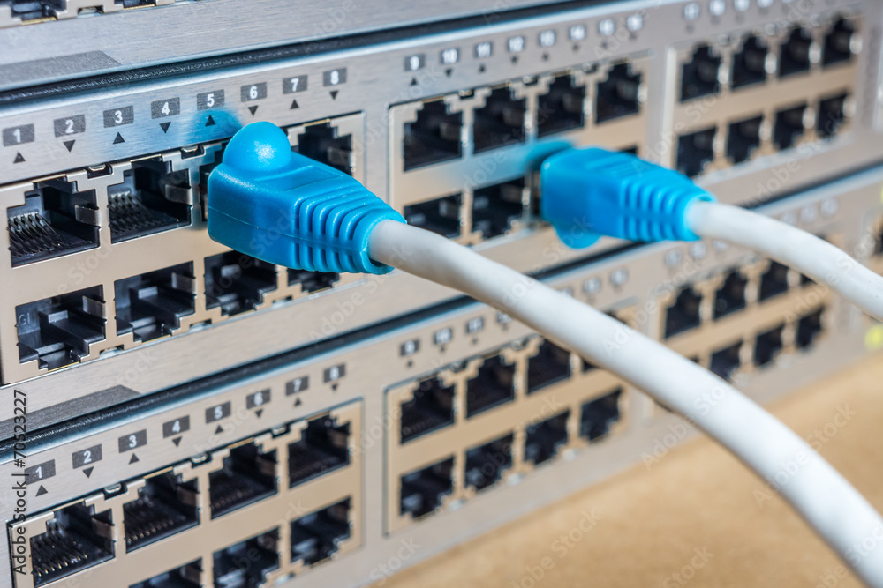
HARDWARE DEVICES
BRIDGES
INTERCONNECTING TWO LAN’S WORKING ON SAME PROTOCOL

Slide 53
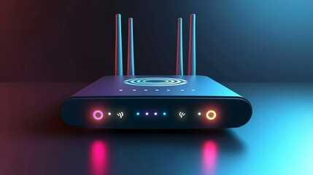
HARDWARE DEVICES
ROUTERS
PACKETS WILL BE ROUTED TO DESTINATION IN BEST ROUTING PATH

Slide 54

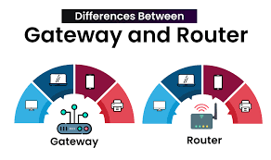
HARDWARE DEVICES
GATEWAY
PASSING DATA NETWORK OF DIFFERENT NETWORK MODELS(OSI/TCP-IP)

Slide 55
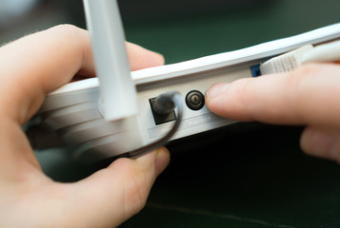
HARDWARE DEVICES
SWITCH
GOOD DATA PACKETS WILL SEND TO CONNECTED PATH

Slide 56

HARDWARE DEVICES
USED TO TRANSMIT DATA PACKETS TO ALL CONNECTED DEVICES

Slide 57
REFERNCE MODELS
Reference models such as OSI and TCP/IP play a vital role in networking by offering a
structured framework
communication between different systems and devices.

Slide 58
Out Line
Introduction OSI
OSI Layers
Introduction TCP/IP
TCP/IP Layers

Slide 59
Introduction OSI
The Open System Interconnection Reference Model (OSI Reference Model or OSI Model) is an abstract description for layered communications and computer network protocol design.

Slide 60
OSI Layers
OSI Model
 | Data unit | Layer | Function
Host layers | Data | 7. Application | Network process to application
 |  | 6. Presentation | Data representation, encryption and decryption
 |  | 5. Session | Interhost communication
 | Segments | 4. Transport | End-to-end connections and reliability, Flow control
Media layers | Packet | 3. Network | Path determination and logical addressing
 | Frame | 2. Data Link | Physical addressing
 | Bit | 1. Physical | Media, signal and binary transmission

Slide 61
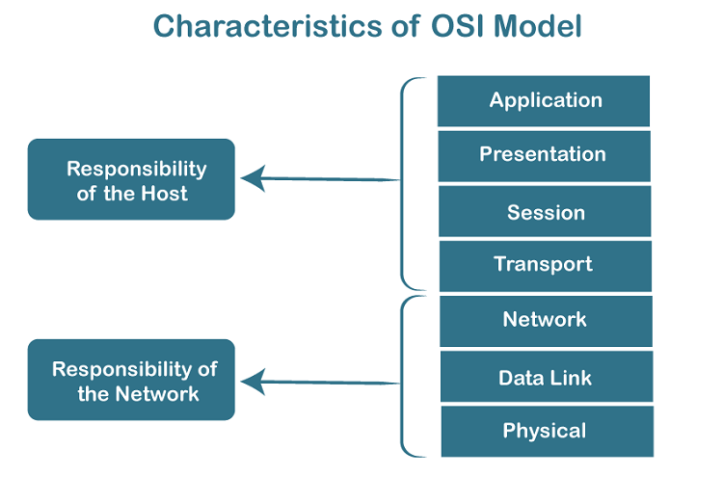

Slide 62
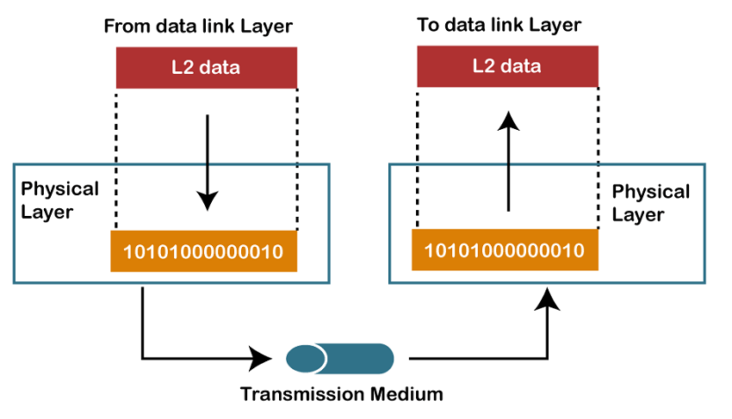
Layer1: Physical Layer
FUNCTIONALITIES
the physical layer is to transmit the individual bits from one node to another node.
It is the lowest layer of the OSI model.
It establishes, maintains and deactivates the physical connection.
It specifies the mechanical, electrical and procedural network interface specifications.
Notes:
Establishment and termination of a connection to a communications medium.

Slide 63
Real-World Example for Physical Layer
Ex: A video call using a fiber-optic internet connection.
Explanation:
When you're on a video call (e.g., using Zoom or Google Meet), your voice and video are converted into digital signals.
These signals are transmitted as light pulses through fiber-optic cables.
Physical layer is responsible for:
Transmitting raw bits (0s and 1s) over the medium.
Defining the physical characteristics of the connection (e.g., voltage levels, timing, connectors, cable types).
Ensuring the signal integrity during transmission from your device to the network infrastructure and ultimately to the recipient's device.

Slide 64
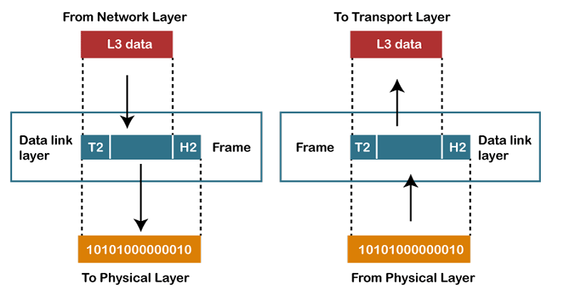
Layer 2: Data Link Layer
Functionalities:
Framing:
Physical Addressing:
Flow Control:
Error Control:
Access Control:

Slide 65
Real-World Example for Data Link Layer
Ex:A Wi-Fi connection in a home or office network
Explanation:
When your laptop connects to a Wi-Fi router to access the internet, the Data Link layer is responsible for:
Framing: Breaking data into frames for transmission.
MAC (Media Access Control): Assigning and using the MAC address to identify devices on the same local network.
Error detection and handling: Identifying errors that may occur during transmission and requesting retransmission if needed.
Flow control at the local network level.

Slide 66
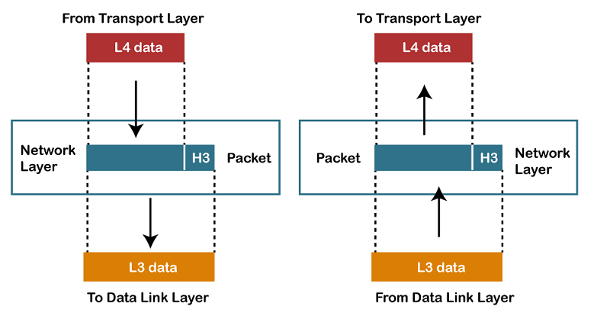
Layer 3: Network Layer
Functionalities:
Internetworking
Addressing
Routing
Packetizing

Slide 67
Real-World Example for Network Layer
Ex: Sending an email from India to the USA
Key functions:
✅ Logical Addressing: Assigns IP addresses to both sender and receiver so that data knows where to go.
✅ Routing: Determines the best path the data packets should take through routers across global networks (internet).
✅ Packet Forwarding: Moves data packets from one network node to another until they reach the destination.

Slide 68
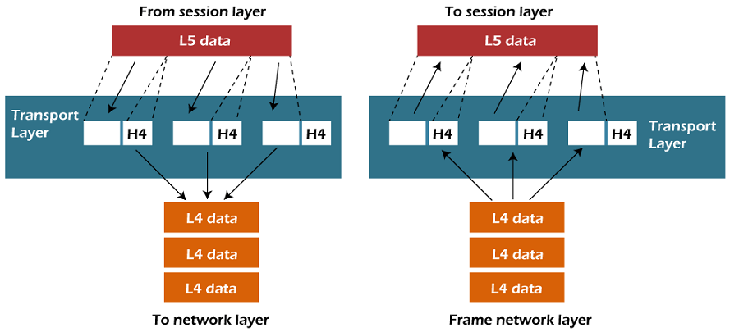
Layer 4: Transport Layer
Functions:
Service-point addressing
Segmentation and reassembly
Connection control
Flow control
Error control

Slide 69
Real-World Example for Transport Layer
Ex: Streaming a movie on Netflix or YouTube
Key functions:
✅ Segmentation and Reassembly: Breaks the video file into smaller segments and reassembles them correctly on your device.
✅ Error Detection & Correction: Ensures that no corrupted or missing data affects the video playback.
✅ Flow Control: Adjusts the rate of data flow to prevent overwhelming your device if the internet is slow.
✅ Reliable Transmission (TCP): If a part of the video data is lost, it is retransmitted automatically.

Slide 70
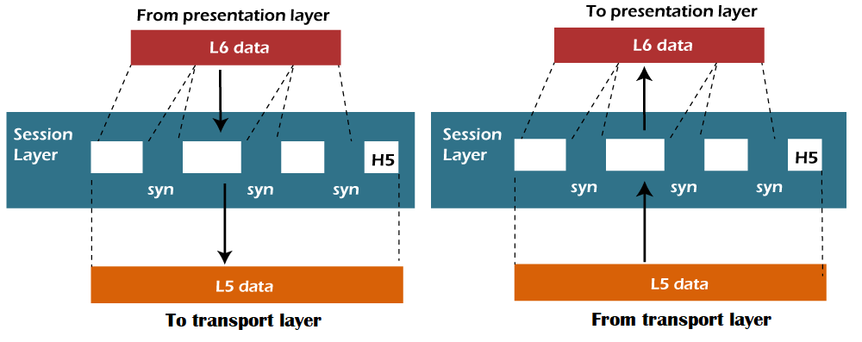
Layer 5: Session Layer
Functions of Session layer:
Dialog control:
Synchronization:

Slide 71
Real-World Example for Session Layer
Ex: Online Banking Session (Net Banking)
Key functions:
✅ Session Establishment: Authenticates and starts a session once you log in with your credentials.
✅ Session Maintenance: Keeps the session active while you perform banking tasks, ensuring smooth communication.
✅ Synchronization: Inserts checkpoints so that if there’s a disruption (like network failure), the session can resume from the last saved point.
✅ Session Termination: Ends the session securely when you log out or after a timeout due to inactivity.

Slide 72
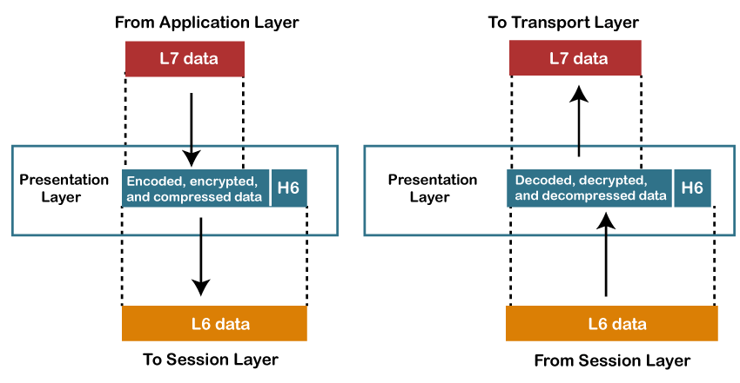
Layer 6: Presentation Layer
Functions of Presentation layer:
Translation:
Encryption
Compression:

Slide 73
Real-World Example for Presentation Layer
Ex: Accessing a Secure Website (HTTPS)
Key roles:
✅ Encryption & Decryption: It encrypts sensitive data (like passwords and credit card numbers) before sending it and decrypts it upon receipt to ensure privacy and security.
✅ Data Translation: Converts data into a standard format (e.g., from binary to readable text or vice versa) that both systems can understand.
✅ Data Compression: Reduces file sizes (e.g., images, videos) for faster transmission over the network.

Slide 74
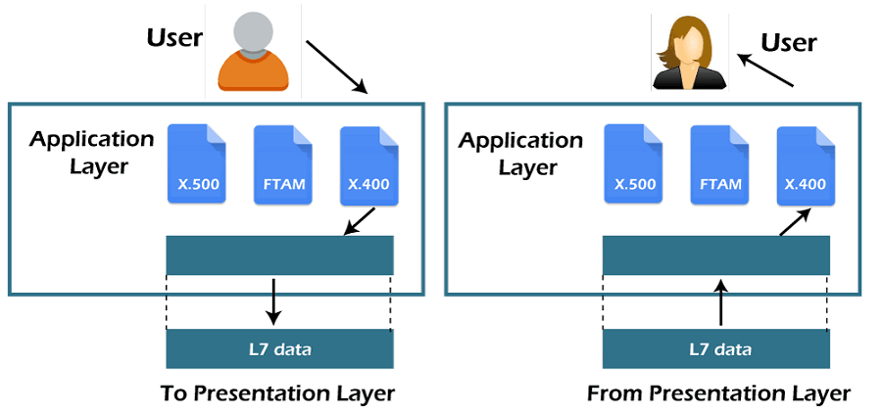
Layer 7: Application Layer
Functions of Application layer:
File transfer, access, and management (FTAM) .
Mail services
Directory services

Slide 75
Real-World Example for Application Layer
Ex: Sending an Email Using Gmail or Outlook
Key roles:
✅ User Interface Support: Provides the interface (Gmail page or Outlook app) for users to compose, send, and receive emails.
✅ Protocol Handling: Uses protocols like SMTP (Simple Mail Transfer Protocol) for sending and IMAP(Internet Message Access Protocol) /POP3(Post Office Protocol version 3) for receiving emails.
✅ Data Handling: Ensures that your email, attachments, and metadata are correctly formatted and understood by both sender and recipient applications.

Slide 76
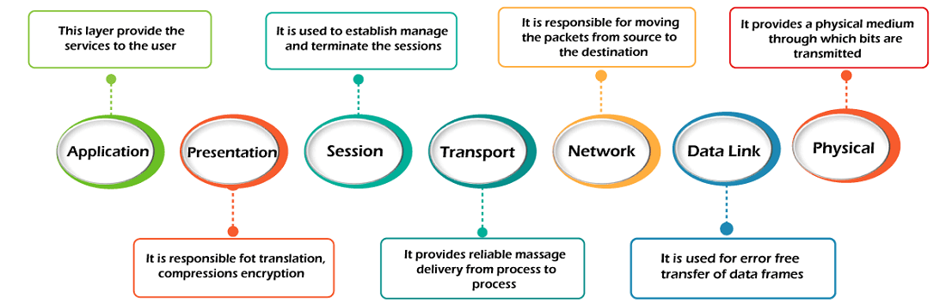

Slide 77
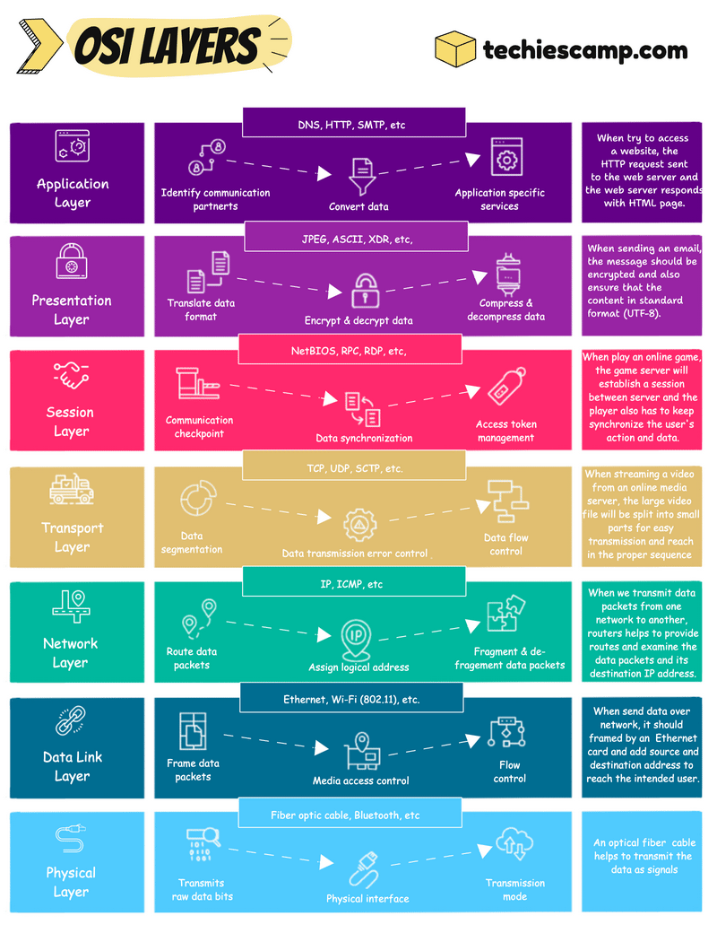

Slide 78
Every time you make a video call:
Layer 7:lets you click “Call”(Application Layer)
Layer 6:makes sure it’s secure and compressed(Presentation Layer)
Layer 5:keeps the call going(Session Layer)
Layer 4:ensures smooth transmission(Transport Layer)
Layer 3:finds the best path(Network Layer)
Layer 2:handles local delivery(Data Link Layer)
Layer 1:physically sends your voice and video as signals(Physical Layer)

Slide 79
Introduction TCP/IP
The Internet Protocol Suite (commonly known as TCP/IP) is the set of communications protocols used for the Internet and other similar networks.
It is named from two of the most important protocols in it:
  the Transmission Control Protocol (TCP) and
  the Internet Protocol (IP), which were the first two networking protocols defined in this standard.

Slide 80
TCP/IP Layers
OSI | TCP/IP
Application Layer | Application Layer TELNET, FTP, SMTP, DNS..
Presentation Layer
Session Layer
Transport Layer | Transport Layer TCP , UDP , ...
Network Layer | Internet Layer IP ...
Data Link Layer | Host to Network Layer Ethernet, Frames Relay, Token Ring
Physical Layer

Slide 81
Connection Oriented N/W
In a connection-oriented communication model, a dedicated path or virtual circuit is established between the sender and the receiver before any data is transmitted.
Only after the connection is established can data be sent.
Once the communication is complete, the connection is terminated.
Ex: TCP,SMTP, FTP, HTTP

Slide 82
TCP Process:
Connection Setup (Three-Way Handshake): Before sending data, a three-way
handshake is done to establish the connection.
Data Transfer: Data is sent, and retransmissions are requested if packets are lost.
Connection Termination: The connection is closed after the transfer.

Slide 83
Key Characteristics:
Reliability: There is a guarantee that data will be delivered correctly and in order.
Error Recovery: Lost or corrupted packets are retransmitted.
Flow Control: Mechanisms are in place to prevent the receiver from being
overwhelmed with data.
Session Establishment: The devices first communicate to establish the
Session and decide on parameters like the data transfer rate, maximum size of packets, etc.
Termination: The session is explicitly terminated once the data transfer is complete.

Slide 84
Connectionless Communication
In a connectionless communication model, there is no need for an established connection before data transmission.
Each data packet is sent independently, and there is no guarantee of delivery or order.
Ex: UDP(User Data Gram Protocol)

Slide 85
UDP Process:
No Setup: Data is sent without any handshake.
No Acknowledgment: The sender does not wait for confirmation of receipt.
No Error Recovery: Lost packets are not retransmitted automatically.

Slide 86
Key Characteristics:
No Setup or Termination: Data can be sent immediately without the
overhead of establishing or terminating a connection.
Unreliable: There is no guarantee that the data will reach the destination.
Lost packets are not retransmitted automatically.
No Flow Control or Error Recovery: The sender does not wait for
acknowledgment from the receiver
before sending more data.
Packet-Based: Each packet is independent, with the destination information
included in the packet itself

