Slide 1
A Novel Hybrid Approach for Efficiently Forecasting Air Quality Data
WaveCatBoost: Wavelet-Based CatBoost for Air-Quality Forecasting
Jintu Borah, Tanujit Chakraborty, Md. Shahrul Md. Nadzir, Mylene G. Cayetano, Francesco Benedetto, Shubhankar Majumdar
IEEE Sensors Letters, Vol. 9, No. 1, 2025
Air-quality sensor
Time-series signal
WaveCatBoost
(MODWT + CatBoost)
Forecast +
uncertainty
Notes:
This paper proposes WaveCatBoost, a hybrid model for forecasting air pollutant levels. The core idea has three parts: MODWT to decompose the signal, CatBoost to forecast each component, and conformal prediction to quantify uncertainty. In short: decompose the air-quality signal, forecast each component, reconstruct the signal, and quantify uncertainty.

Slide 2
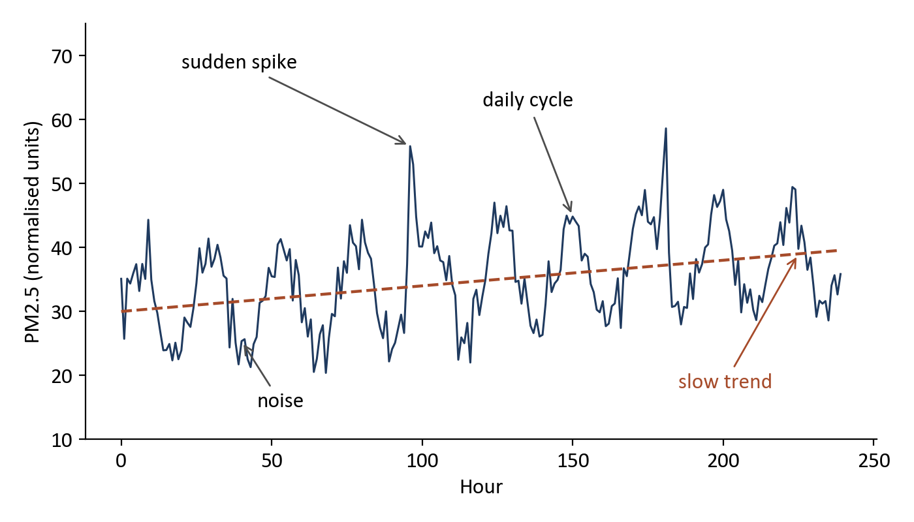
Why Is Air-Quality Forecasting Difficult?
• Sudden pollution spikes can occur
• Daily and seasonal behaviour appears
• The underlying dynamics change over time
• Past-to-future relationship is nonlinear
Main question
Can we separate these different patterns before forecasting?
Illustrative synthetic signal, not data from the paper
WaveCatBoost: Hybrid Air Quality Forecasting
2
Notes:
Air-quality data is not a simple smooth sequence. A pollutant signal mixes fast variations, medium-scale patterns such as daily cycles, a long-term trend, and noise. Spikes happen suddenly, the dynamics change over time, and the link between past and future is nonlinear. Instead of forcing one model to learn every behaviour in the raw signal, the paper asks whether we can first separate the signal into simpler components.

Slide 3
Research Gap and Proposed Idea
Existing approach | Main issue | WaveCatBoost response
Traditional forecasting | Nonlinear, nonstationary dynamics | Decompose the signal first (MODWT)
Deep learning | Training / prediction cost for real time | Fast tree-based CatBoost
Conventional boosting | Prediction shift / target leakage | Ordered boosting in CatBoost
Proposed solution
Y(t)
MODWT
Components
CatBoost
Point
forecast
Conformal
prediction
Prediction
interval
WaveCatBoost: Hybrid Air Quality Forecasting
3
Notes:
Traditional forecasting struggles with nonlinear, nonstationary pollutant dynamics. Deep learning models complex temporal dependencies, but training and prediction cost is a problem for real-time use. Conventional boosting is efficient, but on sequential data it suffers from prediction shift, or target leakage. WaveCatBoost decomposes the signal first, uses CatBoost with ordered boosting, and adds conformal prediction for a prediction interval.

Slide 4
Dataset
Meghalaya, India
CPCB
Central Pollution Control Board sensor network
ID1
Low-cost air-quality sensor system
Data period
July 2022 → July 2023
Sampling
15-minute observations
Forecast horizons
1, 7, 14, 31 days
Pollutants
WaveCatBoost: Hybrid Air Quality Forecasting
4
Notes:
Two real-world datasets are used, both from Meghalaya in India. CPCB is the Central Pollution Control Board sensor network. ID1 is a low-cost air-quality sensor system. Data runs from July 2022 to July 2023 with 15-minute observations. Four forecast horizons are tested: 1, 7, 14 and 31 days, for six pollutants.

Slide 5
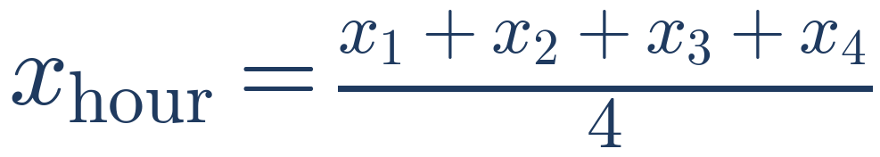
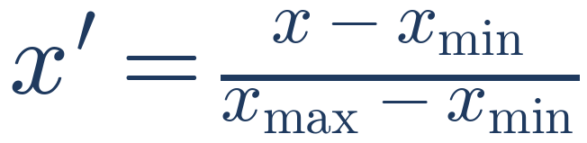
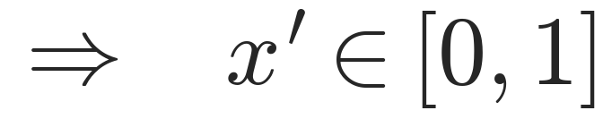
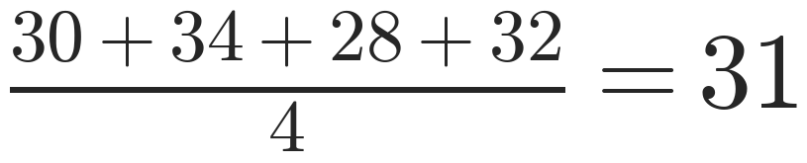
Data Preprocessing
15-min data
Missing-value
handling
Hourly
averaging
Min-max
normalisation
Hourly averaging
Min-max normalisation
Example
• Puts all pollutants on the same scale
• Helps the model converge
WaveCatBoost: Hybrid Air Quality Forecasting
5
Notes:
The purpose of preprocessing is to turn irregular, noisy raw sensor observations into a consistent hourly forecasting series. Missing values are handled by imputation, four 15-minute readings are averaged into one hourly value, and min-max normalisation scales every series to the range zero to one.

Slide 6
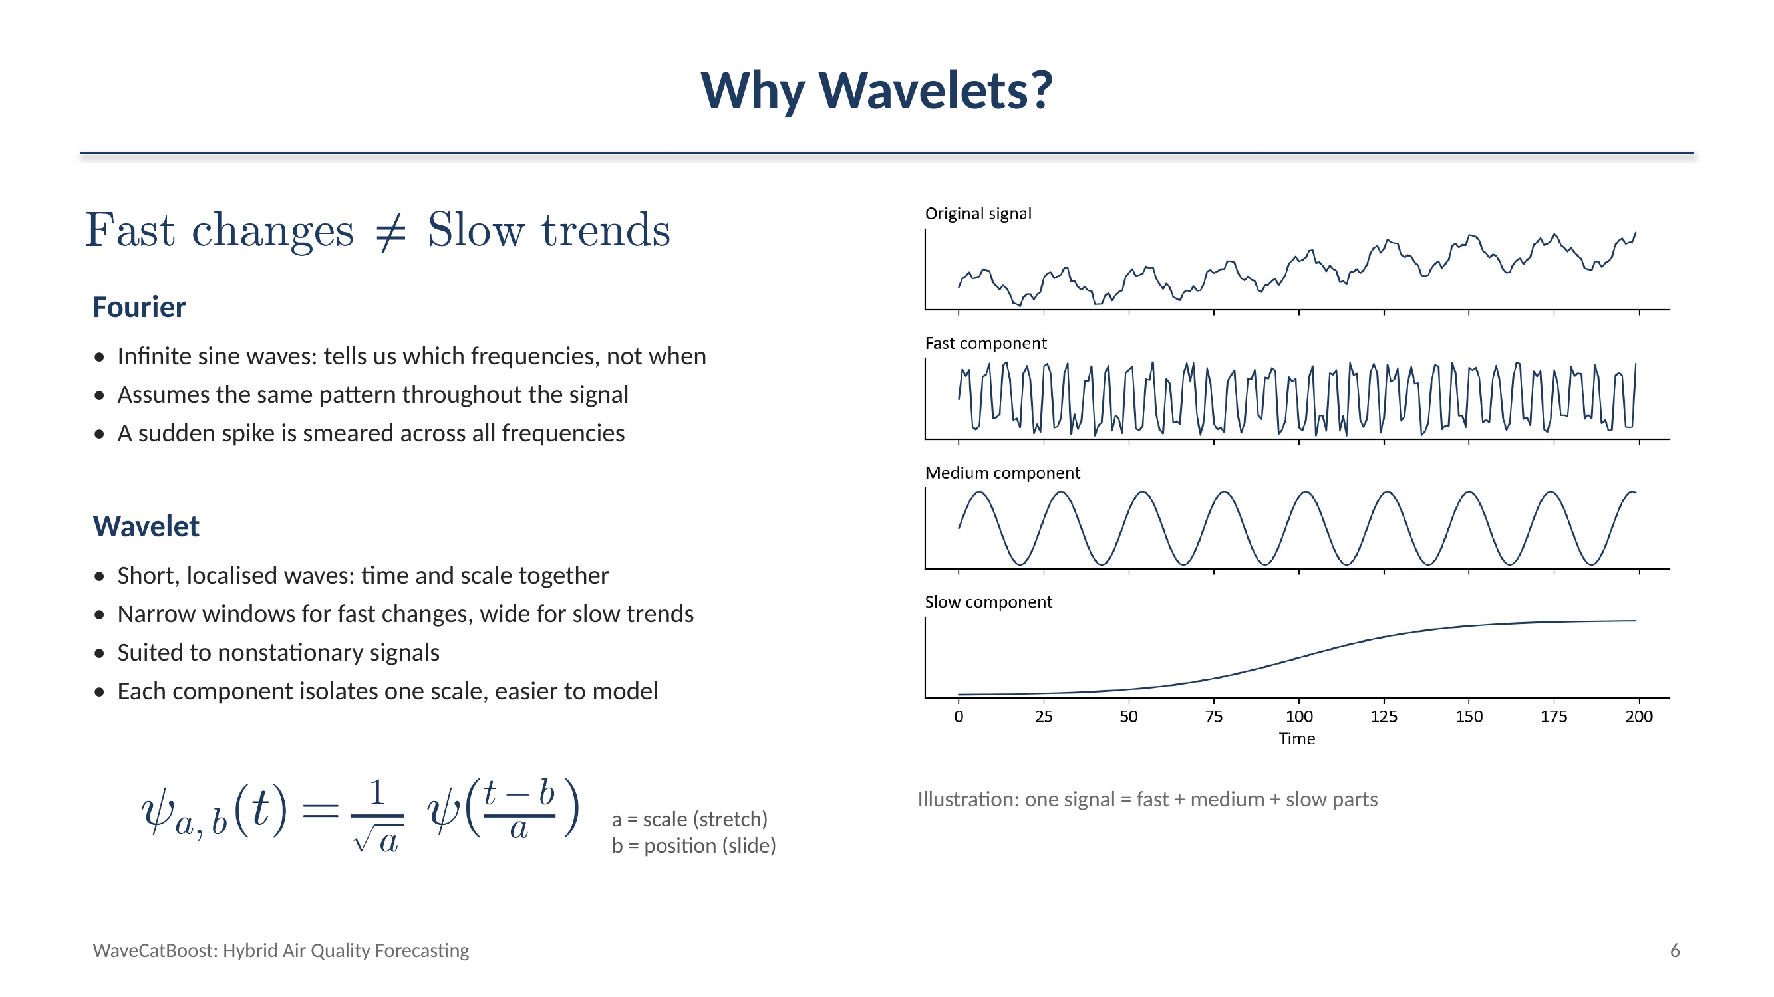

Slide 7
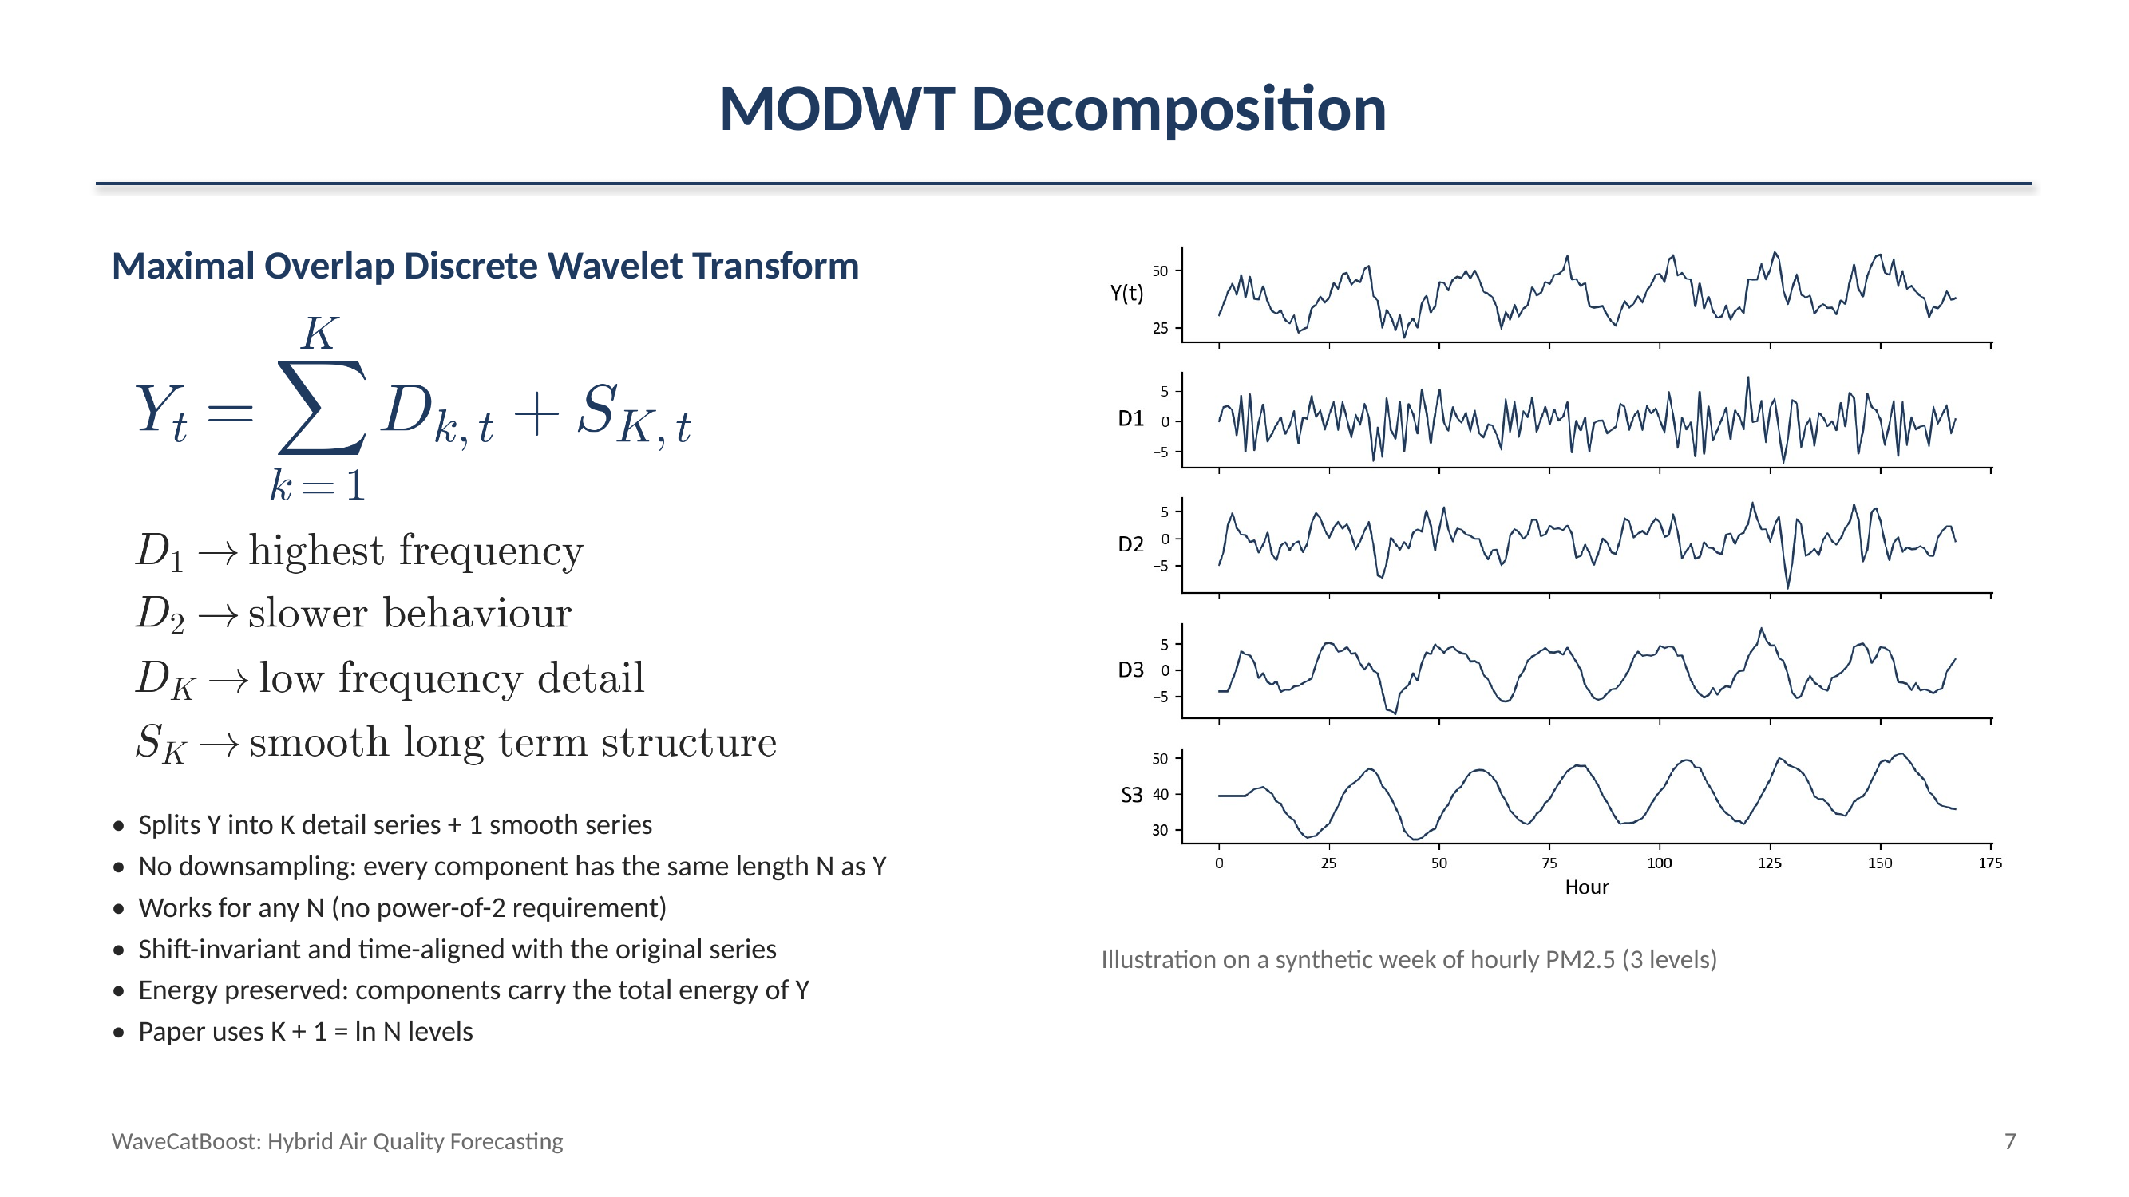

Slide 8
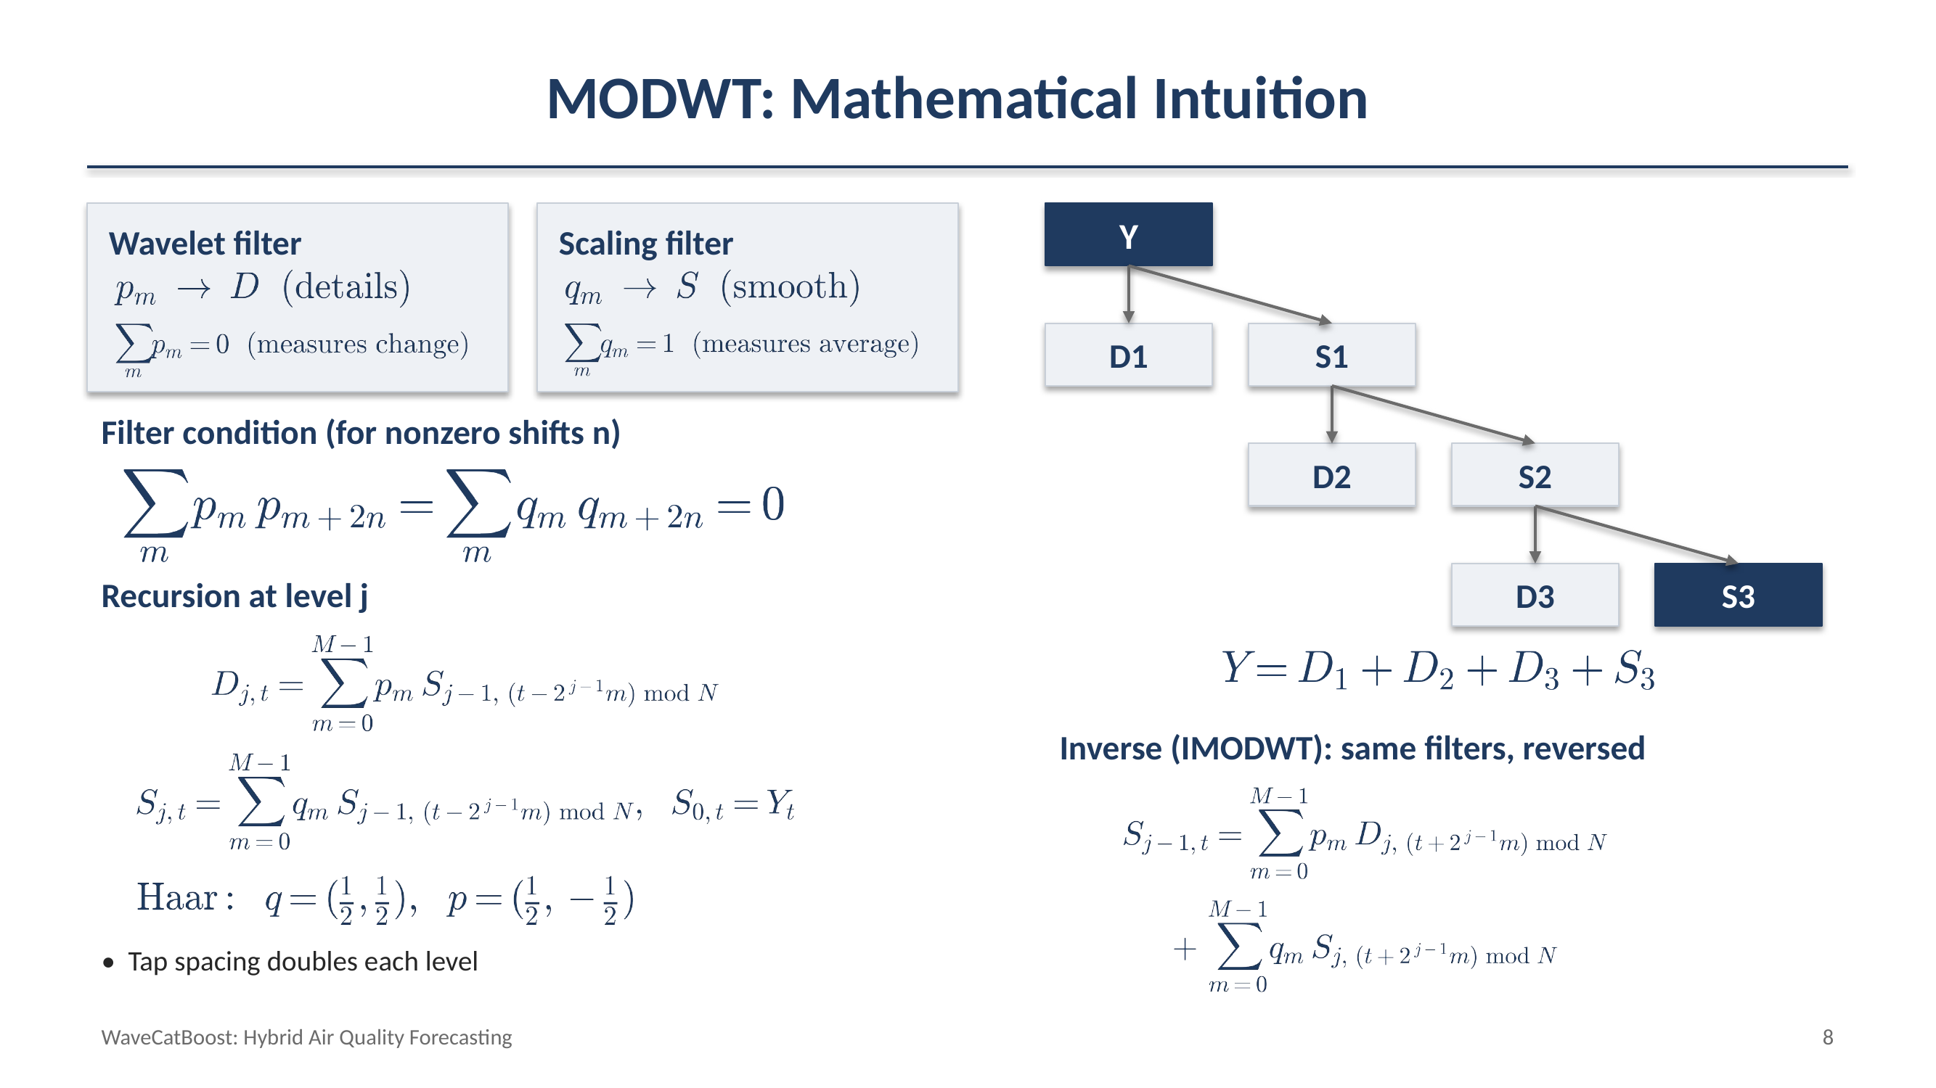

Slide 9
Why Forecast Components Separately?
Direct approach
MODWT approach
Messy signal
Messy signal
MODWT
One model
D1
D2
…
SK
Forecast
Model
Model
…
Model
One model must learn noise + short-term variation + trend + seasonality at the same time
Reconstruct
Forecast
WaveCatBoost: Hybrid Air Quality Forecasting
9
Notes:
In the direct approach, one model must learn noise, short-term variation, trend and seasonality all at once. In WaveCatBoost, MODWT first splits the signal, and a separate CatBoost model forecasts each component. One difficult problem becomes several simpler forecasting problems, and the component forecasts are then recombined.

Slide 10

How should we model the series ?
Autoregressive Process :
Neural Networks :
Tree Based Models :
$\boxed{Y_{t}=c+φ_{1}Y_{t−1}+⋯+ε_{t}}$
Captures complex nonlinear temporal relationships
RNNs / Transformers
High model complexity and computational cost
Real-time forecasting → latency matters
A complex architecture may introduce unnecessary computational overhead for this task.
Capture nonlinear relationships
Decision trees can model nonlinear relationships
Efficient and relatively lightweight
Ensemble methods improve individual trees
Gradient Boosting is particularly suitable
Each new tree focuses on correcting the errors of the existing ensemble.
Assumes Linear Dependence
on previous lags
AR(p) is simple and efficient, but its linear assumption limits its ability to capture complex nonlinear pollutant dynamics.
WaveCatBoost: Hybrid Air Quality Forecasting
10
Notes:
In the direct approach, one model must learn noise, short-term variation, trend and seasonality all at once. In WaveCatBoost, MODWT first splits the signal, and a separate CatBoost model forecasts each component. One difficult problem becomes several simpler forecasting problems, and the component forecasts are then recombined.

Slide 11
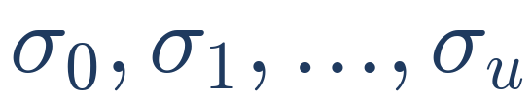

CatBoost Forecasting
CatBoosting
Random Permutations & Ordered Boosting
Gradient boosting: sequentially builds trees, where each new tree corrects errors of the previous ensemble.
Nonlinear modelling: captures complex relationships between lagged PM2.5/component values.
Ordered boosting: reduces prediction shift caused by using the same observations to train the model and calculate their gradients/residuals.
Suitable for our setting: gives nonlinear tree-based modelling without requiring a large neural architecture.
CatBoost creates a random permutation of the training samples and uses the preceding samples to build a supporting model for each observation.
Residual/gradient is calculated using a model that has not seen that observation, reducing prediction shift (training bias).
Random permutations
$$g_{C}=\frac{∂L\left(y_{C},{\overset{ˆ}{y}}_{C}\right)}{∂{\overset{ˆ}{y}}_{C}}$$
L: loss y_c: observed target y_c^: supporting model prediction
WaveCatBoost: Hybrid Air Quality Forecasting
11
Notes:
When predicting Y at time t, the model may only use information available before t. Using future information would cause temporal leakage. CatBoost trains on time-dependent permutations of the data, and the gradient for each point is computed with a supporting model that only saw earlier points. This reduces prediction shift. It does not remove the need for a proper chronological train/test split or careful lag construction.

Slide 12
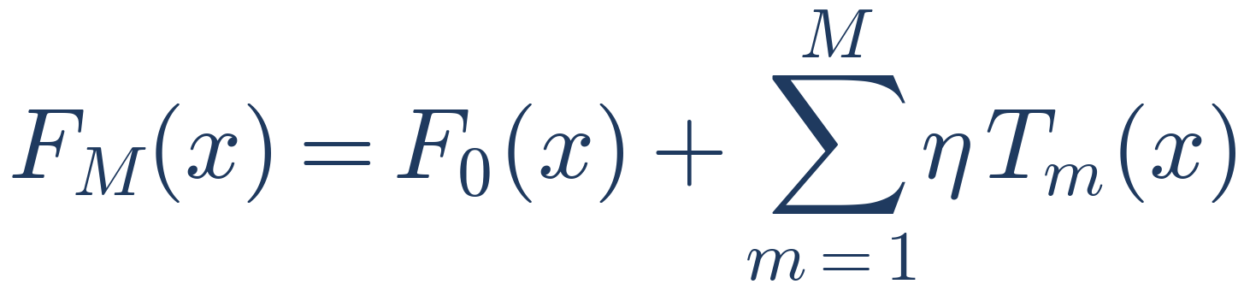
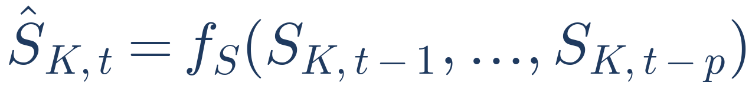
CatBoost Forecasting
Gradient-boosted decision trees (simplified)
Dk(t-3)
Dk(t-2)
Dk(t-1)
– T_m: tree added at iteration m
– M: number of boosting iterations
– η: learning-rate scaling
CatBoost
Component forecasting
Dk(t)
Important
A separate CatBoost model is trained for each wavelet component
WaveCatBoost: Hybrid Air Quality Forecasting
12
Notes:
CatBoost is a gradient-boosted decision-tree model. Trees are added one at a time, each scaled by a learning rate. For every wavelet component, a separate CatBoost model takes the last p lagged values of that component and predicts its next value. The same is done for the smooth component.

Slide 13
Complete WaveCatBoost Architecture
D1
CatBoost 1
D1 forecast
Raw data
Preprocessing
MODWT
D2 … DK
CatBoost 2…K
D2…DK forecasts
Inverse
MODWT
Final
forecast
SK
CatBoost S
SK forecast
Conformal
prediction
Final forecast
Prediction
interval
Decompose → Forecast → Reconstruct → Quantify uncertainty
WaveCatBoost: Hybrid Air Quality Forecasting
13
Notes:
Here is the whole pipeline. Raw data is preprocessed and decomposed by MODWT. Each component gets its own CatBoost model. The component forecasts are combined with the inverse MODWT to give the final forecast, and conformal prediction adds a prediction interval. In one line: decompose, forecast, reconstruct, quantify uncertainty.

Slide 14
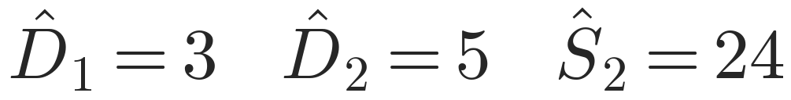
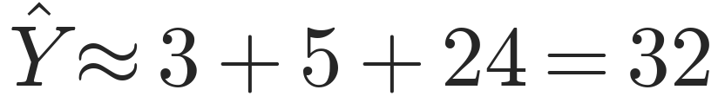
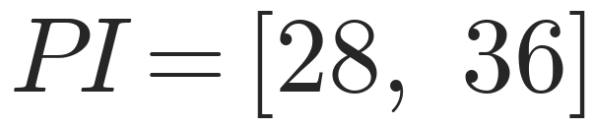
Simple Worked Example (Illustrative)
Step 1: Decompose the observed series
Step 2: Forecast components
t | 1 | 2 | 3 | 4 | 5 | 6
Y (observed) | 20 | 22 | 25 | 24 | 28 | 30
D1 | 1 | 2 | 1 | 3 | 2 | 4
D2 | 2 | 2 | 3 | 3 | 4 | 4
S2 | 17 | 18 | 21 | 18 | 22 | 22
D1 + D2 + S2 | 20 | 22 | 25 | 24 | 28 | 30
Step 3: Reconstruct (simplified)
• Each component is forecast by its own CatBoost model
• Values are illustrative only, not reported by the paper
• Real method uses the full inverse-MODWT reconstruction
Step 4: Add uncertainty (margin 4)
WaveCatBoost: Hybrid Air Quality Forecasting
13
Notes:
A toy example. We observe six PM2.5 values and want the next one. Suppose the decomposition gives these three components; each column adds back to the observed value. CatBoost forecasts each component: 3, 5 and 24. Adding them gives about 32. With an uncertainty margin of 4 the prediction interval is 28 to 36. These numbers are illustrative only, not from the paper. A real implementation uses the full inverse MODWT reconstruction.

Slide 15
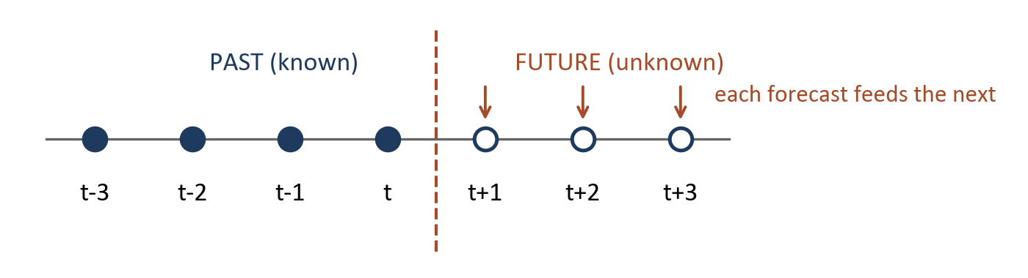
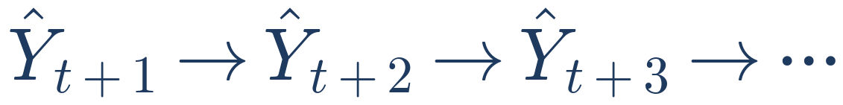

Multi-Step Forecasting
Horizon | Hourly steps
1 day | 24
7 days | 168
14 days | 336
31 days | 744
Advantage
Simple way to generate long horizons
Challenge
Errors can propagate
Recursive forecasting
WaveCatBoost: Hybrid Air Quality Forecasting
14
Notes:
The processed data is hourly, so a one-day forecast is 24 steps, seven days is 168 steps, fourteen days is 336 and thirty-one days is 744. The model forecasts one step, feeds that forecast back in as an input, and repeats. This is a simple way to reach long horizons, but an error in an early step can carry forward into later ones.

Slide 16
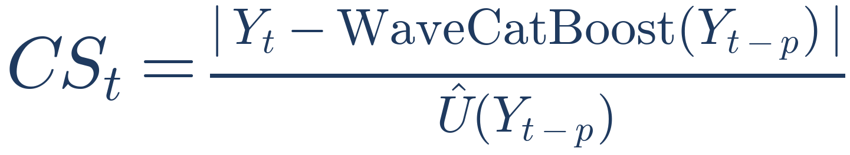
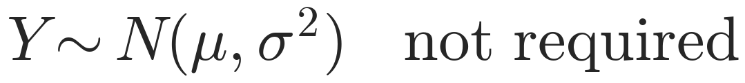
Conformal Prediction
How uncertain is this prediction?
Past predictions
Past errors
• Numerator: the prediction error
• Denominator: the estimated uncertainty scale
• So CS_t is a normalised prediction-error score
• No parametric distribution needs to be assumed:
Conformal scores
Current uncertainty
Prediction interval
WaveCatBoost: Hybrid Air Quality Forecasting
15
Notes:
A point forecast gives one number, but we also want to know how uncertain it is. The conformal score divides the absolute prediction error by an estimated uncertainty scale, so it is a normalised error score. Conformal prediction does not need to assume a particular distribution, such as normal errors.

Slide 17
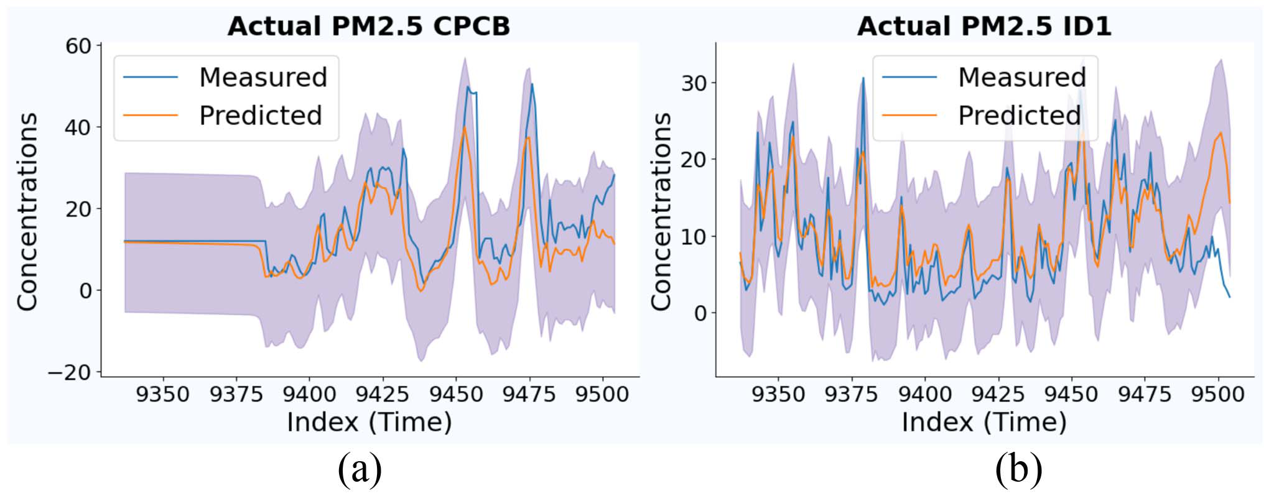
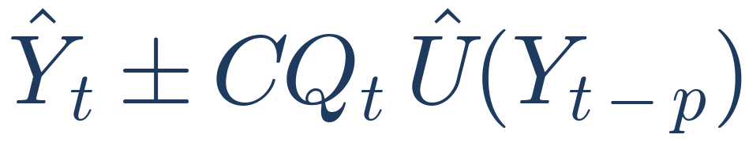
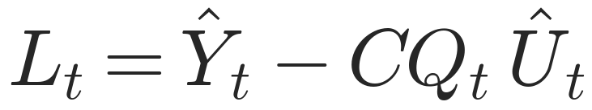
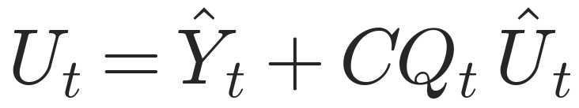
Prediction Interval
Conformal quantile CQ_t from a recent window of length κ
Blue: actual PM2.5 Orange: WaveCatBoost prediction
Shaded band: lower and upper prediction boundaries
7-day horizon, (a) CPCB, (b) ID1. Figure 2 of the paper
WaveCatBoost: Hybrid Air Quality Forecasting
16
Notes:
Air-quality behaviour is nonstationary, so the paper uses only a recent window of length kappa to compute the conformal quantile. The interval is the forecast plus or minus the quantile times the uncertainty scale. With alpha equal to 0.05 the nominal level is 95 percent. The band is more informative than a single prediction because it tells us how much uncertainty surrounds the forecast.

Slide 18
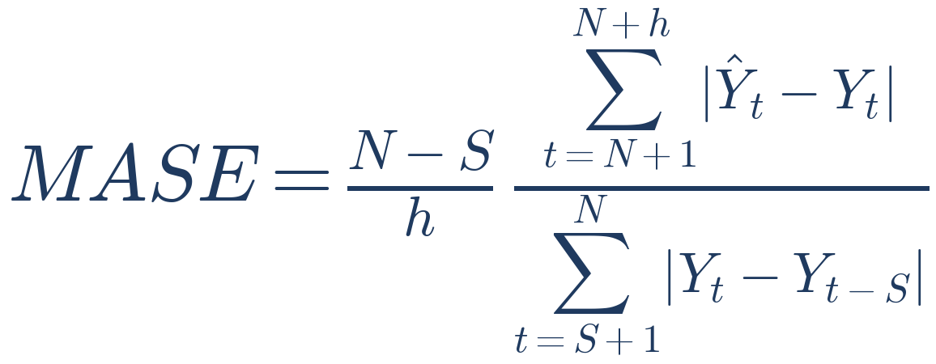
Recorded Model Results
PM2.5 MASE (recorded results)
Sensor | Horizon | XGB | CatBoost | WaveCatBoost
CPCB | 1 d | 1.37 | 0.82 | 0.71
CPCB | 7 d | 1.50 | 1.50 | 1.50
CPCB | 14 d | 0.73 | 0.78 | 0.75
CPCB | 31 d | 2.48 | 2.39 | 1.06
ID1 | 1 d | 0.87 | 0.67 | 0.42
ID1 | 7 d | 0.79 | 0.62 | 0.59
ID1 | 14 d | 0.65 | 0.69 | 0.68
ID1 | 31 d | 0.58 | 0.55 | 0.55
Lower MASE = better
Recorded recursive forecasts; seasonality S = 24
• Same recorded run as the R document
• CPCB 1-day: WaveCatBoost is lowest here
• CPCB: the best model varies with horizon
• ID1: WaveCatBoost is lowest at 1 and 7 days
• Winner depends on station and horizon
Bold = lowest unrounded score among shown models.
WaveCatBoost: Hybrid Air Quality Forecasting
17
Notes:
Accuracy is measured with the mean absolute scaled error, MASE; lower is better. WaveCatBoost is compared with RNN, LGBM, TCN, TFT, Transformer, XGB and CatBoost. On CPCB it is strongest for 14 and 31 day forecasts for most pollutants, comparable with the boosting models at 7 days, and competitive with Transformer-based models at 1 day. On ID1 it is strong across horizons and pollutants, except SO2 where XGB and CatBoost remain competitive. The table shows PM2.5 values taken from Table 1.

Slide 19
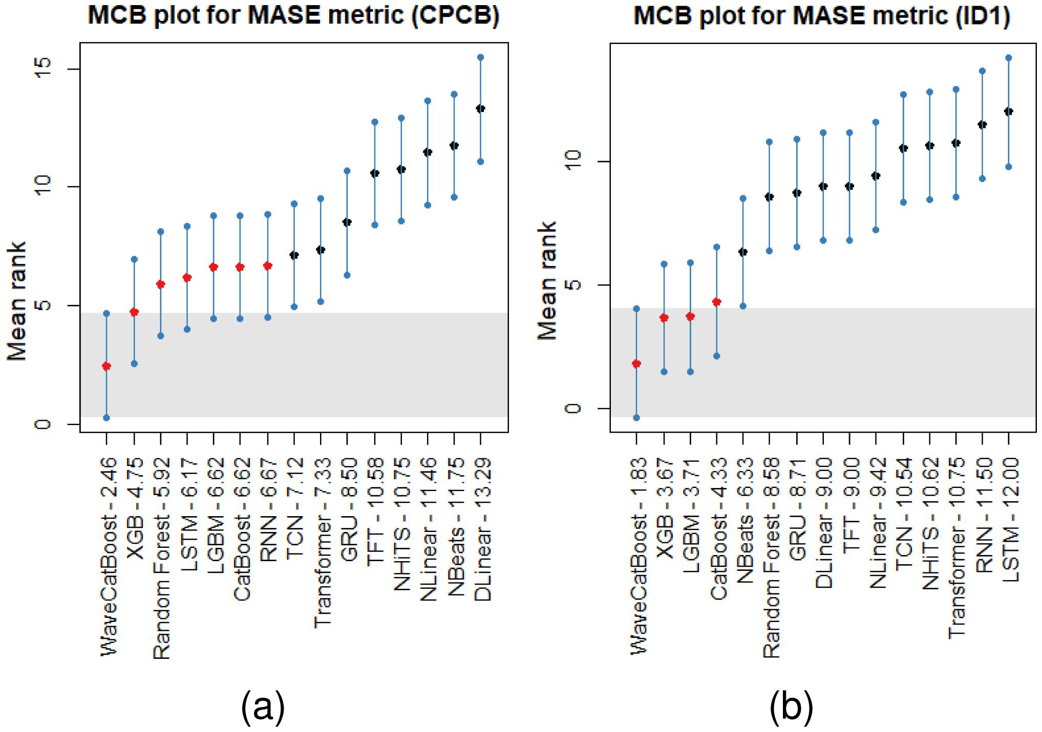
Statistical Validation: MCB
Multiple Comparisons with the Best
• A small MASE gap does not prove one model is better
• MCB ranks every model and compares it to the best one
• Shaded band = critical distance of the best model
Best overall rank
WaveCatBoost, for CPCB and ID1
Lower rank = lower MASE
Most baselines are significantly worse
Figure 1 of the paper: MCB plots for (a) CPCB and (b) ID1
WaveCatBoost: Hybrid Air Quality Forecasting
18
Notes:
A small difference in MASE does not automatically mean one model is genuinely better. The multiple comparisons with the best test ranks each model across the pollutants and compares the rankings against the best method. WaveCatBoost has the best overall rank for both CPCB and ID1. Most baselines fall outside its critical-distance band, so the difference is significant.

Slide 20
Strengths, Limitations and Future Work
Strengths
Multiscale view: MODWT splits the signal into time scales
Nonlinear forecasting: CatBoost per component
Uncertainty: conformal prediction intervals
Compared with multiple ML and deep learning baselines
Limitations
1. Both datasets from Meghalaya only
2. No spatial links between sensor locations
3. Haar only, no wavelet-family comparison
4. Recursive forecasts can propagate errors
5. No deployment-level latency / throughput benchmark
Future work
Authors' stated direction: model spatial dependencies
Station A
Station B
Station C
Spatial + temporal model
WaveCatBoost: Hybrid Air Quality Forecasting
19
Notes:
Strengths: multiscale representation from MODWT, nonlinear forecasting from CatBoost, prediction intervals from conformal prediction, and a broad comparison against ML and deep learning models. Limitations: both datasets are from Meghalaya, no spatial relationships between stations, only the Haar wavelet is used with no wider wavelet comparison, recursive forecasts can propagate errors, and there is no detailed deployment latency benchmark. The authors name spatial dependencies as future work.

Slide 21
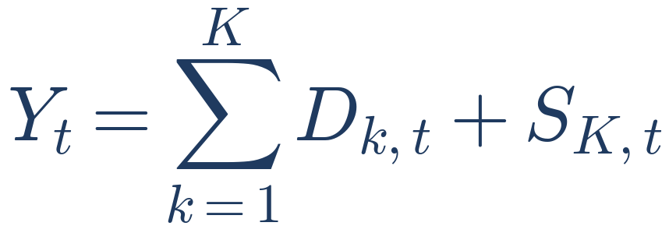
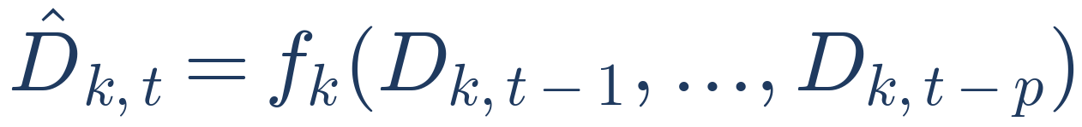

Final Takeaway
1. Decompose
2. Forecast
3. Reconstruct
4. Quantify uncertainty
Signal → MODWT → components → CatBoost models → inverse MODWT → conformal prediction → forecast + uncertainty
First separate the signal into temporal components, forecast each one, reconstruct, then quantify how uncertain the forecast is.
WaveCatBoost: Hybrid Air Quality Forecasting
20
Notes:
Remember the paper in four steps. Decompose the signal with MODWT. Forecast each component with its own CatBoost model. Reconstruct the forecast with the inverse MODWT. Quantify uncertainty with a conformal prediction interval. The central idea is simple: separate the complicated air-quality signal into temporal components, forecast them individually, reconstruct the signal, and measure how uncertain the forecast is. Thank you.

