Slide 1
A Novel Hybrid Approach for Efficiently Forecasting Air Quality Data
WaveCatBoost: Wavelet-Based CatBoost for Air-Quality Forecasting
Jintu Borah, Tanujit Chakraborty, Md. Shahrul Md. Nadzir, Mylene G. Cayetano, Francesco Benedetto, Shubhankar Majumdar
IEEE Sensors Letters, Vol. 9, No. 1, 2025
Air-quality sensor
Time-series signal
WaveCatBoost
(MODWT + CatBoost)
Forecast +
uncertainty
Notes:
This paper proposes WaveCatBoost, a hybrid model for forecasting air pollutant levels. The core idea has three parts: MODWT to decompose the signal, CatBoost to forecast each component, and conformal prediction to quantify uncertainty. In short: decompose the air-quality signal, forecast each component, reconstruct the signal, and quantify uncertainty.

Slide 2
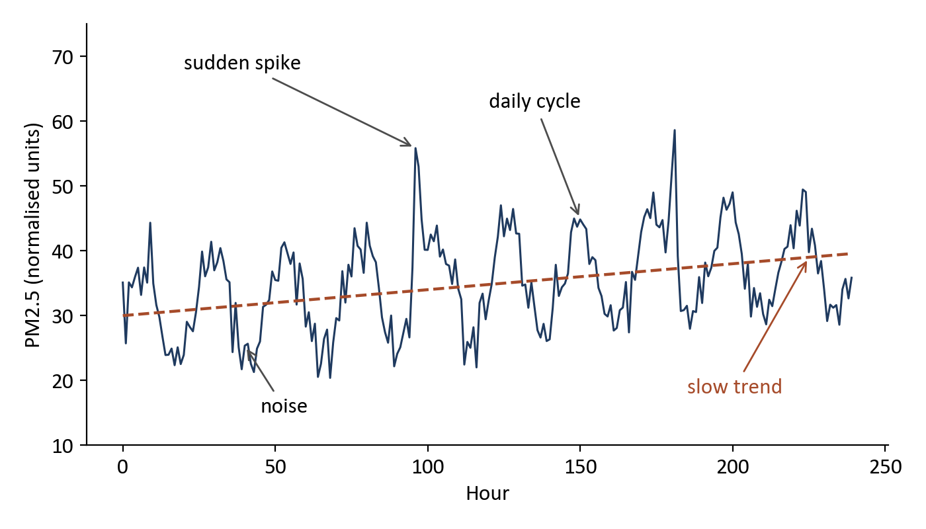
Why Is Air-Quality Forecasting Difficult?
• Sudden pollution spikes can occur
• Daily and seasonal behaviour appears
• The underlying dynamics change over time
• Past-to-future relationship is nonlinear
Main question
Can we separate these different patterns before forecasting?
Illustrative synthetic signal, not data from the paper
WaveCatBoost: Hybrid Air Quality Forecasting
2
Notes:
Air-quality data is not a simple smooth sequence. A pollutant signal mixes fast variations, medium-scale patterns such as daily cycles, a long-term trend, and noise. Spikes happen suddenly, the dynamics change over time, and the link between past and future is nonlinear. Instead of forcing one model to learn every behaviour in the raw signal, the paper asks whether we can first separate the signal into simpler components.

Slide 3
Research Gap and Proposed Idea
Existing approach | Main issue | WaveCatBoost response
Traditional forecasting | Nonlinear, nonstationary dynamics | Decompose the signal first (MODWT)
Deep learning | Training / prediction cost for real time | Fast tree-based CatBoost
Conventional boosting | Prediction shift / target leakage | Ordered boosting in CatBoost
Proposed solution
Y(t)
MODWT
Components
CatBoost
Point
forecast
Conformal
prediction
Prediction
interval
WaveCatBoost: Hybrid Air Quality Forecasting
3
Notes:
Traditional forecasting struggles with nonlinear, nonstationary pollutant dynamics. Deep learning models complex temporal dependencies, but training and prediction cost is a problem for real-time use. Conventional boosting is efficient, but on sequential data it suffers from prediction shift, or target leakage. WaveCatBoost decomposes the signal first, uses CatBoost with ordered boosting, and adds conformal prediction for a prediction interval.

Slide 4
Dataset
Meghalaya, India
CPCB
Central Pollution Control Board sensor network
ID1
Low-cost air-quality sensor system
Data period
July 2022 → July 2023
Sampling
15-minute observations
Forecast horizons
1, 7, 14, 31 days
Pollutants
WaveCatBoost: Hybrid Air Quality Forecasting
4
Notes:
Two real-world datasets are used, both from Meghalaya in India. CPCB is the Central Pollution Control Board sensor network. ID1 is a low-cost air-quality sensor system. Data runs from July 2022 to July 2023 with 15-minute observations. Four forecast horizons are tested: 1, 7, 14 and 31 days, for six pollutants.

Slide 5
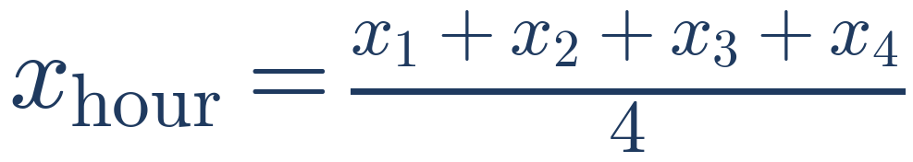
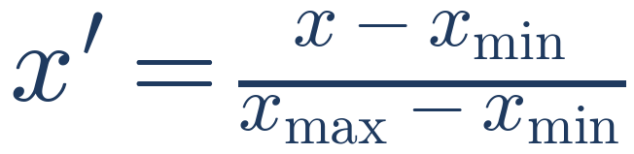
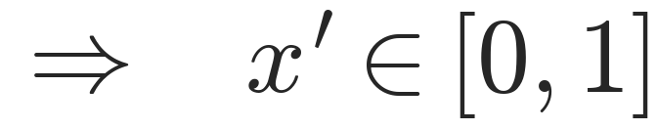
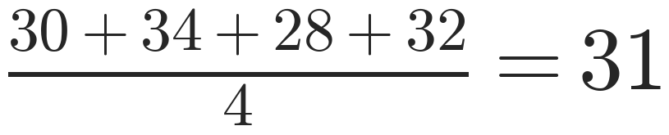
Data Preprocessing
15-min data
Missing-value
handling
Hourly
averaging
Min-max
normalisation
Hourly averaging
Min-max normalisation
Example
• Puts all pollutants on the same scale
• Helps the model converge
WaveCatBoost: Hybrid Air Quality Forecasting
5
Notes:
The purpose of preprocessing is to turn irregular, noisy raw sensor observations into a consistent hourly forecasting series. Missing values are handled by imputation, four 15-minute readings are averaged into one hourly value, and min-max normalisation scales every series to the range zero to one.

Slide 6
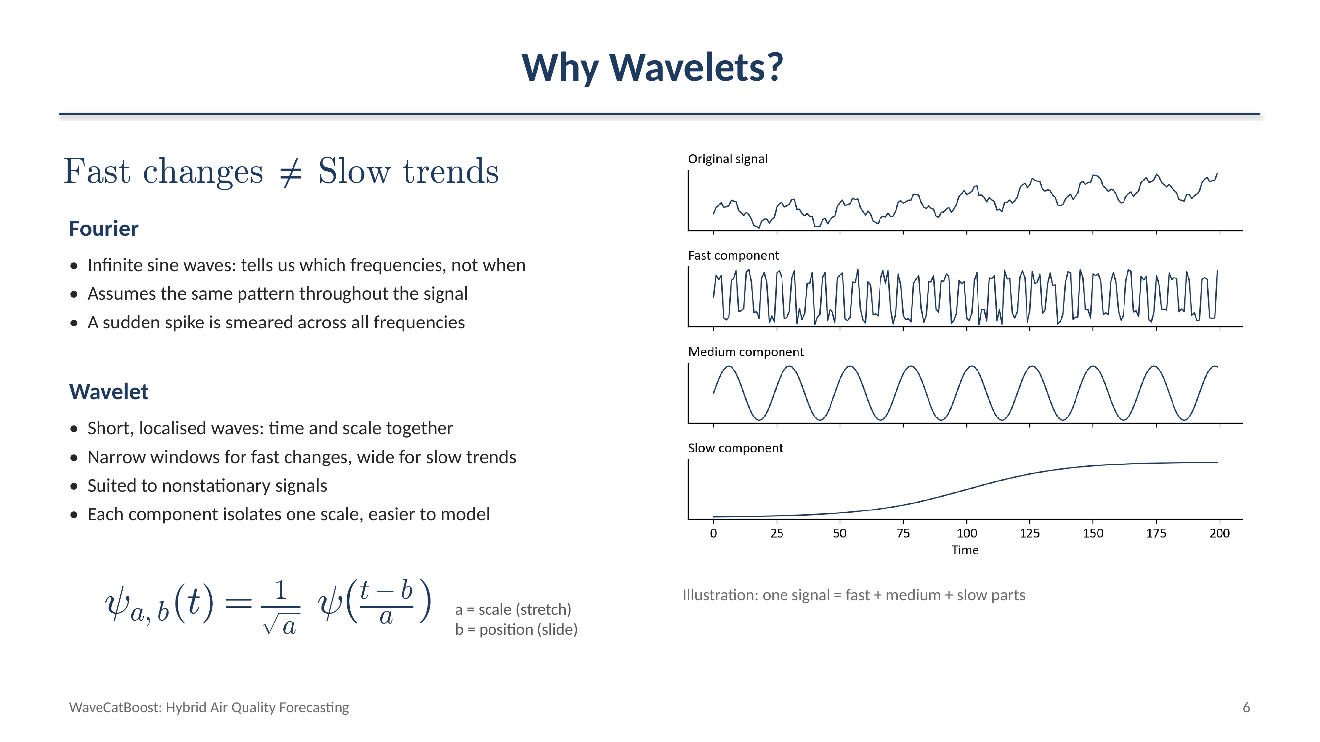

Slide 7
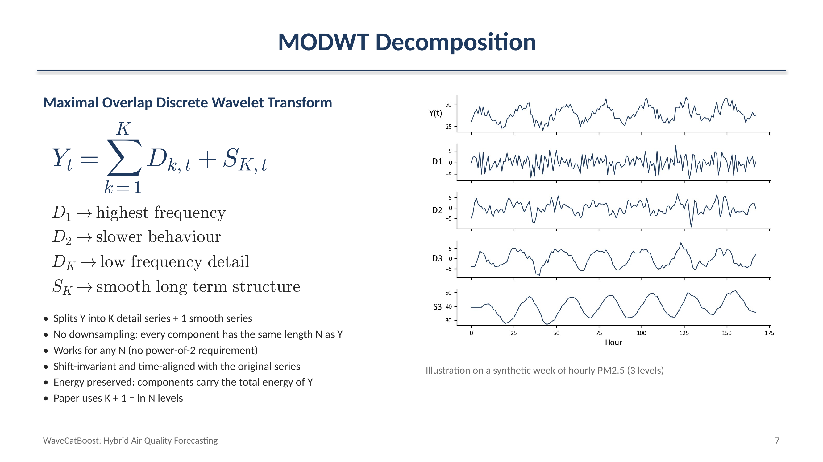

Slide 8
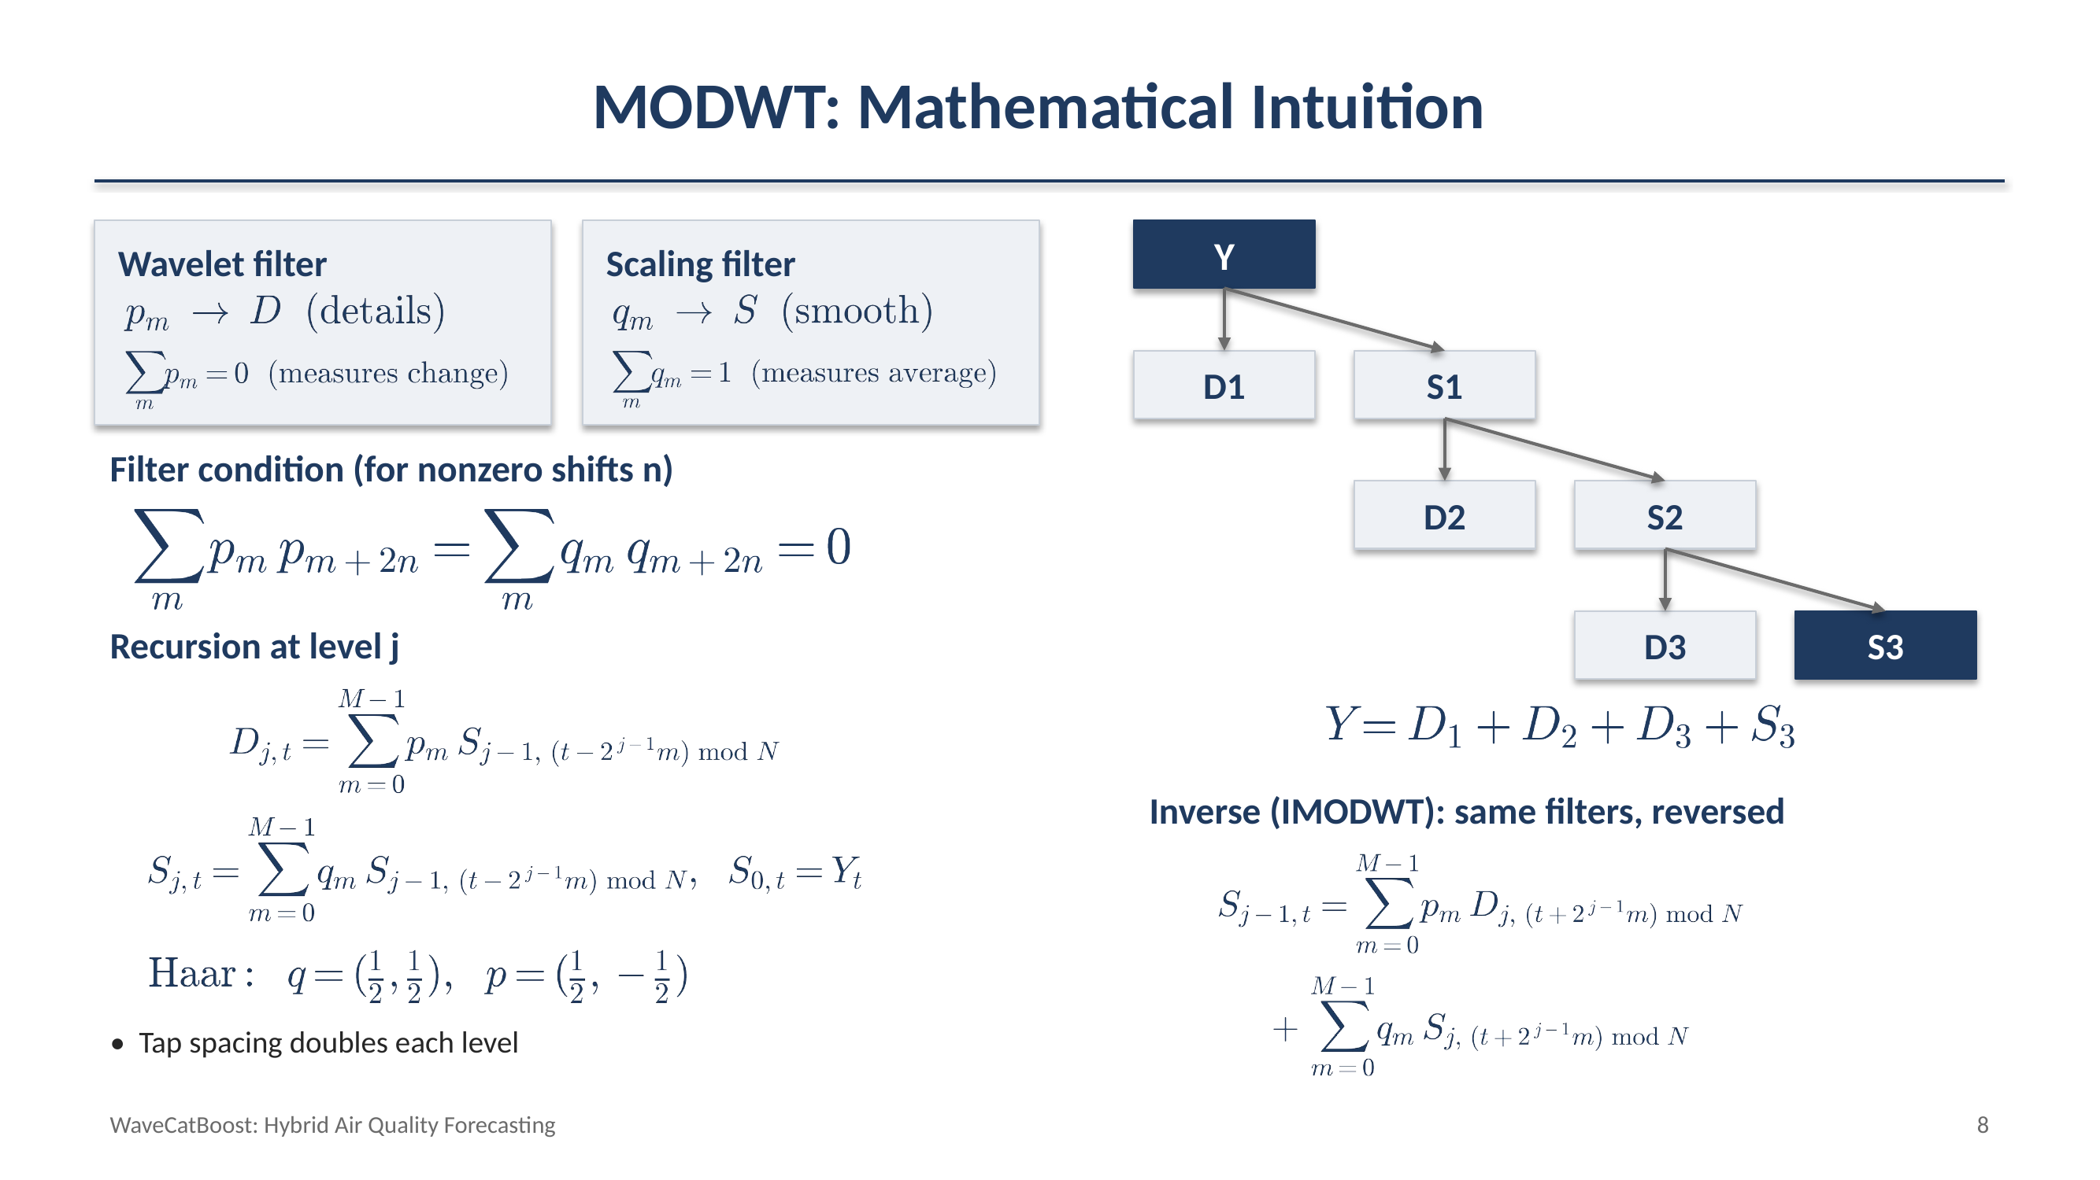

Slide 9
Why Forecast Components Separately?
Direct approach
MODWT approach
Messy signal
Messy signal
MODWT
One model
D1
D2
…
SK
Forecast
Model
Model
…
Model
One model must learn noise + short-term variation + trend + seasonality at the same time
Reconstruct
Forecast
WaveCatBoost: Hybrid Air Quality Forecasting
9
Notes:
In the direct approach, one model must learn noise, short-term variation, trend and seasonality all at once. In WaveCatBoost, MODWT first splits the signal, and a separate CatBoost model forecasts each component. One difficult problem becomes several simpler forecasting problems, and the component forecasts are then recombined.

Slide 10

How should we model the series ?
Autoregressive Process :
Neural Networks :
Tree Based Models :
$\boxed{Y_{t}=c+φ_{1}Y_{t−1}+⋯+ε_{t}}$
Captures complex nonlinear temporal relationships
RNNs / Transformers
High model complexity and computational cost
Real-time forecasting → latency matters
A complex architecture may introduce unnecessary computational overhead for this task.
Capture nonlinear relationships
Decision trees can model nonlinear relationships
Efficient and relatively lightweight
Ensemble methods improve individual trees
Gradient Boosting is particularly suitable
Each new tree focuses on correcting the errors of the existing ensemble.
Assumes Linear Dependence
on previous lags
AR(p) is simple and efficient, but its linear assumption limits its ability to capture complex nonlinear pollutant dynamics.
WaveCatBoost: Hybrid Air Quality Forecasting
10
Notes:
In the direct approach, one model must learn noise, short-term variation, trend and seasonality all at once. In WaveCatBoost, MODWT first splits the signal, and a separate CatBoost model forecasts each component. One difficult problem becomes several simpler forecasting problems, and the component forecasts are then recombined.

Slide 11
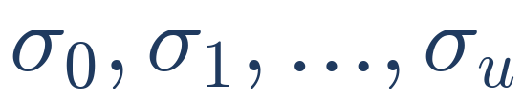

CatBoost Forecasting
CatBoosting
Random Permutations & Ordered Boosting
Gradient boosting: sequentially builds trees, where each new tree corrects errors of the previous ensemble.
Nonlinear modelling: captures complex relationships between lagged PM2.5/component values.
Ordered boosting: reduces prediction shift caused by using the same observations to train the model and calculate their gradients/residuals.
Suitable for our setting: gives nonlinear tree-based modelling without requiring a large neural architecture.
CatBoost creates a random permutation of the training samples and uses the preceding samples to build a supporting model for each observation.
Residual/gradient is calculated using a model that has not seen that observation, reducing prediction shift (training bias).
Random permutations
$$g_{C}=\frac{∂L\left(y_{C},{\overset{ˆ}{y}}_{C}\right)}{∂{\overset{ˆ}{y}}_{C}}$$
L: loss y_c: observed target y_c^: supporting model prediction
WaveCatBoost: Hybrid Air Quality Forecasting
11
Notes:
When predicting Y at time t, the model may only use information available before t. Using future information would cause temporal leakage. CatBoost trains on time-dependent permutations of the data, and the gradient for each point is computed with a supporting model that only saw earlier points. This reduces prediction shift. It does not remove the need for a proper chronological train/test split or careful lag construction.

Slide 12
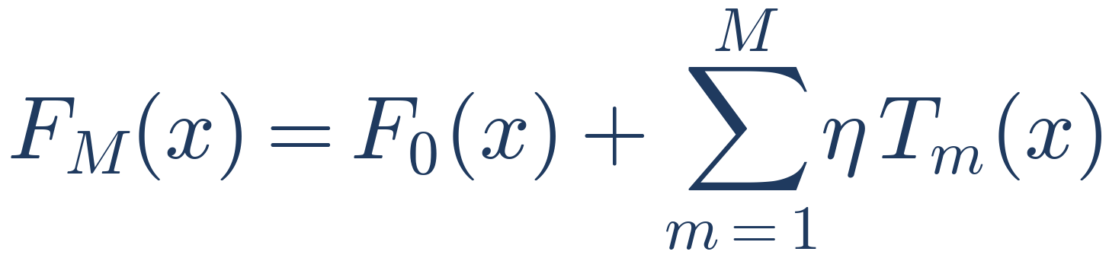
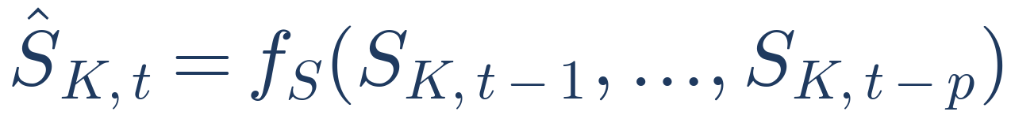
CatBoost Forecasting
Gradient-boosted decision trees (simplified)
Dk(t-3)
Dk(t-2)
Dk(t-1)
– T_m: tree added at iteration m
– M: number of boosting iterations
– η: learning-rate scaling
CatBoost
Component forecasting
Dk(t)
Important
A separate CatBoost model is trained for each wavelet component
WaveCatBoost: Hybrid Air Quality Forecasting
12
Notes:
CatBoost is a gradient-boosted decision-tree model. Trees are added one at a time, each scaled by a learning rate. For every wavelet component, a separate CatBoost model takes the last p lagged values of that component and predicts its next value. The same is done for the smooth component.

Slide 13
Complete WaveCatBoost Architecture
D1
CatBoost 1
D1 forecast
Raw data
Preprocessing
MODWT
D2 … DK
CatBoost 2…K
D2…DK forecasts
Inverse
MODWT
Final
forecast
SK
CatBoost S
SK forecast
Conformal
prediction
Final forecast
Prediction
interval
Decompose → Forecast → Reconstruct → Quantify uncertainty
WaveCatBoost: Hybrid Air Quality Forecasting
13
Notes:
Here is the whole pipeline. Raw data is preprocessed and decomposed by MODWT. Each component gets its own CatBoost model. The component forecasts are combined with the inverse MODWT to give the final forecast, and conformal prediction adds a prediction interval. In one line: decompose, forecast, reconstruct, quantify uncertainty.

Slide 14
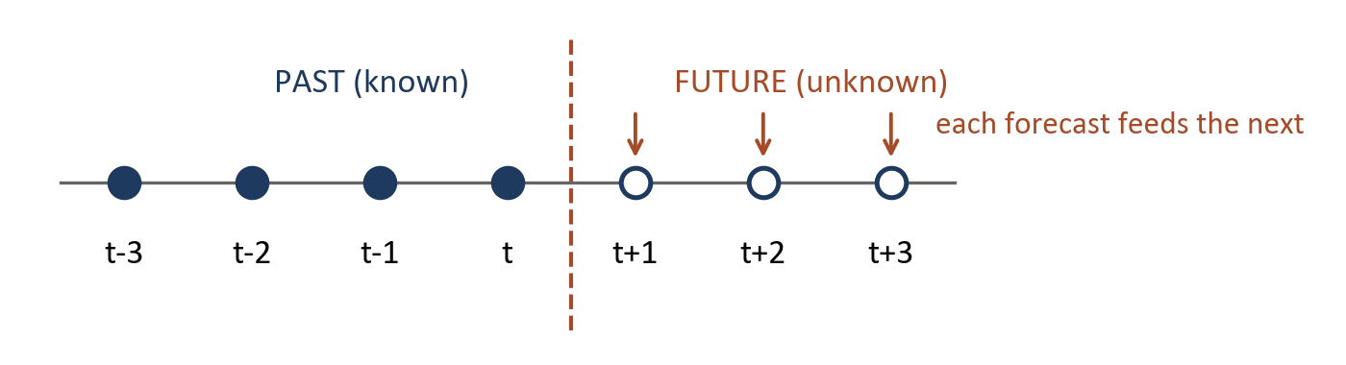
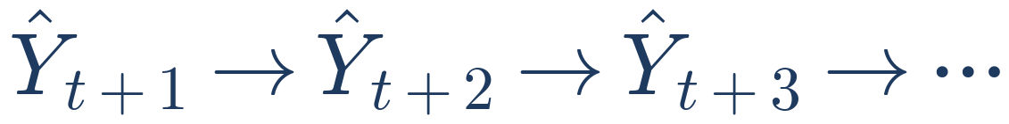

Multi-Step Forecasting
Horizon | Hourly steps
1 day | 24
7 days | 168
14 days | 336
31 days | 744
Advantage
Simple way to generate long horizons
Challenge
Errors can propagate
Recursive forecasting
WaveCatBoost: Hybrid Air Quality Forecasting
14
Notes:
The processed data is hourly, so a one-day forecast is 24 steps, seven days is 168 steps, fourteen days is 336 and thirty-one days is 744. The model forecasts one step, feeds that forecast back in as an input, and repeats. This is a simple way to reach long horizons, but an error in an early step can carry forward into later ones.

Slide 15
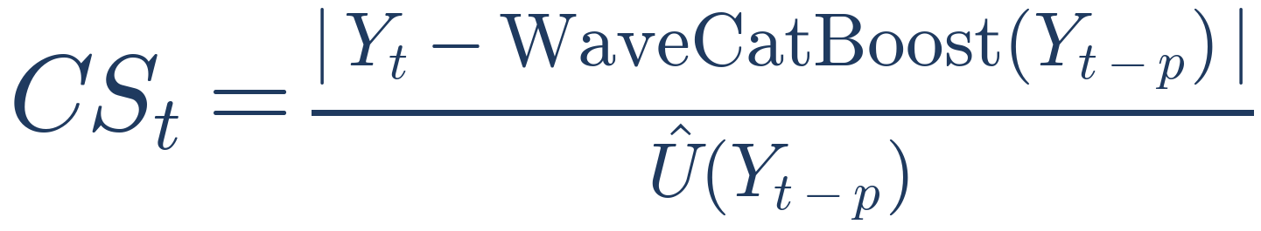
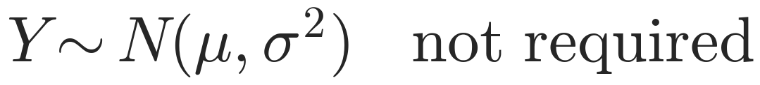
Conformal Prediction
How uncertain is this prediction?
Past predictions
Past errors
• Numerator: the prediction error
• Denominator: the estimated uncertainty scale
• So CS_t is a normalised prediction-error score
• No parametric distribution needs to be assumed:
Conformal scores
Current uncertainty
Prediction interval
WaveCatBoost: Hybrid Air Quality Forecasting
15
Notes:
A point forecast gives one number, but we also want to know how uncertain it is. The conformal score divides the absolute prediction error by an estimated uncertainty scale, so it is a normalised error score. Conformal prediction does not need to assume a particular distribution, such as normal errors.

Slide 16
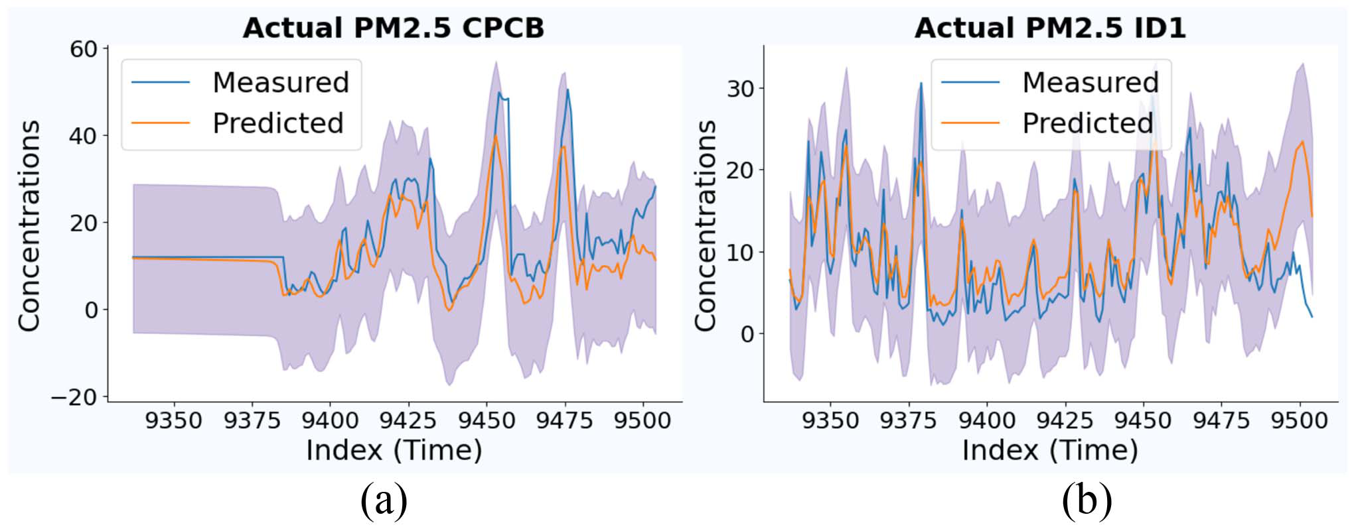
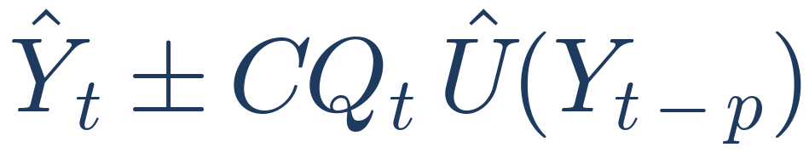
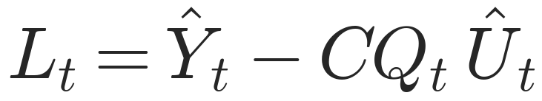
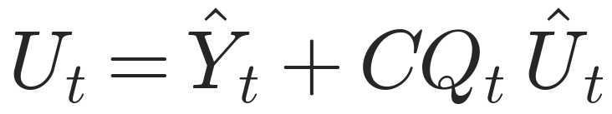
Prediction Interval
Conformal quantile CQ_t from a recent window of length κ
Blue: actual PM2.5 Orange: WaveCatBoost prediction
Shaded band: lower and upper prediction boundaries
7-day horizon, (a) CPCB, (b) ID1. Figure 2 of the paper
WaveCatBoost: Hybrid Air Quality Forecasting
16
Notes:
Air-quality behaviour is nonstationary, so the paper uses only a recent window of length kappa to compute the conformal quantile. The interval is the forecast plus or minus the quantile times the uncertainty scale. With alpha equal to 0.05 the nominal level is 95 percent. The band is more informative than a single prediction because it tells us how much uncertainty surrounds the forecast.

Slide 17
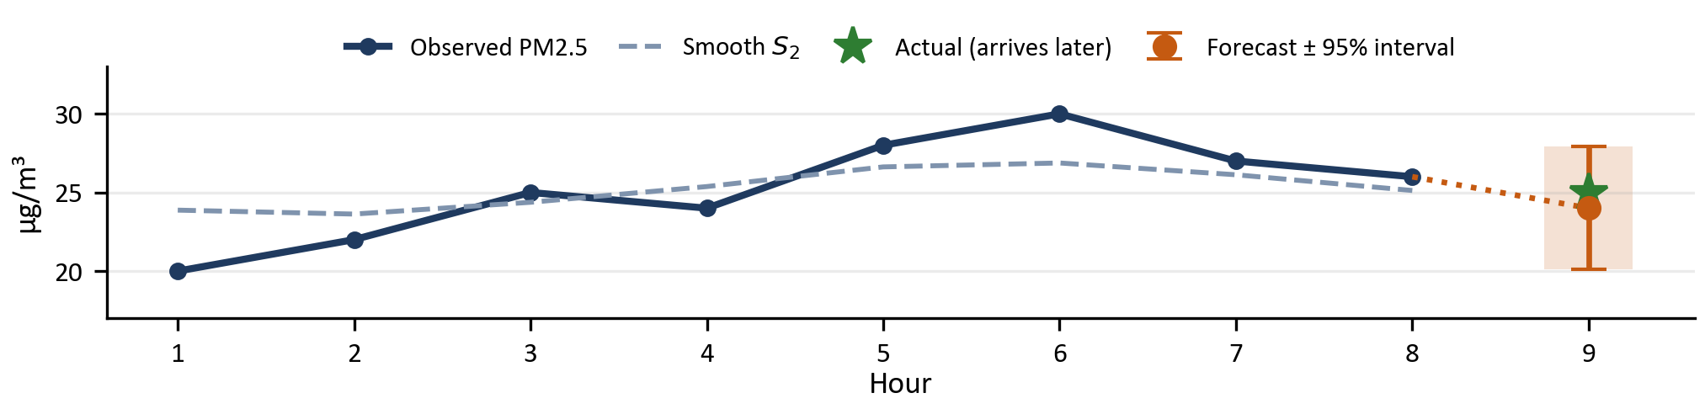
Worked Example: Forecasting Next-Hour PM2.5
Task: a CPCB sensor reports PM2.5 every 15 minutes. Forecast hour 9 and give a 95% range.
① Preprocess
Hour 8 readings 27, 26, 25, 26 → hourly mean 26 µg/m³ (then min-max scaled)
③ Forecast each component (CatBoost, last 3 lags)
D₁(6, 7, 8) → 0.25 D₂(6, 7, 8) → −0.75
S₂(6, 7, 8) → 24.50 one separate model per component
② Decompose the last 8 hours with Haar MODWT (K = 2)
Hour | 1 | 2 | 3 | 4 | 5 | 6 | 7 | 8
Y (observed) | 20 | 22 | 25 | 24 | 28 | 30 | 27 | 26
D₁ fast | −2.00 | −0.25 | 1.00 | −1.25 | 0.50 | 1.25 | −0.50 | 1.25
D₂ medium | −1.88 | −1.38 | −0.38 | −0.12 | 0.88 | 1.88 | 1.38 | −0.38
S₂ smooth | 23.88 | 23.62 | 24.38 | 25.38 | 26.62 | 26.88 | 26.12 | 25.12
④ Reconstruct, then repeat
Inverse MODWT: Ŷ₉ = 0.25 − 0.75 + 24.50 = 24.0
Feed 24.0 back in → hour 10 → … (24 steps = 1 day)
⑤ Conformal 95% interval
Recent window: scores CS = |error| / Û → CQ = 1.95
Current scale Û = 2.0 → 24.0 ± 1.95 × 2.0 = 24.0 ± 3.9
Answer: 24.0 µg/m³, range [20.1, 27.9]
Actual = 25 → inside the band.
Its score |25 − 24| / 2 = 0.5 joins the window for next time.
D, S: exact Haar MODWT of the series (rounded). CatBoost outputs, Û and CQ are illustrative.
WaveCatBoost: Hybrid Air Quality Forecasting
17
Notes:
Here is the whole method on one concrete case. A CPCB sensor reports PM2.5 every fifteen minutes, and we want the next hour with a 95 percent range. First, preprocessing: the four readings in hour eight, 27, 26, 25 and 26, average to 26, and the series is min-max scaled. Second, Haar MODWT splits the last eight hours into a fast component D1, a medium component D2 and a smooth trend S2; every column adds back exactly to the observed value. Third, a separate CatBoost model takes the last three values of each component and predicts its next value: 0.25, minus 0.75 and 24.5. Fourth, the inverse MODWT recombines them into 24 micrograms per cubic metre. For longer horizons this forecast is fed back in as if it were data, and the process repeats; 24 steps give one day. Fifth, conformal prediction: from recent errors, normalised by the uncertainty scale, the 95th-percentile score is 1.95. With a current scale of 2, the margin is 3.9, so the forecast is 24 with a range of 20.1 to 27.9. When the real value of 25 arrives it falls inside the band, and its score joins the window for the next forecast. The decomposition is exact; the CatBoost outputs and uncertainty values are illustrative.

Slide 18
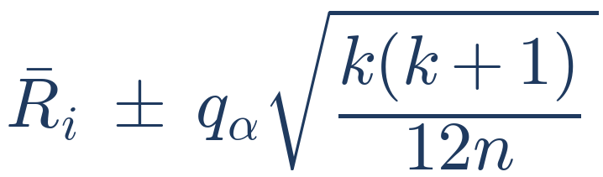
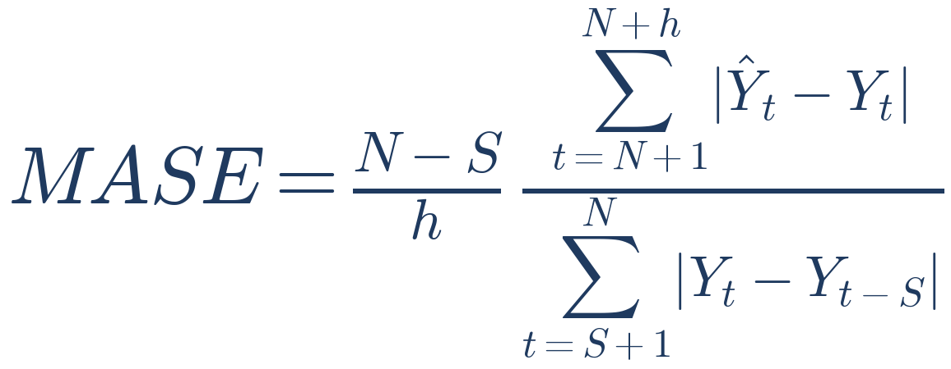
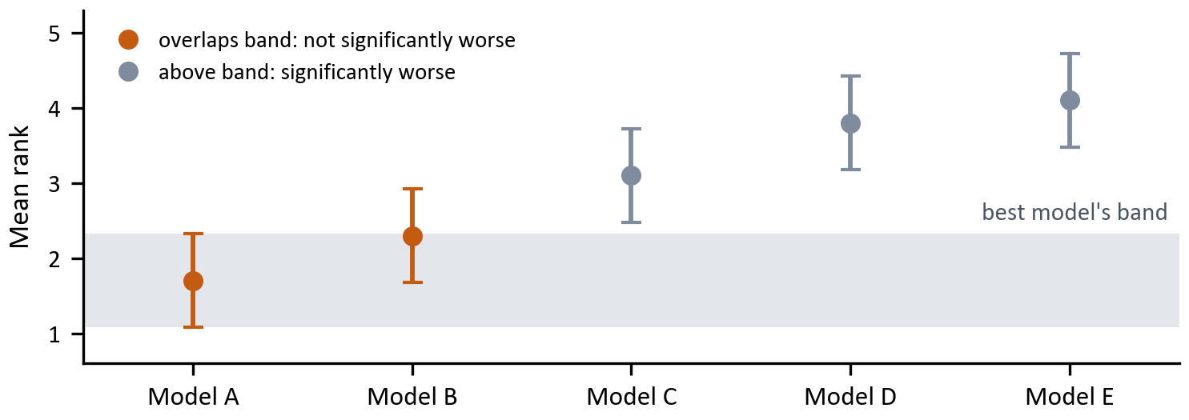
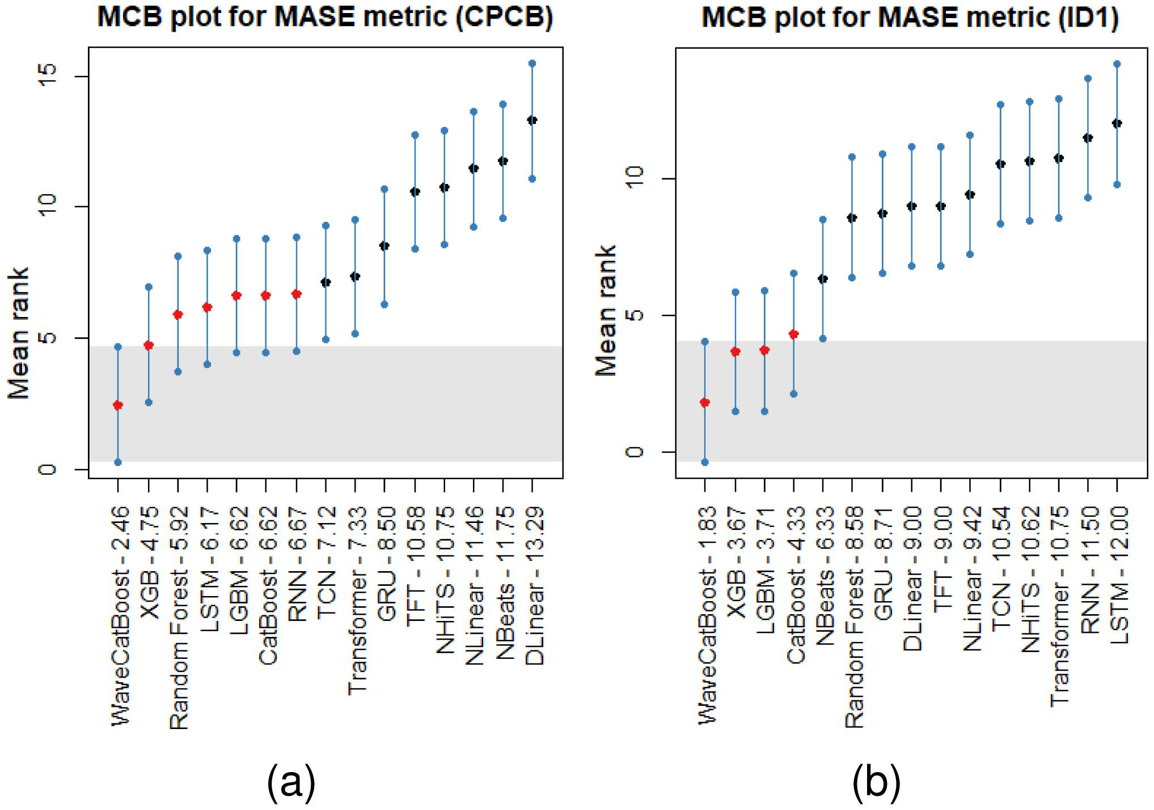
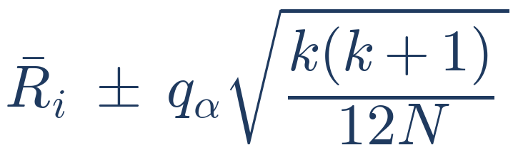
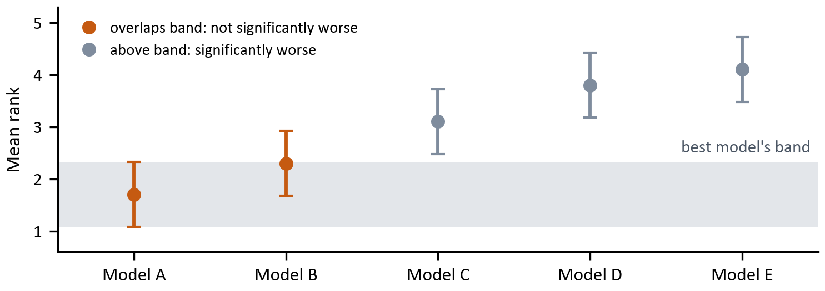
Evaluation Plan: MASE and MCB
Plan: give every model the same data, score it with MASE, then test whether the differences are real with MCB.
① Fair comparison setup
• Chronological split: train on earlier months, test on later ones (no shuffling)
• Horizons 1, 7, 14, 31 days × 6 pollutants × 2 sensors = n = 48 test cases
• WaveCatBoost + baselines (e.g. plain CatBoost, XGB, LSTM) with identical inputs
③ Is the difference real? MCB test
1. Rank the k models by MASE in each of the n cases (1 = best)
2. Average each model’s ranks, then give it an interval:
k = number of models, n = test cases
q_{α} = critical value (α = 0.05)
② Score each forecast with MASE
3. Grey band = best model’s interval. A model whose interval stays above it is significantly worse.
Top: model's mean absolute error over the h test hours
Bottom: training error of a seasonal naive forecast (S = 24: “same hour yesterday”)
Lower is better. < 1 beats naive; scale-free, so pollutants can be compared
e.g. model error 3.0, naive error 5.0 → MASE = 0.6
Chart is a schematic with made-up models to show how the test is read; no results from the paper are shown.
WaveCatBoost: Hybrid Air Quality Forecasting
18
Notes:
This is how I would evaluate the method. First, a fair setup: split the data in time, training on earlier months and testing on later ones, and give every model the same inputs. With four horizons, six pollutants and two sensors that is 48 test cases. Second, each forecast is scored with MASE: the model's mean absolute error divided by the error of a seasonal naive forecast, which simply repeats the value from the same hour yesterday. Lower is better, below one means we beat the naive forecast, and because it is scaled we can compare pollutants with different units. For example, an error of 3 against a naive error of 5 gives a MASE of 0.6. Third, a small MASE gap could be luck, so I would use the MCB test: rank the models in each case, average the ranks, and put an interval around each average. The grey band is the best model's interval; any model whose interval stays above it is significantly worse. The chart is only a schematic of how to read the test.

Slide 19
Strengths, Limitations and Future Work
Strengths
Multiscale view: MODWT splits the signal into time scales
Nonlinear forecasting: CatBoost per component
Uncertainty: conformal prediction intervals
Compared with multiple ML and deep learning baselines
Limitations
1. Both datasets from Meghalaya only
2. No spatial links between sensor locations
3. Haar was the letter's only filter (D4 / LA8 now scored)
4. Recursive forecasts can propagate errors
5. No deployment-level latency / throughput benchmark
Future work
Authors' stated direction: model spatial dependencies
Station A
Station B
Station C
Spatial + temporal model
WaveCatBoost: Hybrid Air Quality Forecasting
19
Notes:
Strengths: multiscale representation from MODWT, nonlinear forecasting from CatBoost, prediction intervals from conformal prediction, and a broad comparison against ML and deep learning models. Limitations: both datasets are from Meghalaya, no spatial relationships between stations, only the Haar wavelet is used with no wider wavelet comparison, recursive forecasts can propagate errors, and there is no detailed deployment latency benchmark. The authors name spatial dependencies as future work.

Slide 20
What we added on top of the letter
Paper pipeline (Sections 1–9 of analysis.Rmd)
Missing values → hourly files → min-max on train → Haar MODWT → one model per D_k, S_K → IMODWT → conformal PI.
Cross-questions, implemented in code and in this deck
1. Fourier vs MODWT — global sinusoids cannot be lagged; Haar D_k,t can. Same WaveLGB head, 1-day MASE.
2. EMD — data-adaptive IMFs as an alternative to any wavelet bank.
3. Haar / D4 / LA8 — filter menu sits in the MODWT section; MASE comparison at the end.
Interactive report: analysis.Rmd (RStudio → Run Document). Scores: run_extensions.R
WaveCatBoost: Hybrid Air Quality Forecasting
20

Slide 21
Why MODWT, not Fourier?
A spike at hour 1000 enters every Fourier bin. Haar D1 keeps the hour it happened.
Fourier (FFT)
Haar MODWT (letter)
No time index — one coefficient per frequency
A pollution spike is smeared across the whole window
Assumes the same frequencies hold in winter and monsoon
Cannot build lag features F(ω, t−1) for a tree
Reconstruction: IFFT of kept bins
D_k,t is indexed by time t
The same spike sits in D1 at that hour
Local in time, so a level shift does not leak into every coefficient
Lag D_k,t−1 lines up with Y_t → one CatBoost per component
Y_t = Σ D_k,t + S_K,t (additive MRA / IMODWT)
WaveCatBoost: Hybrid Air Quality Forecasting
21

Slide 22
Other wavelet filters: Haar, D4, LA8
The letter uses Haar (two taps). D4 (4 taps) and LA8 (8 taps) are smoother octave filters. Reconstruction is still Y_t = Σ D_k,t + S_K,t.
Haar (paper)
p = ½(1, −1), q = ½(1, 1)
Shortest support. D1 is jagged.
Default in WaveCatBoost.
Daubechies-4
4 taps, cleaner band split
A spike in D1 lasts a few extra hours.
Extension — same WaveLGB head.
Least-Asymmetric-8
8 taps, near-linear phase
Smoothest D_k of the three.
Extension — same WaveLGB head.
WaveLGB MASE, 1-day horizon (lower is better). Same K, p, and split.
Series Haar D4 LA8 Fourier
CPCB PM2.5 1.031 1.250 1.112 1.272
CPCB NO2 0.518 0.519 0.534 0.692
ID1 PM2.5 0.360 0.414 0.476 0.473
ID1 NO2 1.259 1.309 1.324 1.438
Haar is lowest (or tied) on these 1-day cases. Extra taps clean the D_k plot, not the MASE.
WaveCatBoost: Hybrid Air Quality Forecasting
22

Slide 23
Another decomposition: Empirical Mode Decomposition
EMD peels Intrinsic Mode Functions from the data. No Haar / D4 / LA8 bank is chosen in advance.
Y_t = IMF_1(t) + … + IMF_K(t) + r(t)
We map IMF_1 → D_1, IMF_2 → D_2, … and put the residue in S_K, then use the same CatBoost / LightGBM head as WaveCatBoost.
What EMD gives
Bands adapt to the series, so a rare dust event need not sit in a fixed 2–4 h octave.
Reconstruction is exact: IMFs plus residue return Y_t.
Shown on the first 500 hours in analysis.Rmd §10.3.
Why Haar still wins as the default
Mode mixing: two different events with a similar local period can land in one IMF.
Cost is much higher than O(N K) Haar.
Haar D_1 is always the 2–4 h band, so lag features mean the same thing every day.
WaveCatBoost: Hybrid Air Quality Forecasting
23

Slide 24
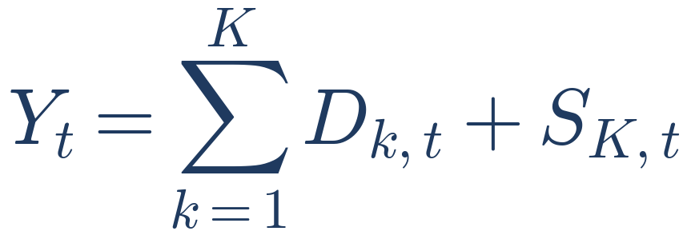
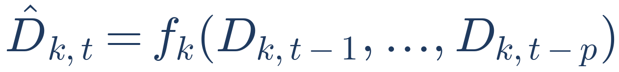

Final Takeaway
1. Decompose
2. Forecast
3. Reconstruct
4. Quantify uncertainty
Signal → MODWT → components → CatBoost models → inverse MODWT → conformal prediction → forecast + uncertainty
First separate the signal into temporal components, forecast each one, reconstruct, then quantify how uncertain the forecast is.
WaveCatBoost: Hybrid Air Quality Forecasting
24
Notes:
Remember the paper in four steps. Decompose the signal with MODWT. Forecast each component with its own CatBoost model. Reconstruct the forecast with the inverse MODWT. Quantify uncertainty with a conformal prediction interval. The central idea is simple: separate the complicated air-quality signal into temporal components, forecast them individually, reconstruct the signal, and measure how uncertain the forecast is. Thank you.

